Slide 1
Progress Report
Multi-regional evaluation of new machine learning algorithms for mapping tree species distribution and abundance
CAFS.20.79
Kasey Legaard¹, Aaron Weiskittel¹, Larry Whitsel², Erin Simons-Legaard³
¹ University of Maine, Center for Research on Sustainable Forests
² University of Maine, Advanced Computing Group
³ University of Maine, School of Forest Resources
Presenter: Kasey Legaard
Center for Advanced Forestry Systems 2021 Meeting
Notes:
1

Slide 2
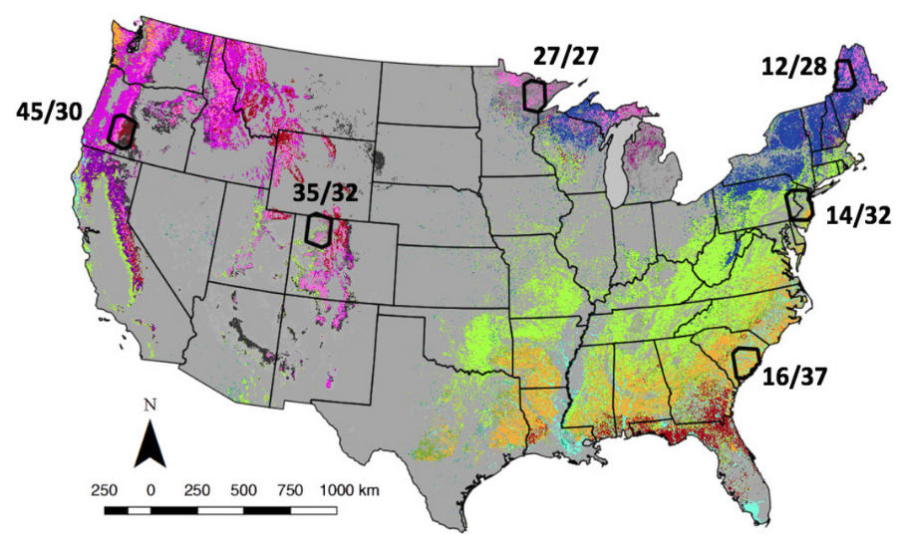
Justification
Goals:
High-quality, affordable spatial data to support data-driven management
Multi-regional validation of automated machine learning and geospatial processing methods developed at UMaine
10 m species, composition classes, disturbance history, and biomass
Algorithms, workflows integrated into high-volume production software
USDA FIA and NASA Carbon Monitoring System (CMS) data for benchmarking
(CMS 2013, Cohen et al.)
Center for Advanced Forestry Systems 2021 Meeting

Slide 3
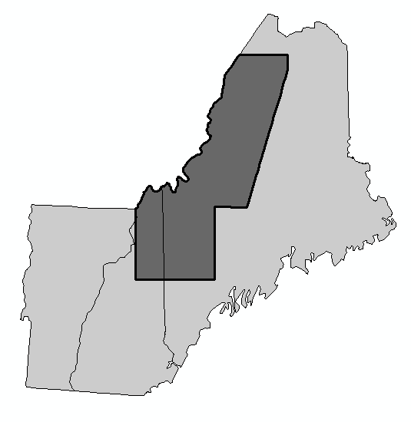
Objectives
Year 1 objectives, Maine trial area:
Develop and validate maps of tree species relative abundance (% AGB) at 10 m pixel resolution
  Sentinel + Landsat integration
  Two-stage species occurrence, abundance modeling
Pool species predictions into canopy composition classes
Develop and validate annual time series of forest disturbance
7 million acre trial area
Center for Advanced Forestry Systems 2021 Meeting

Slide 4
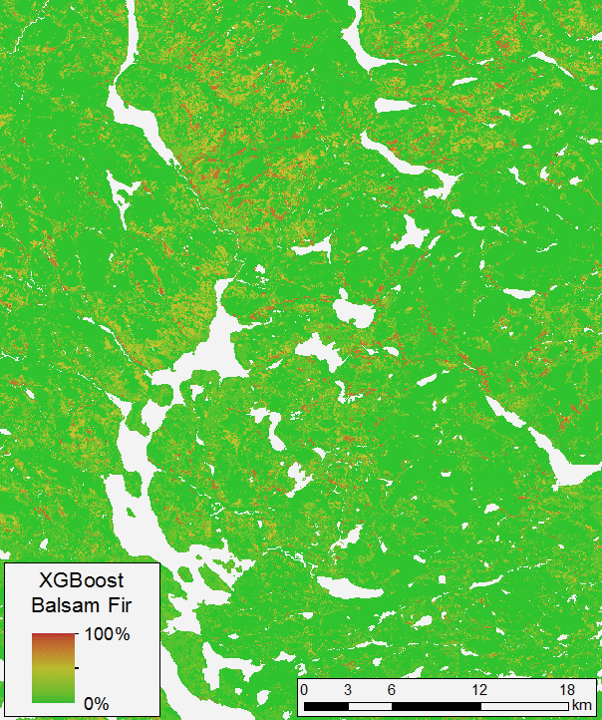
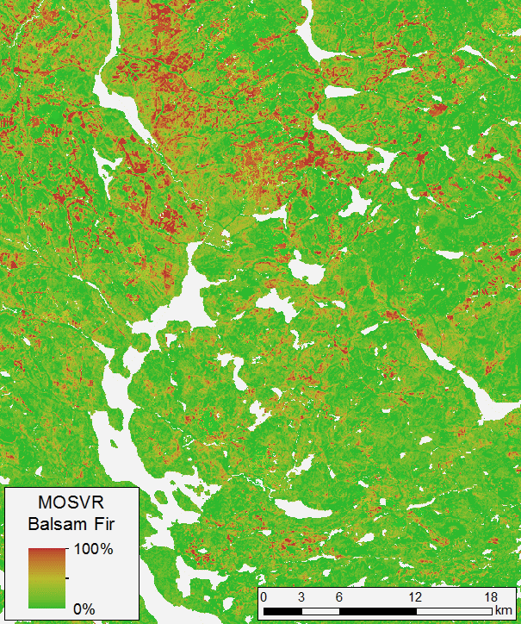
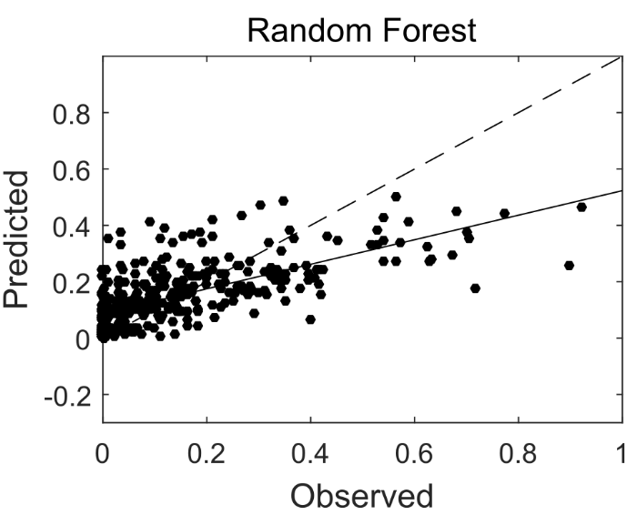
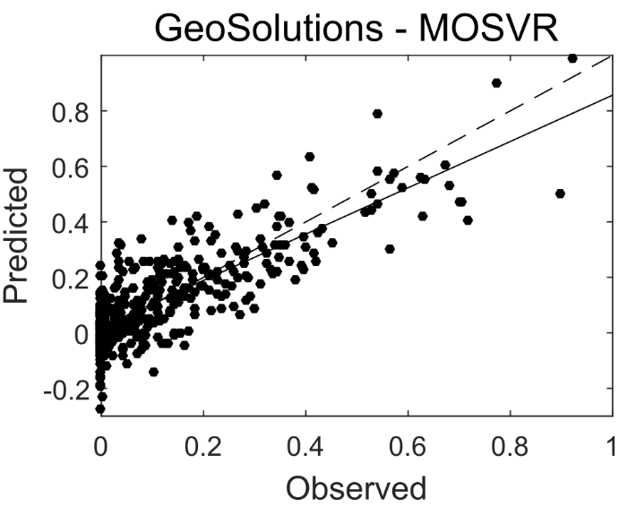
Methods
XGBoost gradient boosting algorithm
Multi-objective machine learning (SVMs)
Systematic Error
Balsam fir, % biomass
Balsam fir, % biomass
Total Error
Center for Advanced Forestry Systems 2021 Meeting

Slide 5
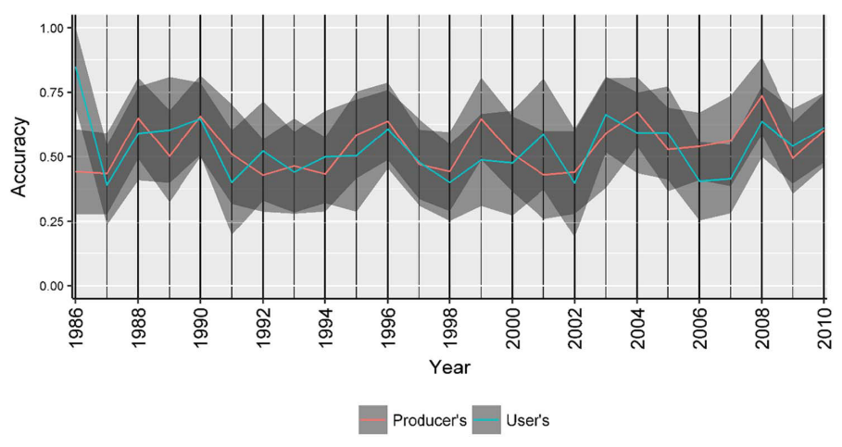
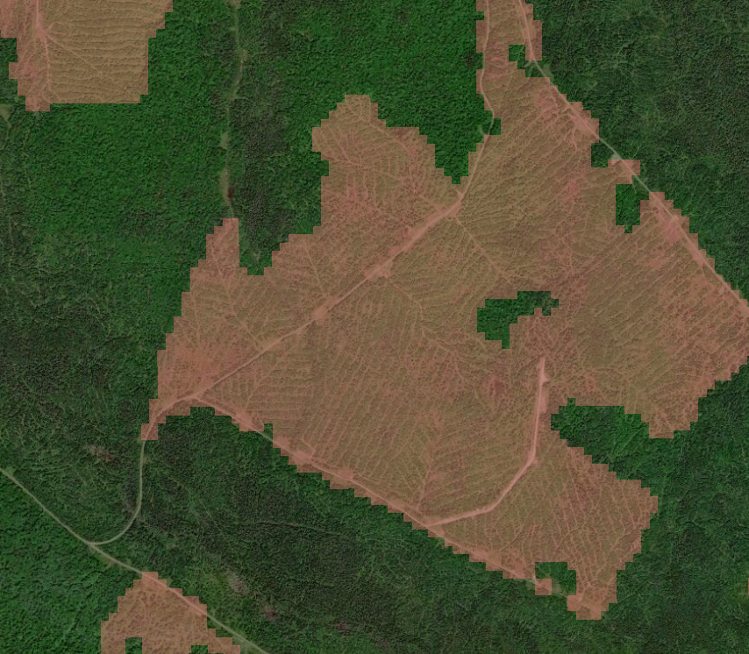
Methods
Forest change detection and harvest mapping:
Simultaneous minimization of omission and commission error
Vegetation Change Tracker, annual Landsat:
Our target:
UA = PA = 90+%
Zhao et al. 2018
Center for Advanced Forestry Systems 2021 Meeting

Slide 6
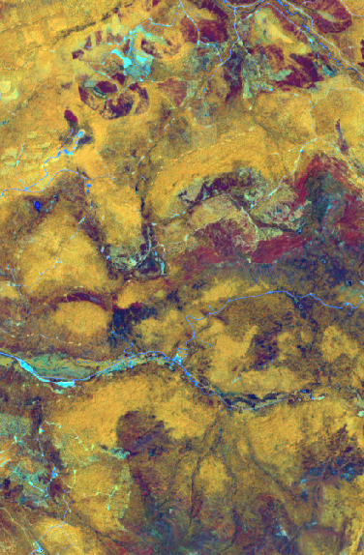
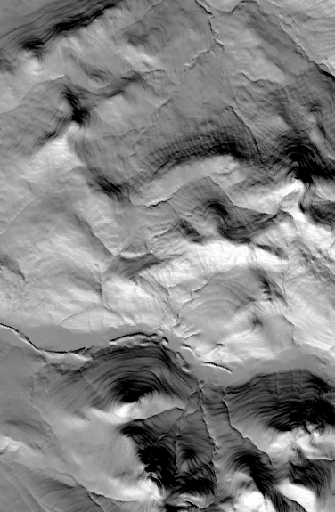
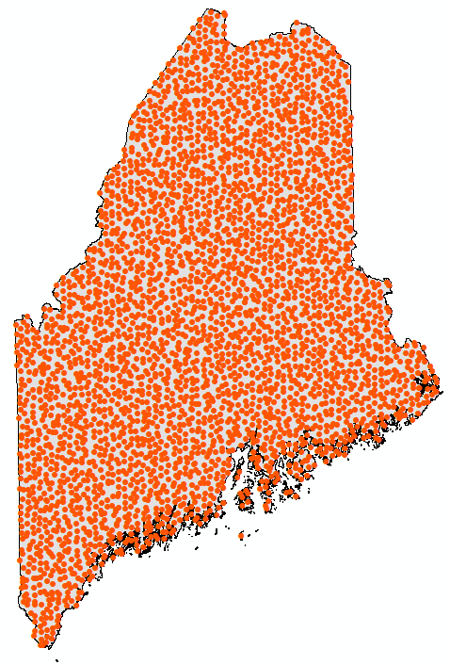
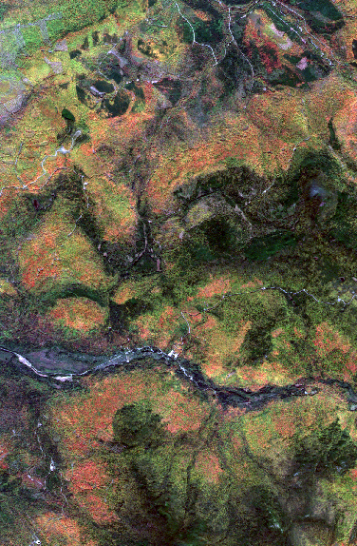
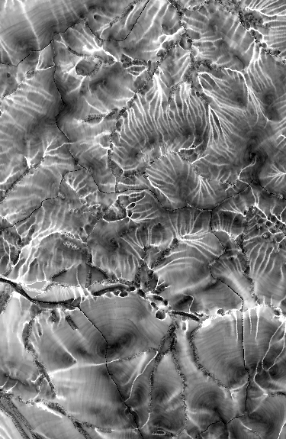
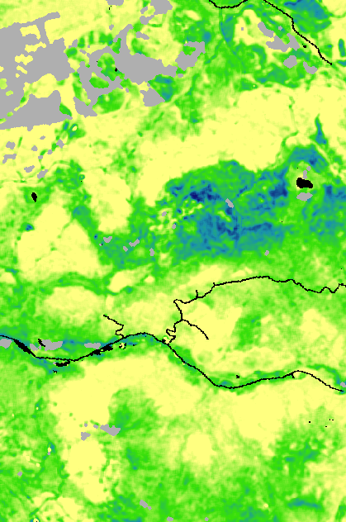
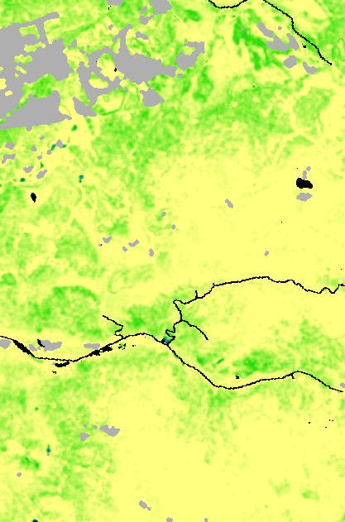
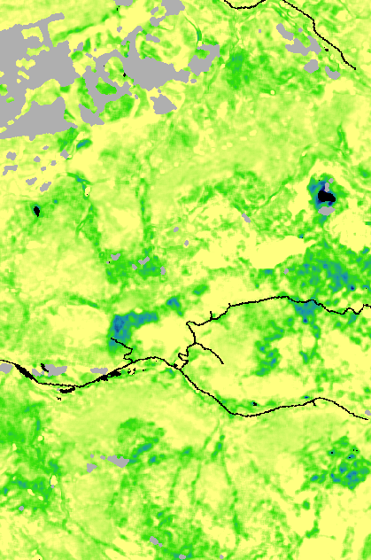
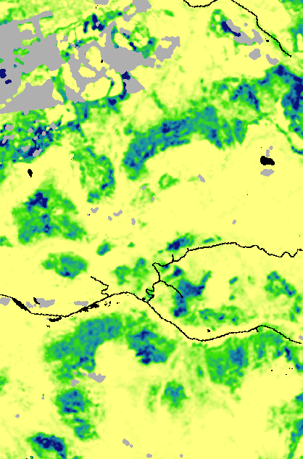

Methods
+
Multispectral, multi-temporal satellite imagery, terrain attributes, climate normal data
US Forest Service field data
balsam fir
red maple
High
% biomass
Predictions of tree species abundance
(% of live biomass)
Low
% biomass
red spruce
sugar maple
Center for Advanced Forestry Systems 2021 Meeting

Slide 7

Methods
Production software developed in collaboration
with the UMaine Advanced Computing Group
ESA and USGS APIs
UMaine cloud services
UMaine HPC services
Process management database
Sentinel/Landsat
image processing
Raster data storage
Problem definition and management
Machine learning
Map generation
LiDAR processing
(area-based)
Reference data storage
LiDAR import
USDA FIA,
Other reference
Center for Advanced Forestry Systems 2021 Meeting

Slide 8
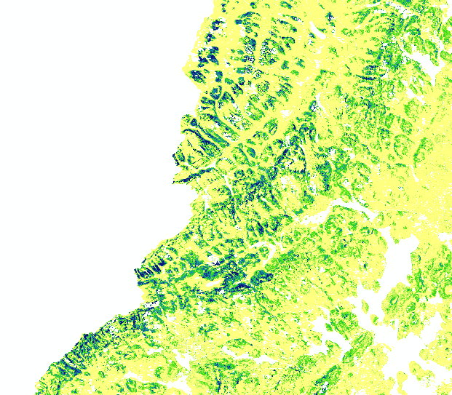
Major Findings
Year 1 objectives, Maine trial area:
Develop and validate maps of tree species relative abundance (% AGB) at 10 m pixel resolution
Fully and semi-automated production workflows
MAE typically 5-15%, but still evaluating multiple alternative workflows
Includes new software for ML prediction post-processing and map production, including automated and seamless mosaicking for large area applications
Includes new software for automated Sentinel image retrieval from ESA
Center for Advanced Forestry Systems 2021 Meeting

Slide 9
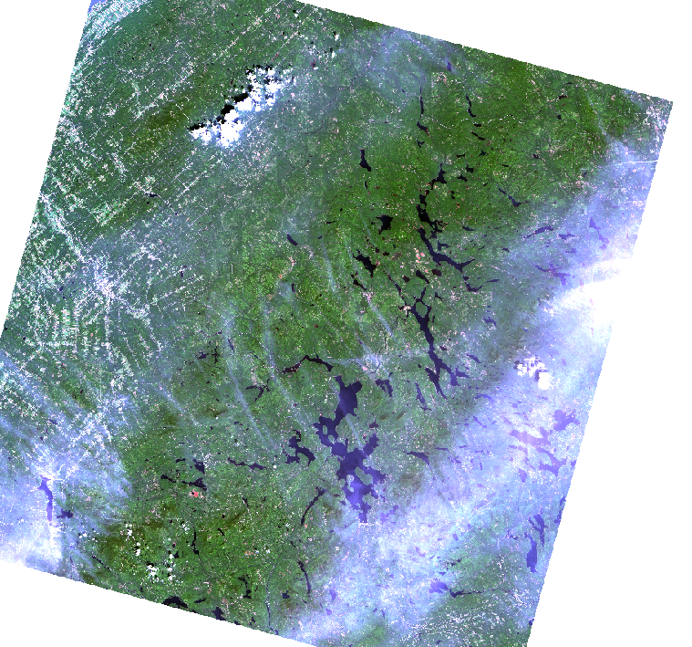
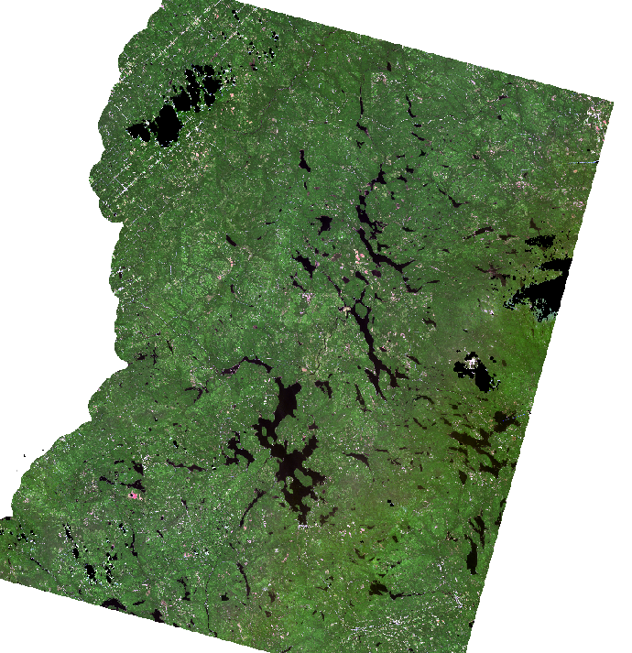
Major Findings
Year 1 objectives, Maine trial area:
Develop and validate maps of tree species relative abundance (% AGB) at 10 m pixel resolution
  Sentinel + Landsat integration
Automated warping/coregistration
Improved Landsat haze correction
Preliminary results suggest minimal or modest improvement, but this is probably case-specific
Fully integrated into production software as an option
Center for Advanced Forestry Systems 2021 Meeting

Slide 10
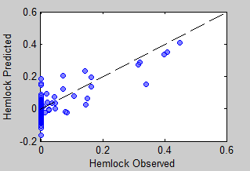
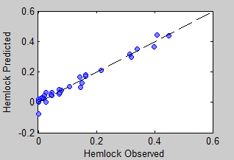
Major Findings
Year 1 objectives, Maine trial area:
Develop and validate maps of tree species relative abundance (% AGB) at 10 m pixel resolution
  Sentinel + Landsat integration
  Two-stage species occurrence, abundance modeling
Eastern hemlock, northern Maine
Predict species occurrence, then abundance
Reduces influence of low abundance samples on predictions at higher abundance
Control of omission/commission error when predicting occurrence is important
Validation is challenging, particularly for rarer species
Fully integrated into production software (major compute time/cost savings)
Center for Advanced Forestry Systems 2021 Meeting

Slide 11
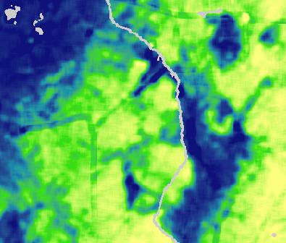
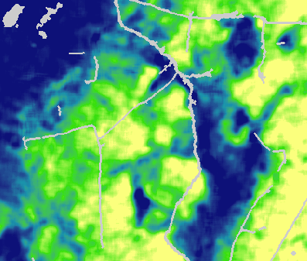
Major Findings
Year 1 objectives, Maine trial area:
Develop and validate maps of tree species relative abundance (% AGB) at 10 m pixel resolution
  Sentinel + Landsat integration
  Two-stage species occurrence, abundance modeling
  Forest roads delineation
Not originally planned, but needed to eliminate linear artifacts in species maps caused by intermixing of road/forest reflectance
Center for Advanced Forestry Systems 2021 Meeting

Slide 12
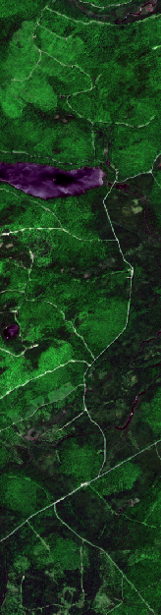
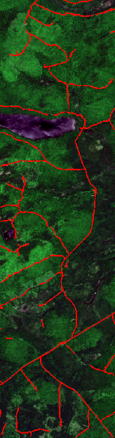
Major Findings
Year 1 objectives, Maine trial area:
Develop and validate maps of tree species relative abundance (% AGB) at 10 m pixel resolution
  Sentinel + Landsat integration
  Two-stage species occurrence, abundance modeling
  Forest roads delineation
Not originally planned, but needed to eliminate linear artifacts in species maps caused by intermixing of road/forest reflectance
New approach based on image morphology and adaptive thresholding
Fully integrated into production software
Center for Advanced Forestry Systems 2021 Meeting

Slide 13
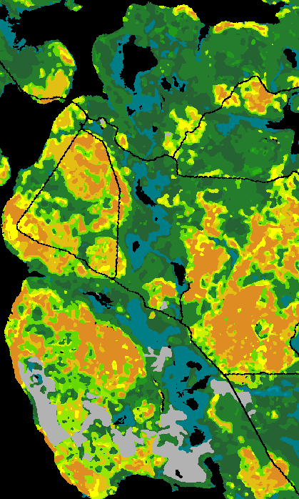
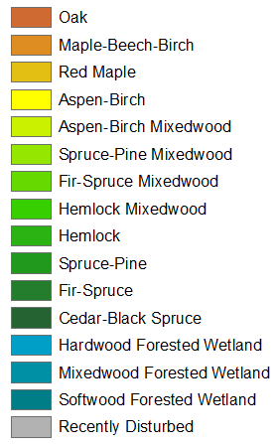
Major Findings
Year 1 objectives, Maine trial area:
Develop and validate maps of tree species relative abundance (% AGB) at 10 m pixel resolution
Pool species predictions into canopy composition classes
Multiple type mapping approaches based on species dominance/codominance
Center for Advanced Forestry Systems 2021 Meeting

Slide 14
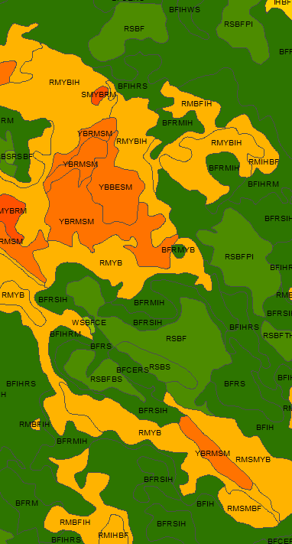
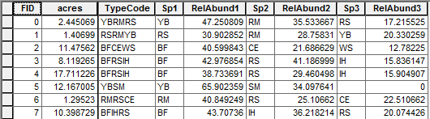
Major Findings
Year 1 objectives, Maine trial area:
Develop and validate maps of tree species relative abundance (% AGB) at 10 m pixel resolution
Pool species predictions into canopy composition classes
Multiple type mapping approaches based on species dominance/codominance
New software to implement alternative procedures for aggregating species predictions to the stand-level
Production software to scale over large areas; validation software in development
Center for Advanced Forestry Systems 2021 Meeting

Slide 15
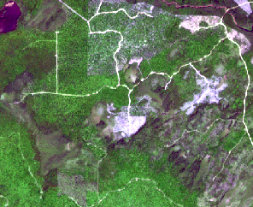
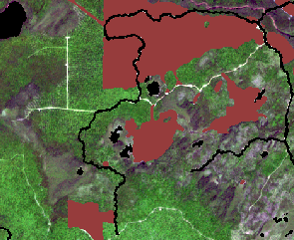
Major Findings
Year 1 objectives, Maine trial area:
Develop and validate maps of tree species relative abundance (% AGB) at 10 m pixel resolution
Pool species predictions into canopy composition classes
Develop and validate annual time series of forest disturbance
Currently testing strategies for efficient training of annual change detection models
Accuracies of 90-94%, with balanced error, at 10 m (Sentinel) and 30 m (Landsat)
New procedures for improving outcomes by multi-model fusion at either pixel or patch levels
Awaiting completion of software to support model training for efficient large area application
Center for Advanced Forestry Systems 2021 Meeting

Slide 16
Company Benefits
Year 1:
Continued development and refinement of multi-objective ML and remote sensing workflows:
  Tree species mapping at 10 m resolution
  Canopy composition / forest type mapping
  Timing, intensity of past disturbance
Full integration of workflows into efficient production software
Continued progress in the reduction of production time and cost
Center for Advanced Forestry Systems 2021 Meeting

Slide 17
Summary
Good progress on tree species mapping and canopy composition/forest type mapping
Running a bit behind on disturbance history mapping (software development delays)
Validation within Maine is ongoing
  Validation of 2-stage species mapping and canopy composition mapping is somewhat difficult
  Developing software to ease validation efforts when extending work to other regions
Years 2-3 to will focus on AGB mapping approaches and multi-regional implementation and validation
Center for Advanced Forestry Systems 2021 Meeting

