Slide 1
Continuing Project
Stand and Tree Responses to Late-Rotation Fertilization
CAFS.16.69
Eric Turnblom, Kim Littke, Jason Cross, Mason Patterson, and Rob Harrison (UW)
Kim Littke
Center for Advanced Forestry Systems 2021 Meeting
Notes:
1

Slide 2
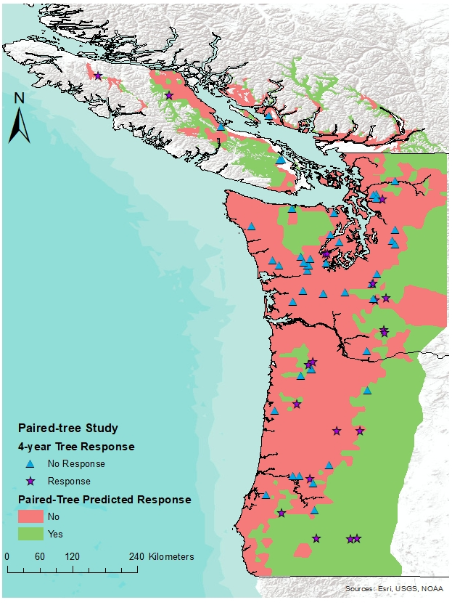
Justification
Soils in the Pacific Northwest have responded the best to N fertilization
Paired-Tree fertilization study found the greatest response on stands with:
  High elevation
  Low-moderate site index
  Cold spring temperatures
  Low summer precipitation
  Lower latitudes
Focusing fertilization on responding, late-rotation stands that are 8-10 years to harvest can decrease the risk and cost of fertilization
Center for Advanced Forestry Systems 2021 Meeting

Slide 3
Objectives
Determine the average, area-based volume response to late-rotation fertilization
Estimate the regional economic returns of late-rotation fertilization
Validate the models developed from the CAFS supported Paired-Tree Study
Assess the ability to predict response to fertilization using plant root simulator (PRS) probes
Center for Advanced Forestry Systems 2021 Meeting

Slide 4
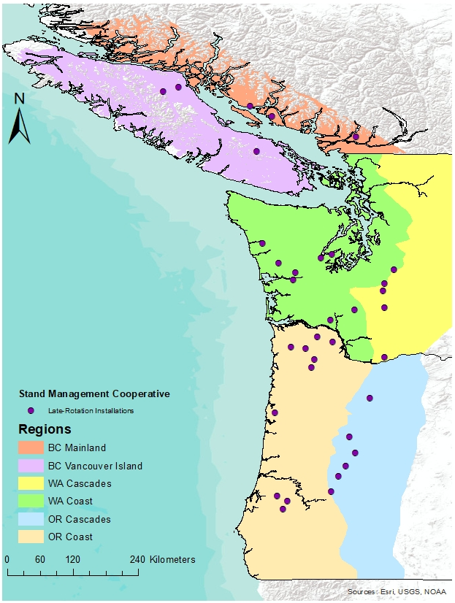
Methods
Randomly chosen latitude/longitude coordinates
30-50 years total age
Plots are 0.25-0.5 ac. circular
Paired by most similar DBH distribution and plot TPA and BA (<10% difference)
One plot in each pair randomly assigned the fertilizer treatment (224 kg N ha⁻¹)
Measure fertilizer response over 2-8 years and at harvest
  All installations measured for two-year response
  11/34 measured for four-year response
  Four installations destroyed by fire or windstorms will be replaced
Center for Advanced Forestry Systems 2021 Meeting

Slide 5
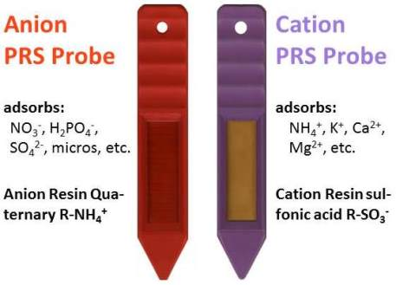
Methods
At each paired plot, sampled one soil pit to 1 meter
Installed Plant Root Simulator (PRS) probes over 12 weeks in control and fertilized plots prior to fertilization
Foliage, branch, and tree core samples were sampled for total nutrients
Center for Advanced Forestry Systems 2021 Meeting

Slide 6
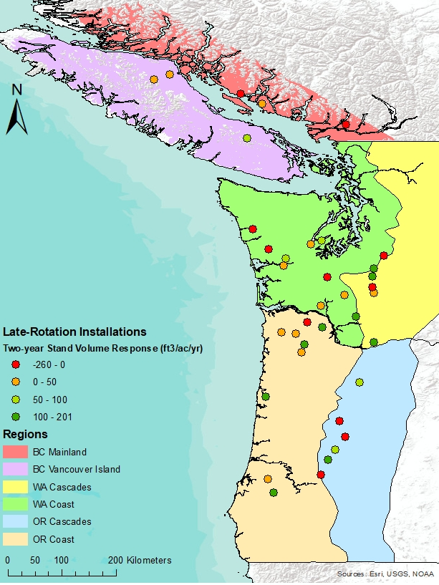

Major Findings
Greatest volume response per acre in BC Vancouver Island, Washington East and West, and Oregon West
Variable response per acre within each region
Region | Two-year Tree Response | Two-year Plot Response
BC Mainland (n=3) | -7 ± 18% | -51 ± 59 ft³/ac/yr
BC Vancouver Island (n=3) | 18 ± 34% | 43 ± 48 ft³/ac/yr
WAW (n=10) | 14 ± 16% | 33 ± 70 ft³/ac/yr
WAE (n=6) | 18 ± 23% | 53 ± 109 ft³/ac/yr
ORW (n=9) | 16 ± 14% | 67 ± 60 ft³/ac/yr
ORE (n=6) | 14 ± 36% | -24 ± 179 ft³/ac/yr
Center for Advanced Forestry Systems 2021 Meeting

Slide 7
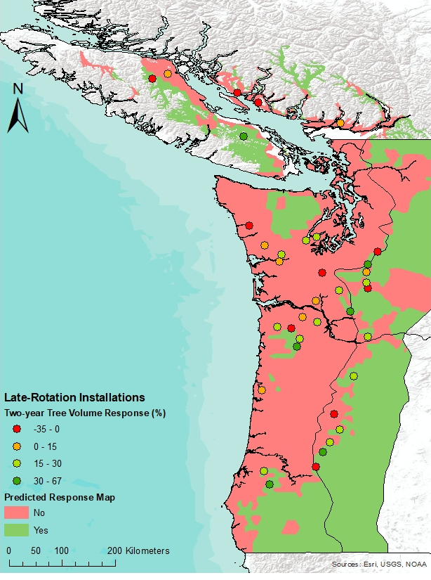

Major Findings
Late-rotation tree volume response matches predicted response regions from the Paired-Tree Study
Similar response from 0-4 years on first cohort of measurements
Predicted | Two-year Tree Response | Two-year Plot Response
No Response | 8% | 11 ± 82 ft³/ac/yr
Response | 25% | 63 ± 123 ft³/ac/yr
Center for Advanced Forestry Systems 2021 Meeting

Slide 8
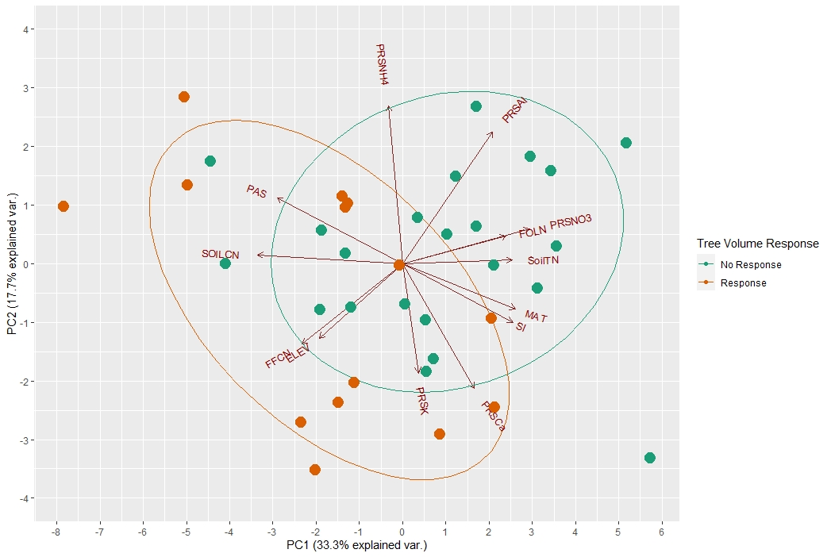
Major Findings
Greater tree volume response found on installations with greater elevation, precipitation as snow, and forest floor and surface soil C:N ratio
  Responders also tend to have greater cation and lower ammonium adsorption
Non-responders had greater soil and foliar N and site index
  Lower response over 50 μg NO₃ adsorption
Non-responders found within the responsive group would be expected to respond due to NO₃ availability
  Low exchangeable cation or high ammonium adsorption
Exch.
Cation availability
N availability
Center for Advanced Forestry Systems 2021 Meeting

Slide 9
Deliverables
38 Late-Rotation installations
Soil, tree, and PRS probe nutrient data collected
Manuscripts planned:
  Relationship between PRS probe nutrient adsorption, soil and site productivity, and four-year fertilizer response
  Economic analysis of regional fertilization of late-rotation stands
Inclusion of response data into growth models
Center for Advanced Forestry Systems 2021 Meeting

Slide 10
Company Benefits
Average area-based volume response in six distinct regions
Examination into the economics of late-rotation fertilization
Conversion of Paired-Tree response models to per area response
Greater understanding of nutrient availability in predicting fertilizer response
Center for Advanced Forestry Systems 2021 Meeting

Slide 11
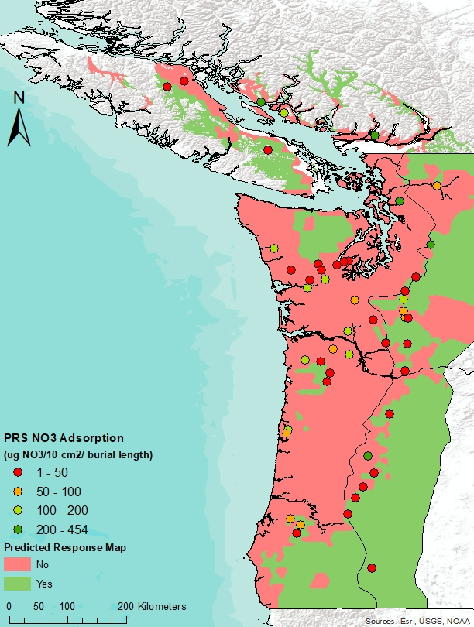
Summary
Greater response in stands predicted to respond in the Paired-Tree fertilizer response models
Plant Root Simulator probes provide an understanding of available nutrients and potential for fertilizer response
Tree response similar between regions, but plot response is more variable
Center for Advanced Forestry Systems 2021 Meeting

Slide 12
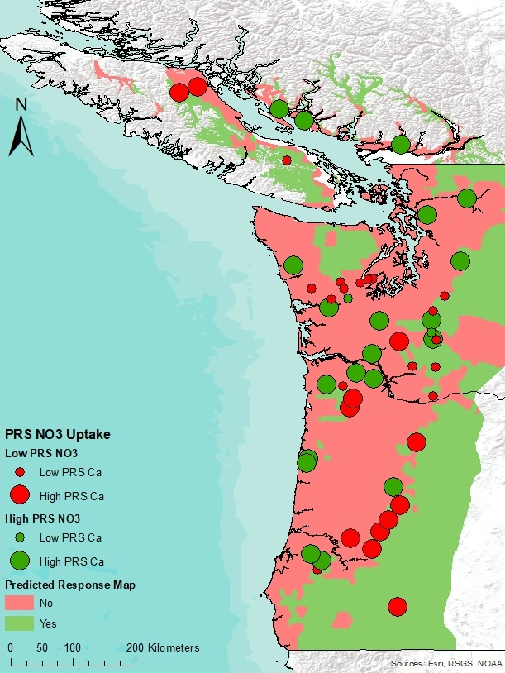
Recommendations
Select fertilization stands based on models and maps from the Paired-Tree study
Install more PRS probes to further understand nutrient availability and fertilizer response
Prioritize fertilization in regions that have the greatest tree and plot response
  Currently, Vancouver Island, Washington, and Oregon West are responding the best to N fertilization
Center for Advanced Forestry Systems 2021 Meeting

Slide 13
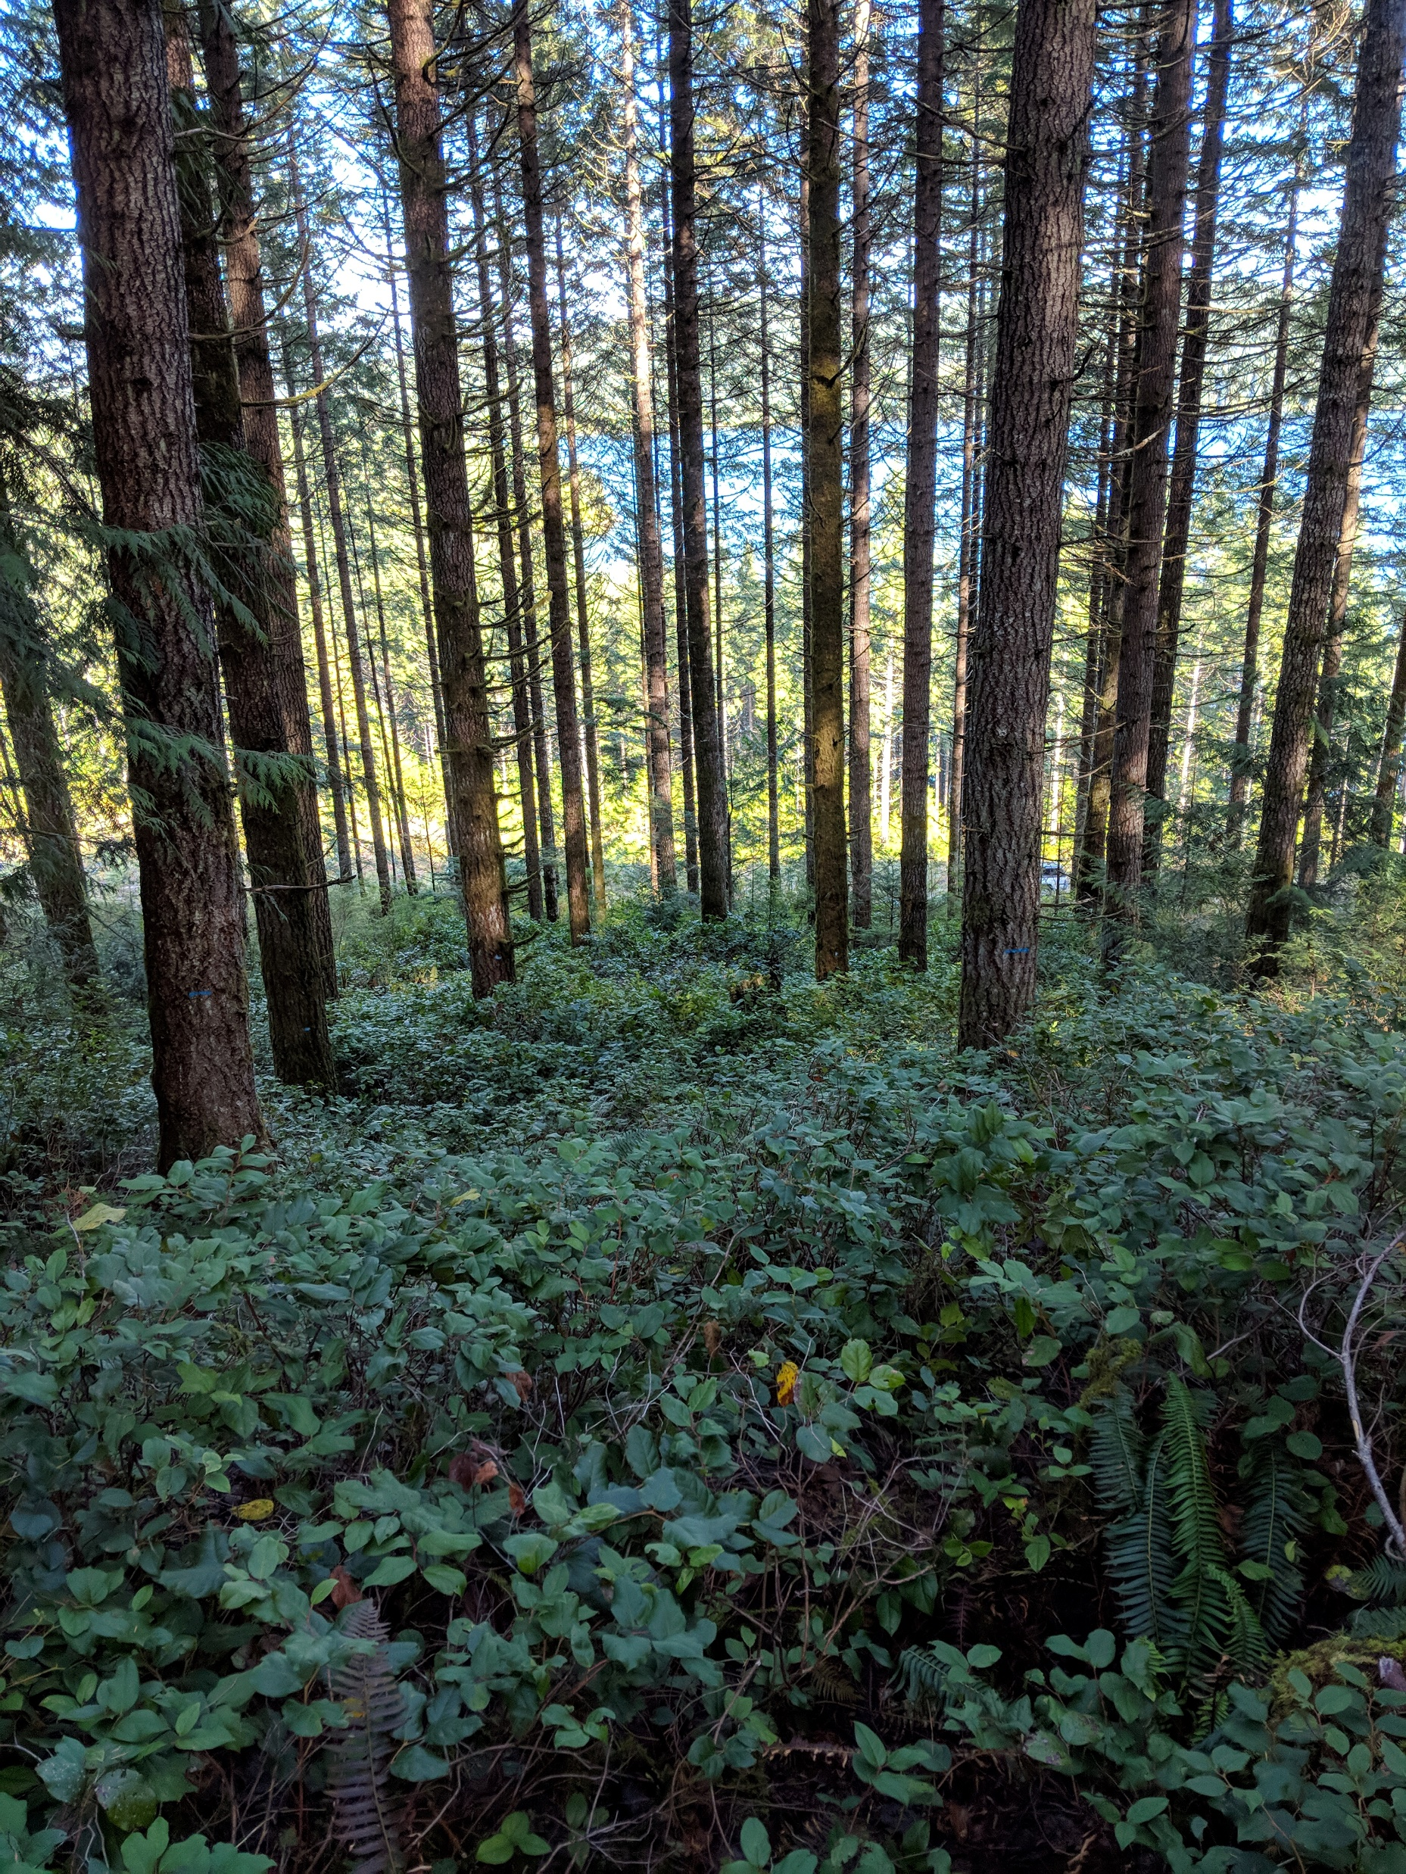
Questions?
Thanks:
SMC Field Crew
Stand Management Cooperators

