Slide 1
Progress Report
Multi-regional evaluation of new machine learning algorithms for mapping tree species distribution and abundance
CAFS.20.79
Kasey Legaard¹, Aaron Weiskittel¹, Larry Whitsel², Erin Simons-Legaard³
¹ University of Maine, Center for Research on Sustainable Forests
² University of Maine, Advanced Computing Group
³ University of Maine, School of Forest Resources
Presenter: Kasey Legaard
Center for Advanced Forestry Systems 2020 Meeting
Notes:
1

Slide 2
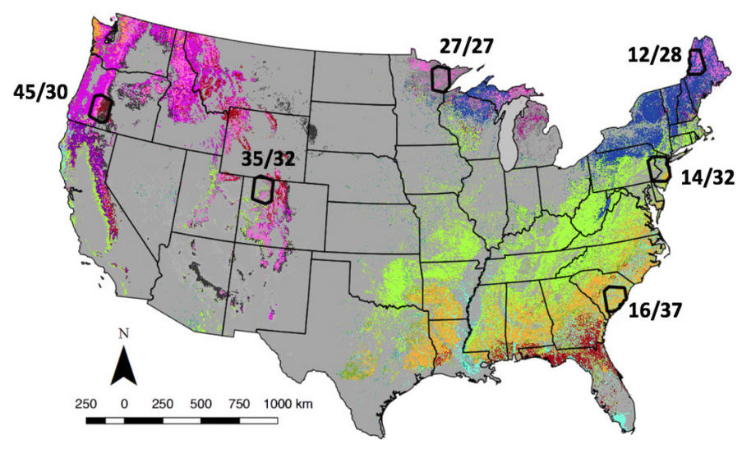
Project Overview
Goals:
High-quality, affordable spatial data to support data-driven management
Multi-regional validation of automated machine learning and geospatial processing methods developed at UMaine
10 m species, composition classes, disturbance history, and biomass
Algorithms, workflows integrated into high-volume production software
USDA FIA and NASA Carbon Monitoring System (CMS) data for benchmarking
(CMS 2013, Cohen et al.)
Center for Advanced Forestry Systems 2020 Meeting

Slide 3
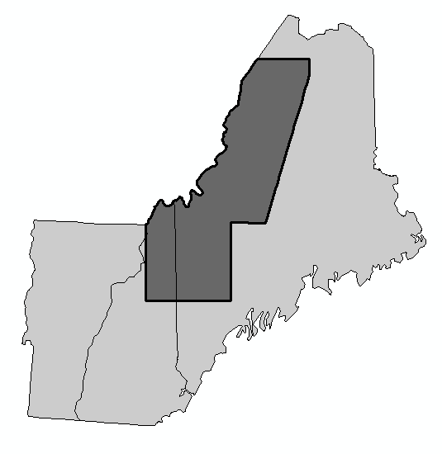
Project Overview
Year 1 objectives, Maine trial area:
Develop and validate maps of tree species relative abundance (% AGB) at 10 m pixel resolution
  Sentinel + Landsat integration
  Two-stage species occurrence, abundance modeling
Pool species predictions into canopy composition classes
Develop and validate annual time series of forest disturbance
7 million acre trial area
Center for Advanced Forestry Systems 2020 Meeting

Slide 4
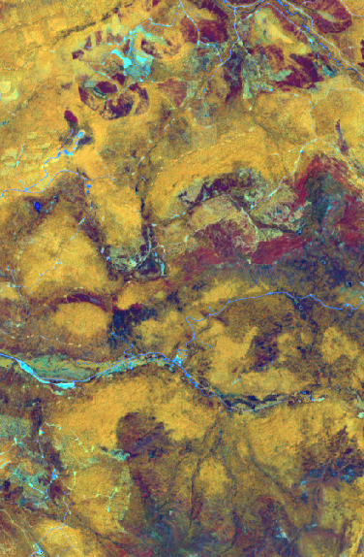
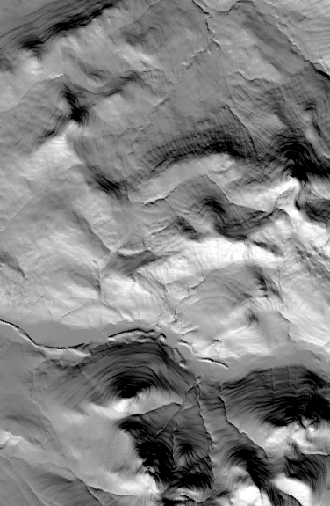
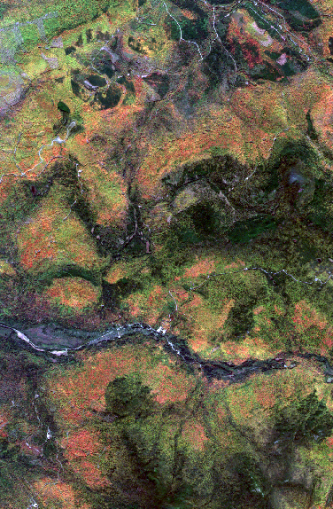
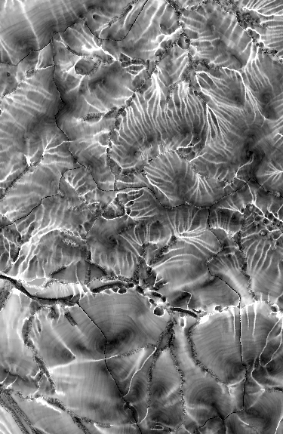
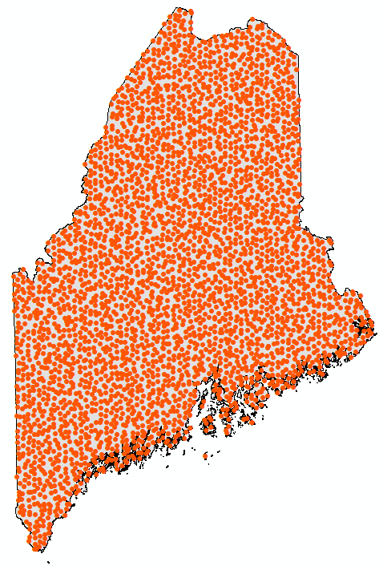
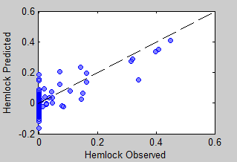
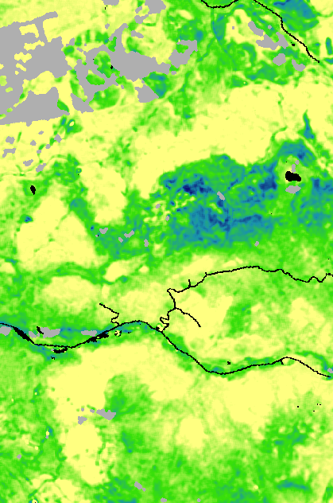
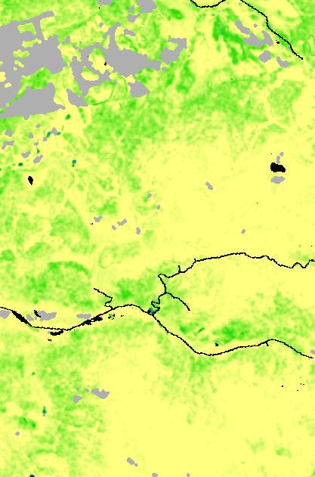
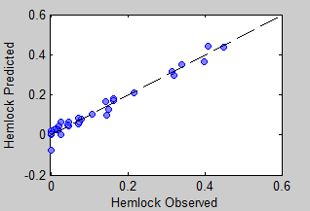
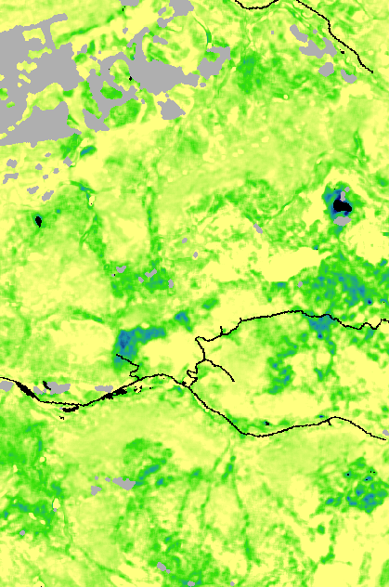
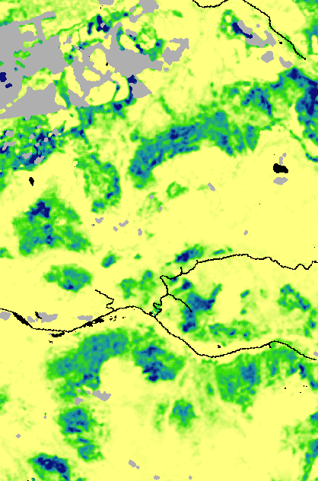

Current Progress
Multispectral, multi-temporal satellite imagery, terrain attributes, climate normal data
2-stage machine learning;
Predict occurrence, then abundance
+
Eastern hemlock, northern Maine
FIA plots
1-stage results
Predictions of tree species abundance
balsam fir
red maple
High
% biomass
2-stage results
Low
% biomass
red spruce
sugar maple
Center for Advanced Forestry Systems 2020 Meeting

Slide 5
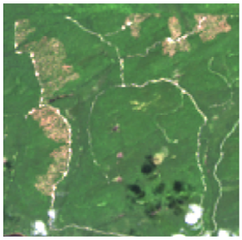
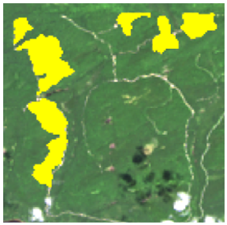
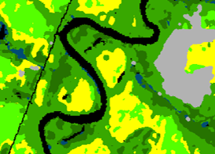
Current Progress
Multispectral, multi-temporal satellite imagery, terrain attributes, climate normal data
Forest change detection
+
FIA plots
Predictions of tree species abundance
Forest type classes from predictions of individual tree species abundance
balsam fir
red maple
High
% biomass
Low
% biomass
red spruce
sugar maple
Center for Advanced Forestry Systems 2020 Meeting

Slide 6
Future Plans
Continued development of algorithms and code to construct and post-process composition data
Wrap up primary software development
Validation against FIA and CMS data
AGB estimation based on automated machine learning methods, including LiDAR/Sentinel integration
Multi-regional validation of composition, disturbance, AGB, and derivative products against FIA and CMS data
High resolution land cover and forest type mapping for the state of Maine (1m and 10m) in collaboration with NOAA C-CAP
Center for Advanced Forestry Systems 2020 Meeting

