Slide 1
Progress Report
Stand and Tree Responses to Late-Rotation Fertilization
CAFS.16.69
Eric Turnblom, Kim Littke, Jason Cross, Mason Patterson, and Rob Harrison (UW)
Kim Littke
Center for Advanced Forestry Systems 2020 Meeting
Notes:
1

Slide 2
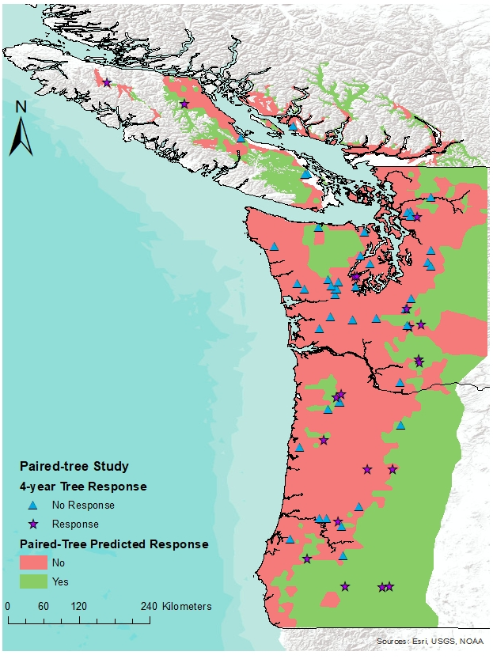
Justification
Soils in the Pacific Northwest have responded the best to N fertilization
Paired-Tree fertilization study found the greatest response on stands with:
  High elevation
  Low-moderate site index
  Cold spring temperatures
  Low summer precipitation
  Lower latitudes
Focusing fertilization on responding, late-rotation stands that are 8-10 years to harvest can decrease the risk and cost of fertilization
Center for Advanced Forestry Systems 2020 Meeting

Slide 3
Objectives
Determine the average, area-based volume response to late-rotation fertilization
Estimate the regional economic returns of late-rotation fertilization
Validate the models developed from the CAFS supported Paired-Tree Study
Assess the ability to predict response to fertilization using plant root simulator (PRS) probes
Center for Advanced Forestry Systems 2020 Meeting

Slide 4
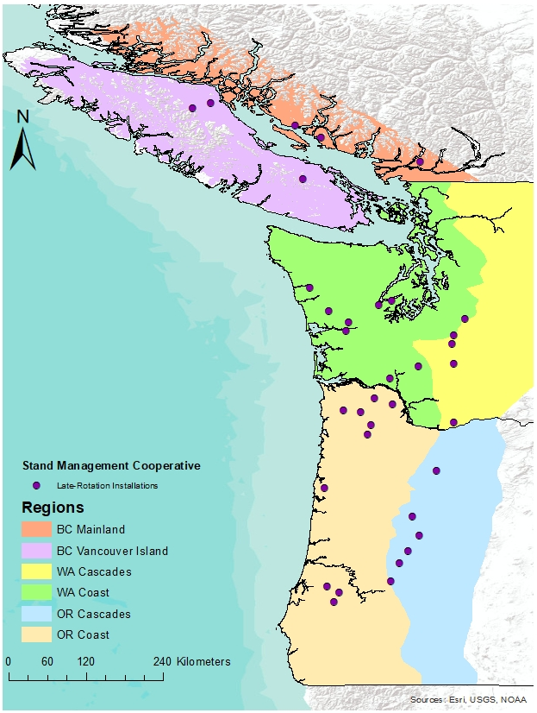
Methods
Randomly chosen latitude/longitude coordinates
30-50 years total age
Plots are 0.25-0.5 ac., circular
Paired by most similar DBH distribution and plot TPA and BA (<10% difference)
One plot in each pair randomly assigned the fertilizer treatment (224 kg N ha⁻¹)
Measure fertilizer response over 2-8 years and at harvest
  33/37 installations measured for two-year response
Center for Advanced Forestry Systems 2020 Meeting

Slide 5
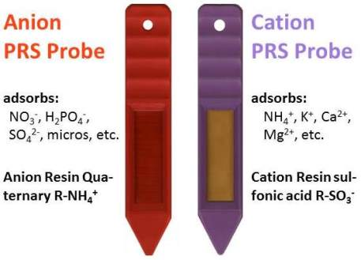
Methods
At each paired plot, sampled one soil pit to 1 meter
Installed Plant Root Simulator (PRS) probes over 12 weeks in control and fertilized plots prior to fertilization
Foliage, branch, and tree core samples were sampled after 2 growing seasons
Center for Advanced Forestry Systems 2020 Meeting

Slide 6
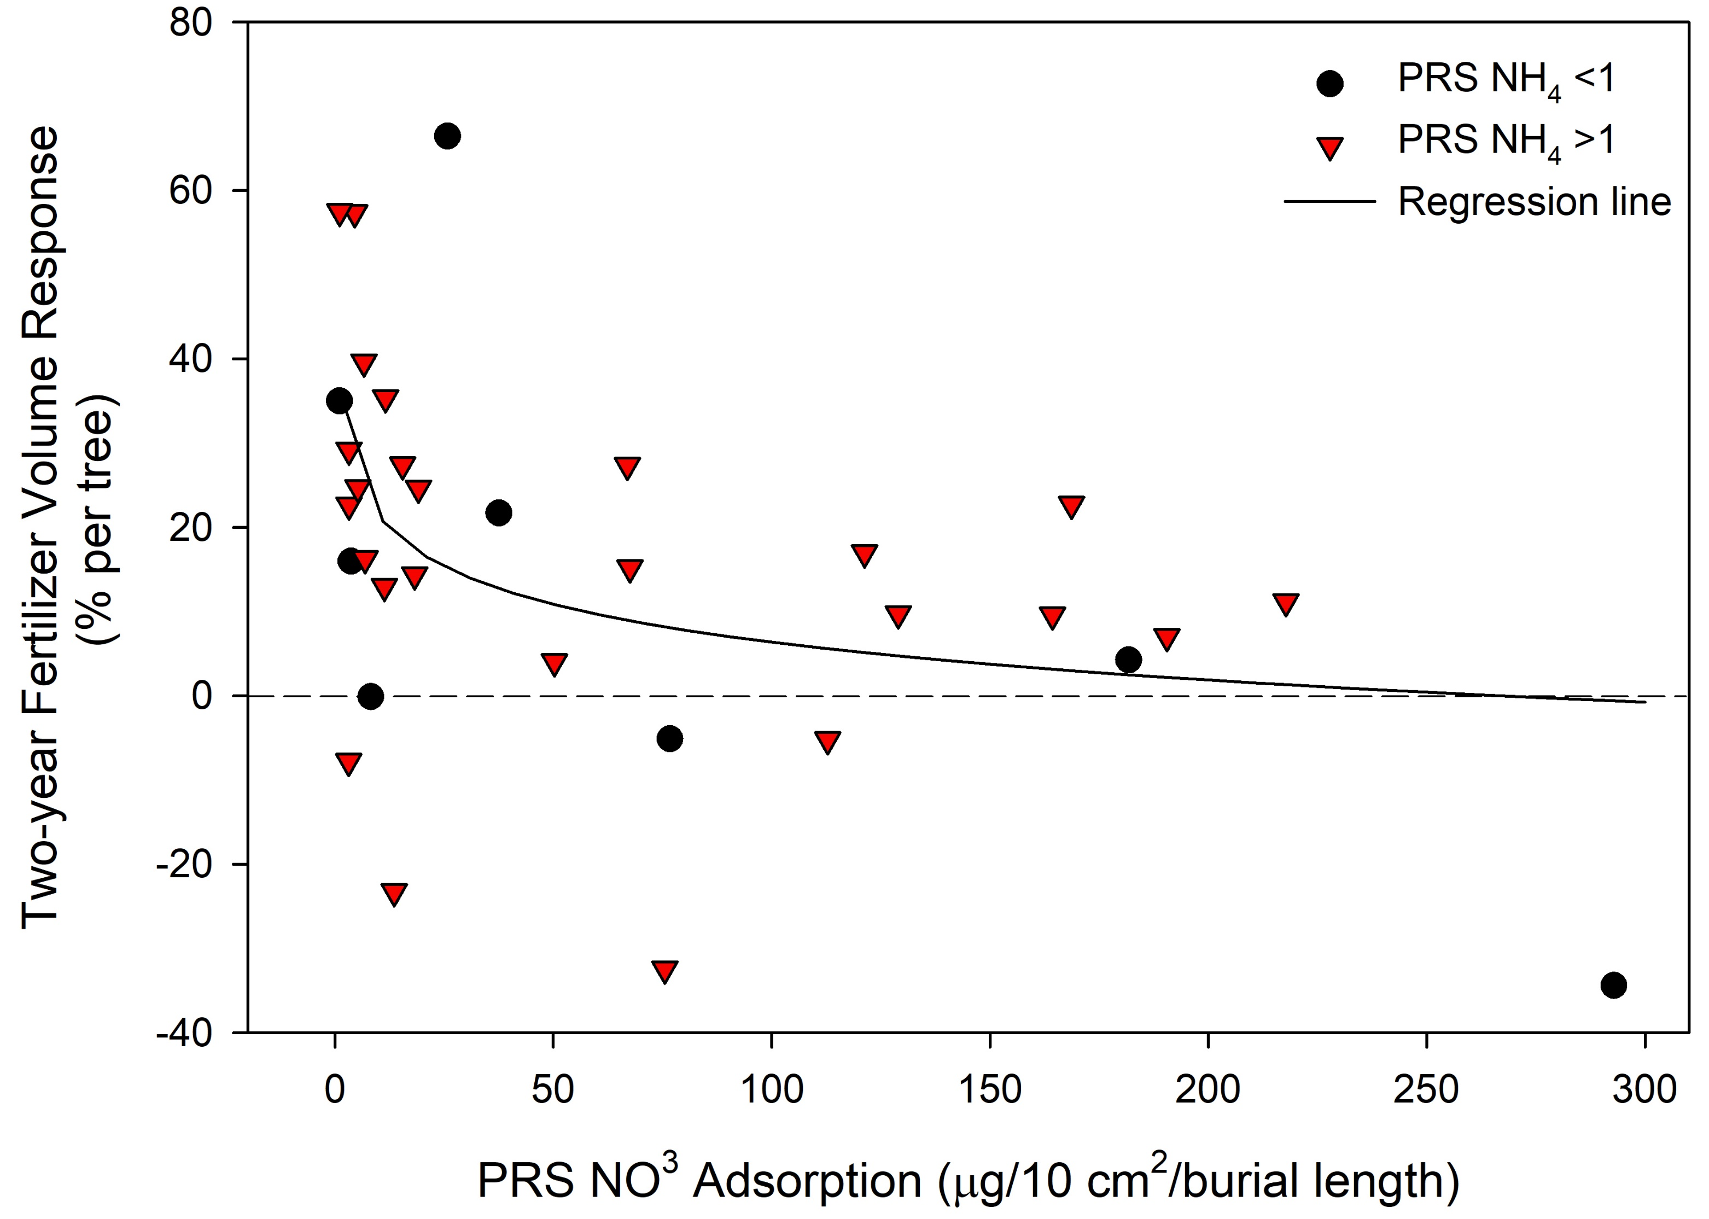
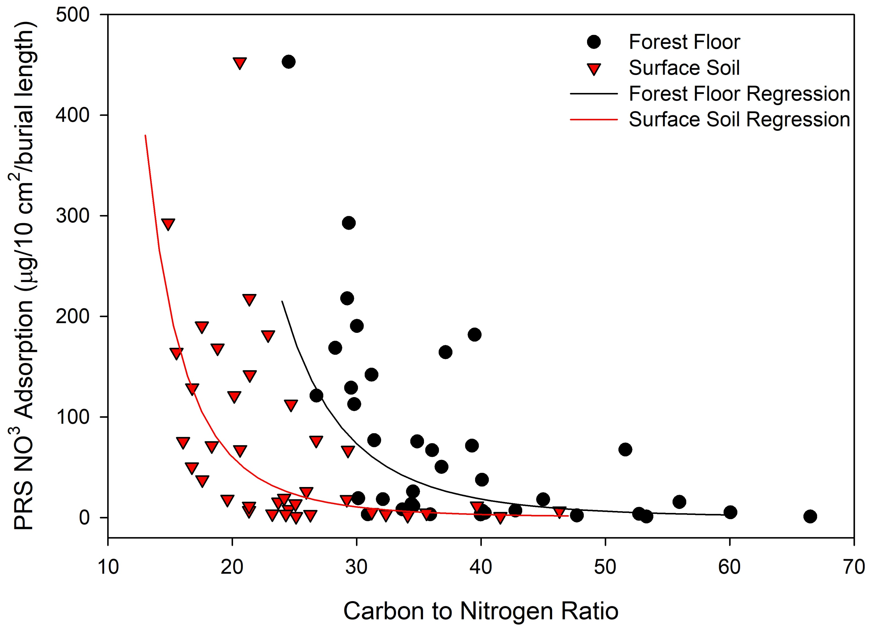
Major Findings
Greater tree volume response on installations with low NO₃ adsorption (<50 mg)
Non-responding installations
  High NO₃ availability
  No N limitation due to adequate ammonium
  One installation had secondary limitations
NO₃ adsorption is also related to forest floor and surface soil C:N ratio
  Mineralization of N
Center for Advanced Forestry Systems 2020 Meeting

Slide 7


Major Findings
Late-rotation tree volume response matches predicted response regions from the Paired-Tree Study
Regional NO₃ adsorption also agrees with regions predicted to respond
Predicted | Tree Response | Plot Response
No Response | 10% | 14 ± 88 ft³/ac/yr
Response | 27% | 69 ± 133 ft³/ac/yr
Center for Advanced Forestry Systems 2020 Meeting

Slide 8
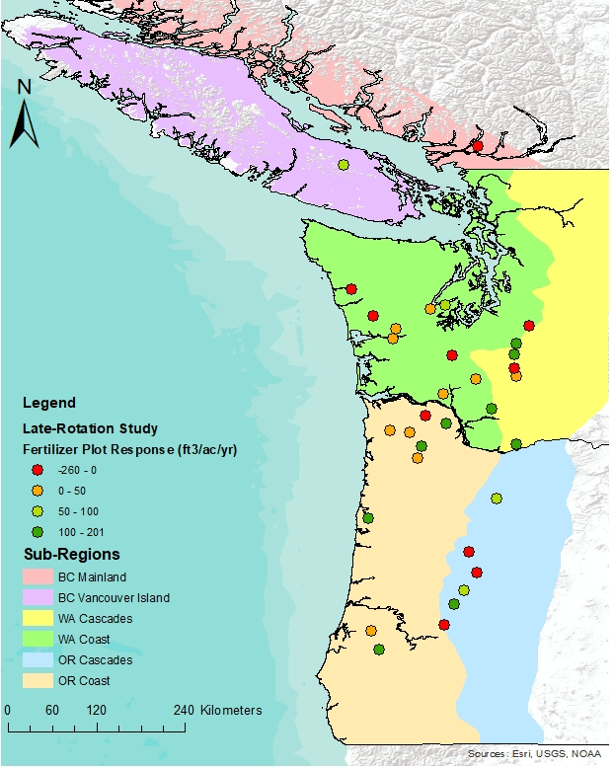
Major Findings
Plot response is linearly correlated with tree response (R₂=0.54)
Tree and plot response are variable by region
Region | Tree Response | Plot Response
BC Mainland (n=1) | 11% | -71 ft³/ac/yr
BC Vancouver Island (n=1) | 56% | 96 ft³/ac/yr
WAW (n=10) | 12 ± 20% | 29 ± 73 ft³/ac/yr
WAE (n=6) | 18 ± 23% | 52 ± 109 ft³/ac/yr
ORW (n=9) | 16 ± 14% | 71 ± 64 ft³/ac/yr
ORE (n=6) | 13 ± 37% | -27 ± 184 ft³/ac/yr
Center for Advanced Forestry Systems 2020 Meeting

Slide 9
Deliverables
38 Late-Rotation installations
Pre-treatment soil and PRS probe data collected
Manuscripts planned:
  Relationship between PRS probe uptake, soil and site productivity, and fertilizer response
  How aboveground and belowground nutrient allocation affect fertilizer response
  Economic analysis of regional fertilization of late-rotation stands
Inclusion of response data into growth models
Center for Advanced Forestry Systems 2020 Meeting

Slide 10
Company Benefits
Examination into the economics of late-rotation fertilization
Average area-based volume response in four distinct regions
Conversion of Paired-Tree response models to per area response
Greater understanding of PRS probe uptake and nutrient allocation in predicting fertilizer response
Center for Advanced Forestry Systems 2020 Meeting

Slide 11
Summary
Late-Rotation stands respond similarly to N fertilization as younger stands
Plant Root Simulator probes show promise to give an understanding of available nutrients and potential for fertilizer response
Greater response in stands predicted to respond in the Paired-Tree fertilizer response models
Tree response similar between regions, but plot response is more variable
Center for Advanced Forestry Systems 2020 Meeting

Slide 12
Recommendations
Increase the spread of PRS probes to further understand the N availability and fertilizer response across the Pacific Northwest
Select fertilization stands based on models and maps from the Paired-Tree study
Prioritize fertilization in regions that have the greatest tree and plot response
  Vancouver Island, Washington Cascades, and Oregon Coast are currently responding the best to N fertilization
Center for Advanced Forestry Systems 2020 Meeting

Slide 13
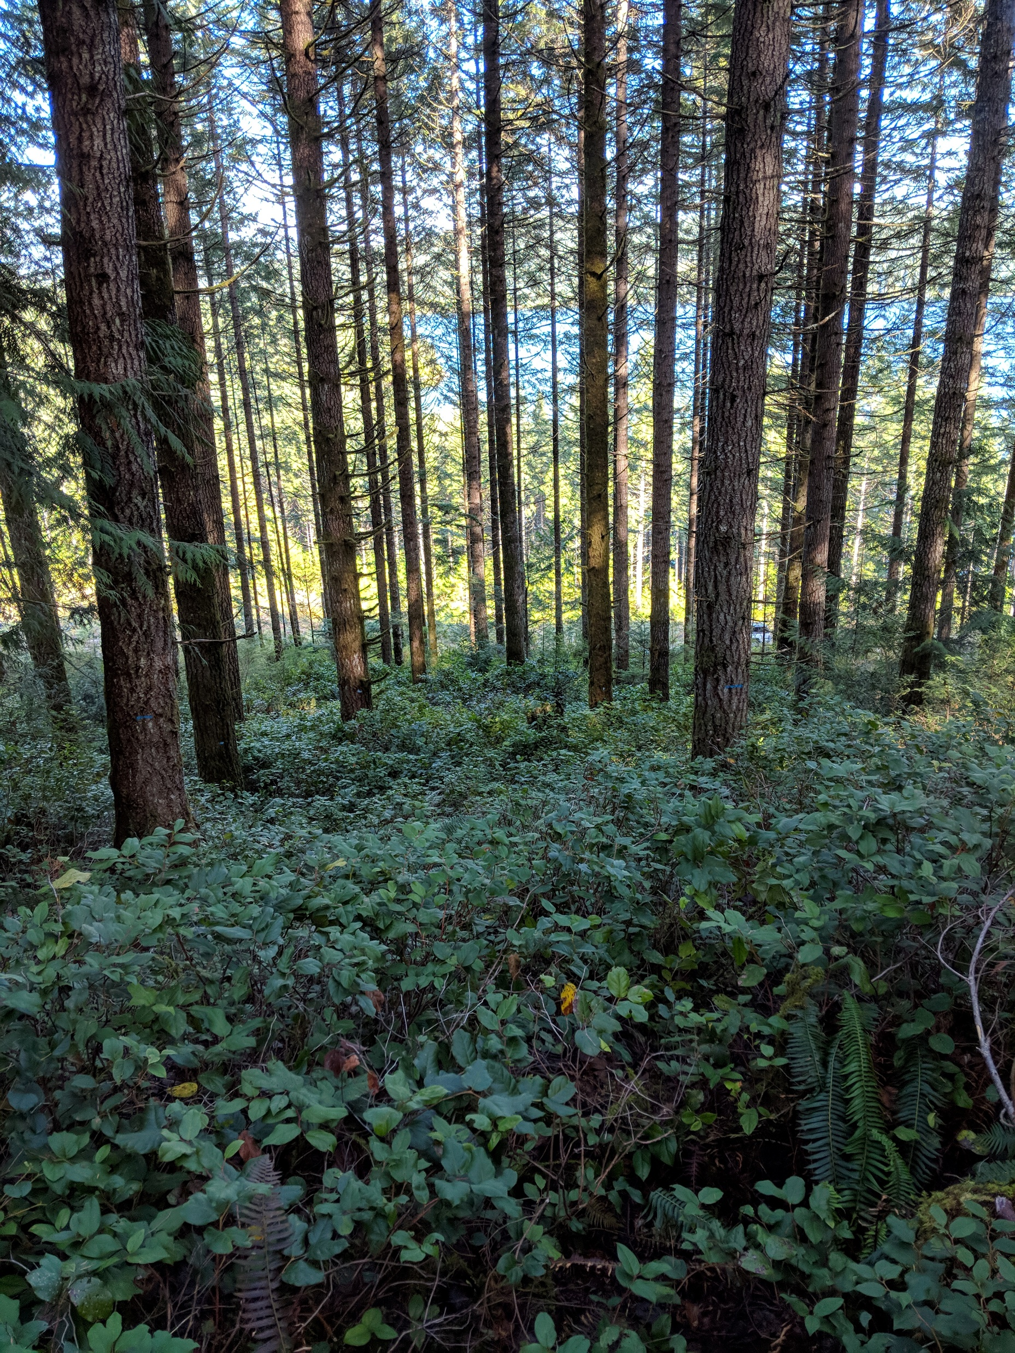
Questions?
Thanks:
SMC Field Crew
  Eric Snoozy, Bob Gonyea, Mason Patterson, Alex Macgregor
Stand Management Cooperators
Center for Advanced Forestry Systems 2019 Meeting

