Slide 1
New Project
Assessing & Mapping Regional Variation in Site Productivity
CAFS.19.75
Investigators: Rachel Cook (NCSU), Aaron Weiskittel (UM), Jeff Hatten (OSU), Cristian Montes (UGA), Mark Coleman (UI), Doug Jacobs (Purdue), Mark Kimsey (UI), Doug Maguire (OSU), Kim Littke (UW)
Presented by:
Rachel Cook and Cristian Montes
North Carolina State University and University of Georgia
Center for Advanced Forestry Systems 2020 Meeting
Notes:
1

Slide 2
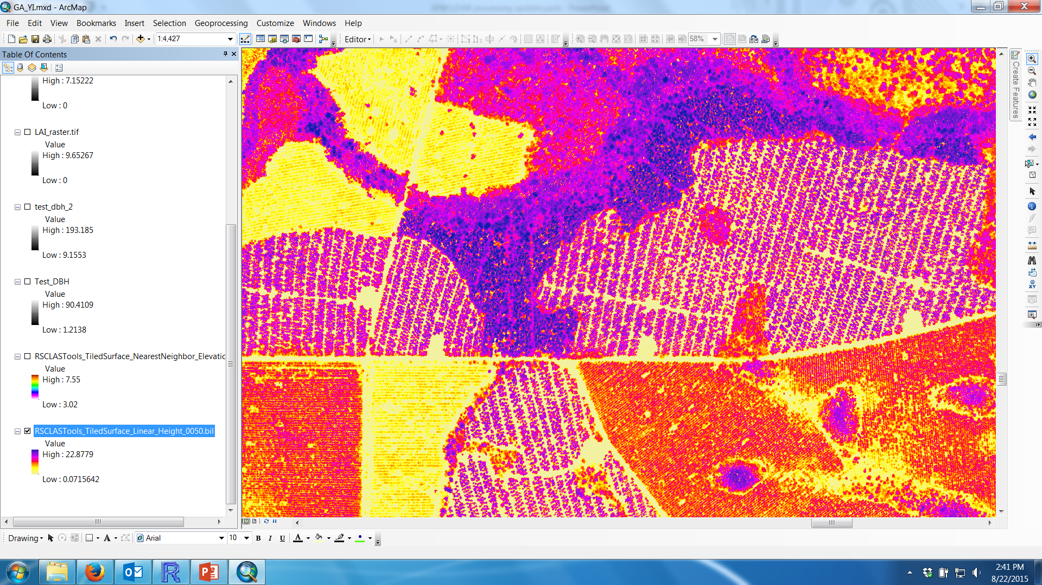
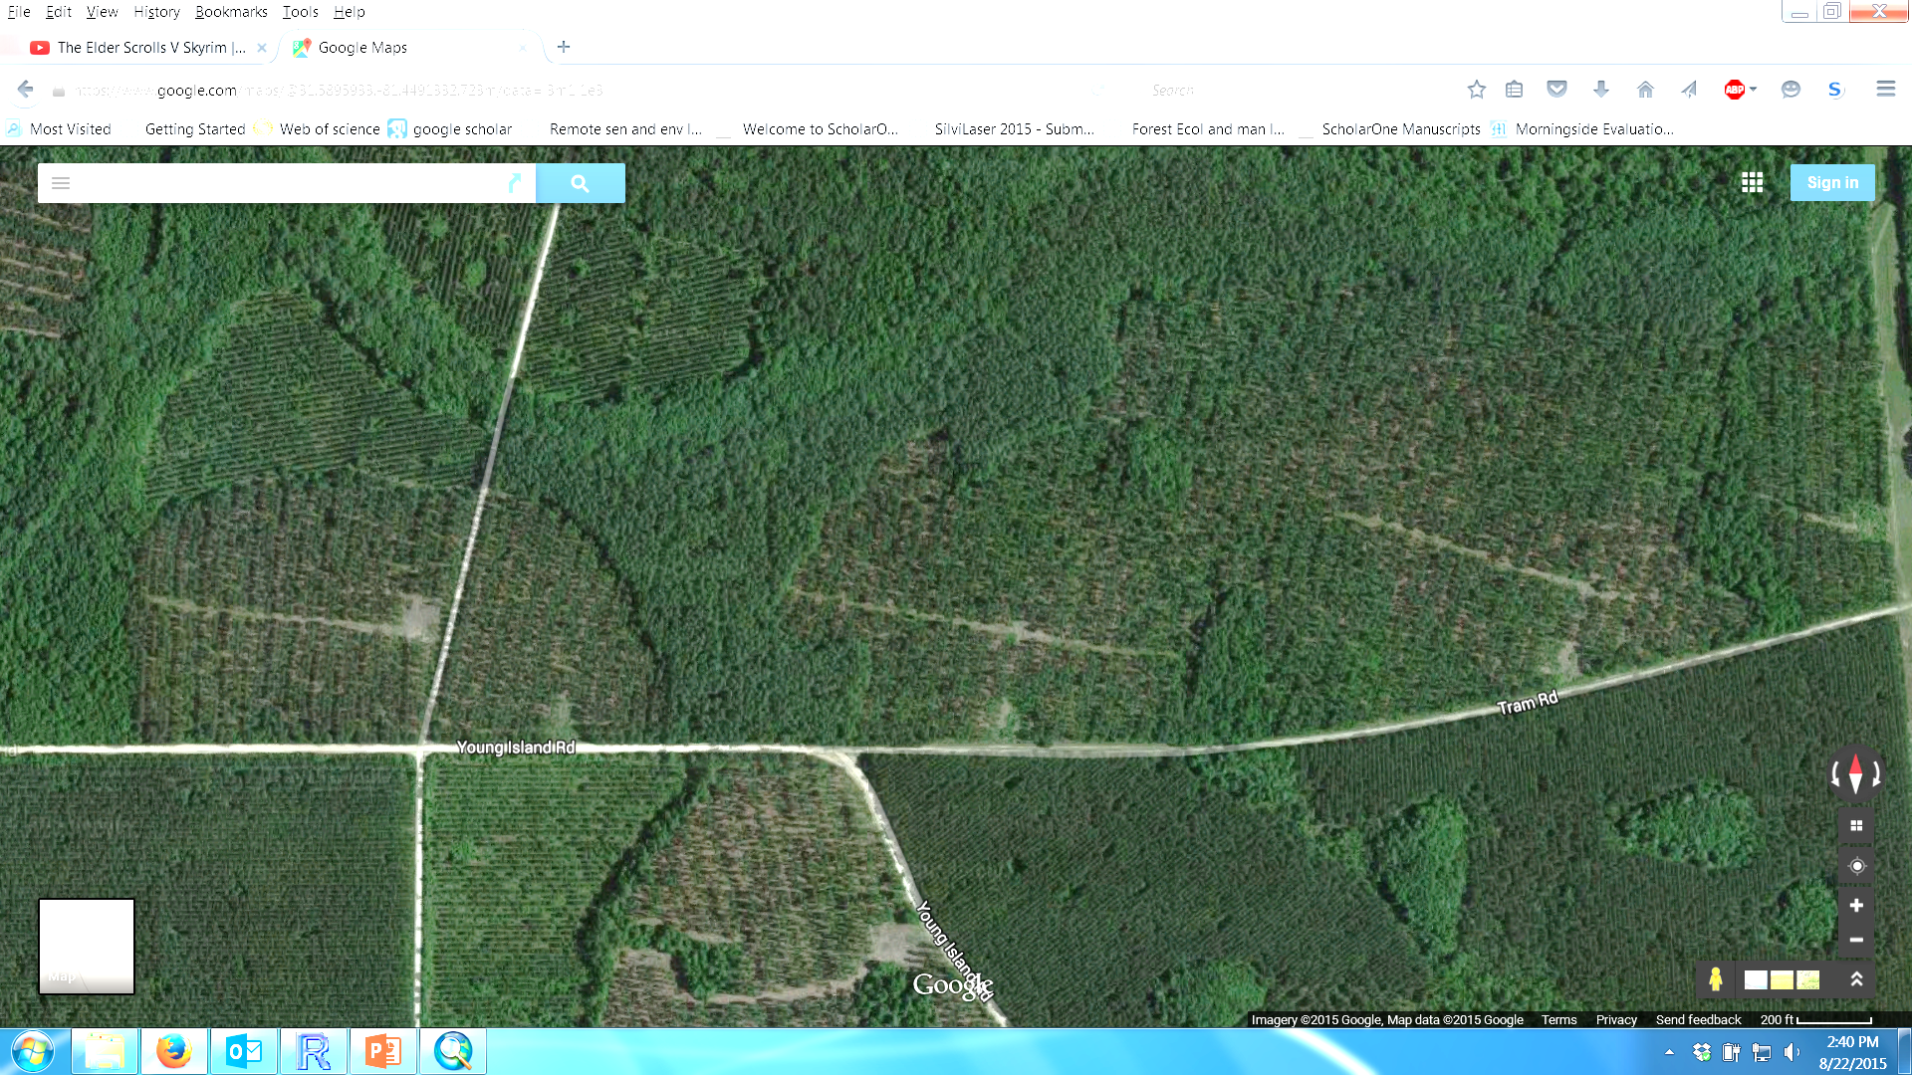
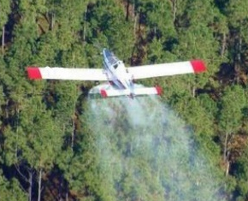
Background
Precision forestry could help optimize management
LiDAR Derived Map of Tree Height
Center for Advanced Forestry Systems 2020 Meeting

Slide 3
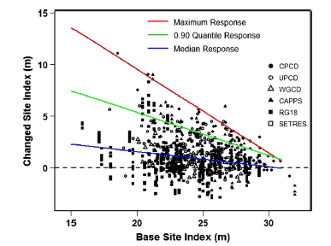
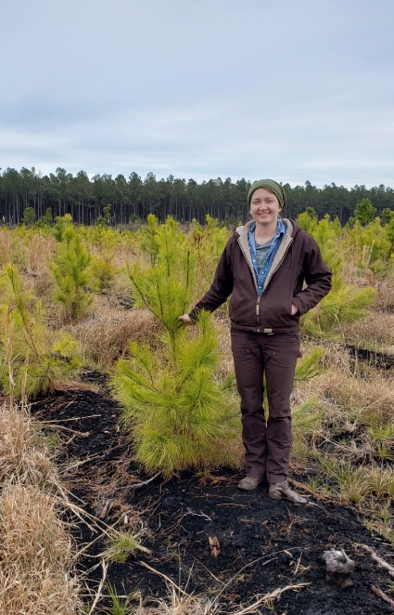
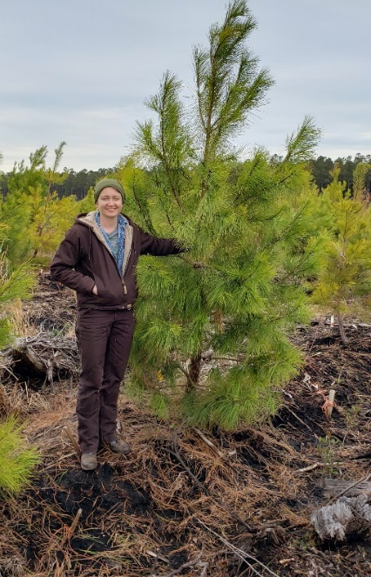
What limits site productivity and how do we make predictions?
Center for Advanced Forestry Systems 2020 Meeting

Slide 4
Objectives
Develop a consistent and biologically meaningful metric of potential site productivity
Relate environmental and edaphic variable to site productivity
Map across major forest regions
Center for Advanced Forestry Systems 2020 Meeting

Slide 5
Experimental Plan
Use long-term measurements of stand conditions
High-resolution rasters of environmental factors
Incorporate LAI and age of stands
Spatially model soil characteristics that influence site productivity
Center for Advanced Forestry Systems 2020 Meeting

Slide 6
Three-year Timeline
Year 1 (2020): Data gathering and compilation of forest soil map units and available stand data
Year 2: Spatial modeling and model comparisons of site productivity and drivers
Year 3: Develop web-based interface of base and potential site productivity
Center for Advanced Forestry Systems 2020 Meeting

Slide 7
Deliverables
Methodology for quantifying site productivity
Harmonized dataset of variables for assessing regional variation in site productivity
Final model for relating site productivity metrics to environmental and edaphic variables
Center for Advanced Forestry Systems 2020 Meeting

Slide 8
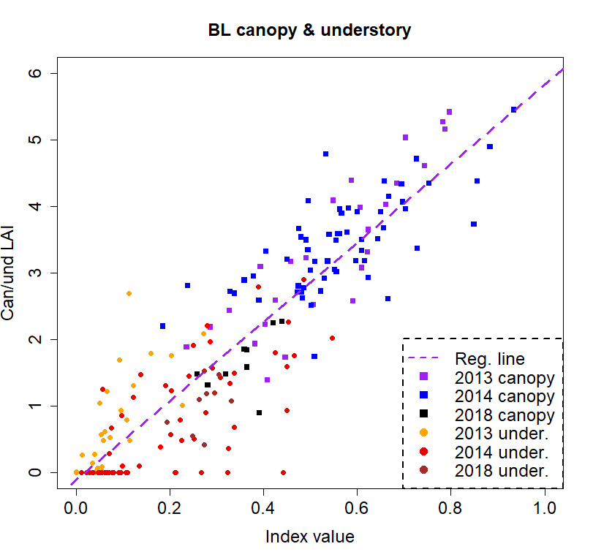
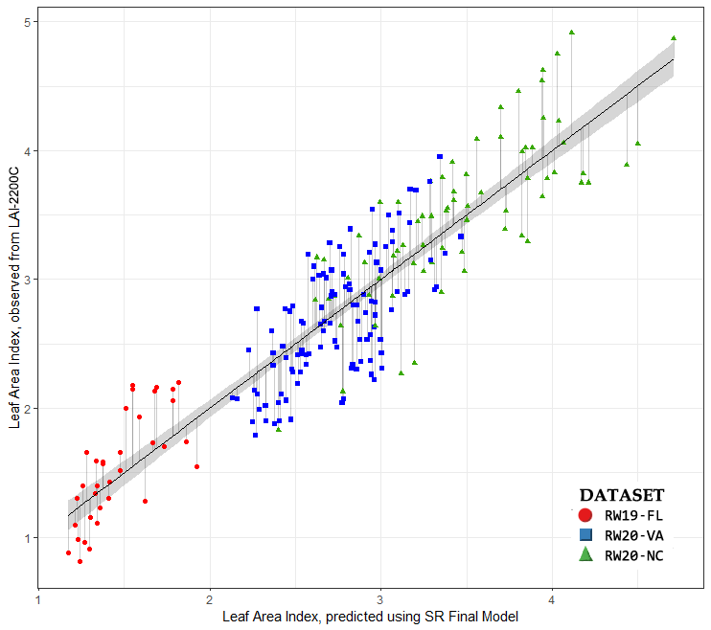
Methodology for quantifying site productivity
What is site productivity exactly?
  Site Index
  Biomass
  LAI
LiDAR-derived LAI
Sentinel-2 LAI
Modified Beer’s law equation for canopy and understory relationship with eLAI (BL_{over} and BL_{under}). Sumnall et al. In revisions
Cohrs et al., 2020. Sentinel-2 LAI Estimation for Pine Plantations in the SEUS. Remote Sensing

Slide 9
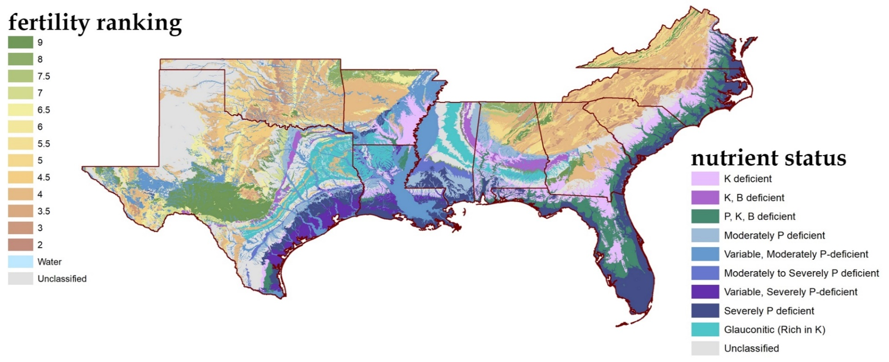
Derive a National Soil Productivity Map for Production Forest Systems
Center for Advanced Forestry Systems 2020 Meeting

Slide 10
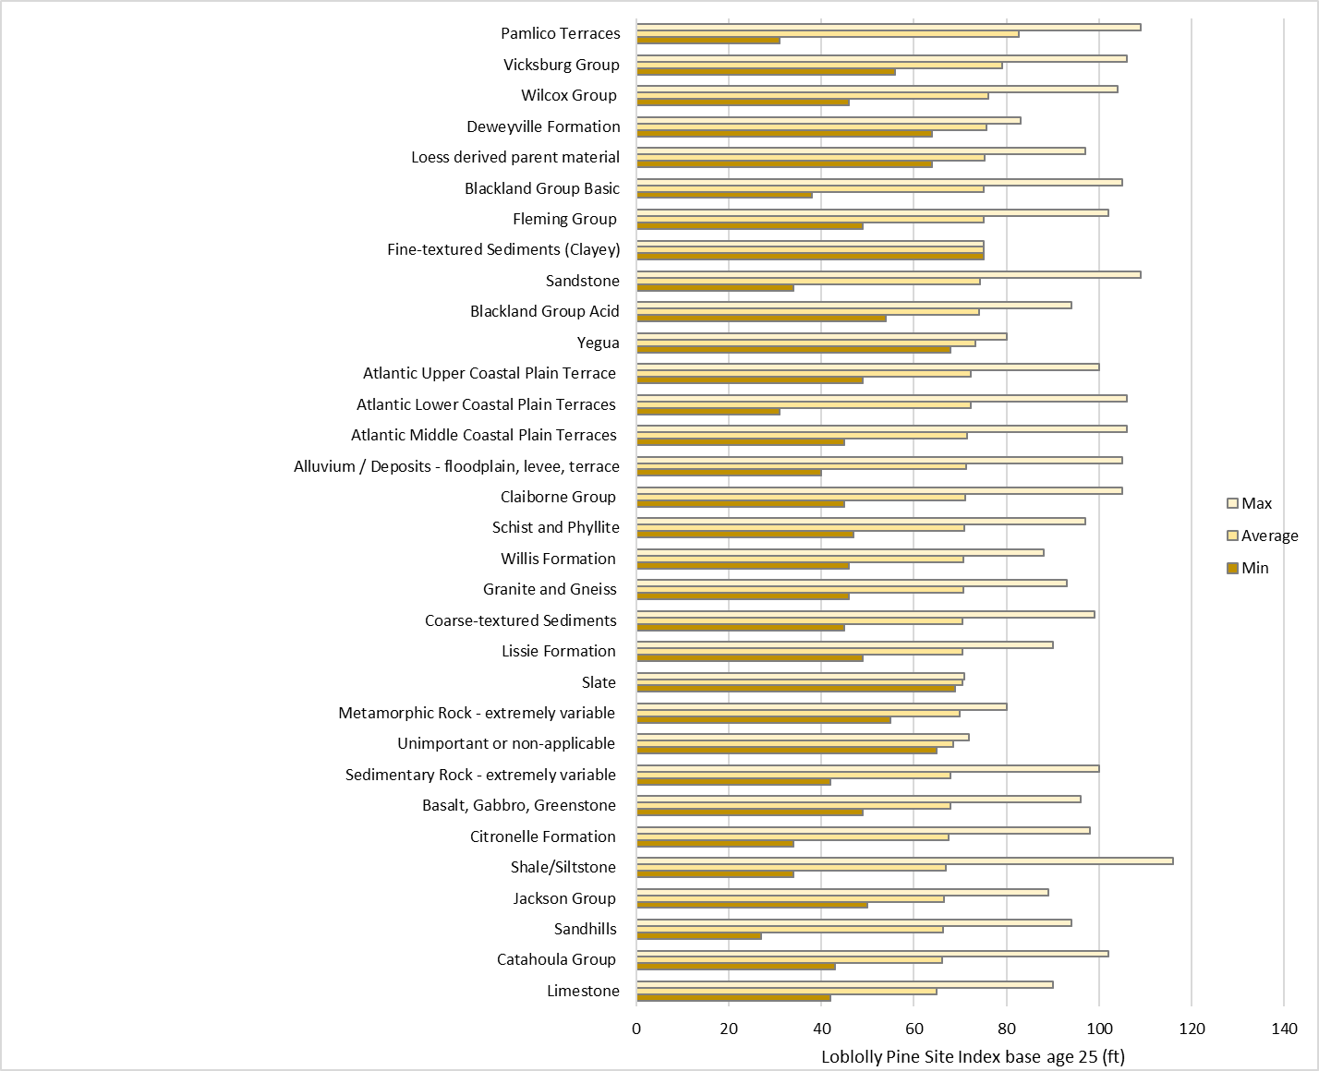
Relating site productivity metrics to environmental and edaphic variables
Site Index by Geologic Formation or Rock Category
**Very preliminary (don’t read too much into this yet)**

Slide 11
Moving forward as a team

Slide 12
Original project in a nutshell
Geologic maps compiled by NCSU and UMaine, hypotheses about nutrient limitations.
Use ALS to estimate Site Index, Biomass, and/or LAI using area based lidar parameters.
Combine Soil, Geology, and Environmental Variables for a prediction model.
Combine auxiliary variables with Site Productivity estimates make predictions for a larger area.

Slide 13
Different aims
Potential productivity
  Require monthly/daily weather, soil water storage capacity, Organic Matter.
  Plots without nutritional limitation.
  3PG, FullCam, Cabala.
  Aims at finding upper boundary for stand productivity.
Attainable productivity/Current productivity
  Require monthly/yearly weather, soil water storage capacity, soil hydraulic conductivity, organic matter.
  Inventory plots, growth plots, estimated yield parameters.
  Aims at finding growth subject to current operational limitations.

Slide 14
Common goals
Consolidated soil maps using DSM methods to produce similar outputs at common resolution.
Climatic data with known uncertainty.
Unified way to process remotely sensed data
Develop raster datasets to use as auxiliary variable for countless models to test their relationship with complex systems.

Slide 15
Env. inputs and desired outputs
Climatic information
Potential evapotranspiration
Total rainfall
Total radiation
Water deficit
Excess water
Useable water
Depth to water table
Deliverables
Climate raster maps
Error maps
Soil Information (NRSC soil pits)
Water Storage Capacity
Rooting volume
Bulk density
Organic matter
Hydraulic Conductivity
Depth to water table
Deliverables
Raster maps
Error maps
Productivity Information
Satellite LAI
Ground LAI from optical sensors
Ground Productivity plots
Deliverables
Biomass Equations
Growth Equations
Productivity maps (potential/actual)
Error maps

Slide 16
Some pitfalls
Productivity defined as Site Index involved prediction and projection errors
Soil variables involve VERY large estimation errors.
Legacy soil pits not well located, different, soil characteristics measured differently by site.
What climatic variables to use, that make an operational tool for the industry?
Satellite info is prone to large error as well.

Slide 17














Digital Soil Mapping & Environmental Correlation
SCORPAN model (Soil, Climate, Organisms, Relief, Parent Material, Age, Spatial locatioN).
Aux. Variables
Base Maps
Operational Maps
Prescription Maps
Soil Pits
Sand
Water Storage Capacity
Machine resistance
Silt
Carbon 0-60 cm
Fragiity
Environmental Vars.
Parent Material
Clay
Nitrogen Stock
Fertilization
Remote Sensing
Organic Matter
C/N ratio
DEM
% gravel
Productivity
Hydraulic Conductivity
Veg. Control
Climate
Bulk Density
Texture
Vegetation
Depth
Cristian R. Montes 2020

Slide 18
Using environmental variables introduces bias unless those are corrected using error-in-variable methods

Slide 19
Company Benefits
Improved metrics for assessing site productivity
Development of simplified soil classification system for forest management
Incorporation of LAI to enhance predictive response
Reduce need for costly measurements
Improve confidence of response and therefore return on investment
Center for Advanced Forestry Systems 2019 Meeting

Slide 20
Summary
Narrow down the project to produce a unified approach to use soil and climate information, informing the uncertainty involved.
Allow for multiple approaches using these databases, targeting issues specific to each CAFS Site.
Use existing resources (Grad. students working on already existing projects) to approach the unified approach.
Allow each site to manage the same unified SOIL and CLIMATE database (and depth to water table).
Working groups to held scientific meetings more often to discuss progress issues.

Slide 21
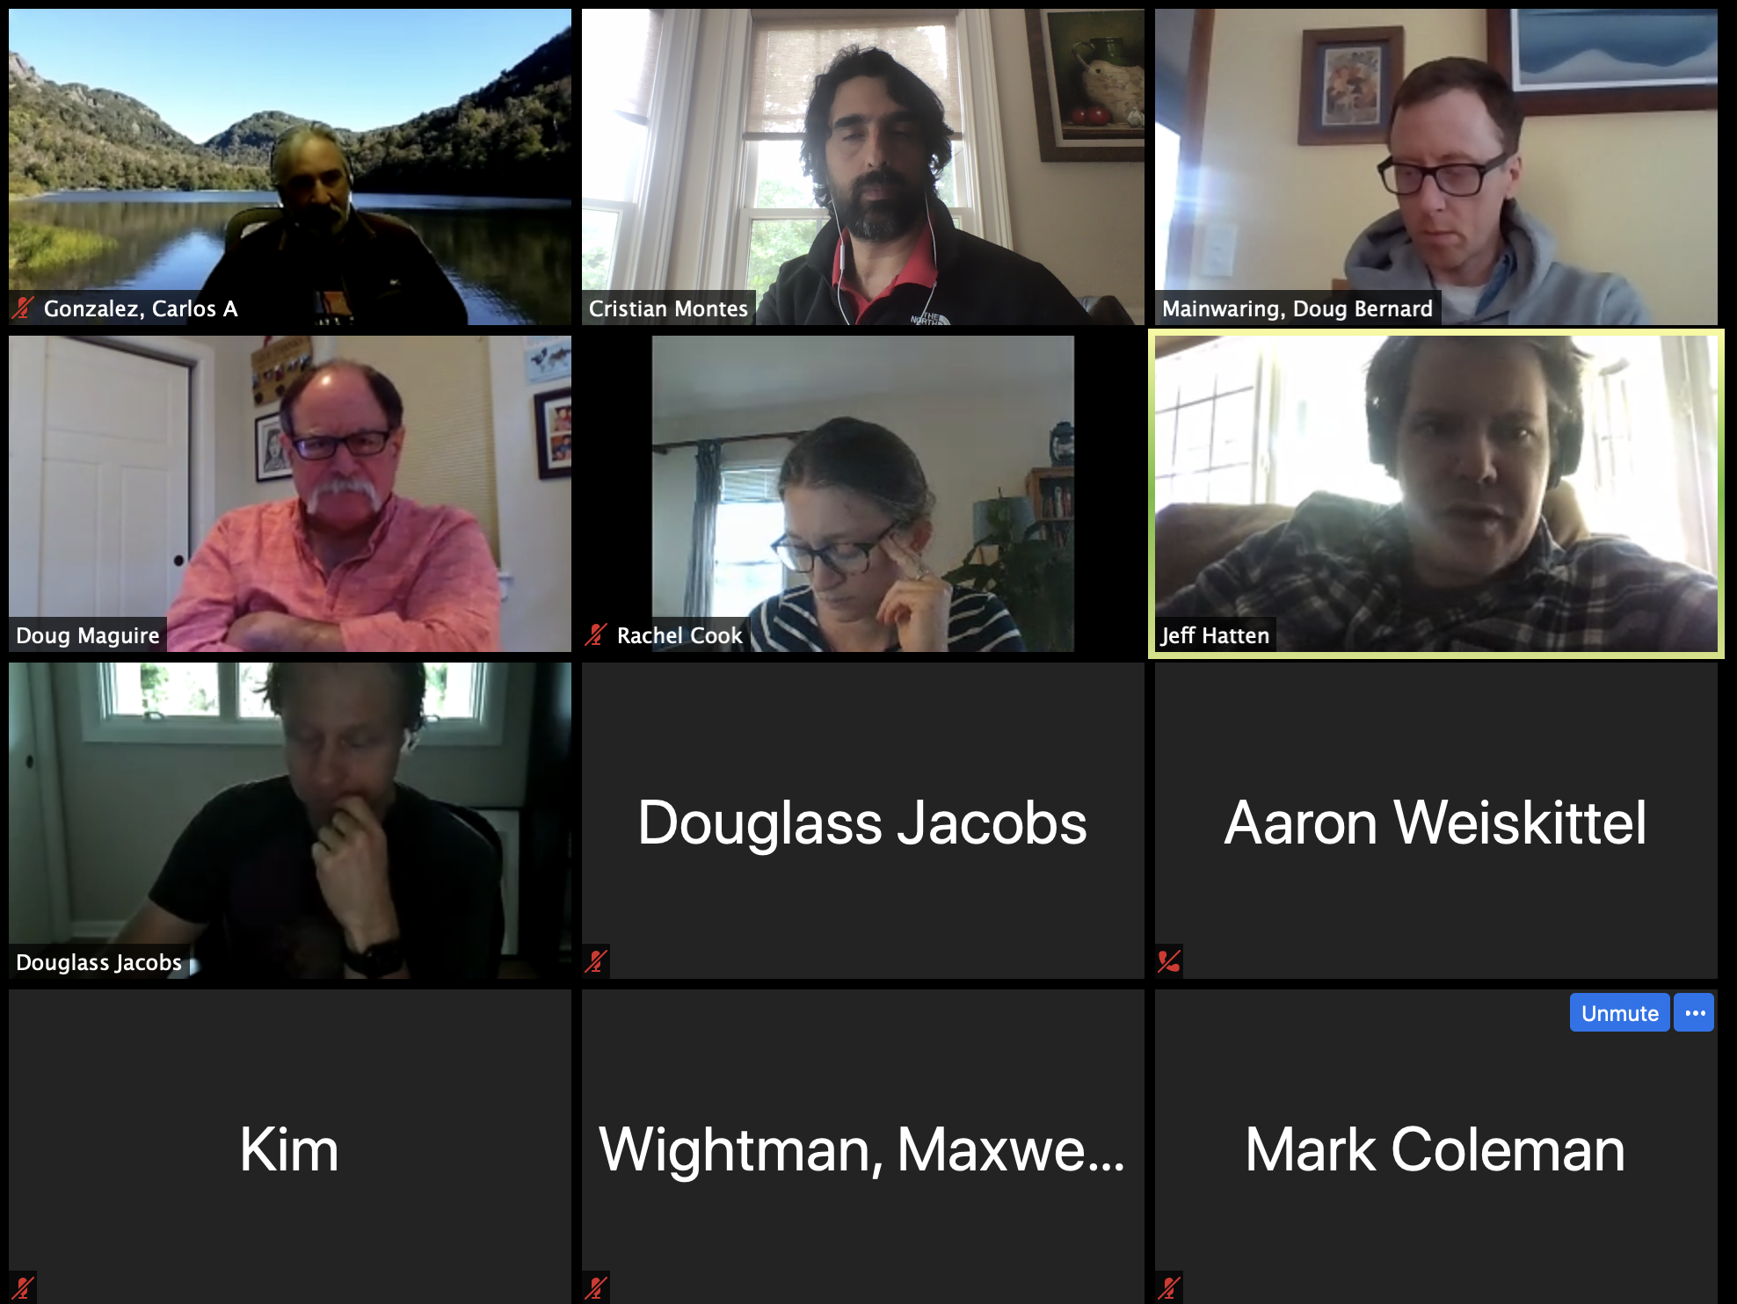
We are actually meeting to figure out what to do!

