Slide 1
Progress report
Environmental Predictors of Form and Quality
CAFS.18.74
Cristian R. Montes, Joseph Dahlen and Bronson P. Bullock
Presented by Cristian R. Montes
Center for Advanced Forestry Systems 2020 Meeting
Notes:
1

Slide 2
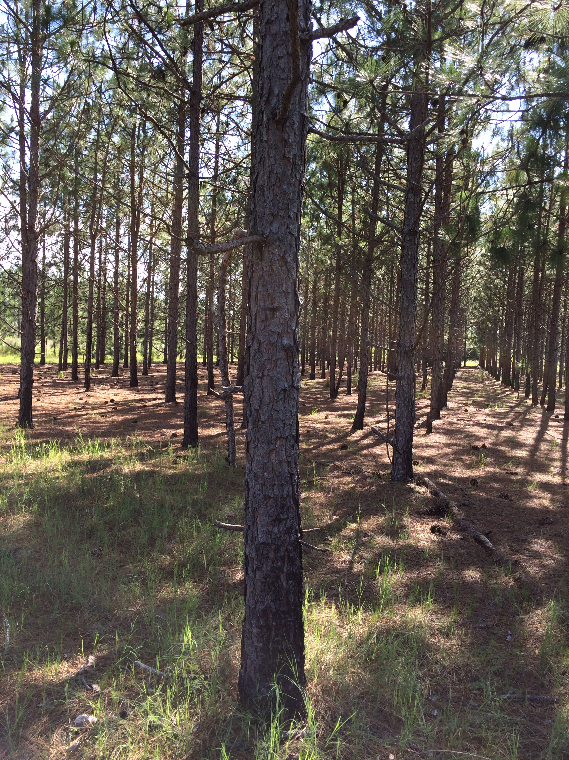
Justification
Stem quality is an important trait but is subjectively measured.
Stem quality influenced by
Soil
Climate
Stand productivity
Genetics
Inventory with full tree scanning using LiDAR might be able to accurately measure form, therefore improving information on a stand, and in the long run not increase inventory costs.
Center for Advanced Forestry Systems 2020 Meeting

Slide 3
Hypotheses or Objectives
Tree size and form are primarily related to biophysical variables.
Quantify stem form using LiDAR
Develop equations that relate tree size and form with biophysical variables (soil physical properties, environment proxies for water balance)
Center for Advanced Forestry Systems 2020 Meeting

Slide 4
Methods
GLS
(ground-based laser scanning)
Diameter and Branch density
Traditional Stem Taper
Sampling
Estimate Taper
Estimate Sweep
Estimate Branch Index
Biophysical Variables
Spatial Productivity
Spatial Taper
Spatial Sweep
Spatial Branch index
Center for Advanced Forestry Systems 2020 Meeting

Slide 5
Methods
Biophysical Variables
Spatial Taper Influences
Spatial Sweep
Spatial Branch index
Water Deficit
Excess Water
Water Deficit
Excess Water
Useable water
Center for Advanced Forestry Systems 2020 Meeting

Slide 6
What about the soil?
Lack of water: We need soil to store water for periods of stress.
Excess water: We need soil to drain in order to reduce negative effects.

Slide 7
Maps that characterize either WSC or Hydraulic Conductivity
Water Storage Capacity (mm)

Slide 8
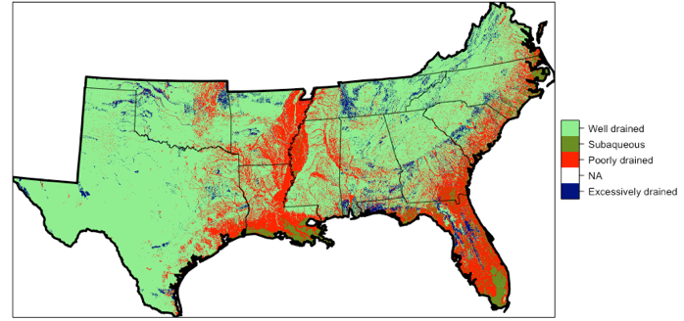
Maps that characterize either WSC or Hydraulic Conductivity

Slide 9
Water Deficit
Excess Water
Useable Water
Major Findings
Loblolly pine Site Index (m)
Machine learning
used to estimate & interpolate
a Site Index Equation
Koirala et al. submitted 2020

Slide 10
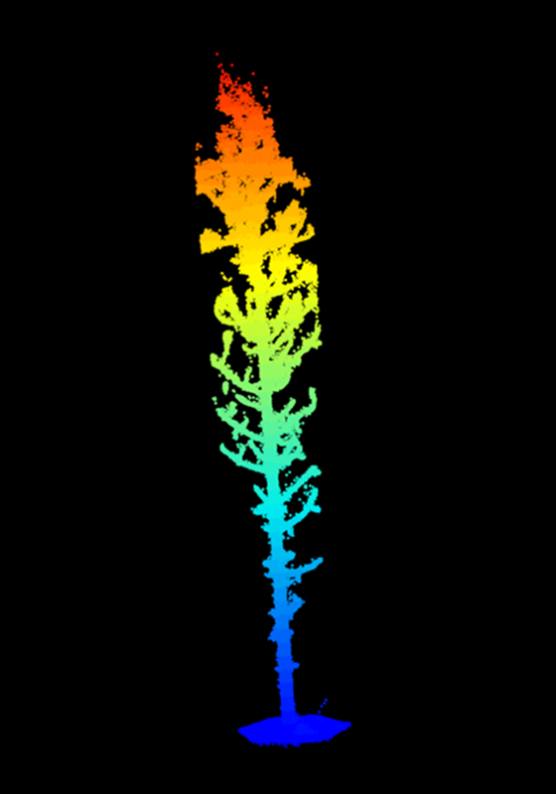
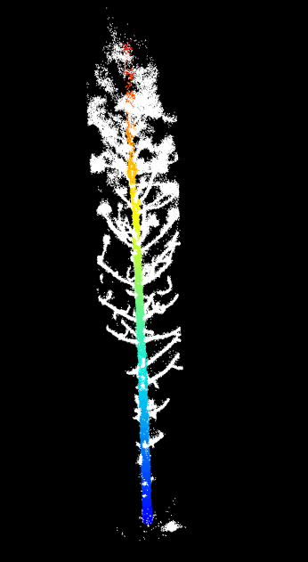
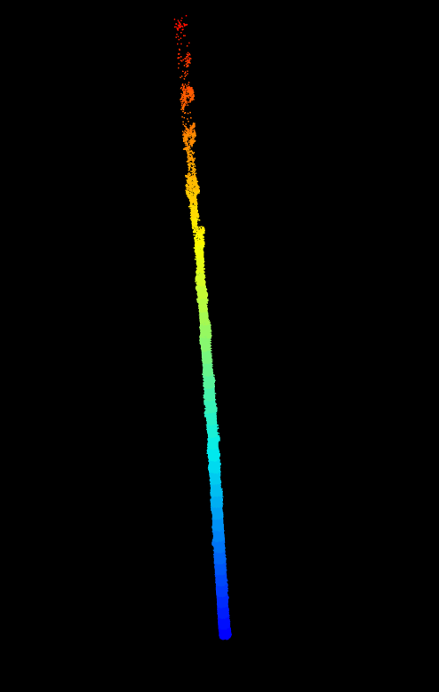
Segmenting LiDAR point clouds – separating the bole from the branches

Slide 11
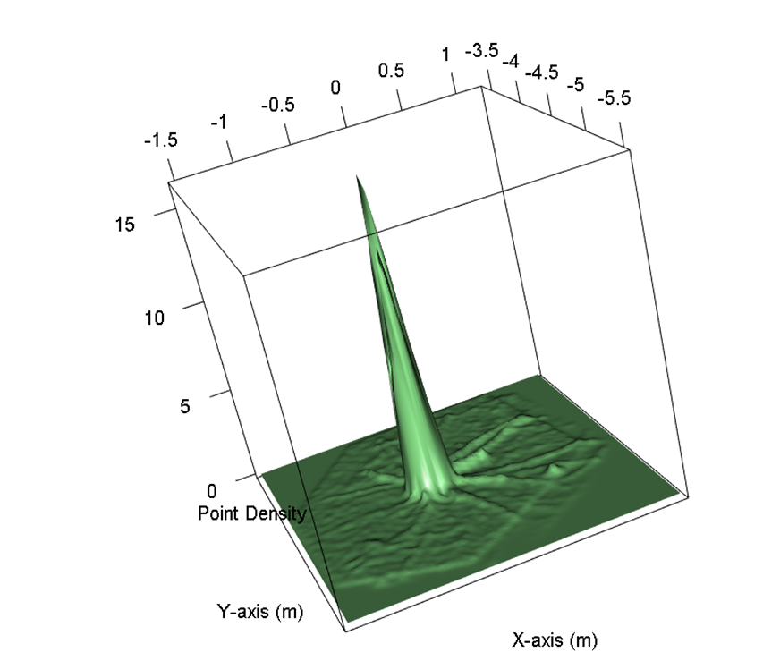

2D Kernel Density Estimation (KDE) of in a tree scan
Stem is solid and thus higher density points
2D kernel is computed after ground segmentation but before stem segmentation

Slide 12
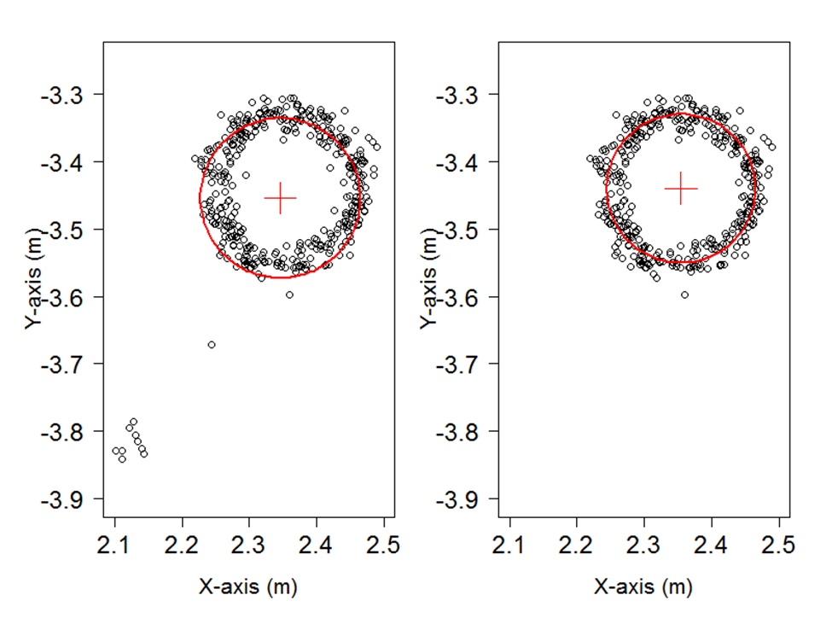
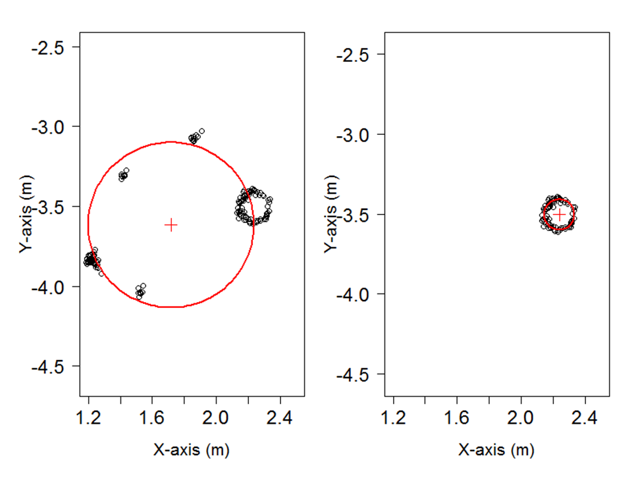
Improved fitting algorithm using a geometric transformation to separate branches from stem
Breast Height (1.3m), 1cm thick slice
6.1m above ground, 1cm slice

Slide 13
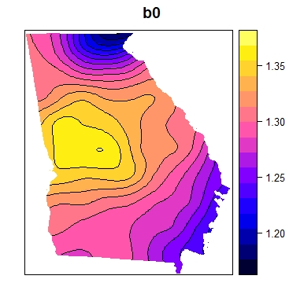
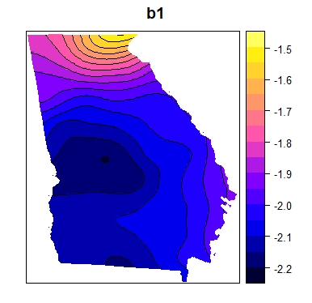
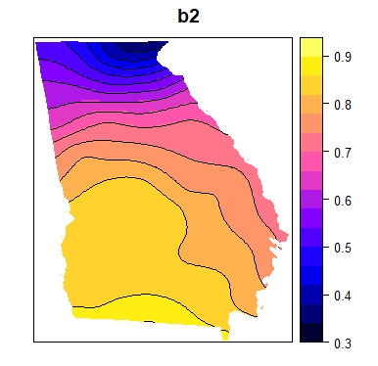
Deliverables
Fitting taper models to segmented stems
Spatial Variation in Kozak Taper Equation Parameters
Center for Advanced Forestry Systems 2020 Meeting

Slide 14
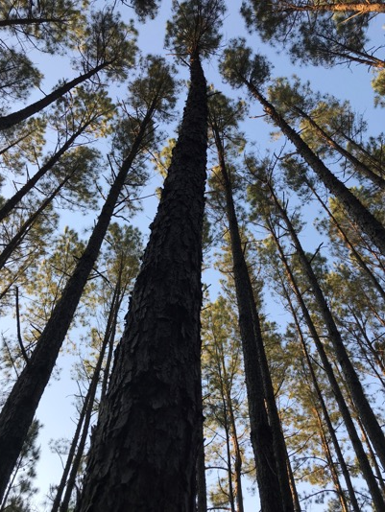
Major findings so far
Environmental variables biometrically linked to a traditional site index equation.
Taper equation parameters vary with respect to water deficit.
No stand origin effect (cut over or old field)
Improved tree diameter estimation algorithm (as compared to last year)
Bias correction equations developed.

Slide 15
Company Benefits
Consolidated soil maps with known uncertainty
Consolidated climatic maps with known uncertainty
Spatially explicit G&Y equations and stem form equations.
G&Y systems need a way to predict tree defects which will improve improve lumber value estimates out of G&Y systems for improved forest management decisions.
Center for Advanced Forestry Systems 2020 Meeting

Slide 16
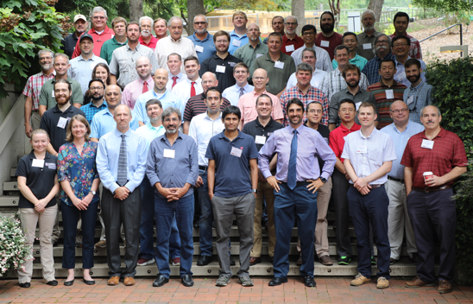
Acknowledgements
The PMRC and the WQC at the University of Georgia
Notes:
16

