Slide 1
New Project
Using hyperspectral imaging
to evaluate forest health risk
CAFS.20.80
John Couture, Melba Crawford, Matthew Ginzel,
Brady Hardiman Douglass Jacobs (Purdue University)
Aaron Weiskittel, Parinaz Rahimzadeh, Peter Nelson (University of Maine) Cristian Montes, Caterina Villari, Kamal Ghandi (University of Georgia)
John Couture (Purdue University)
Center for Advanced Forestry Systems 2020 Meeting
Notes:
1

Slide 2
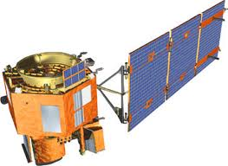
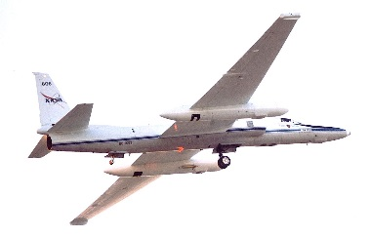
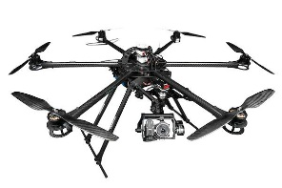
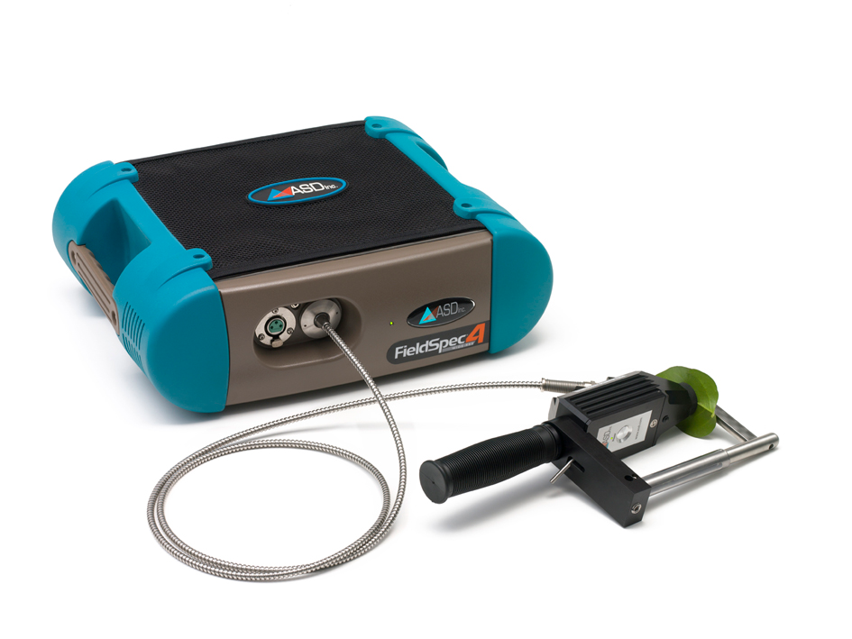
Justification
Monitoring forest health is challenging because of the spatial scale (both horizontal and vertical) of forests
Remote sensing approaches to monitor natural and managed forest systems have the potential to resolve logistical challenges with integrating precision agricultural into forest management
Questions remain about relating information available from remote sensing into forest management
Center for Advanced Forestry Systems 2020 Meeting

Slide 3
Hypotheses or Objectives
We have three specific objectives:
determine the ability of hyperspectral data to provide information related to tree status in response to abiotic and biotic stress
assess the reliability of hyperspectral information to scale from leaf, to tree, to stand, to landscape-level measurements
evaluate the validity of hyperspectral data to characterize stress responses over different spatial and temporal scales in different geographic locations
Center for Advanced Forestry Systems 2020 Meeting

Slide 4
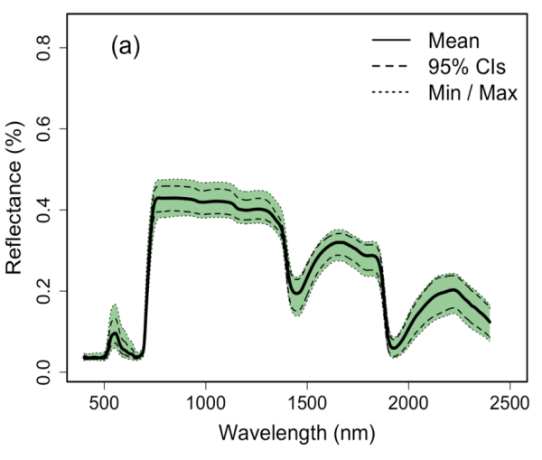

Methods
Spectroscopy:
Study of molecular structure and dynamics through the absorption, reflectance, and scattering of light.
In vegetation, changes in spectral profiles are caused by variations in biochemical and biophysical traits.
Much of the information is contained outside of what we can see.
NIR
SWIR
VIS
Center for Advanced Forestry Systems 2020 Meeting

Slide 5
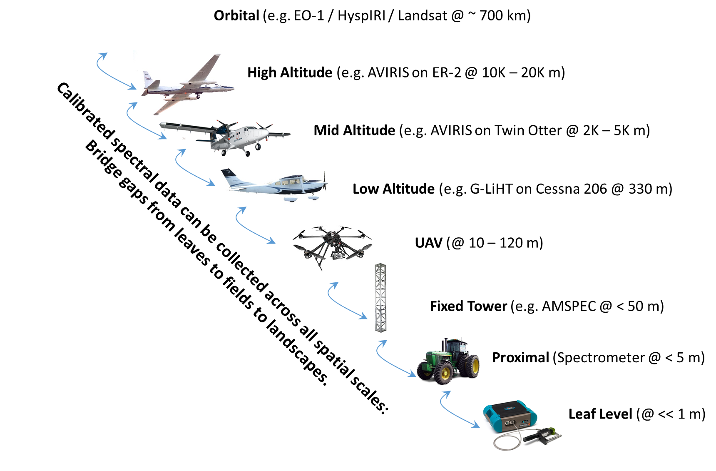
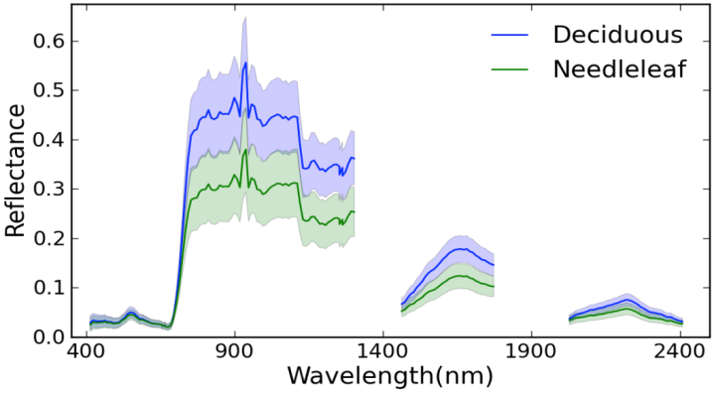
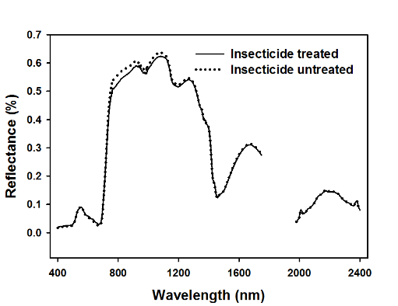
Methods
Center for Advanced Forestry Systems 2020 Meeting

Slide 6

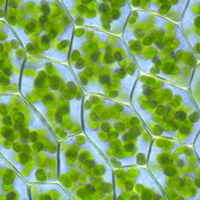
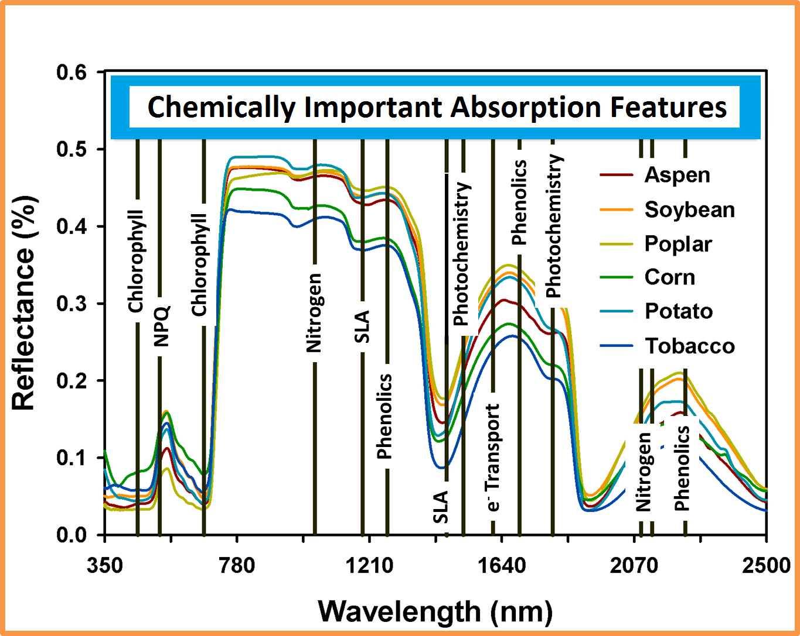
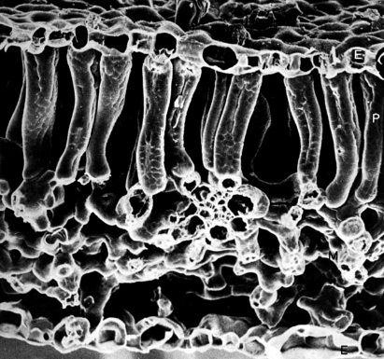
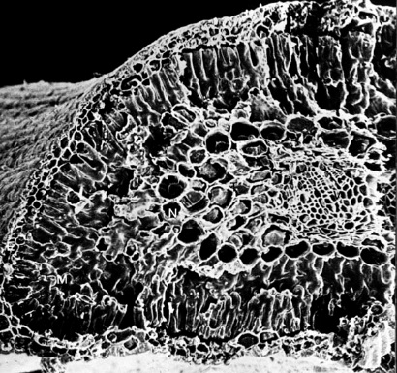
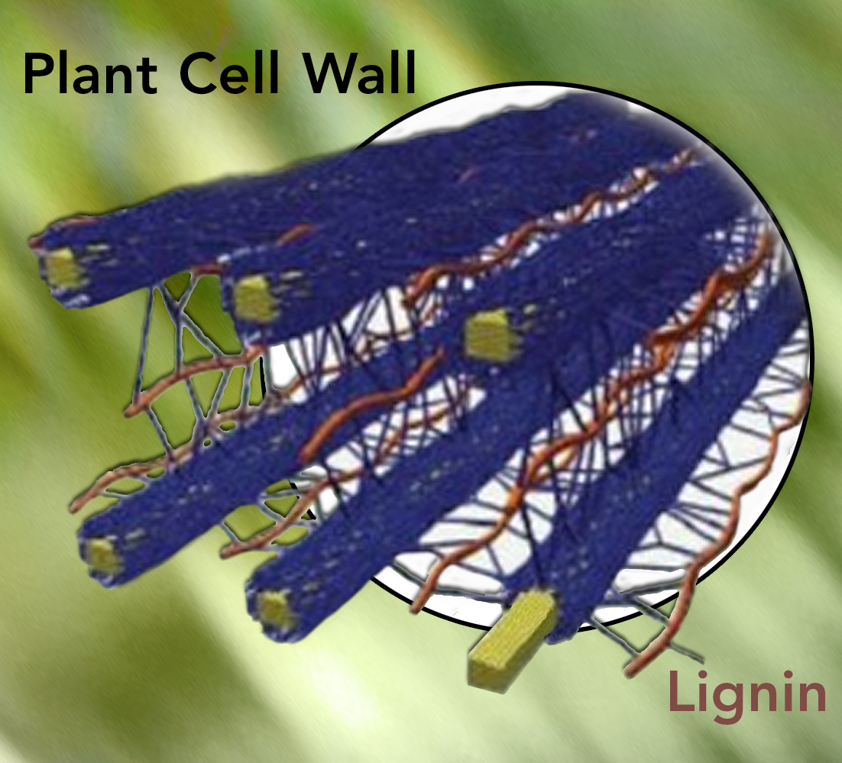
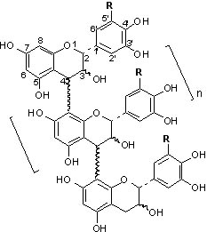
Methods
Trait retrievals
Center for Advanced Forestry Systems 2020 Meeting

Slide 7
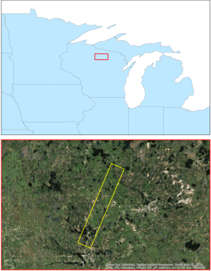
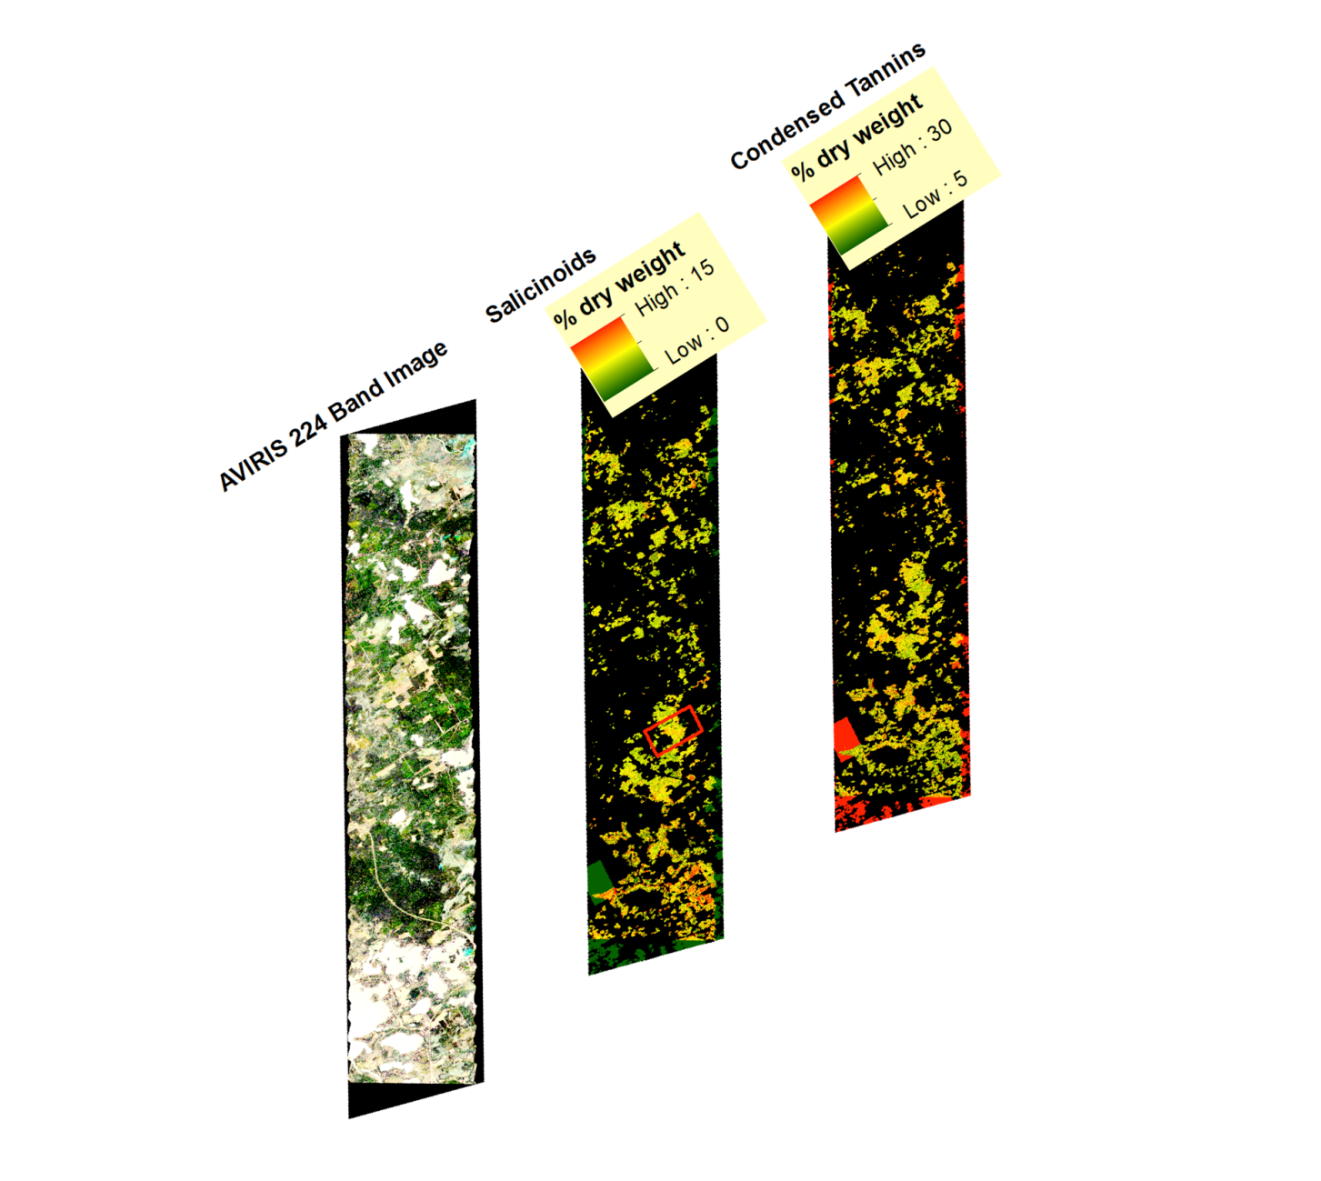
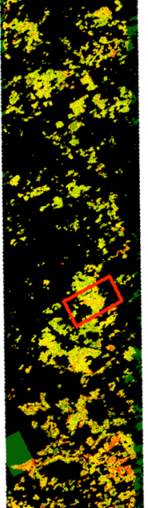
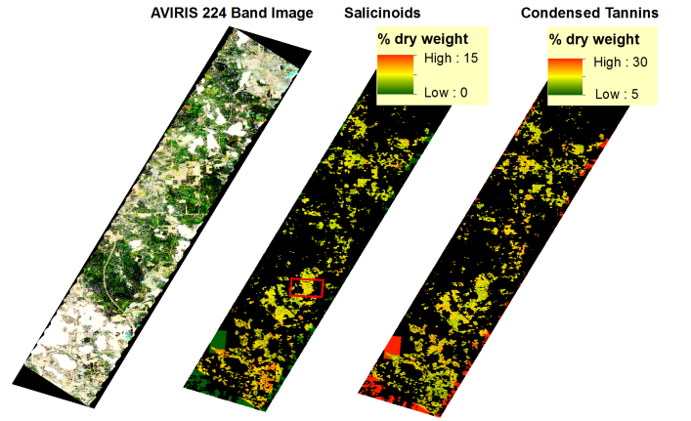
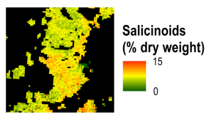
Methods
Maps - scaling up
Condensed tannins
224 band image
Salicinoids
Couture et al. in prep
Center for Advanced Forestry Systems 2020 Meeting

Slide 8
Methods
Spectral phenotyping
What drives spectral variation in plants?
  Chemistry? Yes.
  Genetics? Yes, indirectly.
  But can we measure all chemical constituents or identify all genotypes? No.
We can use the variation in leaf spectra as a surrogate for:
  Total expression of biochemical, biophysical, and genetic variation (even when not explicitly measured)
  So that plant spectral data be used as an indicator of genetic variation or plant responses to stress
Center for Advanced Forestry Systems 2020 Meeting

Slide 9
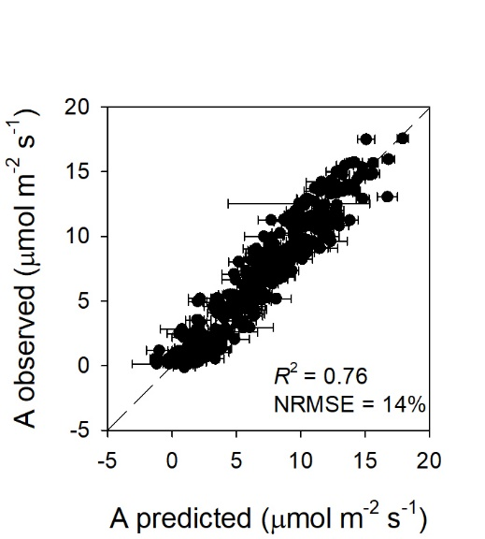
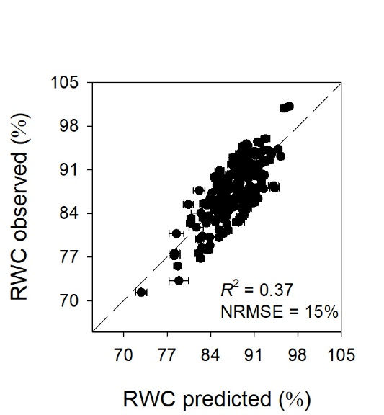
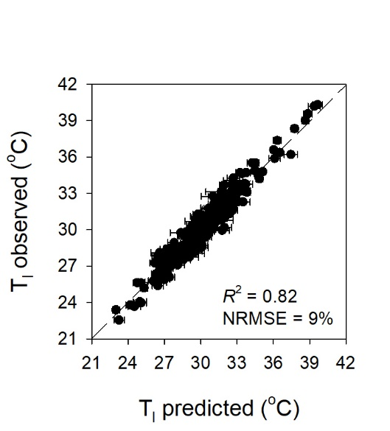
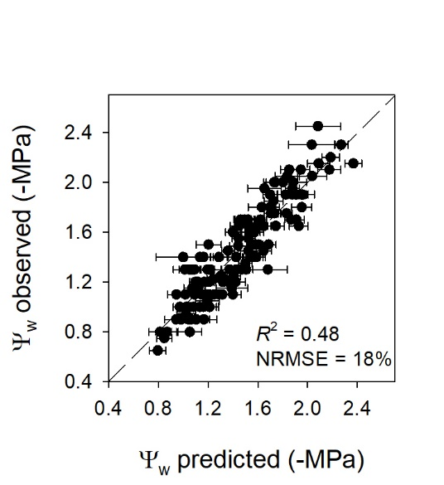
Preliminary Findings
Center for Advanced Forestry Systems 2020 Meeting

Slide 10
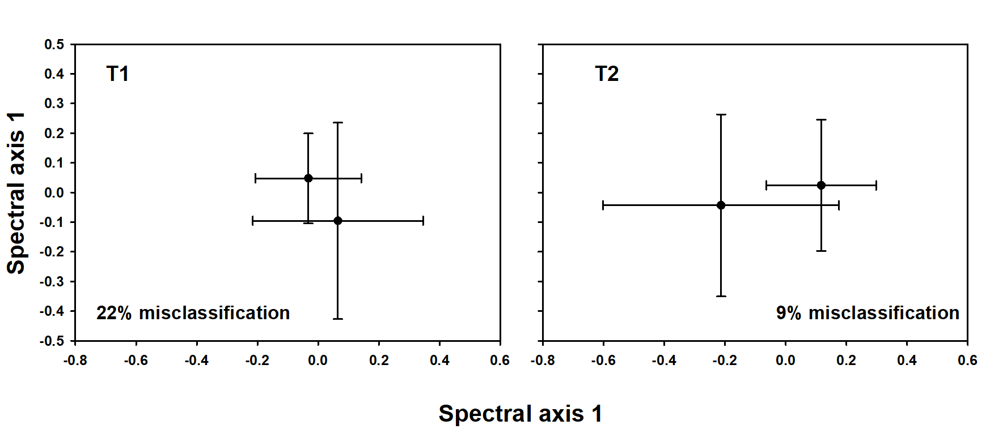
Preliminary Findings
Preliminary results: disease detection
GM detection in walnut saplings
2
Center for Advanced Forestry Systems 2020 Meeting

Slide 11
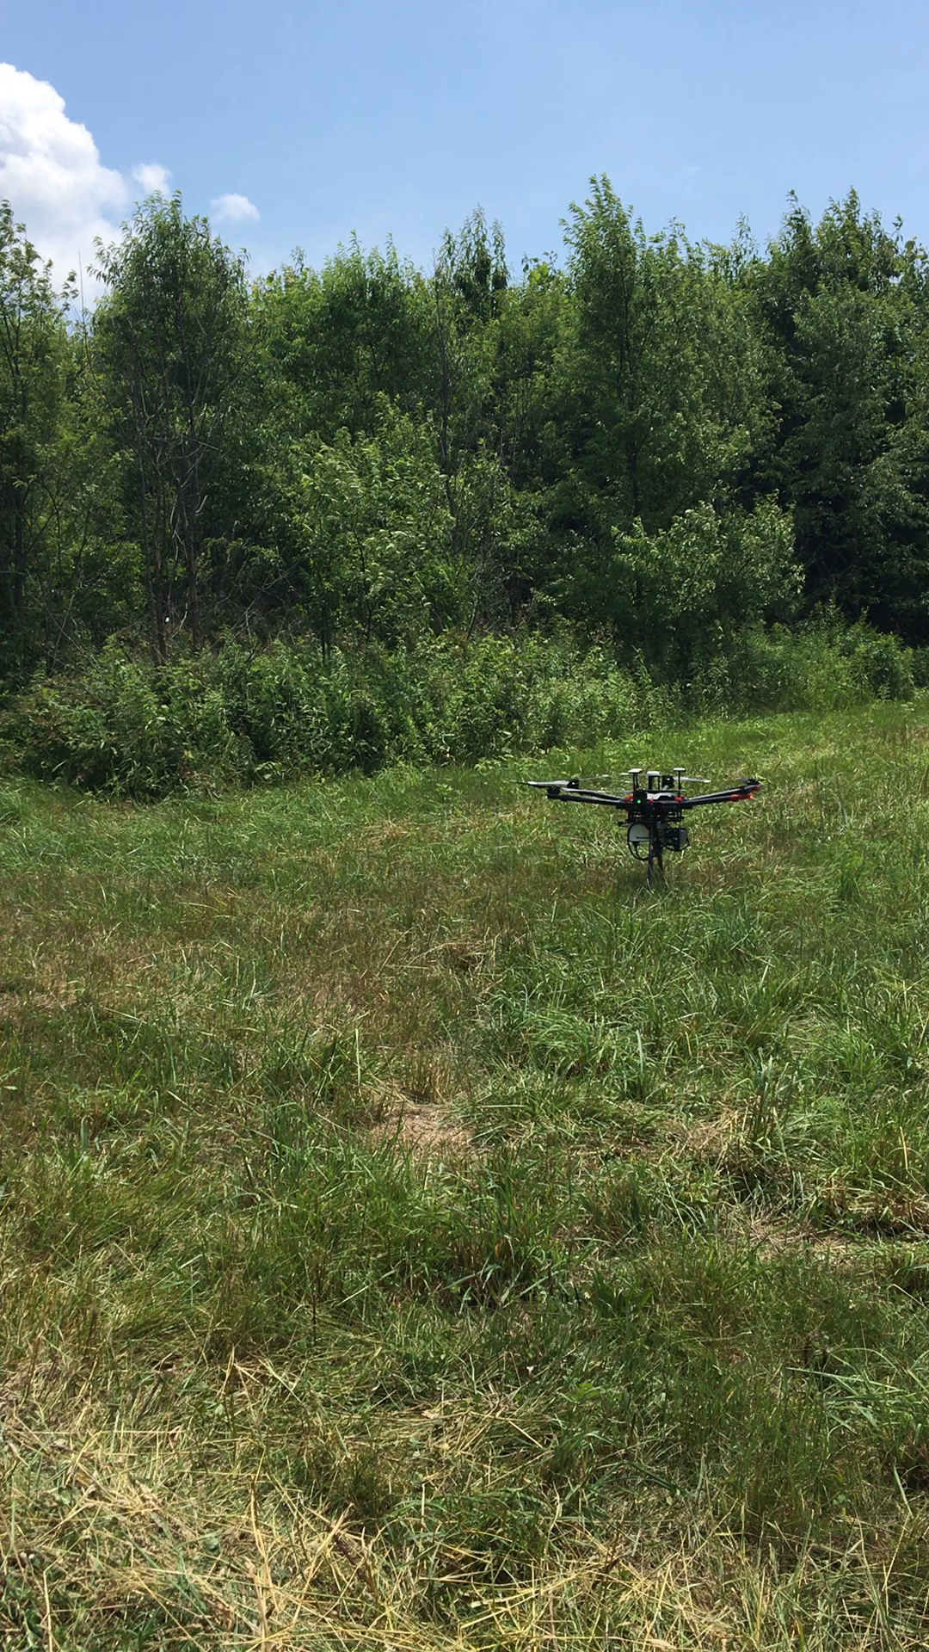
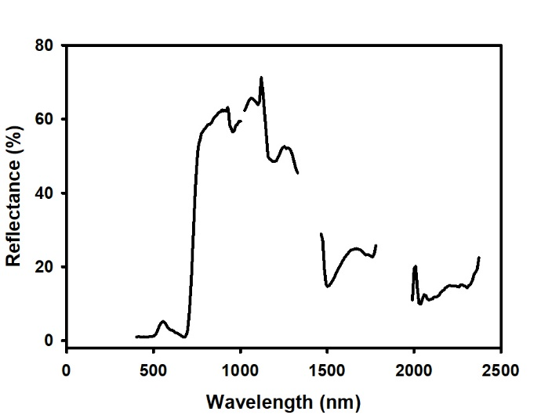
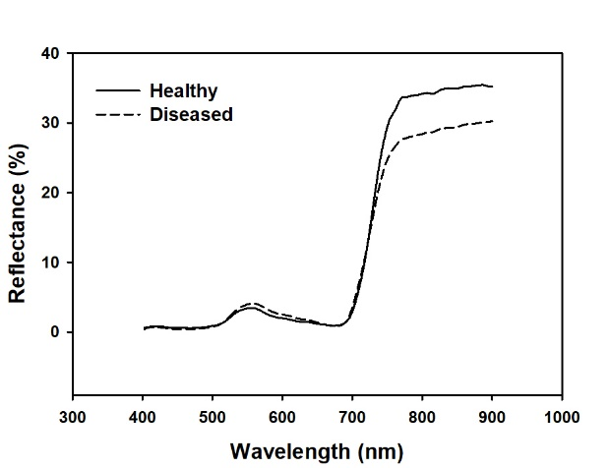
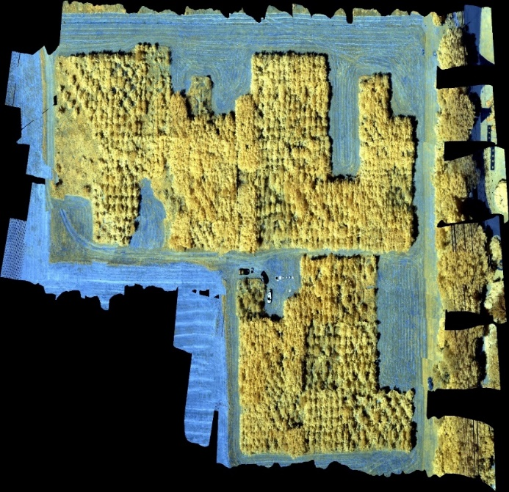
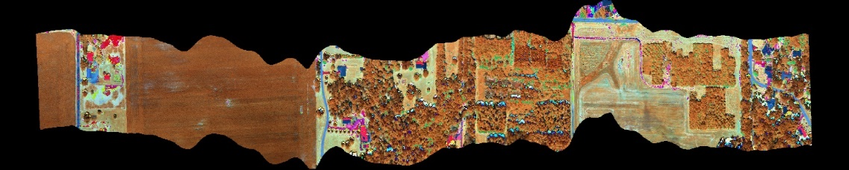
Preliminary Findings
Center for Advanced Forestry Systems 2020 Meeting

Slide 12
Deliverables
Expected Deliverables – One Year
Outline of a plan for acquisition of an aligned dataset that integrates different forms of remotely sensed data.
Expected Deliverables – Long term
Long-term outcomes from this project will be the most advanced and extensive effort to date to integrate multi-modal RS products into precision forest management. Training of graduate students and postdoctoral scientists.
Center for Advanced Forestry Systems 2020 Meeting

Slide 13
Company Benefits
Member Company Benefits
Generate outcomes that can directly inform potential management decisions involving forest plantation management through more efficient and specific characterization of tree health using RS data.
This project will be at a national-scale and should be relevant for all industry members.
Center for Advanced Forestry Systems 2020 Meeting

Slide 14
Project Timeline
Timeline
 | 2020 |  |  | 2021 |  |  |  | 2022 |  |  |  | 2023
 | Sum | Fall | Wntr | Spring | Sum | Fall | Wntr | Spring | Sum | Fall | Wntr | Spring | Sum
Field spectral/reference measurements
Greenhouse experiments
Analyses of reference measurements
Spectral processing and analyses
CAFS Reports
Center for Advanced Forestry Systems 2020 Meeting

Slide 15
Budget
Project Budget
NSF/CAFS Portion:
  Support of graduate PhD student Sylvia Park who will focus on leaf-level measurements and reference measurements.
Other Sources of Funding:
  We will leverage grants received by Couture et al. from the HTIRC that covers expenses associated with the UAV and manned aircraft components of the project. The HTIRC grant supports post-doctoral scientist, Dr. Ali Masjedi, who will focus on the UAV and manned aircraft acquisitions.
Center for Advanced Forestry Systems 2020 Meeting

