Slide 1
Center for Advanced Forestry Systems (CAFS) Phase III

Slide 2
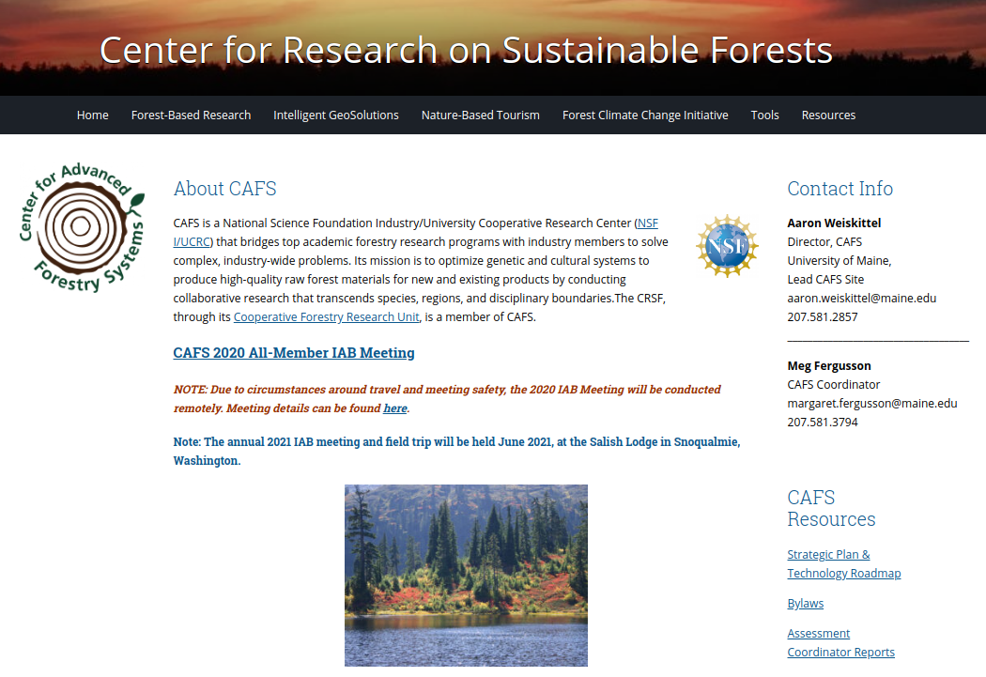
CAFS Website
https://crsf.umaine.edu/forest-research/cafs/

Slide 3
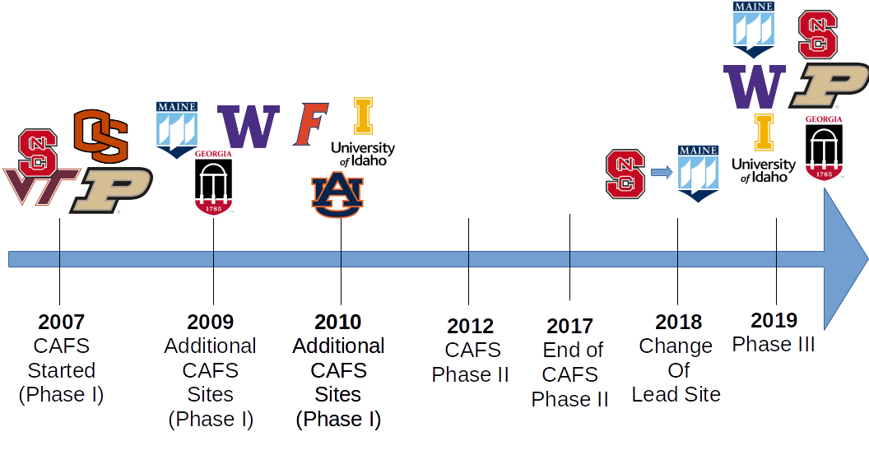
CAFS History

Slide 4
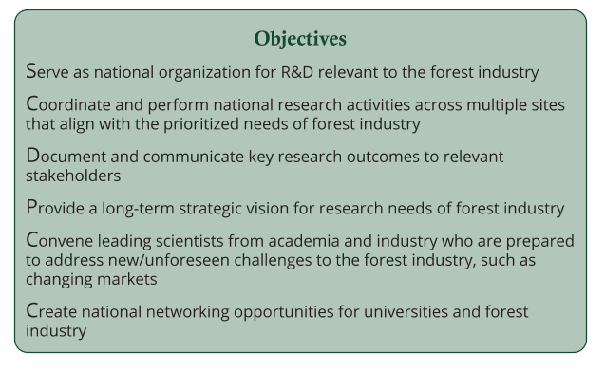
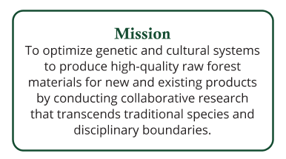
Mission & Objectives

Slide 5
Phase 2 Outcomes

Slide 6
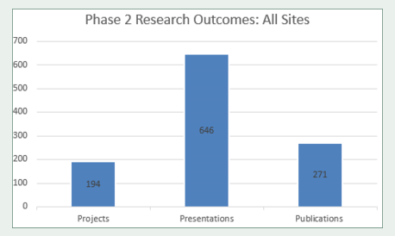
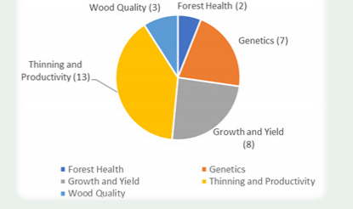
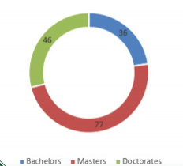
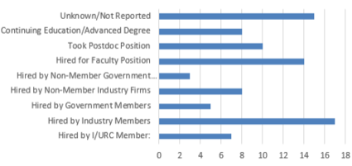
Phase 2 Outcomes

Slide 7
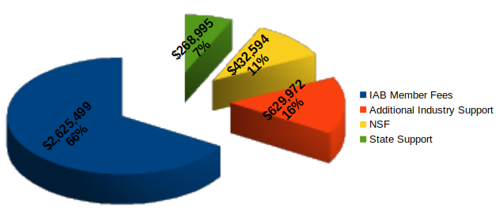
FY21 Budget
$3.7M across 6 sites and 138 IAB members

Slide 8
University Sites
University | Expertise
North Carolina State University (NCSU) | Forest soils, pine plantation management, productivity modeling
Oregon State University (OSU) | Douglas-fir plantation management, growth and yield modeling, genetics, remote sensing
Purdue University (PU) | Genetics, central hardwoods management, nursery technology
University of Georgia | Genetics, pine plantation management, wood quality, remote sensing, growth and yield modeling
University of Idaho | Mixed-species management, natural regeneration, productivity modeling, remote sensing
University of Maine (UM; lead site) | Mixed-species management, natural regeneration, growth and yield modeling, remote sensing
University of Washington | Douglas-fir plantation management, wood quality, remote sensing, productivity modeling

Slide 9
Membership
Membership Type | Membership Fee | Vote | IP Property Access
Primary | $25,000/yr | 10 votes per membership | Yes
Secondary | $10,000/yr | 5 votes per membership | Upon Approval
Affiliate | $5,000/yr | 0 | No
Observer | In-kind (<$10,000k) | 0 | No

Slide 10
Governance
Bylaws annual assessed and approved
Standard agreements maintained and adhered
-Inter-institution MOUs for university
-Industry membership agreements for IAB members
Research projects and bylaw amendments require majority approval
Reporting and center business conducted at biannual meetings or as needed

Slide 11
IAB Executive Committee
Representation from each CAFS Site with two co-chairs
Plan to meet regularly to discuss progress, direction, and sustainability of CAFS

Slide 12
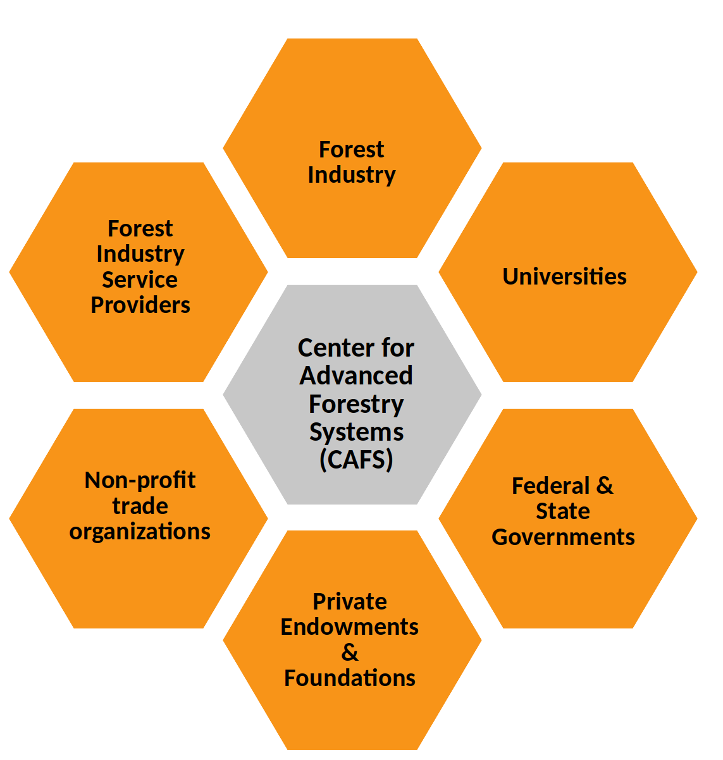
Key Partners

Slide 13
Phase III Timeline & Milestones
Milestone | Fiscal Year
 | 18-19 | 19-20 | 20-21 | 21-22 | 22-23
Apply for & secure NSF Phase III funding
Approve bylaws, strategic plan, & technology roadmap
Initiate research projects identified on technology roadmap
Revise and refine bylaws, strategic plan, & technology roadmap
Secure additional partners including industry, academia, and non-profit sectors.
Integrate center research and education activities that effectively train and benefit undergraduate and graduate students
Survey, document, and prioritize industry member research needs
Plan and host biannual meetings
Annually report progress, outcomes, and finances

Slide 15
IAB Meetings
0
Virtual
-Dec 7 2020, 3-5 pm
-Project updates
In-person
-June 2-3 2021
-Salish Lodge, Snoqualmie WA
-Project updates and proposals with field trip
-Will explore meeting co-hosting

Slide 16
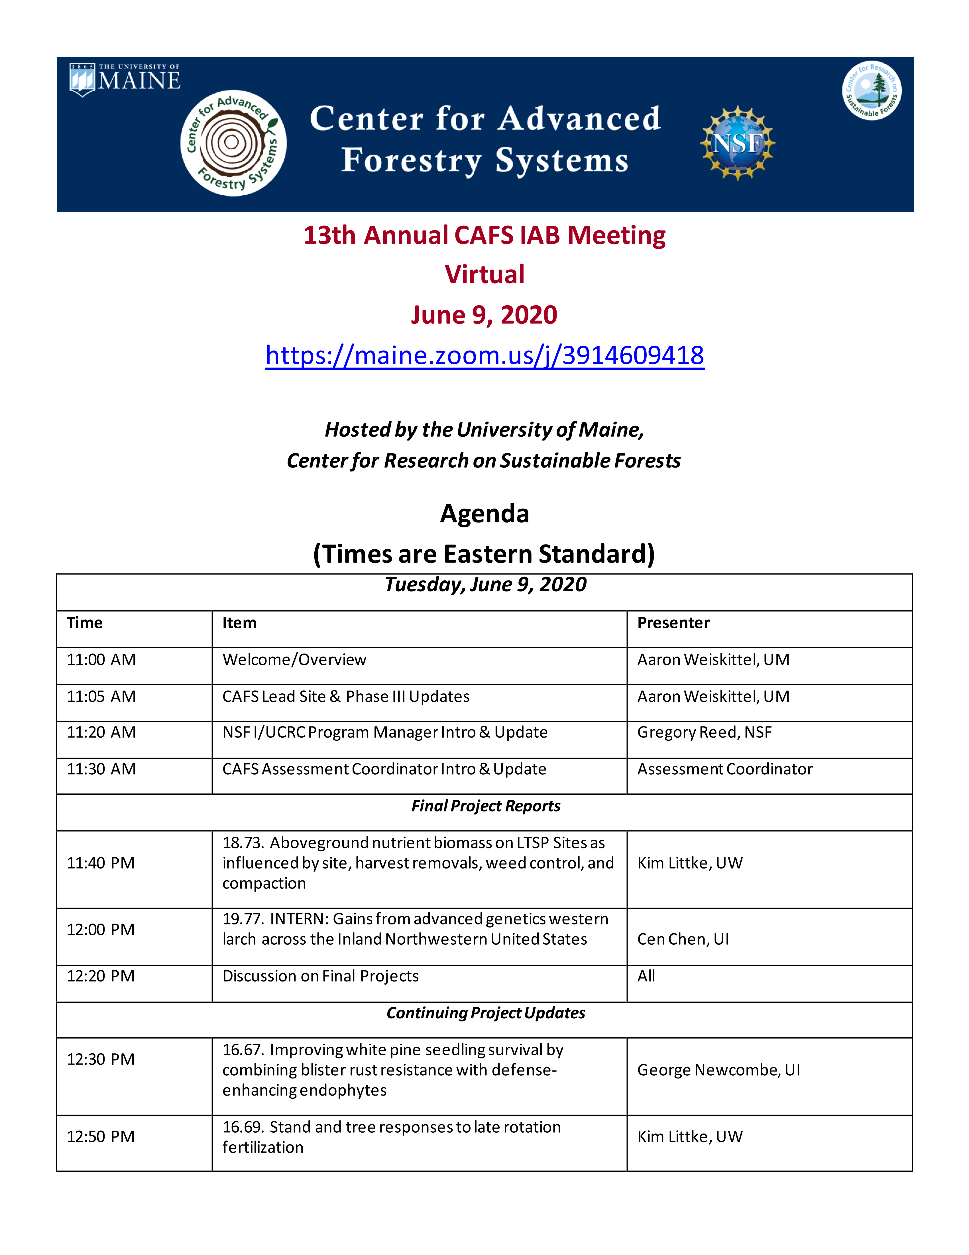
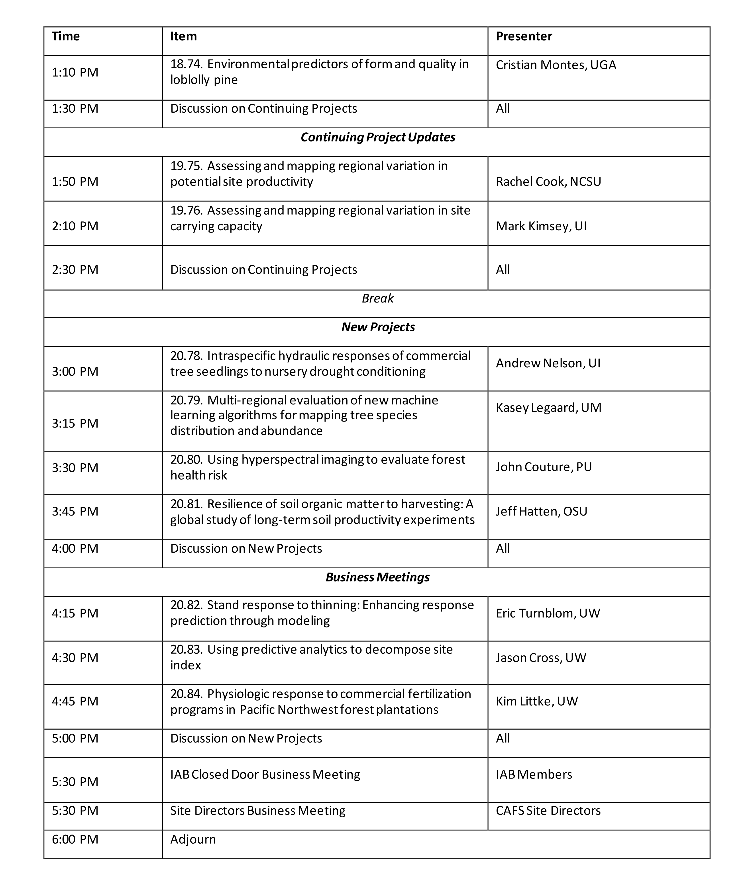
Meeting Agenda

Slide 17
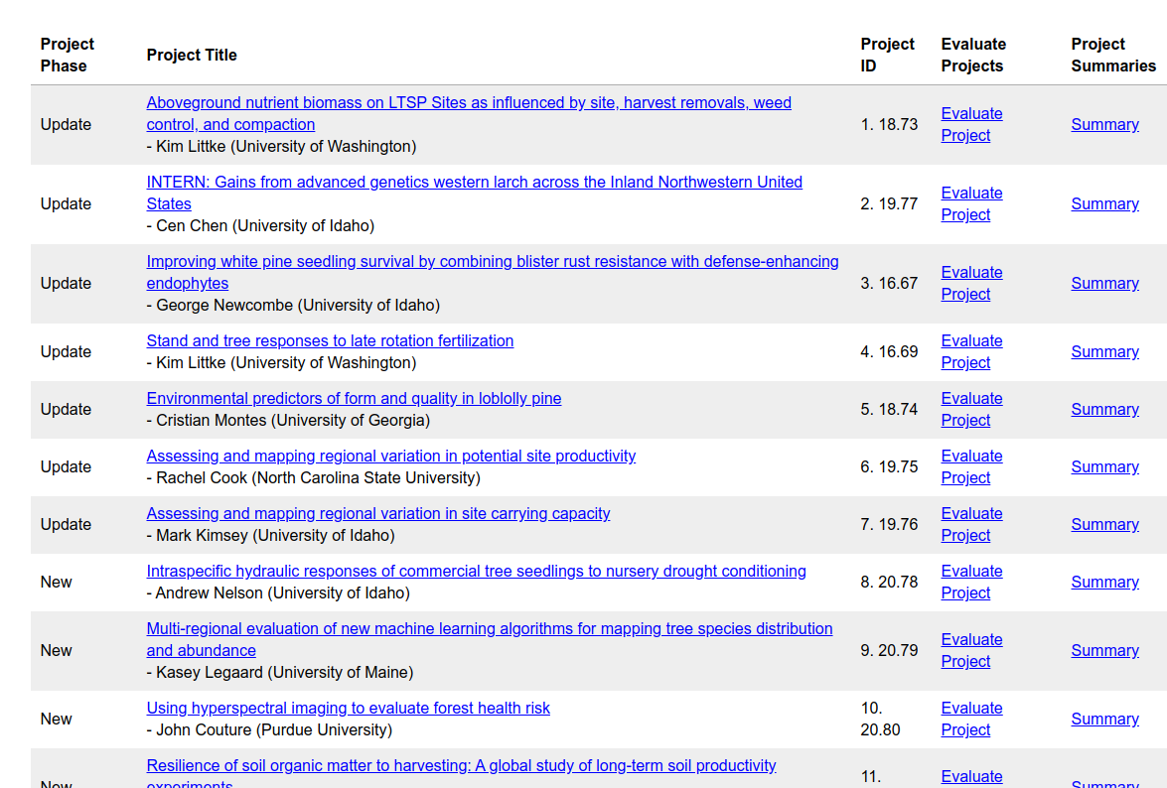
LIFE Forms
https://iucrclife.chass.ncsu.edu/lifeforms/; PW = CAFS

Slide 18
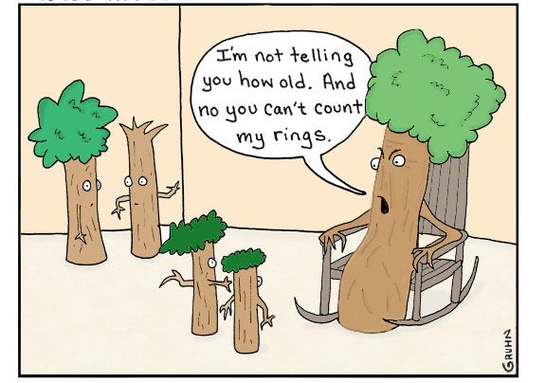
Questions/Comments?
aaron.weiskittel@maine.edu
207-581-2857

