Slide 1
New Project
Physiologic Response to Commercial Fertilization Programs in Pacific Northwest Forest Plantations
CAFS 20.84
Eric Turnblom (UW), Kim Littke (UW), Michael Premer (Rayonier)
Kim Littke
Center for Advanced Forestry Systems 2020 Meeting
Notes:
1

Slide 2
Justification
Fertilizer response is highly variable in the Pacific Northwest mostly due to N availability
  Paired-tree study identified biogeoclimatic variables that are indicative of fertilizer response
  Pre-treatment soil and stand conditions affect the magnitude and continuation of response
Fertilization causes a temporary increase in photosynthetic rate and water use efficiency, but long-term response requires an increase in leaf area
  Dense stands or stands that cannot support increased leaf area will likely not respond to fertilization even if N is limiting
Measurements of physiologic processes through C and O isotope ratios should further explain fertilizer response and guide future fertilization decisions
Center for Advanced Forestry Systems 2020 Meeting

Slide 3
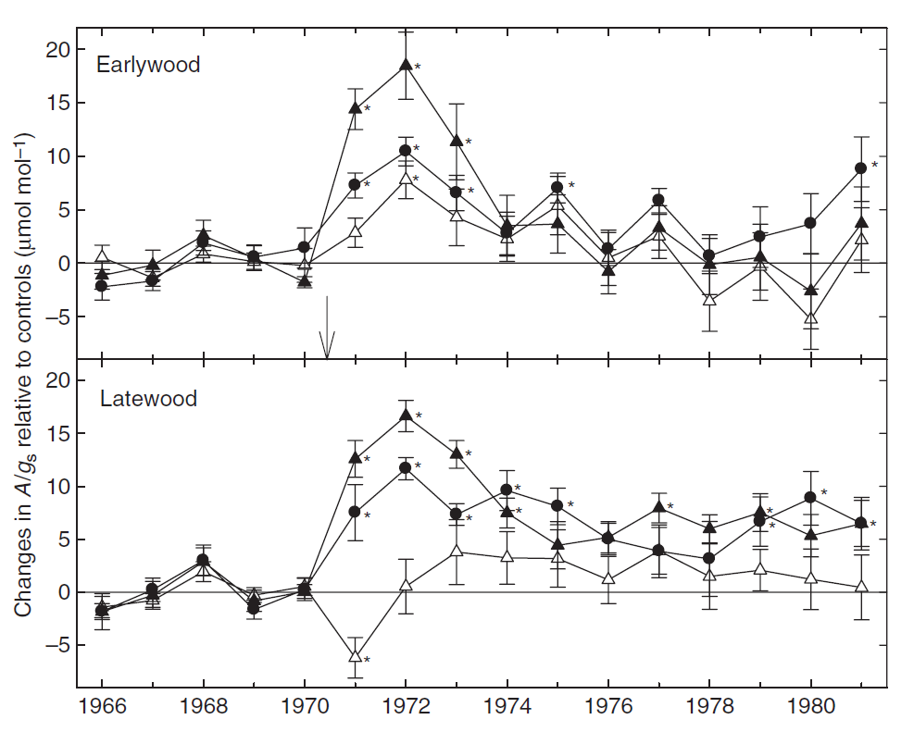
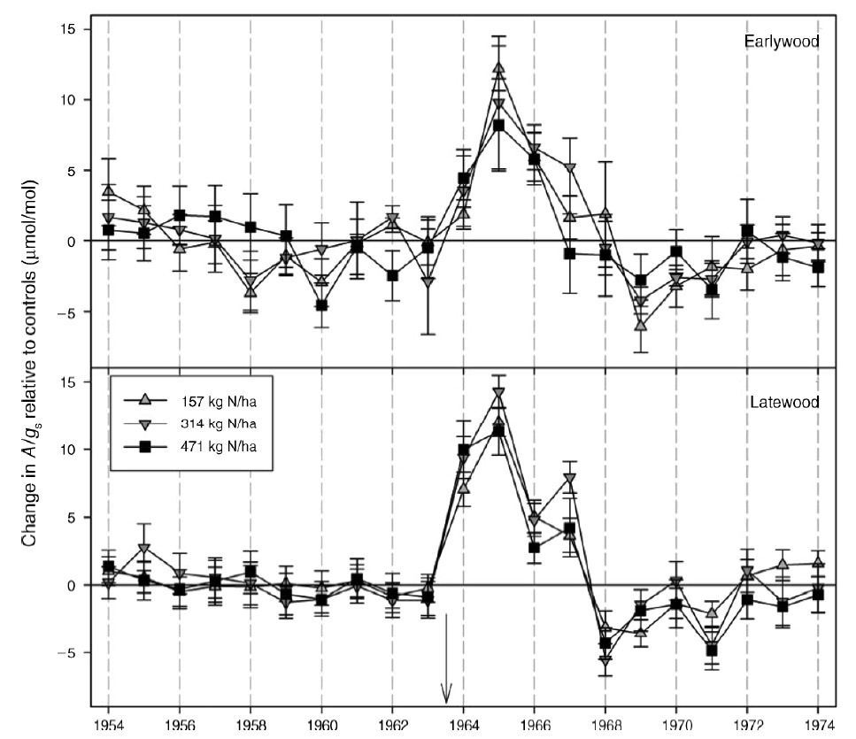
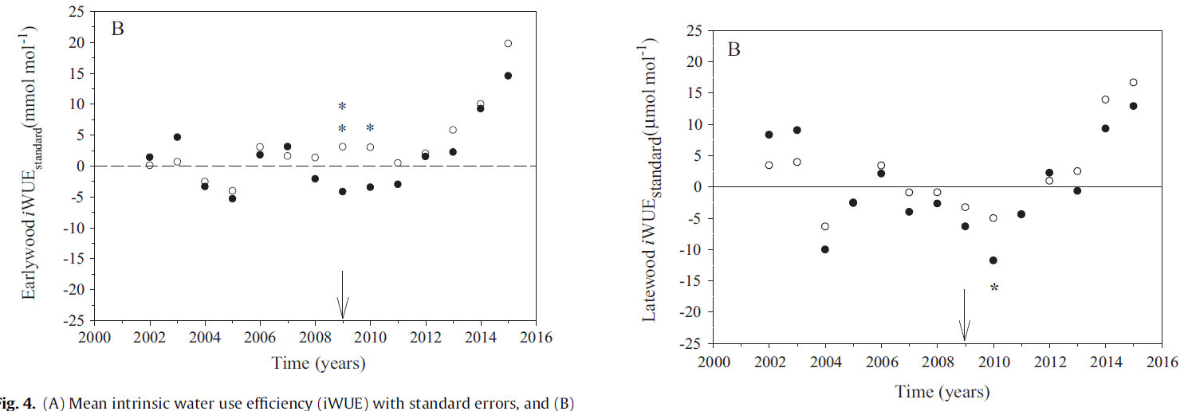
Justification
Results from Three Douglas-fir Stands
Fertilization caused a decrease in δ¹³C for 2+ years
  Temporary increase in water use efficiency
δ¹⁸O increased for 4+ years and was related to summer temperature
  Decrease in stomatal conductance
Length and level of response appears to be related to site productivity and N availability
Shawnigan Lake (Brooks and Mitchell, 2011)
Wind River (Brooks and Coulombe, 2009)
Coastal Oregon (Cornejo-Oviedo et al., 2017)
Center for Advanced Forestry Systems 2020 Meeting

Slide 4
Objectives
Understand physiological patterns of response in fertilized Douglas-fir plantations
Investigate mechanisms between biogeoclimatic variables, physiological processes, and fertilizer response
Develop regional silvicultural nutrition guidelines for commercial forest operations
Provide data to inform changes in silvicultural treatments due to future climate change
Center for Advanced Forestry Systems 2020 Meeting

Slide 5
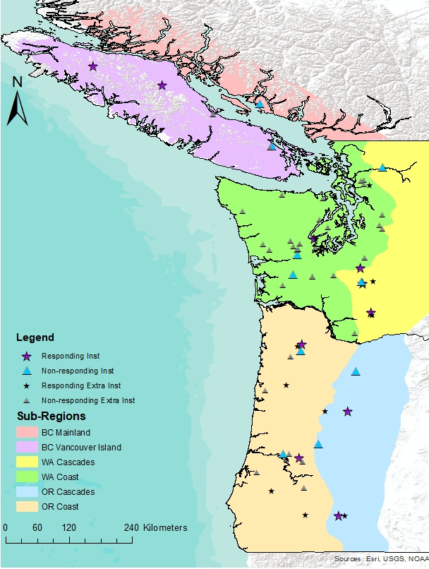
Methods
Utilize remaining SMC Paired-tree installations
Select a subset of responding and non-responding installations from each region
  20 installations
Core ten trees from each treatment
Measure earlywood and latewood for 6 years after fertilization
Split cores into EW/LW and composite by treatment and installation
Isotopic composition (δ¹³C and δ¹⁸O) will be analyzed at Northern Illinois University
Center for Advanced Forestry Systems 2020 Meeting

Slide 6
Timeline
Summer 2020 Sample 10 Paired-Tree installations; Measurement and processing
Fall 2020 Sample analysis
Summer 2021 Sample 10 Paired-Tree installations; Measurement and processing
Fall 2021 Sample analysis
Winter 2022 Statistical analysis
Spring 2022 Final report and prepare manuscripts
Center for Advanced Forestry Systems 2020 Meeting

Slide 7
Deliverables
Synthesized relationships between stand structure, biogeoclimatic variables, and N fertilization physiologic response
Proposed silviculture alternatives under potential changes in future climate
Three publications to be submitted to peer-reviewed journals that reflect each project objective
A study design that can be applied to national forests through the Center for Advanced Forestry Systems
Center for Advanced Forestry Systems 2020 Meeting

Slide 8
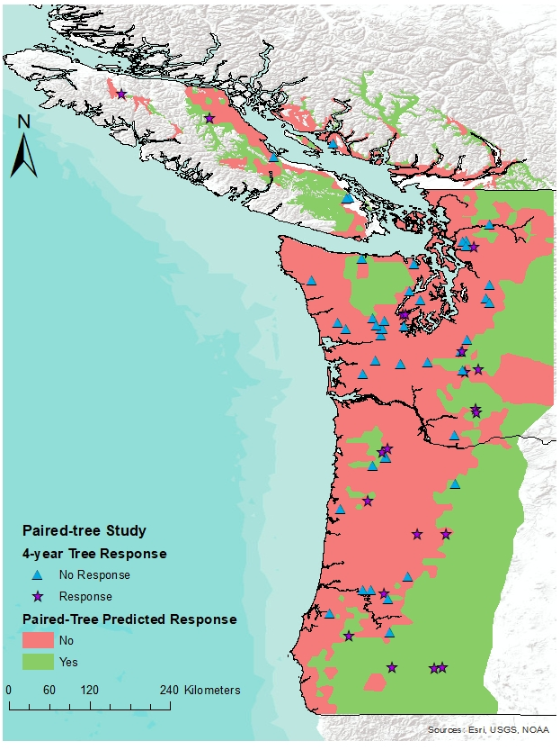
Company Benefits
Improved fertilization and thinning recommendations for Douglas-fir plantations based on physiologic response
Recommendations for silviculture under future climate scenarios
Center for Advanced Forestry Systems 2020 Meeting

Slide 9
Budget
Budget item: | Justification | Cost
Summer Student Research Assistant | 3 months. Responsible for field sampling and laboratory processing | $9,333.61
Contract Services (Laboratory processing): | 10 installations * 2 treatments * 12 EW/LW increments * $36 C and O sample processing fee | $8,640
Travel | 20 travel days | $6,110.41
Supplies and Equipment | Increment borer and supplies | $1,000
Project Total |  | $25,084.02
Salary for Littke and Turnblom provided by SMC $15,568
Center for Advanced Forestry Systems 2020 Meeting

Slide 10
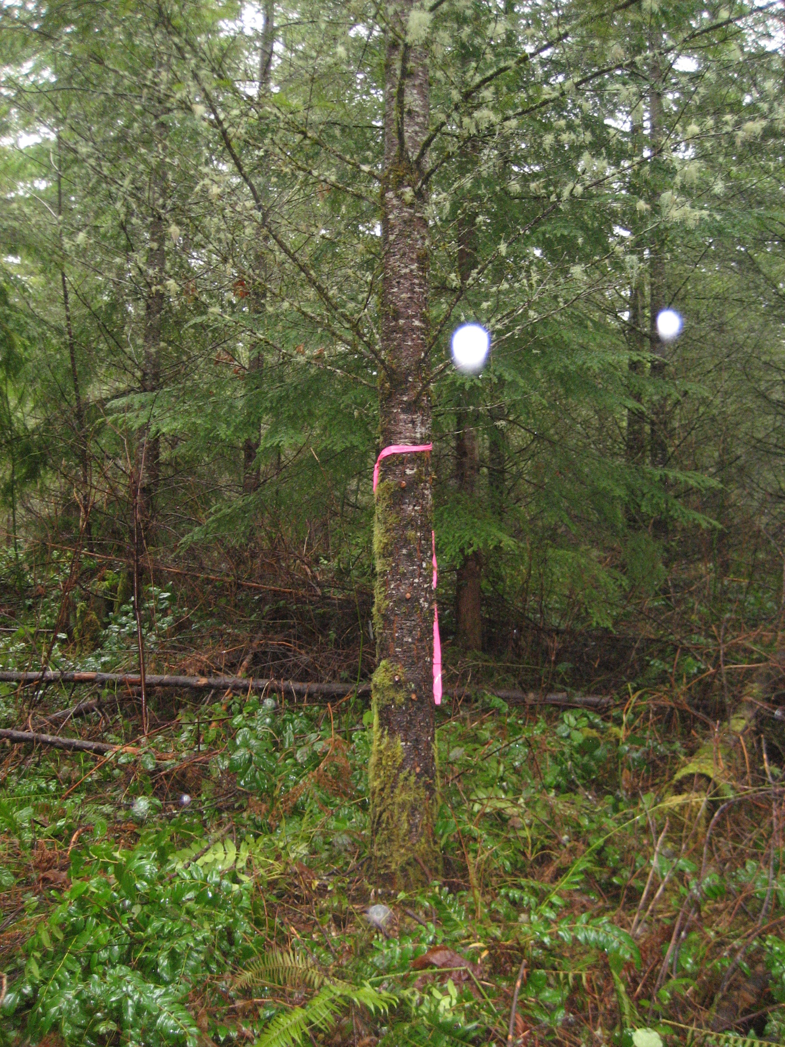
Questions and Comments

