Slide 1
New Project Proposal
Stand Response to Thinning:
Enhancing Response Prediction Through Modeling
CAFS 20.82
Eric Turnblom, Jason Cross (UW)
Aaron Weiskittel (U ME)
Cristian Montes, Bronson Bullock (UGA)
Eric Turnblom, Presenter
Center for Advanced Forestry Systems 2020 Meeting
Notes:
1

Slide 2
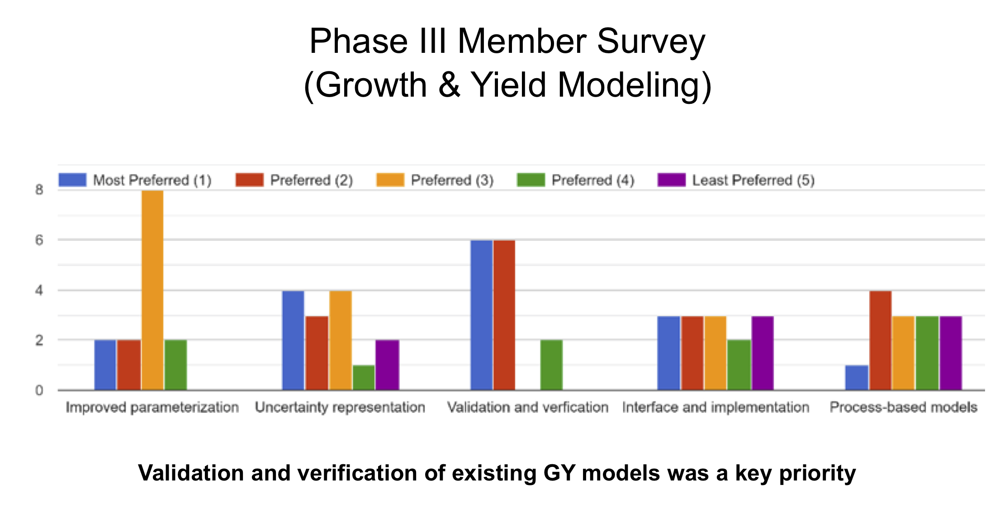
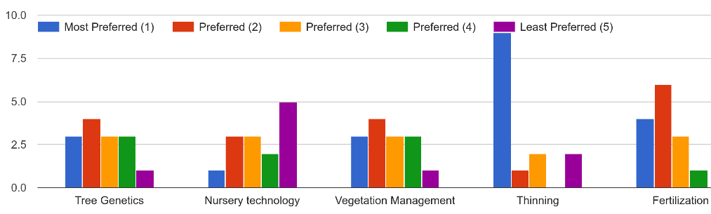
Justification
Phase III Member Survey
(Silviculture)
Strong support for continued focus on thinning
Center for Advanced Forestry Systems 2020 Meeting

Slide 3
Justification
Forecasting yield is a primary objective of forest managers
Thinning a stand has a propensity to alter stand allometry
Stand productivity:
Actual → Realistic [Realizable?] → Potential
Decision space is clearly in zone between Actual and Potential
Center for Advanced Forestry Systems 2020 Meeting

Slide 4
Objectives
Update the existing base stand yield model (untreated stands) within the SMC Plantation Yield Calculator (SMC-PYC) given another two full cycles of data collection
Incorporate Pre-commercial and Commercial Thinning effects using results of Bose, et al (2018) and Cross & Turnblom (2019)
Benchmark fitted model against independent data set, adjust if necessary,
Expand technology to other commercial forest types, as appropriate
Center for Advanced Forestry Systems 2020 Meeting

Slide 5
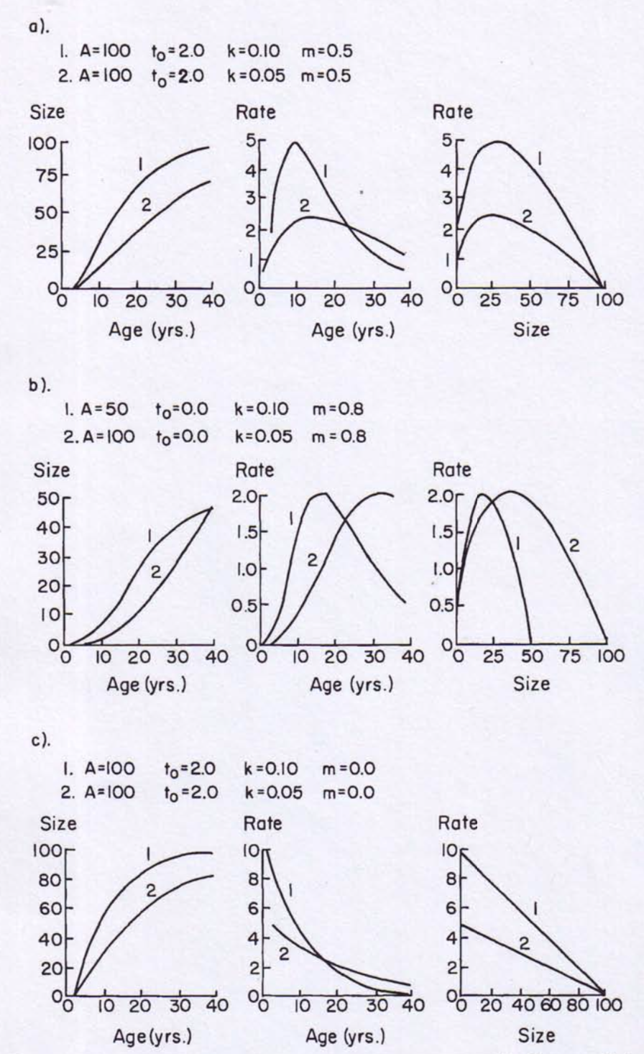
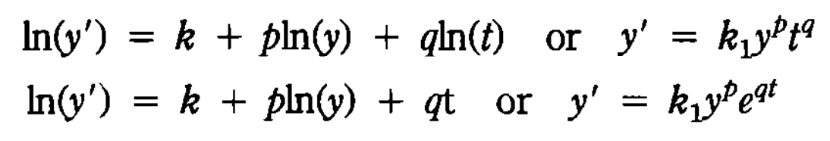
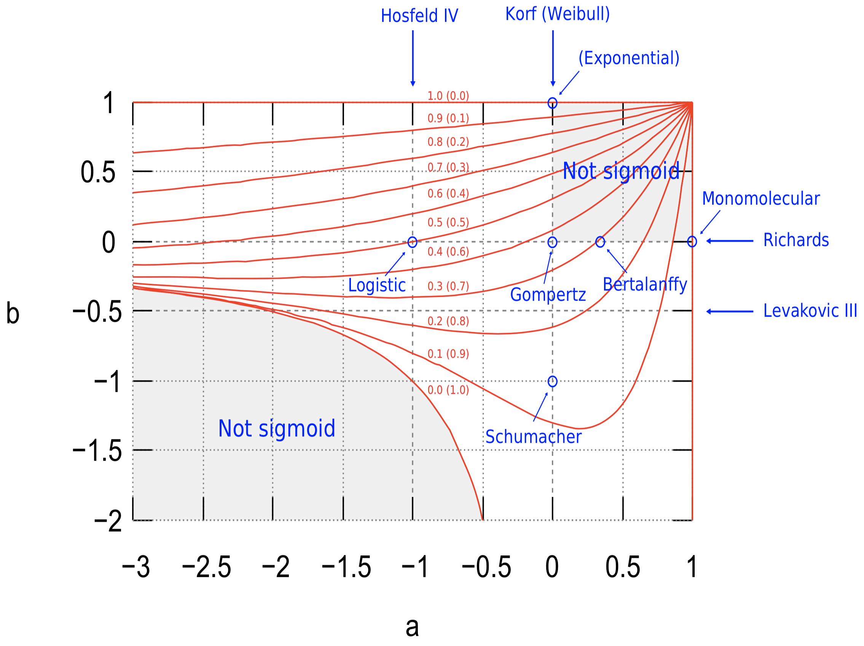
Methods
Challenge existing base model framework of SMC-PYC: Chapman-Richards function
Center for Advanced Forestry Systems 2020 Meeting

Slide 6
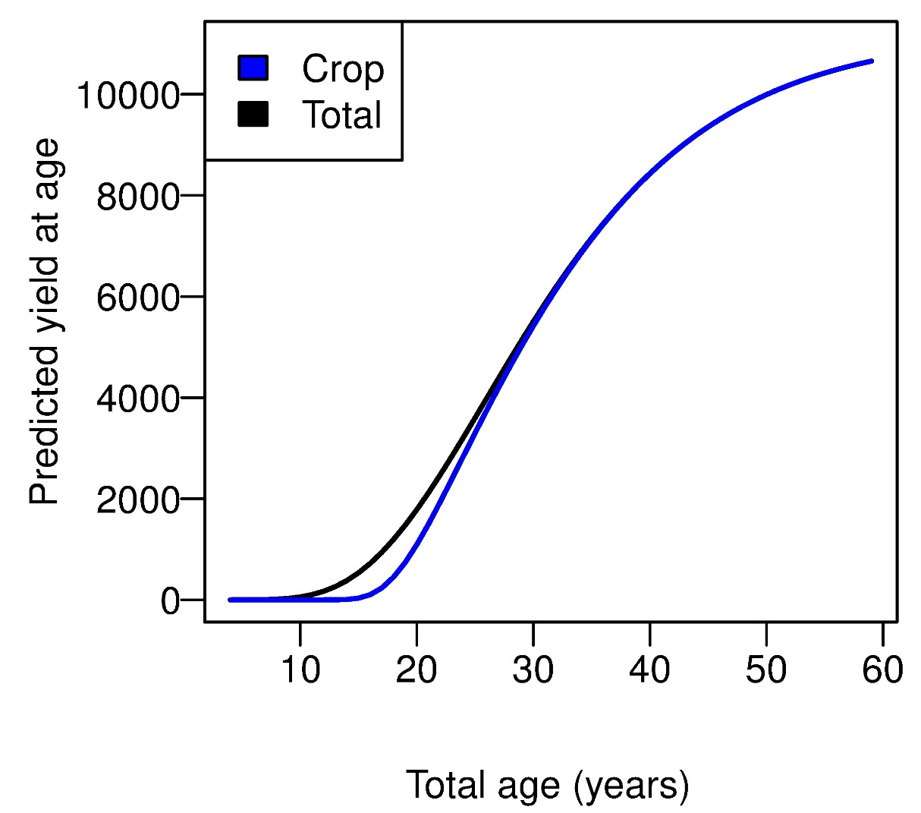



Methods
Augment model with silvicultural treatment variables
  Treatment type
  Treatment intensity / degree
  Time (years) since treatment
$$f_{cr} ={ \left(1−e^{−bt}\right)}^{c}$$
$$Y_{thin} = Y_{base} + b{ YST}^{−c YST}$$
Center for Advanced Forestry Systems 2020 Meeting

Slide 7
Methods
Benchmark Model with treatment augmentations
  Jackknifing
  Cross-validation
Expand efforts to other regions, as appropriate
  Enhance existing relationships between scientists and personnel at the relevant CAFS sites
  Develop new relationships
  Develop data sharing plans
  Identify personnel at each collaborating site
Center for Advanced Forestry Systems 2020 Meeting

Slide 8
Deliverables
EXPECTED DELIVERABLES – ONE YEAR:
Updated SMC-PYC baseline (untreated) stand yield model
Annotated Bibliography of stand yield model treatment augmentation strategies
Preliminary results of tested treatment augmentation strategies, including confidently directed plan for fitting a 'treated' model using 'the best' or 'best blend' of treatment augmentation strategies
Public presentation of findings at CAFS Annual Meeting and Regional research meetings
Draft manuscript destined for peer-reviewed journal
Center for Advanced Forestry Systems 2020 Meeting

Slide 9
Company Benefits
Project results would be a standardized framework for stand modeling
Easier future calibrations of growth and yield prediction models given framework for model updates
Improved forest panning and financial assessments
Center for Advanced Forestry Systems 2020 Meeting

Slide 10
Timeline & Budget
Year 1: Assemble PNW data, derive modeling variables, error check, update baseline stand yield model; Literature search for treatment augmentation strategies; Testing of treatment augmentation strategies.
Year 2: Final fit of treatment augmented stand yield model; Benchmark / cross-validate model, refine as necessary; Assemble data from collaborating regions / staging personnel for independent within-region work
Year 3: Final models fit across regions, evaluated, refined; Web browser-based user interface concluded.
Budget item description | Year 1 Cost
CAFS funding request:
Graduate Student RA | $ 9,800
Supplies & equipment | $ 1,000
TOTAL | $ 10,800
Other sources (UW CAFS site):
2 qtrs. TA salary, SEFS | $ 19,600
1 summer qtr hourly GRSA | $ 9,100
1 mo salary Turnblom, Cross | $ 24,400
Center for Advanced Forestry Systems 2020 Meeting

