Slide 1

Change in U.S. Forest Resources Expertise Over the Past Four Decades
Robert G. Wagner, Kristen M. Bellisario, and Ningning N. Kong
Purdue University
Center for Advanced Forestry Systems IAB Meeting
Snoqualmie, WA
June 7-8, 2022

Slide 2
Background
Forest resources R&D capacity has eroded substantially in U.S. over past several decades.
Has occurred across federal, university and industry organizations.
  75% reduction of USFS staffing in wood products during last three decades.
  40% staffing reduction in fields critical to protecting forest health (e.g., entomology and pathology).

Slide 3
Background
15% decline in number of university forestry professors and USFS scientists since 2002.
Forest industry research units and support have declined substantially more.
Reduction has occurred when risks and opportunities for U.S. forests have never been greater.
Potentially threatens long-term stewardship of nation’s forests and global competitiveness of the U.S. forest products sector.

Slide 4
Question:
Did forest resources expertise change while the decline in national R&D capacity was occurring?

Slide 5
Answer (take-home message)
Yes!
Significant decrease in PhD-level expertise in applied forest and wildlife management topics over past two decades.
Significant increase in PhD-level expertise in adjacent sciences supporting forest resources.

Slide 6
Methods
Used doctoral dissertations because they represent national capacity to:
  Lead future government, university and industry research efforts,
  Educate next generation of forest resources students,
  Lead extension and outreach programs, and
  Provide expertise and advice to policy makers.
Used ProQuest Dissertations and Theses Global database
Searched universities qualifying for support from McIntire-Stennis Cooperative Forestry Research Act (56 universities)
Searched titles and abstracts for all dissertations that included terms “forest”, “forests”, “forestry”, “silviculture”, “wood technology”, or “wood science”

Slide 7
Methods
Found 11,530 doctoral dissertations containing the terms from 1978 to 2017
Used Automated Content Analysis and Latent Dirichlet Allocation to group dissertations into topics
  ACA uses text data to generate topical patterns
  LDA is a text clustering technique that quantifies probability of document being part of a topic group
Optimal number of topic groupings was 20 (tested 6, 12, 20, 24, and 50 groupings)
7,742 dissertations that met final selection criteria

Slide 8
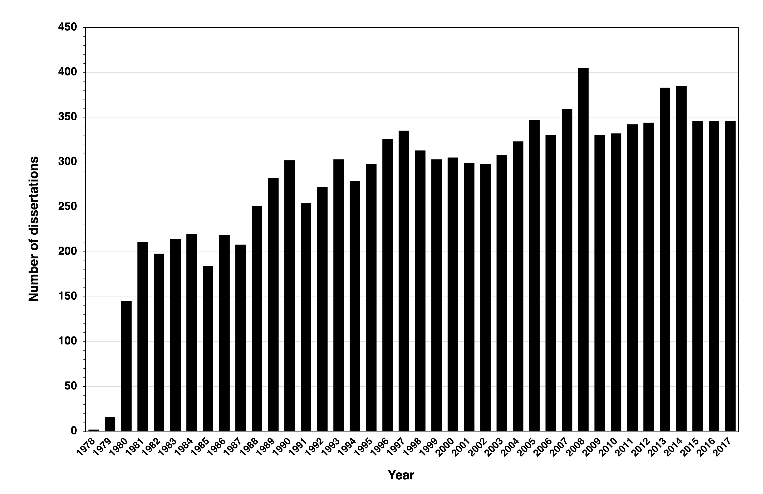
Qualifying dissertations produced over time

Slide 9
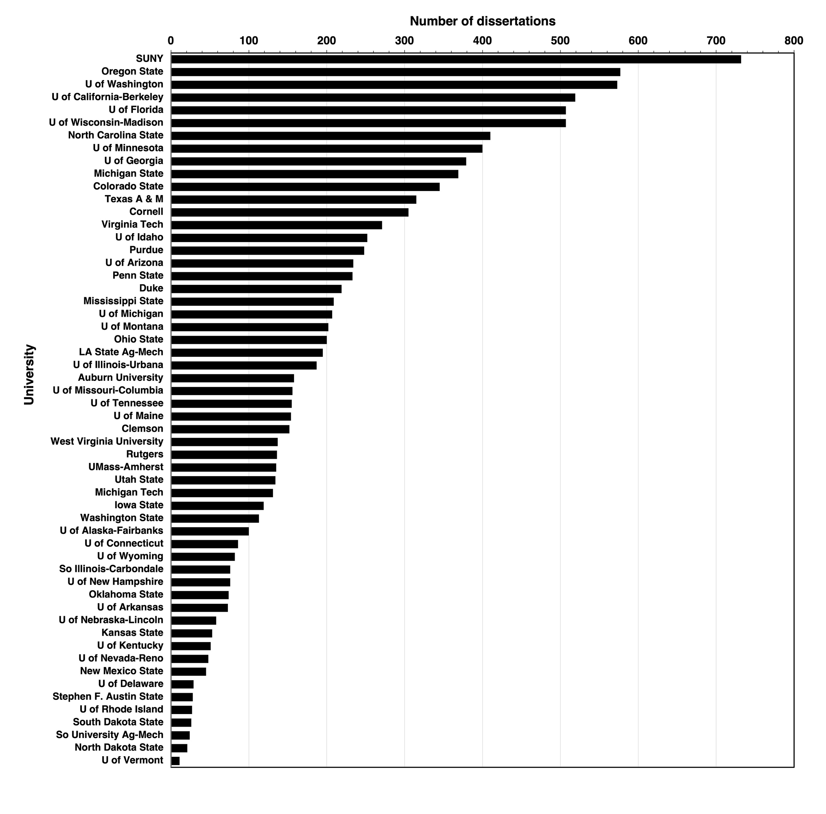
Qualifying dissertations by university

Slide 10
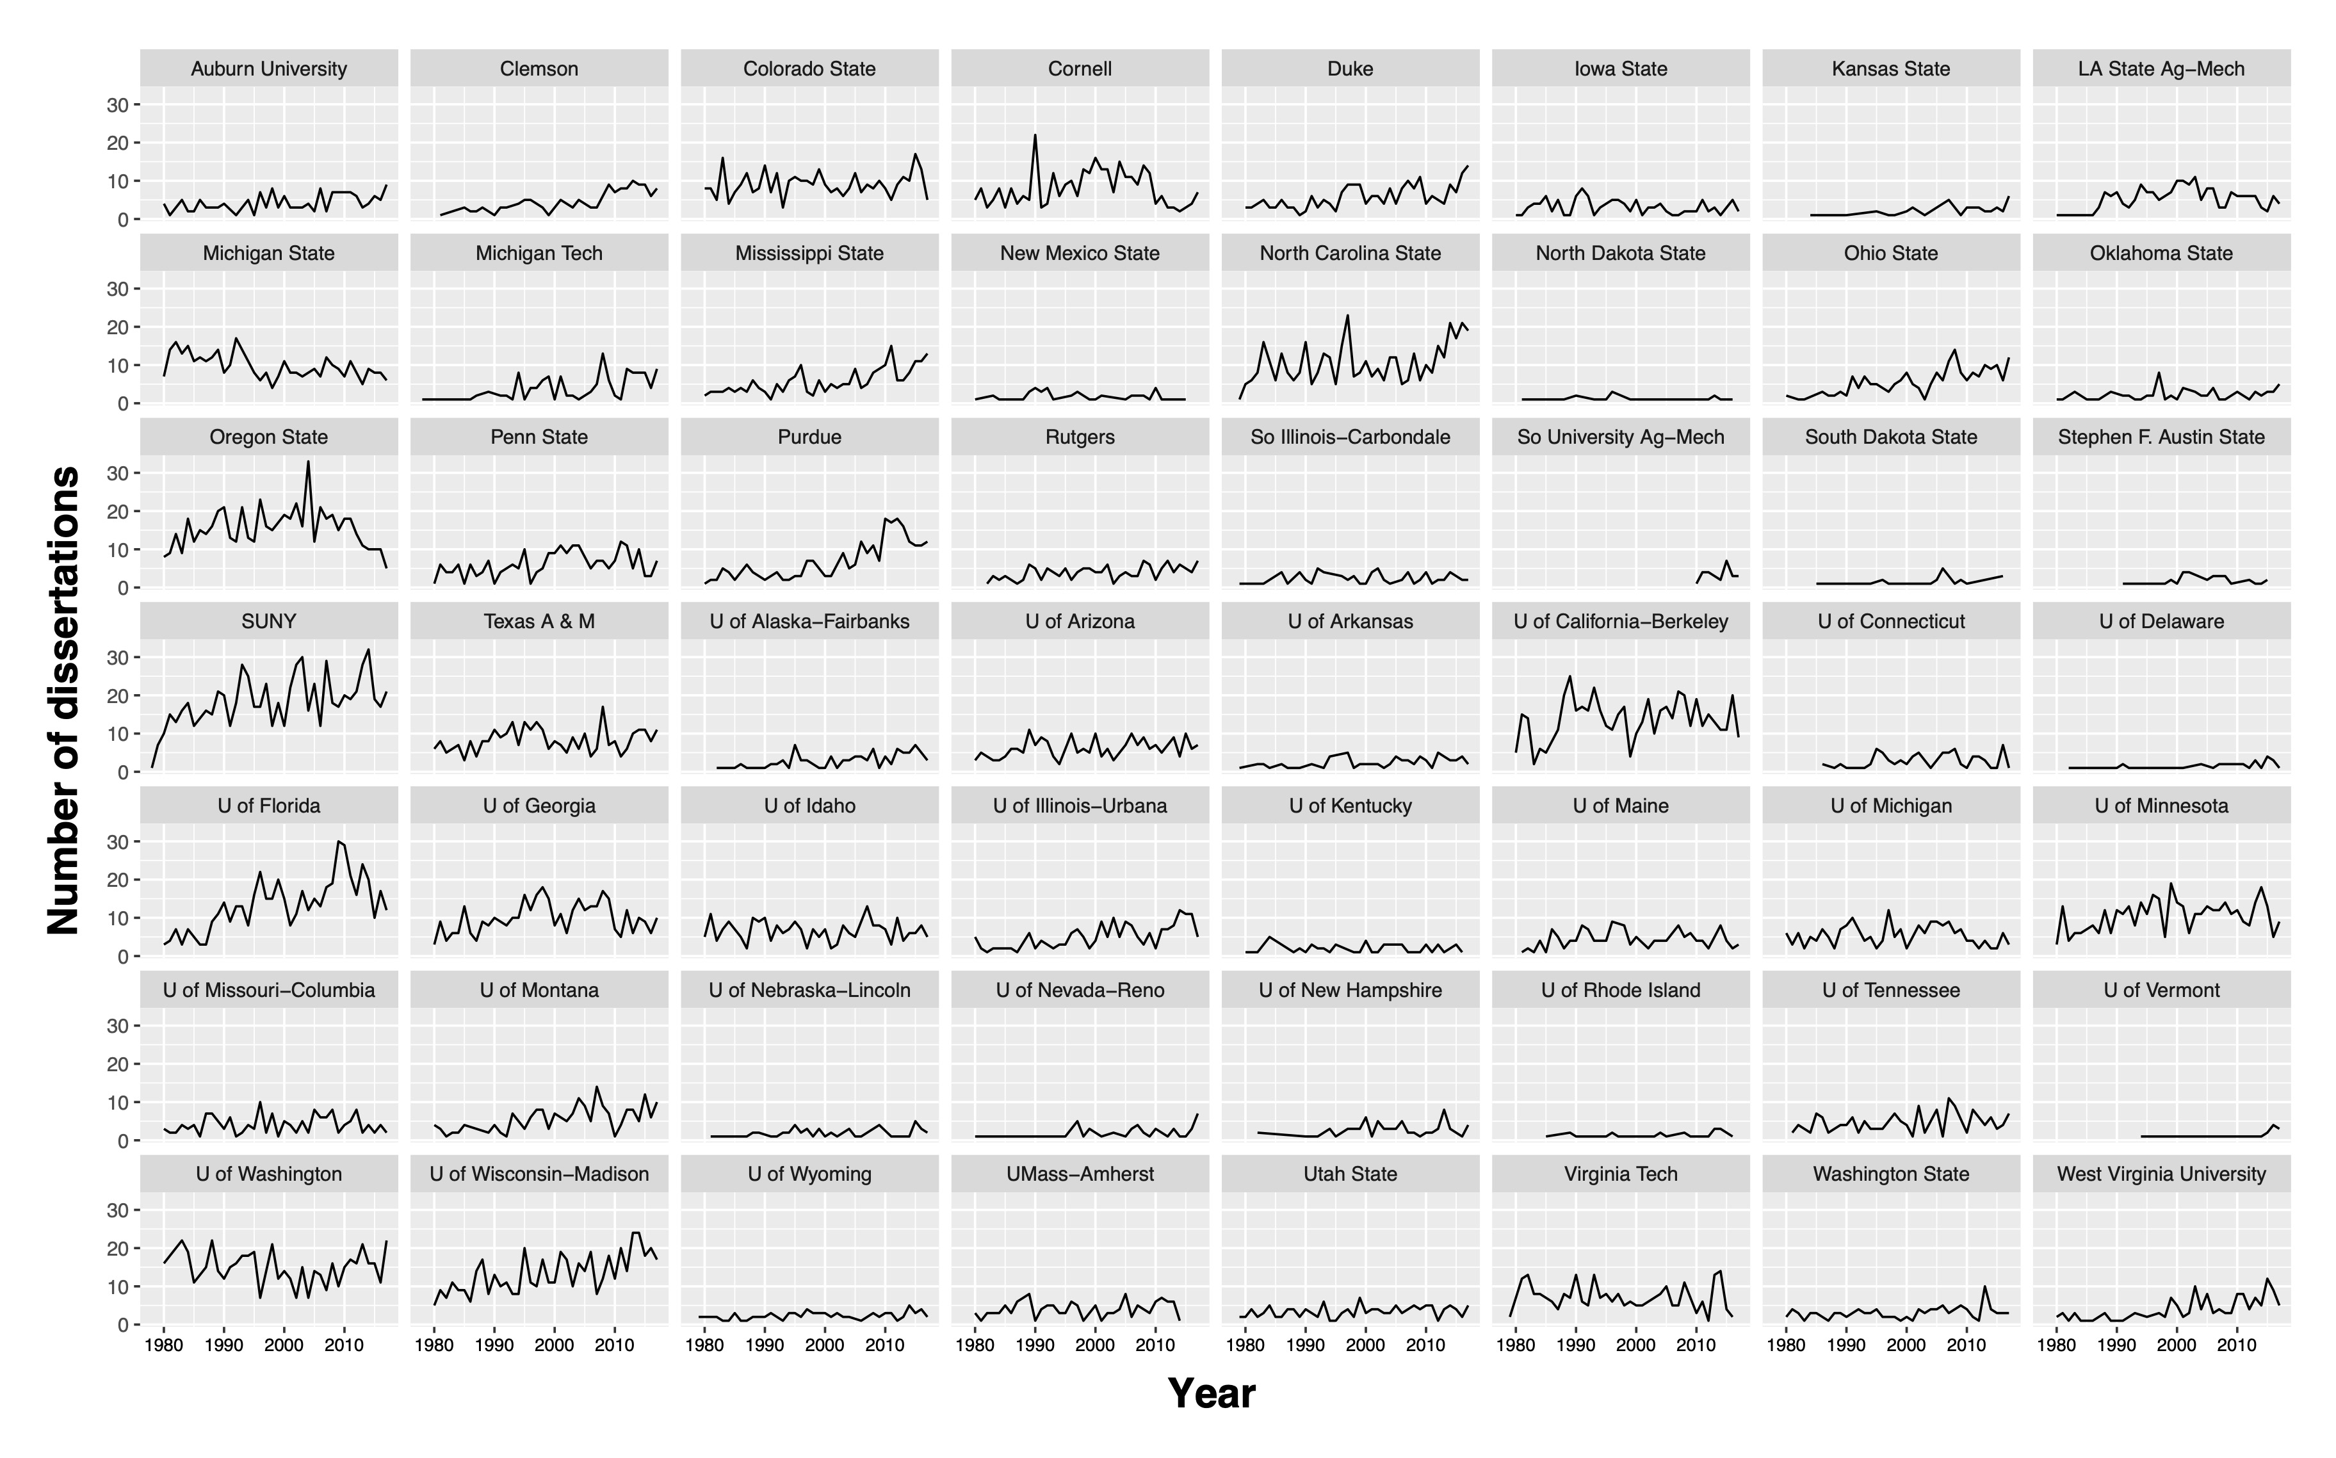
Qualifying dissertations produced by university and year

Slide 11
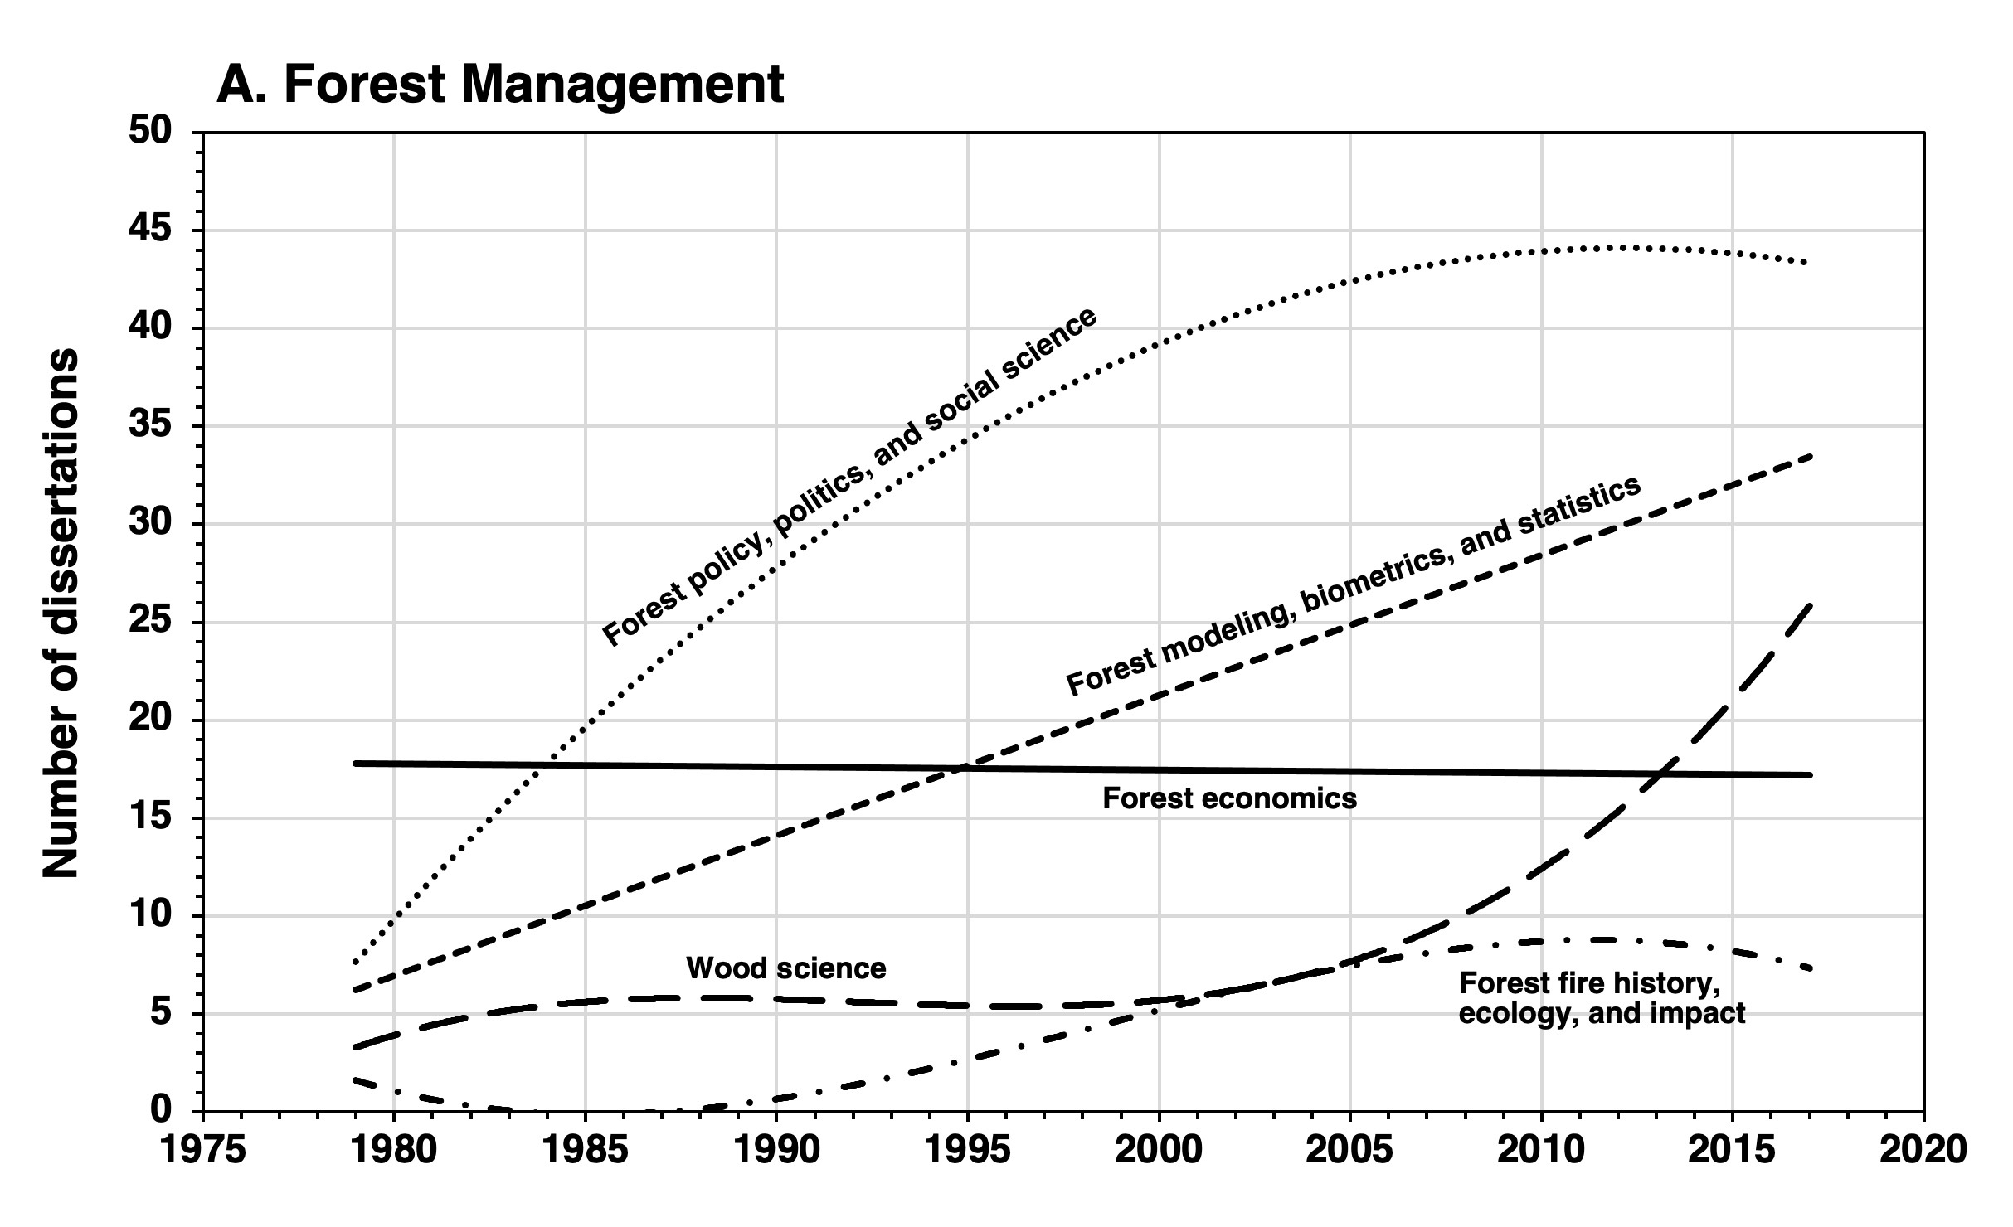
Dissertation production over time
Year

Slide 12
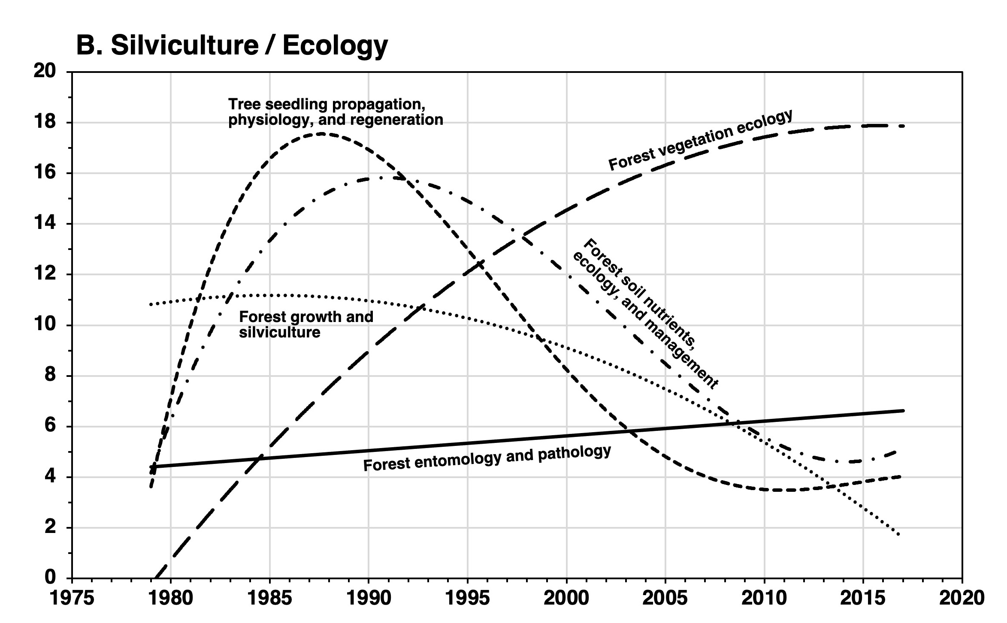
Dissertation production over time
Number of dissertations
Year

Slide 13
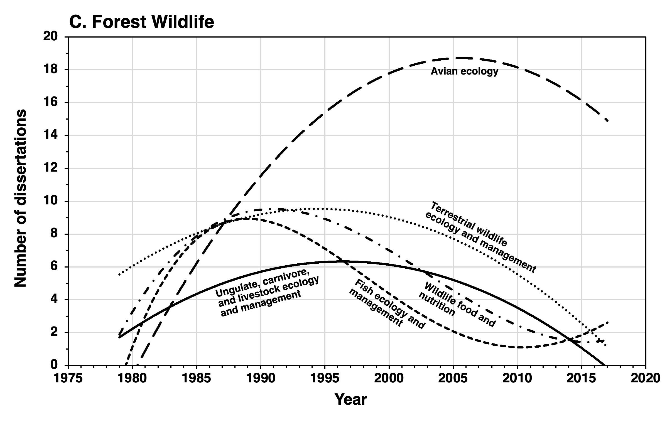
Dissertation production over time

Slide 14
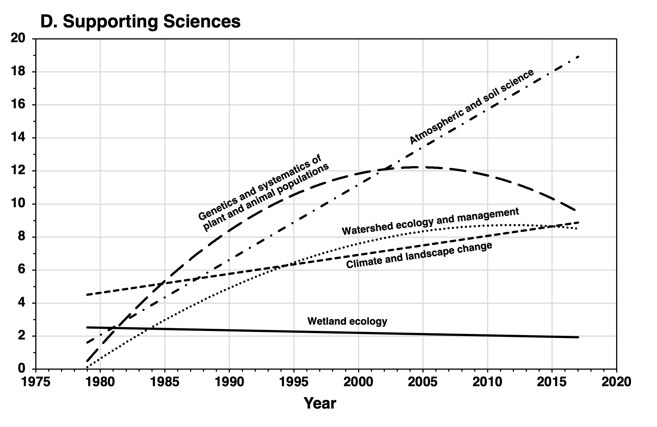
Dissertation production over time
Number of dissertations

Slide 15
Doctoral dissertation topic trends
Decreased
Forest growth and silviculture
Tree seedling propagation, physiology, and regeneration
Forest soil nutrients, ecology, and management
Terrestrial wildlife ecology and management
Wildlife food and nutrition
Ungulate, carnivore, and livestock ecology and management
Fish ecology and management
Stable
Forest economics
Forest entomology and pathology
Wetland ecology
Increased
Forest policy, politics, and social science
Forest modeling, biometrics, and statistics
Forest fire history, ecology, and impact
Wood science
Forest vegetation ecology
Avian ecology
Watershed ecology and management
Climate and landscape change
Genetics and systematics of plant and animal populations
Atmospheric and soil science

Slide 16
Implications
Reduced capacity after early 2000s to address practical problems facing both forest and wildlife managers
Fewer university professors qualified to teach applied forest and wildlife management courses
Reduced expertise on applied forest management issues for policy, legislation, and white papers
Increased expertise in adjacent sciences supporting forest resources (e.g., climate, genetics, landscape change)

Slide 17
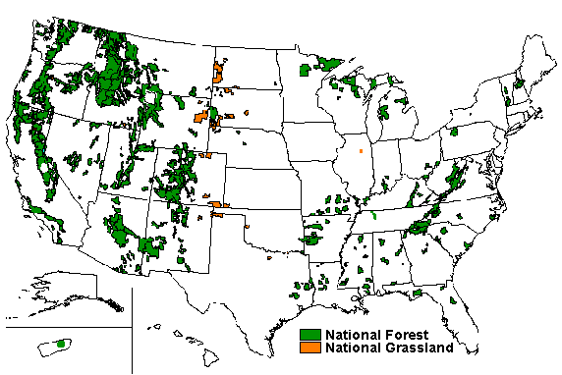
Possible reasons driving trends
Likely the result of changes in priorities for information about forest management
Early 1990s - Adoption of “ecosystem management” by USFS as new management paradigm dramatically changed information needs by federal forest managers
  193 million acres, 25% of US forestland
Source: USFS, https://www.fs.fed.us/recreation/map/finder.shtml

Slide 18
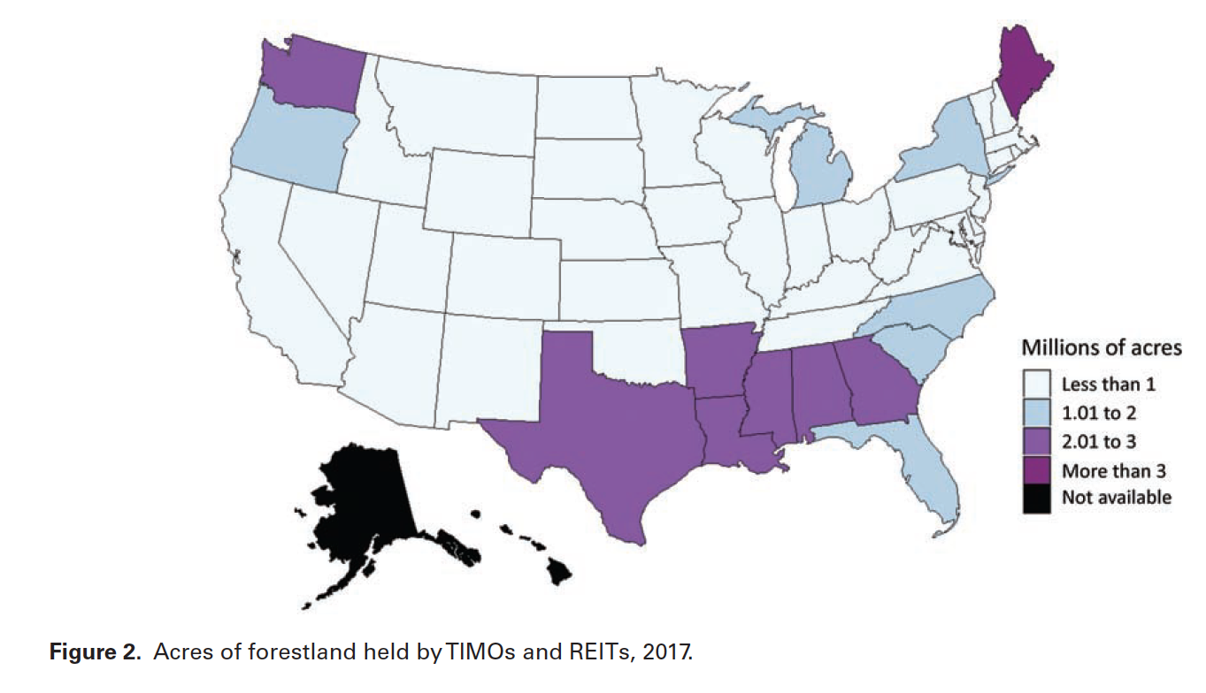
Possible reasons driving trends
Late 1990s - Large-scale conversion of private industrial forestlands to Timber Investment Management Organizations and Real Estate Investment Trusts in the U.S.
  TIMOs and REITs own and manage about 40 million acres in US (5% of US forestlands)
Source: Sass, E.M. et al. 2021. Dynamics of Large Corporate Forestland Ownerships in the United States. Journal of Forestry Vol. 119, No. 4

Slide 19
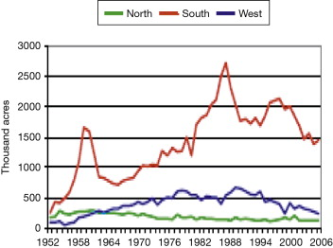
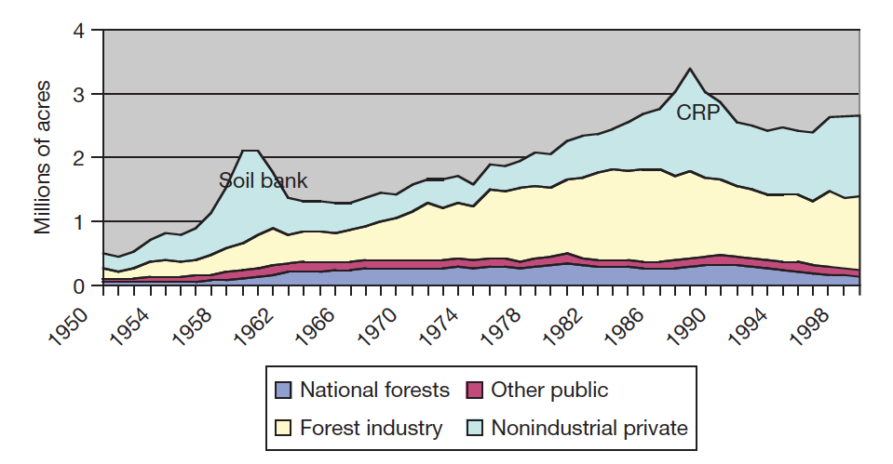
Possible reasons driving trends
Coincidently, planting trees in the US also peaked in the early 1990s
Conclusion - Dramatic changes in forest management in the 1990s altered information needs, the research funding to fill those needs, and ultimately the kinds of questions addressed in doctoral research programs.
Source: R.A. Sedjo, in Encyclopedia of Energy, Natural Resource, and Environmental Economics, 2013

Slide 20
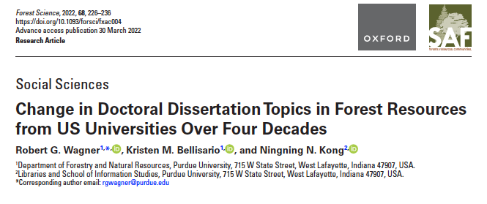
Thank you
Questions?

Slide 21
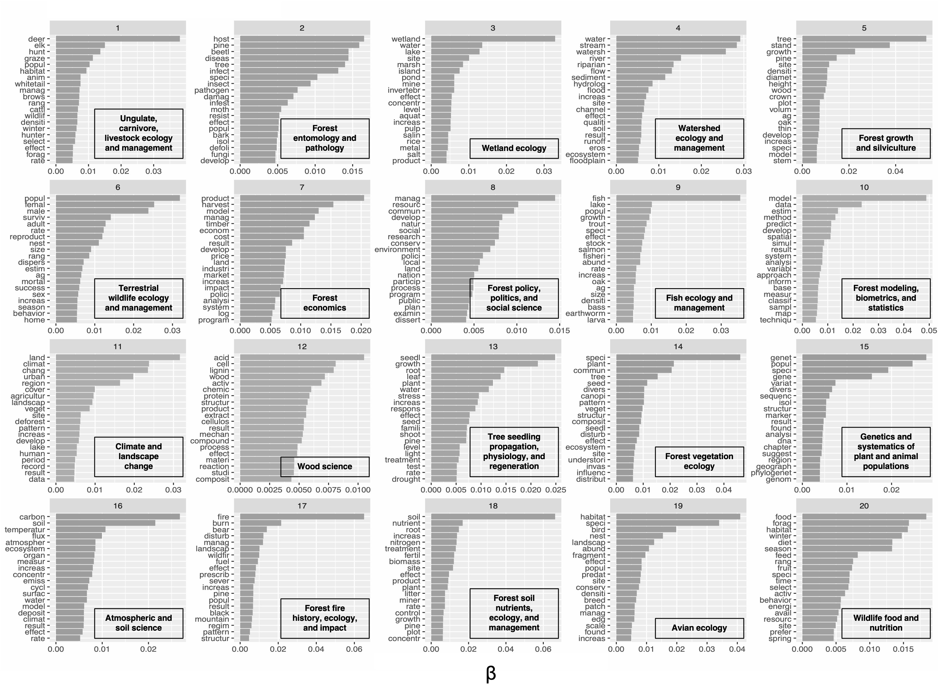
Twenty most frequently occurring words and their β values

Slide 22
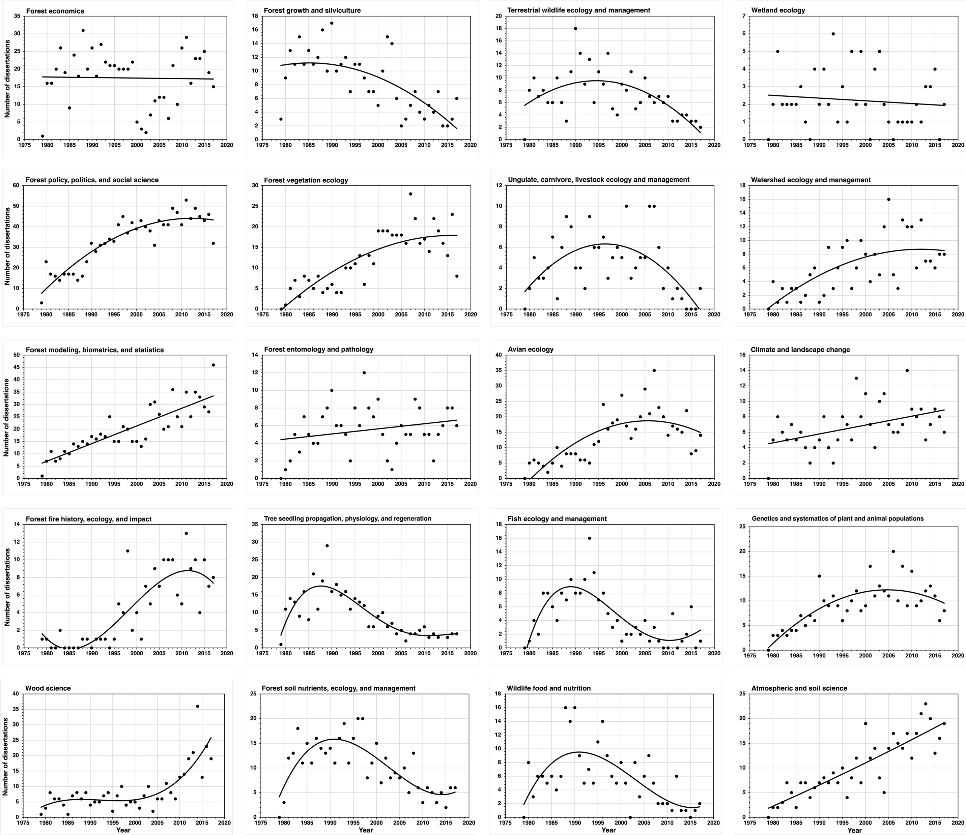
Scattergrams

