Slide 1
Ending Project
Analysis of Aboveground Nutrient Biomass on LTSP Sites Due to the Effects of Site, Harvest Removals, Weed Control, and Compaction
CAFS 18.73
Kim Littke, Eric Turnblom, and Rob Harrison (UW)
Kim Littke
Center for Advanced Forestry Systems 2020 Meeting
Notes:
1

Slide 2
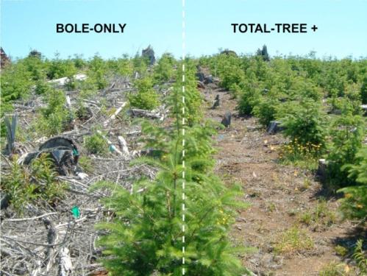
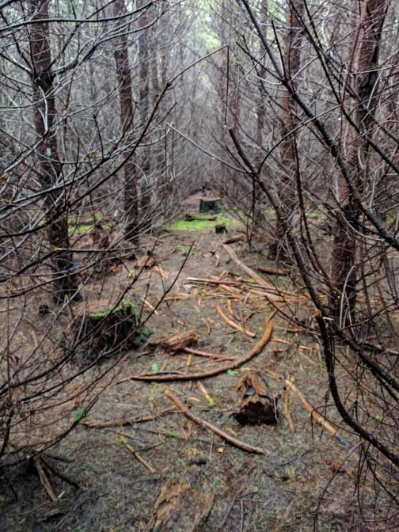
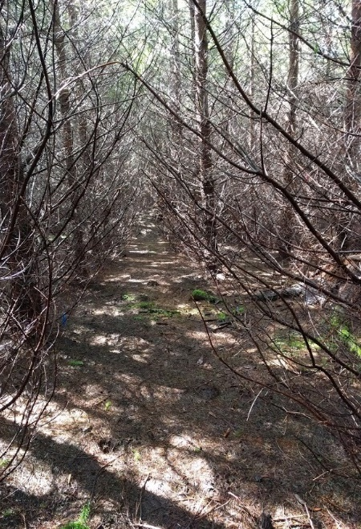
Justification
Long-Term Soil Productivity Study
Effects of intensive forest management on soil and site productivity
Responses to treatments vary by site due to soil nutrition, time since harvest, and treatment severity
Recent soil sampling shows decreases in soil nutrients due to treatments
Losses through leaching or removals
Greater uptake by trees and understory
Center for Advanced Forestry Systems 2020 Meeting

Slide 3
Introduction
Fall River
20 years old
Bole only (BO), whole tree (WT), whole tree + coarse woody debris (WT+)
Initial (IVC) and annual (AVC) vegetation control
Matlock and Molalla
16 years old
BO, WT
IVC, AVC
NARA
6 years old
BO, WT, whole tree + forest floor removal (WTFF)
No compaction (NC) and compaction (C)
Center for Advanced Forestry Systems 2019 Meeting

Slide 4
Objectives
Compare biomass allocation according to tree measurements to previously established biomass allocation equations
Examine aboveground biomass and nutrient contents on four LTSP sites
Understand the nutrient holding capacity of competing vegetation due to treatments on each site
Compare the belowground and aboveground nutrient contents due to organic matter, vegetation control, and compaction treatments
Center for Advanced Forestry Systems 2020 Meeting

Slide 5
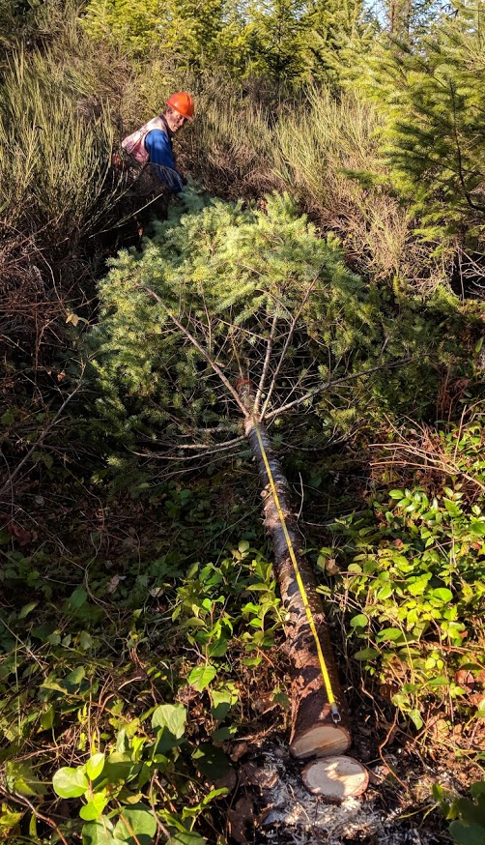
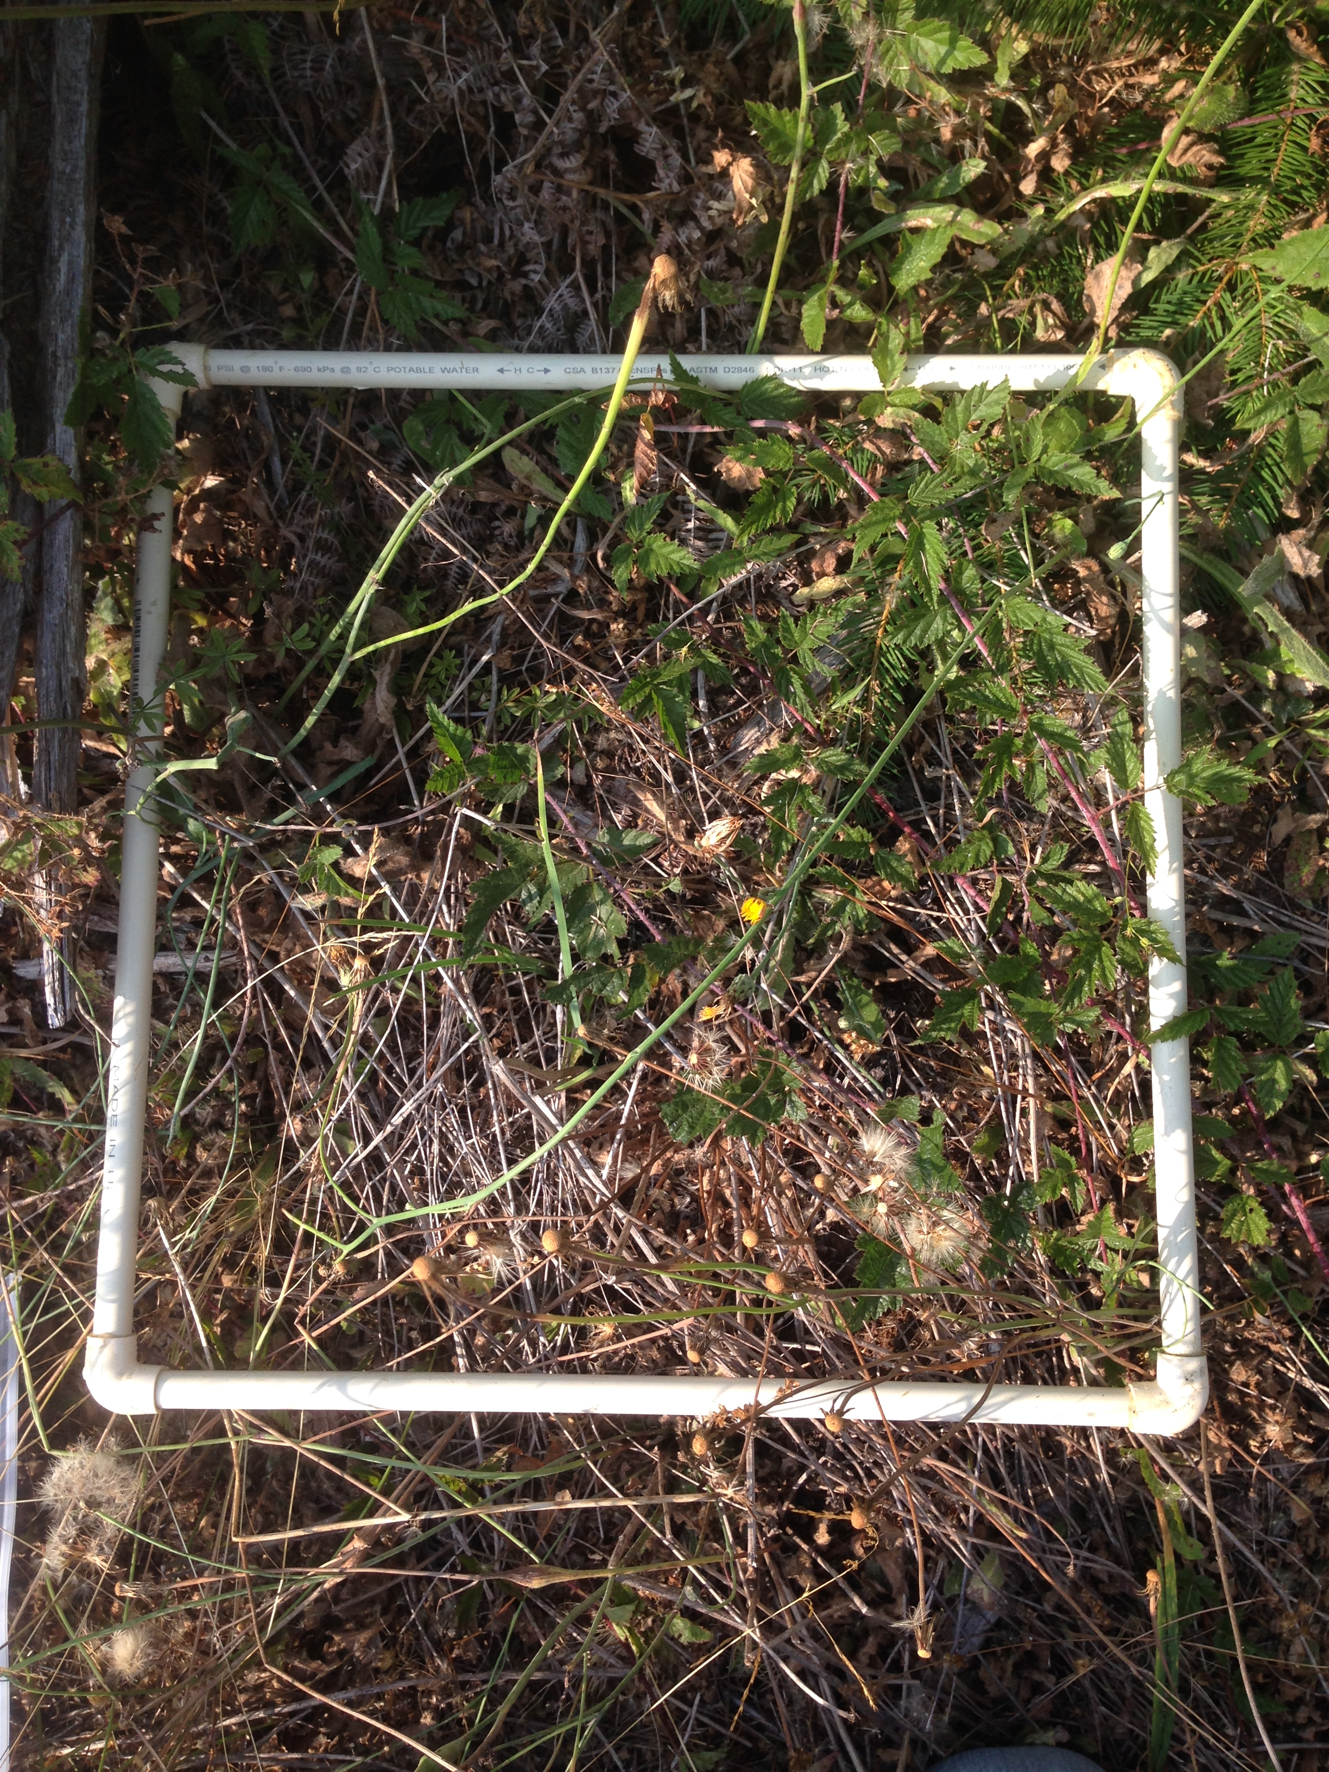
Methods
Measured Douglas-fir biomass at Matlock, Molalla, and NARA in 2018 and Fall River in 2019
At each plot (16-20 per site):
1 whole tree was harvested
Samples analyzed for biomass and total N, Ca, Mg, K, Al, and P
Biomass compared to previous analyses (Harrison et al. 2009; Devine et al. 2011; Devine et al. 2013)
In the summer before measurements, understory was sampled using subplots of known area
Analyzed for biomass and total N, Ca, Mg, K, Al, and P
Center for Advanced Forestry Systems 2020 Meeting

Slide 6
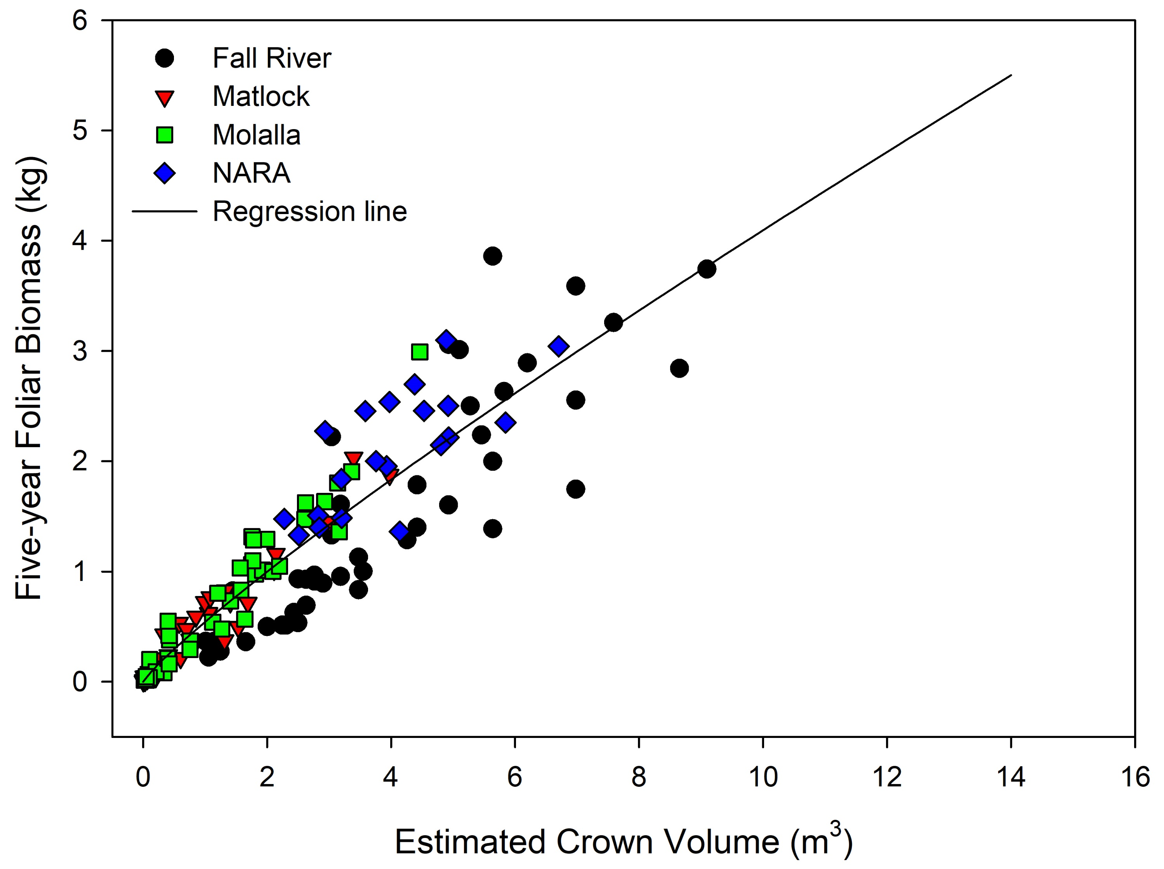
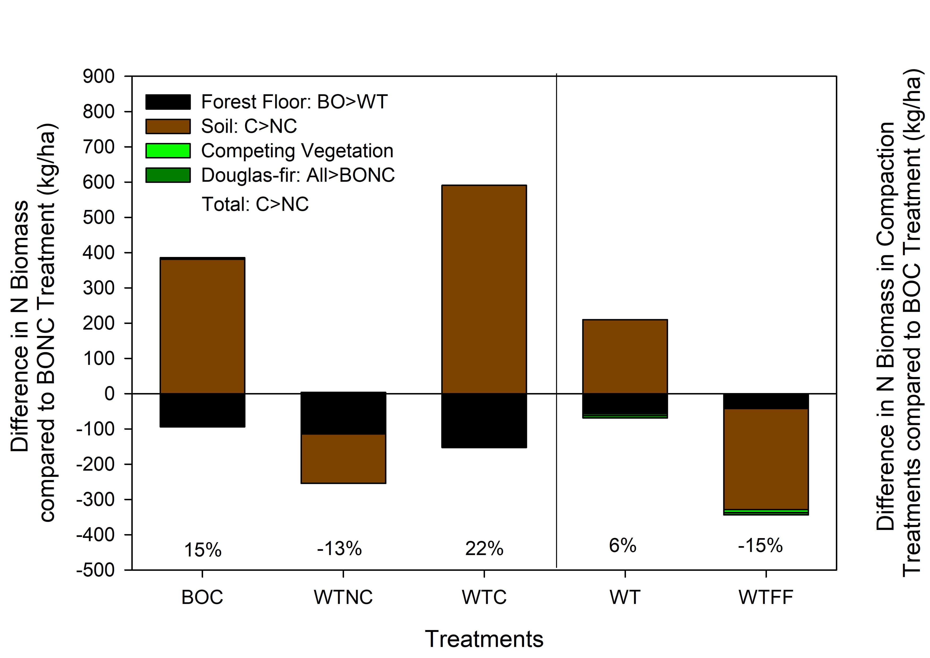
NARA
Major Findings
Crown volume was the best predictor of foliar, branch, and total biomass in five-year-old trees
NARA contained 2X foliar biomass than Fall River at the same crown volume
Optimal soil nutrients, greater annual growing degree days, and improvements in genetics
Stem biomass was strongly related to stem volume.
WT removals decreased forest floor N content, while compaction increased soil and total C and N biomass
Likely due to mixing of the forest floor into the mineral soil and a decrease in decomposition in compacted soils
Center for Advanced Forestry Systems 2020 Meeting

Slide 7
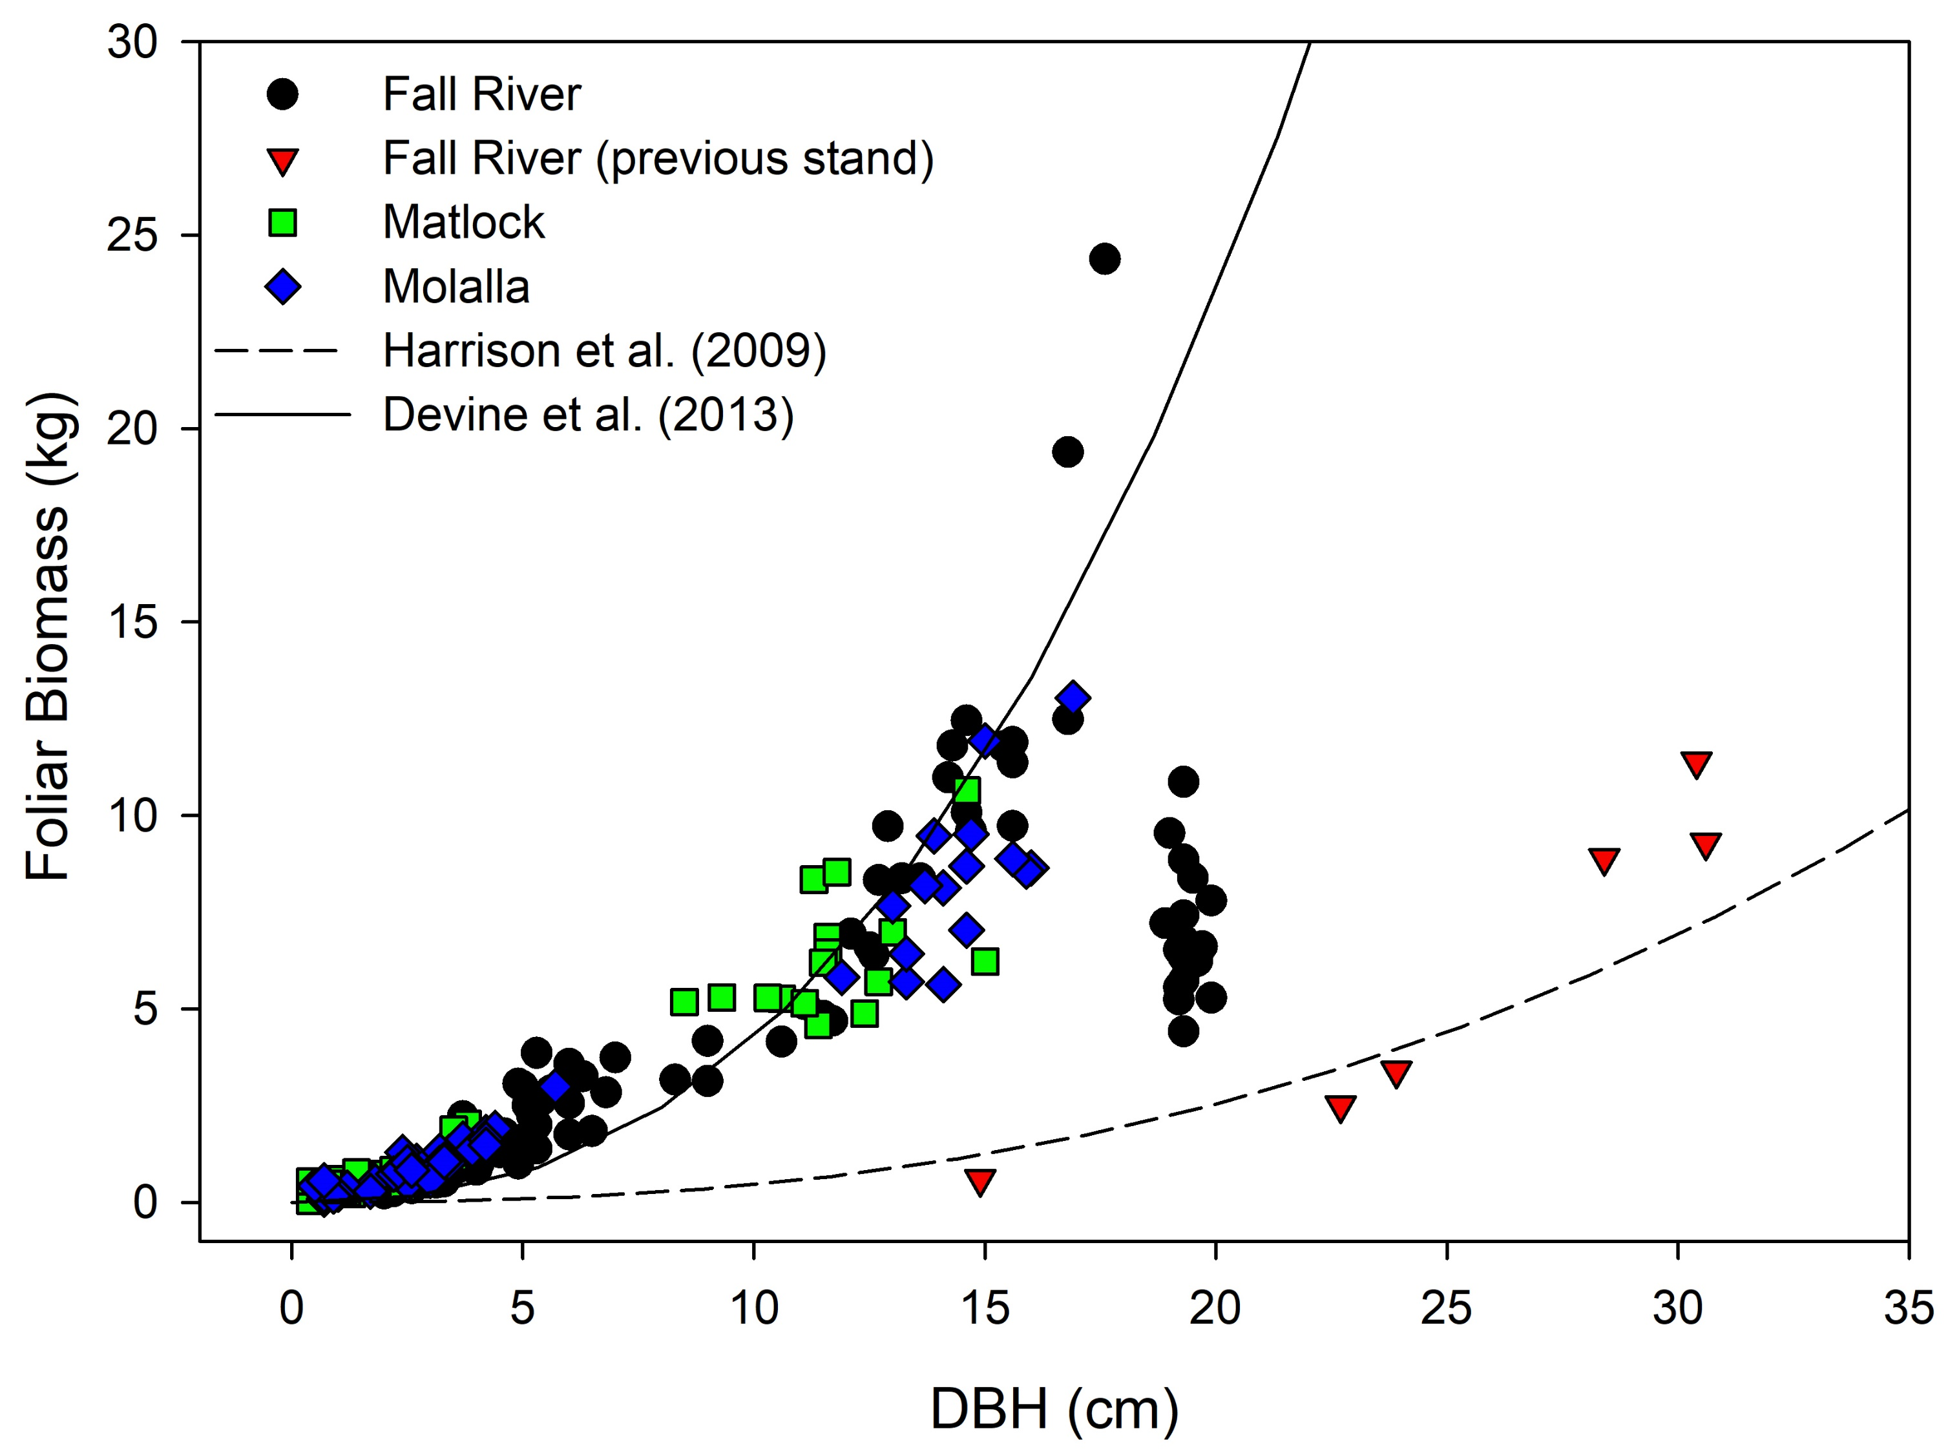
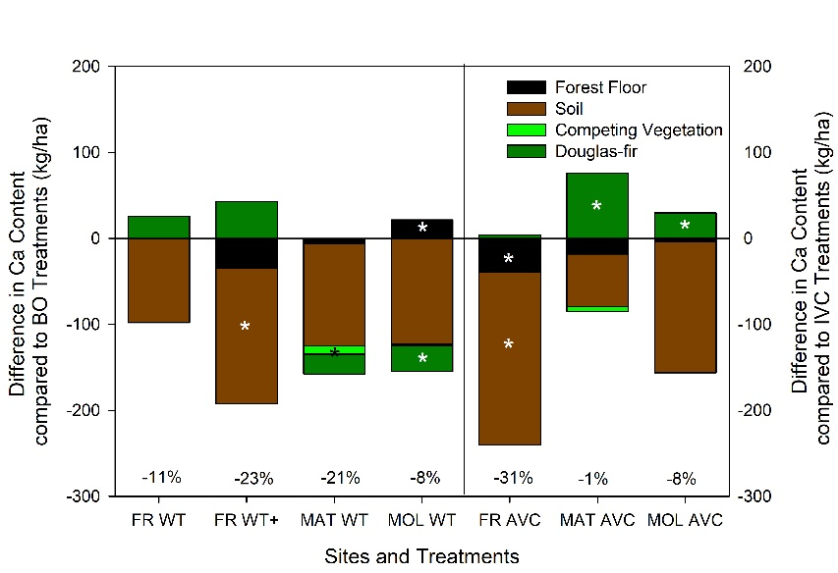
Matlock, Molalla, and Fall River
Major Findings
Crown ratio improved prediction of foliar, branch, and total biomass for trees with crown ratio<0.7
WT removals resulted in lower Douglas-fir biomass and C and P contents
No net change in total nutrient contents
Annual vegetation control decreased soil, forest floor, and competing vegetation base cations
Improved Douglas-fir biomass and nutrient contents
Net losses in base cations were likely due to increased leaching after annual vegetation control
Center for Advanced Forestry Systems 2020 Meeting

Slide 8
Deliverables
Overstory and understory biomass sampling at Fall River, Matlock, Molalla, and NARA sites were completed
We have developed separate biomass allocation equations for 5-year and 5-50 year regional Douglas-fir using standard tree measurements.
One manuscript published in Forest Ecology and Management
Two manuscripts are in preparation
Center for Advanced Forestry Systems 2020 Meeting

Slide 9
Company Benefits
Improved understanding of nutrient dynamics following organic matter removal, vegetation control, and compaction over the short- and long-term
Instructed forest product companies on changes in soil and site productivity due to intensive forest practices
Better timing and application of vegetation control and/or fertilization
Center for Advanced Forestry Systems 2020 Meeting

Slide 10
Summary
Whole tree removals resulted in lower Douglas-fir biomass, but little effects on net nutrient contents
Even though Douglas-fir biomass and nutrient contents increased due to annual vegetation control there were net losses in total base cations
Compaction increased soil and total N and C contents
Center for Advanced Forestry Systems 2020 Meeting

Slide 11
Recommendations
Whole tree removals have the potential for greater effects as stands reach canopy closure
Intensive vegetation control should be balanced with retaining site nutrients
Consider soil nutrition before applying whole tree removals and intensive vegetation control
Sites with limiting soil nutrients will be more impacted by these treatments
Center for Advanced Forestry Systems 2020 Meeting

Slide 12
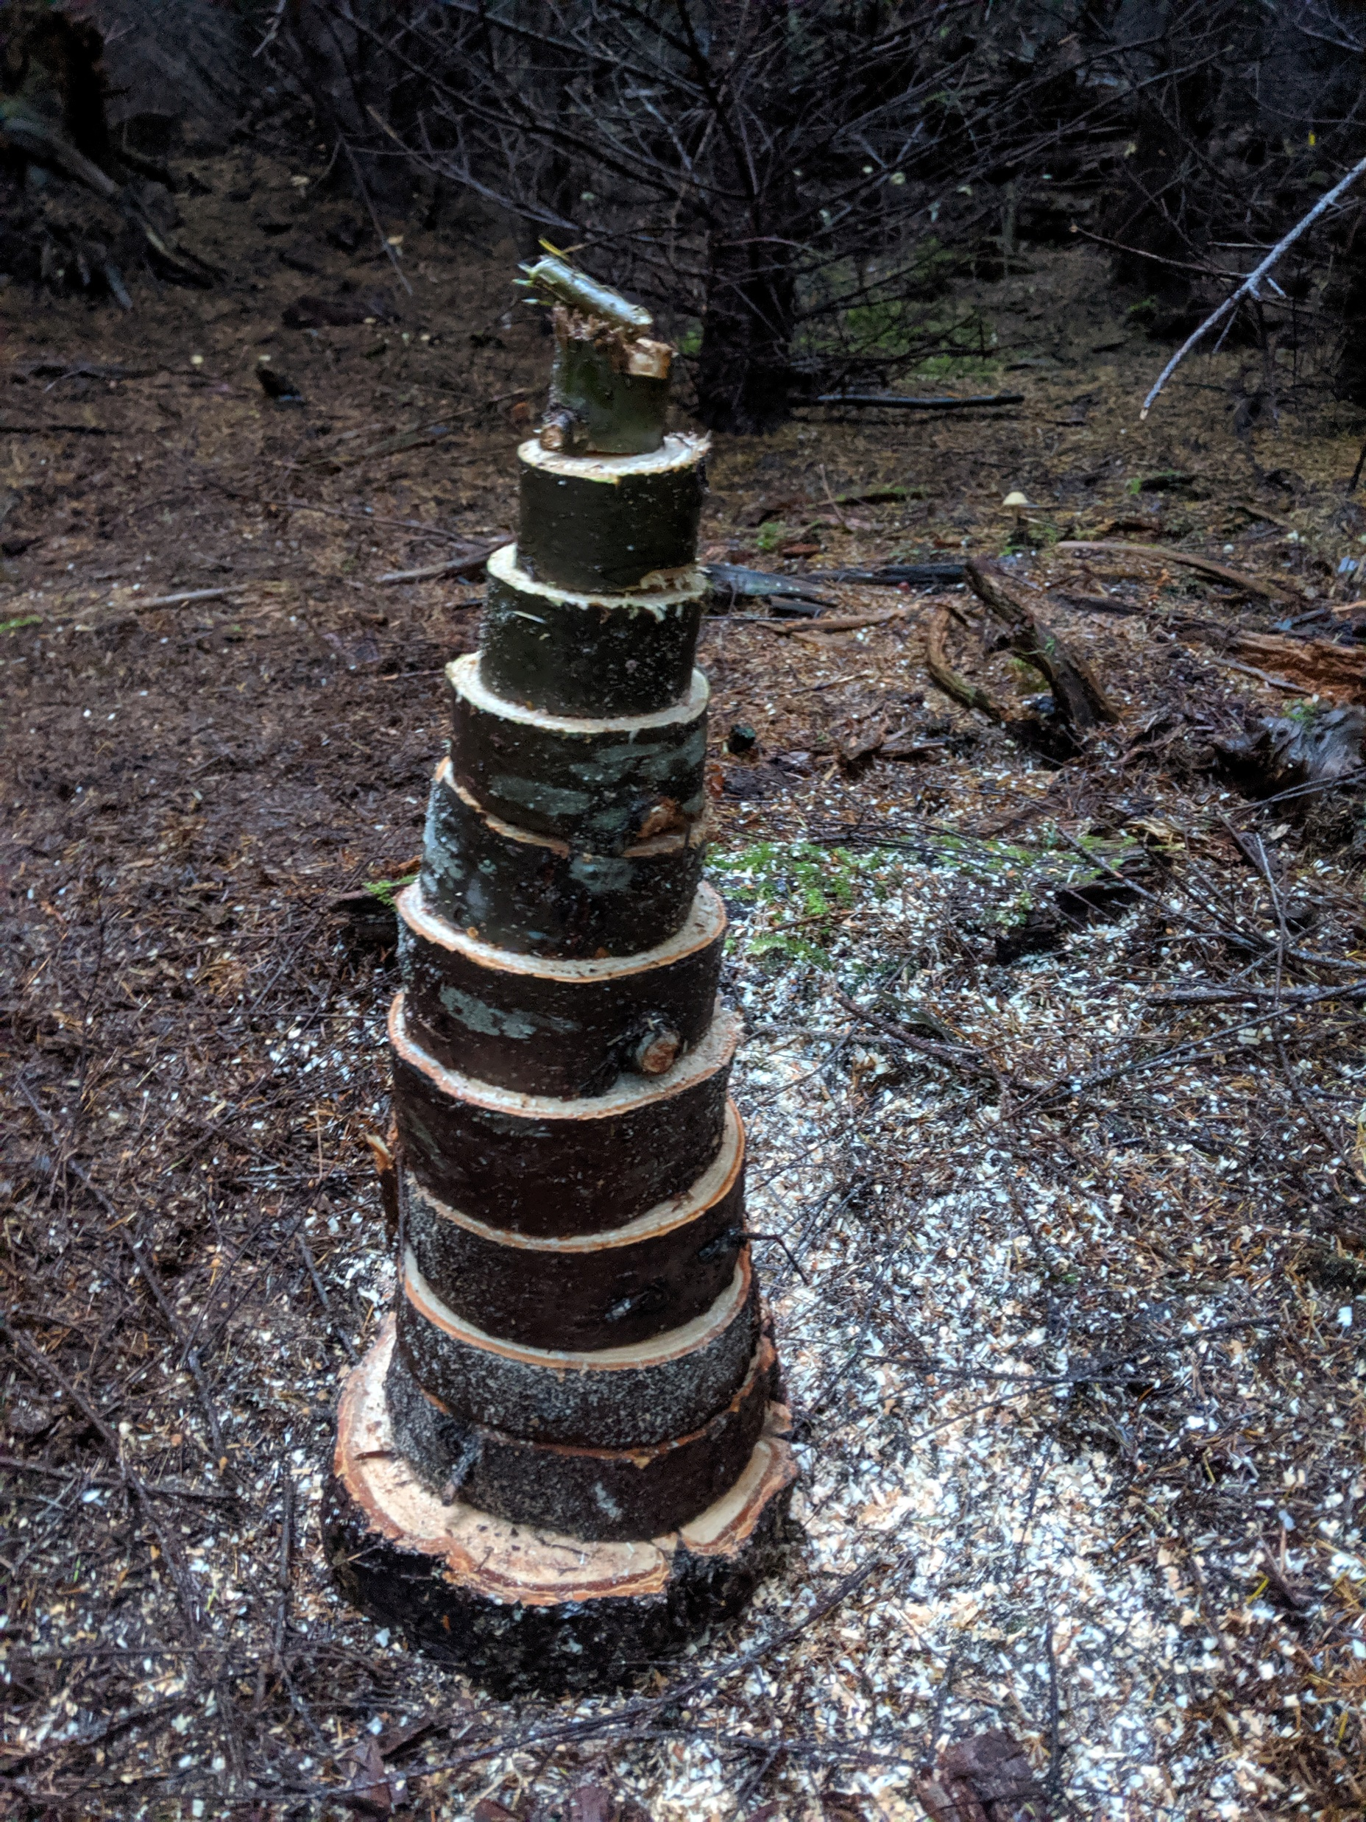
Questions
Thanks to Weyerhaeuser, Green Diamond, Port Blakely, and US Forest Service
Field assistance: Scott Holub, Lauren Magalska, Theresa Marquardt, Tim Harrington, and Will Littke

