Slide 1
Continuing Project Update
Assessing and mapping regional variation in potential site carrying capacity
CAFS 19.76
Mark Kimsey, University of Idaho
Cristian Montes, University of Georgia
Rachel Cook, North Carolina State University
Douglas McGuire, Oregon State University
Aaron Weiskittel, University of Maine
Mark Coleman, University of Idaho
Presenter: Ryan Heiderman (PhD Candidate)
Post-Doctoral Fellow: Cen Chen
Center for Advanced Forestry Systems 2020 Meeting
Notes:
1

Slide 2
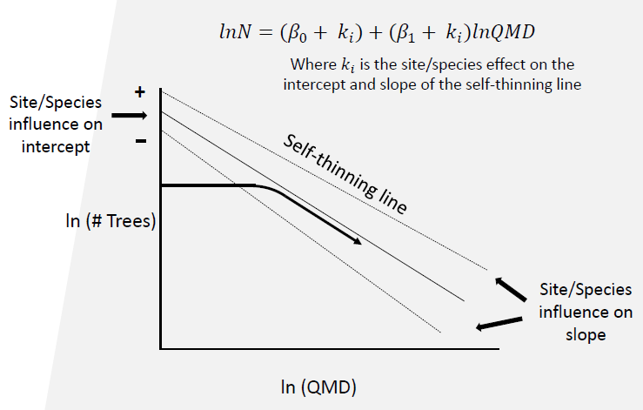
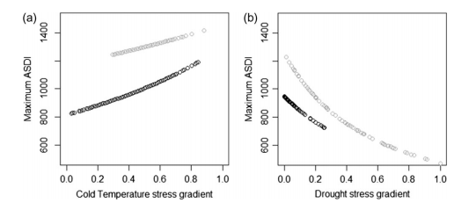
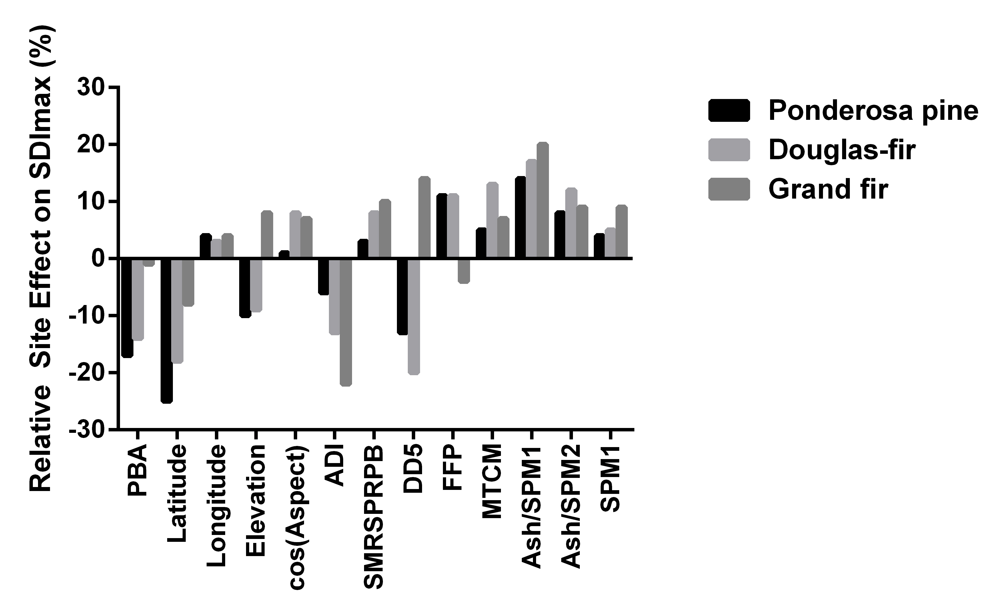
Justification
SDImax: Site-Stand Interactions Matter
Site
Climate
Geography
Soil parent material
Stand
Species mixing
Shade/drought tolerance
Specific gravity
Size/Stocking
Bravo-Oviedo et. al. 2018
Kimsey et. al. 2019
Center for Advanced Forestry Systems 2020 Meeting

Slide 3
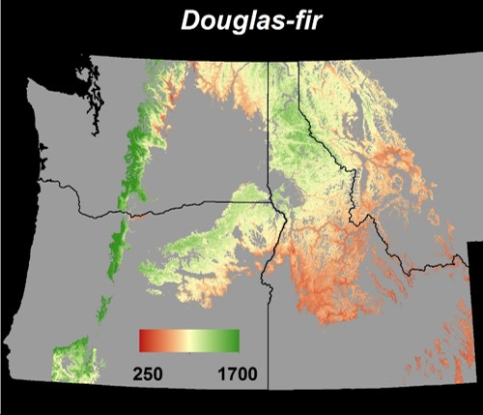
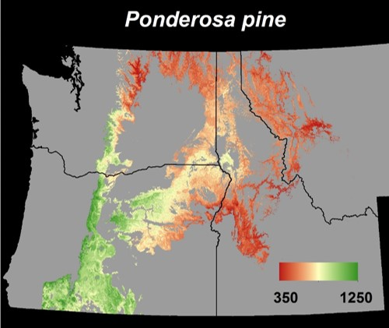
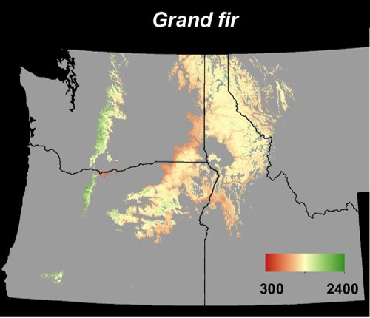
Objectives
OBJECTIVE:
Develop Regional Site-Sensitive,
Mixed Species SDImax Models
Rationale
Overstocked stands are slow to develop and susceptible to wildfire, drought and insect outbreaks due to competition for limited resources
Understocked stands underutilize site resources and will not reach maximum potential productivity
Center for Advanced Forestry Systems 2020 Meeting

Slide 4
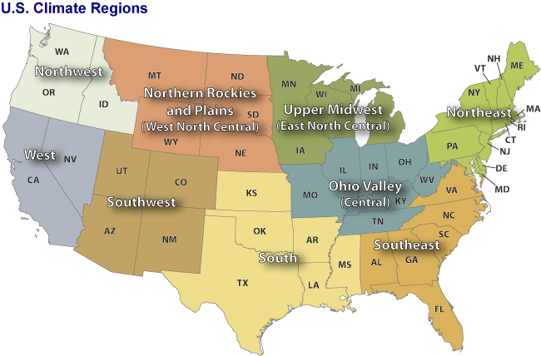
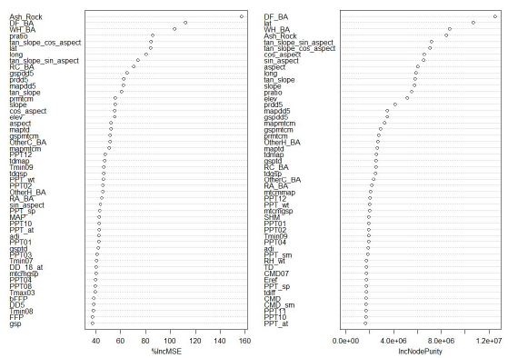
Methods
National x Regional Focus:
Northwest, West, Southwest, Northern Rockies, South, Southeast, Ohio Valley, Upper Midwest, Northeast
Species Focus:
Commercially important conifer/hardwood species by region
Statistical Modeling:
Variable Selection:
Machine learning with multivariate analysis
Frontier Fitting
Stochastic Frontier Regression
Center for Advanced Forestry Systems 2020 Meeting

Slide 5
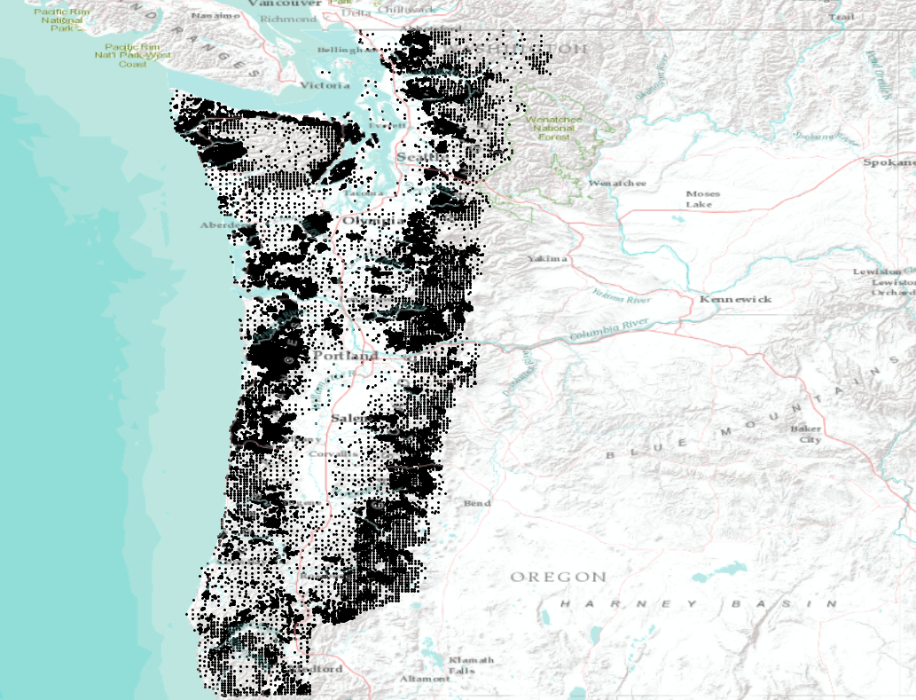
Progress: Northwest
n=188,159
Center for Advanced Forestry Systems 2020 Meeting

Slide 6
Methods
Database Development and Analysis
Dataset – multiple sources FIA, FS-Veg, state and private
200,000+ initial records
Plot level (unfuzzed) coordinates
10% of dataset used stand centroid
Tree data – QMD, TPA
Species BA proportions
Douglas-fir, western hemlock, western redcedar, red alder, Other Hardwood, Other Conifer
Topography extracted from 30m DEM + transformations
Climate NA – 247 climate variables (annual, month, season) + interactions
Geology and Soils Layers
Analysis – multistep approach
Linear quantile mixed models to determine 95% quantile line of ln(TPH)~ln(QMD) with random intercept by record
Random Forests to find variable importance
Stochastic Frontier Analysis with selected variables
Center for Advanced Forestry Systems 2020 Meeting

Slide 7
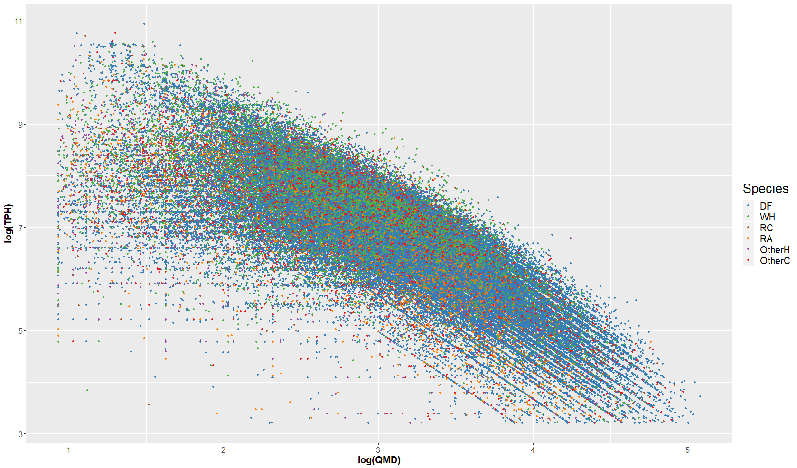
Methods
TPH x QMD Point Cloud for the Pacific Northwest
n=188,159
Center for Advanced Forestry Systems 2020 Meeting

Slide 8
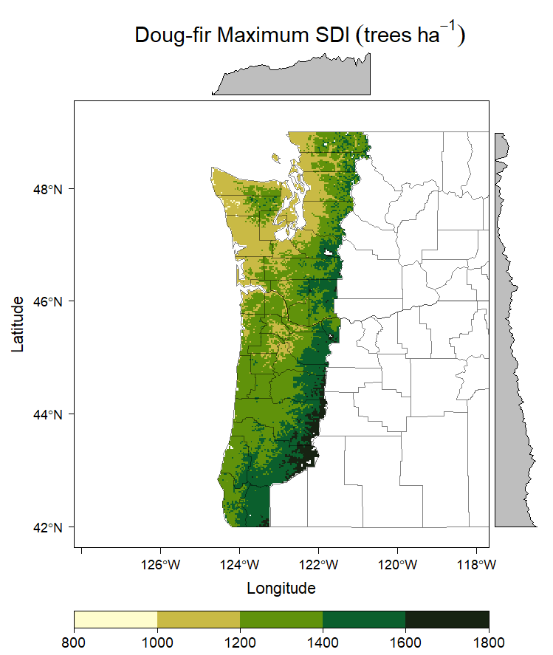
Major Findings
Douglas fir/mixed species model
n=155,083
Min | 25% | 50% | 75% | 95%
839 | 1203 | 1301 | 1415 | 1579
Max SDI | Source
1360-1470 | Reineke, 1933
1450 | Long, 1985
1451 | Weiskittel et al, 2009
1376 | Woodall et al, 2005
1478 | Long et al, 1988
1815 (BC,CAN) | Comeau et al, 2010
1491 (GB) | Comeau et al, 2010
Center for Advanced Forestry Systems 2020 Meeting

Slide 9
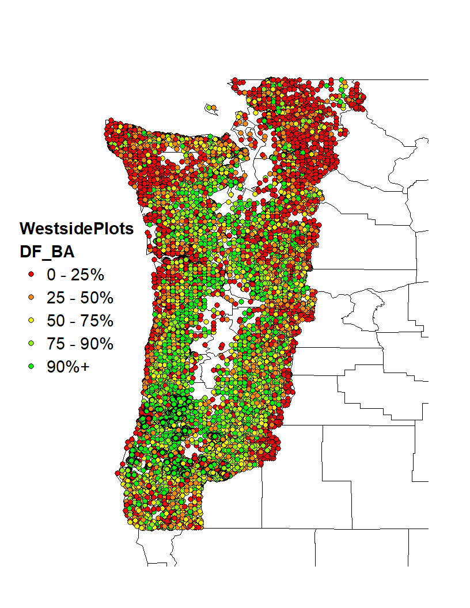
Major Findings
Center for Advanced Forestry Systems 2020 Meeting

Slide 10
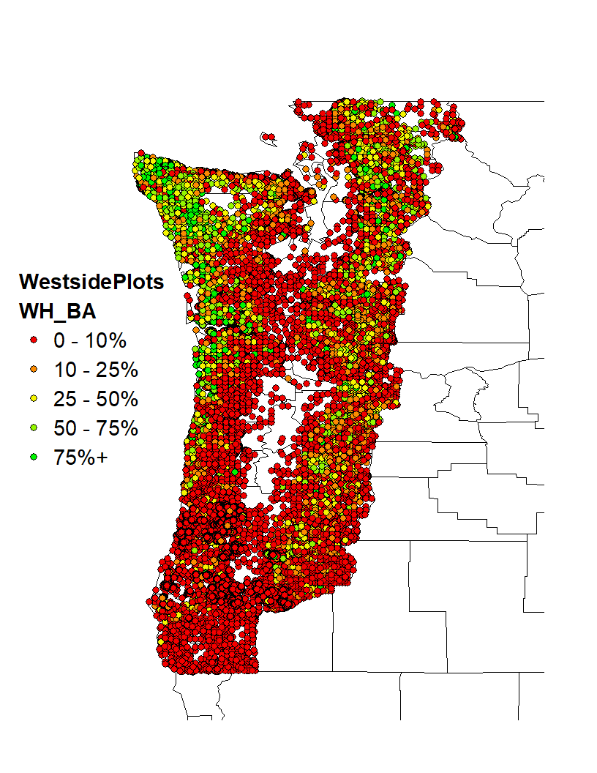
Major Findings
Center for Advanced Forestry Systems 2020 Meeting

Slide 11
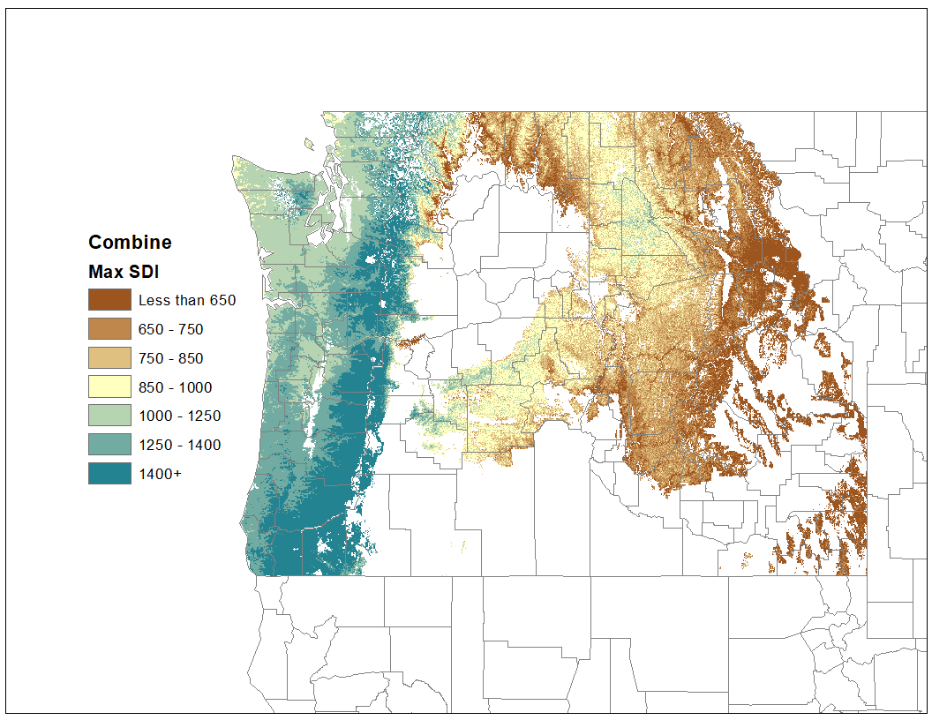
Deliverables
Pure Doug-fir SDImax model for the West Region
Center for Advanced Forestry Systems 2020 Meeting

Slide 12
Deliverables
Expected Deliverables – First Year
(Combined) Regional datasets with plot location, tree-plot data and environmental variables
West Region Douglas-fir SDImax geospatial model
Expected Deliverables – Second Year
Standardized model equations and coefficients which relate observed species-site factors to SDImax
Preparation of peer-reviewed manuscript for documenting the standardization of SDImax computation as a function of region, site, and stand characteristics
Expected Deliverables – Third Year
High-resolution (30m) raster map of predicted SDImax values with ability to manipulate species proportions (and QMD) by region
Center for Advanced Forestry Systems 2020 Meeting

Slide 13
Deliverables
Expected Deliverables – Long Term
Hire and train 2 post-doctoral fellows, apply for Intern/REUs in forest biometrics
Present results at regional/national forestry forums and develop peer-reviewed publications
Provide a consistent, standardized approach to modeling SDImax, which in turn improves stand density management
Center for Advanced Forestry Systems 2020 Meeting

Slide 14
Company Benefits
Member Company Benefits
Consistent, standardized, species specific, site sensitive maximum density estimates that are scalable from stand to watershed to region
Optimize species mix to achieve stocking objectives depending on economic or ecological management scenarios
Aid/improve mortality estimation in Growth & Yield models reliant on SDImax
Center for Advanced Forestry Systems 2020 Meeting

Slide 15
Preliminary Recommendations
West Region
Westside: Isolate WH stands wo/DF component when estimating SDImax
Westside-Eastside: Utilize species SDImax raster layers as mixed conifer models by adjusting species BA proportion
Utilize species model that dominates Stand BA or desired future stand species composition
Center for Advanced Forestry Systems 2020 Meeting

Slide 16
Summary
Update and Timeline
First Northwest SDImax model produced for Douglas-fir
Contribution to CAFS effort through IFC core research and USFS-Region 6 funding
Post-doc (Cen Chen, prior CAFS Intern) hired to begin assembling inventory/CFI datasets for regional SDImax modeling
Database recruitment beginning June 2020
Data QA/QC, standardization throughout 2020
Project handover to Ryan Heiderman June 2021
Continued data recruitment/standardization
Regional SDImax modeling commences
Regional SDImax species model rollout throughout 2022
Center for Advanced Forestry Systems 2020 Meeting

