Slide 1
New Project
Resilience of soil organic matter to harvesting: A global study of long-term soil productivity experiments
CAFS. 20.81
Jeff Hatten (OSU), Stephanie Winters (OSU), Kate Heckman (USFS), Deb Dumroese (USFS), Scott Holub (WY), Loretta Garrett (Scion, NZ), Kim Littke (UW), Carlos Gonzalez (OSU), Doug Maguire (OSU), Aaron Weiskittel (UM)
Presenter: Jeff Hatten (OSU)
Center for Advanced Forestry Systems 2020 Meeting
Notes:
1

Slide 2
SOM and Site Productivity
Soil Organic Matter is positively related to site productivity
  >99% soil N is organic in form
  Large portion of soil P is in organic forms
  Cation exchange capacity
  Water holding capacity
  Structure and root penetrability
SOM is central to many other Ecosystem Services
  Soil carbon is the largest actively cycled terrestrial pool of carbon on the earth
  Water purification
SOM may also be affected by harvesting

Slide 3
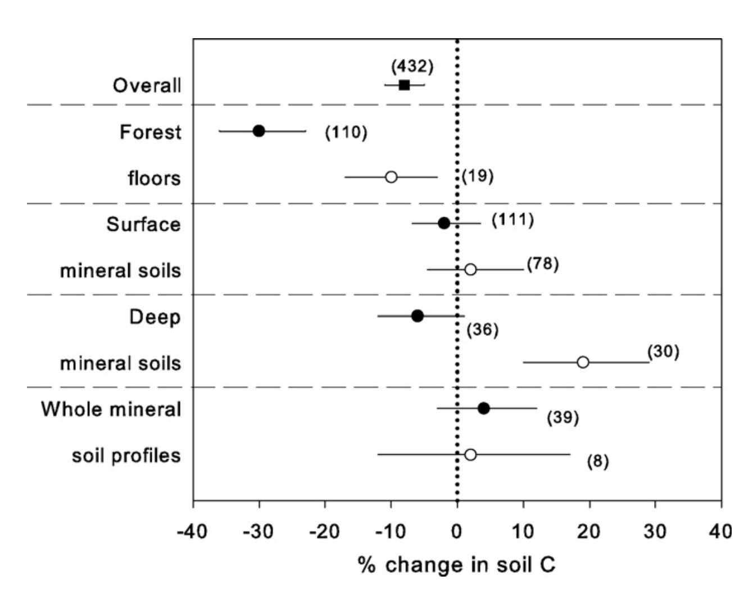
Harvesting Effects on SOM
Nave et al., 2010
Notes:
Harvesting and thinning operations alter soil carbon cycling by cutting the supply of root and litter inputs, disturbing the soil surface, and changing temperature and moisture regimes, all of which tend to increase heterotrophic respiration rates; however, they also move some forest floor carbon into deeper, mineral soil layers.

Slide 4
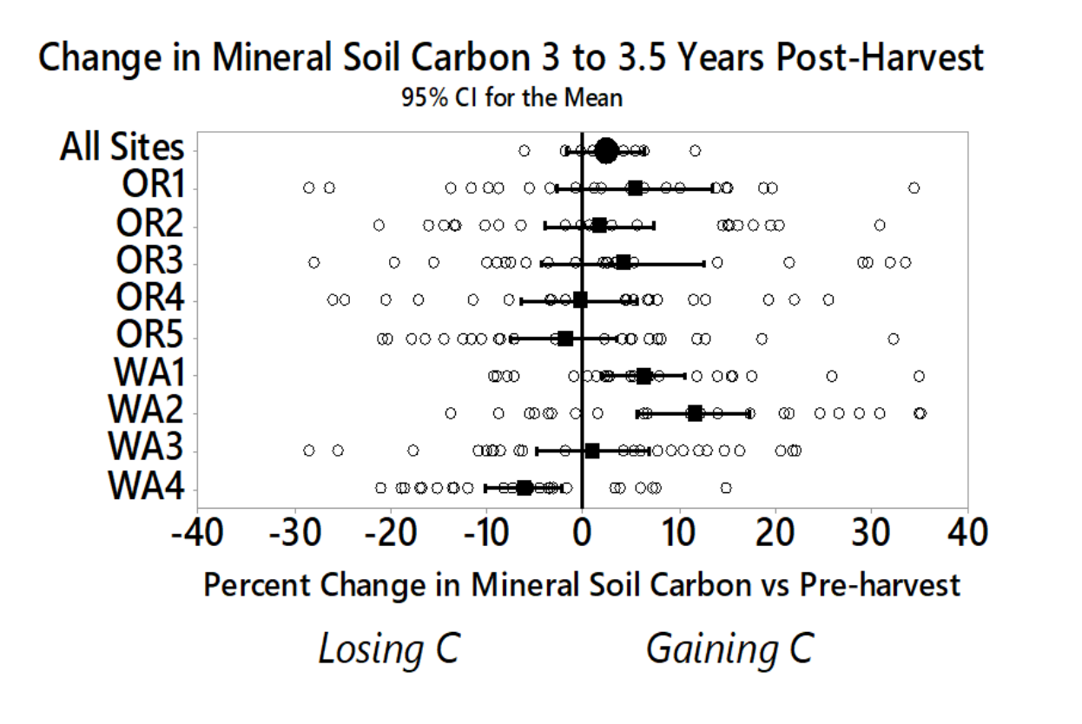
Harvesting Effects on SOM
Includes:
O-horizon
Mineral Soil to 1m
Soil <4.75cm
Holub and Hatten, 2019
Notes:
Harvesting and thinning operations alter soil carbon cycling by cutting the supply of root and litter inputs, disturbing the soil surface, and changing temperature and moisture regimes, all of which tend to increase heterotrophic respiration rates; however, they also move some forest floor carbon into deeper, mineral soil layers.

Slide 5
Why doesn’t soil carbon change after harvesting?

Slide 6
Objectives
Hypotheses or Objectives
1) Characterize soil carbon dynamics after forest harvesting using treatments designed by the long-term soil productivity experiments (LTSP).
2) Determine the mechanisms of resilience, resistance, or vulnerability of soil carbon to forest harvesting.
Center for Advanced Forestry Systems 2020 Meeting

Slide 7
Hypotheses
Forests with a higher proportion of mineral stabilized SOC will resist changes
A) Dead biomass (i.e. roots, stumps, and slash) and/or B) a higher rate of stabilization of the C that is available will cause soils to be more resilient to changes.

Slide 8
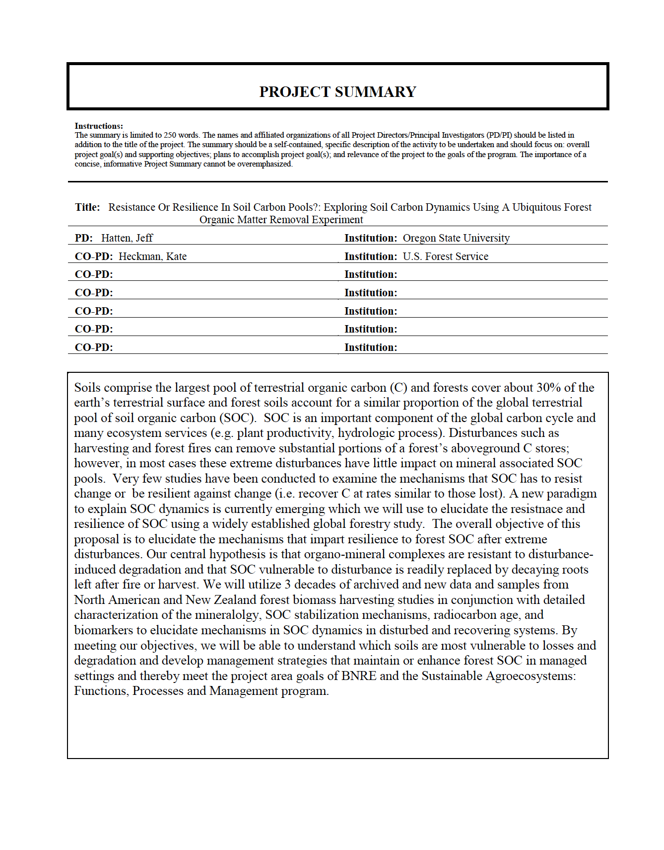
FUNDED
3 years
1 PhD student
Lots of analytical
Request from CAFS:
Travel for student

Slide 9
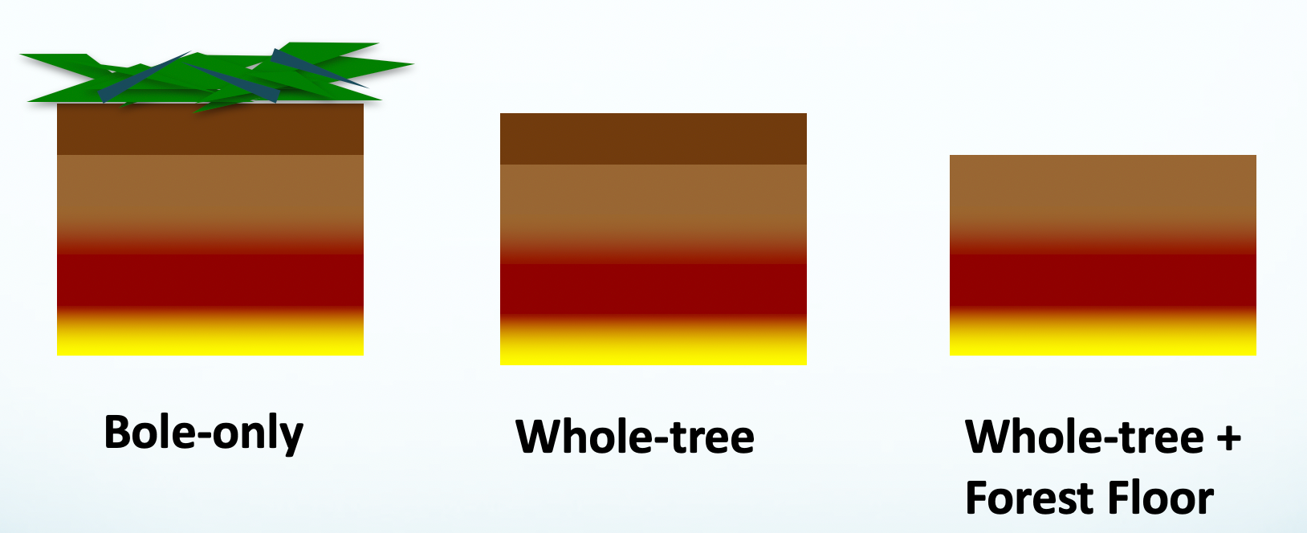
Methods: LTSP
Methods
Center for Advanced Forestry Systems 2020 Meeting

Slide 10
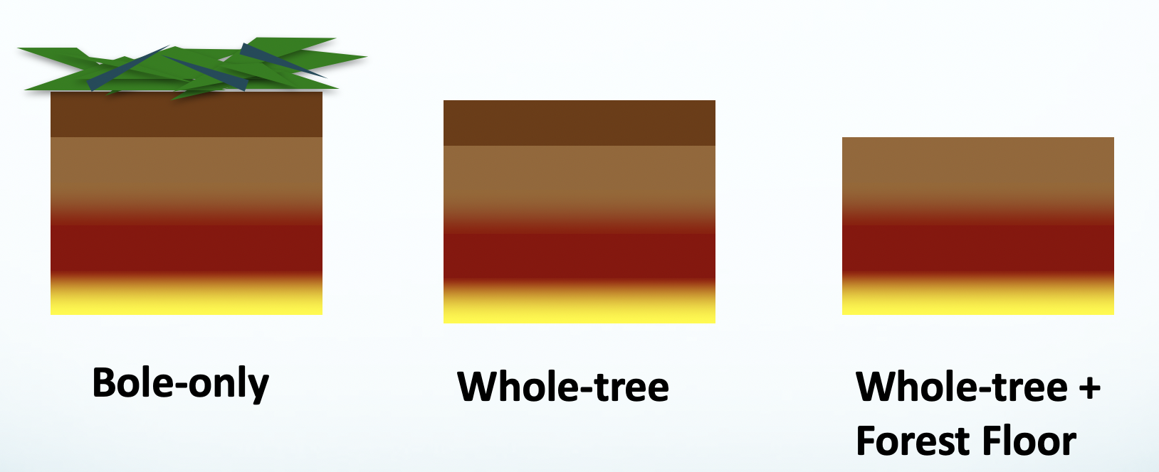
Methods: LTSP
Methods
Center for Advanced Forestry Systems 2020 Meeting

Slide 11
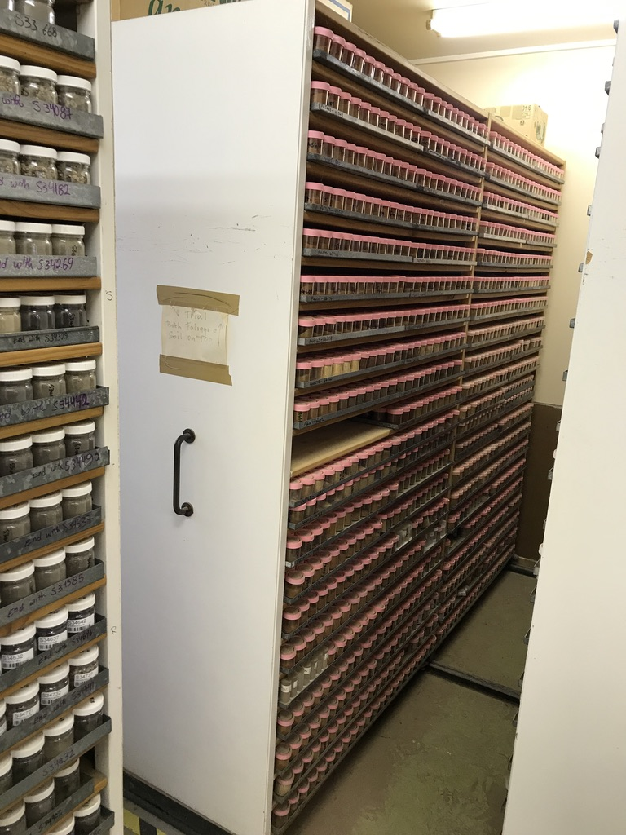
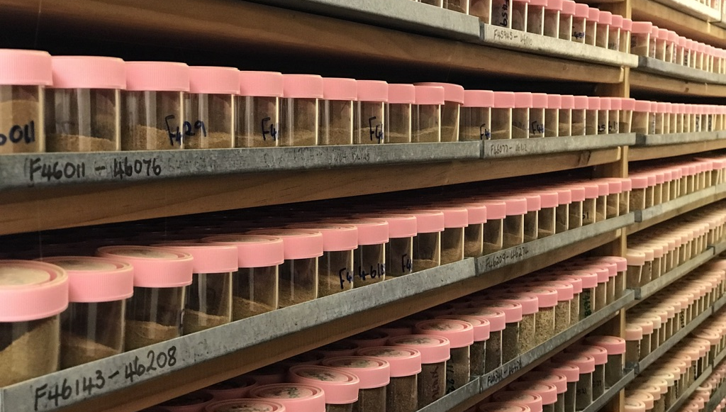
Methods
Methods
Sample Archives: Soils
  Pre-treatment
  Immediate post-treatment
  Years post-treatment
Center for Advanced Forestry Systems 2020 Meeting

Slide 12
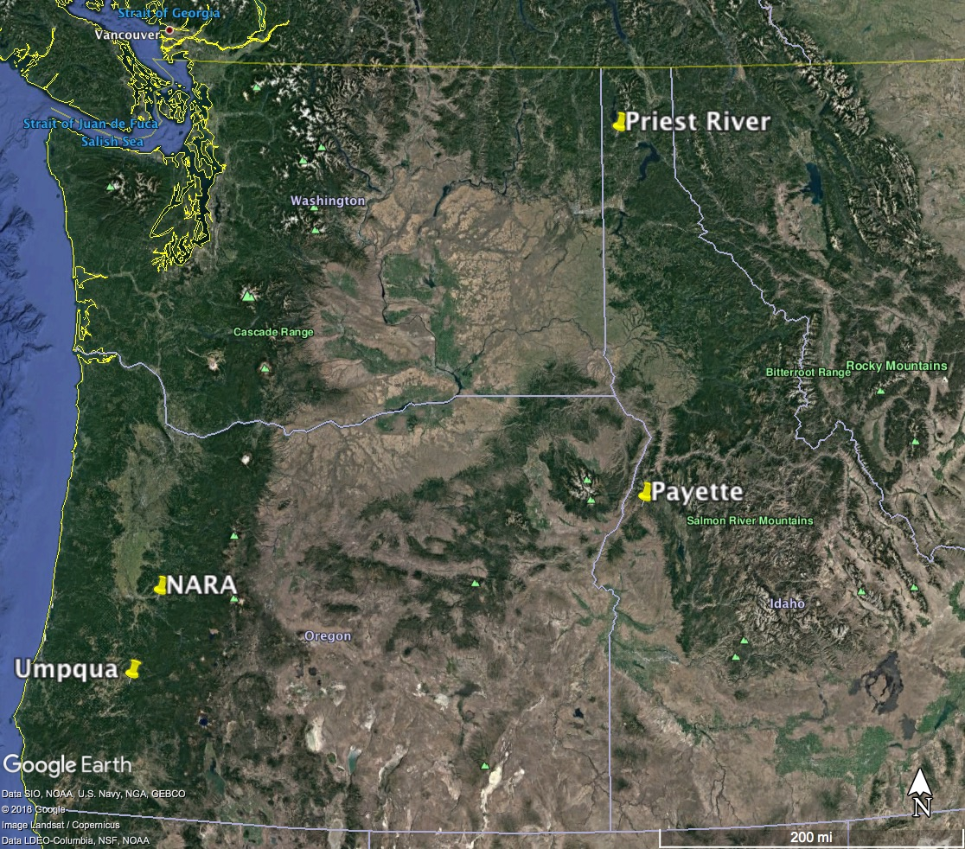
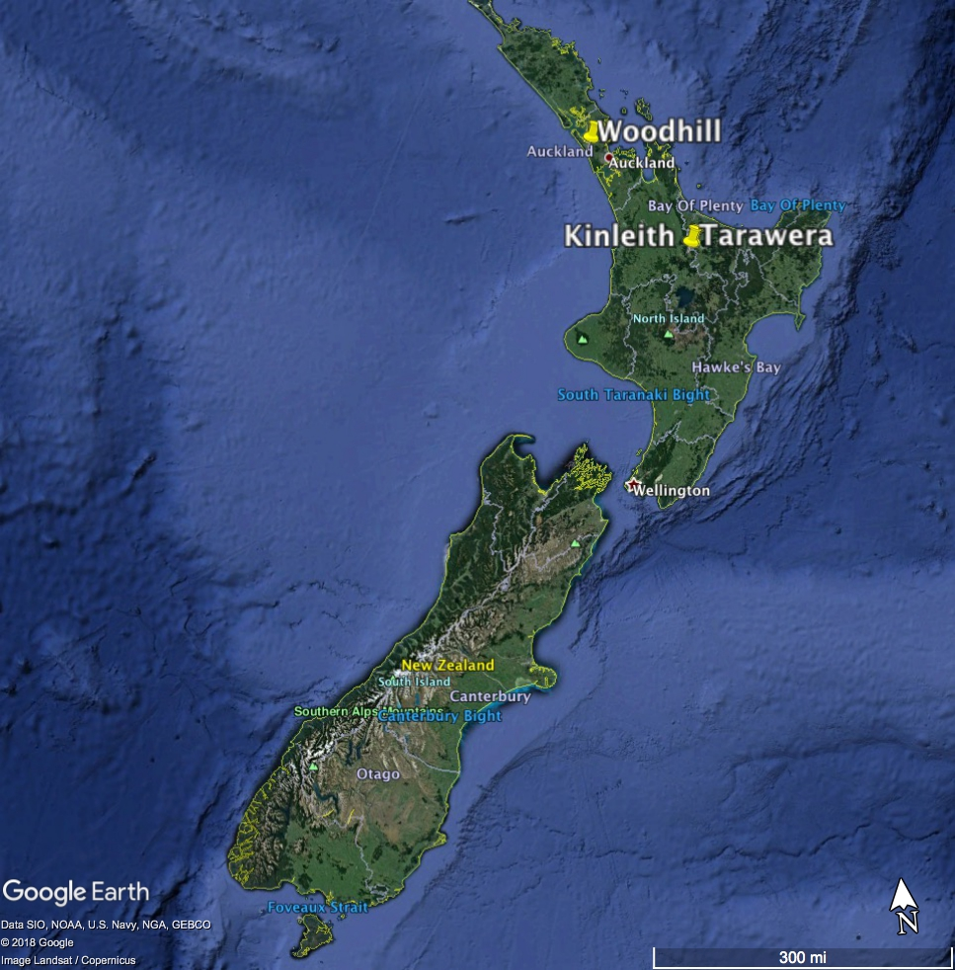
Methods
Methods: Sites
Since these figures:
6 Sites in California
1 Site in North Carolina
Center for Advanced Forestry Systems 2020 Meeting

Slide 13
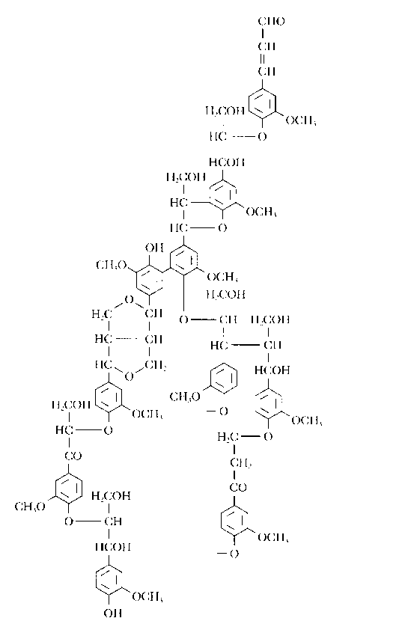
Biomarkers: CuO Oxidation
Method:
CuO oxide oxidation
COP determinations made with GC/MS after hydrolysis of OM
Lignin (vascular plant only)
Goni and Thomas, 2000
Notes:
To trace the source or inputs of carbon in the soil we can use the various lignin monomers. Different classes of plants produce differing proportions of lignin monomers.
Microorganisms and vegetation produce para-hydroxy benzenes. By taking the ratio of P to V we can normalize for vascular plant contributions and isolate the contributions as a result of OM added by microorganisms. I would expect that if N and OM mineralization rates were higher there would be a higher contribution of P relative to V. So if the REMOVED plots have expereinced higher mineralization rates then there would be higher ratios of P to V.
I would also expect the P:V to have a positive relationship with 15N if high mineralization rates lead to enriched 15N ahd high P:V
Let’s see…

Slide 14
Methods
Trace source of SOM: Biomarkers
Trace age and turnover of SOM: ¹⁴C
Examine factors of stabilization: Fe/Al from selective dissolution, texture

Slide 15
Deliverables
Deliverables
Determination of the mechanisms that impart soil carbon resilience and resistance to change from forest harvesting.
Identify soil forest management strategies that protect soil carbon and associated ecosystems services such as forest productivity and health.
Student dissertation
Annual reports and presentations
Center for Advanced Forestry Systems 2020 Meeting

Slide 16
Company Benefits
Company Benefits
Management and harvest operations that maintain or enhance site productivity.
Center for Advanced Forestry Systems 2020 Meeting

Slide 17
Summary
Summary
Examining impacts of forest harvesting on SOM
Determining mechanisms important for resistance to or resilience
LTSP sample and data archives
Geochemical techniques
ID sites (practices?) where SOM may increase of decrease
Benefit decision making on harvesting
Center for Advanced Forestry Systems 2020 Meeting

Slide 18
More OM decomp.
Cupric Oxidation Method
Provides estimates of plant & microbial degradation products
All axes normalized to Vanillin
Bulk soils
Each point = avg of 4 replicates within each treatment
Less OM decomp.
belowground contribution
Below ground
Increasing levels of organic matter decomposition
Soil-C has a higher contribution from belowground (root) components for all treatments
Aboveground contribution
Above ground
Notes:
Remake with right plots

Slide 19
Methods
Methods
Mechanism | Expected shift in source | Expected shift in D¹⁴C age
Resist D in SOC | No change Negative relationship between SOC loss and aggregate and mineral associated SOC, clay content + active iron and aluminum | SO & FF: SOC age = pre-treatment + time since disturbance
Resilience from aboveground residuals | SO:↑ shoot biomarkers immediate to 5 years post-treatment FF: No change | SO: SOC age < pre-treatment immediate to 5 years post-treatment FF: SOC age = pre-treatment + time since disturbance
Resilience from aboveground production | SO & FF:↑ shoot biomarkers a decade post-treatment | SOC age < pre-treatment a decade post-treatment
Resilience from belowground residuals | SO & FF:↑ root biomarkers immediate to a few years post-treatment | SO & FF: SOC age < pre-treatment immediate to 5 years post-treatment
Resilience from belowground production | SO & FF:↑ root biomarkers a decade post-treatment | SO & FF: SOC age < pre-treatment a decade post-treatment
Center for Advanced Forestry Systems 2020 Meeting

Slide 20
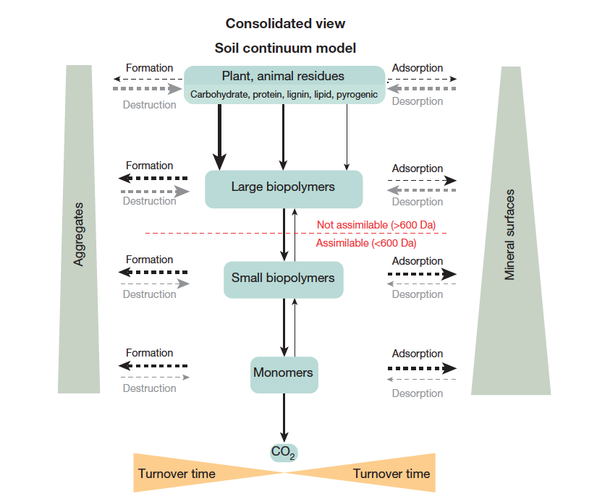
Lehmann and Kleber, 2015

