Slide 1
Project Proposal: CAFS 20.83
Using predictive analytics
to decompose site index
Jason Cross (University of Washington)
Eric Turnblom (University of Washington)
Jason Cross, Presenter
Center for Advanced Forestry Systems 2020 Meeting
Notes:
1

Slide 2
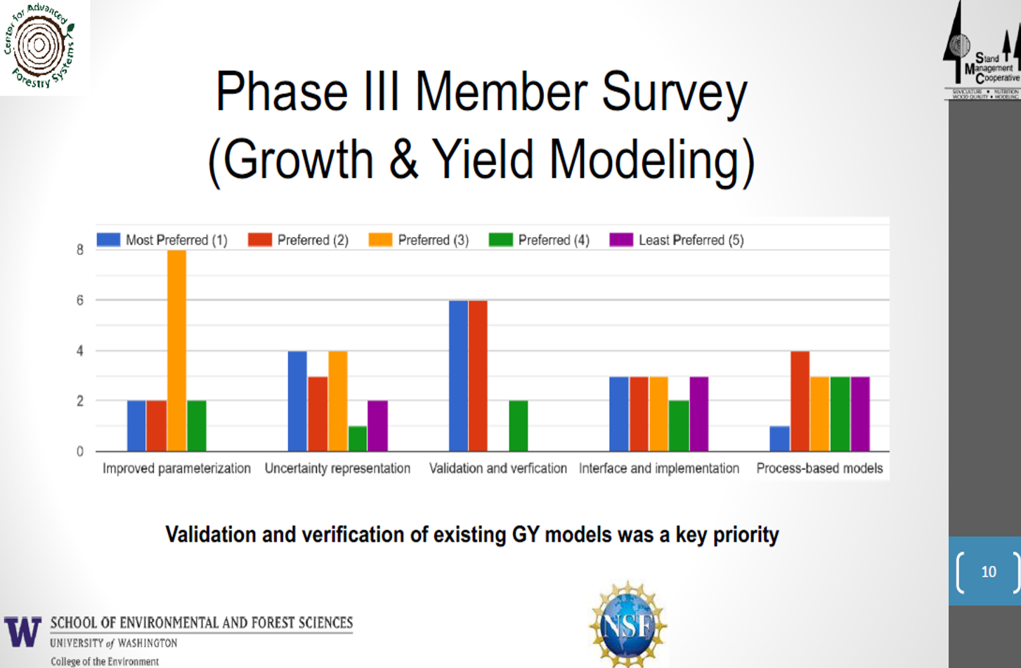
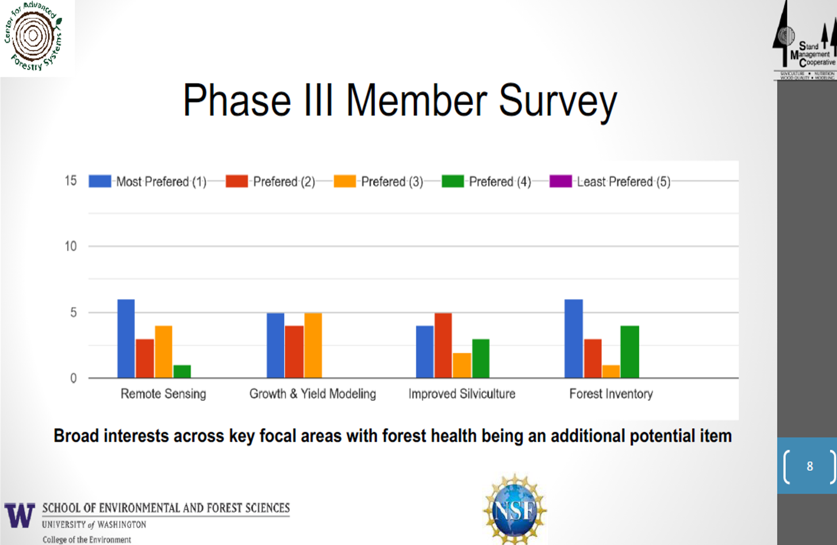
Justification
Center for Advanced Forestry Systems 2020 Meeting

Slide 3
Hypotheses or Objectives
∫
Geology
Climate
Weather
Geography
Topography
Density
Top Height →
Stand Age →
Center for Advanced Forestry Systems 2020 Meeting

Slide 4
Methods
December temperature
Clay content
Plant available water
Climate
Seed source location / zone
Summer
precipitation
Geology
Elevation
Solar insolation
A-horizon C:N ratio
Topography
Base saturation
Latitude
Center for Advanced Forestry Systems 2020 Meeting

Slide 5
Methods
Top Height →
Stand Age →
Base Age
Center for Advanced Forestry Systems 2020 Meeting

Slide 6
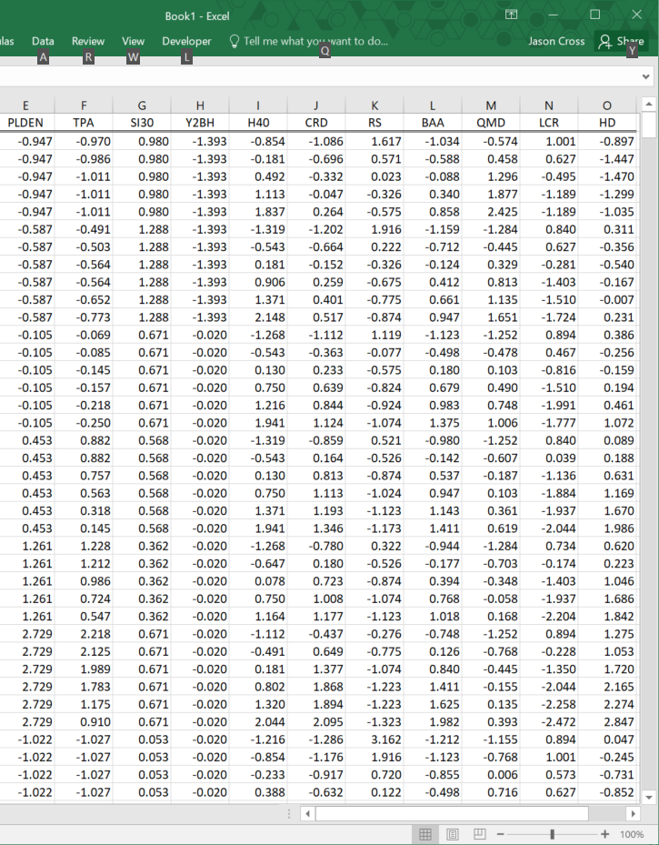
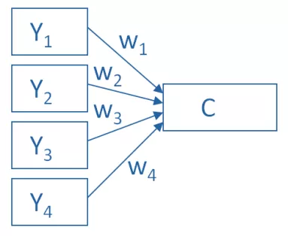
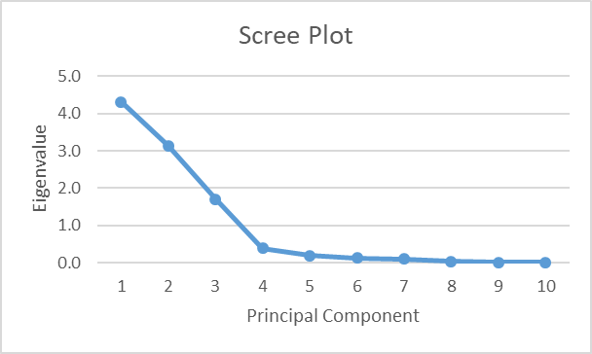
Methods
www.theanalysisfactor.com
Center for Advanced Forestry Systems 2020 Meeting

Slide 7
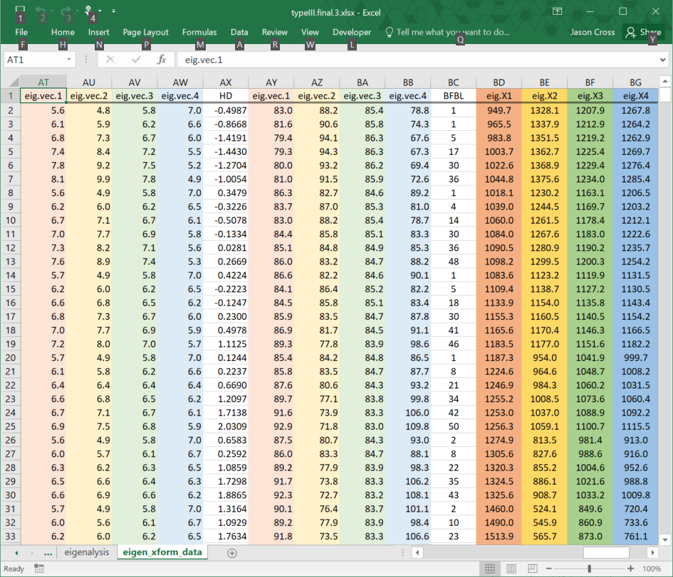
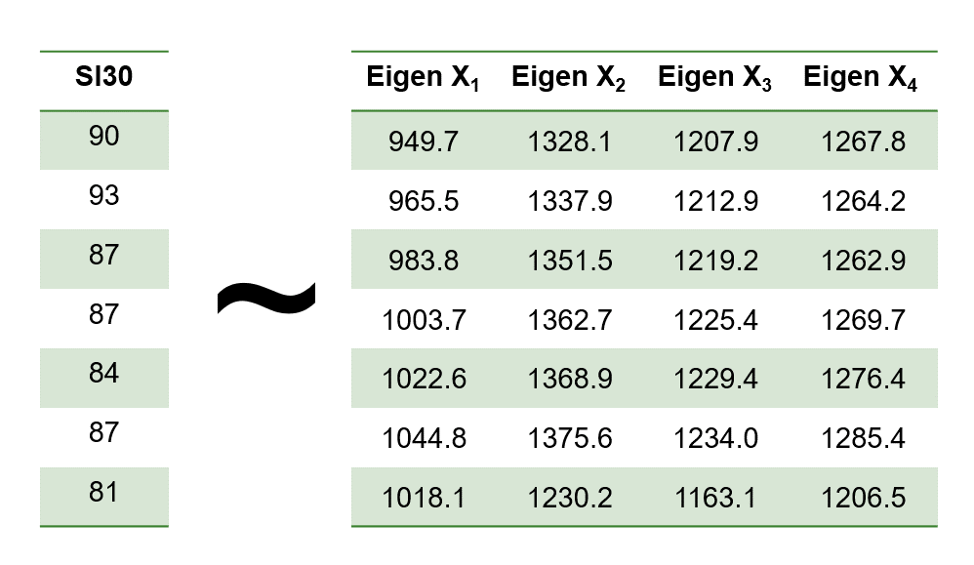
Methods
Center for Advanced Forestry Systems 2020 Meeting

Slide 8
Deliverables
1. Annotated bibliography of factors thought to affect site index:
universal factors plus additional factors specific to geographic
region (PNW, SE, NE)
2. Updated, plot-specific height/age curves for all plots included in
analysis.
3. Equation / response surface / methods to calculate updated
site index values by species and location for a given base-age.
Values may be updated as often as are the underlying datasets.
Center for Advanced Forestry Systems 2020 Meeting

Slide 9
Company Benefits
1. Addresses CAFS / IAB issues related to validation and
verification of growth & yield models.
2. Site index is an input in most growth and yield systems in the
PNW (e.g. FPS, ORGANON FVS). If successful, the
methodology will provide a direct substitution for site index
that accounts for changes in patterns of predictors of site index.
Center for Advanced Forestry Systems 2020 Meeting

Slide 10
Timeline & Budget
2020 Summer: Assemble site-index component annotated bibliography
Prepare SMC data for updated height / age curves
2021 Winter: Build updated height / age curves for plot
2021 Spring: Prepare updated site index curve manuscript
2021 Summer: Assemble datasets base on bibliography results
2021 Fall: Prepare and analyze data
2022 Spring: Manuscript preparation and final report
Budget item description | Year 1 Cost ($)
CAFS funding request:
Graduate Student RA | $ 9,800
Library contract services | $ 7,500
Supplies & equipment | $ 1,000
TOTAL | $ 18,300
Other sources (SMC):
2 months’ salary + benefits | $ 20,731
Center for Advanced Forestry Systems 2020 Meeting

