Slide 1
Ending Project / Final Report
INTERN: Gains from advanced genetics western larch across the Inland Northwestern United States
CAFS.19.77
Cen Chen, Andrew Nelson, and Mark Coleman
University of Idaho
Center for Advanced Forestry Systems 2020 Meeting
Notes:
1

Slide 2
Justification
Planting is critical for the establishment of forests for future timber production and is the predominant practice in the Inland Northwest.
6.1 million conifers and 4,400 ha in 2012
11.6 million conifers and 8,600 ha in 2018
Planting facilitates introduction of genetics selected for rapid growth and disease/pest resistance, and can be used for climate change adaptation, but also requires significant investment.
Initial seedling performance is influenced by the quality of seedlings, which is often difficult to assess.
Center for Advanced Forestry Systems 2020 Meeting

Slide 3
Justification
Forests of the Inland Northwest vary dramatically in site quality based on aspect, elevation, depth of surficial volcanic ash deposits, soil parent material, and annual precipitation.
Initial seedling growth and survival is a major missing link in forest growth and yield models as they are predominantly designed to model established trees.
The lack of examinations of the multitude of both biotic and abiotic factors that influence initial growth and mortality of planted seedlings is likely due to their high variability and complexity, as well as the general lack of available data.
Center for Advanced Forestry Systems 2020 Meeting

Slide 4
Hypotheses or Objectives
Our project evolved from western larch to also covering Douglas-fir, both are commonly planted in the region, and comprehensively evaluated potential influential factors besides genetic improvements.
1) assess the effects of various factors of seedling origins, morphological attributes, soil, topography, weather, and competition on early growth and mortality of planted Douglas-fir and western larch seedlings.
2) predict early seedling growth and morality using significant and influential factors from the assessment.
3) compare specific differences between interior Douglas-fir and western larch and provide management suggestions.
Center for Advanced Forestry Systems 2020 Meeting

Slide 5
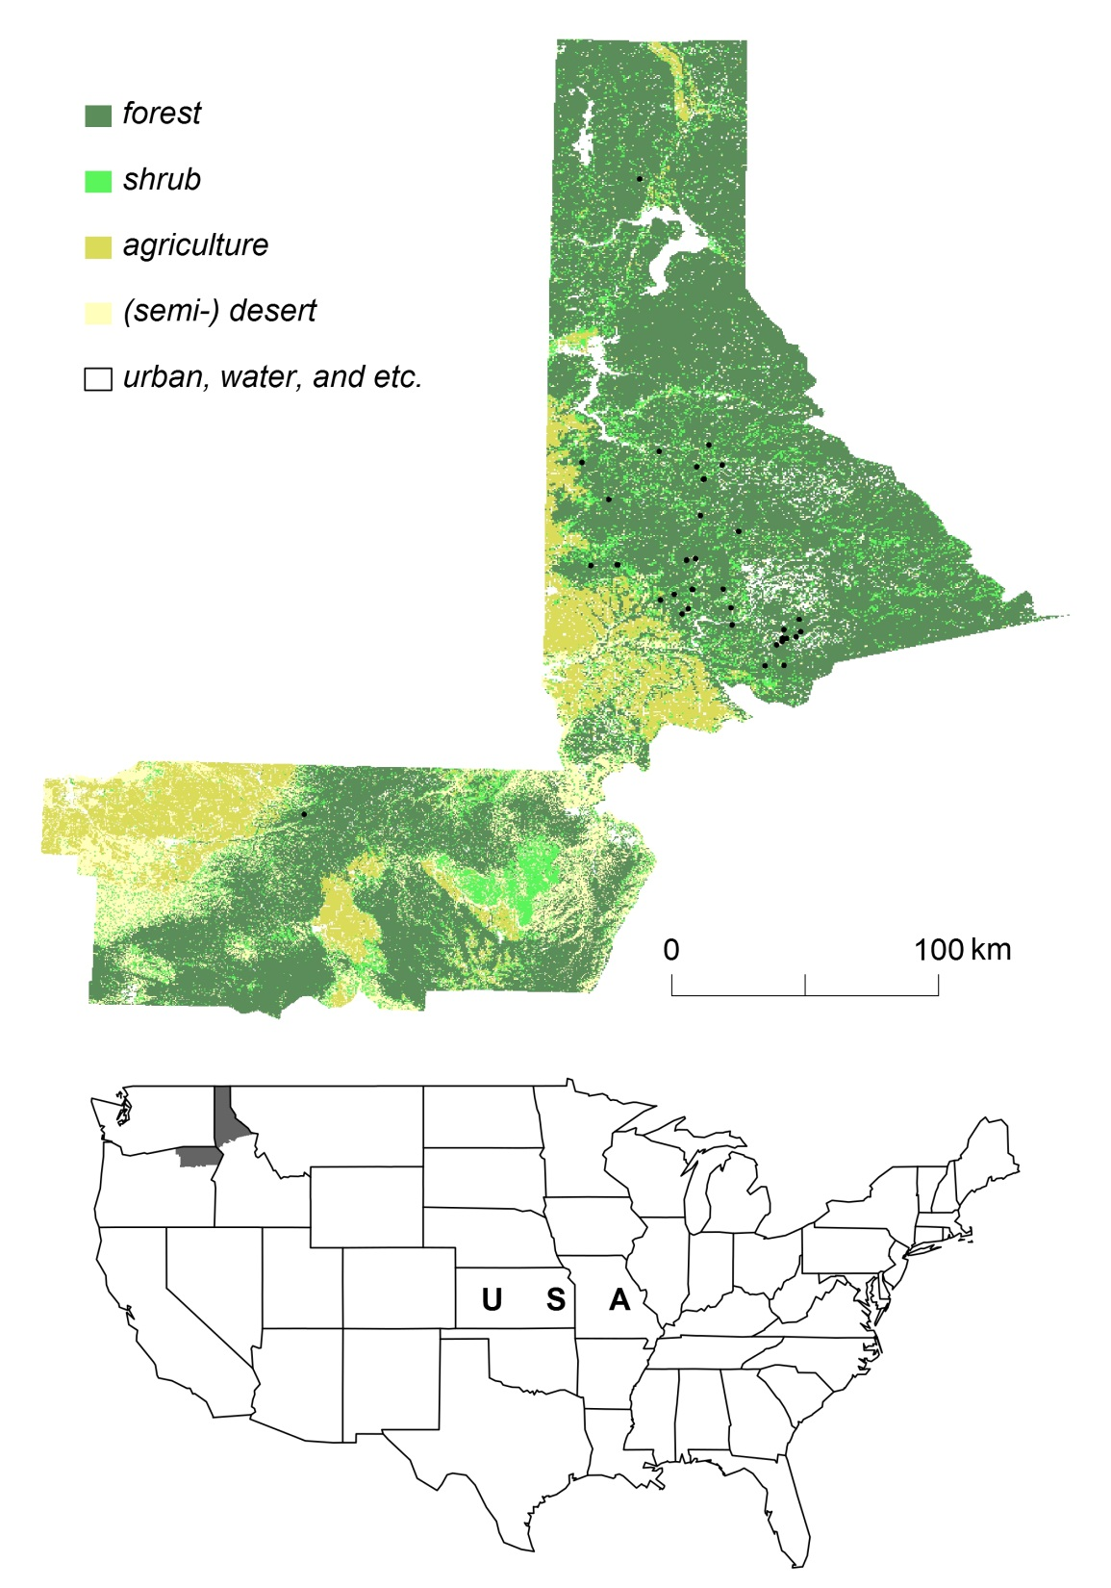
Methods
Study area,
land cover, and sample plots
50 plots
15,000+ seedlings
annual measurements since 2016
Center for Advanced Forestry Systems 2020 Meeting

Slide 6
measurements of seedlings
Methods
vegetation cover
soil
species-specific annual seedling growth and mortality
weather
topography
nursery and seedlot
container
Center for Advanced Forestry Systems 2020 Meeting

Slide 7
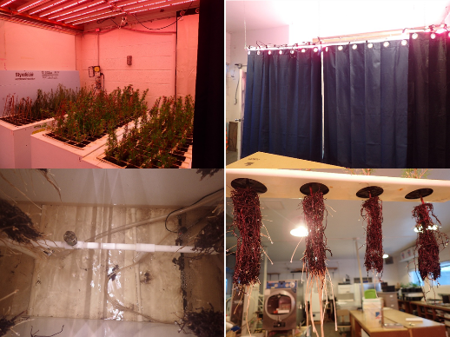
Methods
Data: diameter, height, and root growth potential
Root growth potential was expressed as average number of new white roots ≥ 1 cm long produced by a seedlot.
Assesses seedling vitality (free of disease, injury, or stress).
Center for Advanced Forestry Systems 2020 Meeting

Slide 8
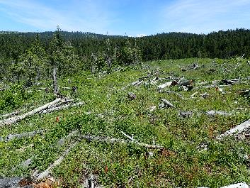
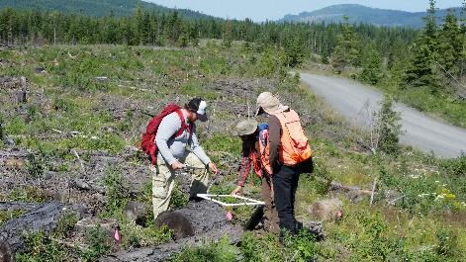
Methods
Data: competition
Competition Variable | Western Larch | Douglas-fir
 | Mean (Range)
Forb (%) | 12.2 (0 – 100) | 18.0 (0 – 100)
Shrub (%) | 3.4 (0 – 100) | 7.5 (0 – 90)
Grass (%) | 1.9 (0 – 100) | 3.4 (0 – 90)
Slash (%) | 27.4 (0 – 100) | 22.7 (0 – 100)
Center for Advanced Forestry Systems 2020 Meeting

Slide 9
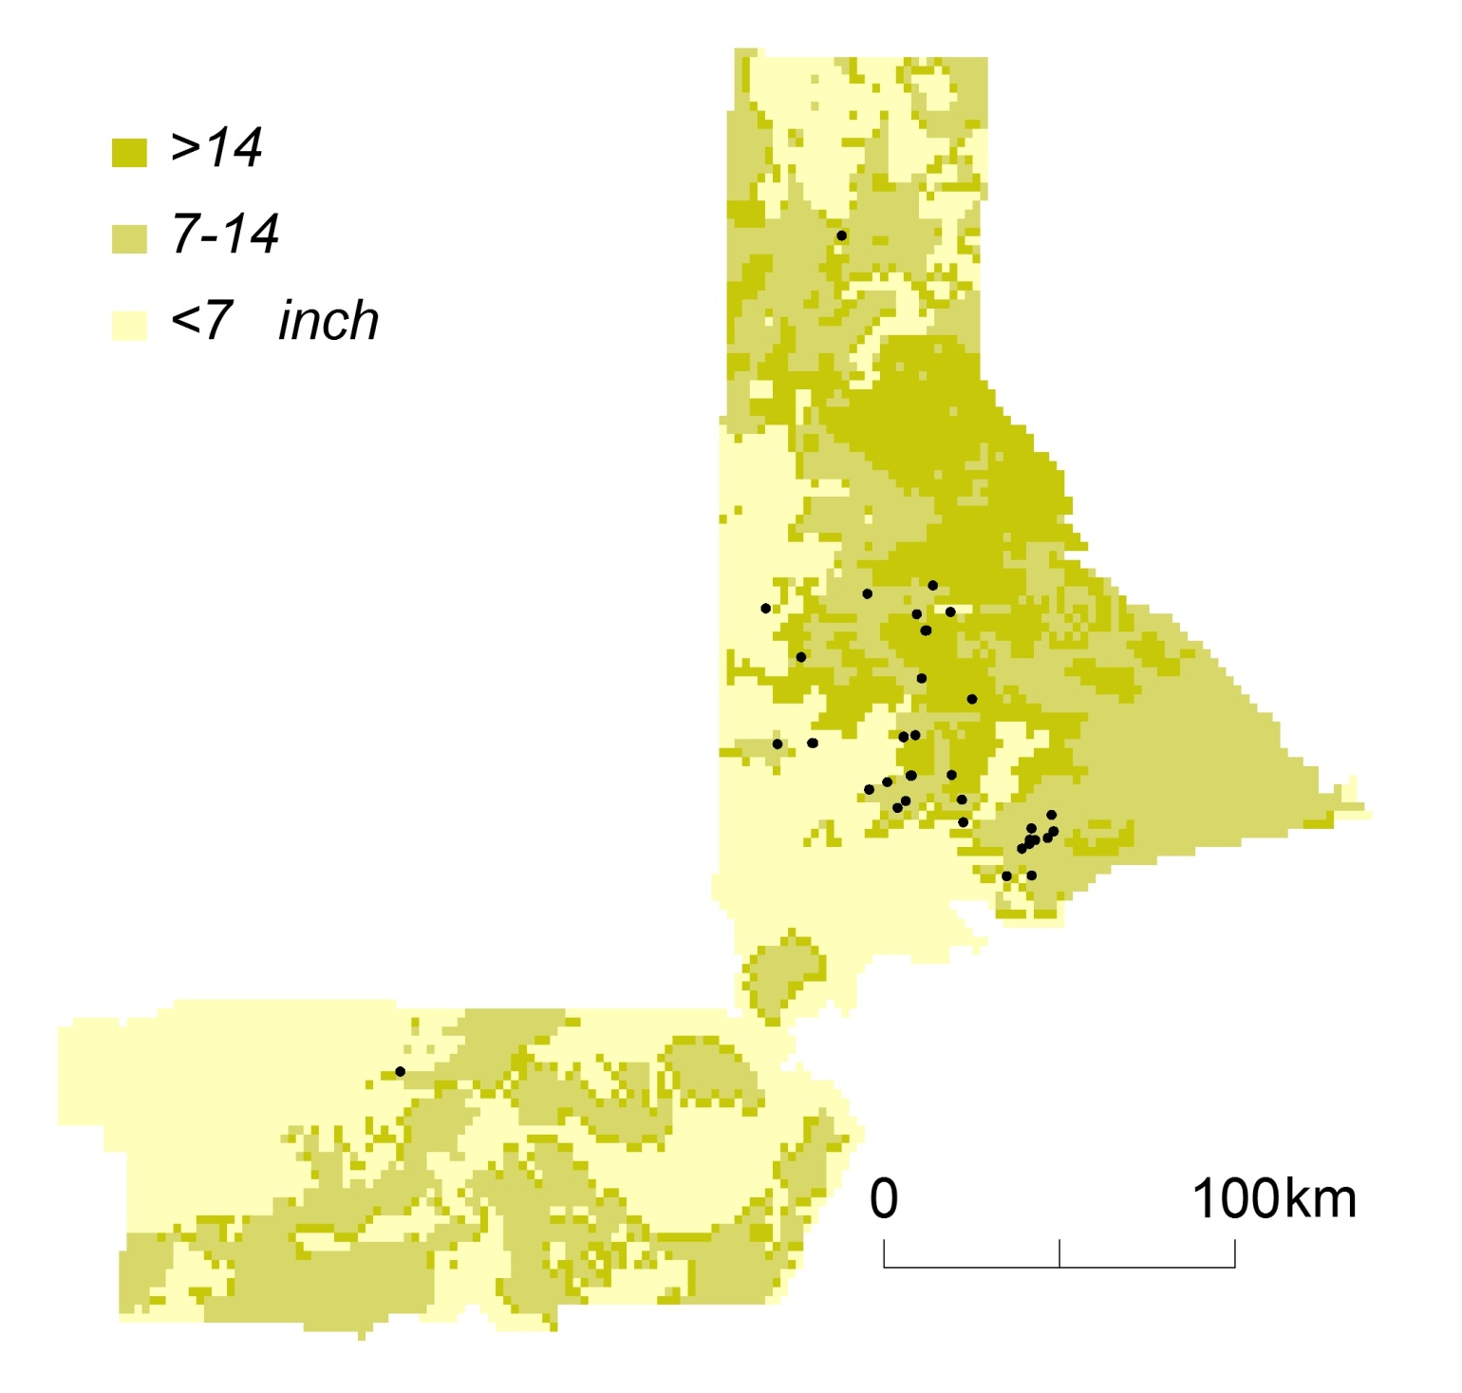
Methods
Data: ash cap depth
and parent material
Center for Advanced Forestry Systems 2020 Meeting

Slide 10
Methods
Data
Daily observations of precipitation, snow depth, and min., max., and average temperature from 98 stations located in the study area interpolated to sample plots.
30-meter resolution elevation data from the Idaho Geospatial Office used to derive elevation, slope, and aspect at sample plots.
Information of nursery, seedlot, and container.
Center for Advanced Forestry Systems 2020 Meeting

Slide 11
Major Findings
Mortality varied greatly among seedlings, while less variability was observed in growth.
Mortality of Douglas-fir (3.7%) was lower than that of western larch (5.3%) in the 1st year, but two-year totals were similar between the two species (~11%).
Both mortality and growth were greater for seedlings from genetically superior seed orchards compared to wild collected, but gains in growth were small in size.
Mortality was understandably lower for seedlings with larger containerized rooting volume (220-250 ml), but their growth also was lower.
Center for Advanced Forestry Systems 2020 Meeting

Slide 12
Major Findings
Root growth potential was not found to be significantly related to seedling growth and mortality. It may be more influential on poorer quality sites. Competing vegetation had a similarly small effect probably due to chemical preparation.
Temperature and precipitation played imperative roles in seedling growth and mortality. Greater precipitation greatly improved both diameter and height growth, while increased number of precipitation days lowered both growth and mortality.
Mortality varied greatly across nurseries and seedlots (between 0 and 15.7%)
Center for Advanced Forestry Systems 2020 Meeting

Slide 13
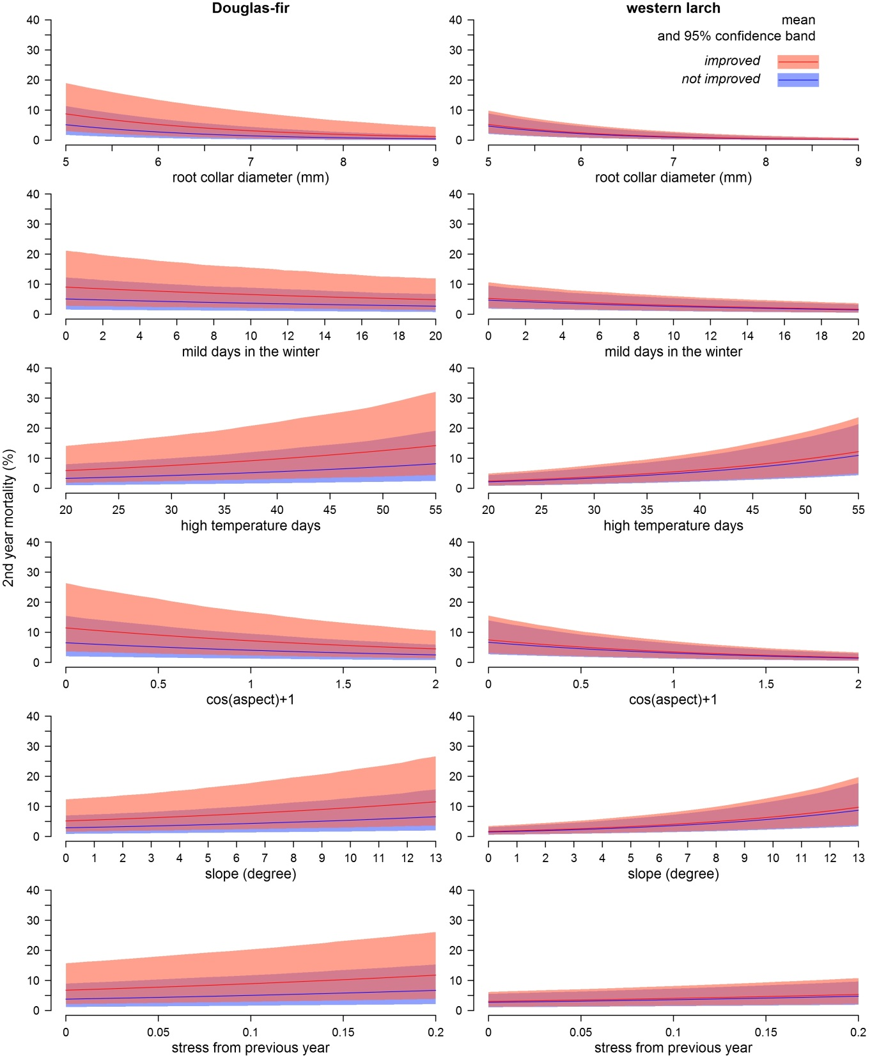
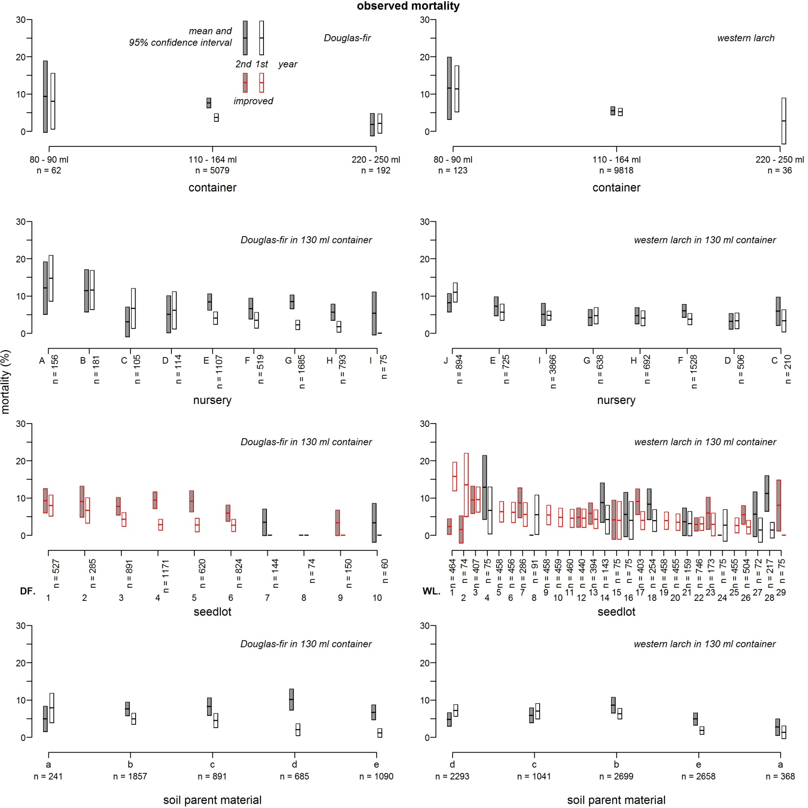
Major Findings
Effects of container size, nursery, seedlot, genetic improvement, and soil parent material on observed mortality
Predicted
2nd year mortality
Center for Advanced Forestry Systems 2020 Meeting

Slide 14
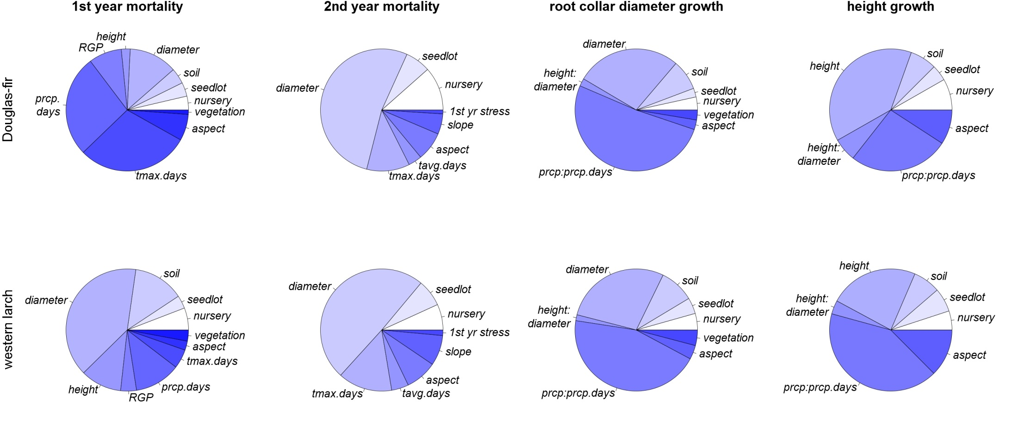
Relative importance of various factors
Center for Advanced Forestry Systems 2020 Meeting

Slide 15
Deliverables
Publication
Chen, C. and Nelson, A. In review. Growth and mortality of planted interior Douglas-fir and western larch seedlings during the establishment phase in Idaho, USA. Submitted to Forest Ecology and Management.
Presentation
Chen, C. and Nelson, A. 2020. Early growth and mortality of planted interior Douglas-fir and western larch seedlings. Intermountain Forestry Cooperative annual meeting.
Center for Advanced Forestry Systems 2020 Meeting

Slide 16
Company Benefits
Companies may use the developed models to extend individual tree growth and yield models' ability to forecast seedlings during and after establishment, and consequently allow these models' applicability to full rotations.
Inform companies of the significant effects of seedling quality and potential trade-off of improvements on reforestation success, in addition to site and environmental conditions.
Companies may use information provided by this study to inform reforestation objectives and long-term management goals for the region that is seeing rapid increases in tree planting.
Center for Advanced Forestry Systems 2020 Meeting

Slide 17
Recommendations
The effects of nursery, seedlot, soil, and genetic improvement are less addressed in previous studies, but all have contributed to the high stochasticity in seedling growth and mortality.
Both mortality and growth were greater for seedlings from genetically superior seed orchards compared to those from wild collected sources.
Future planning of planting should consider variabilities of seedlings of various origins, while evaluations of potential gains from genetic improvement probably should also take into consideration the effect of improvement on mortality.
Center for Advanced Forestry Systems 2020 Meeting

Slide 18
Summary
The developed seedling models readily fit into the architecture of current individual tree growth and yield models, which extend these models' ability to forecast seedlings during and after establishment.
The identified influential factors and specific differences in seedling growth and mortality during the establishment phase provide critical information and guidance to the increasingly important reforestation practice of planting.
The overall analytical framework presented in this analysis is generally applicable to species beyond Douglas-fir and western larch.
Center for Advanced Forestry Systems 2020 Meeting

