Slide 1
Center for Advanced Forestry
Systems (CAFS) Phase III

Slide 2
Agenda
Vision and Strategic Plan
Plans Phase III
Future role of CAFS
Current Project Updates
Open Discussion
CAFS materials available online:
https://crsf.umaine.edu/forest-research/cafs/

Slide 3
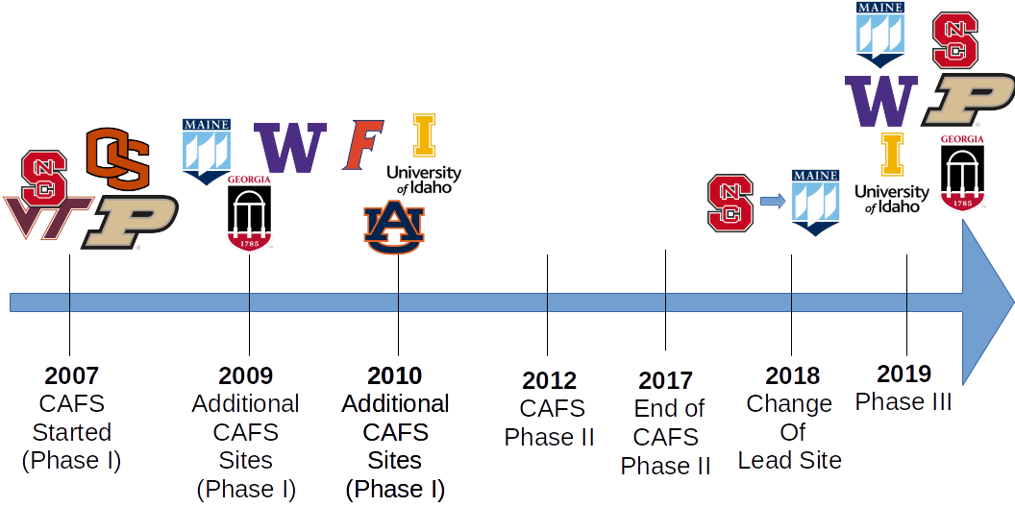
CAFS History

Slide 4
Vision
Support the US forest industry by solving problems with targeted, applied, and collaborative research coordinated across multiple universities

Slide 5
Phase III

Slide 6
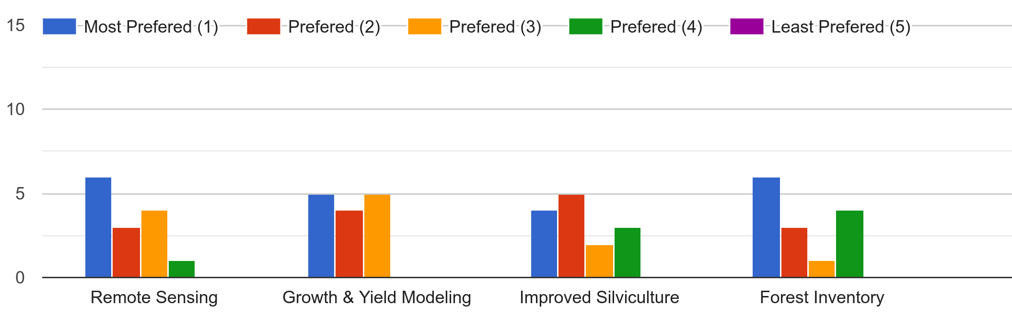
Phase III Member Survey
Broad interests across key focal areas with forest health being an additional potential item

Slide 7
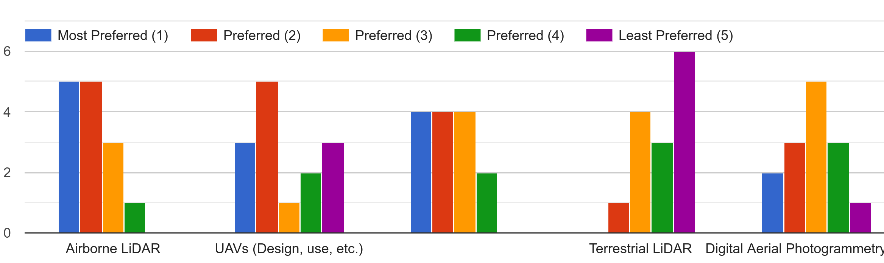
Phase III Member Survey (Remote Sensing)
Satellites
Strong interest in airborne LiDAR & satellites

Slide 8
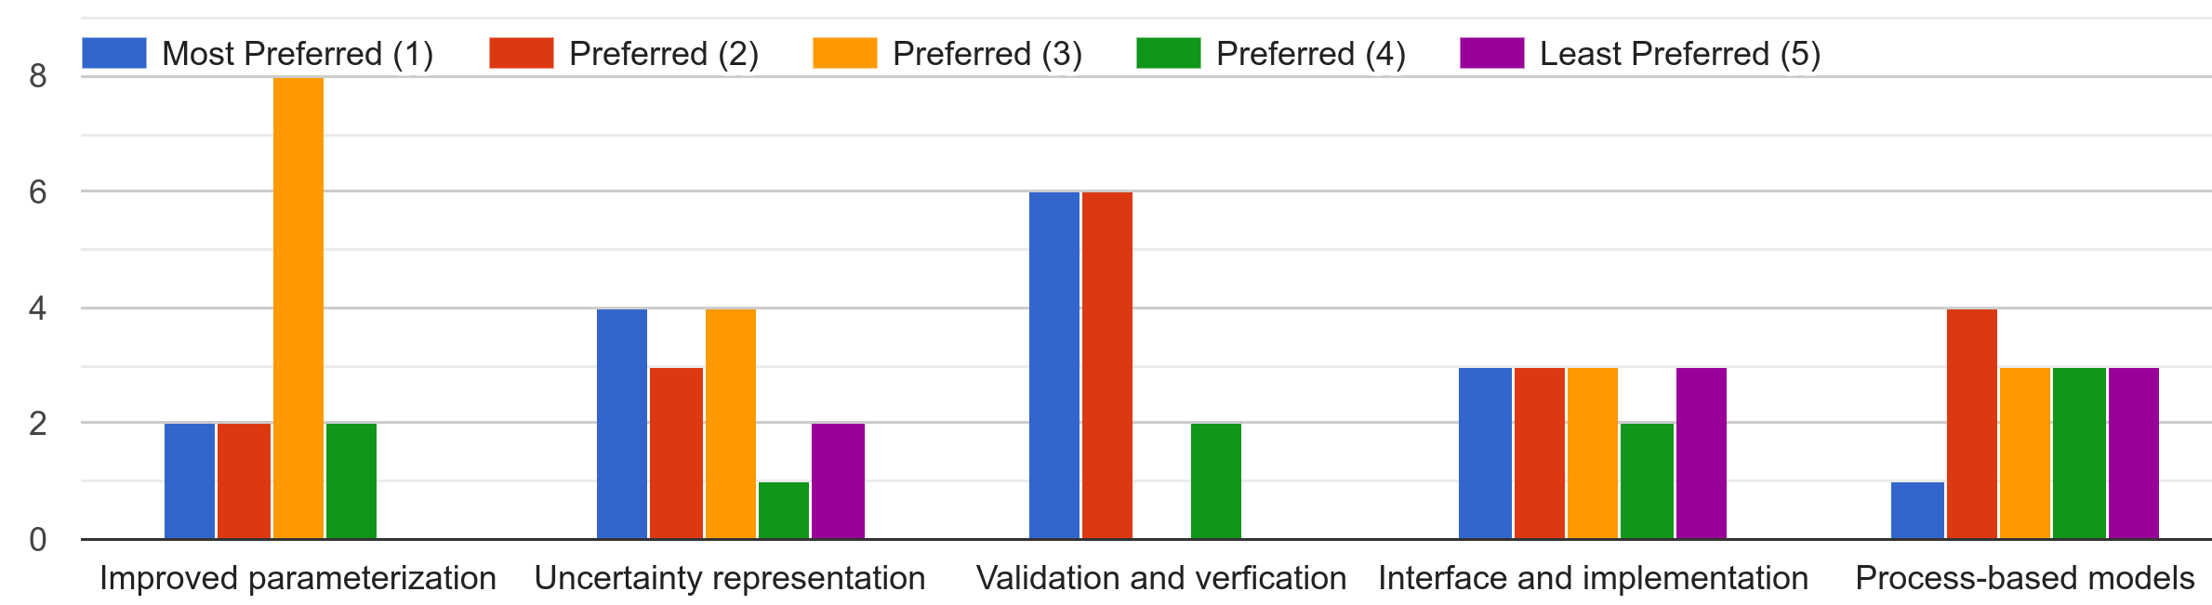
Phase III Member Survey (Growth & Yield Modeling)
Validation and verification of existing GY models was a key priority

Slide 9
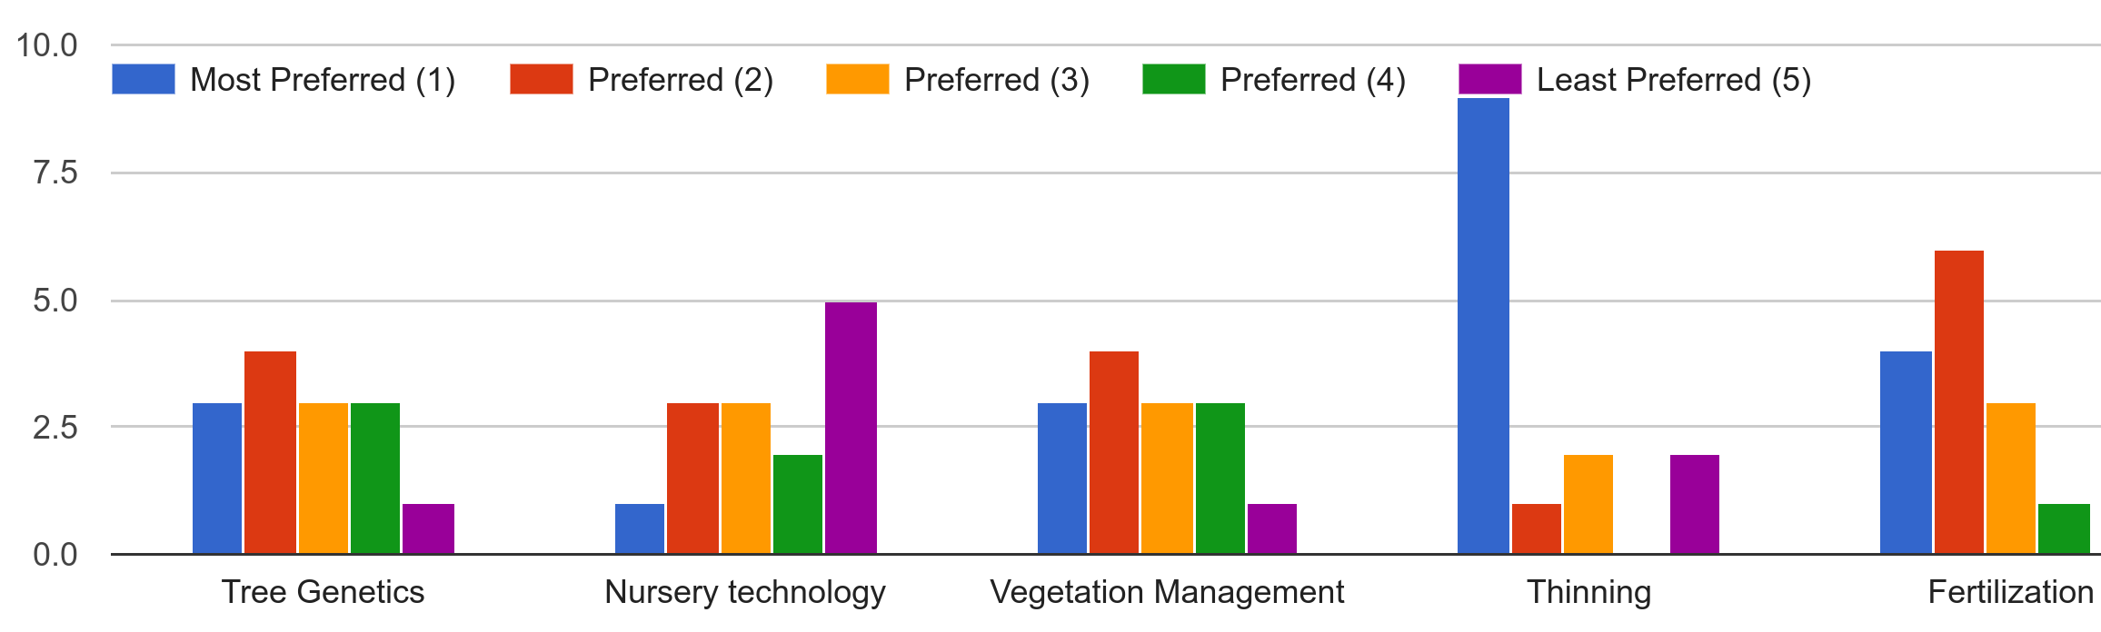
Phase III Member Survey (Silviculture)
Strong support for continued focus on thinning

Slide 10
Phase III Member Survey (Forest Inventory)
Linkages to remote sensing and site productivity assessment top priorities

Slide 11
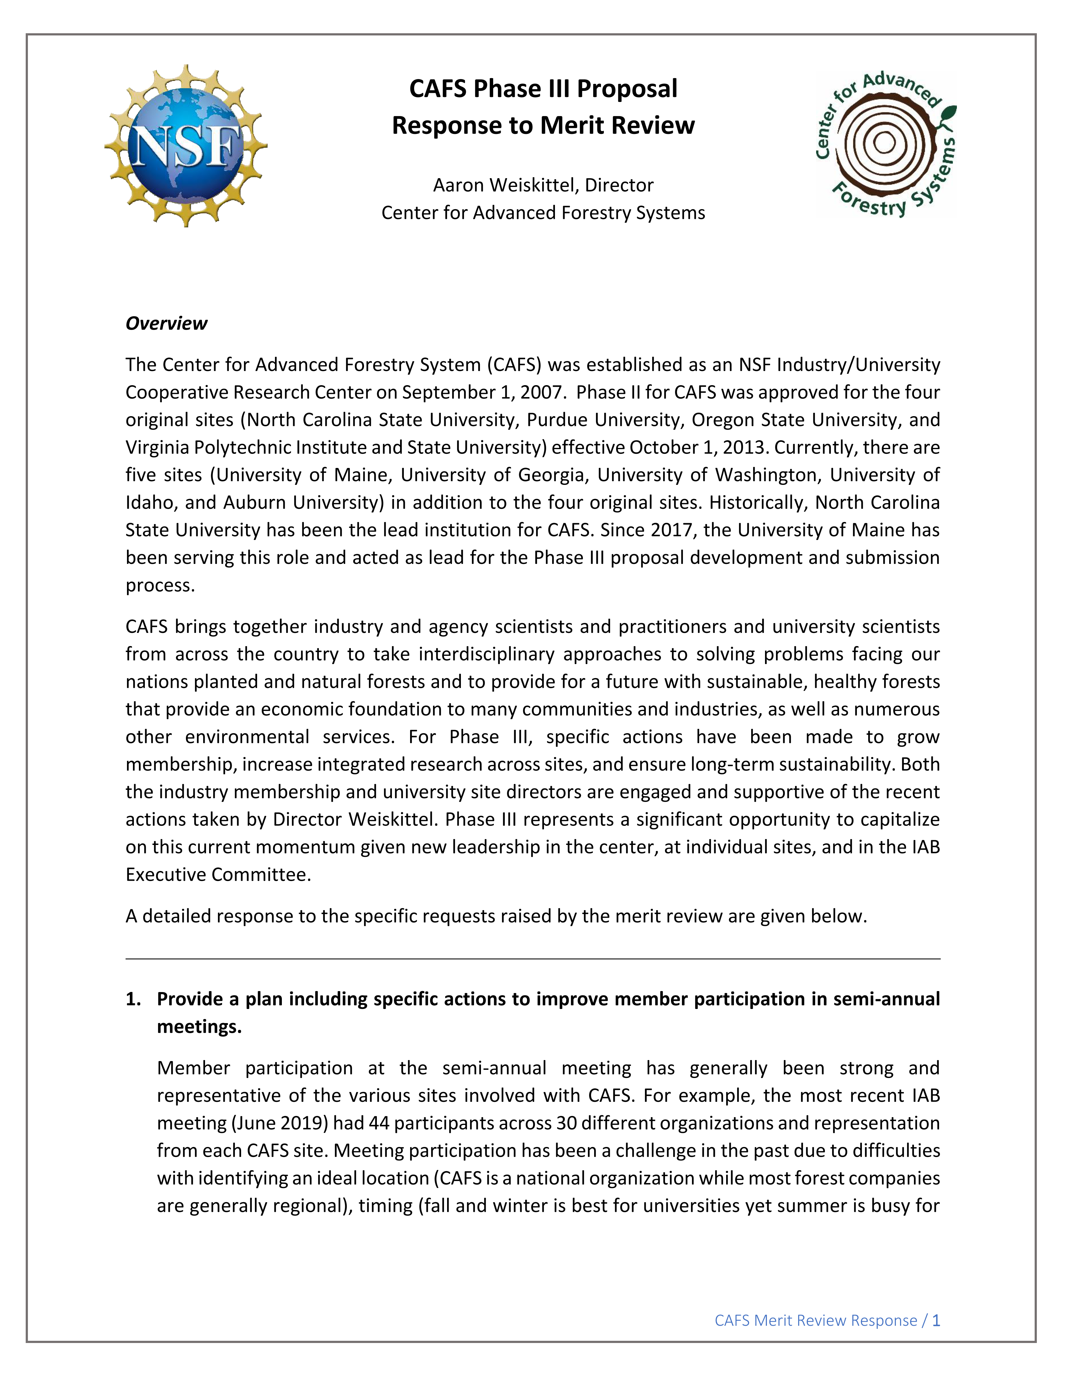
Phase III Proposals
Phase III proposals likely approved by NSF in coming weeks
Provide another 5-years of funding from NSF assuming membership requirements are maintained
$85-100k/yr per site
Can leverage other NSF programs if successful
REU
INTERN
New NSF Program Manager
Greg Reed <gregreed@nsf.gov>

Slide 12
Phase III Merit Review
Provide a plan including specific actions to improve member participation in semi-annual meetings.
The center management should discuss and if appropriate elaborate a plan to grow the number of faculty PIs at the sites where only 1 PI is today involved in the center.
Develop center-wide policies/action to better balance membership across all sites.
Provide a summary table with all Center outcomes including organized by Site including specific technology highlights that will facilitate the intellectual merit evaluation.
Provide a summary table of all Faculty and PIs in the Center and the number of projects that each one of them is involved (organized by Site).
Develop a clear plan including specific tasks to ensure the sustainability of such successful center after NSF support ends. Consider involving the universities management on such development.

Slide 13
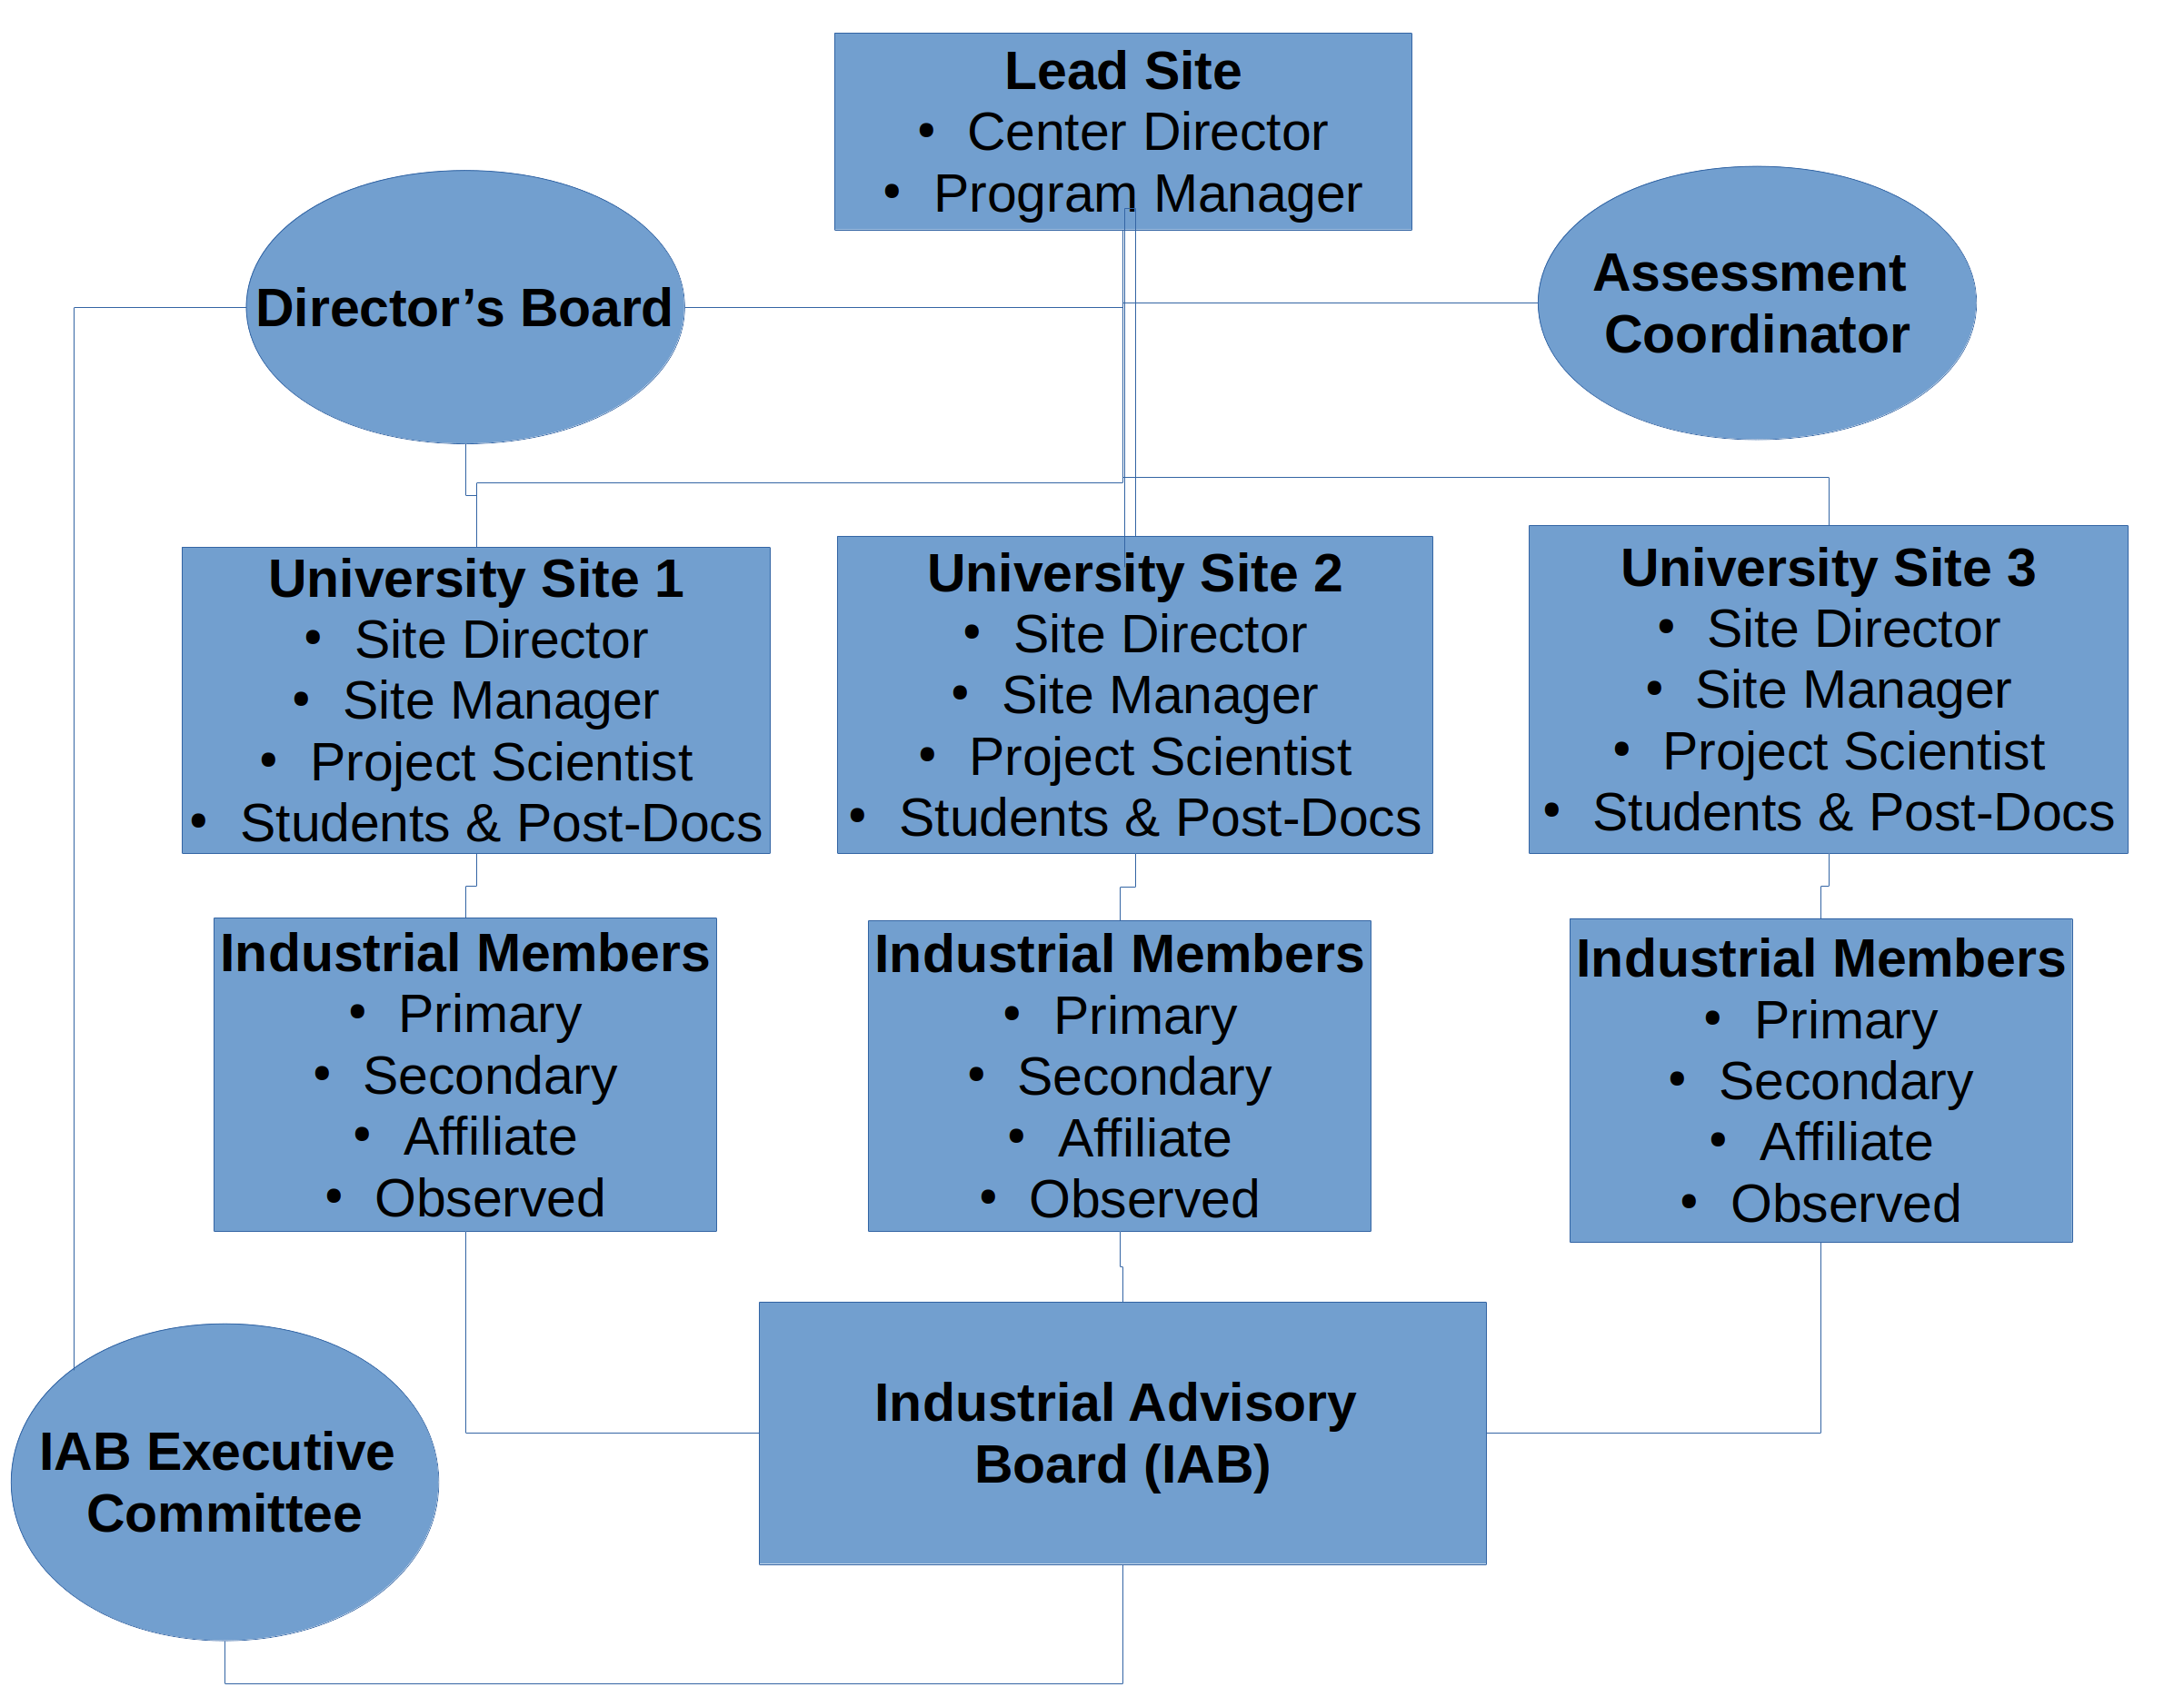
General Center Organization

Slide 14
IAB Executive Committee
1 Industry Member Representative from Each Site

Slide 15
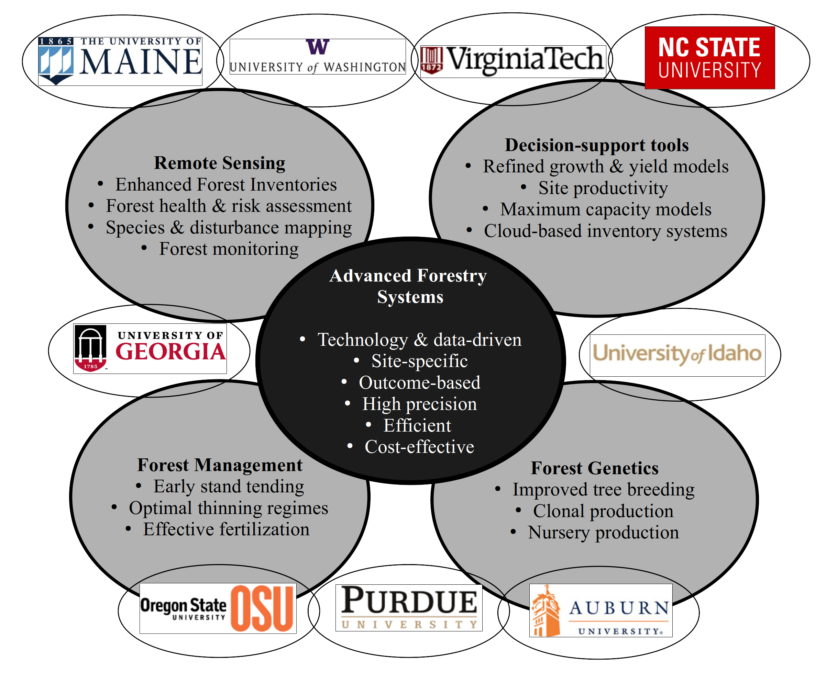
Research Focal Area

Slide 16
University Sites
University | Director | Expertise
North Carolina State University (NCSU) | Rachel Cook | Forest soils, pine plantation management, productivity modeling
Oregon State University (OSU) | Jeff Hatten/Doug Maguire/Carlos Gonzalez | Douglas-fir plantation management, growth and yield modeling, genetics, remote sensing
Purdue University (PU) | Doug Jacobs | Genetics, central hardwoods management, nursery technology
University of Georgia (UGA) | Cristian Montes/Bronson Bullock | Genetics, pine plantation management, wood quality, remote sensing, growth and yield modeling
University of Idaho (UI) | Mark Coleman/Andrew Nelson | Mixed-species management, natural regeneration, productivity modeling, remote sensing
University of Maine (UM; lead site) | Aaron Weiskittel | Mixed-species management, natural regeneration, growth and yield modeling, remote sensing
University of Washington (UW) | Eric Turnblom | Douglas-fir plantation management, wood quality, remote sensing, productivity modeling

Slide 17
Membership
Membership Type | Membership Fee | Vote | IP Property Access
Primary | $25,000/yr | 10 votes per membership | Yes
Secondary | $10,000/yr | 5 votes per membership | Upon Approval
Affiliate | $5,000/yr | 0 | No
Observer | In-kind (<$10,000k) | 0 | No
Phase III requires each site to have >$250k/yr in membership dues with at least 5 distinct primary members

Slide 18
Members
Membership | NCSU | OSU | PU | UGA | UI | UM | UW | VT | Total
Primary | 5 | 4 | 8 | 2 | 8 | 7 | 8 | 8 | 50
Secondary | 5 | 14 | 0 | 19 | 2 | 8 | 12 | 12 | 88
Affiliate | 3 | 0 | 2 | 0 | 0 | 2 | 0 | 3 | 14
Total | 13 | 18 | 10 | 21 | 10 | 17 | 20 | 23 | 152
Diversified membership with strong variation across sites due to the regional and highly specific nature of the forest industry as well as land ownership partners

Slide 19
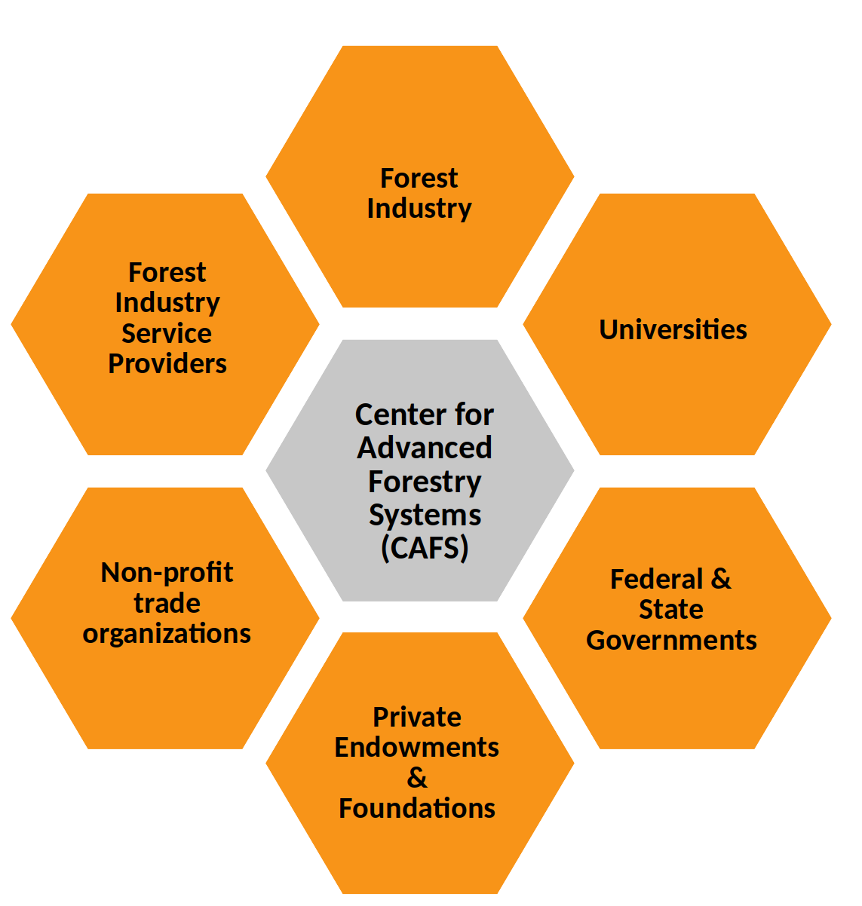
Potential Future Partners
Non-profit trade organizations
National Council of Air & Stream Improvement
American Forest Foundation
Sustainable Forestry Initiative
Climate Action Reserve
Private Endowments & Foundations
U.S. Endowment for Forestry & Communities, Inc.
Service Providers
ESRI Inc.
Sanborn
SilviaTerra
LimGeomatics

Slide 20
CAFS & NCASI
In-kind partner
Serve on IAB
Provide input on projects
Assist with sustainability
Help to communicate value
Financial management

Slide 21
Improving the Current State of Forestry R&D
Forest Industry
Local & Regional
Applied Research
Sustainable &
Thriving
Forest-Economy
National Applied
Research
Desired Outcomes
Synergistic partnerships
Leverage of key resources and expertise
Increased investment in forests including R&D
More integrated and effective messaging
Improved coordination across the sector
Recognition of the broader importance of forests

Slide 22
Sustainability
Multi-faceted approach to future sustainability
Continue to recruit new members, particularly foundations
Seek private support
Federal research grants and contracts
Explore international memberships and partnerships
Direct site contributions

Slide 23
Phase III Timeline & Milestones
Milestone | Fiscal Year
 | 18-19 | 19-20 | 20-21 | 21-22 | 22-23
Apply for & secure NSF Phase III funding
Approve bylaws, strategic plan, & technology roadmap
Initiate research projects identified on technology roadmap
Revise and refine bylaws, strategic plan, & technology roadmap
Secure additional partners including industry, academia, and non-profit sectors.
Integrate center research and education activities that effectively train and benefit undergraduate and graduate students
Survey, document, and prioritize industry member research needs
Plan and host biannual meetings
Annually report progress, outcomes, and finances

Slide 26
IAB Meeting
In-person
June 9-10, 2020
Indoor + field tour
Potential joint meeting with NCASI?
Salish Lodge, WA

Slide 27
Current Projects Updates
8 Current Projects with All Sites Having Involvement on At Least 1 Project

Slide 28
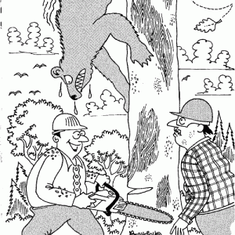
Questions/Comments?
aaron.weiskittel@maine.edu
207-581-2857
https://crsf.umaine.edu/forest-research/cafs/

