Slide 1
Proposal
Stem form of Nitrogen-fertilized
Douglas-fir trees
CAFS.21.86
Doug Mainwaring, Oregon State University
Kim Littke, University of Washington
Eric Turnblom, University of Washington
Aaron Weiskittel, University of Maine
Sukhyun Joo, Oregon State University
Carlos Gonzalez, Oregon State University
Center for Advanced Forestry Systems 2021 Meeting
Notes:
1

Slide 2
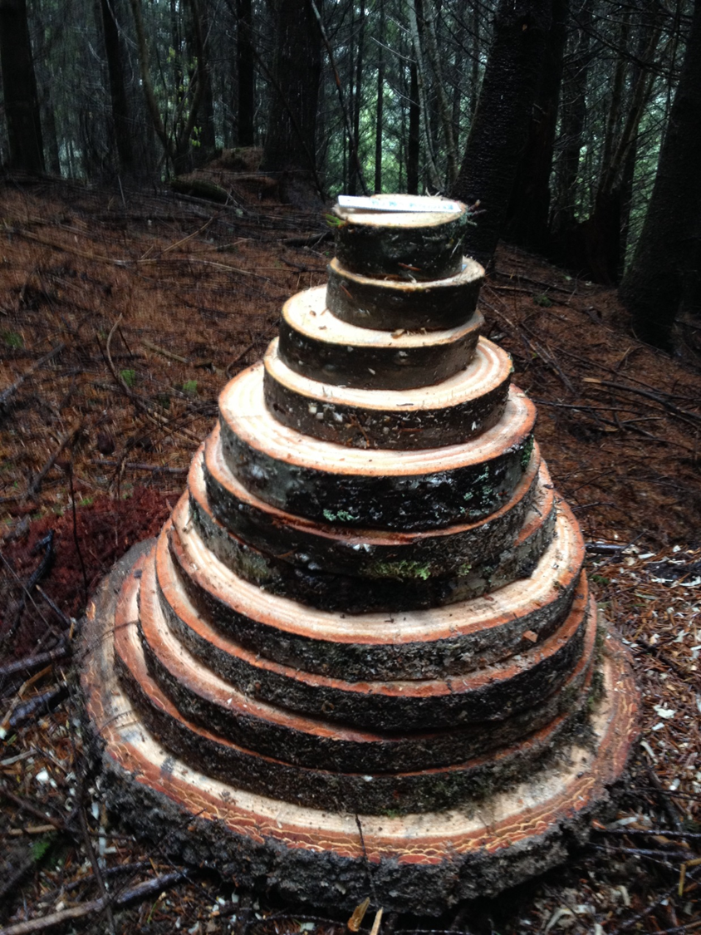
Justification
Fertilization associated with changes to amount and distribution of foliage
Assessment of volume response of Douglas-fir to fertilization are typically based on measurements of Dbh and height
Log volume and final yield based on the size of the scaling diameter
Previous analyses of fertilization effects on stem form are mixed
Assessments of N-fert on Douglas-fir stem form best based on experiments most closely simulating operational conditions
Center for Advanced Forestry Systems 2021 Meeting

Slide 3
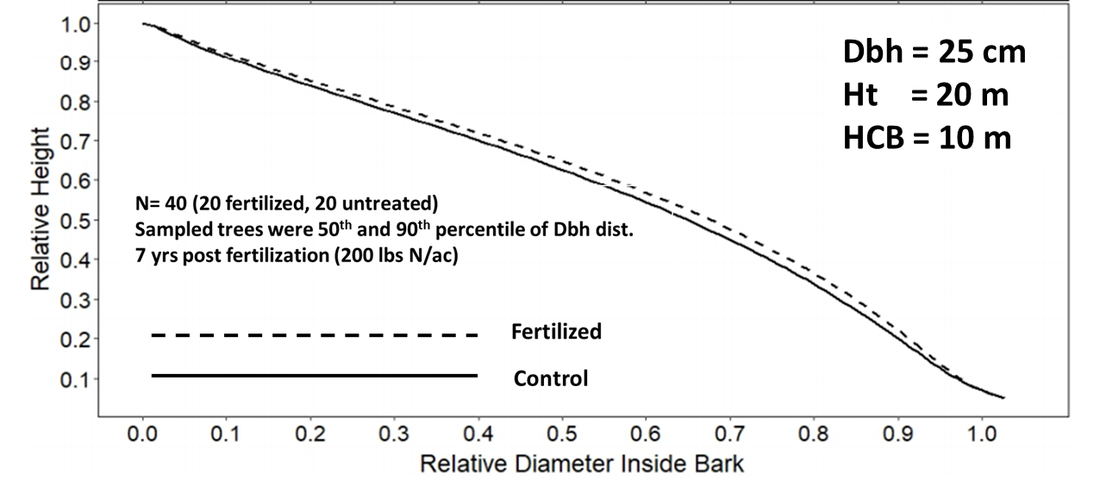
Justification
Recent analysis of taper on 7-yr post fertilization dataset (initial plantation age: 16-25 yrs; SI₅₀: 105-142 ft) found significant effect of fertilization on Douglas-fir upper stem diameters
Fit with Kozak (2004) taper equation, with indicator variable accounting for fertilization
Center for Advanced Forestry Systems 2021 Meeting

Slide 4
Justification
Application of study taper equation to study treelists (7 yrs post-fert) was made with and without fert indicator to assess fertilization differences in BF vol.
Table shows estimated per acre volume difference from use of fertilization indicator
Center for Advanced Forestry Systems 2021 Meeting

Slide 5
Justification
Determination of a stem form response to fertilization would:
Provide a more comprehensive and accurate volume response to fertilization
Improve the ability to determine the financial benefit gained by treatment
Improve the ability to assess where fertilization would be appropriate
Clarify the role of stand density relative to response
Center for Advanced Forestry Systems 2021 Meeting

Slide 6
Hypotheses or Objectives
Upper stem diameters of trees responding positively to operational nitrogen fertilization are under-estimated relative to Dbh using standard taper equations.
Objective will be to construct a taper modifier equation to adjust upper stem diameter estimates of standard taper equations when applied in Douglas-fir stands fertilized with nitrogen.
Center for Advanced Forestry Systems 2021 Meeting

Slide 7
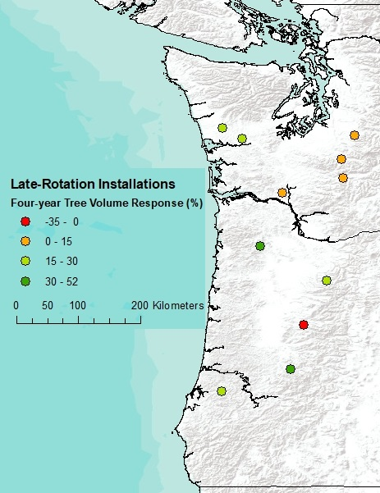
Methods
SMC late-rotation Fertilizer trials
First wave installed in 2017
Located based on potential N response
(Littke et al. 2017)
Ages: 30-50 yrs
Fertilized 8-10 yrs prior to final harvest
5-yrs post-fertilization
Sampled sites chosen based on positive response, dominant height
Center for Advanced Forestry Systems 2021 Meeting

Slide 8
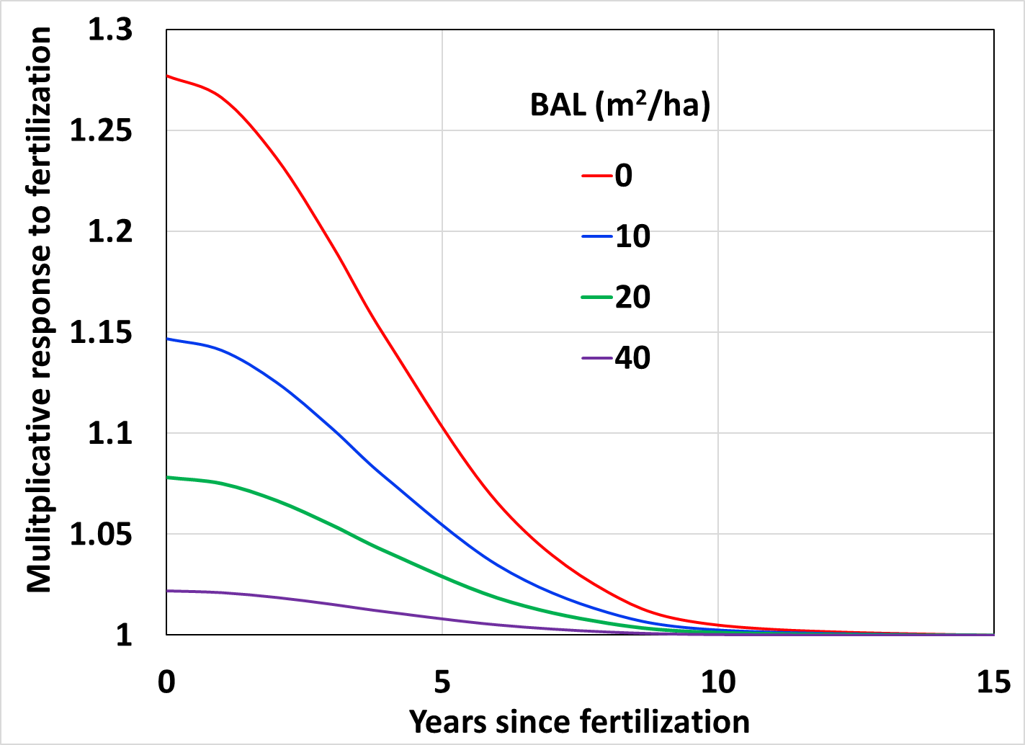
Methods
On six responding installations:
Climb 10 trees per treatment with ladders, chosen based on dbh distribution:
20th percentile (2 trees)
40th percentile (2 trees)
60th percentile (3 trees)
80th percentile (3 trees)
Measure DOB at:
0.3 m
1.37 m
every mid-whorl up to 25.2 m or 10 cm DOB
Center for Advanced Forestry Systems 2021 Meeting

Slide 9
Timeline
Fall 2021: Field sampling
Winter/spring 2021-2022: Statistical analysis
Summer 2022: Final report
Center for Advanced Forestry Systems 2021 Meeting

Slide 10
Deliverables
Dataset of measurements
Report with final models describing stem form, accounting for the effect of fertilization
Public presentation of findings at CAFS Annual Meeting and regional Coop meetings
Draft manuscript for peer-reviewed journal
Center for Advanced Forestry Systems 2021 Meeting

Slide 11
Company Benefits
Model adjusting stem form for sites responsive to nitrogen fertilization
Improved assessment of volume/financial benefit of fertilization
Improved understanding of the role of stand density in fertilization
Incorporation of results into regional growth models
Center for Advanced Forestry Systems 2021 Meeting

Slide 12
Projected Budget
Field sampling (2 people, 15 days) ($9750)
Travel, lodging, sustenance ($2950)
Equipment ($300)
Total: ($13,000)
Center for Advanced Forestry Systems 2021 Meeting

