Slide 1
New Project
Variation in productivity, wood quality and soil carbon of nine conifer species across a gradient in water deficit
CAFS.21.85
Carlos Gonzalez (OSU), Kim Littke (UW), Jeff Hatten (OSU), Doug Mainwaring (OSU), Maxwell Wightman (OSU), Aaron Weiskittel (UM)
Presenter: Carlos Gonzalez (OSU)
Center for Advanced Forestry Systems 2021 Meeting
Notes:
1

Slide 2
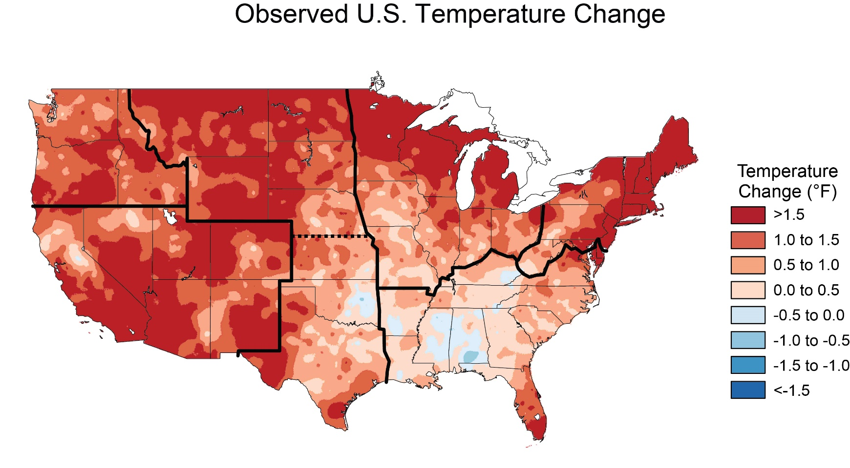
Justification
Climate change is expected to increase average temperatures and shift precipitation regimes, contributing to more severe and widespread disturbances
Change between 1991 - 2012
U.S. Drought Monitor
Center for Advanced Forestry Systems 2021 Meeting

Slide 3
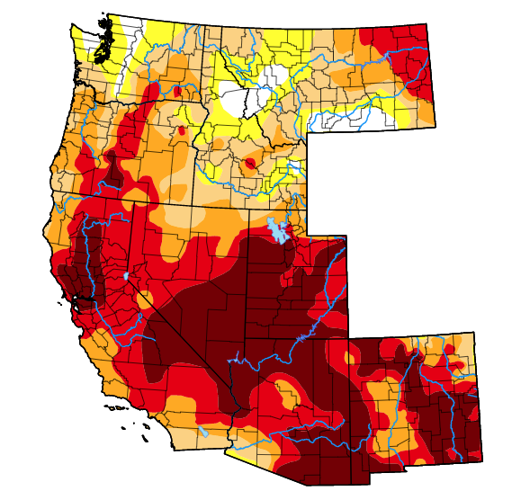
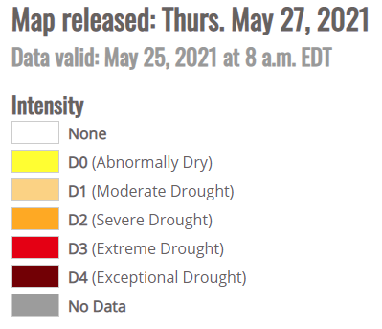
Justification
The higher evapotranspiration demands and the potential increase in water deficit can be detrimental to the growth and survival of tree species in the PNW.
U.S. Drought Monitor
Center for Advanced Forestry Systems 2021 Meeting

Slide 4
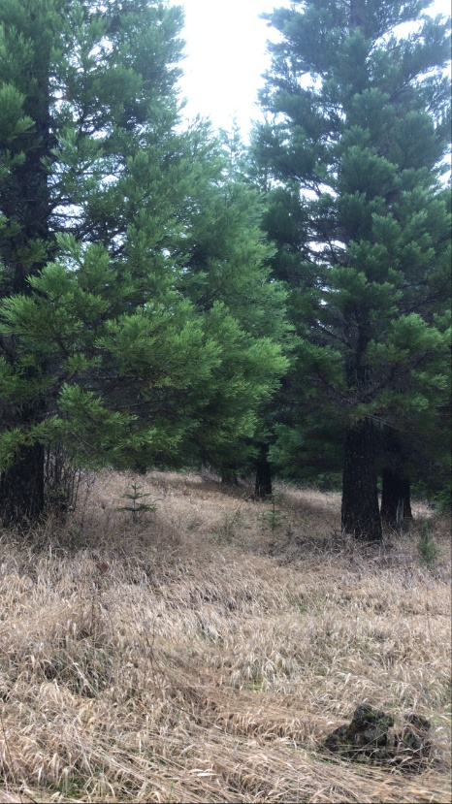
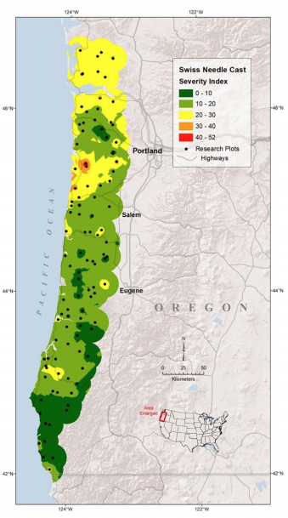
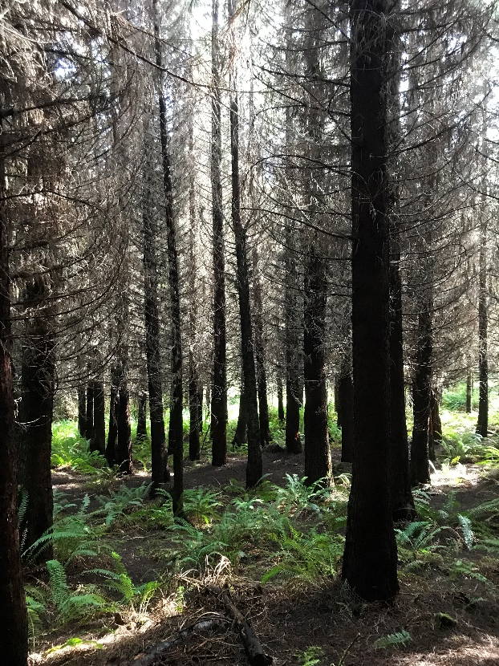
Justification
Understanding how commercially and ecologically valuable species are sensitive to climate can help to guide species selection and management decisions to enhance stand resistance and resilience to projected climate changes.
Swiss Needle Cast
Center for Advanced Forestry Systems 2021 Meeting

Slide 5
Hypotheses or Objectives
For 9 species, across a water deficit gradient in Western Oregon.
Measure and compare the cumulative and inter-annual diameter growth and wood density.
2) Measure and compare LAI and aboveground biomass.
3) Measure and compare soil organic matter and nutrient pools.
4) Correlate environmental factors with radial growth and wood density.
5) Correlate environmental factors with NPP, intercepted radiation, LAI and soil OM.
Center for Advanced Forestry Systems 2021 Meeting

Slide 6
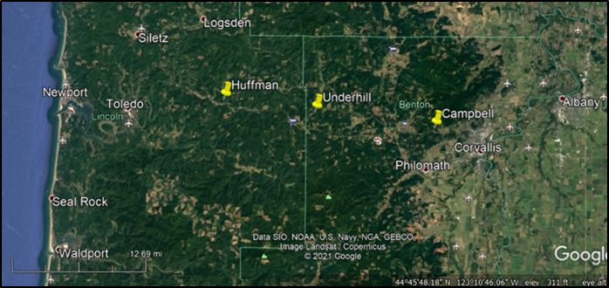
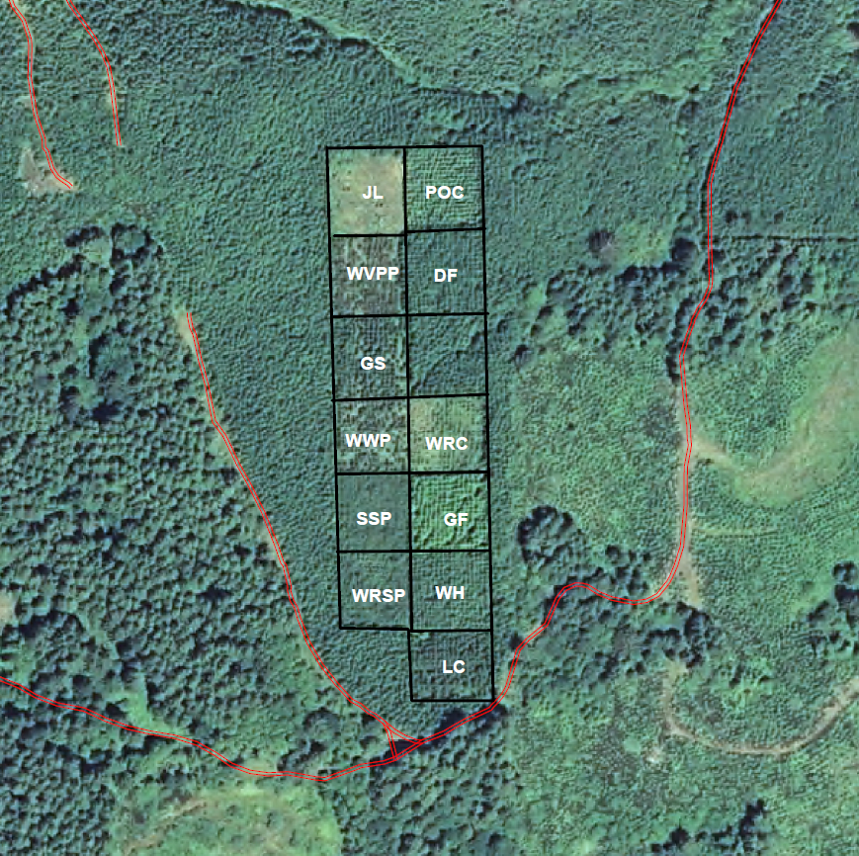
Methods
A species comparison study was installed in 1996 by Starker Forests.
Nine native and non-native conifer species were planted in three sites along a water deficit gradient from the western Coast Range to the Willamette Valley of western Oregon.
Wet
Intermediate
Dry
DF | Douglas-fir
GF | Grand fir
GS | Giant sequoia
POC | Port Orford cedar
PP | Ponderosa pine (Willamette Valley )
SSP | Sitka spruce
WH | Western hemlock
WRC | Western red cedar
WWP | Western white pine (Blister Rust Resistant)
Wet Site
0.5 acre plots
Center for Advanced Forestry Systems 2021 Meeting

Slide 7
Methods
Sites weather 1996-2010
2200 mm
1600 mm
1200 mm
Rain
VPD
Wet
Intrmediate
Source: PRISM
Dry
Center for Advanced Forestry Systems 2021 Meeting

Slide 8
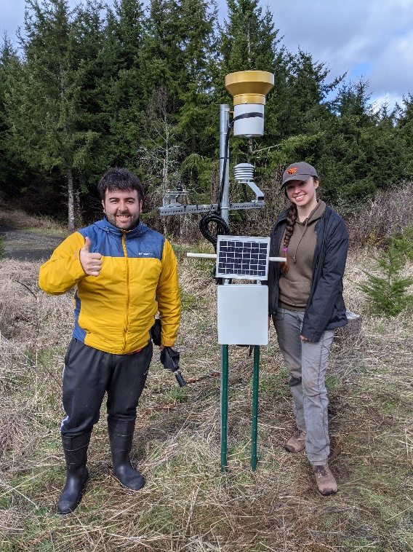
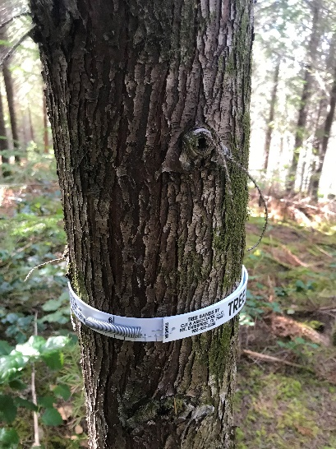
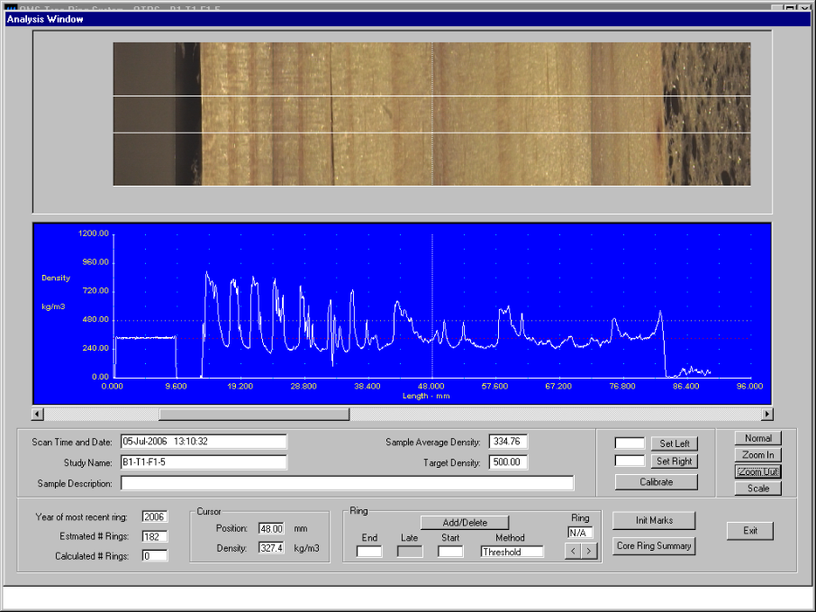
Methods
2 MS students already started working on this project: Emily Von Blon and Erkan Babat
Install measurement plots and tag trees: Done (J-F 2021).
Install Weather Stations: Done (M 2021)
3) Initial Inventory (DBH, HT): Done (J-F 2021)
4) Select 10 trees per plot: Done (J-F 2021)
Monthly DBH growth (dendrobands)
Wood cores sampling (Winter 2022)
Wood density (X-ray densitometry)
δC¹³
Center for Advanced Forestry Systems 2021 Meeting

Slide 9
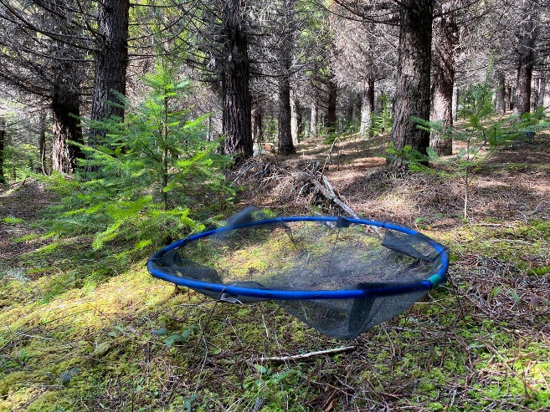
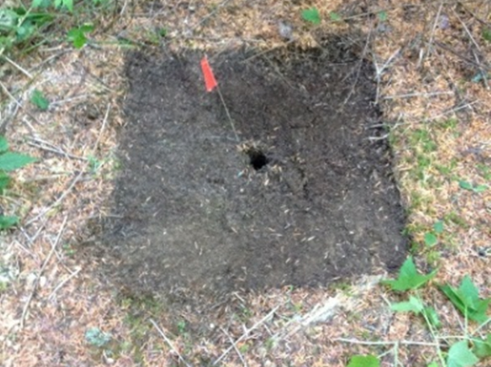
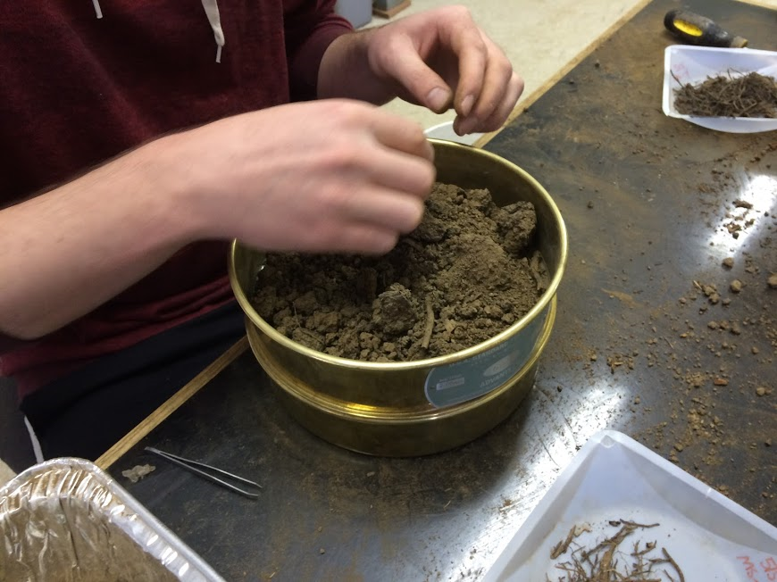
5) Install litterfall traps: Done (M 2021)
Bi-Monthly litter collection for 2 years
6) Measure LAI and Light Interception with
LAI-2200c and Ceptometer
Bi-Monthly for 2 years
7) Foliar sampling (Winter 2022)
4 trees per plot
8) Understory Vegetation Survey
and Biomass sampling
Summer 2021
5 clip plots (1 m²) per plot
9) Forest Floor and Soil Samples
Winter 2022
0-15, 15-30, 30-50, 50-100 cm
Methods
Giant Sequoia
Aboveground biomass will be estimated using inventory data and reported biomass functions for each species
Center for Advanced Forestry Systems 2021 Meeting

Slide 10
Justification
Survival (%)
Basal Area (m² ha⁻¹)
Inventory Date: 02/2021
Age: 25 Years
Center for Advanced Forestry Systems 2021 Meeting

Slide 11
Project Timeline
Timeline
 | 2021 |  |  |  | 2022
 | Winter | Spring | Summer | Fall | Winter | Spring | Summer | Fall
Plots layout Weather Stations Installation
Tree Inventory
Diameter Growth
Litterfall - LAI
Understory Sampling
X-ray Densitometry
Foliage, Litter and Soil Sampling
CAFS Reports
Center for Advanced Forestry Systems 2020 Meeting

Slide 12
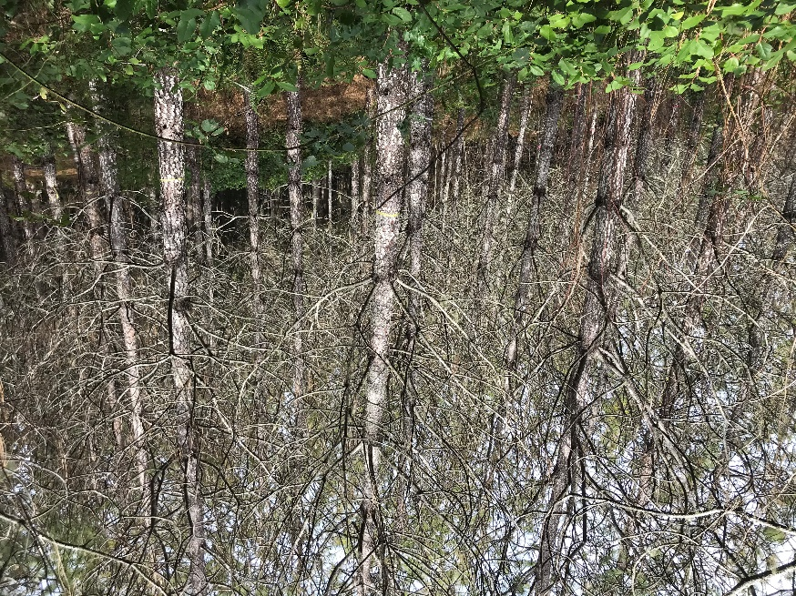
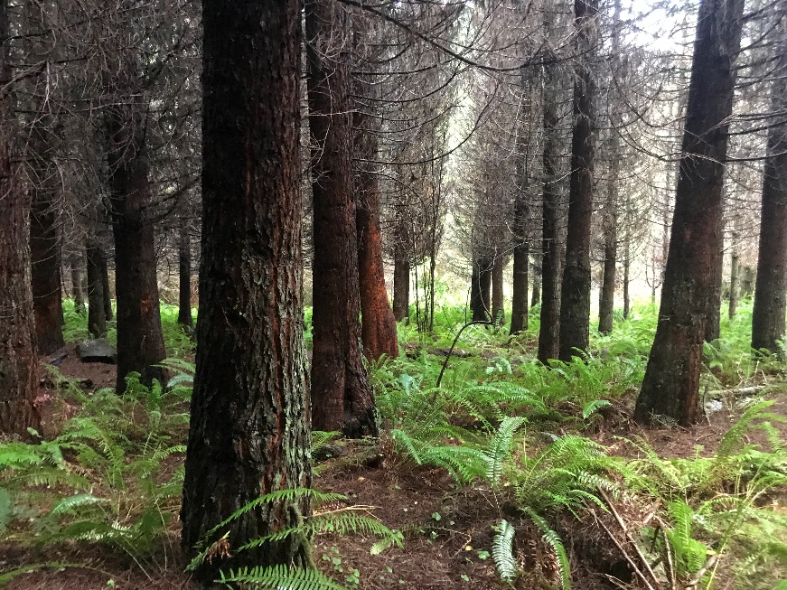
Deliverables
Expected Deliverables – One Year
Results will be prepared for two future MS theses and two publications in peer-reviewed journals.
Giant Sequoia
Ponderosa pine
Center for Advanced Forestry Systems 2020 Meeting

Slide 13
Deliverables
Expected Deliverables – Long-term
Training of MS students and undergraduate REUs in forest ecology research
Enhanced understanding of the productivity and sustainability of the nine conifer species.
Peer-reviewed publications and presentations to broad audiences, including VMRC, CIPS at OSU, SMC at UW and CRSF at UM.
Center for Advanced Forestry Systems 2020 Meeting

Slide 14
Deliverables
Expected Deliverables – Long-term
The data collected will be used to calibrate and validate the model 3-PG, allowing addressing the effects of climate change in productivity and deployment distribution for all nine species.
This project can interact with other CAFS projects
  19.75 Assessing and mapping regional variation in potential site productivity
  21.87 Linking leaf area index and remote sensing across different forest types
Center for Advanced Forestry Systems 2020 Meeting

Slide 15
Company Benefits
Member Company Benefits
Improved assessment of climate effects on growth and wood properties of the selected species
Improved assessment of Biomass Stock and NPP of the selected species
Improved understanding of the effects of climate change in species productivity
Center for Advanced Forestry Systems 2020 Meeting

Slide 16
Budget
Project Budget
NSF/CAFS Portion: $14,000
  $1,500 – Travel to CAFS meeting for 2 MS students.
  $1,500 – Travel to UGA-USDA Wood Properties Lab for X-ray densitometry analysis for 1 MS student.
  $4,000 – Field trips for periodic measurements and field sampling 2 MS student.
  $7,000 – Lab analysis (forest floor, soil and foliar).
  We will apply for CAFS supplemental funding to support undergraduate REUs and a graduate student INTERN to work on field sampling.
Center for Advanced Forestry Systems 2020 Meeting

Slide 17
Budget
Project Budget
Other Sources of Funding:
  MS students already have economic support (Fellowships, TAs)
  Additional funding will come from discretionary funds of PI Gonzalez.
Center for Advanced Forestry Systems 2020 Meeting

