Slide 1
Progress Report
Physiologic Response to Commercial Fertilization Programs in Pacific Northwest Forest Plantations
CAFS 20.84
Eric Turnblom (UW), Kim Littke (UW), Michael Premer (Rayonier)
Kim Littke
Center for Advanced Forestry Systems 2020 Meeting
Notes:
1

Slide 2
Project Overview
Fertilizer response is highly variable in the Pacific Northwest mostly due to N availability
Fertilization causes a temporary increase in photosynthetic rate and water use efficiency, but long-term response requires an increase in leaf area
Measurements of physiologic processes through C and O isotope ratios should further explain fertilizer response and guide future fertilization decisions
Objectives
Investigate mechanisms of physiologic response to fertilization under various soil and stand conditions
Develop regional silvicultural nutrition guidelines for commercial forest operations
Provide data to inform changes in silvicultural treatments due to future climate change
Center for Advanced Forestry Systems 2020 Meeting

Slide 3
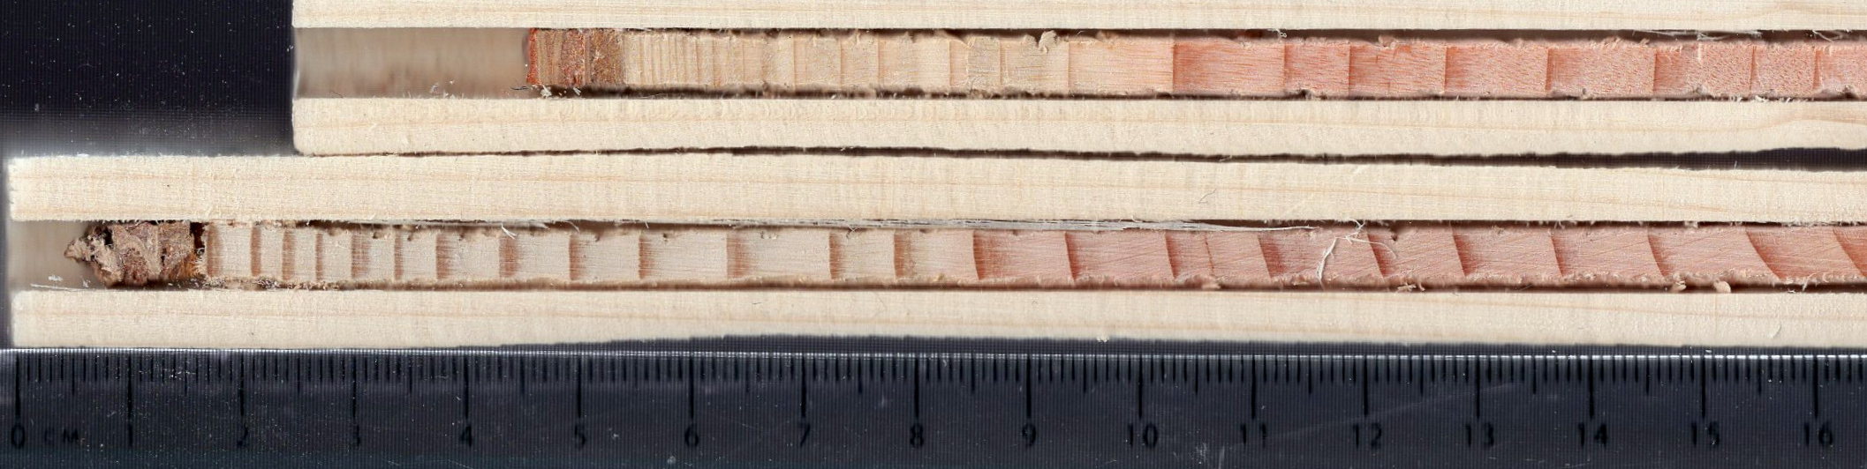
Current Progress
Sampled three Paired-Tree installations
Cored up to twenty trees from each treatment (40 total per installation)
Dried, mounted, and scanned all cores
Responsive Installation:
2010
Control
2010
Fertilized
Center for Advanced Forestry Systems 2020 Meeting

Slide 4
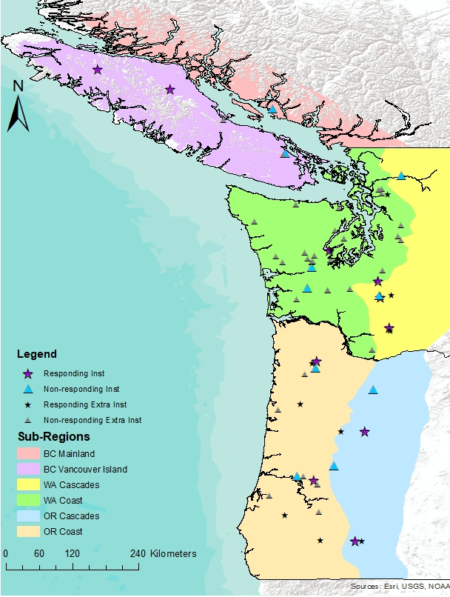
Future Plans
Sample remaining SMC Paired-tree installations
Measure earlywood and latewood growth on all trees
Split cores into annual EW/LW 6 years following fertilization
Composite by treatment and installation
Isotopic composition (δ¹³C and δ¹⁸O) will be analyzed at Northern Illinois University
Center for Advanced Forestry Systems 2020 Meeting

