Slide 1
Continuing Project
Physiologic Response to Commercial Fertilization Programs in Pacific Northwest Forest Plantations CAFS 20.84
Eric Turnblom (UW), Kim Littke (UW), Michael Premer (Rayonier)
Kim Littke
Center for Advanced Forestry Systems 2021 Meeting
Notes:
1

Slide 2
Justification
Fertilizer response is highly variable in the Pacific Northwest mostly due to N availability
Climate, soil, and stand conditions affect the magnitude and continuation of response
Fertilization causes a temporary increase in photosynthetic rate and water use efficiency, but long-term response requires an increase in leaf area
Stands that cannot increase leaf area will likely not respond to fertilization even if N is limiting
Measurements of physiologic processes through C and O isotope ratios should further explain fertilizer response and guide future fertilization decisions
Center for Advanced Forestry Systems 2021 Meeting

Slide 3
Objectives
Understand physiological patterns of response in fertilized Douglas-fir plantations
Investigate mechanisms of physiologic processes under various soil and stand conditions
Develop regional silvicultural guidelines for commercial forest operations
Provide data to inform changes in silvicultural treatments due to future climate change
Center for Advanced Forestry Systems 2021 Meeting

Slide 4
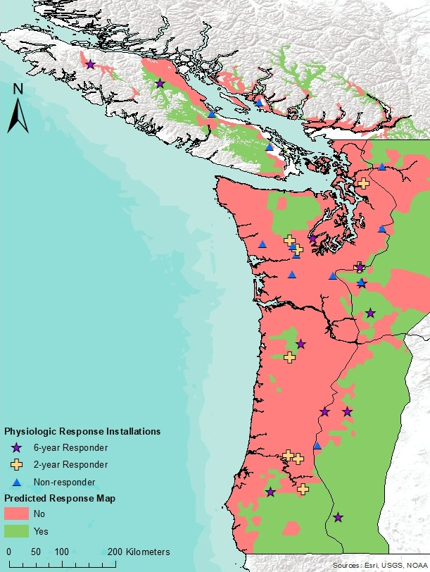
Methods
Utilize remaining SMC Paired-tree installations
Select a subset of responding, temporary response, and non-responding installations from each region
20 installations cored this year
10 installations to be cored next year
Core up to 20 trees from each treatment
Date and measure earlywood and latewood after fertilization
16 installations have been dated and measured
Split cores into EW/LW and composite by treatment and installation
Will be started this month
Isotopic composition (δ¹³C and δ¹⁸O) will be analyzed at Northern Illinois University
Installed Plant Root Simulator probes under control and fertilized trees
Center for Advanced Forestry Systems 2021 Meeting

Slide 5
Major Findings
Responsive installations grew significantly greater cumulative volume from 0-6 years
Fertilized trees grew larger total ring area, earlywood, and latewood up to 10 years after fertilization
The greatest increase in growth was found from 0-4 years
Earlywood response was greatest the first two years after fertilization
Latewood response peaked after two years
Responding installations had higher elevations and mean annual temperature
Lower mean annual precipitation and site index
Center for Advanced Forestry Systems 2021 Meeting

Slide 6
Major Findings
Installations with temporary response only responded in tree volume from 0-2 years
Significant increases in earlywood or latewood were found in the first two years
No differences from control trees after two years
One installation responded in height and not basal area
No tree ring response was measured
No continued response is likely due to increased drought stress and/or secondary nutrient limitations
Center for Advanced Forestry Systems 2021 Meeting

Slide 7
Major Findings
Non-responding installations did not respond in volume from 0-6 years
Some installations had a slight increase in earlywood growth the year of fertilization
After two years, fertilized trees in some installations grew less than the controls
All non-responding installations had high site index and low soil exchangeable Ca
Center for Advanced Forestry Systems 2021 Meeting

Slide 8
Deliverables
Relationships between stand structure, biogeoclimatic variables, and N fertilization physiologic response
Proposed silviculture alternatives under potential changes in future climate
Three peer-reviewed publications that reflect each project objective
A study design that can be applied to national forests through the Center for Advanced Forestry Systems
Center for Advanced Forestry Systems 2021 Meeting

Slide 9
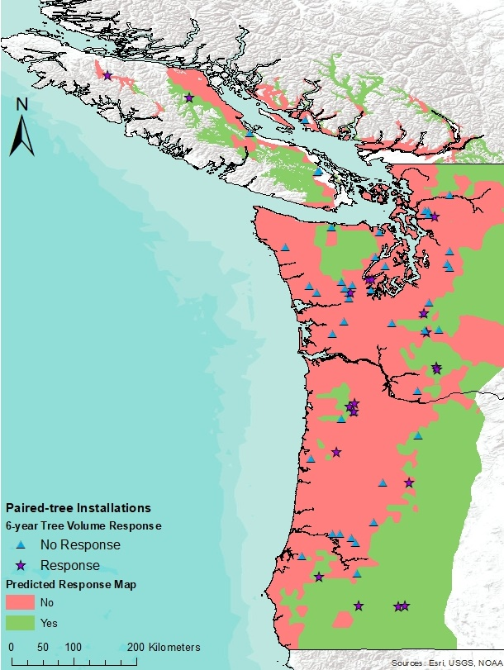
Company Benefits
Improved fertilization and thinning recommendations for Douglas-fir plantations based on physiologic response
Recommendations for silviculture under future climate scenarios
Center for Advanced Forestry Systems 2021 Meeting

Slide 10
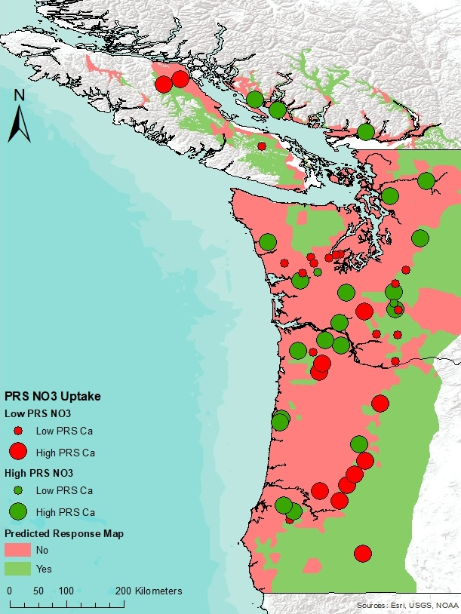
Recommendations
Focus fertilization on regions predicted to respond
Avoid fertilizing stands with high site index or are limited in other nutrients (exchangeable cations)
Center for Advanced Forestry Systems 2021 Meeting

Slide 11
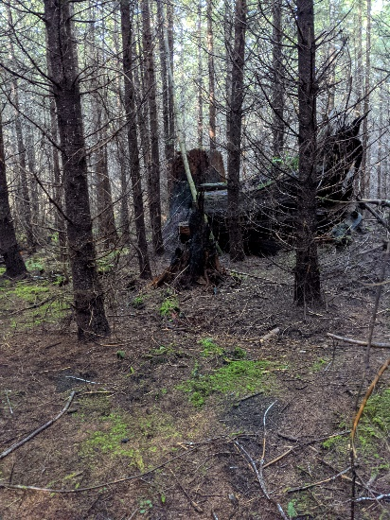
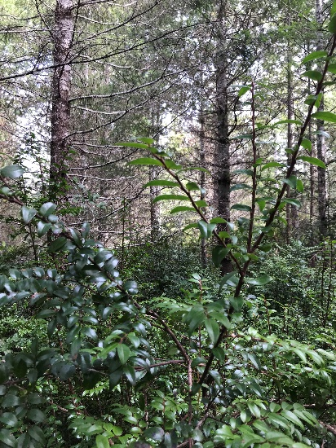
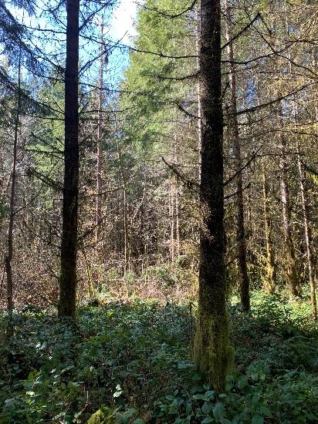
Questions and Comments
Thanks
Lone Rock, Rayonier, Cascade Timber, and BC Ministry of Forests
Stand Management Cooperative Field Crew
Xingyue Zhang, Master’s student

