Slide 1
Final Report
Physiologic Response to Commercial Fertilization Programs in Pacific Northwest Forest Plantations
CAFS 20.84
Eric Turnblom (UW), Kim Littke (UW), Michael Premer (UMaine)
Kim Littke
Center for Advanced Forestry Systems 2025 IAB Meeting
Notes:
1

Slide 2
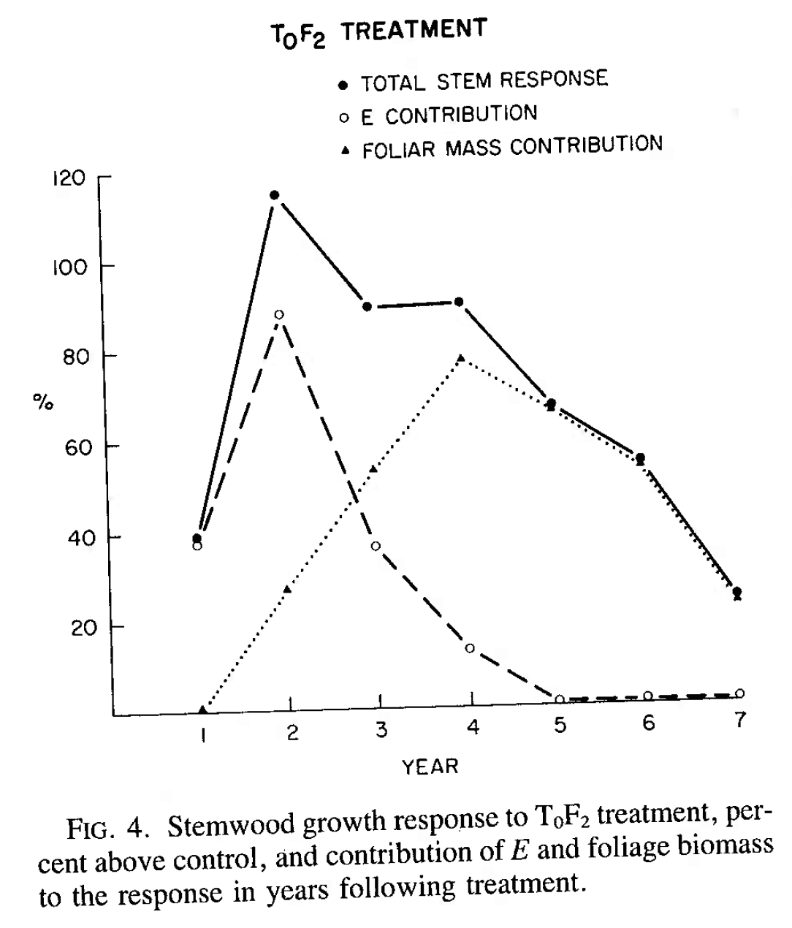
Fertilizer response is highly variable in the Pacific Northwest mostly due to N availability
  Climate, soil, and stand conditions affect the magnitude and continuation of response
Fertilization causes a temporary increase in photosynthetic rate and water use efficiency, but long-term response requires an increase in leaf area
  Stands that cannot increase leaf area will likely not continue response even if N is limiting
Measurements of physiologic processes through C and O isotope ratios should further explain fertilizer response and guide future fertilization decisions
Justification
Brix, 1983
Center for Advanced Forestry Systems 2025 IAB Meeting

Slide 3
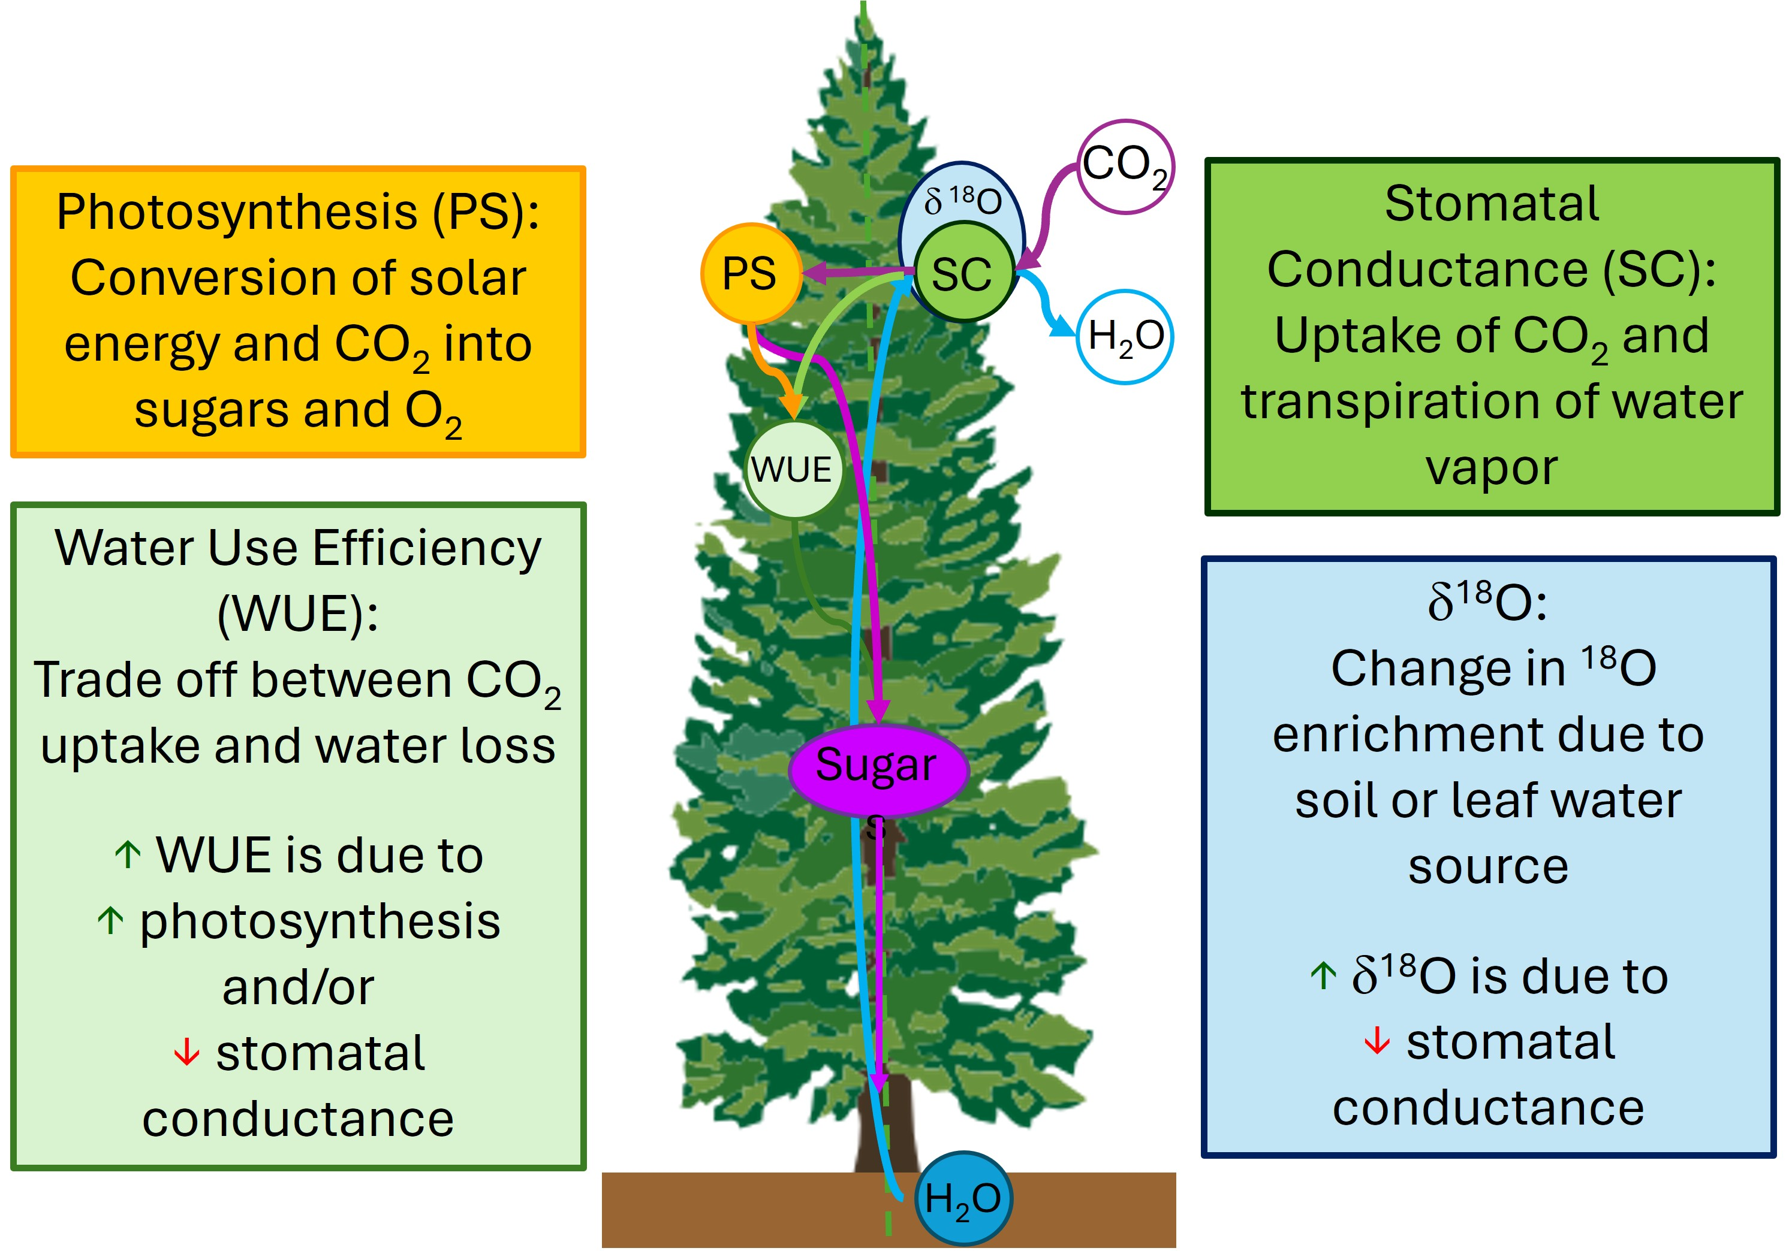
Justification
Center for Advanced Forestry Systems 2025 IAB Meeting

Slide 4
Objectives
Understand physiological patterns of response in fertilized Douglas-fir plantations
Investigate mechanisms of physiologic processes under various climate, soil, and stand conditions
Develop regional silvicultural guidelines for commercial forest operations
Provide data to inform changes in silvicultural treatments due to future climate change
Center for Advanced Forestry Systems 2025 IAB Meeting

Slide 5
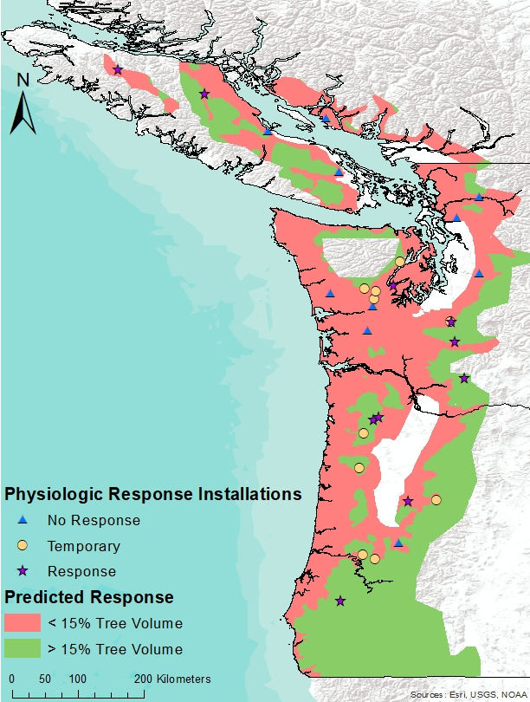
Methods
30 SMC Douglas-fir Paired-tree Fertilization sites
Fertilized with urea and measured over 6 years
  2008-2016
Selected a subset of
  Fertilizer responsive (0-4+ years)
  Temporary response (0-2 years only)
  Non-responsive
  10 sites from each type
Center for Advanced Forestry Systems 2025 IAB Meeting

Slide 6
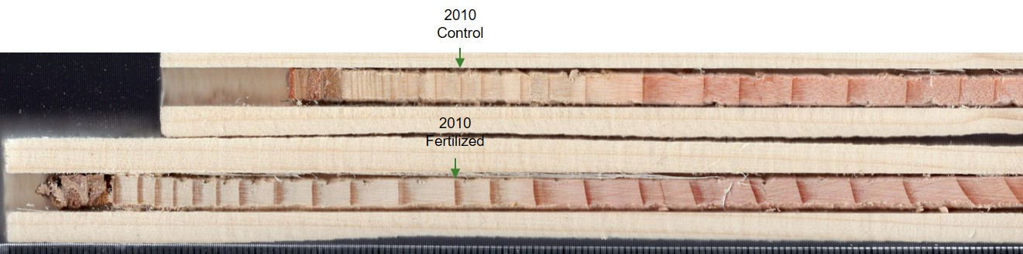

Methods
Dated and measured earlywood and latewood from 894 trees
  Determined mean annual ring area growth in control and fertilized plots
Up to 10 pairs per site split into earlywood/latewood 4 years prior to and 6 years post-fertilization
  Composited by site, treatment, component (EW/LW), and year
Isotopic composition (δ¹³C and δ¹⁸O) analyzed at Columbia University
  δ¹³C converted to intrinsic water use efficiency
    WUE = $\frac{photosynthesis}{stomatal conductance}$
  δ¹⁸O is negatively related to stomatal conductance due to soil or leaf water sources
Center for Advanced Forestry Systems 2025 IAB Meeting

Slide 7
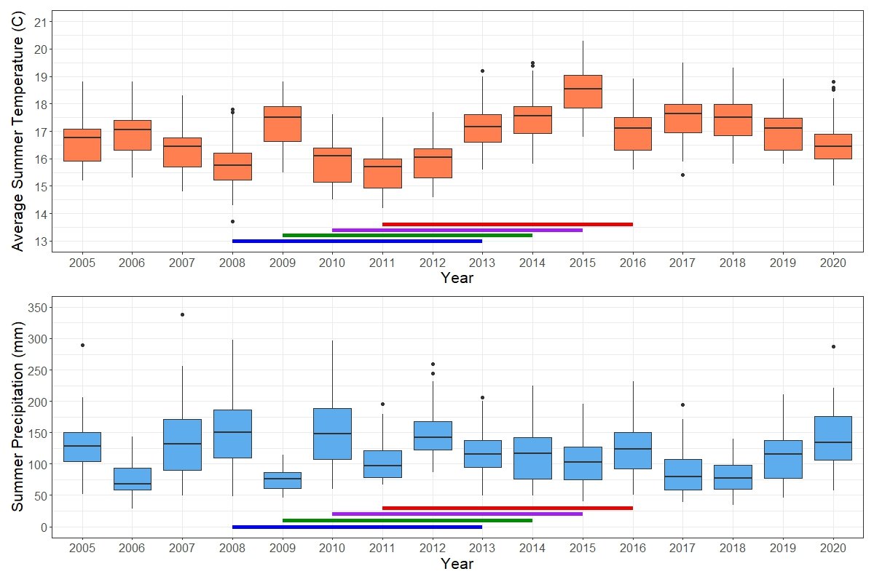
Modeling Methods
Linear mixed models were developed for earlywood and latewood δ18O and WUE and annual ring growth
Separate control and fertilized models for 6 years post-fertilization
Predictors:
  Mean summer temperature
  Total summer precipitation
  Elevation
  Clay concentration at 50-cm
  Forest floor C:N ratio
  Site index
  Relative Density
  Random factor: Installation
Final models were combined into a separate structural equation model (SEM) for control and fertilized plots
Lines show years of plot establishment and measurement for the study
Center for Advanced Forestry Systems 2025 IAB Meeting

Slide 8
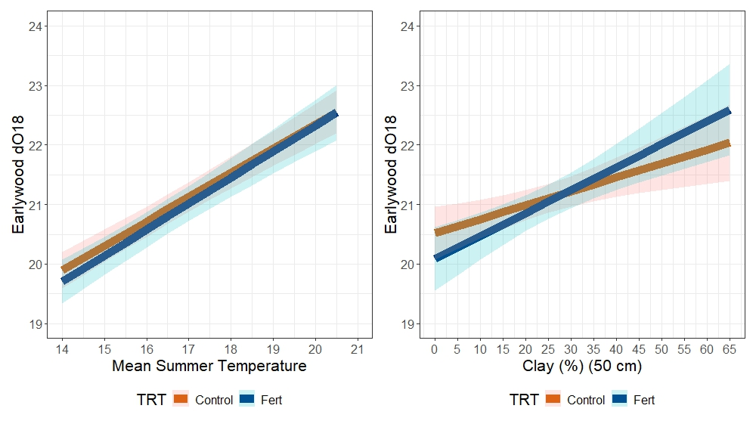
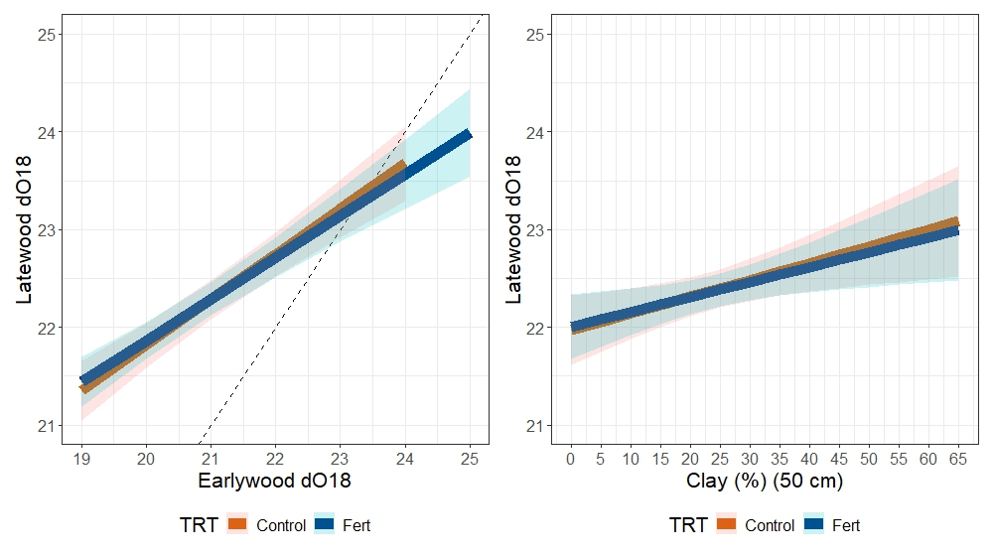
Earlywood δ18O
Stomatal Conductance
Major Findings
δ18O
Stomatal Conductance
Lower stomatal conductance at greater summer temps
Clayey soils had lower stomatal conductance
  Fertilization further reduced early stomatal conductance
  More evaporation in clayey soils
Stomatal conductance controlling earlywood and latewood δ18O similarly
Overall, little effect of fertilization on δ18O
Earlywood δ18O
Earlywood δ18O
Stomatal Conductance
Summer Temp °C
Clay (%) (50-cm)
Latewood δ18O
Stomatal Conductance
Latewood δ18O
Latewood δ18O
Earlywood δ18O
Clay (%) (50-cm)

Slide 9
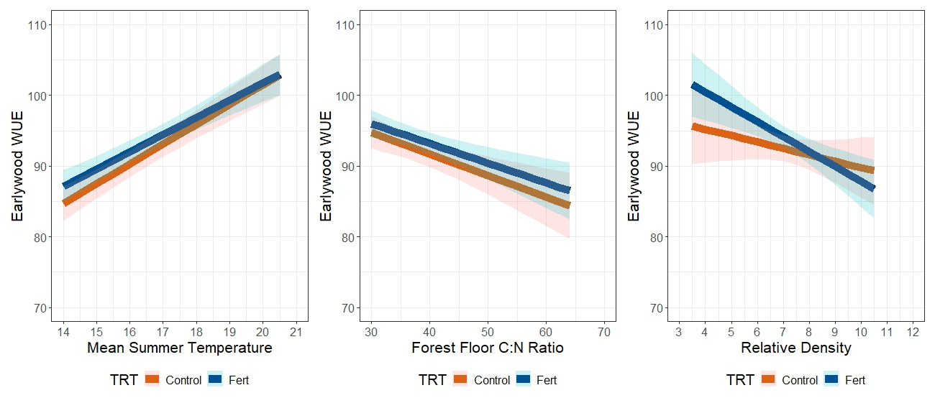
Major Findings
Earlywood Water Use Efficiency
Earlywood and latewood WUE increased with summer temps
  Reduction in stomatal conductance
Higher WUE at lower relative density after fertilization
  Fertilization increased photosynthesis more at lower RD
Higher WUE at low forest floor C:N ratios
  Greater photosynthesis when N is not limiting
Stomatal Conductance
Photosynthesis
Earlywood WUE
Earlywood WUE
Earlywood WUE
Photosynthesis
Summer Temp °C
Relative Density
Forest Floor C:N Ratio

Slide 10
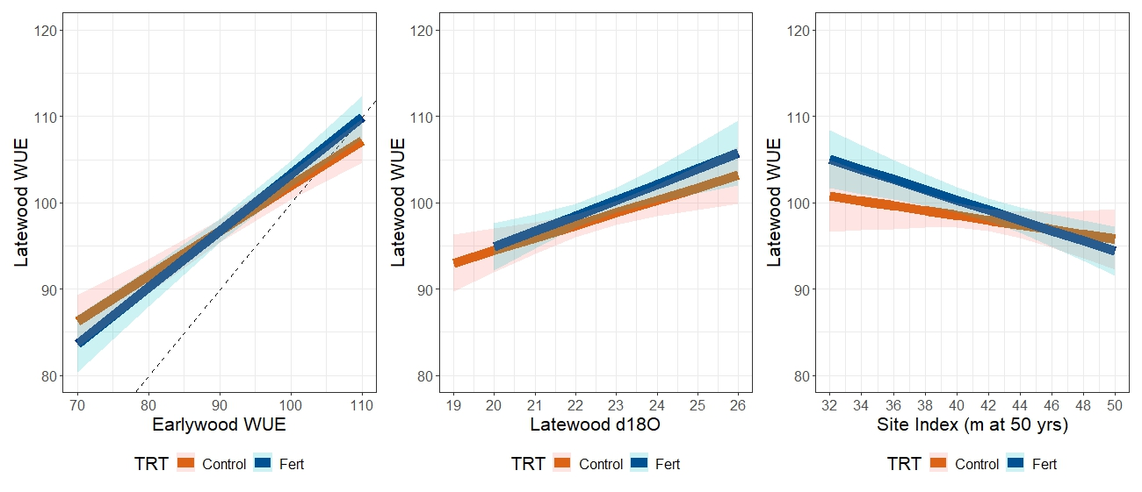
Major Findings
Latewood Water Use Efficiency
Correlation between latewood WUE and earlywood WUE
Positive correlation with δ18O
  Lower stomatal conductance increases WUE
Latewood WUE greater after fertilization at lower site index
  Fertilization increased photosynthesis at lower productivity sites
Stomatal Conductance
Latewood WUE
Latewood WUE
Latewood WUE
Photosynthesis
Earlywood WUE
Latewood δ18O
Site Index (m at 50 yrs)

Slide 11
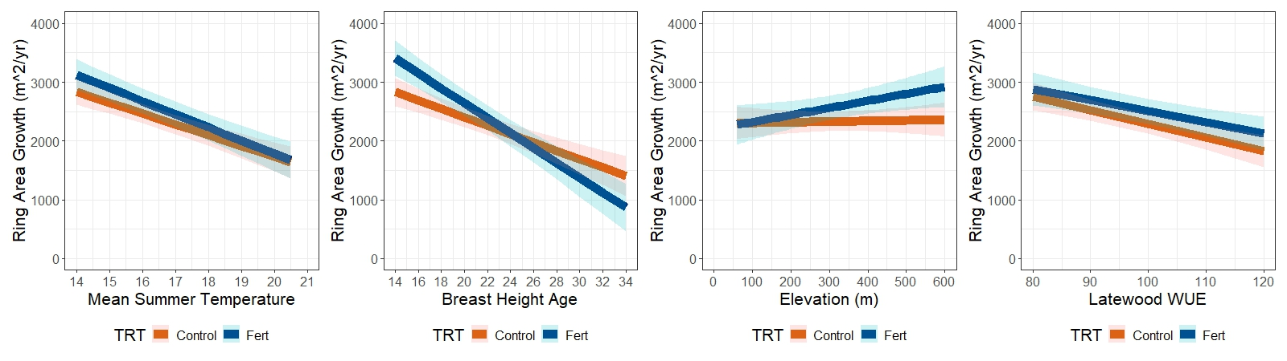
Major Findings - Annual Ring Growth
Annual ring growth decreased with increasing summer temperatures
  Warmer summers decreased growth during drought conditions
  Fertilization increased ring growth at low summer temps
As expected, annual ring growth deceased with age
  Ring growth increased after fertilization at younger ages (<24 years at BH)
Higher elevations responded better to fertilization due to low N availability
Greater annual ring growth at lower latewood WUE especially in control plots
  Less negative effect of WUE on ring growth in fertilized plots due to increased photosynthesis
Photo
synthesis
Ring Area Growth (mm²/yr)
Ring Area Growth (mm²/yr)
Stomatal Conductance
Summer Temp °C
Breast Height Age
Stomatal Conductance
Ring Area Growth (mm²/yr)
Ring Area Growth (mm²/yr)
Photo
synthesis
Photo
synthesis
Elevation (m)
Latewood WUE

Slide 12
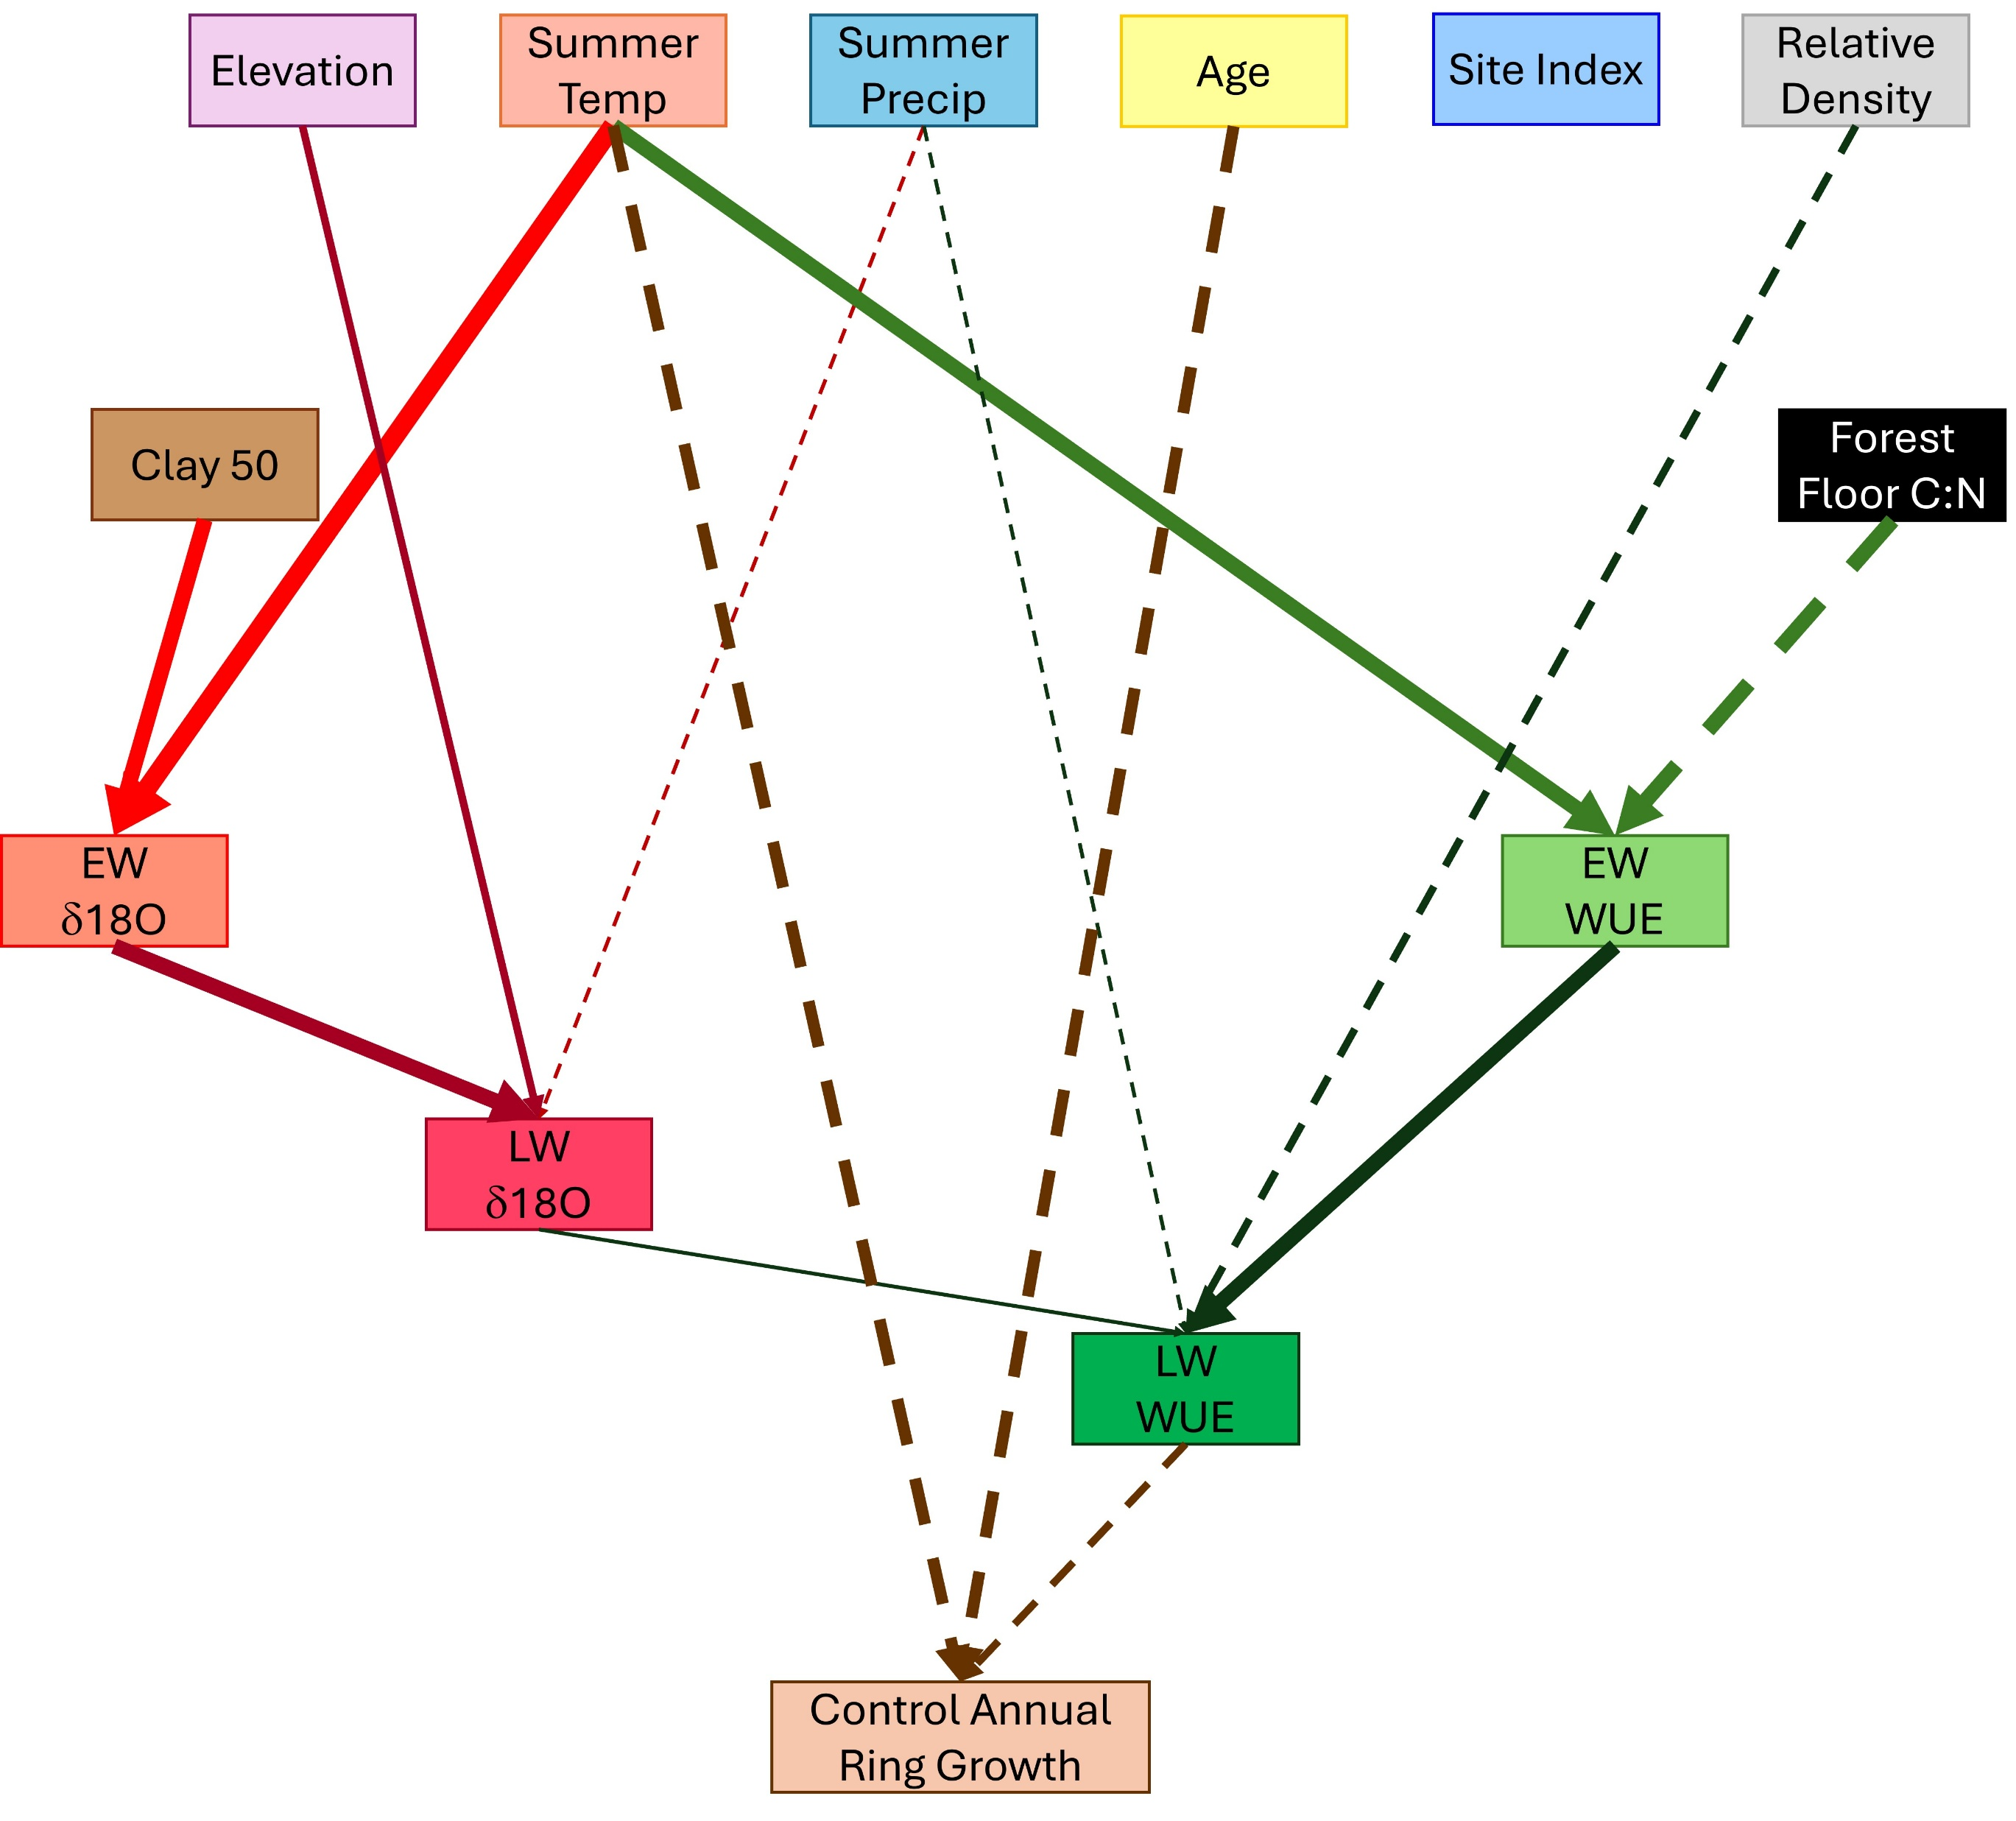
Model Descriptions
Positive relationship
Negative relationship
Arrows indicate predictors of the dependent variable
Arrow width indicates relative strength of each variable
  Describes effect of 1 standard deviation (SD) increase in predictor:
  <0.2 SD change in variable
  >0.5 SD change in variable
Center for Advanced Forestry Systems 2025 IAB Meeting

Slide 13

Control Model
Summer temperature is the most important predictor of δ18O, WUE, and ring growth
  Strong effect on stomatal conductance
Summer precipitation increases stomatal conductance in latewood
Greater control ring growth ~ greater stomatal conductance due to cooler summers and younger ages
Center for Advanced Forestry Systems 2025 IAB Meeting

Slide 14
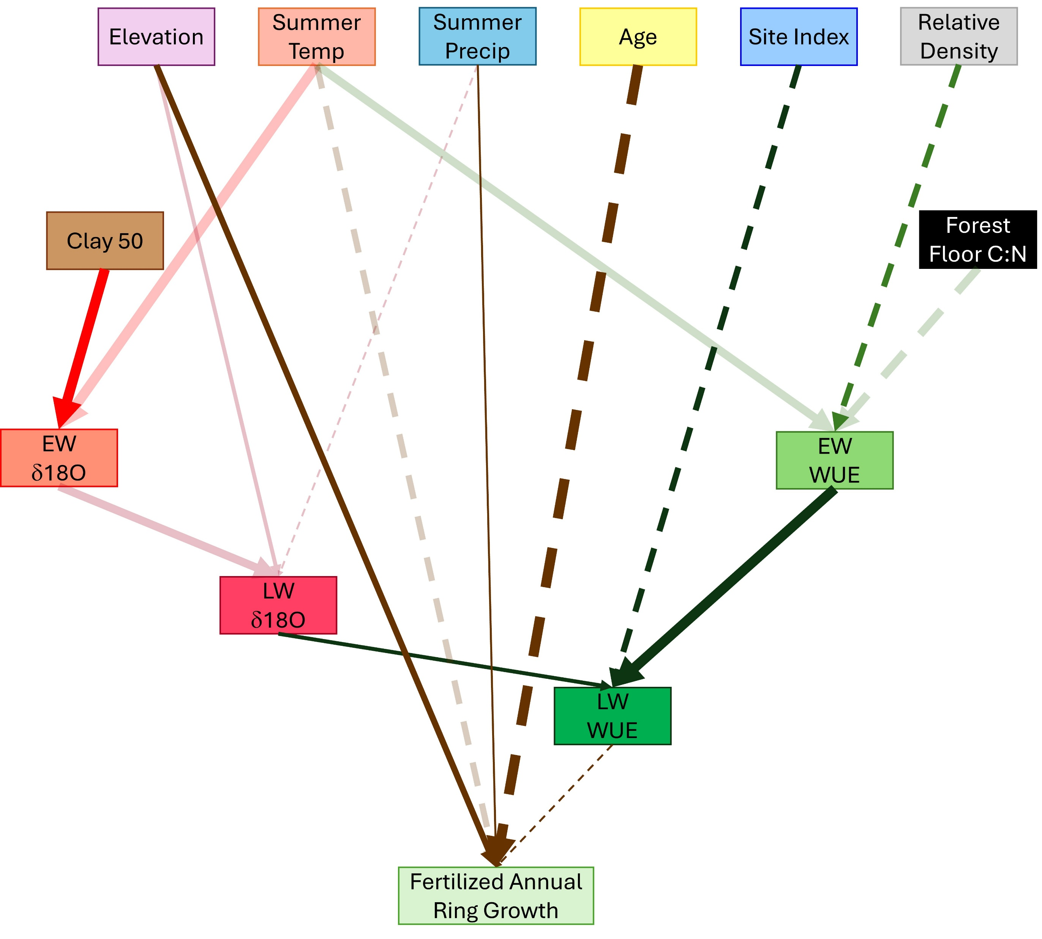
Fertilized Model
Similar model to control (transparent)
Summer precipitation has a further positive impact on ring growth in fertilized plots
  Less effect on WUE (↑ photosynthesis)
Increased fertilized ring growth ~ greater photosynthesis due to cooler, wetter summers, younger ages, and N limitations
Center for Advanced Forestry Systems 2025 IAB Meeting

Slide 15
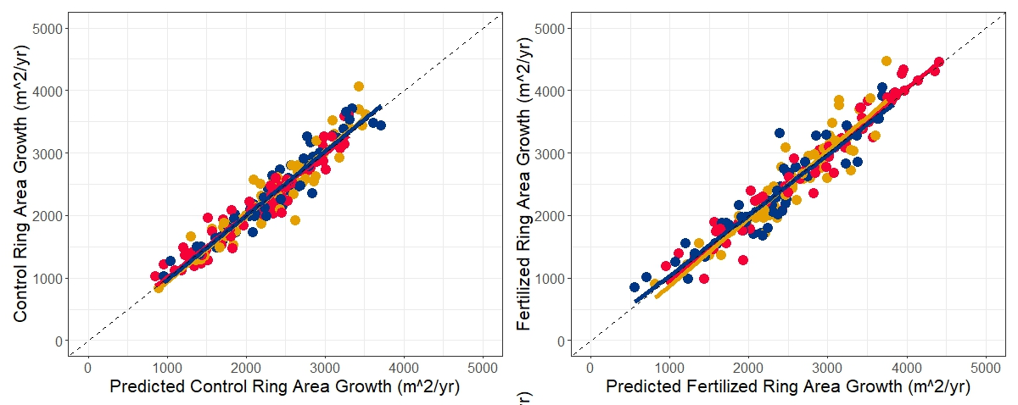
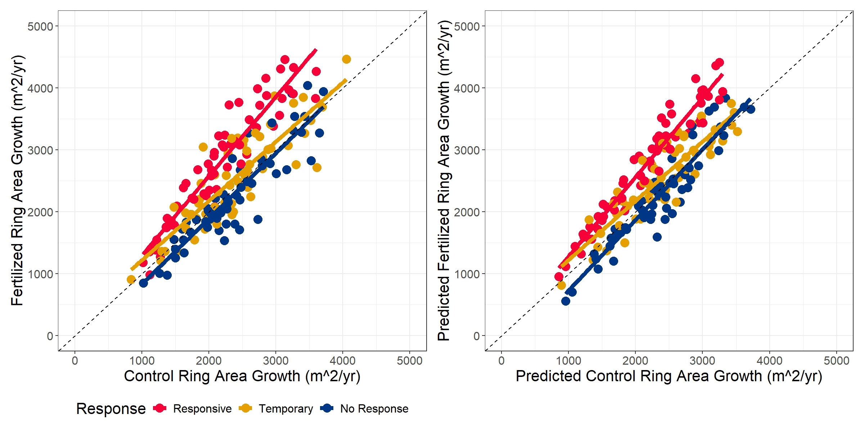
Prediction
Split installations into responsive (4+ yrs), temporary response (0-2 yrs), and non-responders
Predicted ring area growth using measured δ18O and WUE
  Alternative model without δ18O and WUE did not perform as well
Good prediction of control and fertilized ring area
In control plots, non-responsive and temporary stands grew the largest ring area
  Responsive stands took over the largest ring area growth after fertilization
Control
Fertilized
Center for Advanced Forestry Systems 2025 IAB Meeting

Slide 16
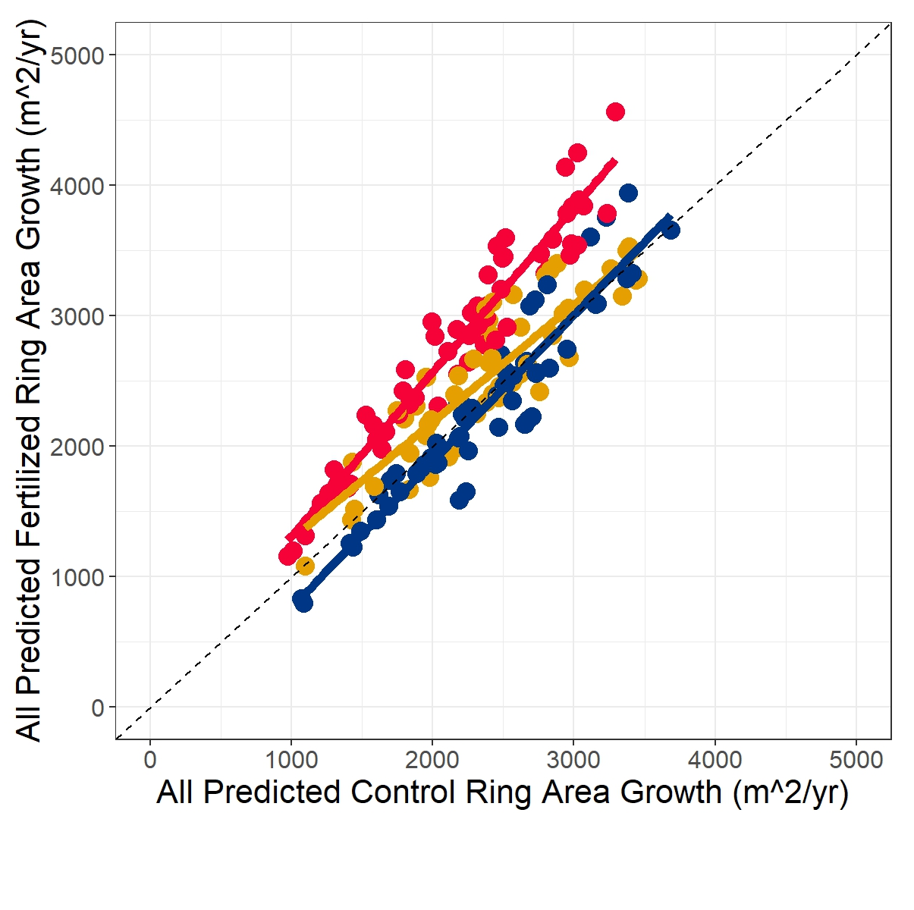
Prediction
As expected, measured data shows increased ring growth in responders
  Slight increase in temporary responders at lower ring area growth
Model predicts similar relationship between ring area growth response for response types
  Responding stands are predicted well in the fertilized model
Similar relationships predicted when EW/LW δ18O/WUE were predicted as well
Measured
Predicted
All Predicted
Center for Advanced Forestry Systems 2025 IAB Meeting

Slide 17
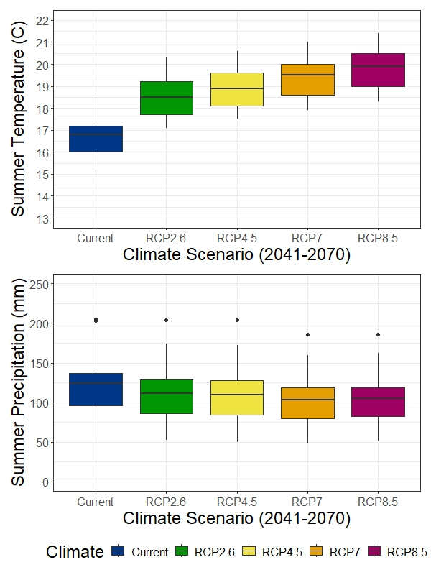
Future Climate Predictions
Predicted δ18O, WUE, and ring area growth from current normal climate data and projected climate change scenarios in 2041-2070
  RCP 2.6 <2°C increase (best case)
  RCP 4.5 ~ 2.2°C increase (moderate)
  RCP 7 ~ 2.7°C increase (high emission, delayed mitigation)
  RCP 8.5 ~ 3.1°C increase (worst case)
  Precipitation is not expected to change much between models (-11 to -19 mm)
Center for Advanced Forestry Systems 2025 IAB Meeting

Slide 18
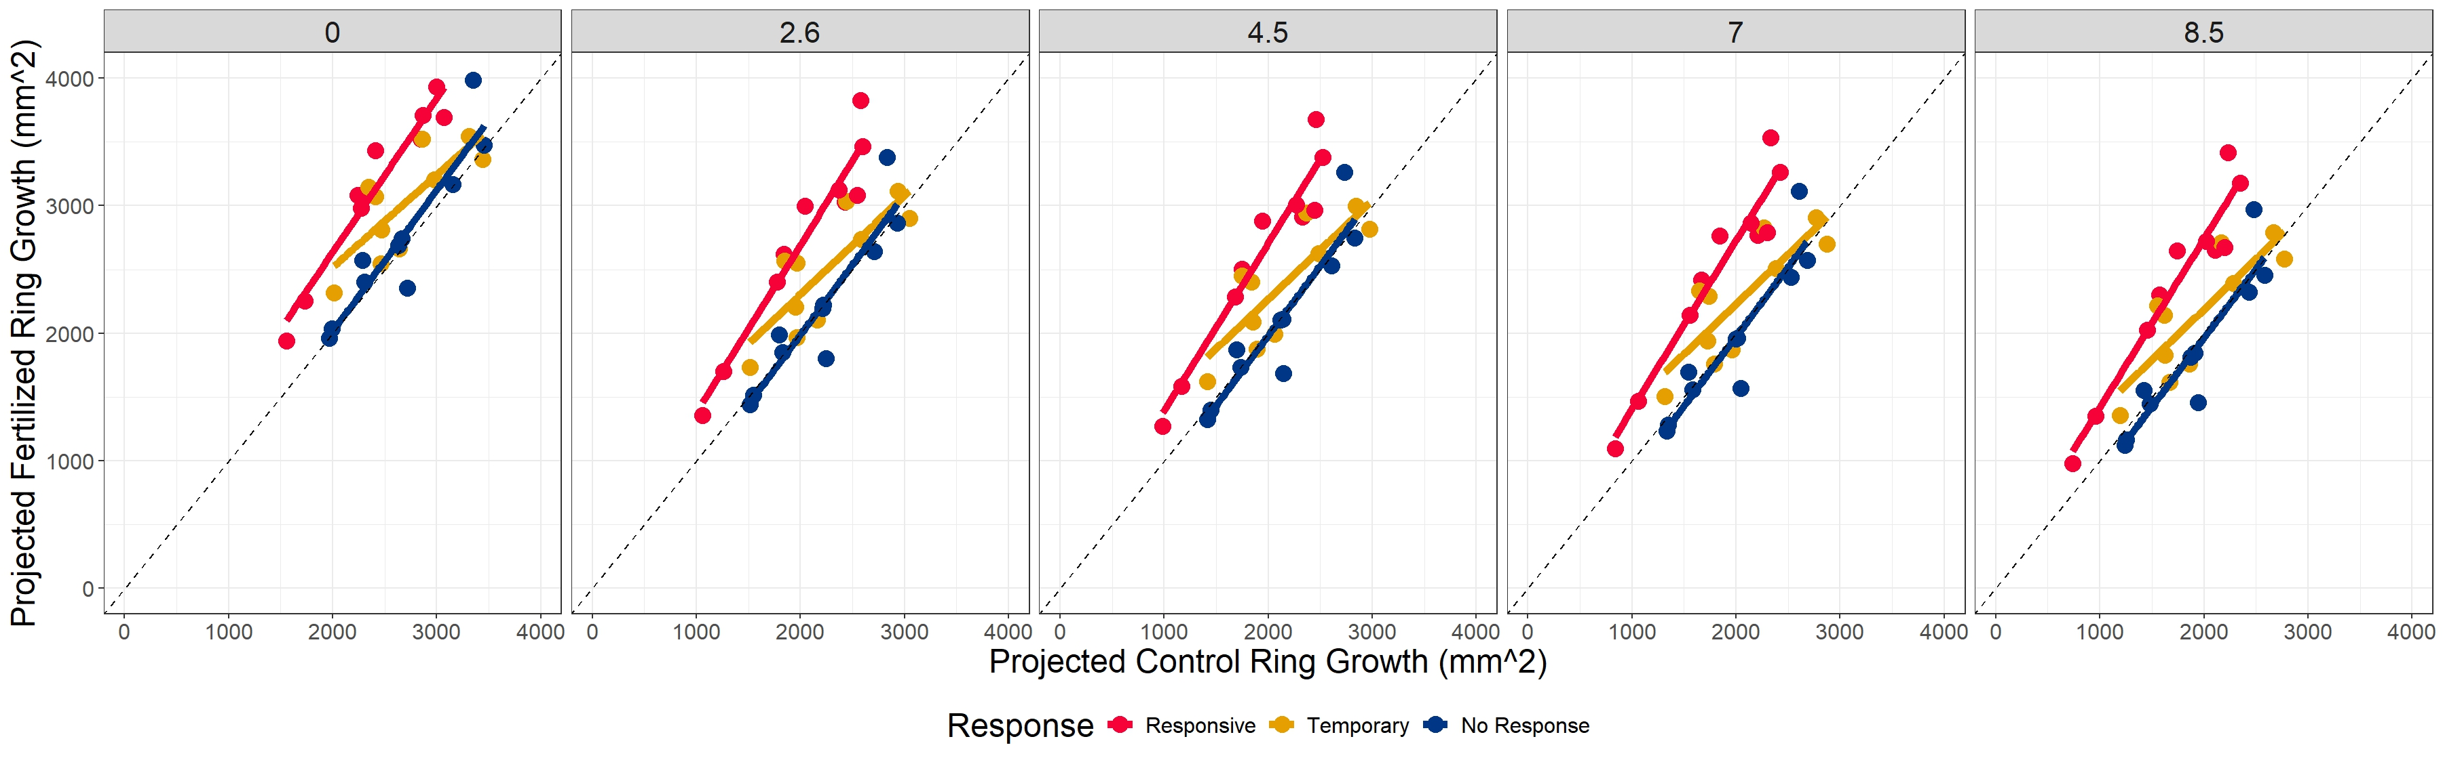
Future Climate Predictions
Average ring growth decreases by 18% in RCP2.6 to 30% in RCP8.5
As temperatures increase, percent response to fertilization increases slightly in responders (31-37%)
  Temporary responders continue moderate response (11%)
  In most extreme scenarios, non-responding stands are projected to grow slightly less after fertilization
In the SEM model, prediction of ring area growth shows only linear effects in climate while keeping other predictors constant (age, relative density, clay content)
  Some predictors could be altered by changing climates (site index and forest floor C:N ratios), but neither were strongly correlated with temperature
  The δ18O and WUE models improve predictions of climate effects on ring area growth
  Changing CO₂ levels were not considered in these models
Center for Advanced Forestry Systems 2025 IAB Meeting

Slide 19
Summary
Structural equation models explain the effects of climate, soil, and site variables on ring growth using δ18O and WUE
Negative relationship between summer temp and stomatal conductance
  Little effect of fertilization on stomatal conductance
  Responding stands increase photosynthesis after fertilization especially at low summer temps and low site productivities
Ring area growth greatest at lower summer temps, younger ages, and greater stomatal conductance
  Greater fertilizer ring growth response at younger ages, higher elevations, and lower summer temps
Models suggest that increasing temperatures due to climate change will result in lower ring growth due to decreases in stomatal conductance
  Fertilization could yield increased growth with rising temps in responding stands
Center for Advanced Forestry Systems 2025 IAB Meeting

Slide 20
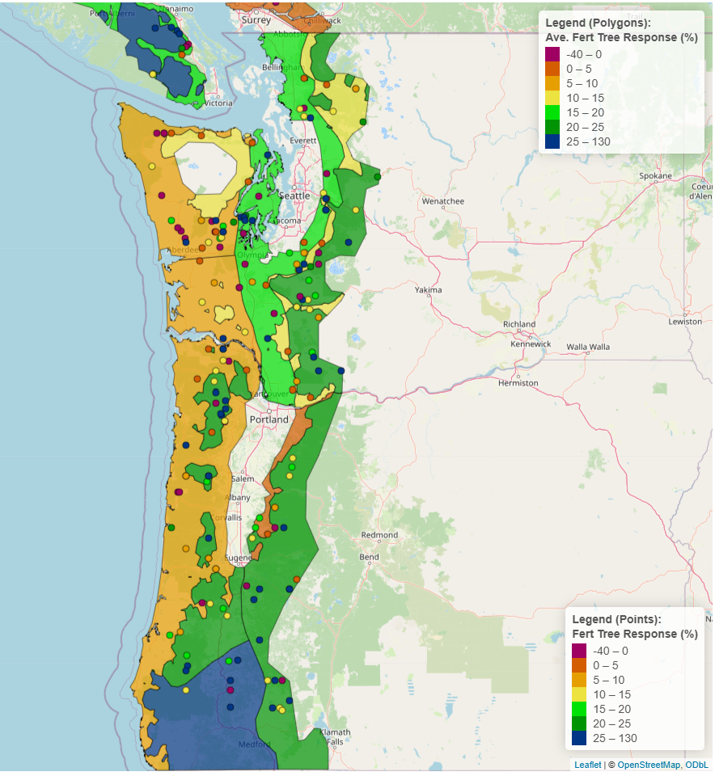
Recommendations
Expect negative impacts of increasing summer temperatures on ring growth due to lower stomatal conductance
  Lower relative densities will reduce competition for water as temperatures rise
Focus fertilization on stands most likely to respond (higher elevations, colder temperatures, and lower site index) due to N limitations
  In responsive stands, fertilization could compensate for expected lower growth due to rising temperatures
Center for Advanced Forestry Systems 2025 IAB Meeting

Slide 21
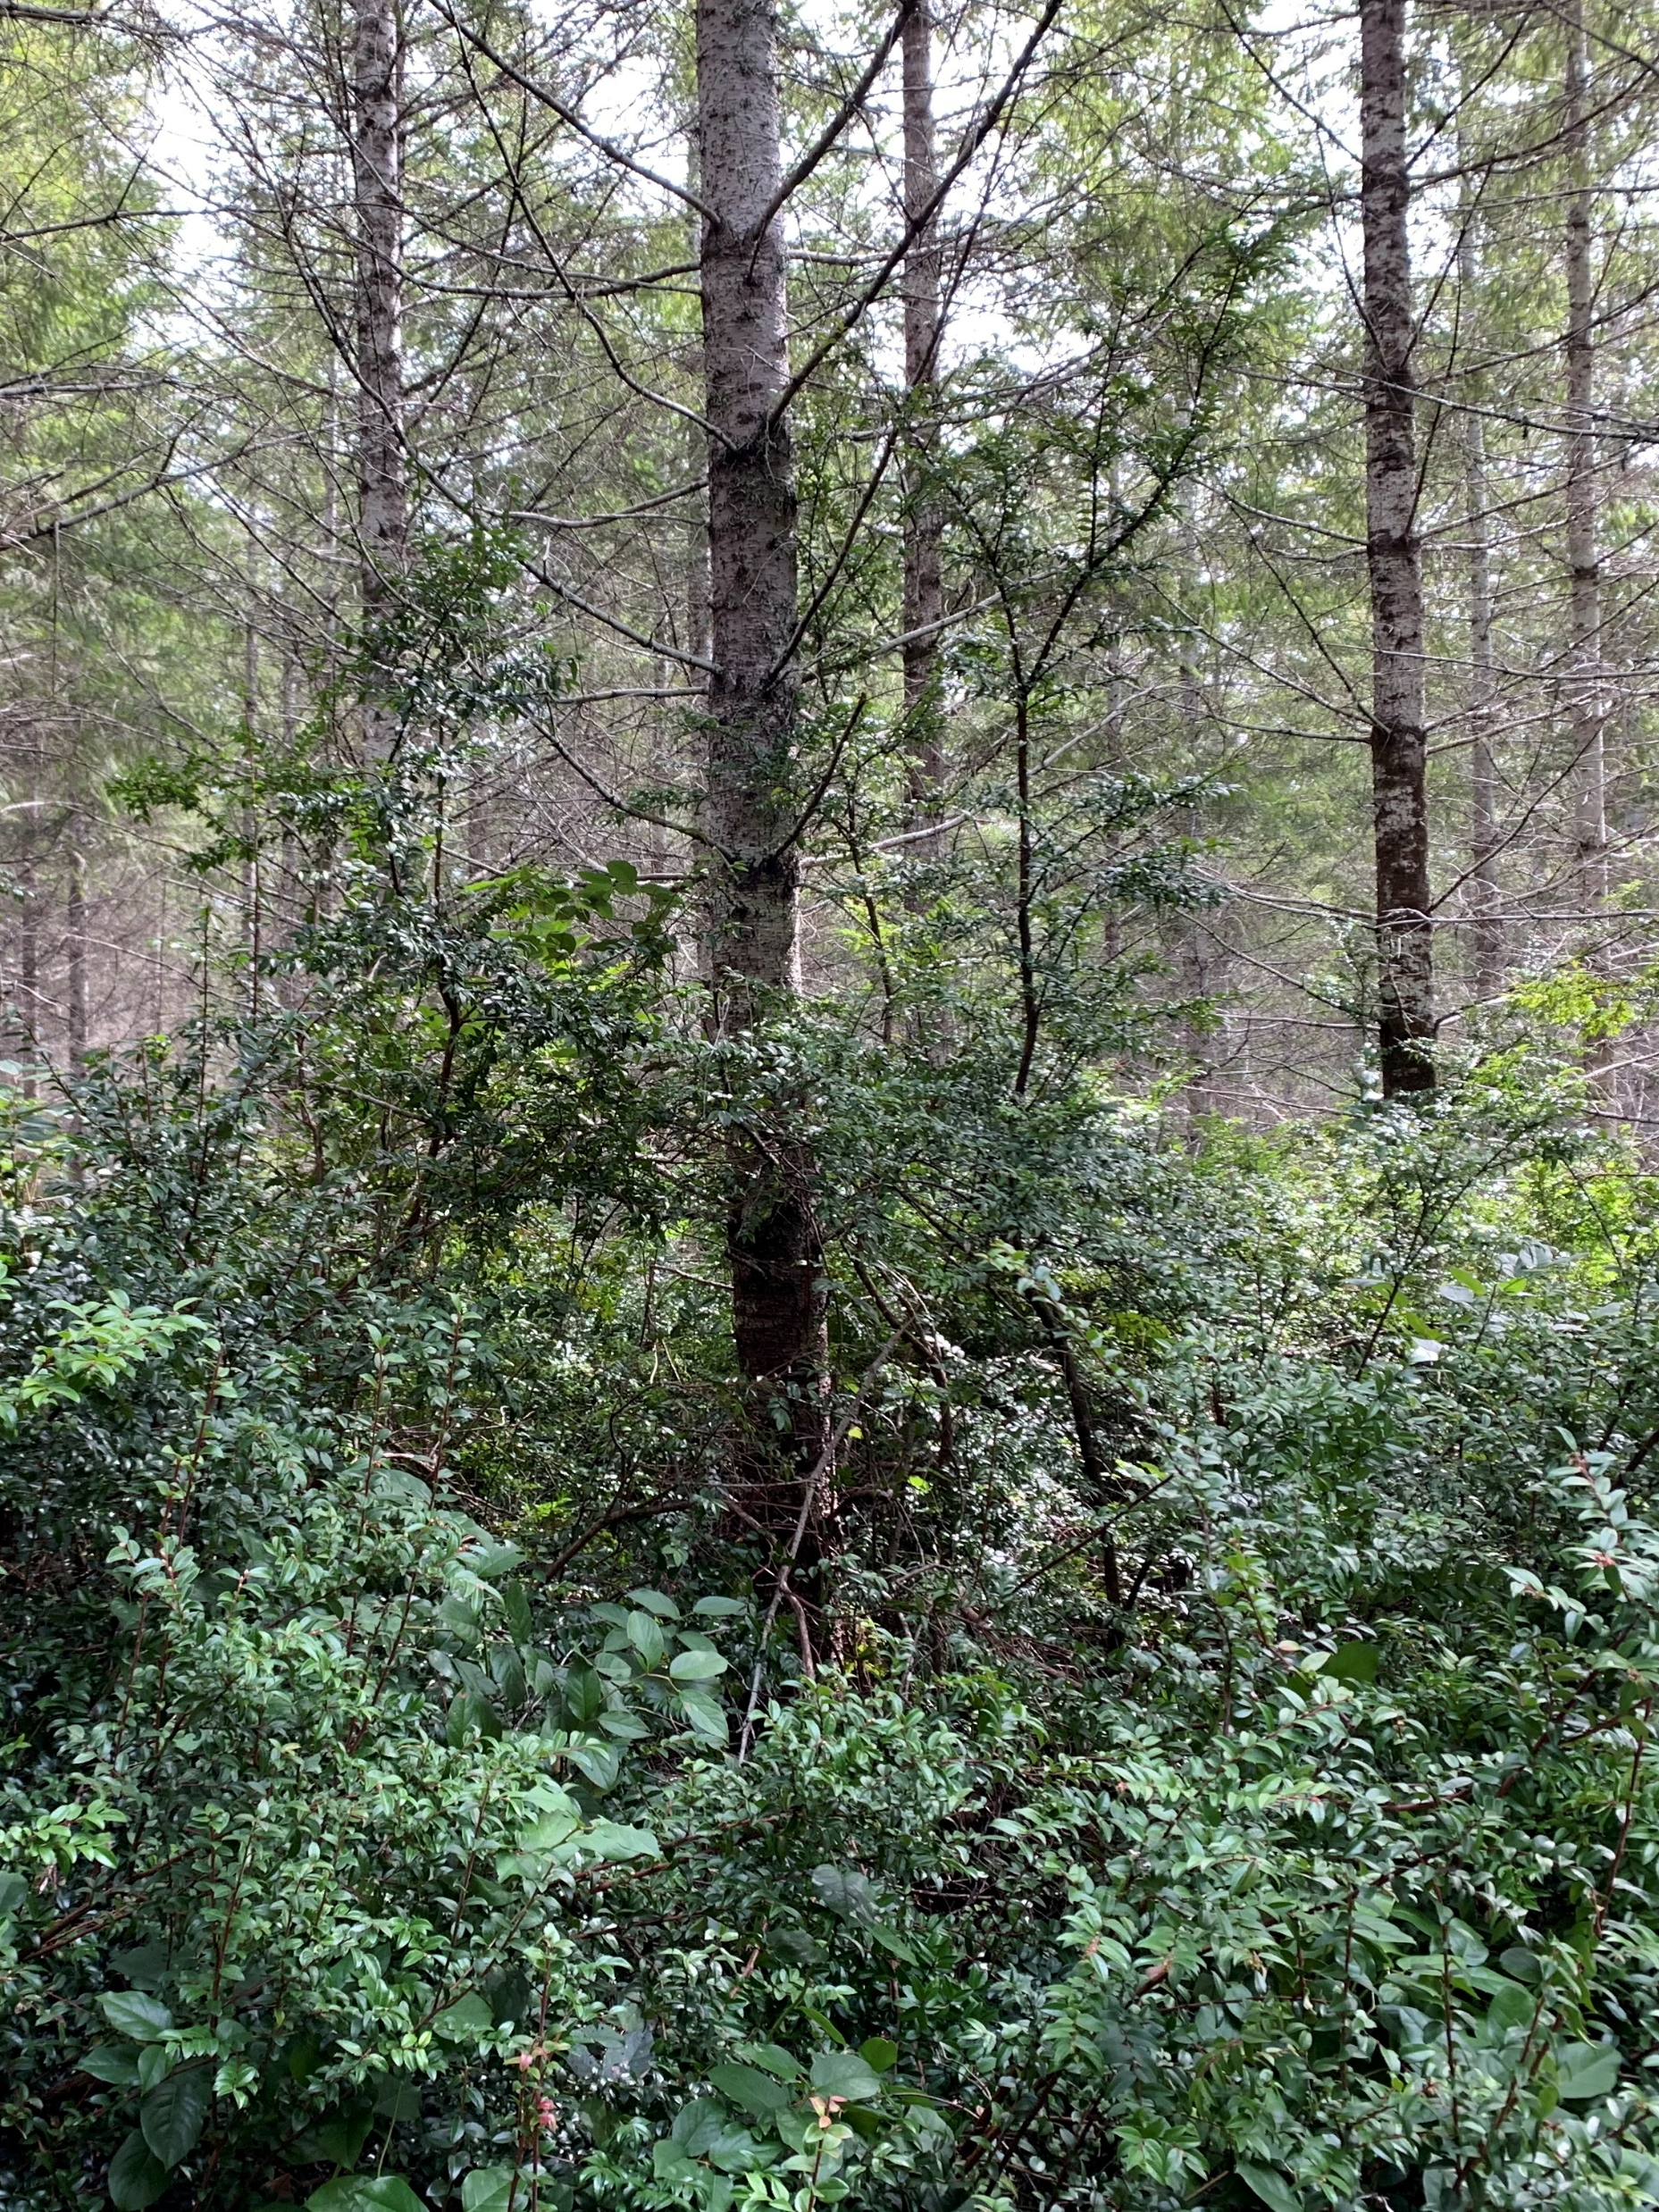
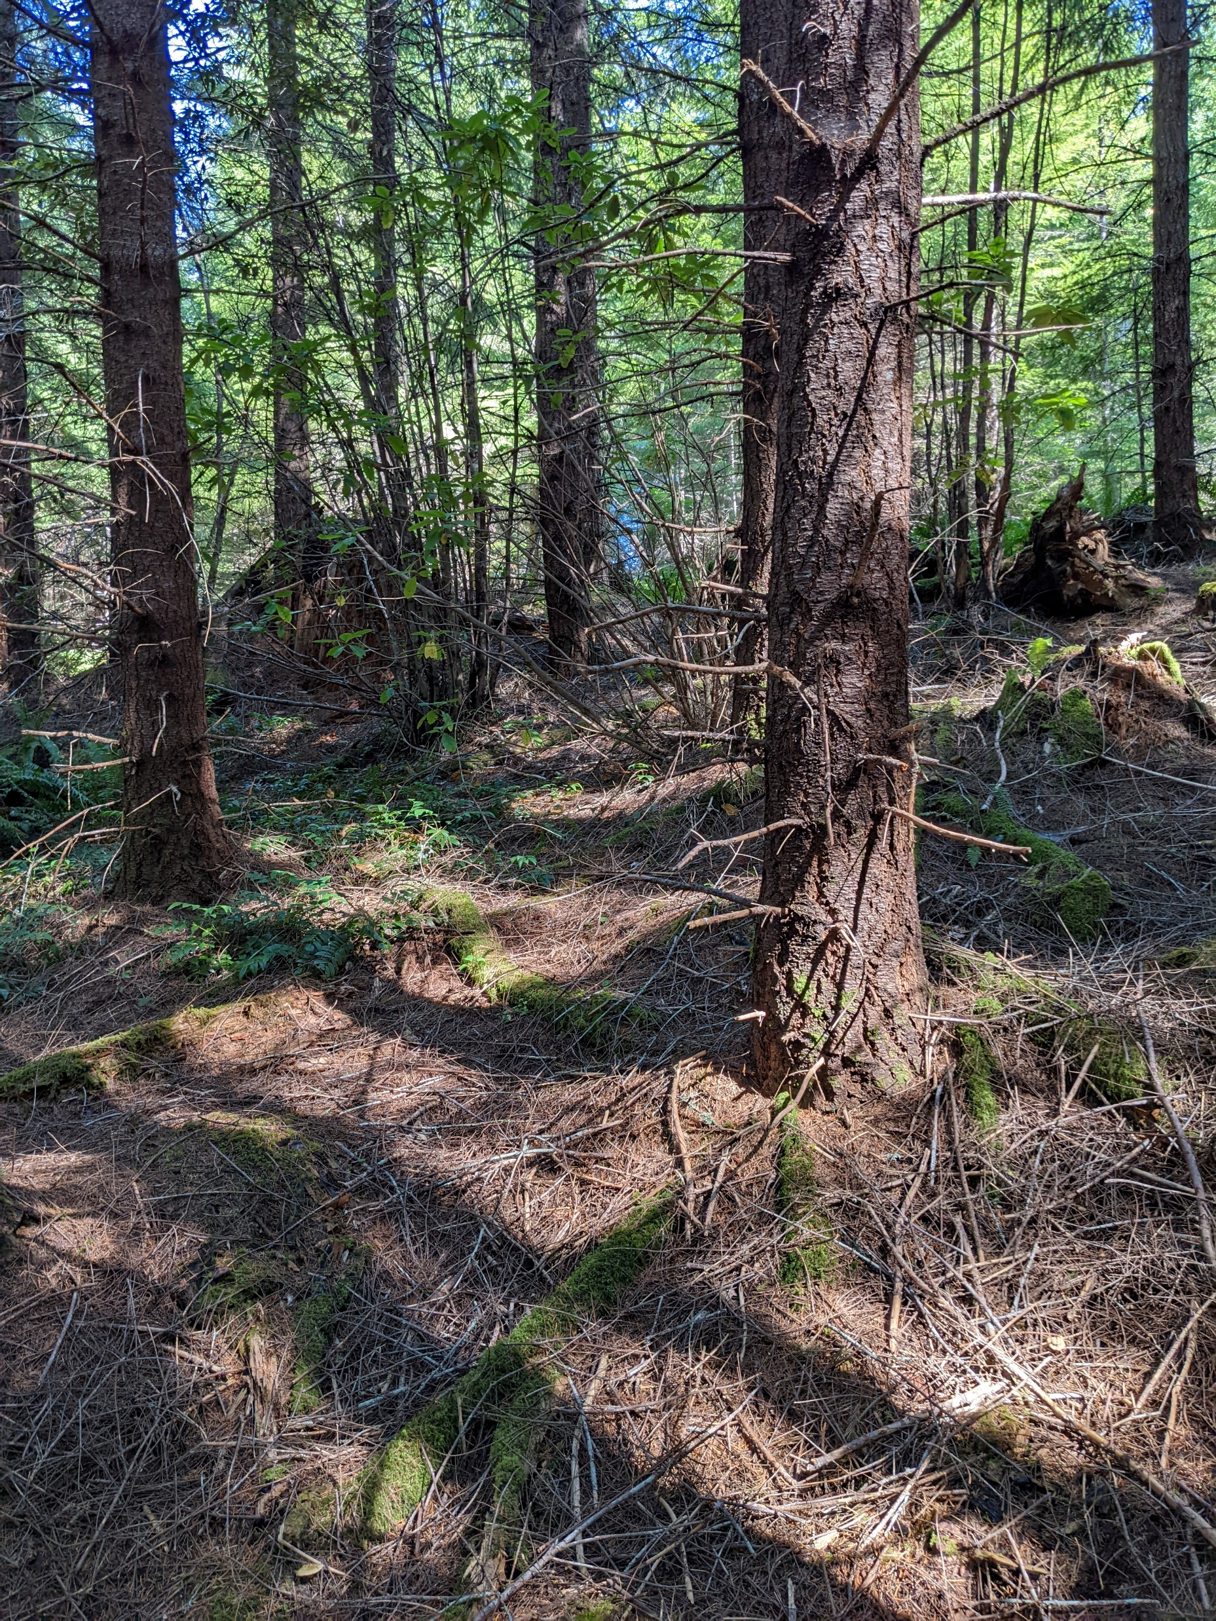
Questions?
Thanks to:
CAFS
Weyerhaeuser
Stimson
Columbia University

Slide 22
Deliverables
Models that describe climate, soil, and site variable effects on stomatal conductance, photosynthesis, and Douglas-fir ring growth under control and fertilized conditions
Fertilization strategies under current and potential changes in future climate
Three peer-reviewed publications that reflect each project objective
A study design that can be applied to national forests through the Center for Advanced Forestry Systems
Center for Advanced Forestry Systems 2025 IAB Meeting

Slide 23
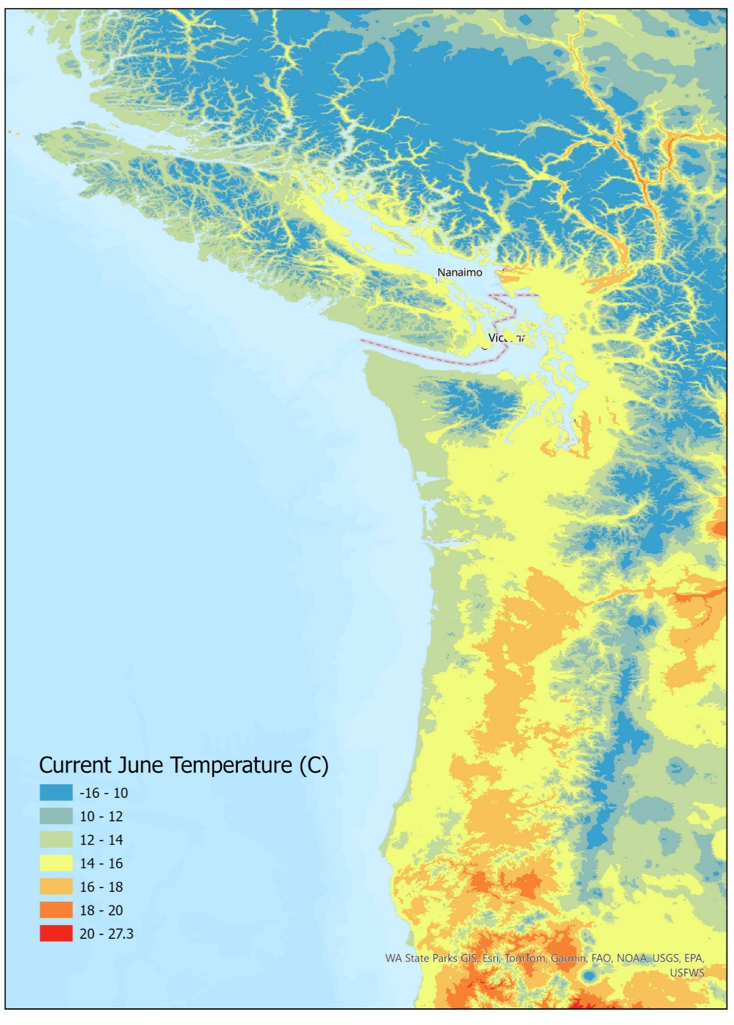
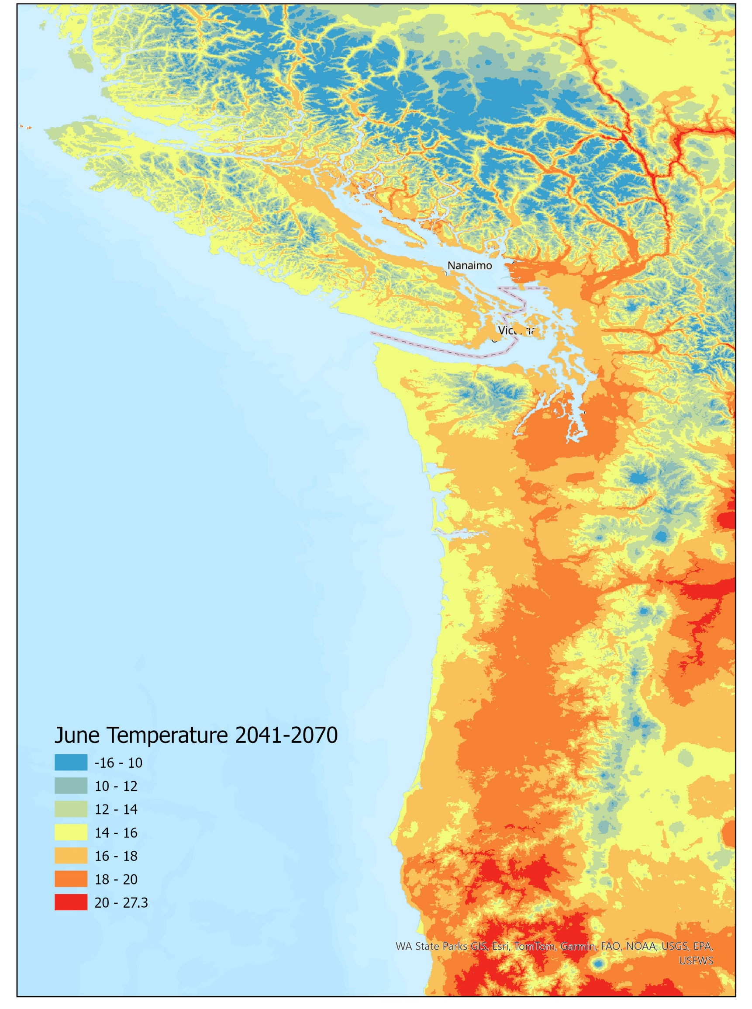
Company Benefits
Improved fertilization and silviculture recommendations for Douglas-fir plantations based on physiologic variables
Recommendations for fertilization under future climate scenarios
Center for Advanced Forestry Systems 2025 IAB Meeting

