Slide 1
Progress Report
Using predictive analytics to decompose site index
CAFS 20.83
Jason Cross University of Washington Eric Turnblom University of Washington
Jason Cross, Presenter
Center for Advanced Forestry Systems 2021 Meeting
Notes:
1

Slide 2
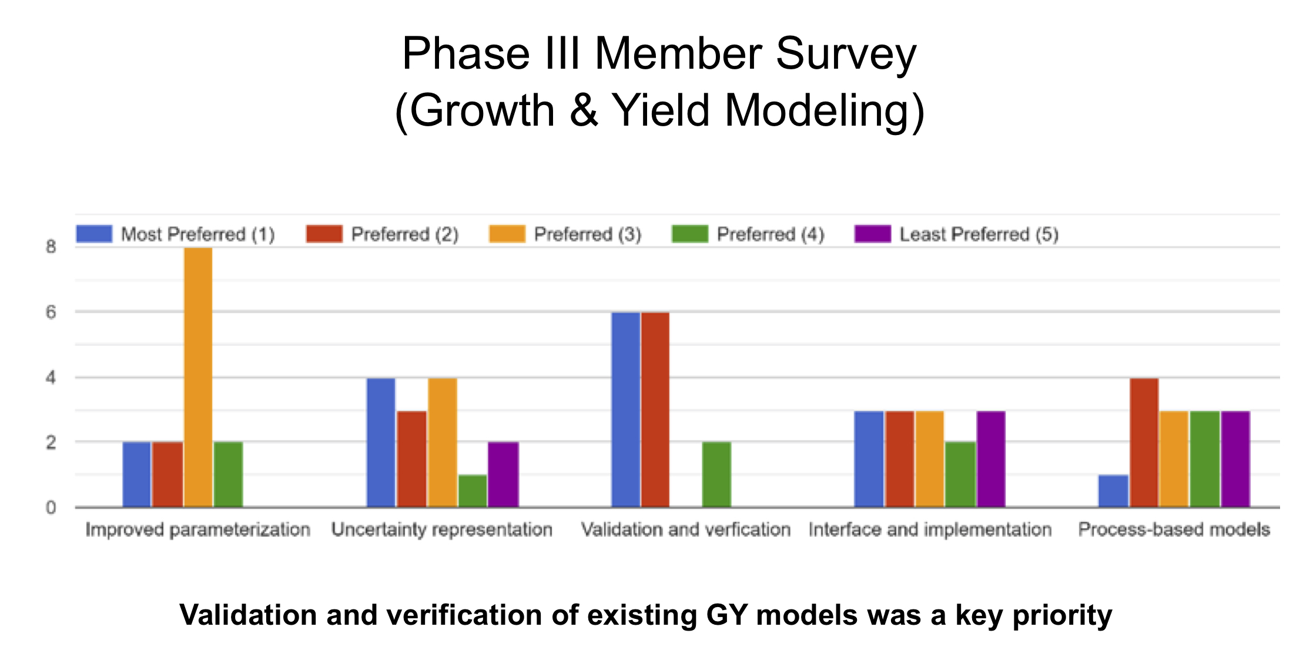
Justification
1. CAFS / IAB Phase III member survey: preference for improving the parameterization of growth and yield models.
2. Verification and validation of relationship between direct measures of site quality with indirect evaluation through top height vs. age.
3. Focus in in growth and yield modeling, but will also impact ‘remote sensing’ and ‘improved silviculture’ subject areas.
Center for Advanced Forestry Systems 2021 Meeting

Slide 3
Hypotheses or Objectives
Dominant trees on site are a good indicator of the myriad available inputs/resources for producing wood.
Observed site index is a function of both static attributes (e.g. elevation, latitude, soil composition), dynamic stand measurements (e.g. basal area, mean diameter), and regional attributes that measure within historic ranges (e.g. temperature, precipitation).
Primary objective is to build a direct model of site quality that incorporates the measures above and may be evaluated in a manner that substitutes directly for site index in applications.
Secondary objective is to provide a mapping of constituent elements of model, allowing for site-specific predictions; a parallel effort to carrying capacity (CAFS 19.75).
Center for Advanced Forestry Systems 2021 Meeting

Slide 4
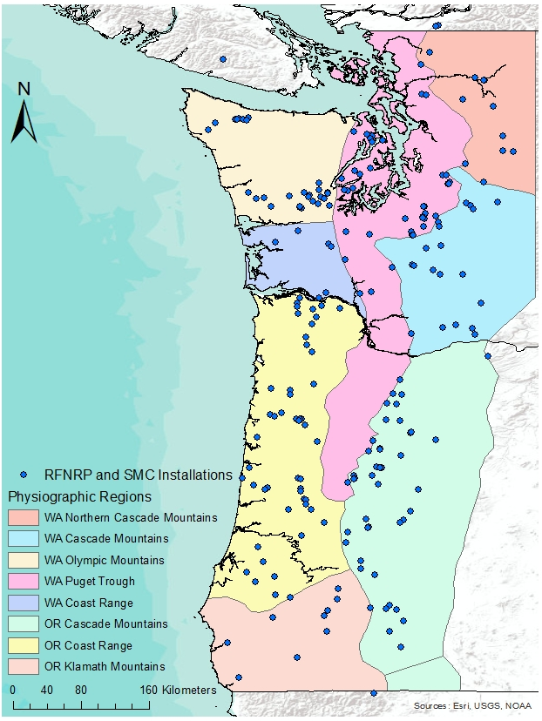
Methods
Summary of plot data sources and critical values
Project Description Plots Obs BH.Age Top.Ht
RFNRP I Unthinned natural stands of Douglas-fir 89 8 39 100
RFNRP II Thinned natural stands of Douglas-fir 39 5 34 5
RFNRP III Young, thinned, and low-site quality planted stands of Douglas-fir 22 9 28 71
RFNRP IV Precomm. thinned and low-stocked planted stands of Douglas-fir 26 6 35 98
SMC I Multiple thinning treatments on juvenile stands of Douglas-fir 91 8 19 61
SMC II Thinning middle aged Douglas-fir plantations 12 6 31 87
SMC III Operationally planted Douglas -fir at a wide range of spacings 127 7 11 36
¹ RFNRP: Regional Forest Nutrition Research Project
² SMC: Stand Management Cooperative
³ Obs: Average number of observations across Plots within Project
⁴ BH.Age: Median breast-height age value among observations
⁵ Top.Ht: Median top-height among observations
Center for Advanced Forestry Systems 2021 Meeting

Slide 5
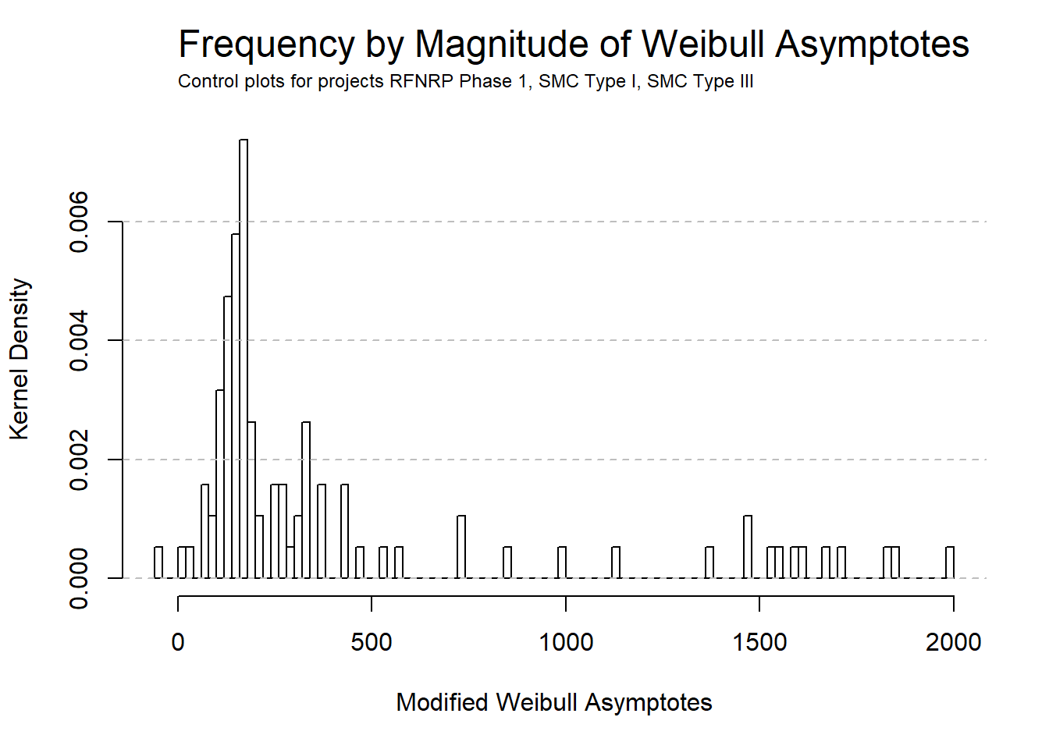
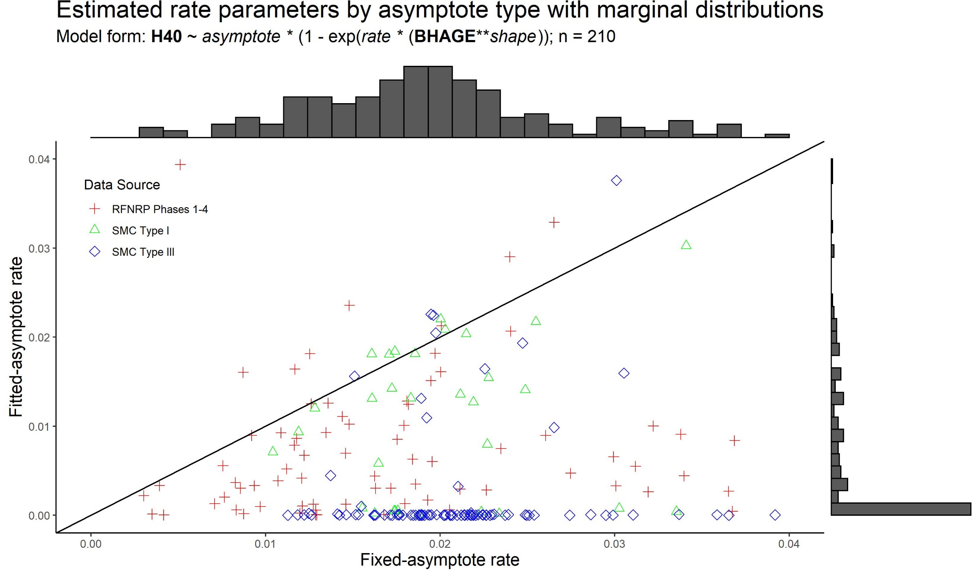
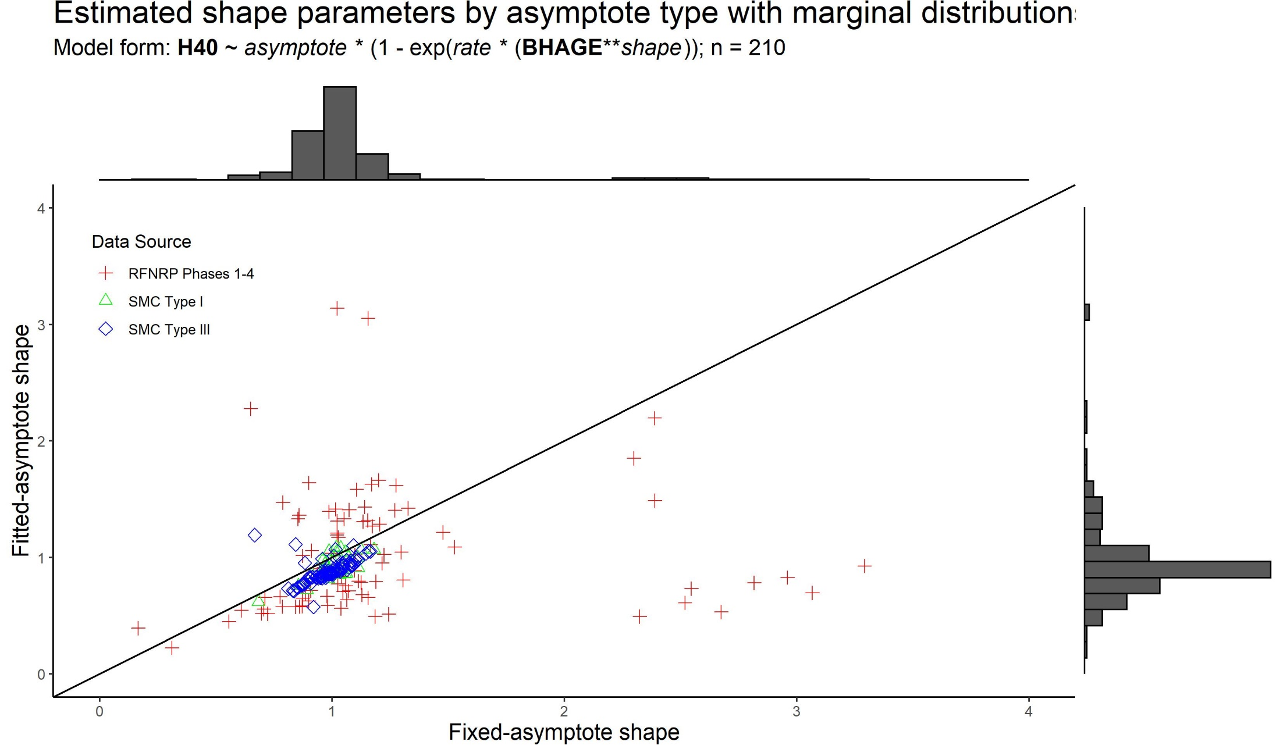
Methods
Modified-Weibull asymptote parameter prediction: Effect of fit/fixed asymptote on rate and shape parameter values. H40 ~ asymptote * {1 – exp[rate * (BHAGE ** shape)]}
Center for Advanced Forestry Systems 2021 Meeting

Slide 6
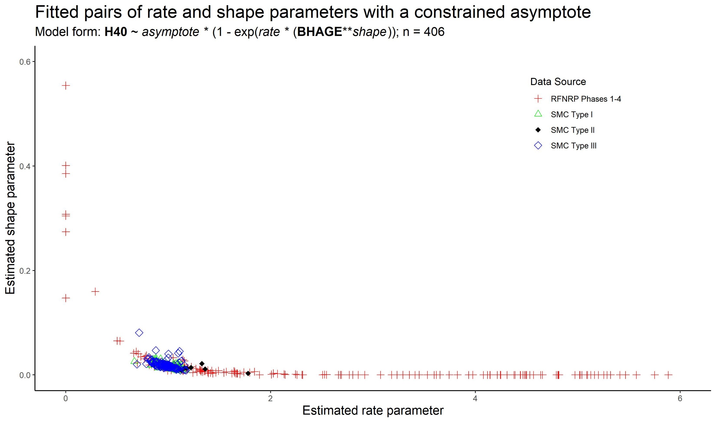
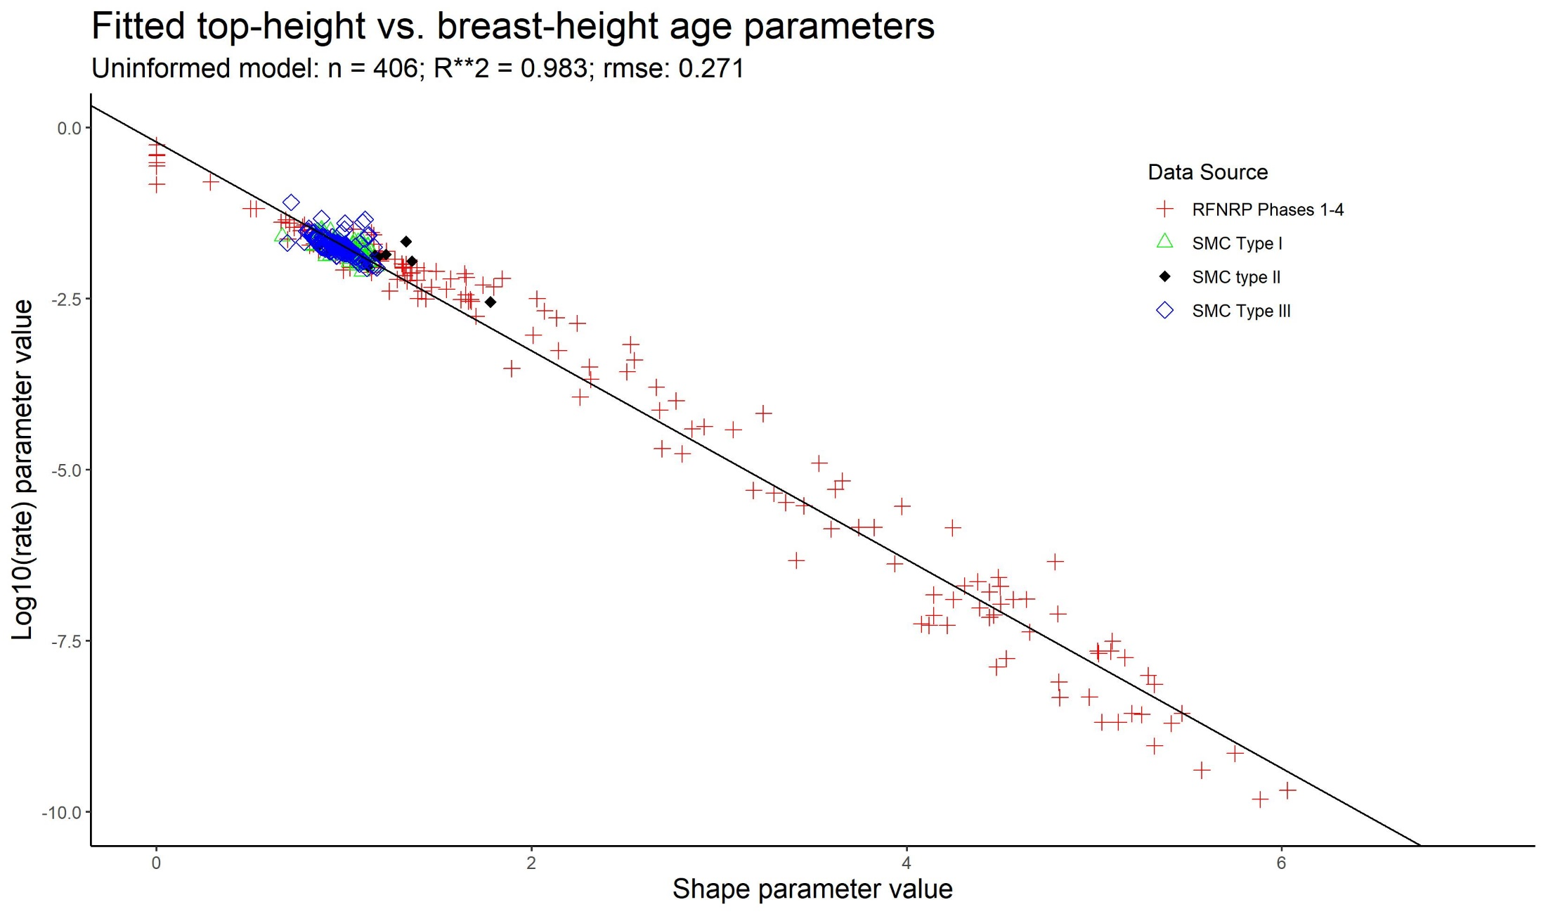
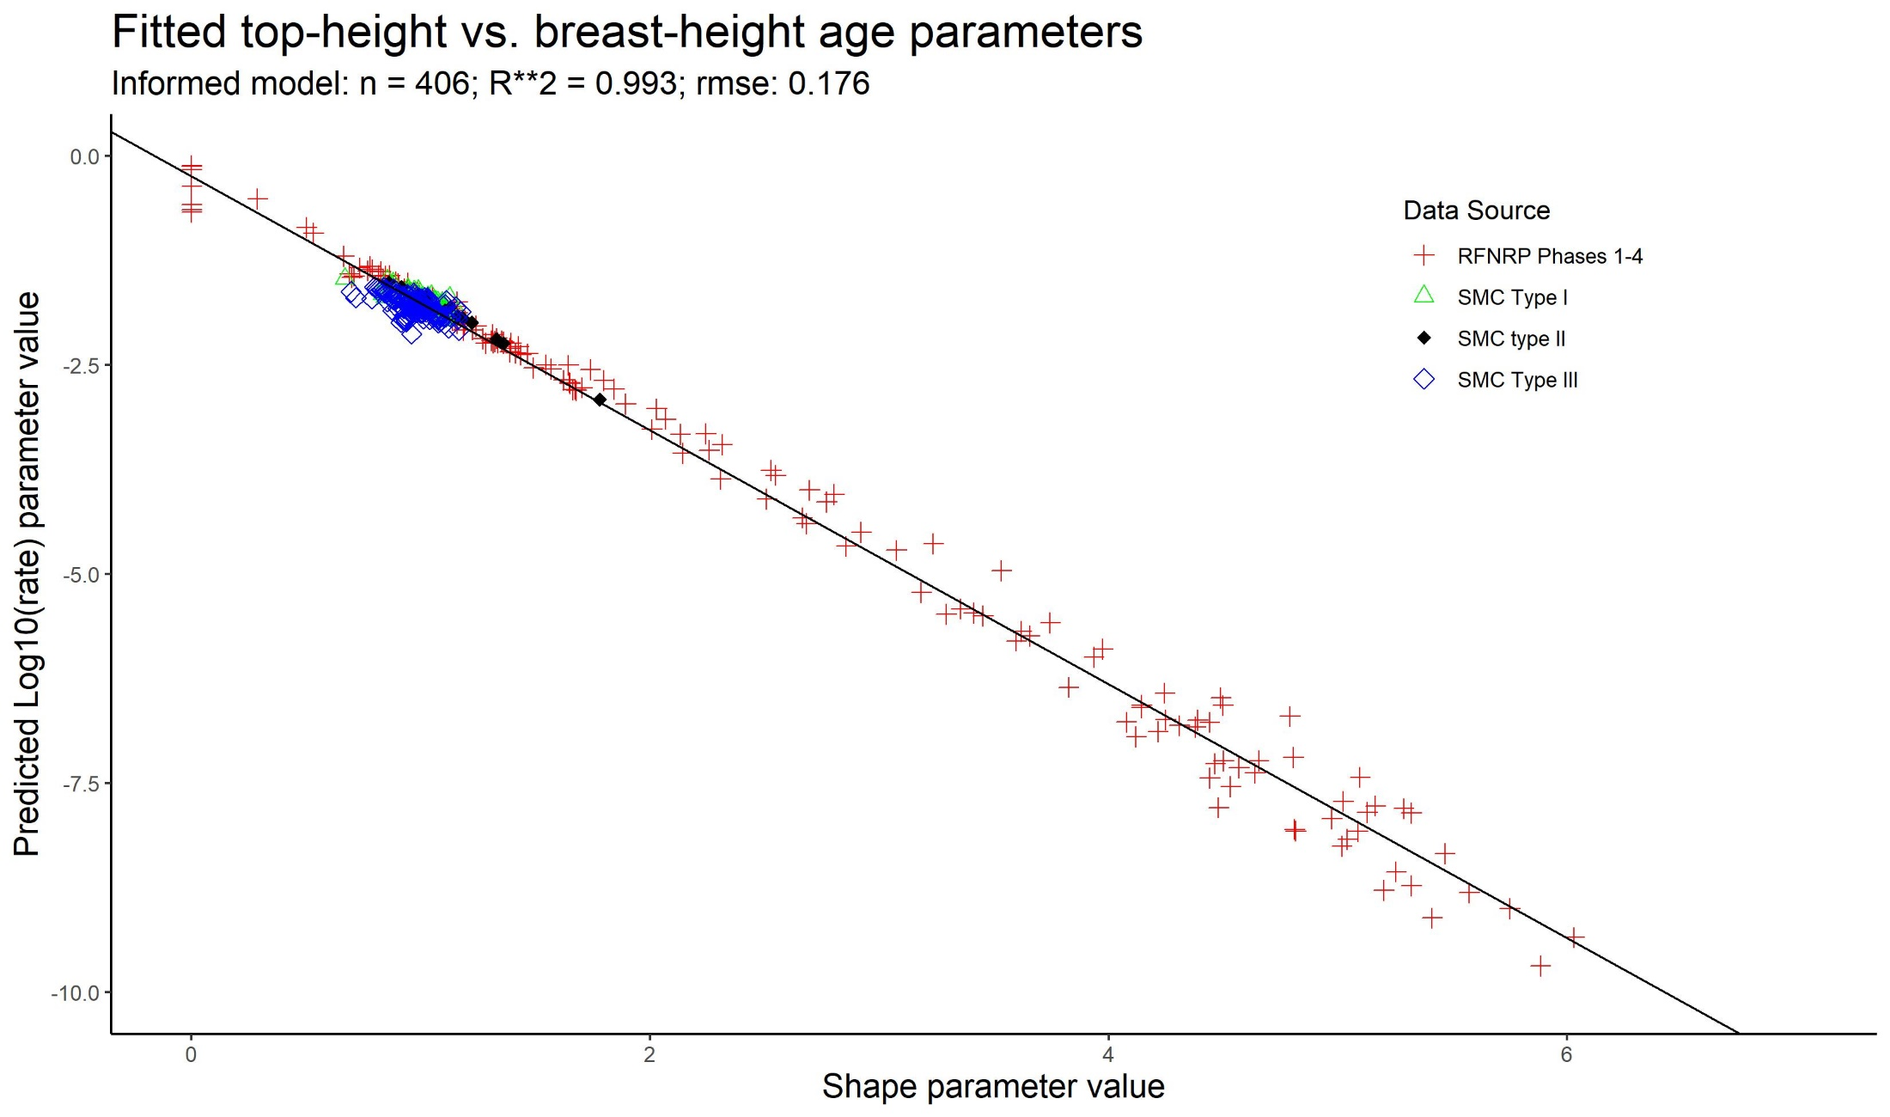
Major Findings
Weibull model rate & shape parameter pairs: Relationship; naïve prediction; size/density informed model
Center for Advanced Forestry Systems 2021 Meeting

Slide 7
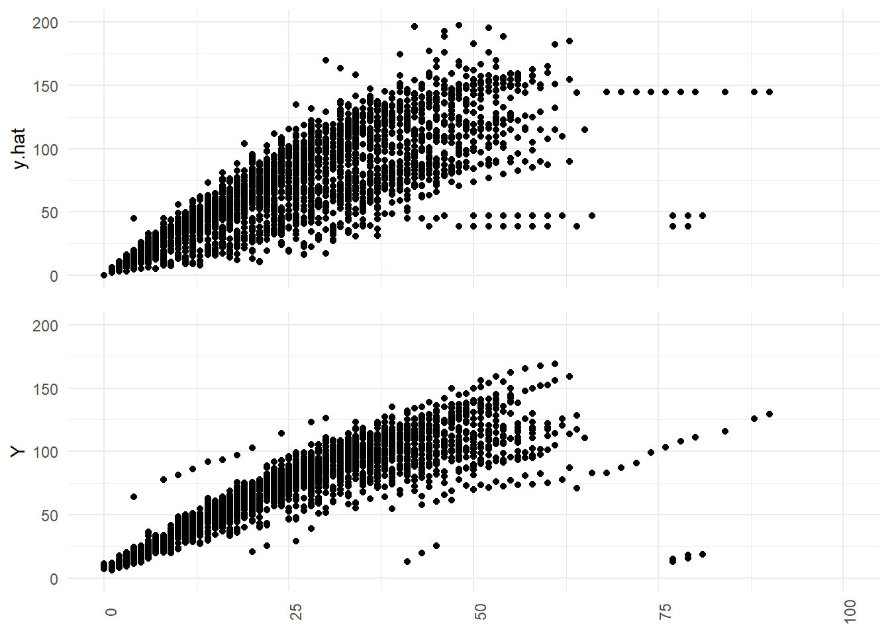
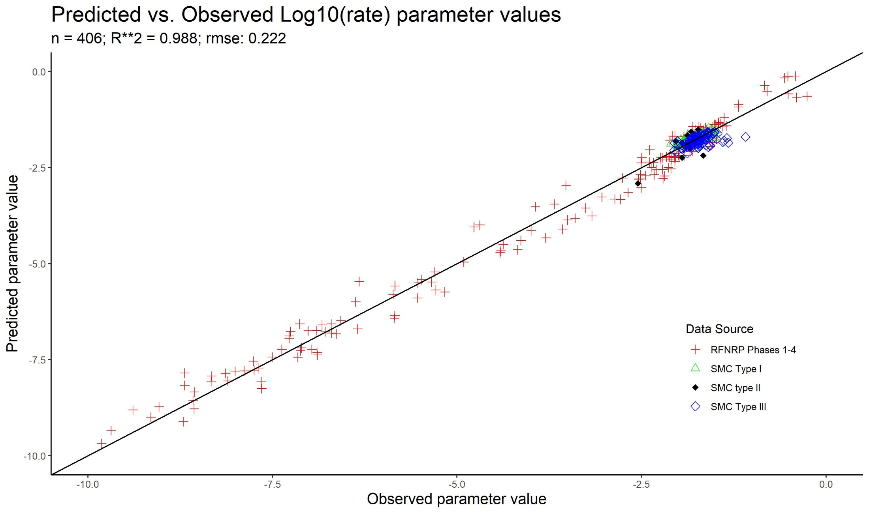
Major Findings
Model-predicted rate parameter: Fit comparisons; back-transformed heights vs. observations
Center for Advanced Forestry Systems 2021 Meeting

Slide 8
Deliverables
Complete: Model relating log₁₀(rate) ~ shape parameter values [LOO cross-validation pending]. Manuscript in preparation.
Forthcoming: Model predicting shape parameter from static, dynamic, and regional attributes.
Public presentation(s) of findings at CAFS Annual Meeting and Regional research meetings.
Online tool for mapping of base layers and facilitating site index predictions in development through partnership with Precision Forestry Cooperative at University of Washington.
Center for Advanced Forestry Systems 2021 Meeting

Slide 9
Company Benefits
Rate and shape prediction allow for both naïve site quality predictions, and predictions informed by a single plot measurement.
Dynamic nature of log₁₀(rate) ~ shape model suggests that there exists an rate-maximizing stand structure given a shape parameter.
Silvicultural strategies, their associated financial implications, and impact on final yield can be analyzed and compared.
Ability to evaluate/predict future changes in site quality as base layers are updated, or changes to historic ranges of predictors can be estimated. Both are likely to occur at a higher frequency than inventory re-measurement.
Center for Advanced Forestry Systems 2021 Meeting

Slide 10
Summary
Observed relationship between rate and shape parameters (when asymptote is constrained) suggest a uniqueness to shape that was originally associated with site index.
Best height predictions when when BHAGE between 12 and 35 years; variance increases with younger & older BHAGE.
Dynamic nature of rate given a shape suggests that crossover effect (Scott et. al. 1993) may be sustained deeper into stem-exclusion stage.
Exploration of machine-learning techniques to relate shape parameter to biogeoclimatic data has begun.
Scott, W.R., Meade, R., and R. Leon. 1993. Observations from 9 to 19-year-old Douglas-fir variable density plantation test beds. Forestry Research Field Notes, Paper #92-2. Weyerhaeuser Company, Timberlands Forest Resources R&D, Silviculture-West,
Center for Advanced Forestry Systems 2021 Meeting

