Slide 1
Progress Report
Stand Response to Thinning:
Enhancing Response Prediction Through Modeling CAFS 20.82
Eric Turnblom, Jason Cross (UW)
Aaron Weiskittel (U ME)
Cristian Montes, Bronson Bullock (UGA)
Jason Cross, presenter
Center for Advanced Forestry Systems 2020 Meeting
Notes:
1

Slide 2
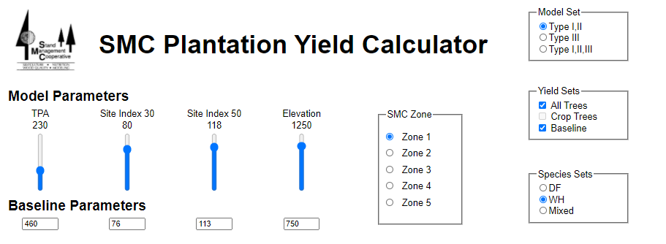
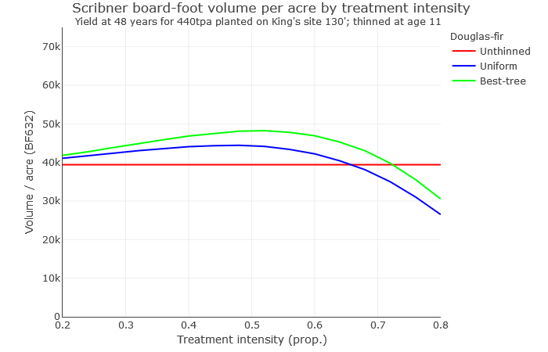
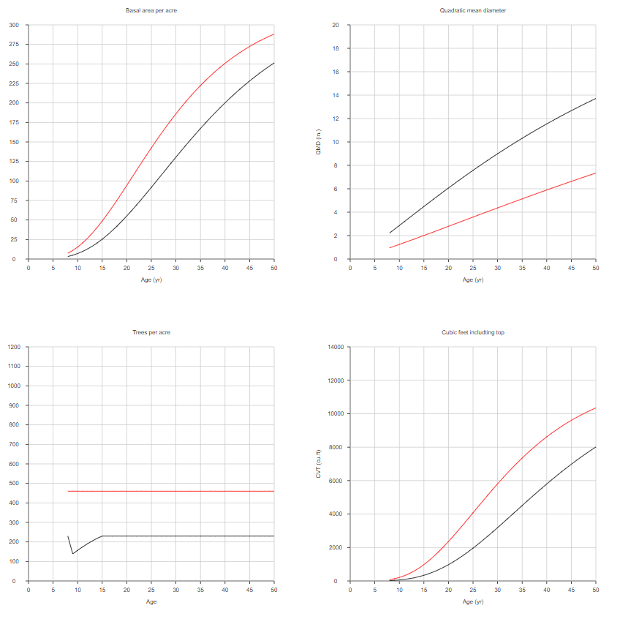
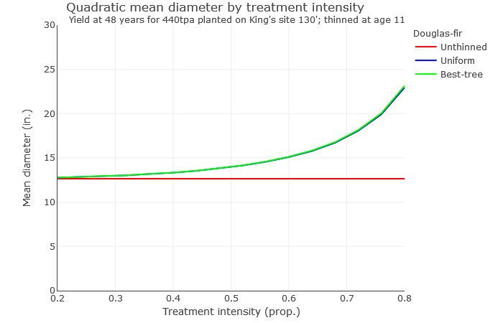
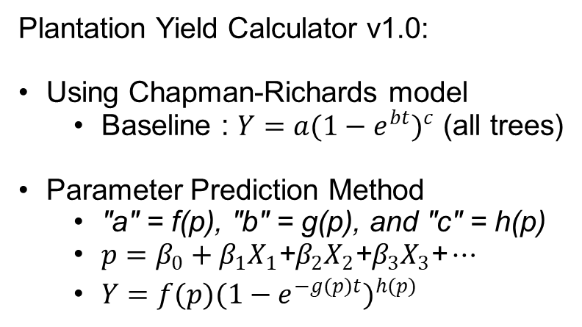
Project Overview
Plantation Yield Calculator v1.0:
Using Chapman-Richards model
Baseline : $Y={a(1−e^{bt})}^{c}$ (all trees)
Parameter Prediction Method
"a" = f(p), "b" = g(p), and "c" = h(p)
$p=β_{0}+β_{1}X_{1}\text{+}β_{2}X_{2}\text{+}β_{3}X_{3}\text{+}⋯$
${Y=f(p)(1−e^{−g(p)t})}^{h(p)}$
Center for Advanced Forestry Systems 2020 Meeting

Slide 3
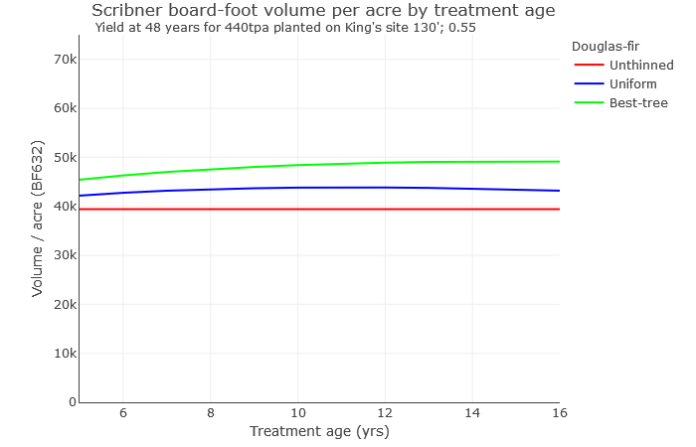
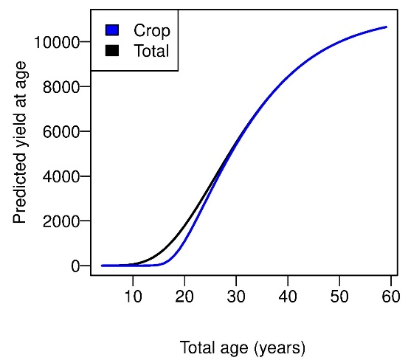
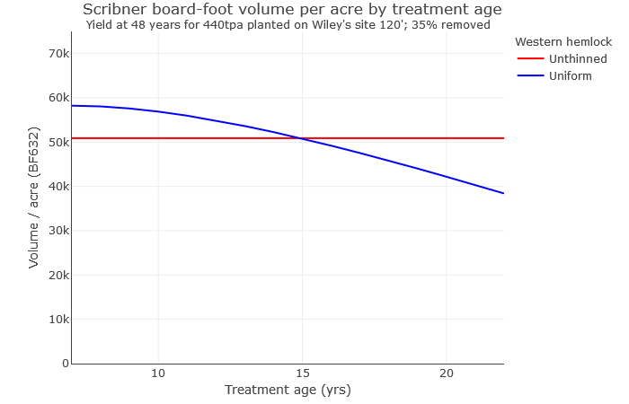



Current Progress
Augment model to allow for silvicultural treatment variables
Treatment type
Treatment intensity / degree
Time (years) since treatment
Pre-Commercial Thinning (PCT)
Use a ratio of ${Yield}_{pct}/{Yield}_{all}$.
$$Y_{trt}= Y_{base} + b{ YST}^{−c YST}$$
Center for Advanced Forestry Systems 2020 Meeting

Slide 4
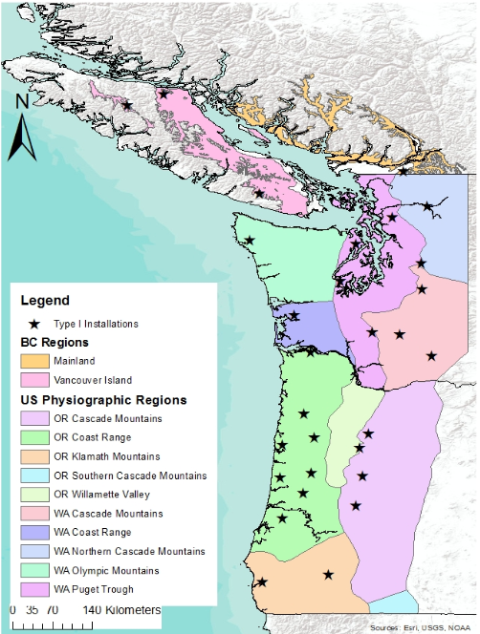
Future Plans
Further updates on PYC modeling
Version 2.0 : Baseline Equations
Version 2.1 : Version 2.0 + PCT effect
Version 2.2 : Version 2.1 + CT effect
Benchmark Model with treatment augmentations
Jackknifing
Cross-validation
Expand efforts to other regions, as appropriate
Enhance existing relationships between scientists and personnel at the relevant CAFS sites
Develop new relationships
Develop data sharing plans
Center for Advanced Forestry Systems 2020 Meeting

