Slide 1
Progress Report
Resilience of soil organic carbon to harvesting: A long-term soil productivity experiment
CAFS.20.81
Jeff Hatten, Oregon State University
Stephanie Winters, Oregon State University, PhD student
Center for Advanced Forestry Systems 2020 Meeting
Notes:
1

Slide 2
Project Overview
Objectives: Elucidate the mechanisms that impart resilience to forest SOC after extreme disturbances across a wide range soils and forest types of the world.
Center for Advanced Forestry Systems 2020 Meeting
Notes:
USFS and New Zealand Scion Long-term Soil productivity sites

Slide 3
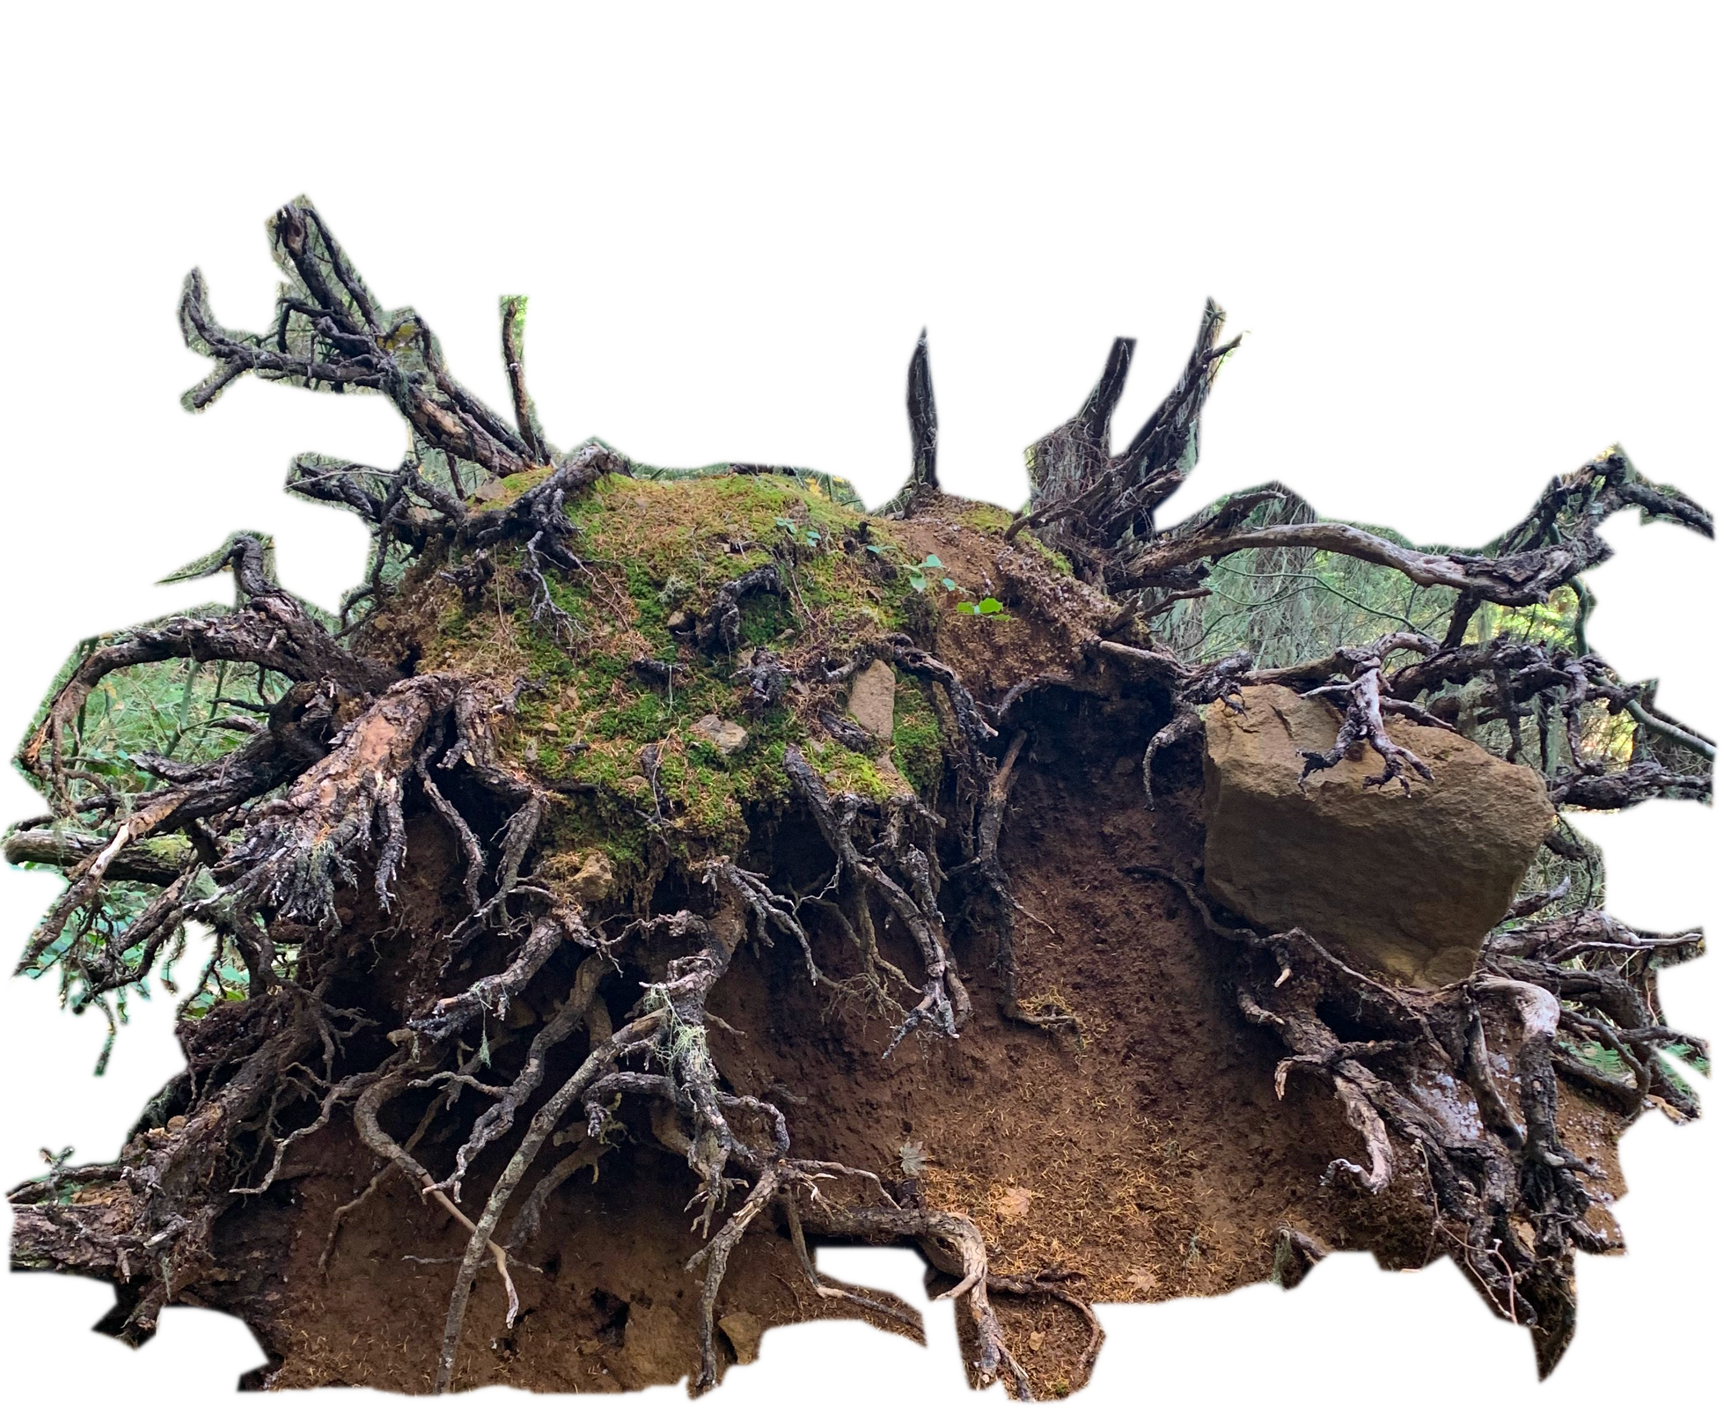
Project Overview
Objectives: Elucidate the mechanisms that impart resilience to forest SOC after extreme disturbances across a wide range soils and forest types of the world.
Hypothesis: Decaying-roots replace SOC vulnerable to disturbance and organo-mineral complexes are resistant to disturbance-induced degradation.
Center for Advanced Forestry Systems 2020 Meeting
Notes:
USFS and New Zealand Scion Long-term Soil productivity sites

Slide 4
Project Overview
Objectives: Elucidate the mechanisms that impart resilience to forest SOC after extreme disturbances across a wide range soils and forest types of the world.
Hypothesis: Decaying-roots replace SOC vulnerable to disturbance and organo-mineral complexes are resistant to disturbance-induced degradation.
Goals: Impact the way forest soils are managed by identifying sites and soils that are vulnerable or resilient to soil carbon loss.
Center for Advanced Forestry Systems 2020 Meeting
Notes:
USFS and New Zealand Scion Long-term Soil productivity sites

Slide 5
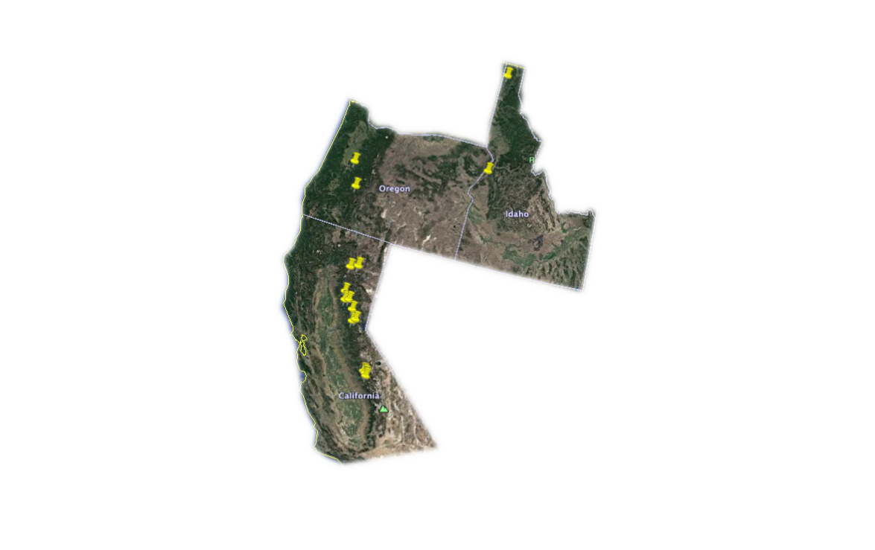
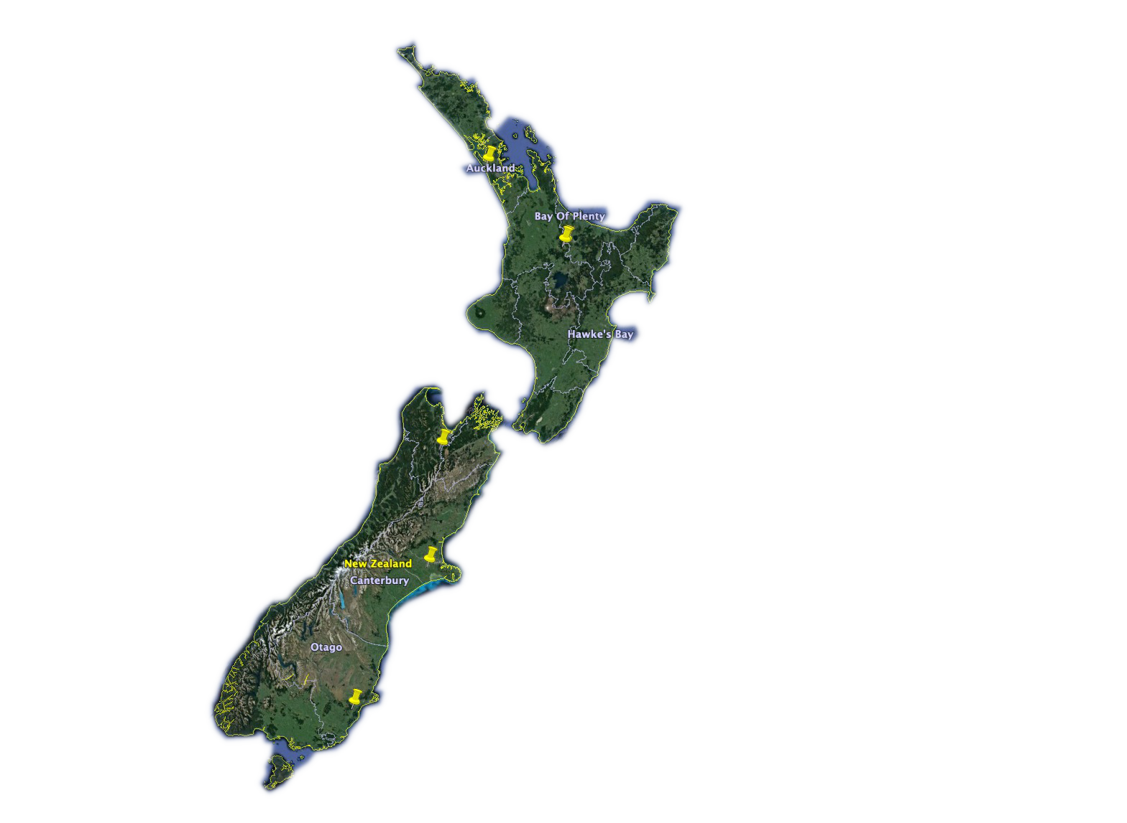
Current Progress
United States
New Zealand
Center for Advanced Forestry Systems 2020 Meeting
Notes:
USFS and New Zealand Scion Long-term Soil productivity sites

Slide 6
Current Progress
United States
New Zealand
Organic Matter Removal Treatments
OM0 - Tree boles removed.
OM2 – All aboveground biomass removed. Bare soil exposed.
Center for Advanced Forestry Systems 2020 Meeting
Notes:
USFS and New Zealand Scion Long-term Soil productivity sites

Slide 7
Current Progress
Soil Sample Timeline
Pre-harvest
5 years
15 years
25 years
United States
New Zealand
Organic Matter Removal Treatments
OM0 - Tree boles removed.
OM2 – All aboveground biomass removed. Bare soil exposed.
Center for Advanced Forestry Systems 2020 Meeting
Notes:
USFS and New Zealand Scion Long-term Soil productivity sites

Slide 8
Current Progress
Soil Sample Timeline
Pre-harvest
5 years
15 years
25 years
United States
New Zealand
Organic Matter Removal Treatments
OM0 - Tree boles removed.
OM2 – All aboveground biomass removed. Bare soil exposed.
Center for Advanced Forestry Systems 2020 Meeting
Notes:
USFS and New Zealand Scion Long-term Soil productivity sites

Slide 9
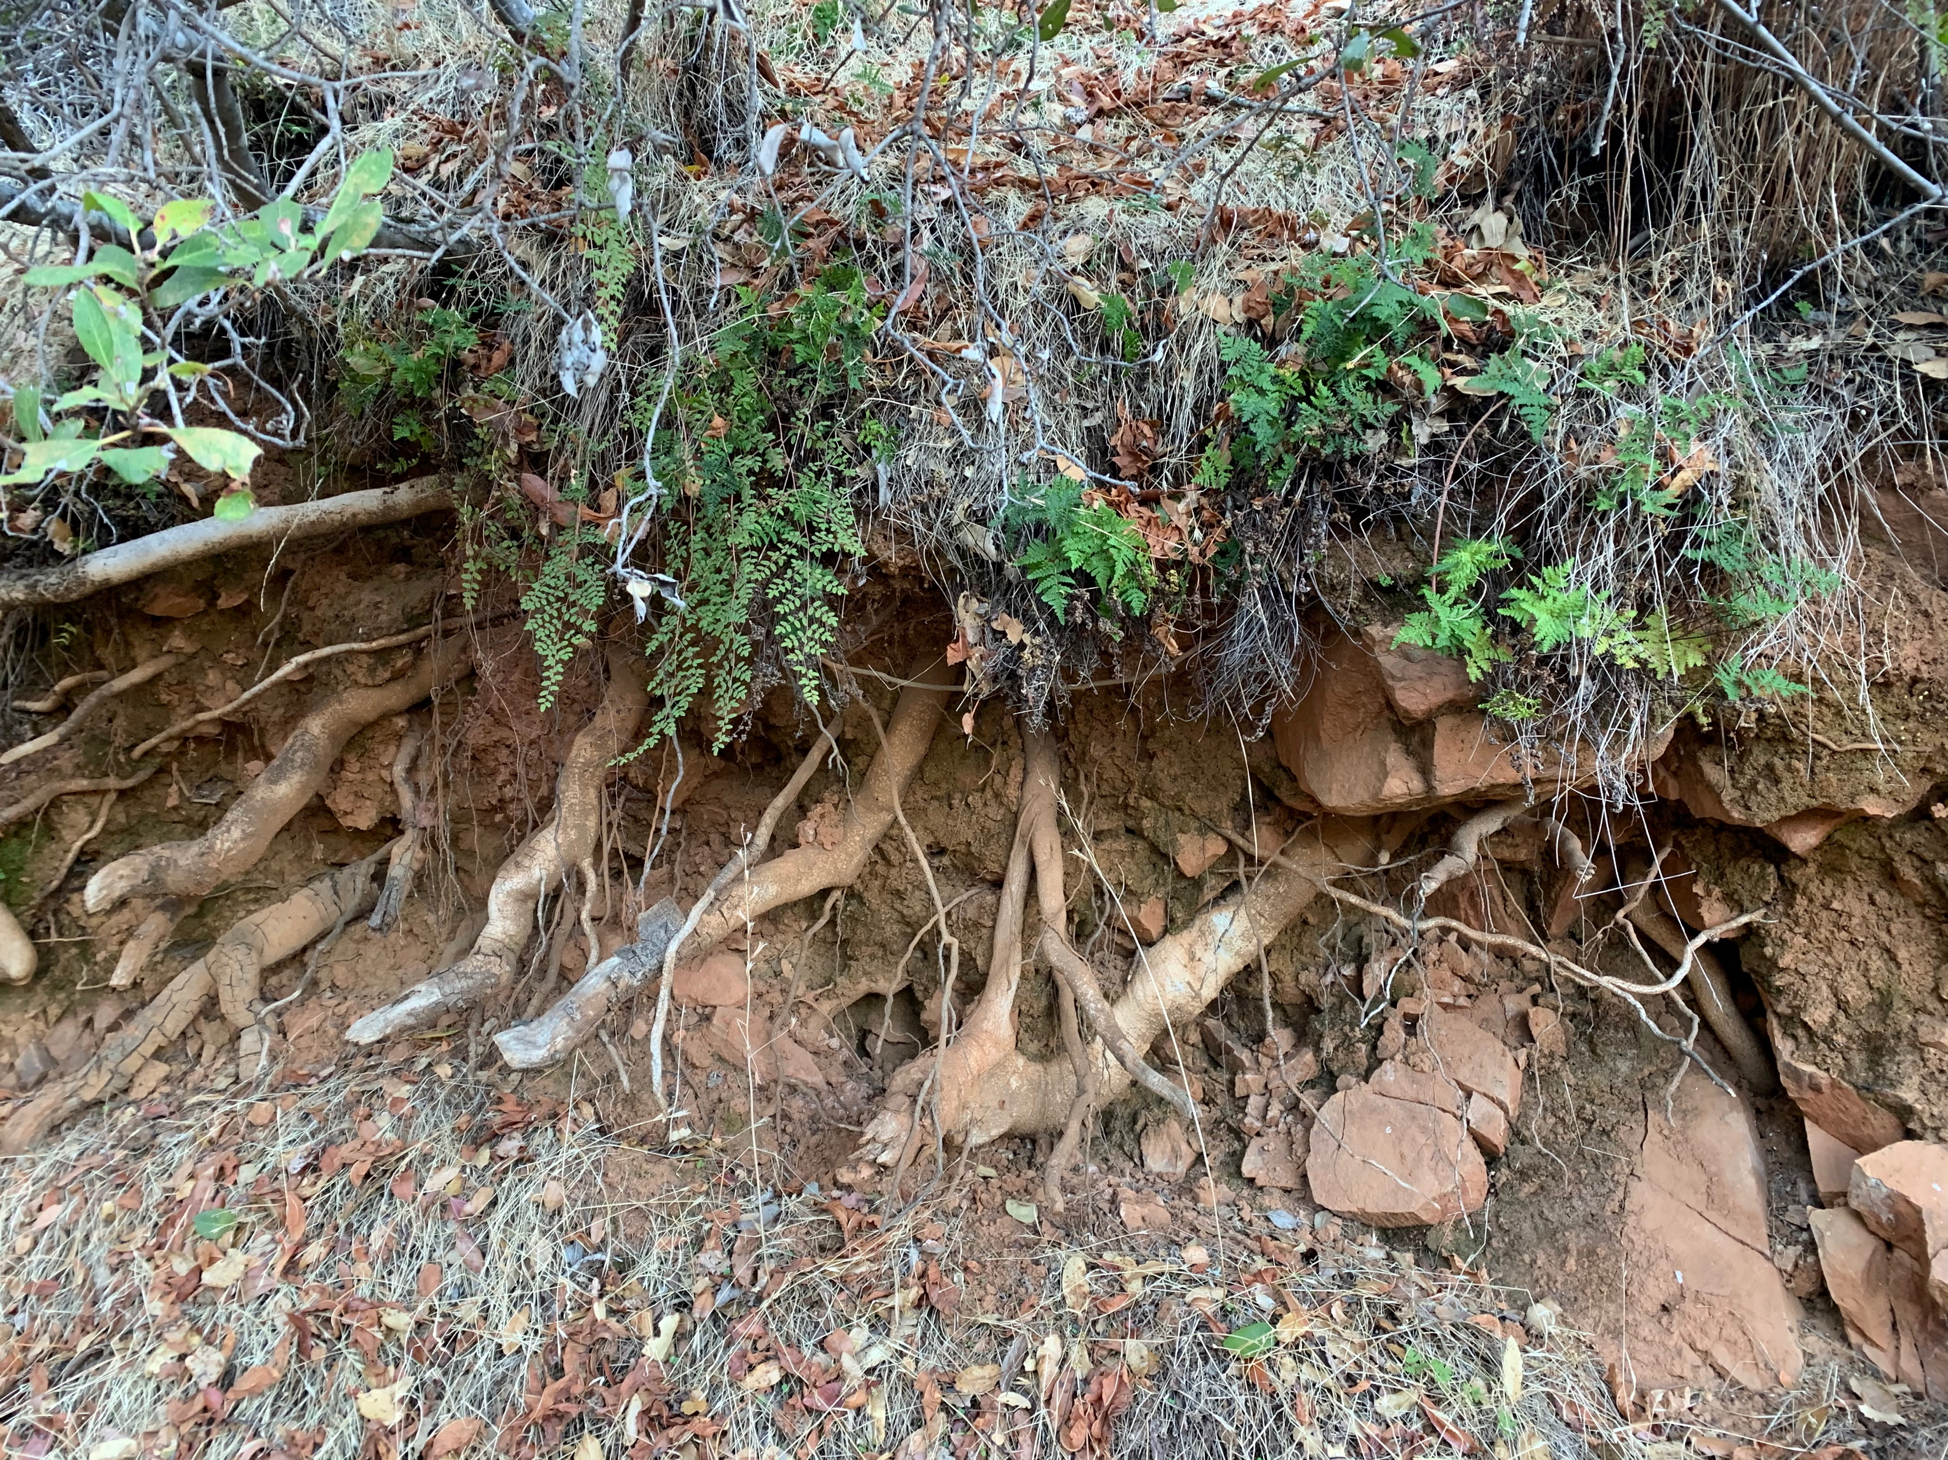
Future Plans
Field sampling summer 2021!
Idaho and Oregon for third time point
Lab Work and Data Analysis
Summer 2021 Field Work
Finish CuO
Biomarker
14C abundances
Stable isotopes
BPCA
Sample ID and OR sites for the 3rd time points
Maybe go to NZ one day…you know, because of…
Center for Advanced Forestry Systems 2020 Meeting

