Slide 1
Progress Report
Using hyperspectral imaging
to evaluate forest health risk
CAFS.20.80
John Couture, Melba Crawford, Matthew Ginzel,
Brady Hardiman Douglass Jacobs (Purdue University)
Aaron Weiskittel, Parinaz Rahimzadeh, Peter Nelson (University of Maine) Cristian Montes, Caterina Villari, Kamal Ghandi (University of Georgia)
John Couture (Purdue University)
Center for Advanced Forestry Systems 2020 Meeting
Notes:
1

Slide 2
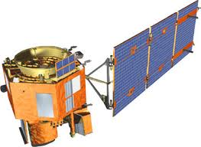
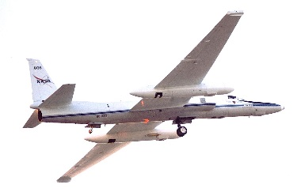
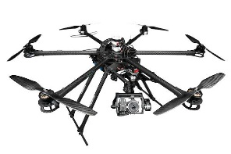
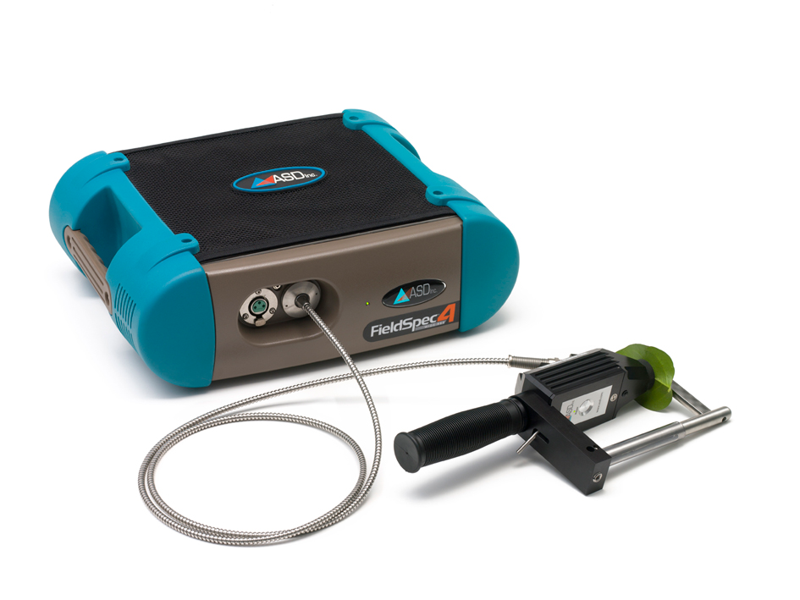
Project Overview
Monitoring forest health is challenging because of the spatial scale (both horizontal and vertical) of forests
Remote sensing approaches to monitor natural and managed forest systems have the potential to resolve logistical challenges with integrating precision agricultural into forest management
Questions remain about relating information available from remote sensing into forest management
Center for Advanced Forestry Systems 2020 Meeting

Slide 3
Current Progress
We have three specific objectives:
determine the ability of hyperspectral data to provide information related to tree status in response to abiotic and biotic stress
assess the reliability of hyperspectral information to scale from leaf, to tree, to stand, to landscape-level measurements
evaluate the validity of hyperspectral data to characterize stress responses over different spatial and temporal scales in different geographic locations
Center for Advanced Forestry Systems 2020 Meeting

Slide 4
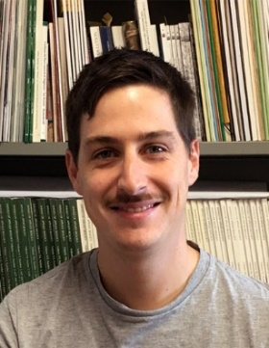

Current Progress
We have three specific objectives:
determine the ability of hyperspectral data to provide information related to tree status in response to abiotic and biotic stress
assess the reliability of hyperspectral information to scale from leaf, to tree, to stand, to landscape-level measurements
evaluate the validity of hyperspectral data to characterize stress responses over different spatial and temporal scales in different geographic locations
Center for Advanced Forestry Systems 2020 Meeting

Slide 5

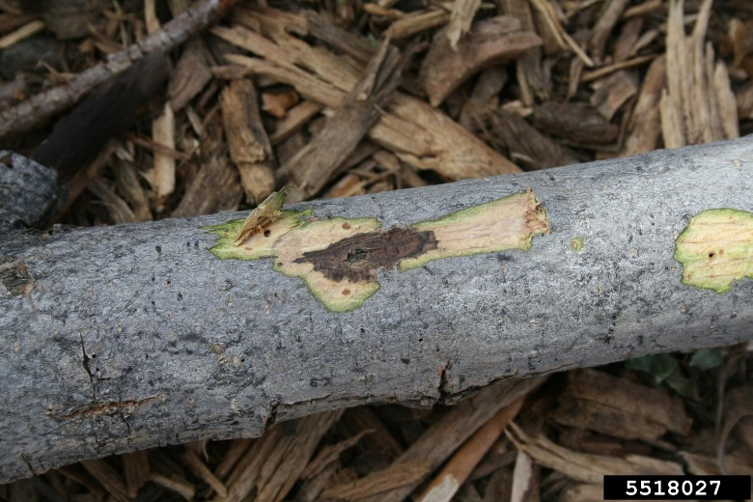
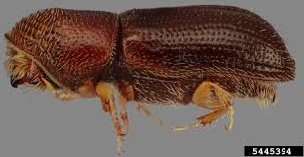
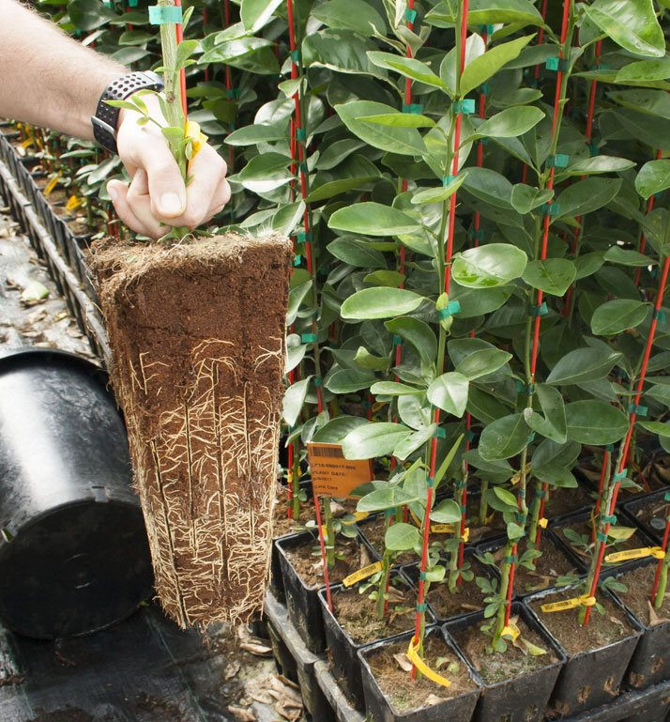
Test case: spectral detection of black walnut stress
Water stress, extended droughts
Pathogens, vectors
Container propagation,
nutrient/salt issue
Center for Advanced Forestry Systems 2020 Meeting

Slide 6
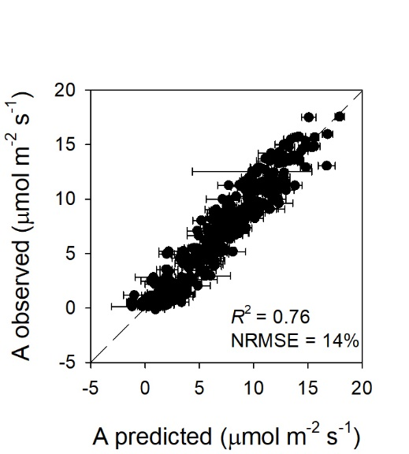
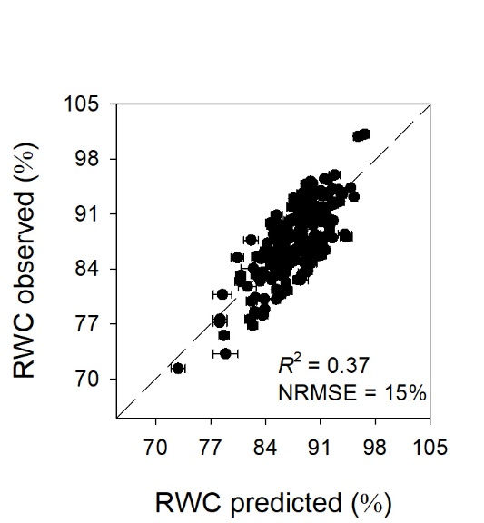
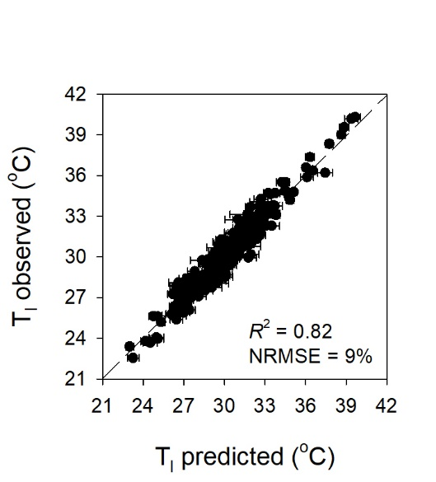
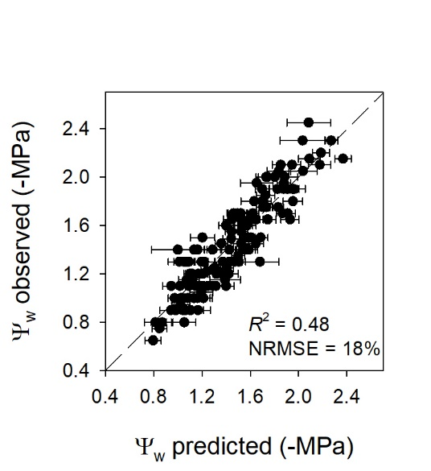
Current Progress: Previsual disease detection
Trait estimation
Center for Advanced Forestry Systems 2020 Meeting

Slide 7
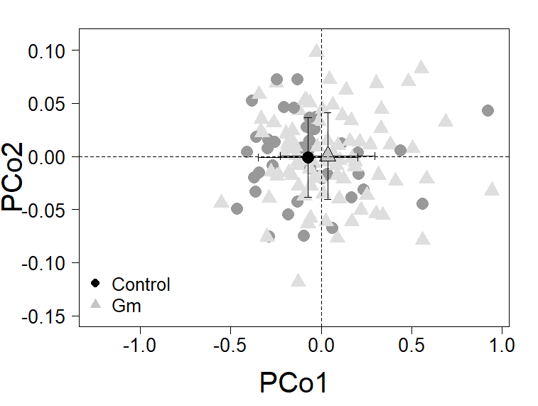
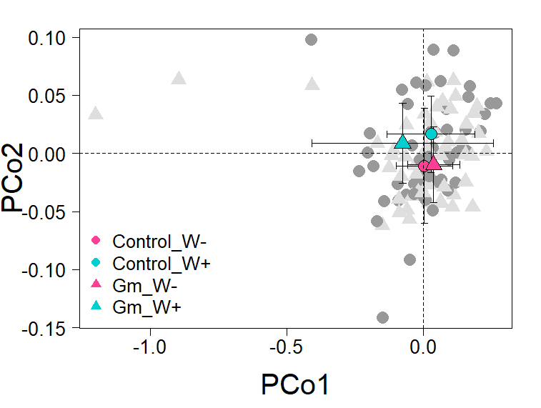
Current Progress: Previsual disease detection
Disease detection
GM detection in walnut saplings and
the influence of water stress on pathogen detection
F = 5.7
P = 0.02
F = 3.3
P = 0.06
Center for Advanced Forestry Systems 2020 Meeting

Slide 8

Current Progress: Aerial detection of chestnut blight
We have three specific objectives:
determine the ability of hyperspectral data to provide information related to tree status in response to abiotic and biotic stress
assess the reliability of hyperspectral information to scale from leaf, to tree, to stand, to landscape-level measurements
evaluate the validity of hyperspectral data to characterize stress responses over different spatial and temporal scales in different geographic locations
Center for Advanced Forestry Systems 2020 Meeting

Slide 9
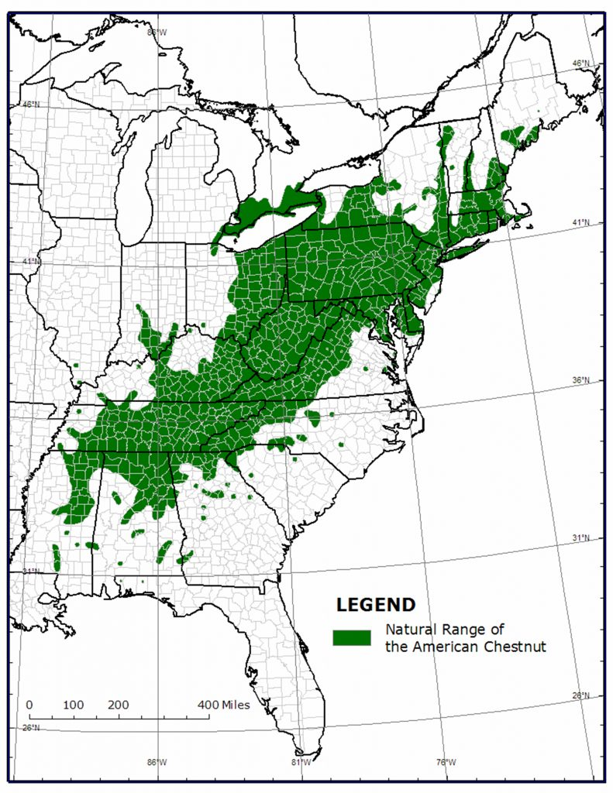
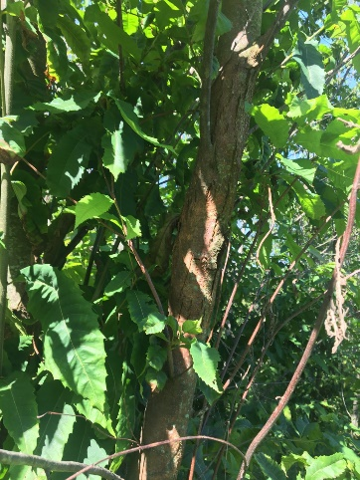
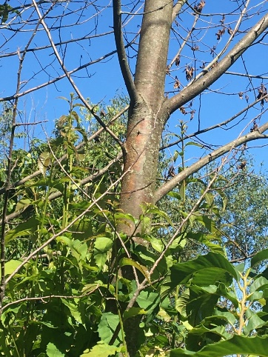
Aerial detection of Chestnut blight in mixed species plantings
American chestnut was a dominant tree species in NE/E US until extirpation due to chestnut blight introduced in early 1900s
Still exists on landscape but fails to recolonize
Stem canker initially proceeding to crown dieback
Center for Advanced Forestry Systems 2020 Meeting

Slide 10
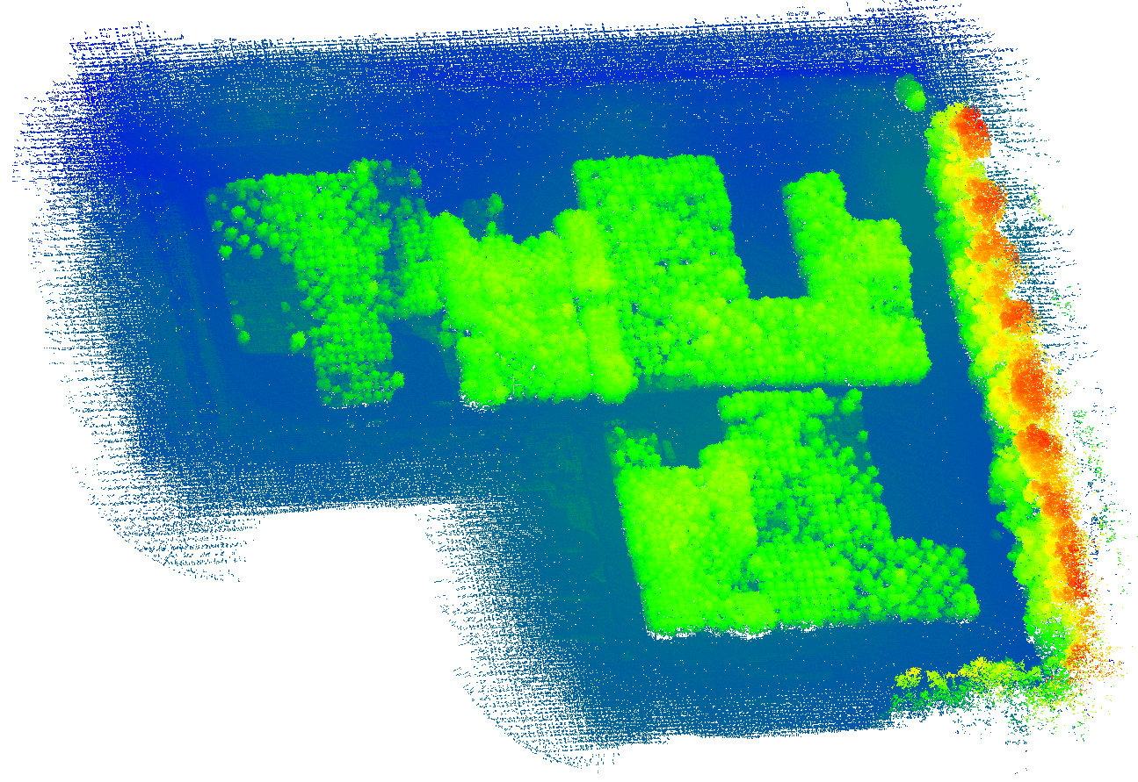
Aerial detection of Chestnut blight
Center for Advanced Forestry Systems 2020 Meeting

Slide 11
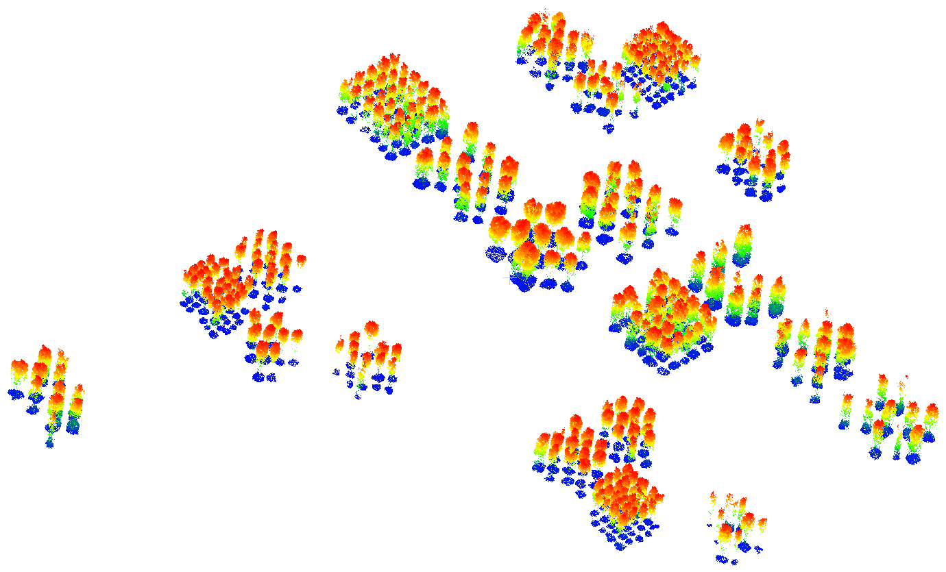
Individual Tree Extraction

Slide 12
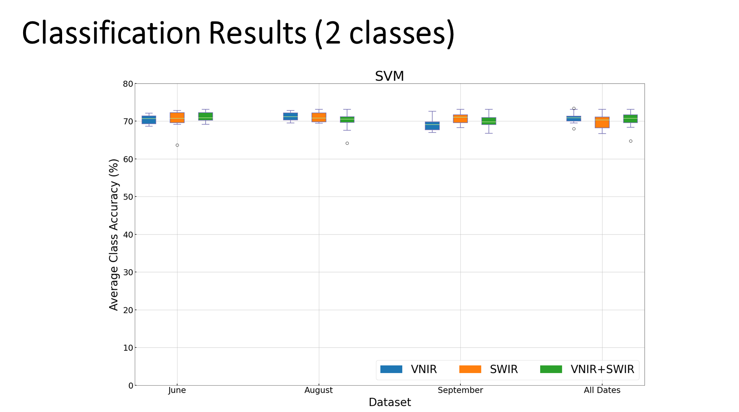
Current Progress: Aerial detection of chestnut blight
Center for Advanced Forestry Systems 2020 Meeting

Slide 13
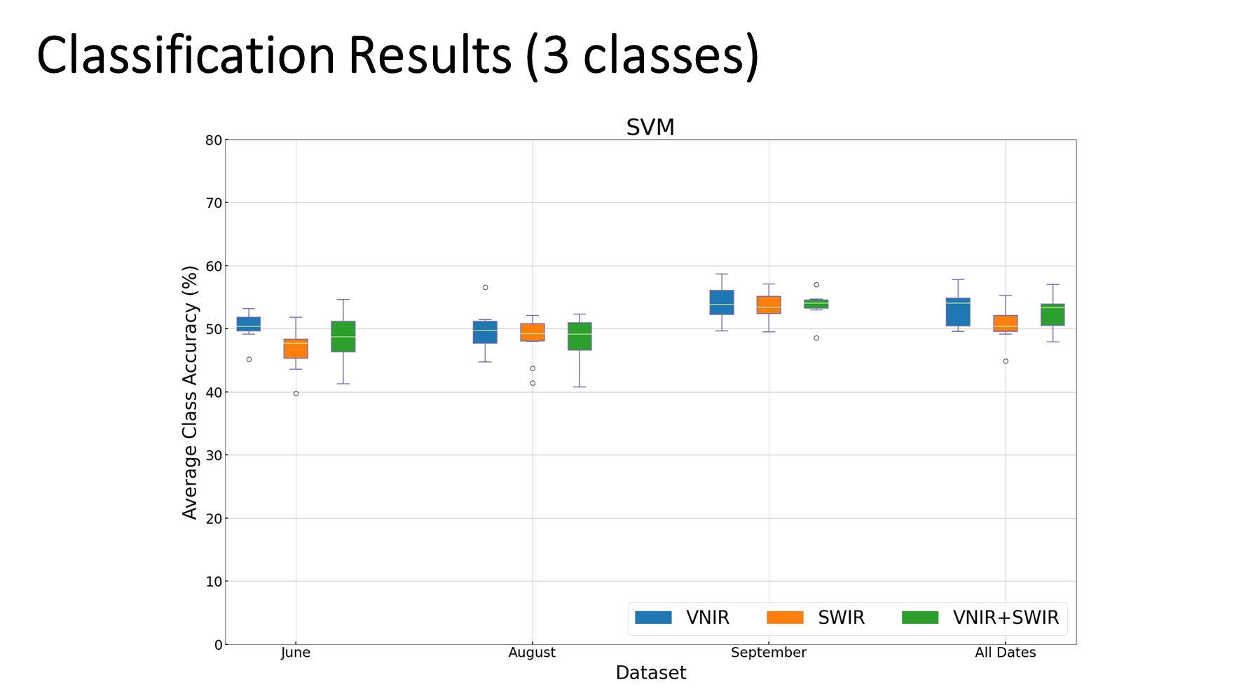
Aerial detection of Chestnut blight
Center for Advanced Forestry Systems 2020 Meeting

Slide 14
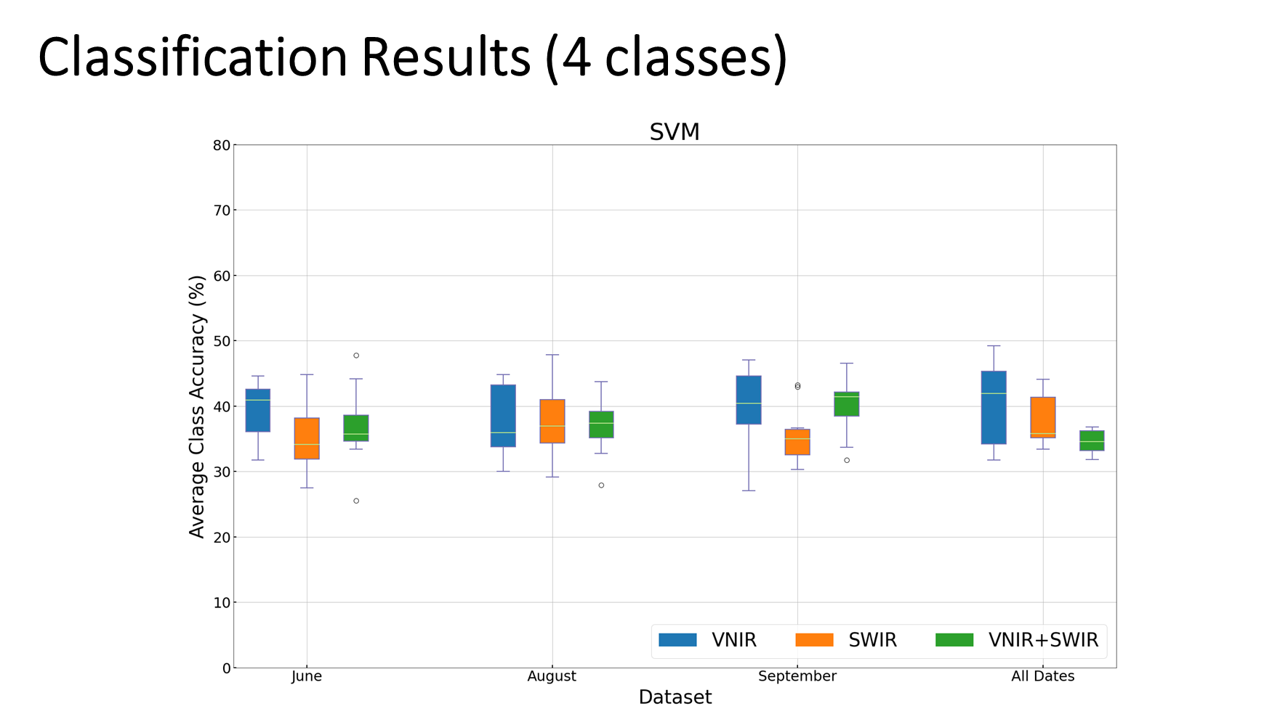
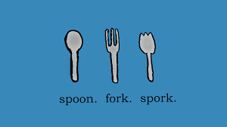
Current Progress: Aerial detection of chestnut blight
Center for Advanced Forestry Systems 2020 Meeting

Slide 15
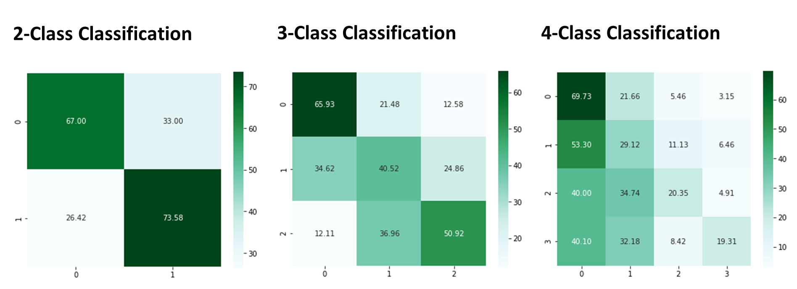
Current Progress: Aerial detection of chestnut blight
Center for Advanced Forestry Systems 2020 Meeting

Slide 16
Future Plans
We have three specific objectives:
determine the ability of hyperspectral data to provide information related to tree status in response to abiotic and biotic stress
assess the reliability of hyperspectral information to scale from leaf, to tree, to stand, to landscape-level measurements
evaluate the validity of hyperspectral data to characterize stress responses over different spatial and temporal scales in different geographic locations
Center for Advanced Forestry Systems 2020 Meeting

