Slide 1
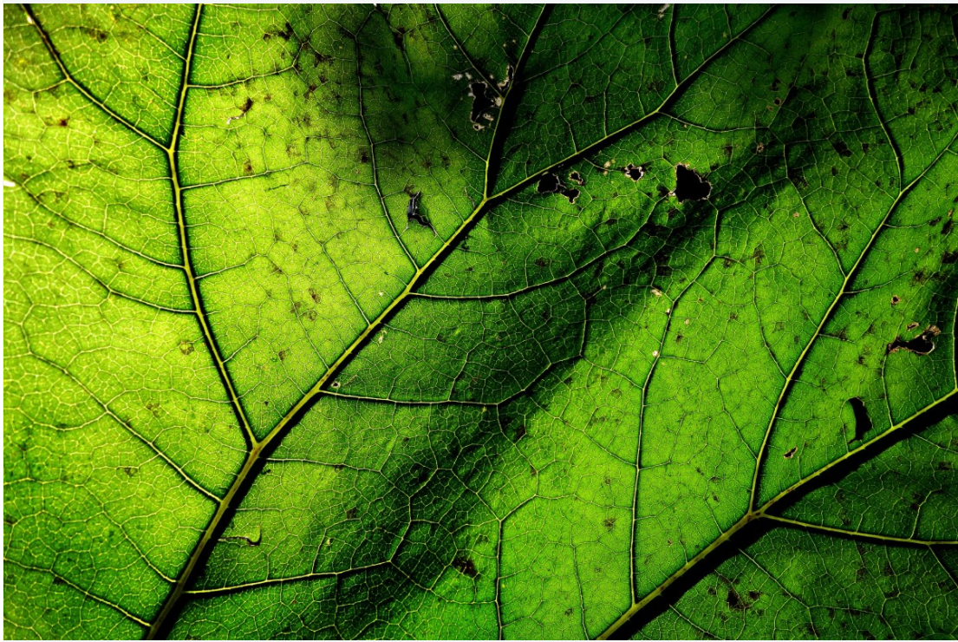
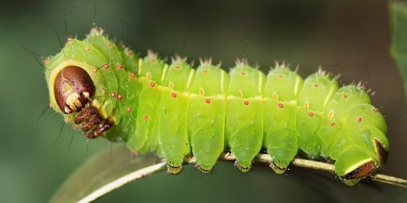
Continuing Project
Characterizing abiotic and biotic tree stress using hyperspectral information
CAFS 20.80
John Couture, Sylvia Park, Melba Crawford, Matthew Ginzel,
Brady Hardiman, Douglass Jacobs (Purdue University)
Aaron Weiskittel, Parinaz Rahimzadeh, Peter Nelson (University of Maine) Cristian Montes, Caterina Villari, Kamal Ghandi (University of Georgia)
Sylvia Park (Purdue University)
Center for Advanced Forestry Systems 2021 Meeting
Notes:
1

Slide 2
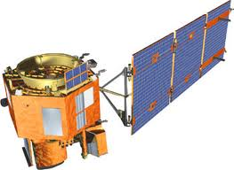
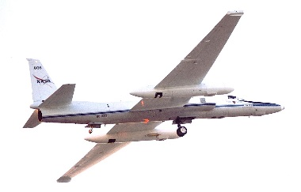
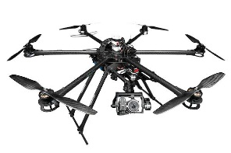
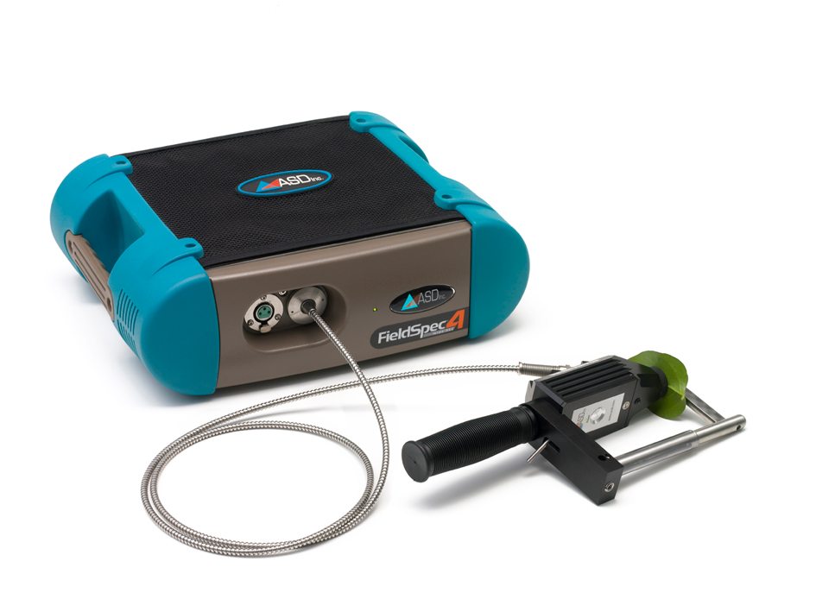
Project Overview
Monitoring forest health is challenging because of the spatial scale (both horizontal and vertical) of forests
Remote sensing approaches to monitor natural and managed forest systems have the potential to resolve logistical challenges with integrating precision agricultural into forest management
Questions remain about relating information available from remote sensing into forest management
Center for Advanced Forestry Systems 2021 Meeting

Slide 3
Reflectance spectroscopy
Background
Reflectance spectroscopy has emerged as an effective tool for assessing vegetation health.
Stress factors influence forest traits and in turn, result in changes to spectral traits.
The incorporation of reflectance spectroscopy into production forest systems, however, has not been fully realized.
Lausch et al. 2016
Center for Advanced Forestry Systems 2021 Meeting

Slide 4
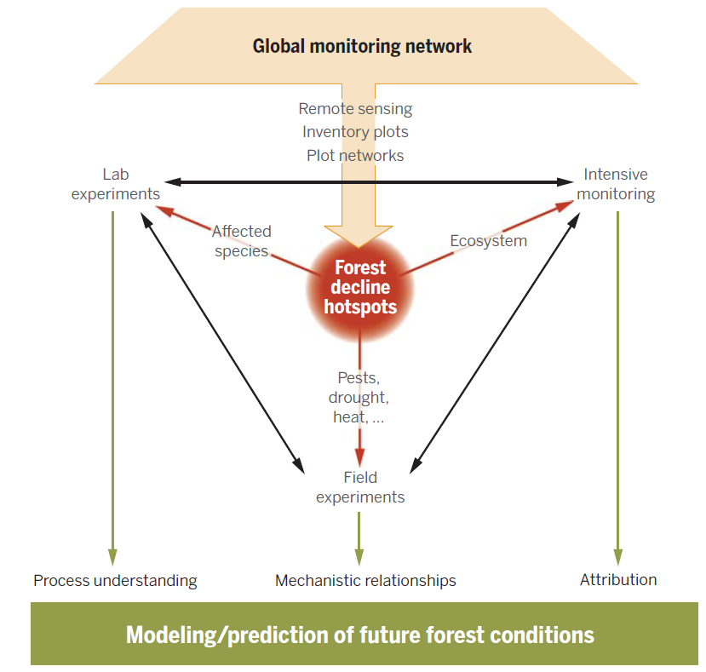
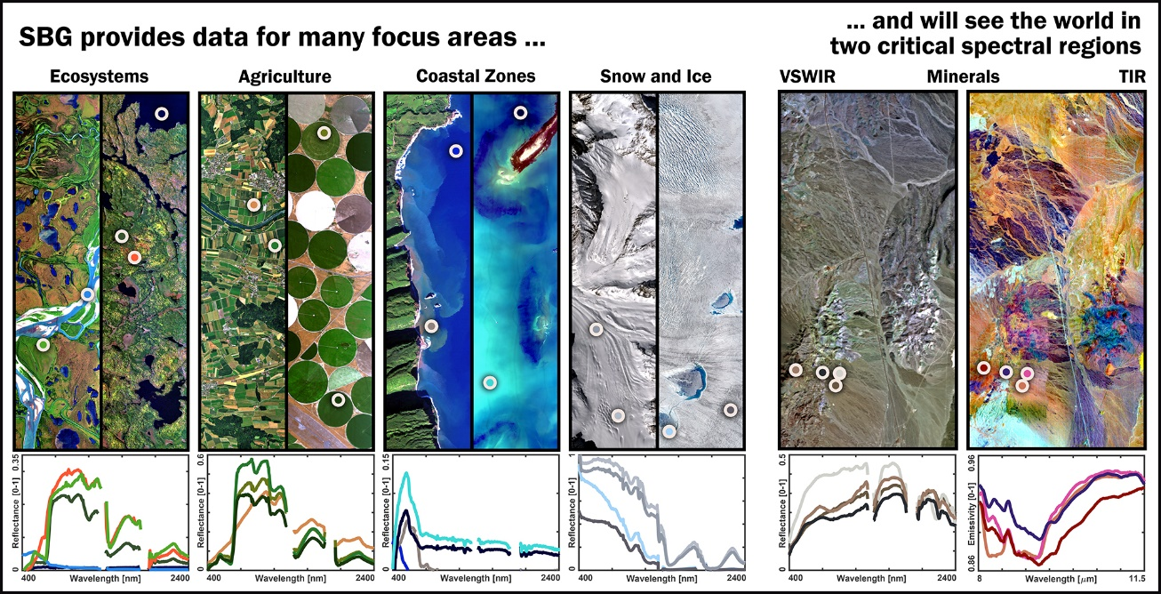
Scientific Efforts to Assess Forest Health
Background
Trumbore et al. 2015
NASA, Surface Biology and Geology
Center for Advanced Forestry Systems 2021 Meeting

Slide 5
Knowledge gaps in using hyperspectral information
Background
Fine-scale information contained in the reflectance spectrum for getting a more accurate classification of plant status.
- Accurate prediction of each functional traits.
- Classification of different abiotic and biotic stress factors.
- Determination of genetic variation in stress tolerance.
Cavender-Bares et al., 2017
Center for Advanced Forestry Systems 2021 Meeting

Slide 6
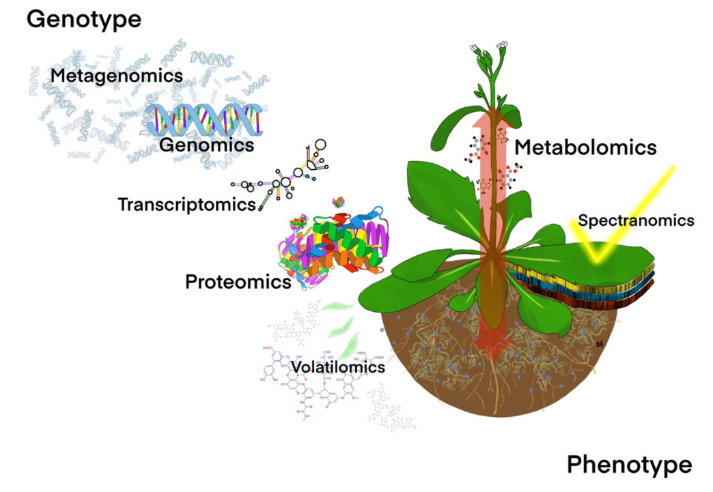
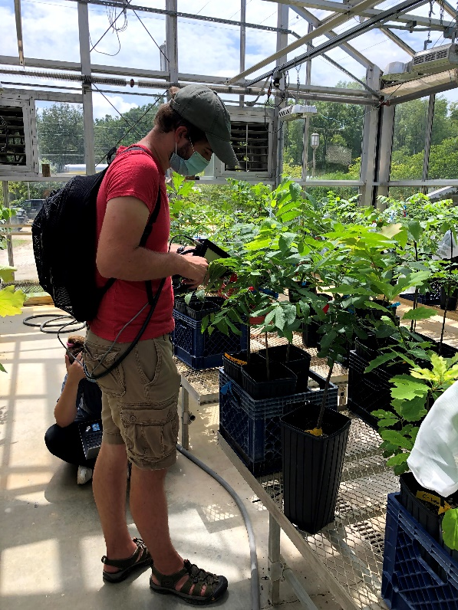
Introduction
Spectroscopy:
Effective tool for measuring phenotypic traits related to plant stress responses rapidly and non-destructively.
Crandall et al. (2020)
Center for Advanced Forestry Systems 2021 Meeting

Slide 7
Research Objectives
1) Quantifying tree foliar chemical and physiological responses to abiotic and biotic stress using hyperspectral data (Greenhouse, 2019).
2) Detecting induced plant defense responses to insect herbivory using hyperspectral data (Greenhouse, 2020).
Center for Advanced Forestry Systems 2021 Meeting

Slide 8
Methods
1. Trait retrievals
(Objective 1. Determination of the ability of hyperspectral data to estimate leaf functional traits)
PLSR*
Reference measurement
Gas-exchange related traits
Water-related traits
Chemical traits
Spectral measurement
Spectral profiles
*PLSR: Partial Least Square Regression
Cotrozzi et al., 2017
Center for Advanced Forestry Systems 2021 Meeting

Slide 9
Methods
2. Spectral phenotyping
(Objective 2. Determine the ability of hyperspectral data to classify different abiotic and biotic stress events)
PERMANOVA*, PCoA**
Ex. Potato disease infected vs non-infected leaves
Changes in foliar properties → Difference between spectral profiles
Plant spectral data can be used as a surrogate for plant chemical and physiological responses to stress.
*Permutational multivariate analysis of variance
**Principal Coordinates Analysis
Couture et al., 2018
Center for Advanced Forestry Systems 2021 Meeting

Slide 10
Research project
Project 1: Quantifying tree foliar chemical and physiological responses to abiotic and biotic stress using hyperspectral data
Two specific objectives:
Determine the ability of hyperspectral data to estimate plant functional traits in responses to different stress events, alone and in combination.
Determine the ability of hyperspectral data to classify different abiotic and biotic stress events.
Center for Advanced Forestry Systems 2021 Meeting

Slide 11
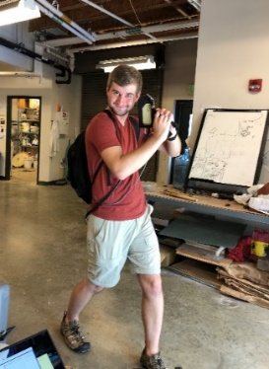
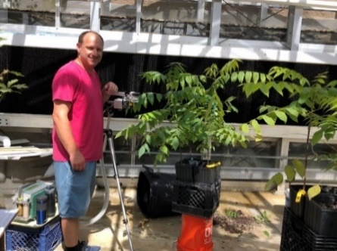
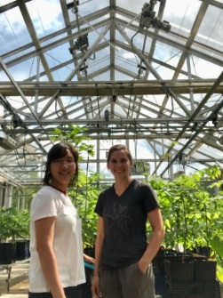
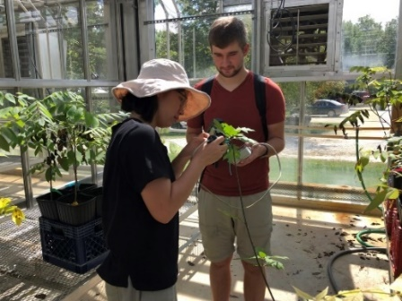
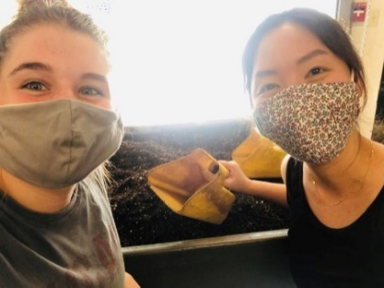
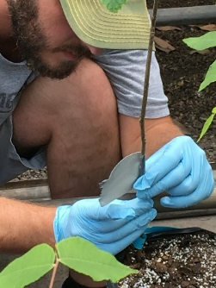
Research project
Project 1 : Quantifying tree foliar chemical and physiological responses to abiotic and biotic stress using hyperspectral data
Four stress combinations
Detection of tree stress responses
Fungal infection +
Soil quality
Nutrient deficiency + Drought
Leaf functional traits
Gas exchange related traits
Water related traits
Chemical traits
using different analytical procedures
and leaf spectral collections.
Nutrient deficiency + Salt deposition
Fungal infection + Drought

Slide 12
Methods
Experimental design
 |  | Greenhouse 1 Purdue Entomology Environmental Lab Greenhouse | Greenhouse 2 Purdue Martell Wright center
2018 | Species | Black walnut | Black walnut
 | Stress | Fungal infection + Soil type | Drought + Nutrient deficiency
 | Details | Geosmithia morbida (0,1) + Soil (Plantation, Forest, Sterile soil) | Tap water (saturation, 50 ml day⁻¹) + fertilizer (0, 1)
2019 | Species | Black walnut | Black walnut and red oak
 | Stress | Fungal infection + Drought | Nutrient deficiency + Salt deposition
 | Details | Geosmithia morbida (0,1), Fusarium solani (0,1) + Tap water (0, 1) | Fertilizer (0, 1) + Salt (NaCl, 50 mM) (0, 1)
Center for Advanced Forestry Systems 2021 Meeting

Slide 13
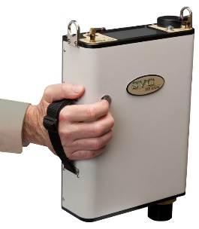
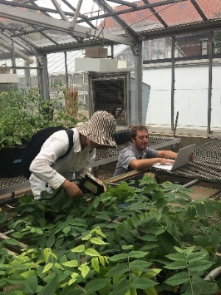
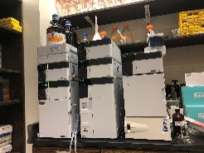
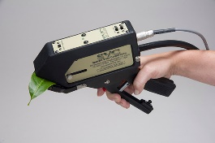
Research project
Project 1 : Quantifying tree foliar chemical and physiological responses to abiotic and biotic stress using hyperspectral data
Abiotic and biotic stressors
Instrumental &
chemical analyses
Ex)
Li-6400
Pressure chamber
HPLC
Foliar stress responses
Trait-based approach
Gas-exchange
Water
Chemical
Leaf spectral collection
Spectroradiometer
Center for Advanced Forestry Systems 2021 Meeting

Slide 14
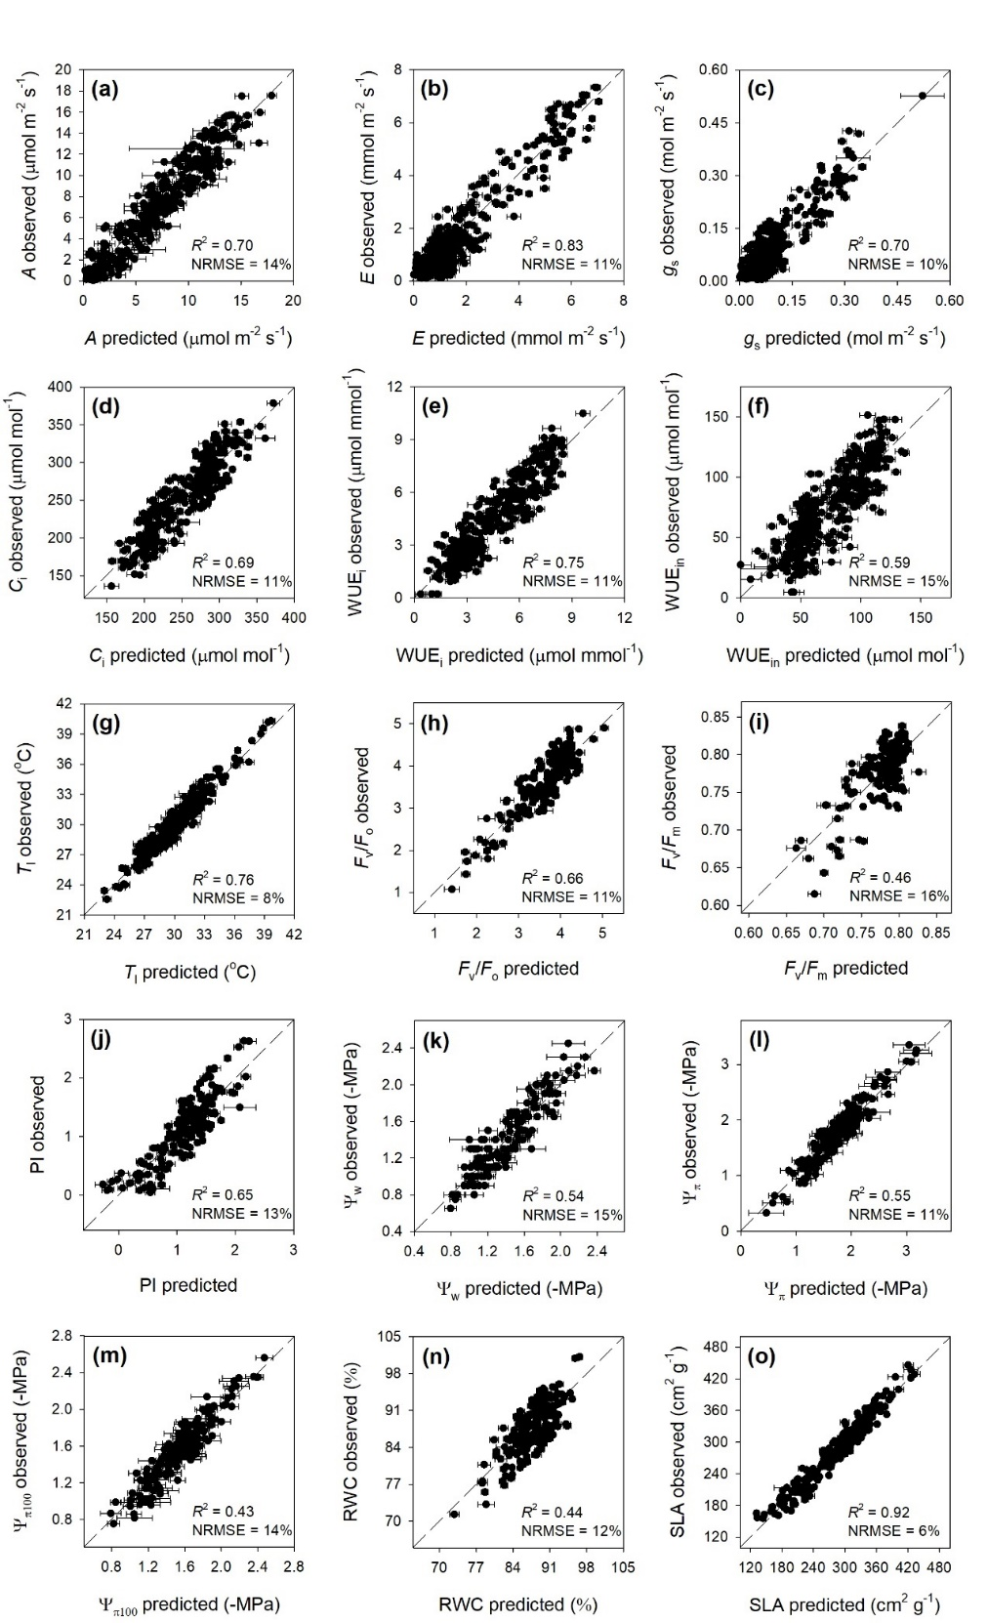
Gas-exchange and chlorophyll fluorescence
Trait retrievals
Observed vs predicted cross-validated values of (a) assimilation, (b) transpiration, (c) stomatal conductance, (d) intercellular CO₂ concentration, (e) instantaneous water-use efficiency, (f) intrinsic water-use efficiency, (g) leaf temperature, (h) maximum primary yield of photochemistry of photosystem II, (i) maximum quantum efficiency of photosystem II. Error bars for predicted values represent the standard deviations generated from the 500 simulated models. For model performance evaluation, goodness-of-fit (R²) and normalized root mean squared error (NRMSE) were presented. Dashed line is 1:1 relationship.
Most functional traits were well predicted by spectral data.
Center for Advanced Forestry Systems 2021 Meeting

Slide 15
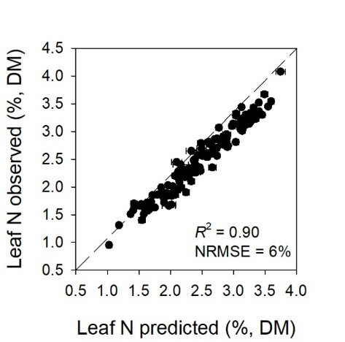
Water status and nitrogen
Trait retrievals
(p)
Observed vs predicted cross-validated values of (j) photosynthetic performance index, (k) leaf water potential, (l) leaf osmotic potential, (m) leaf osmotic potential at full turgor, (n) relative water content, (o) specific leaf area, (p) leaf nitrogen. Error bars for predicted values represent the standard deviations generated from the 500 simulated models. For model performance evaluation, goodness-of-fit (R²) and normalized root mean squared error (NRMSE) were presented. Dashed line is 1:1 relationship.
Most functional traits were well predicted by spectral data.
Center for Advanced Forestry Systems 2021 Meeting

Slide 16
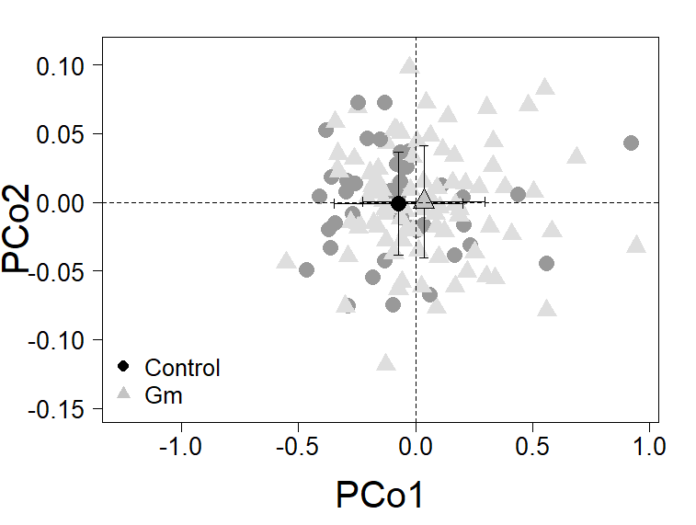
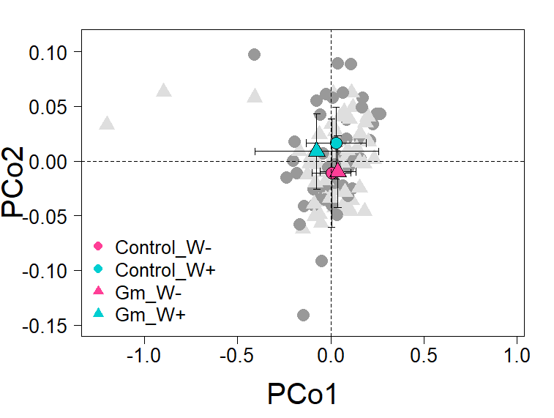
Spectral phenotyping
*** p < 0.001; ** < 0.01; * < 0.05, . < 0.1
Effect | df | F | p
Fungal treatment (Gm, Control) | 1 | 5.79 | 0.017 *
Soil type (S, P, F) | 2 | 12.73 | < 0.001 ***
Time point (1, 2) | 1 | 8.27 | 0.004 **
Fungal:Soil:Time | 2 | 3.52 | 0.030 *
Effect | df | F | p
Gm:Drought | 1 | 3.34 | 0.063 .
P = 0.02
P = 0.06
Spectral data identified differences in fungal treatment, soil type, and time point. However, the change of spectral data to fungal treatment depended on different soil types and time length after fungal infection and also depended on water availability.

Slide 17
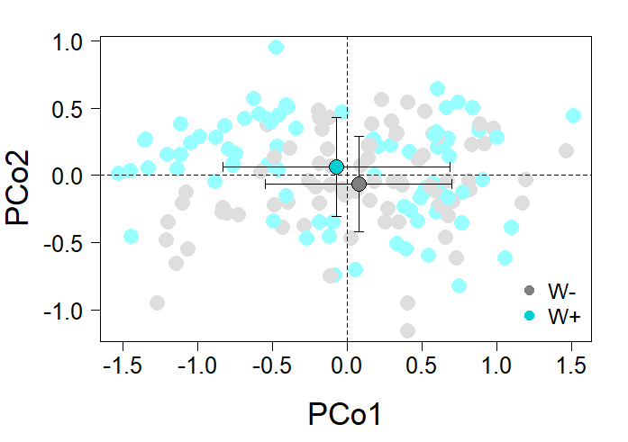
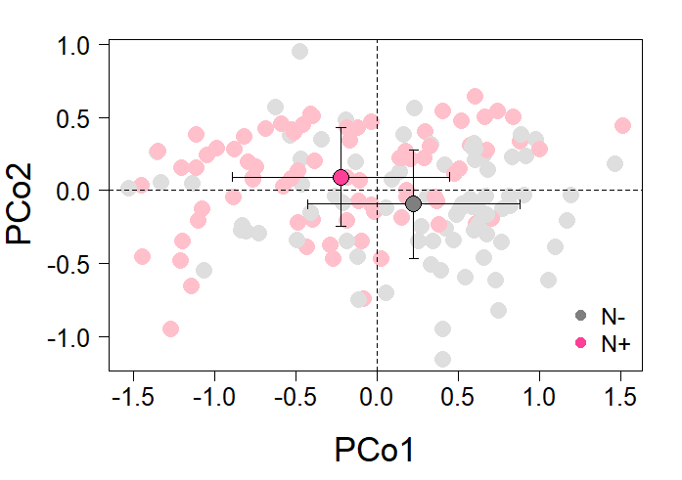
Spectral phenotyping
*** p < 0.001; ** < 0.01; * < 0.05; . < 0.1
Effect | df | F | p
Drought treatment (W+, W-) | 1 | 3.25 | 0.042 *
Nutrient treatment (N+, N-) | 1 | 21.16 | < 0.001 ***
Time point (1, 2) | 1 | 35.97 | < 0.001 ***
Drought:Nutrient | 1 | 2.83 | 0.059 .
Drought:Time | 1 | 8.93 | < 0.001 ***
Nutrient:Time | 1 | 2.68 | 0.068 .
Drought treatment
Nutrient treatment
Spectral data classified different groups in drought and nutrient treatment, and these responses of spectral data were affected with other treatments and time points.
Center for Advanced Forestry Systems 2021 Meeting

Slide 18
Trait retrievals + Spectral phenotyping
Spectrally predictive leaf functional traits
Treatment | df | A | g_{s} | C_{i} | E | WUE_{i} | Ψ_{w} | Ψ_{π} | RWC | Fv/Fm | Fv/Fo
Gm | 1 | 0.018 | 0.020 | 0.215 | 0.016 | 0.074 | 0.777 | 0.741 | 0.592 | 0.387 | 0.506
S | 2 | 0.110 | <0.001 | <0.001 | 0.015 | 0.243 | 0.454 | 0.603 | 0.853 | <0.001 | <0.001
T | 1 | 0.001 | 0.428 | <0.001 | 0.075 | <0.001 | 0.443 | 0.211 | 0.052 | 0.006 | 0.064
Gm×S | 2 | 0.054 | 0.548 | 0.016 | 0.687 | 0.168 | 0.915 | 0.720 | 0.934 | 0.039 | 0.008
Gm×T | 1 | 0.375 | 0.787 | 0.003 | 0.717 | 0.008 | 0.742 | 0.370 | 0.668 | 0.526 | 0.426
S×T | 2 | 0.062 | 0.051 | 0.014 | 0.785 | 0.273 | 0.526 | 0.722 | 0.268 | 0.111 | 0.240
Gm×S ×T | 2 | 0.154 | 0.140 | 0.009 | 0.562 | 0.200 | 0.549 | 0.701 | 0.043 | 0.057 | 0.222
Trait abbreviations: A, CO₂ assimilation rate; g_{s}, stomatal conductance;, C_{i}, intercellular CO₂ concentration; E, transpiration rate; WUE_{i}, instantaneous water use efficiency; Ψ_{w}, leaf water potential; Ψ_{π}, leaf osmotic potential; RWC, relative water content; Fv/Fm, maximum quantum efficiency of PSII; Fv/Fo, maximum primary yield of photochemistry of PSII.
Spectrally predicted leaf trait responses varied among treatments of fungal infection, soil type, and time. We found significant fungal infection effects for gas-exchange related leaf traits.
Center for Advanced Forestry Systems 2021 Meeting

Slide 19
Future Direction
Predict other biochemical leaf traits under abiotic and biotic stressors.
Leaf pigments, phenolic compounds, condensed tannins, sugars, and starch.
Center for Advanced Forestry Systems 2021 Meeting
Notes:
어떤 것이 지금 완료가 됐고, 요약적으로 어땠는지, 뭐가 남았고,
Conclusion, future direction.
몇 개, 뭐뭐뭐. (예측)
앞으로 몇 개 더할지.
Implication, following experiments?
스펙의 큰 장점은 예측이다.
비파괴적으로…
이 결과 data가지고 앞으로 어떻게 할건지?
나의 아이디어로 앞으로..
-필드에서 해서 비슷한 결과가 나오는지 보기.
-블랙월넛의 관점에서 뭘할건지.
Crop에서 한 것
Tree에서 한것 비교
Further study.
Early symptom detect 가능한지.
Sucrose, glucose and fructose

Slide 20
Research project
Project 2: Hyperspectral detection of
induced plant defense responses to insect herbivory
-Abiotic stress: Silvicultural practice
Three fertilization levels;150, 225, & 300 kg N/ha
-Biotic stress: Luna moth (Actias luna L.)
-Tree species: Black walnut
Fertilization
Herbivores
Host plant
Center for Advanced Forestry Systems 2021 Meeting

Slide 21
Project 2: Hyperspectral detection of
induced plant defense responses to insect herbivory
Many questions still remain to be explored in our understanding of how we can incorporate the ability of the hyperspectral approach in studying these insect-plant interactions.
Two specific objectives:
Determine how nitrogen availability affect local and systemic changes in primary and secondary compounds in black walnut foliage in response to luna moth herbivory
Determine how reliably hyperspectral data can detect changes in primary and secondary compounds in black walnut foliage in response to luna moth herbivory.
Center for Advanced Forestry Systems 2021 Meeting

Slide 22
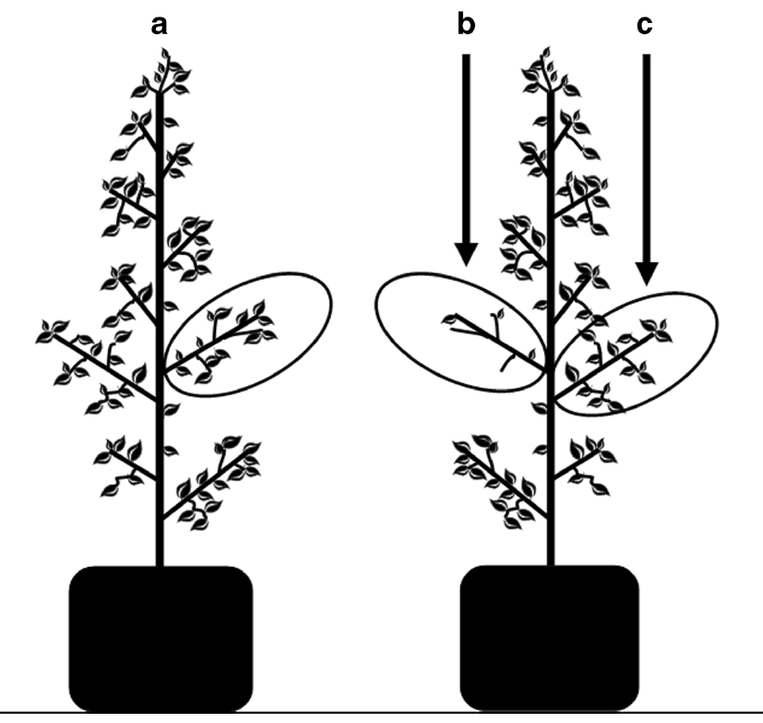
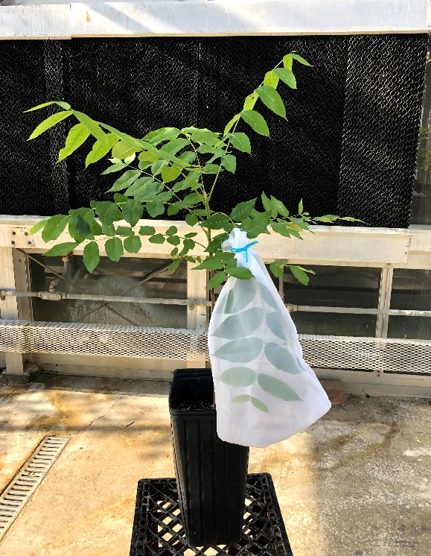
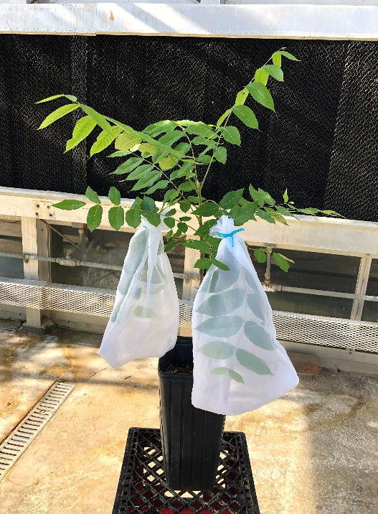
Induced plant defense responses: systemic induction or local induction
Control
Treatment
Local (e.g., within a damaged leaf)
& systemic (e.g., whole-plant) induction of defense chemicals in black walnut
a
b
c
Rubert-Nason et al. 2015
Center for Advanced Forestry Systems 2021 Meeting

Slide 23
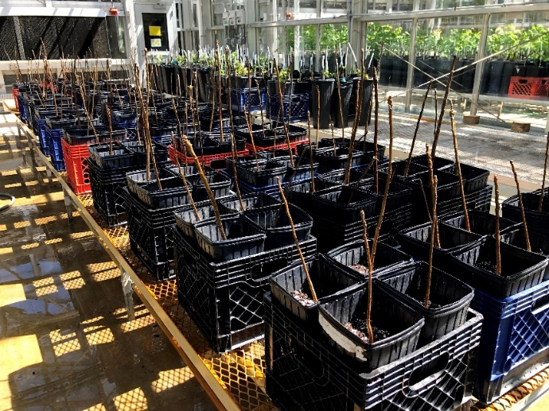
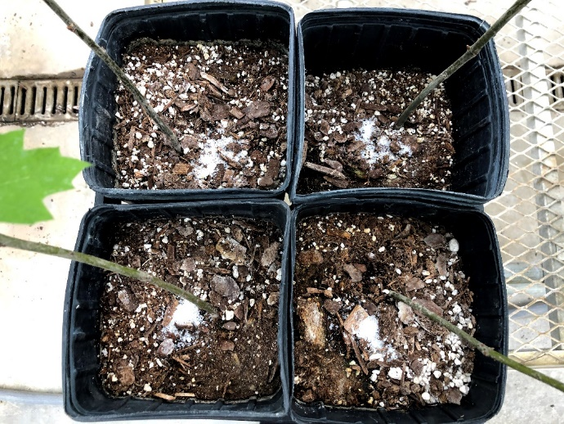
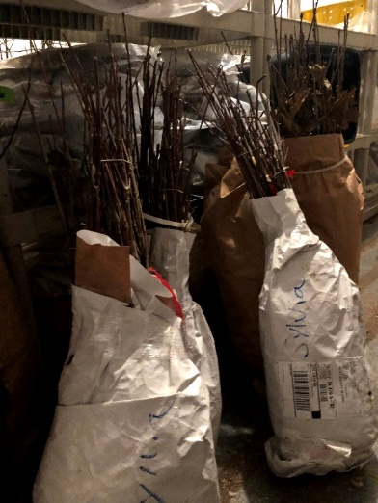
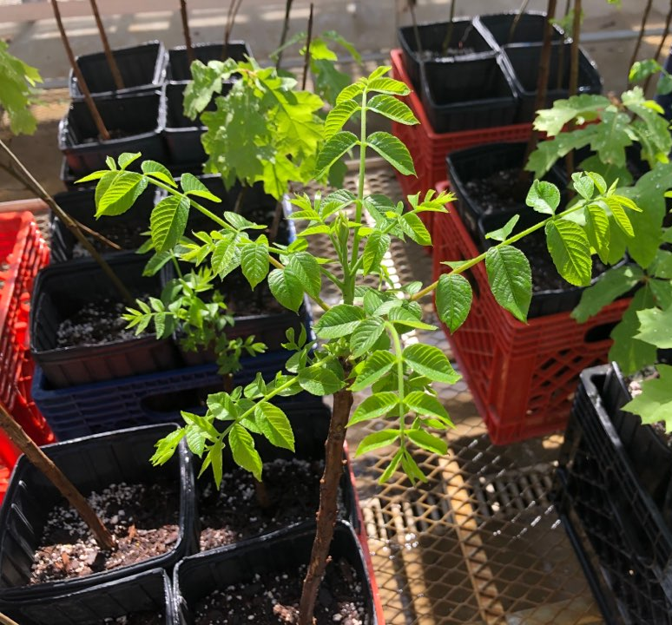
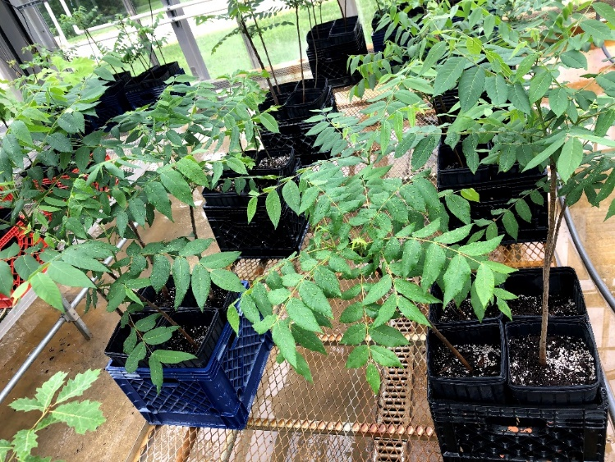
Experimental Procedure: Black walnut
Purdue Wright Forestry Center
June 25
July 19
2020
July 11
June 15
Center for Advanced Forestry Systems 2021 Meeting

Slide 24
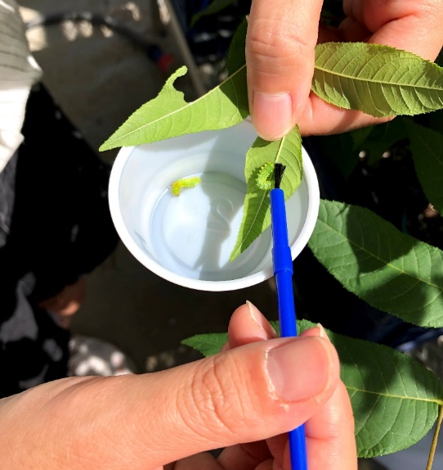
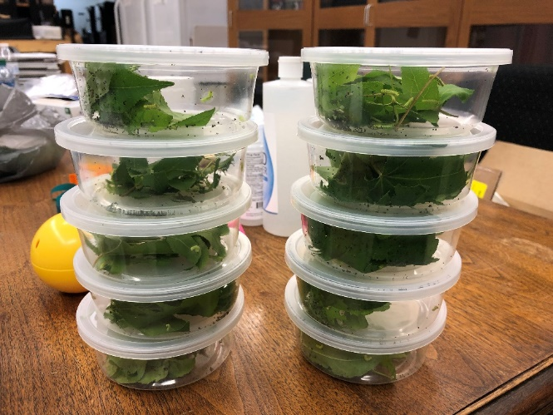
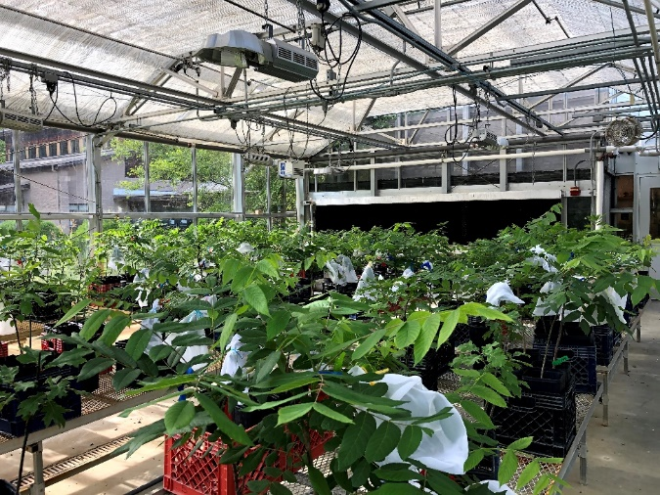
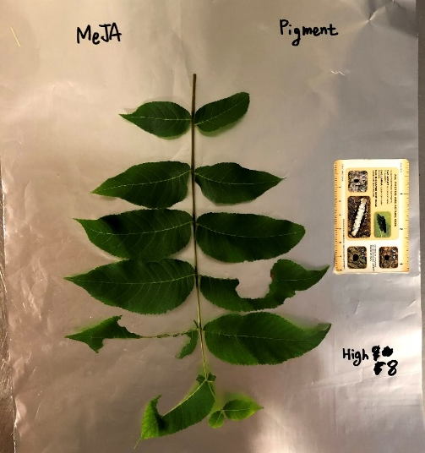
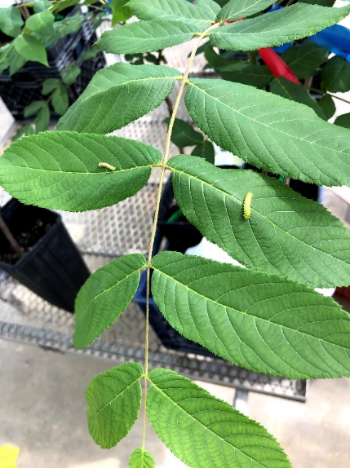
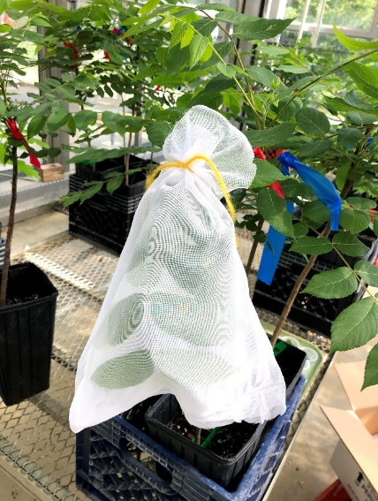
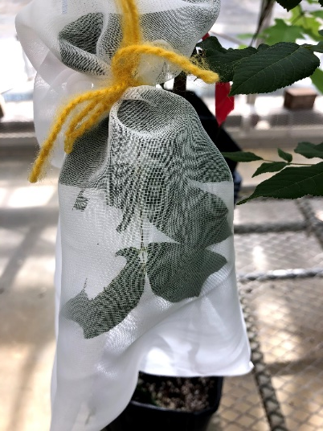
Experimental Procedure: Luna moth
First instar
Aug. 10
Aug. 12
Aug. 13
2020
Aug. 5
Center for Advanced Forestry Systems 2021 Meeting

Slide 25
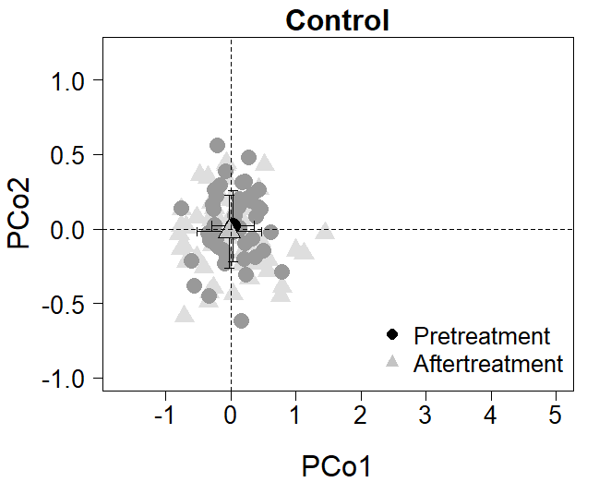
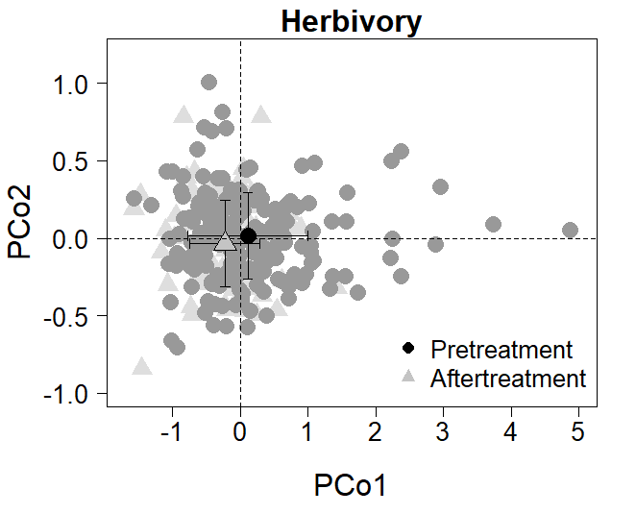
Spectral data identified the influence of luna moth herbivory on trees
Effect | df | F | p
Time | 1 | 1.18 | 0.283
Effect | df | F | p
Time | 1 | 10.60 | < 0.001
Final PERMANOVA revealed that herbivory treatment affected reflectance profile of black walnut, whereas no significant effects were found in control group. Still processing tissues for chemical profiles.
Center for Advanced Forestry Systems 2021 Meeting

Slide 26
Acknowledgements
Funding agency
- National Science Foundation/Center for Advanced Forestry Systems
- Hardwood Tree Improvement & Regeneration Center
Plant-insect chemical ecology lab
Regeneration and Restoration Silviculture Laboratory
Mickelbart lab
Martell Wright center
Center for Advanced Forestry Systems 2021 Meeting

Slide 27
Thank you!
Center for Advanced Forestry Systems 2021 Meeting

