Slide 1
Progress Report
Intraspecific Hydraulic Responses of Commercial Tree Seedlings to Nursery Drought Conditioning
CAFS.20.78
Andrew Nelson, University of Idaho
Douglass Jacobs, Purdue University
Carlos Gonzalez-Benecke, Oregon State University
Presenter: Andrew Nelson
Center for Advanced Forestry Systems 2020 Meeting
Notes:
1

Slide 2
Project Overview
Our objective is to examine seedling physiology and root system architecture in response to nursery-induced drought conditioning subsequent drought of coastal Douglas-fir, western larch, and black walnut seed sources across a range of maternal tree environments
Center for Advanced Forestry Systems 2020 Meeting

Slide 3
Project Overview
Project focuses on Douglas-fir, western larch, and black walnut, all commercially important species for CAFS industry members
Source: Wilson et al. 2013. Live tree species basal area of the contiguous US (2000-2009). USDA Forest Service. https://www.fs.usda.gov/rds/archive/catalog/RDS-2013-0013
Center for Advanced Forestry Systems 2020 Meeting

Slide 4
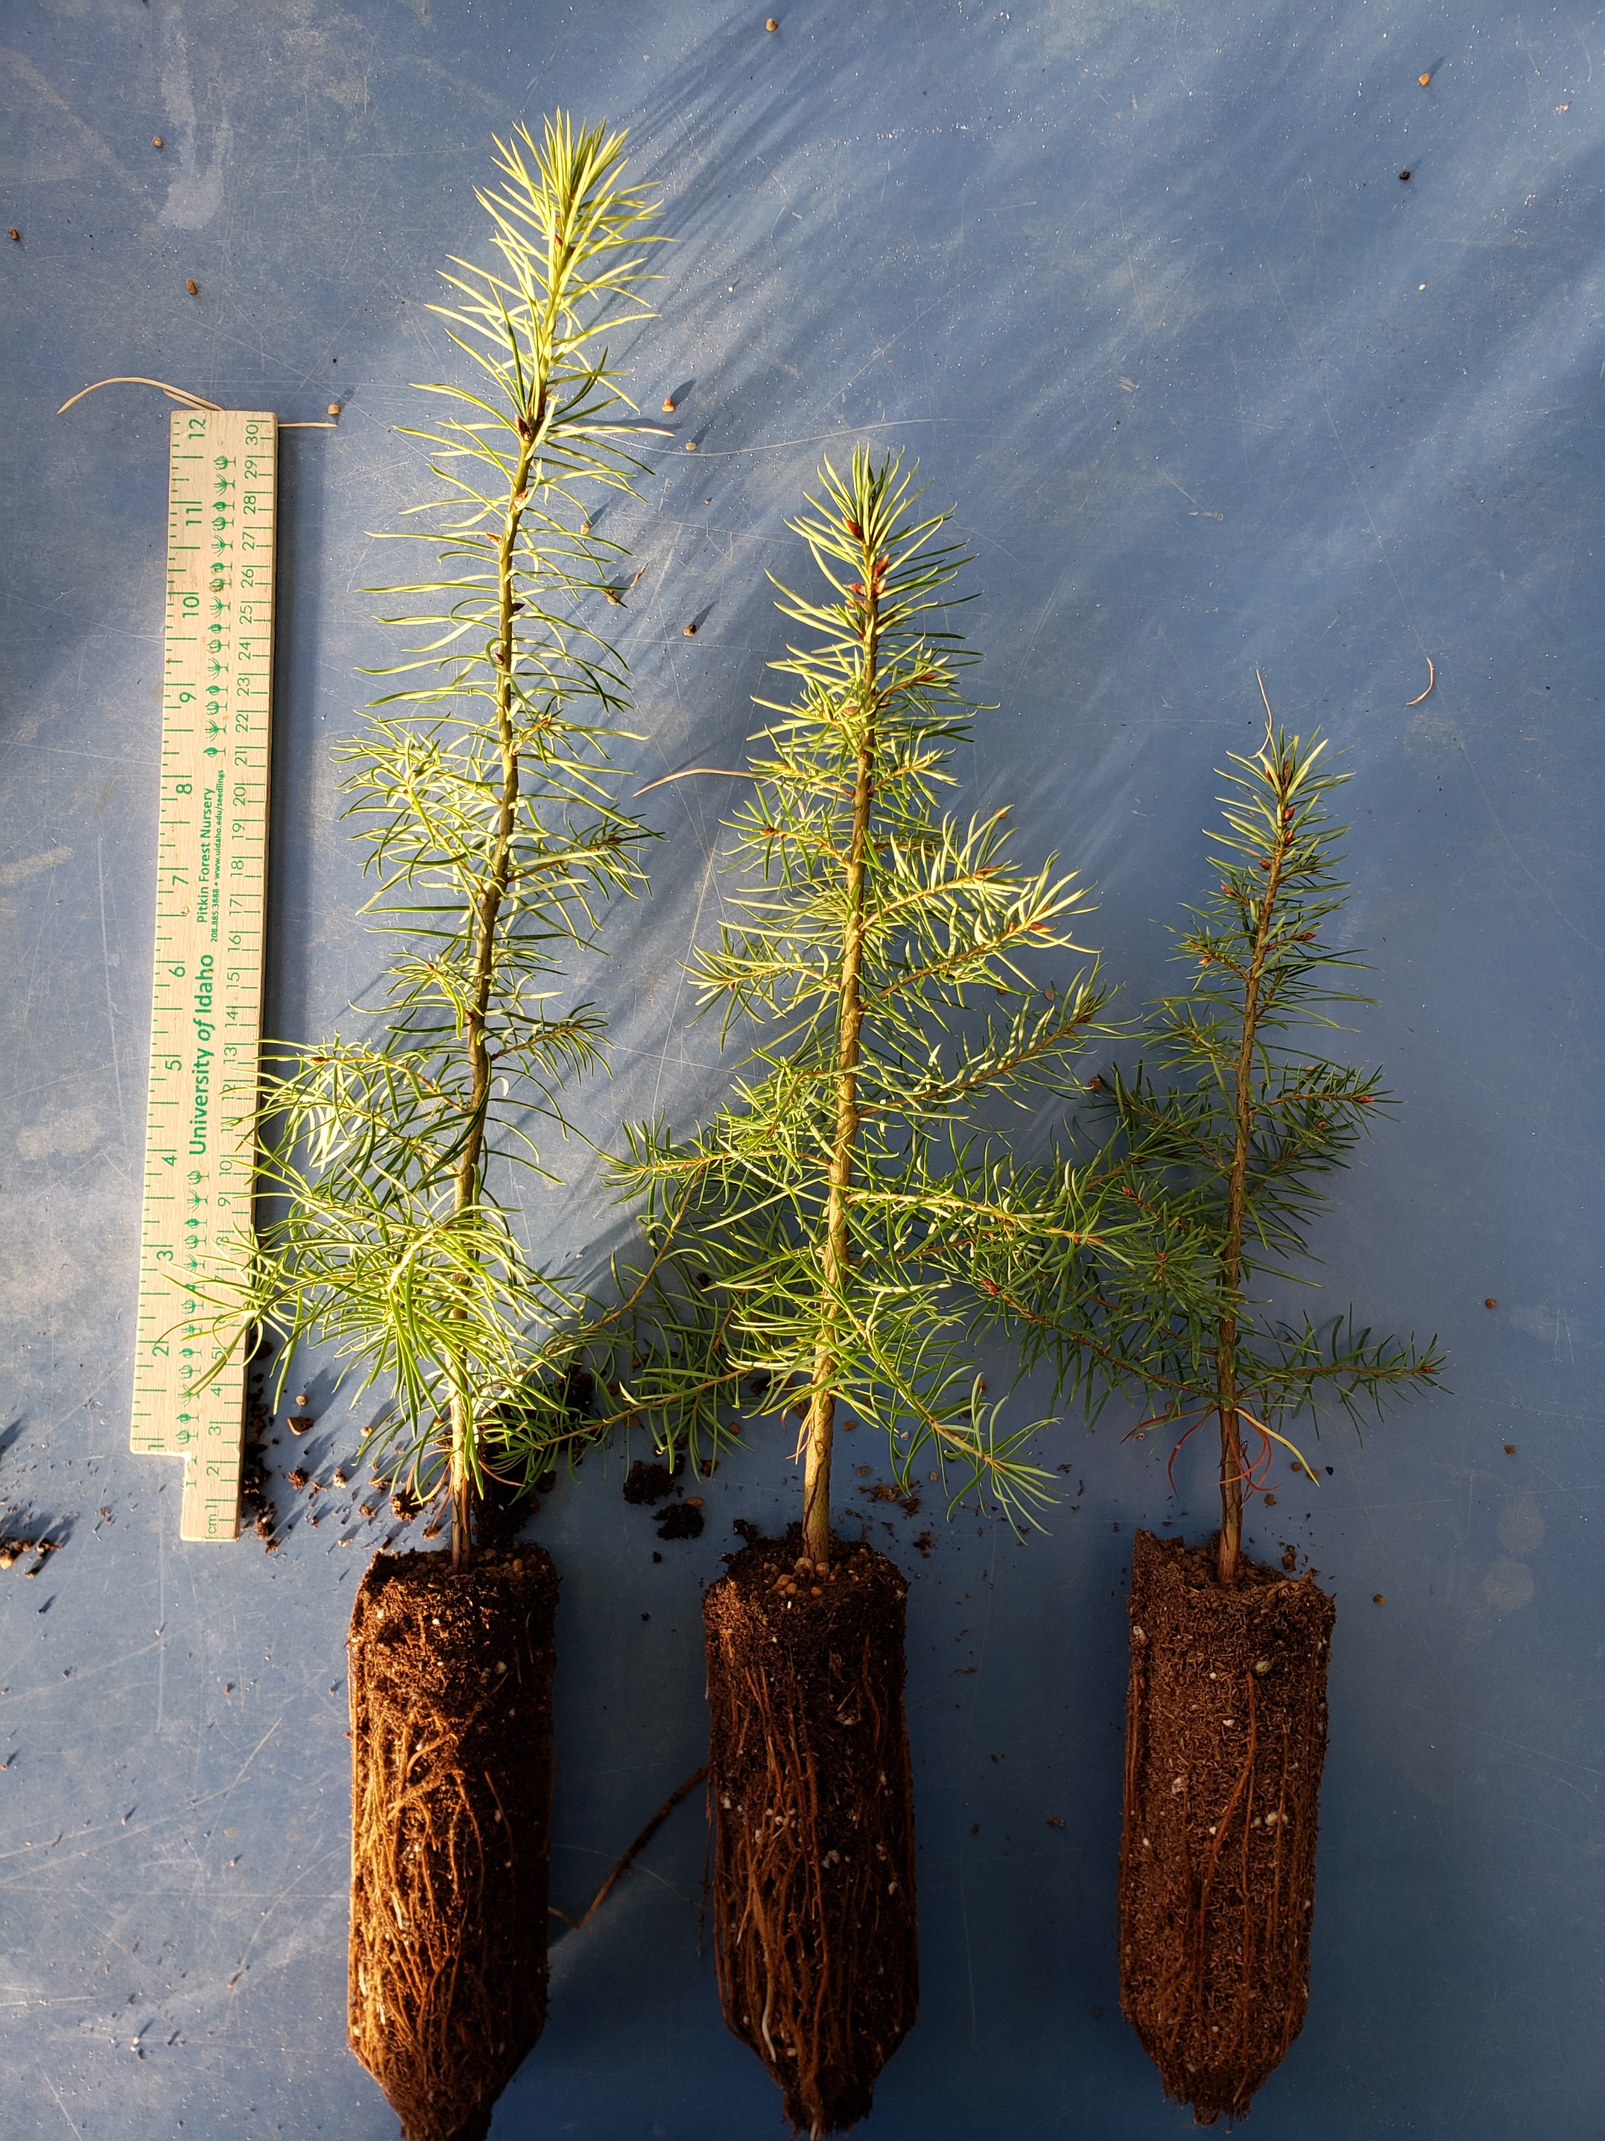
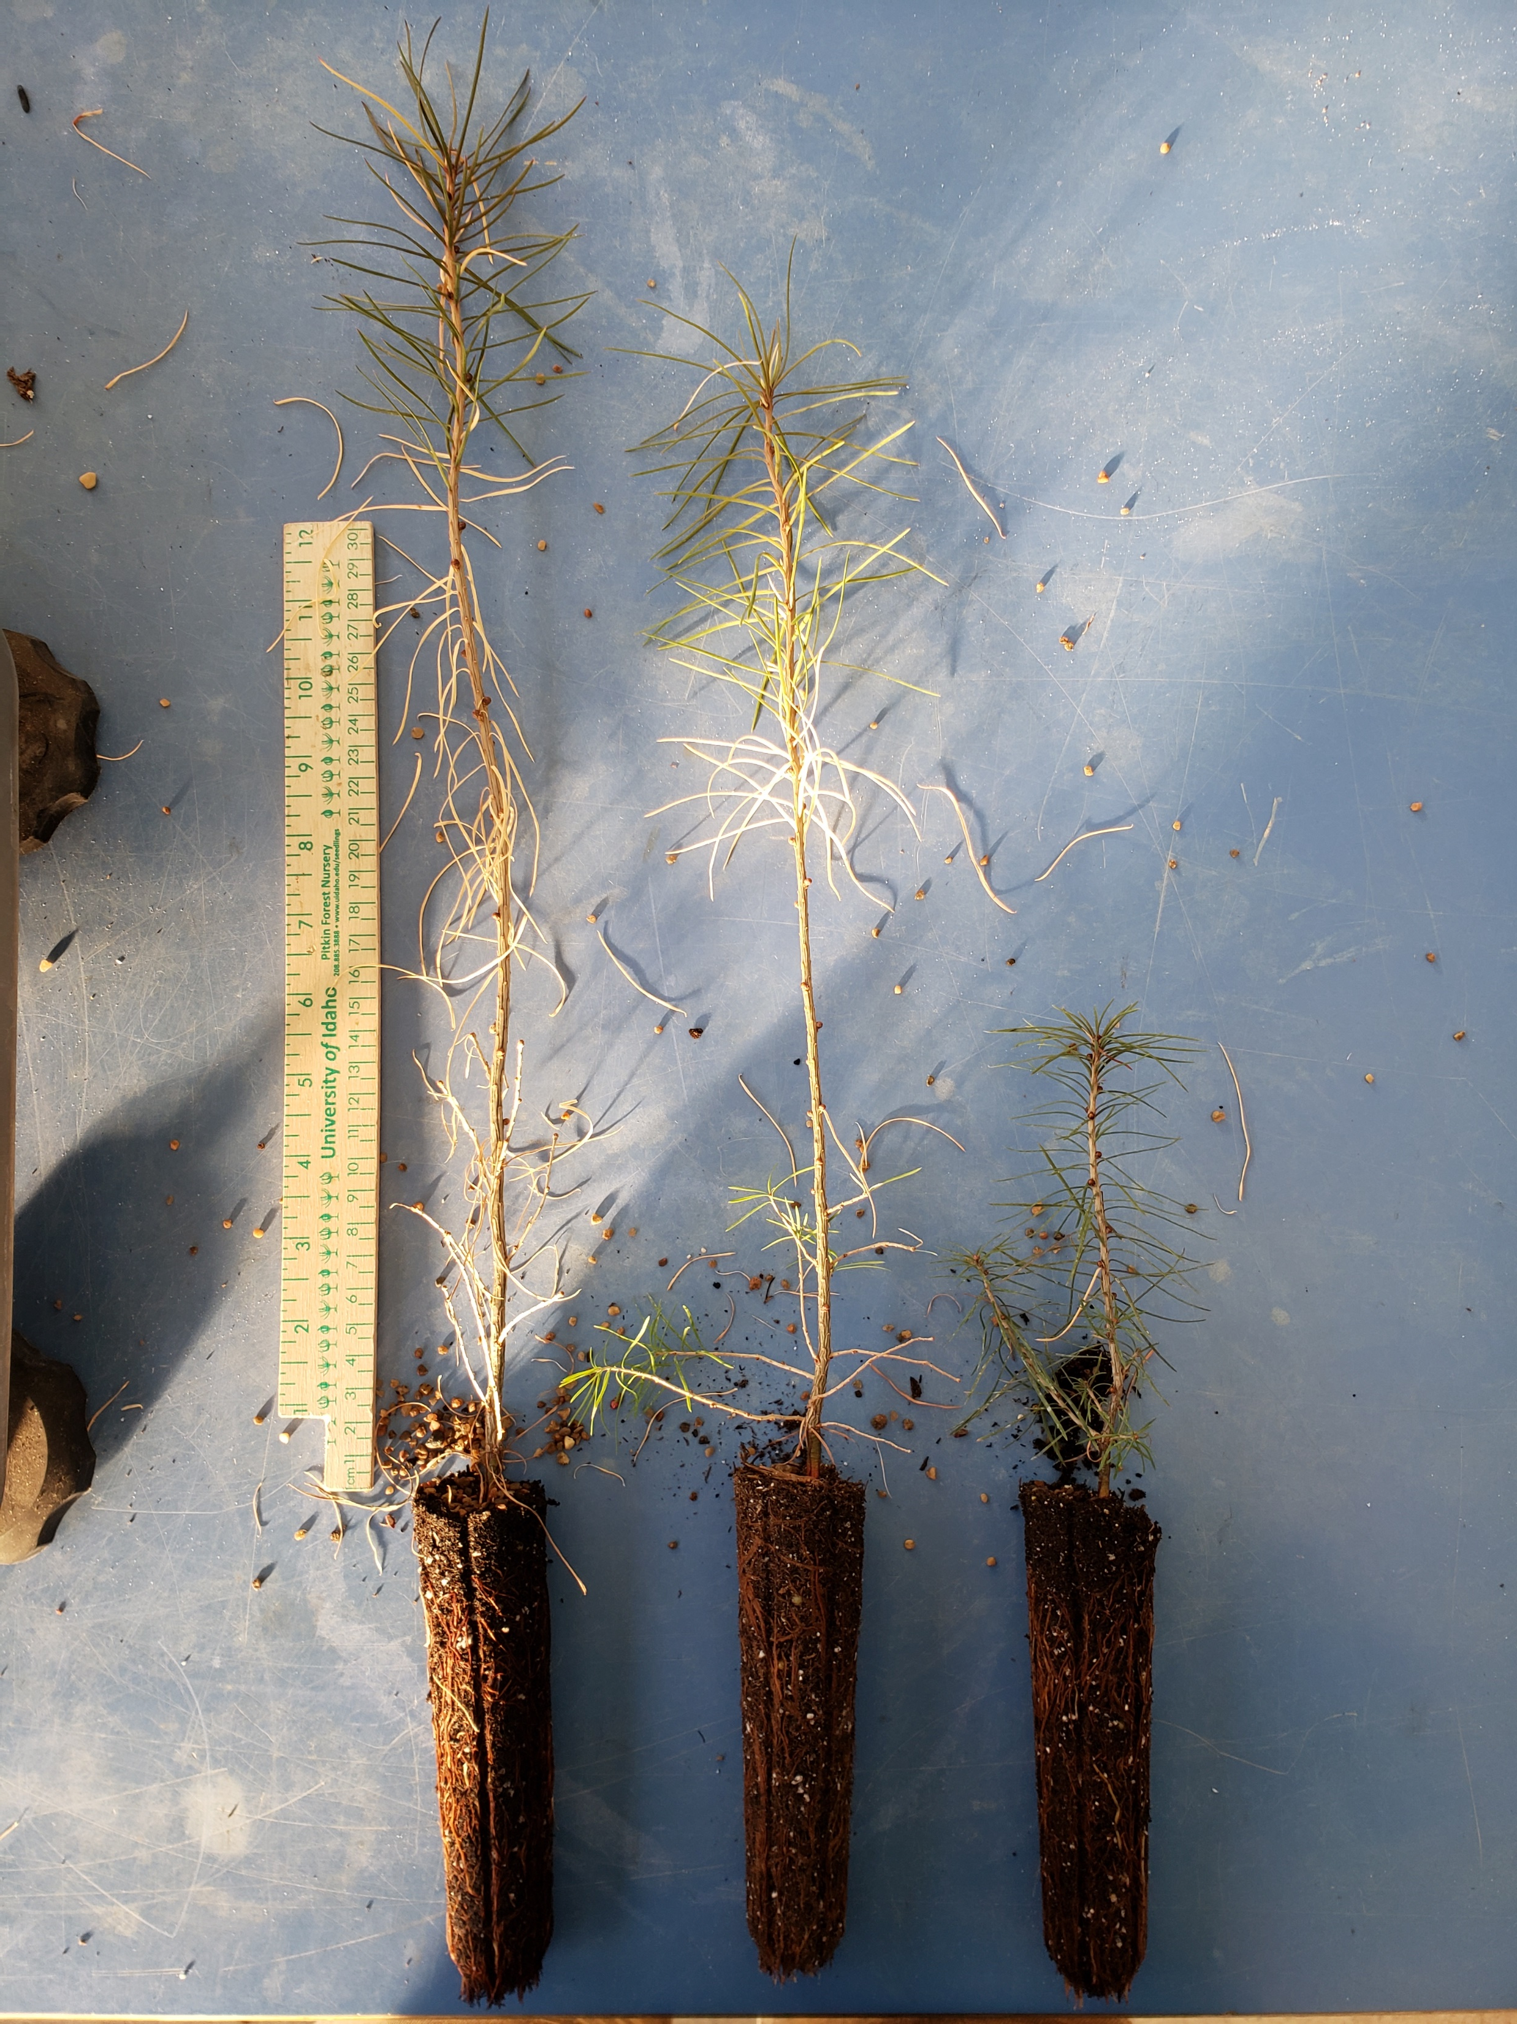
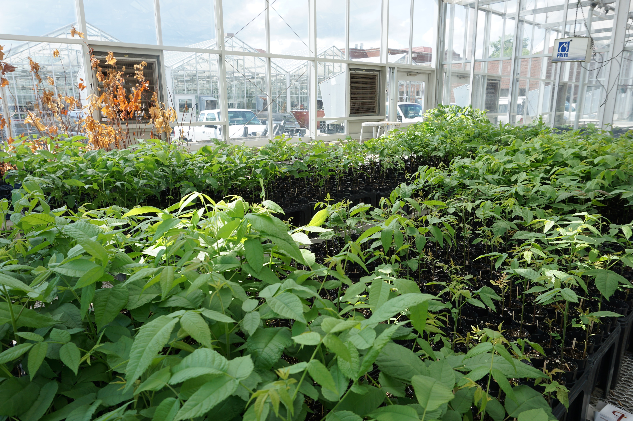
Current Progress
End of Nursery Phase
Control
Control
Moderate
Moderate
Extreme
Extreme
Douglas-fir
Western larch
Black Walnut
Center for Advanced Forestry Systems 2020 Meeting

Slide 5
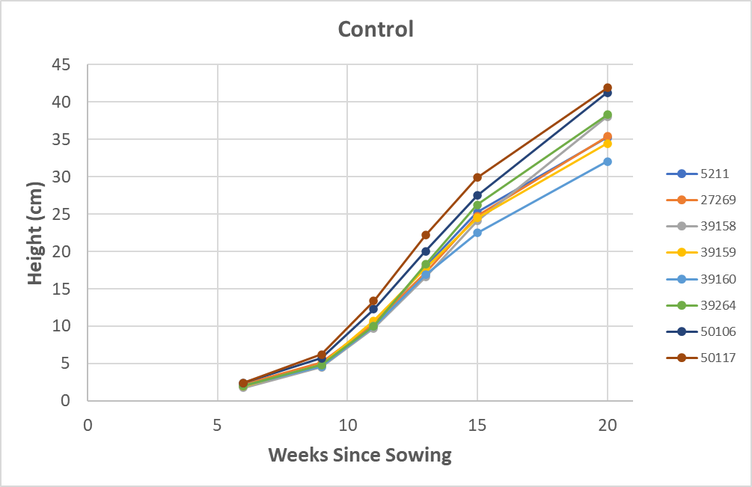
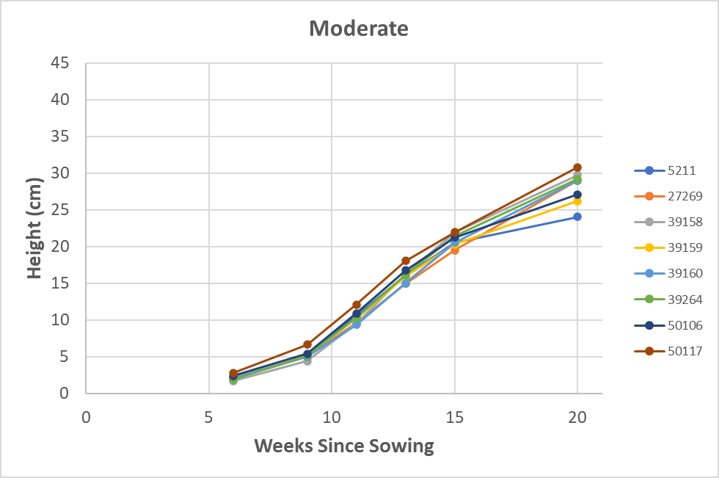
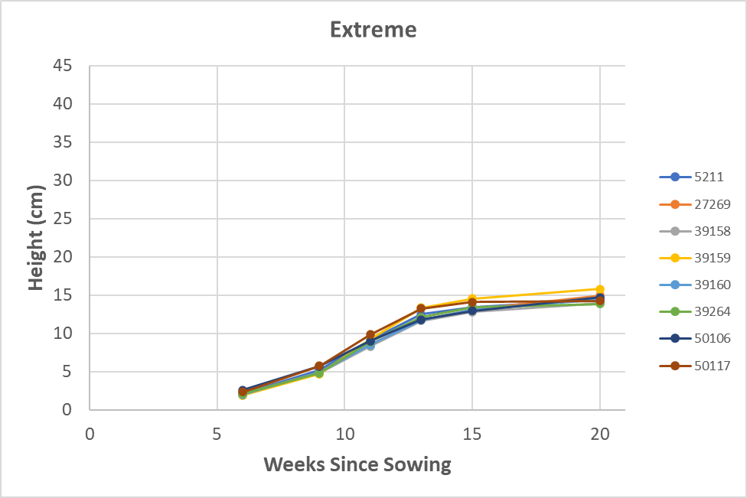
Current Progress
Western Larch Height By Treatment
75-100% Moisture
60-75% Moisture
50-65% Moisture
Center for Advanced Forestry Systems 2020 Meeting

Slide 6
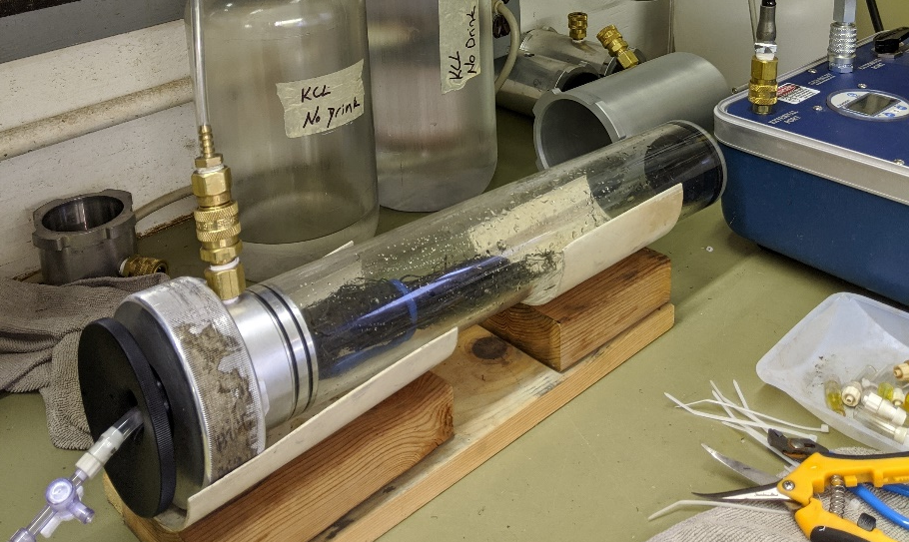
Current Progress
Species-Specific Root Hydraulics
Ψ₅₀ (-Mpa)
WL = 1.41
DF = 1.99
BW = 1.50
Center for Advanced Forestry Systems 2020 Meeting

Slide 7
Future Plans
Complete laboratory analysis and data synthesis of root hydraulics, stem microscopy, plant moisture stress, gas exchange, and biomass allocation
  Prepare manuscripts for publication based on nursery-phase of project
Reciprocal drought treatments at Purdue University Controlled Environment Phenotyping Facility (spring 2021)
  Aboveground traits (height, width, color, and shape) with RGB cameras
  Hyperspectral imagery to link with nutrient content and stress reaction
  X-ray CT root scanner non-destructively measures 3-D root system architecture
Outplanting spring 2021
  Plant at reforestation/afforestation sites in respective regions
  Raised beds for simulated drought experiments
Center for Advanced Forestry Systems 2020 Meeting

