Slide 1
Progress Report
Assessing and mapping regional variation in potential site carrying capacity
CAFS 19.76
Mark Kimsey, University of Idaho
Cristian Montes, University of Georgia
Rachel Cook, North Carolina State University
Eric Turnblom, University of Washington
Aaron Weiskittel, University of Maine
Mark Coleman, University of Idaho
Presenter: Mark Kimsey
Center for Advanced Forestry Systems 2020 Meeting
Notes:
1

Slide 2
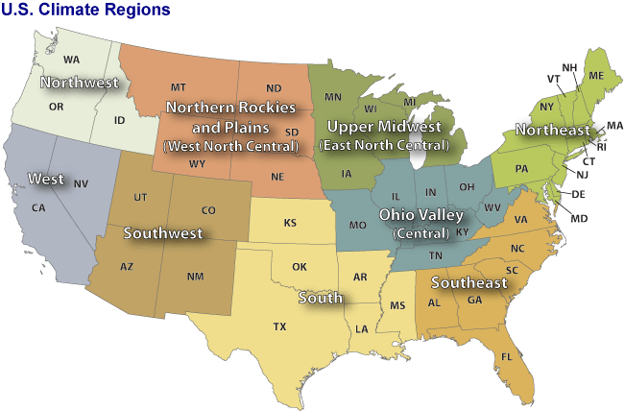
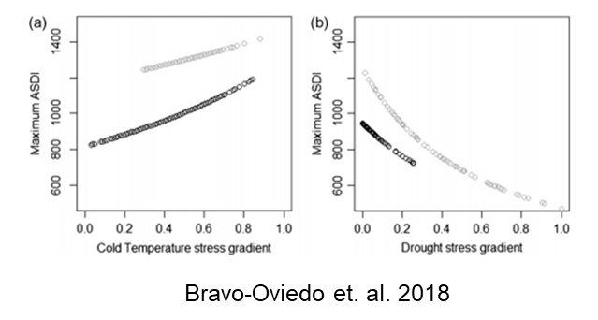
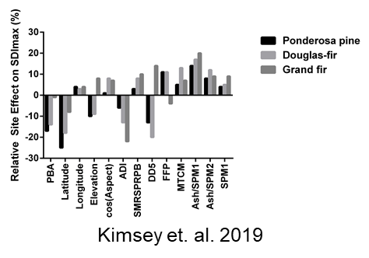
OBJECTIVE:
Develop Regional Site-Sensitive,
Mixed Species SDImax Models
Project Overview
Rationale
Overstocked stands are slow to develop and susceptible to wildfire, drought and insect outbreaks due to competition for limited resources
Understocked stands underutilize site resources and will not reach maximum potential productivity
Site-species mixing influences maximum carrying capacity
Maximum Stand Density Index (SDImax) is a useful metric for helping create healthy, resilient and productive forest stands
Center for Advanced Forestry Systems 2020 Meeting

Slide 3
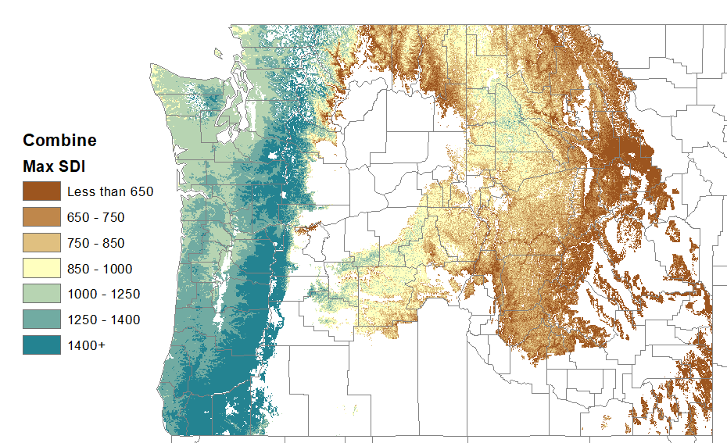
Current Progress
Data sharing agreements and transfer in place with CAFS members in the Southeast and Northeast regions
Priority: SE, South, NE, Upper Midwest, Rocky Mtn States, California
Protocols and procedures developed for standardizing variable selection, extraction, storage and analysis
Regional Northwest SDImax species models complete
Douglas-fir, western hemlock, ponderosa pine, grand fir, western larch and lodgepole pine
SDImax manuscript submitted and under revision for a special issue in Canadian Journal of Forest Research
Center for Advanced Forestry Systems 2020 Meeting

Slide 4
Future Plans
Ongoing database recruitment and development
Focus on obtaining unfuzzed FIA data over winter
Data QA/QC and standardization
Project handover from Post-doc Cen Chen to Ryan Heiderman (current PhD candidate)
Regional SDImax modeling commences - June 2021
Regional SDImax species model rollout throughout 2022 and 2023
Center for Advanced Forestry Systems 2020 Meeting

