Slide 1
Progress Report
Analysis of Aboveground Nutrient Biomass on LTSP Sites Due to the Effects of Site, Harvest Removals, Weed Control, and Compaction
CAFS 18.73
Kim Littke, Eric Turnblom, and Rob Harrison (UW)
Kim Littke
Center for Advanced Forestry Systems 2020 Meeting
Notes:
1

Slide 2
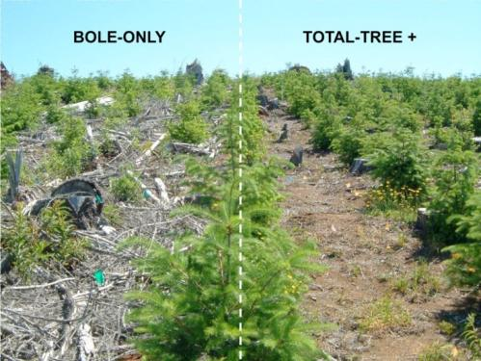
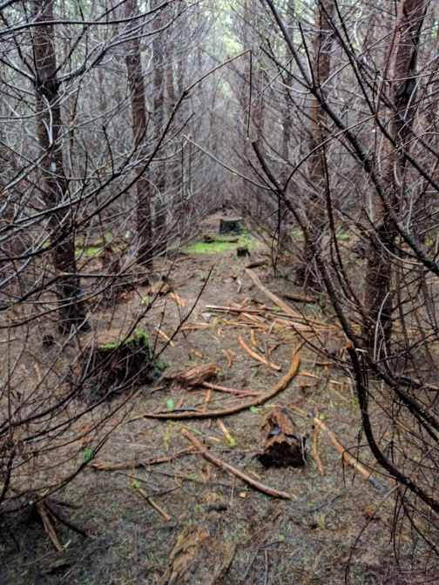
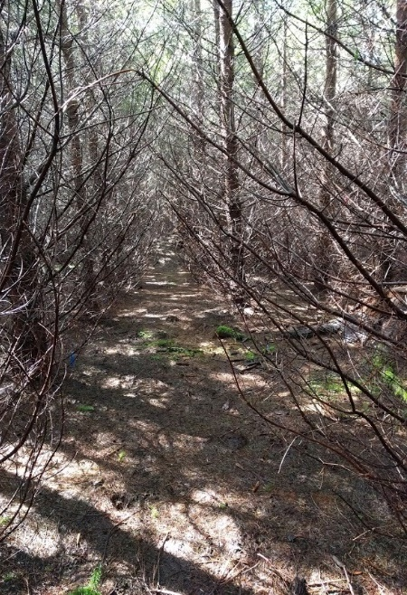
Project Overview
Long-Term Soil Productivity Study
  Effects of intensive forest management on soil and site productivity
Recent soil sampling shows decreases in soil nutrients due to treatments
  Losses through leaching or removals
  Greater uptake by trees and understory
Objectives
  Determine treatment effects on Douglas-fir biomass and aboveground and belowground nutrient pools
Center for Advanced Forestry Systems 2020 Meeting

Slide 3
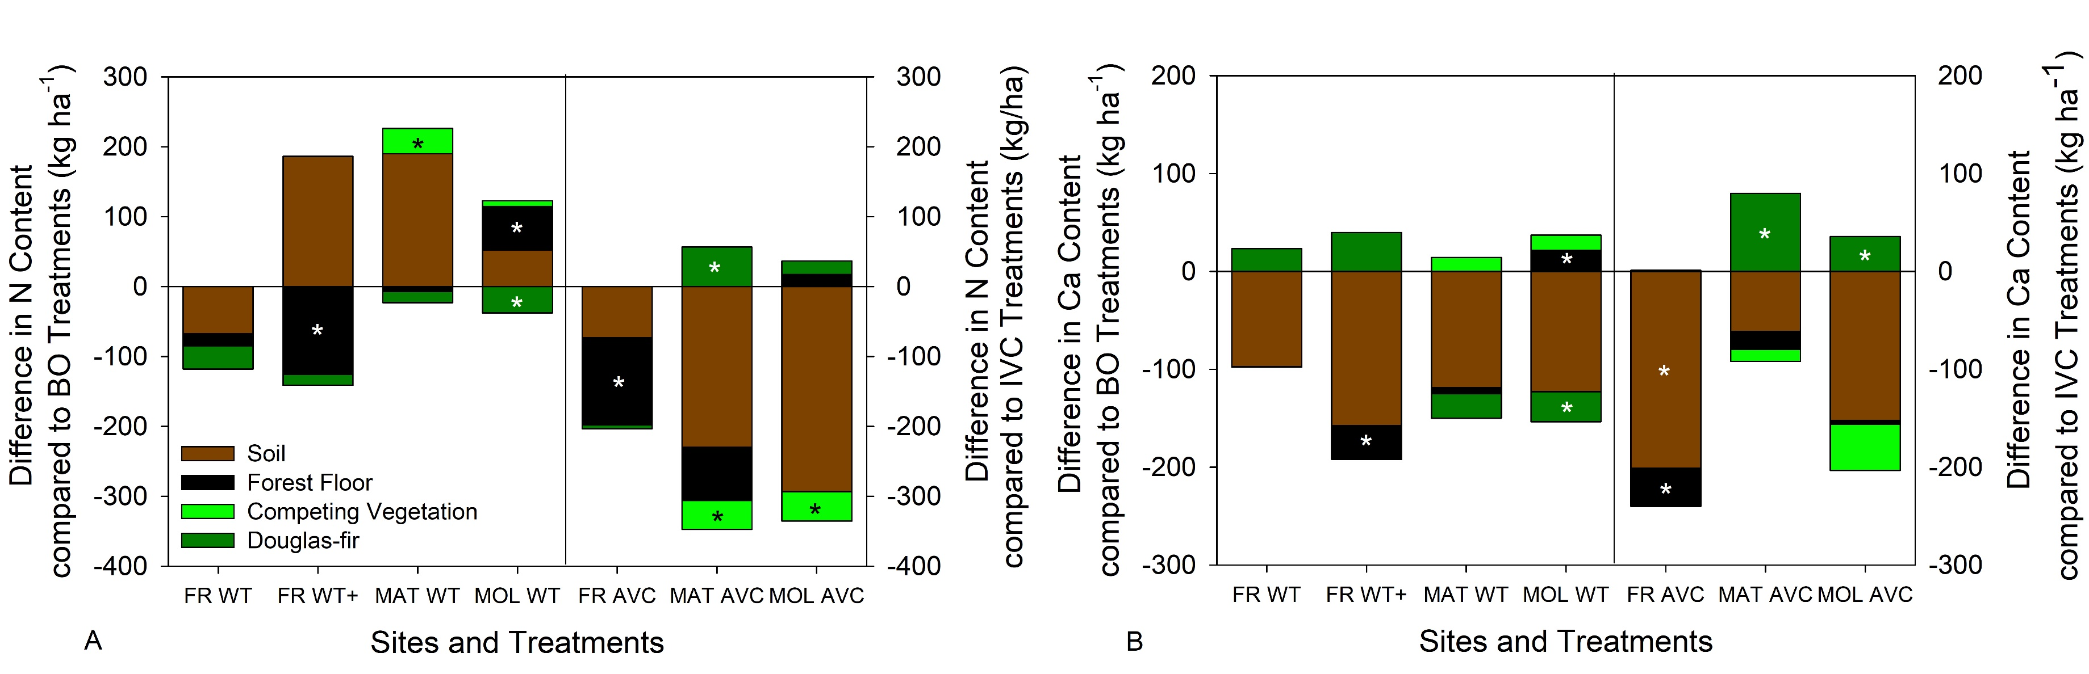
Current Progress
Whole tree removal resulted in lower Douglas-fir biomass at 15-20 years
  Lower Douglas-fir nutrient pools
  No net changes in total nutrient pools
Annual vegetation control decreased soil, forest floor, competing vegetation, and total base cations
  Improved Douglas-fir biomass and nutrient contents account for losses
Center for Advanced Forestry Systems 2020 Meeting

Slide 4
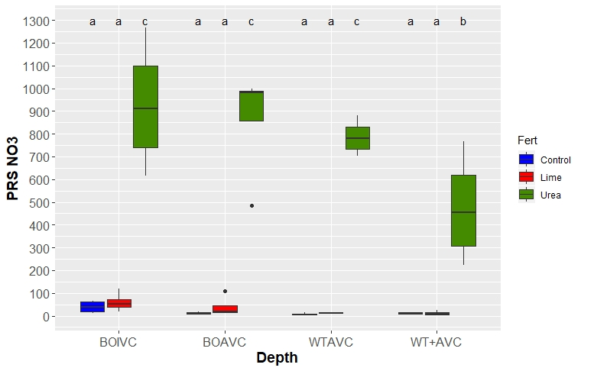
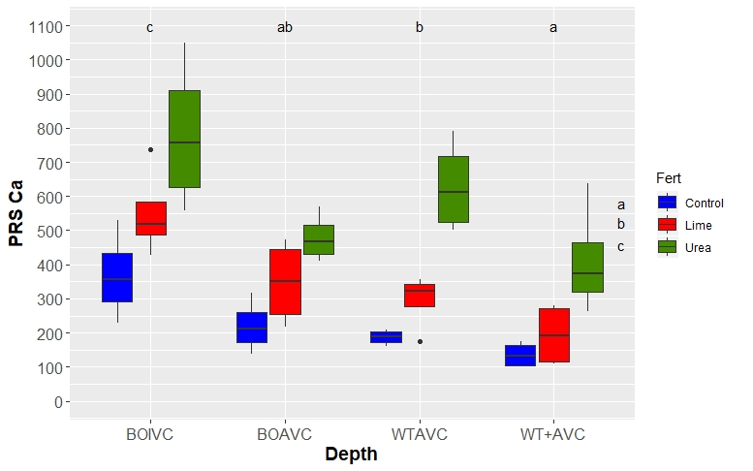
Future Plans
Urea and lime fertilization at Fall River
  Ameliorate losses from whole tree removal and vegetation control treatments
Urea fertilization resulted in a large increase in nitrate
  Decreased soil pH and replaced Ca on the exchange sites
  Potential for increased leaching of Ca
Lime increased forest floor pH and forest floor and surface soil exchangeable Ca
Center for Advanced Forestry Systems 2020 Meeting

