Slide 1
Progress Report
Seed bacteria from poplars and pines: Isolation and effects on generalist herbivores and pathogens
CAFS 16.67
George Newcombe (UI), Stephen Cook (UI), Abigail Ferson (UI), and Mark Coleman (UI)
Abigail Ferson
Center for Advanced Forestry Systems 2020 Meeting
Notes:
1

Slide 2
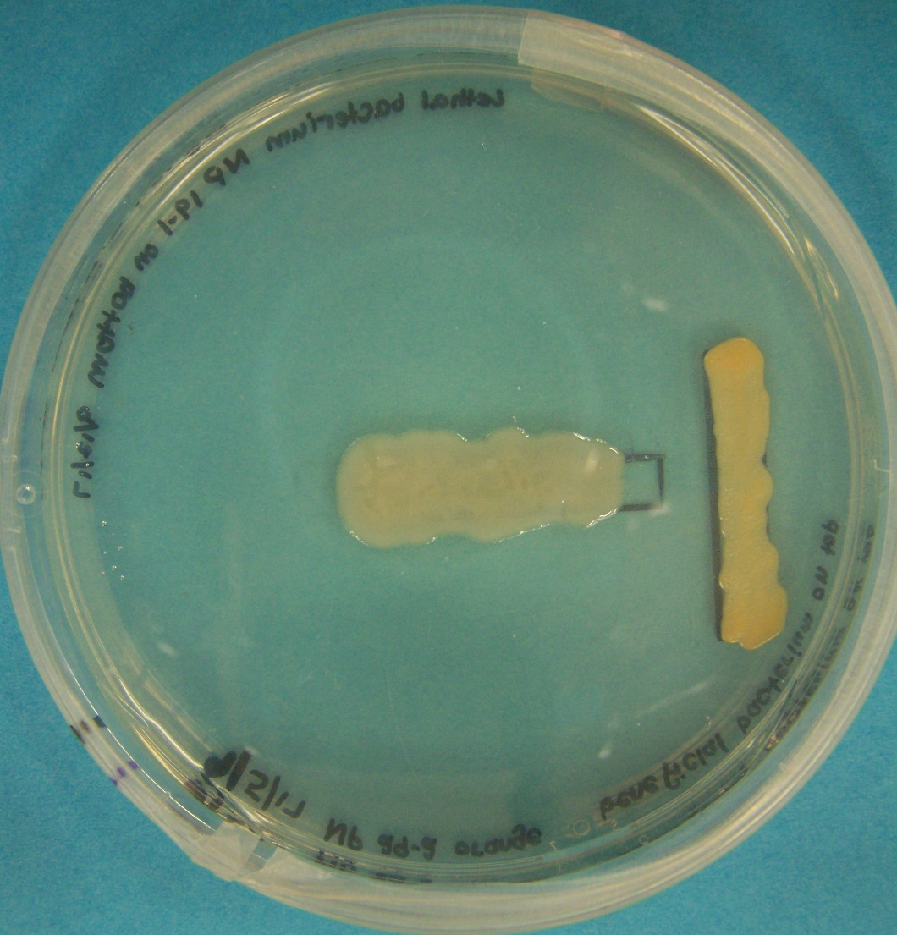
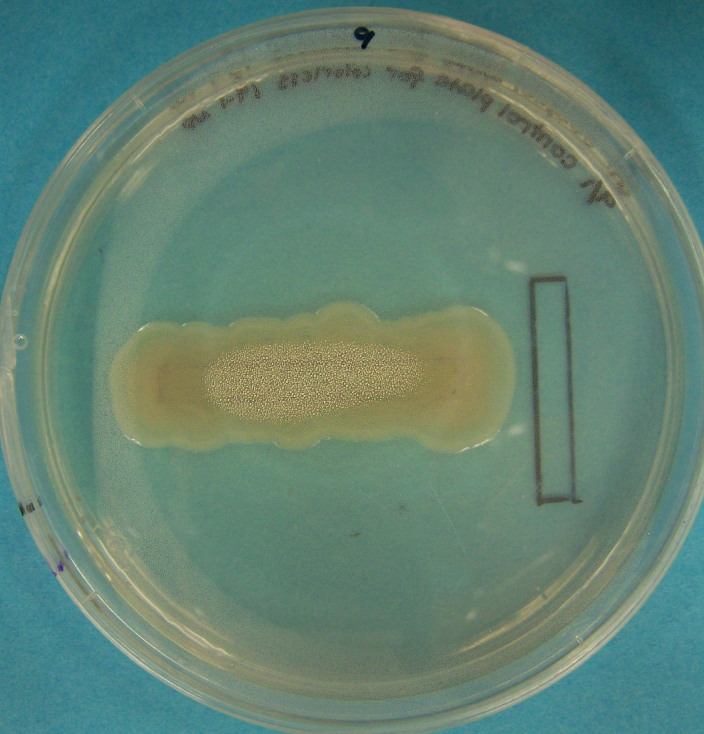
Project Overview
Objective: To test the hypothesis that seed bacteria are strong antagonists, and can therefore protect trees against insects and pathogens.
Exclusionary interactions ensure that seed bacteria are strong antagonists.
Pseudomonas syringae: horizontal colony in each plate. Compare colony on left antagonized by another bacterium (blue arrow) to the control on the right.
Photos: Newcombe lab
Center for Advanced Forestry Systems 2020 Meeting
Notes:
Seed microbes have to be antagonistic and may make the difference between life and death of the seedling.

Slide 3
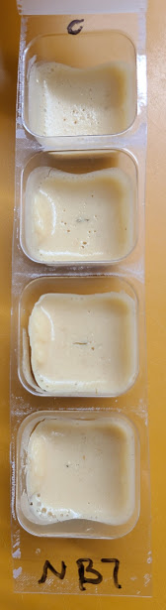
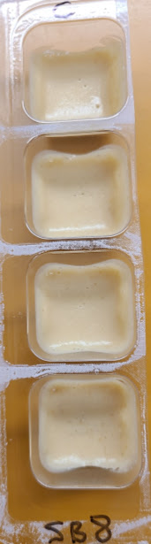
Current Progress
Initial analyses
Trees
Western Cottonwood, Arctic Blue Willow
Seed Bacteria
Bacillus, Streptomyces
Insect
Cabbage Looper
Pathogen
Melampsora rust
Photos: Newcombe lab
Center for Advanced Forestry Systems 2020 Meeting

Slide 4
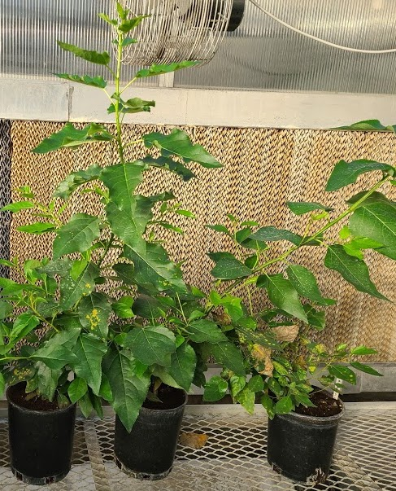
Future Plans
Inoculating insects with seed bacteria on artificial media
Inoculating seed bacteria onto trees & then introducing herbivores or pathogens
Trees
Western Cottonwood, Arctic Blue Willow, Western White Pine, & Paper Birch
Seed Bacteria
Bacillus, Streptomyces
Insects
Gypsy Moths, Hemlock Looper, Black Vine Weevils, & Cabbage Looper
Pathogens
Melampsora, Cronartium
Photo: Newcombe lab
Center for Advanced Forestry Systems 2020 Meeting

