Slide 1
Ending Project / Final Report
Combining blister rust resistance with defense-enhancing endophytes
CAFS 16.67
George Newcombe (UI), Marc L. Rust (UI), Mary Frances Mahalovich (USDA Forest Service), Greg Adams (J.D. Irving), David Miller (Carleton University), and Mark Coleman (UI)
George Newcombe
Center for Advanced Forestry Systems 2021 Meeting
Notes:
1

Slide 2
Justification
Cronartium ribicola
White pine blister rust
Native to Asia; introduced to the West
Coast in the early 20th century.
Destroyed many native soft pine
trees and has had disastrous
economic consequences.
Genetic resistance has been found.
Breeding programs were established
and these resistant seed sources are
planted throughout the Northwest.
Still not entirely effective…..
Photo from Common Tree Diseases of British Columbia by E.A. Allen, D.J. Morrison, and G.W. Wallis
Center for Advanced Forestry Systems 2020 Meeting
Notes:
All native white pine are susceptible, but has been most destructive on WWP and sugar pine. (most acute on these two commercial species)
Less than 5% of its historic range…mountain pine beetle

Slide 3
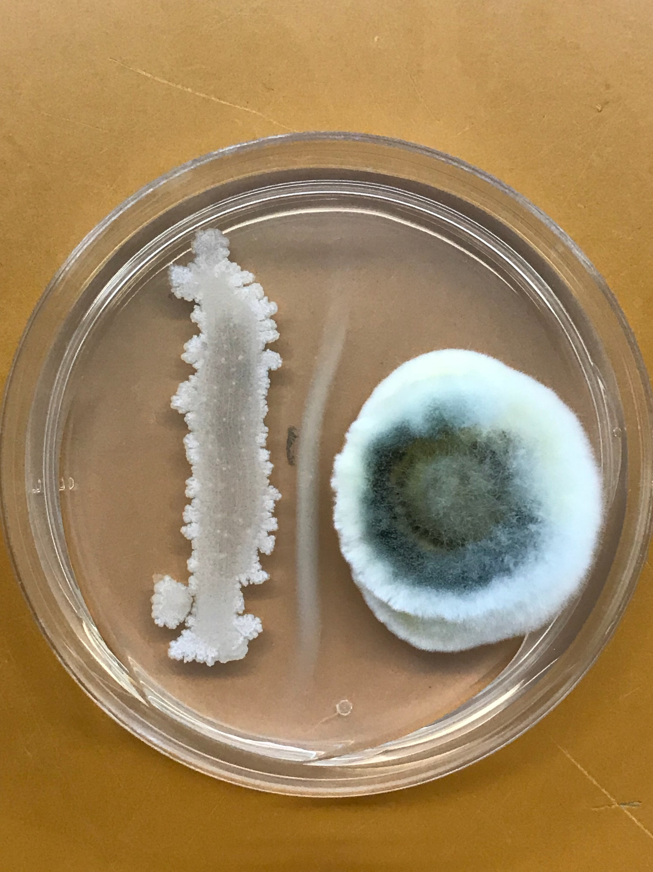
Endophytes! But which ones?
Justification
An endophyte is a microbe (bacterium or fungus) that lives inside plant tissue.
Endophytes can be active in disease
resistance.
Center for Advanced Forestry Systems 2020 Meeting
Notes:
Rice, potato, barley, corn. Can have tremendous effects
on plant fitness, ecology, and evolution.

Slide 4
Justification
Center for Advanced Forestry Systems 2020 Meeting

Slide 5
Justification
Left side inoculated with Ulocladium plus rust, versus right side with rust only.
Center for Advanced Forestry Systems 2020 Meeting

Slide 6
Justification
Control: left and right sides inoculated with rust only.
Center for Advanced Forestry Systems 2020 Meeting

Slide 7
Seed endophytes: more antagonistic than needle endophytes?
Hypotheses or Objectives
Optimal defense theory
Seeds will be more
heavily protected.
Specialized microbes?
Center for Advanced Forestry Systems 2020 Meeting
Notes:
One microbe per seed!

Slide 8
Hypotheses or Objectives
Objective
Can endophytes be used to confer white pine blister rust (WPBR) resistance to Western white pine (WWP) trees?
6 endophytes of interest:
Lophodermium nitens*
Xylaria ellisii*
Four seed endophytes isolated from WWP
seeds. These four isolates demonstrated
antagonist behavior towards other
endophytes in agaro.
*: Isolates provided by J.D. Irving
Photo: Newcombe lab
Center for Advanced Forestry Systems 2020 Meeting
Notes:
Talk about chemicals secreted by Lophodermium and xylaria

Slide 9
WWP Seed lots
Methods
BR (Bark Reaction) Resistant Lot, harvested 2005
SS (Short Shoot) Resistant Lot, collection from 5 different trees/years: ranging from 1978-2002
Susceptible Lot, harvested 2002
196 seedlings per treatment for each seed lot were inoculated with the endophytes.
Center for Advanced Forestry Systems 2020 Meeting
Notes:
Talk about endophyte application and sowing in this slide.

Slide 10
Endophyte application
Methods
Summer 2017
4 Idaho endophytes were applied in late May 2017 to the seeds prior to sowing.
L. nitens and X. ellisii were applied to foliage in August 2017. These endophytes were sprayed on remaining untreated seedlings (~2.5 months old).
Center for Advanced Forestry Systems 2020 Meeting
Notes:
Mention CDA

Slide 11
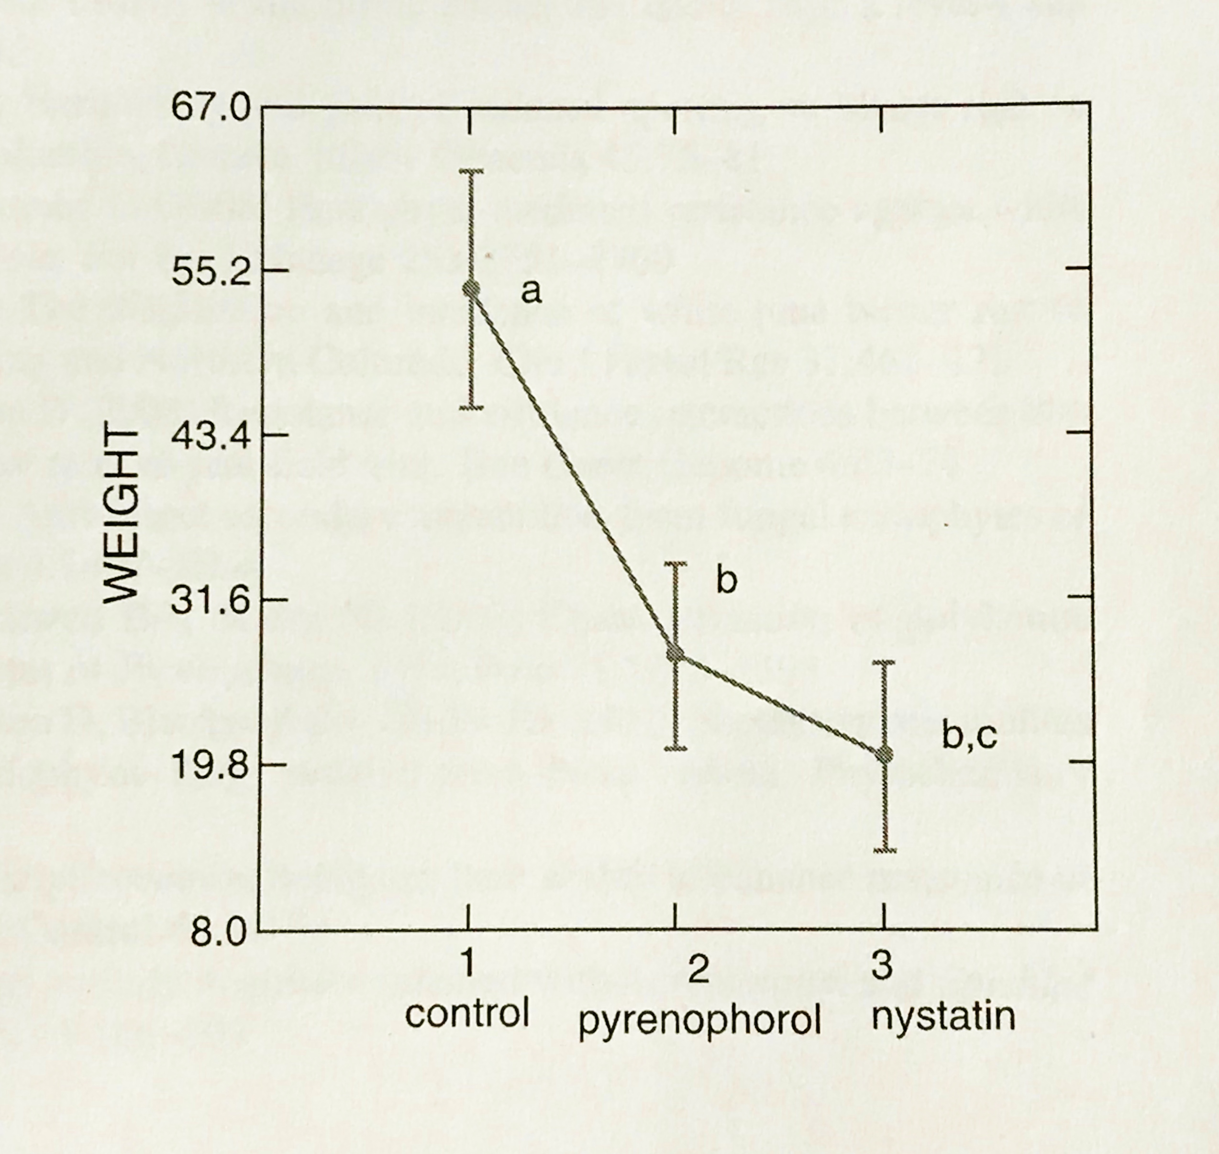
Lophodermium nitens and Xylaria ellisii
Methods
- Provided by our Canadian
collaborators at J.D. Irving; isolated from
Eastern white pine
- High anti-fungal activity; in pure
culture inhibits C. ribicola
- X. ellisii produces griseofulvin.
L. nitens produces pyrenophorol.
From Sumarah et al., 2015
Center for Advanced Forestry Systems 2020 Meeting
Notes:
Griseofulvin is used in antifungal medications. Eastern white pine. JD Irving known for developing endophyte that is inoculated into spruce seedlings for SBW

Slide 12
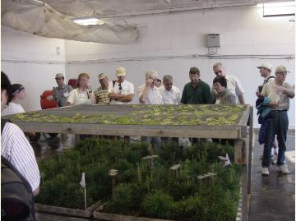
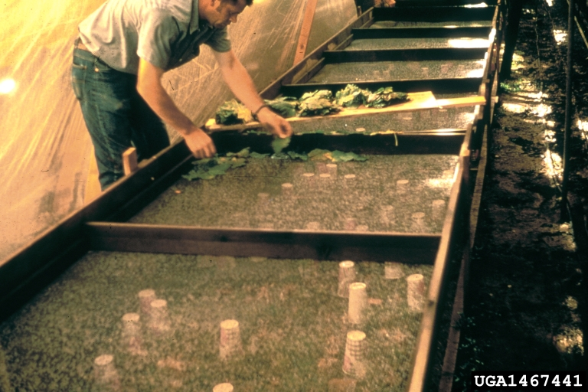
WPBR Inoculation (What it looked like)
Methods
Photos from USDA Forest Service
Center for Advanced Forestry Systems 2020 Meeting

Slide 13
Currently…
Methods
2019: Planted inoculated seedlings in nursery beds. Did not see expected disease symptoms and resistant responses. (Data collection was to have begun in June, 2019.) So, Dave Foushee at the CDA Nursery re-inoculated with rust in Sept.
2020: no rust symptoms
.
2021: final scoring: no rust symptoms.
Center for Advanced Forestry Systems 2020 Meeting
Notes:
First in June is just for presence or absence of needle spots. Then in September 2019 onward we look for bark reactions and cankers

Slide 14
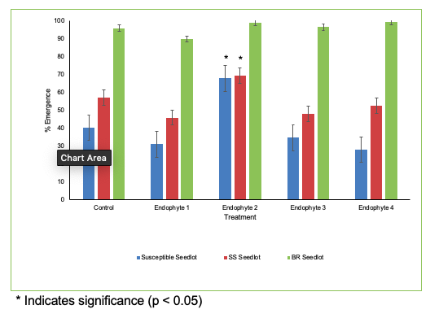
Major Findings
Center for Advanced Forestry Systems 2020 Meeting

Slide 15
Endophyte #2
Major Findings
Control plate
Streptomyces sp.
Demonstrates
extensive antagonistic
behavior towards
many fungi that have
been grown in its
presence.
Test plate with Endophyte 2
Center for Advanced Forestry Systems 2020 Meeting
Notes:
Need to somewhere mention that WPBP is biotropic so Endophyte effects may be different. Cannot test in agaro. Endophyte 2 is from WWP seed

Slide 16
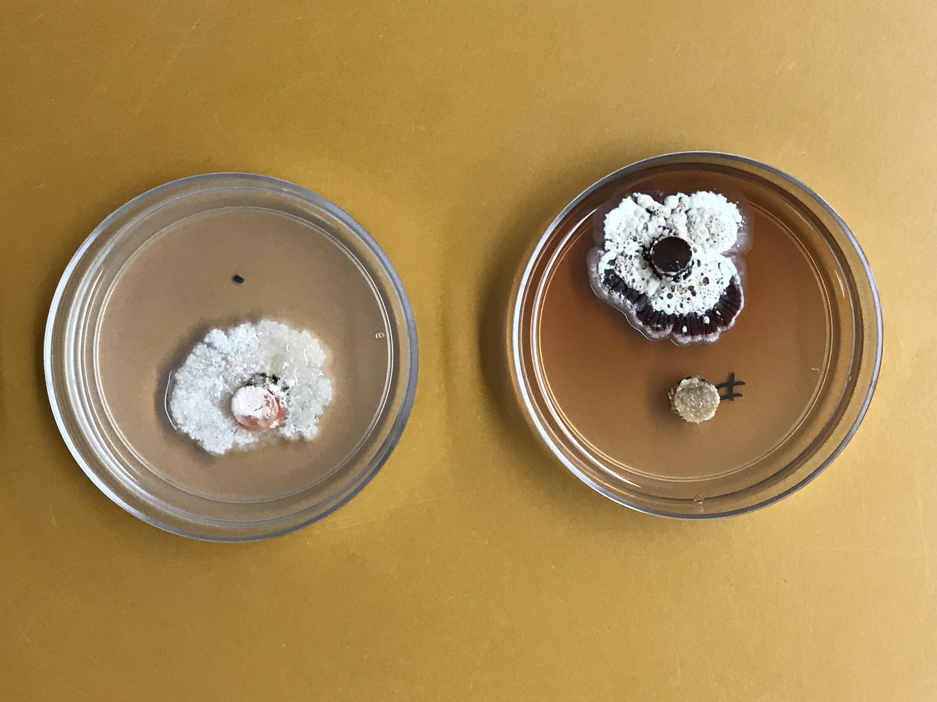
100% Inhibition
Major Findings
Streptomyces (top plate, left) completely inhibiting the
growth of a needle fungus
(top plate, right). Bottom
right is control plate of
needle fungus.
Center for Advanced Forestry Systems 2020 Meeting
Notes:
Summarize: if they can inhibit other WWP fungi, why not WWP?

Slide 17
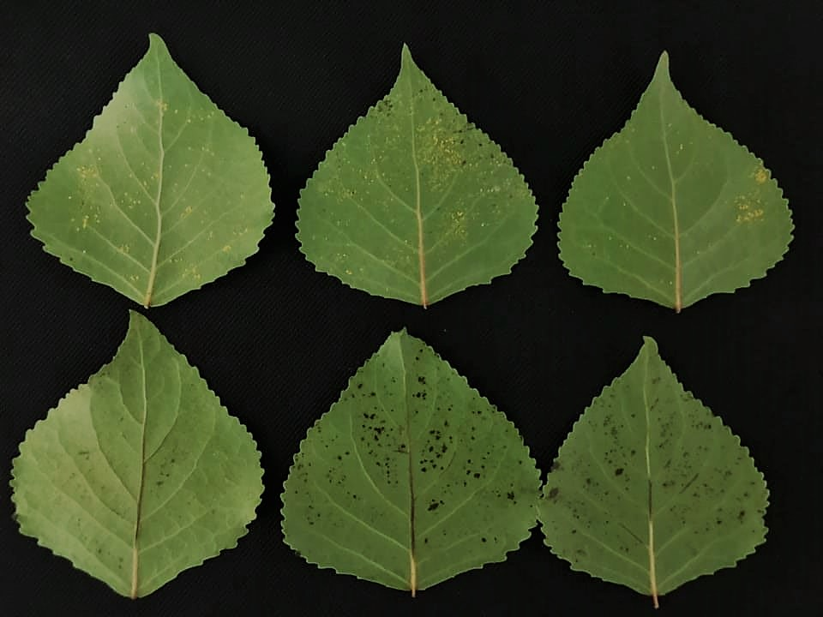
Major Findings
Center for Advanced Forestry Systems 2020 Meeting

Slide 18
Major Findings
Bacterial Endophytes
Streptomyces
Inhibition of 8 different WWP seed fungi:
17.7% ± 13.9%
Inhibition of 8 different WWP needle fungi:
62.0% ± 8.2%
Bacillus (Endophyte #4)
Inhibition of 8 different WWP seed fungi: 26.7% ± 4.6%
Inhibition of 8 different WWP needle fungi:
54.5% ± 6.7%
Center for Advanced Forestry Systems 2020 Meeting

Slide 19
Deliverables
Method to increase emergence of Western white pine seedlings
A new, well-supported emphasis on seed bacteria as the endophytes to use for any forest tree
Center for Advanced Forestry Systems 2020 Meeting
Notes:
Mention the eastern white pine ones? Plant hormones produced by endophytes. Or Streptomyces inhibited somehow pathogens that would have reduced emergence. Or did in the case of control

Slide 20
Company Benefits
Commercial plantings
will benefit from a
reduction in WPBR
rates. Survival of WWP
in such environments
will also increase.
2. Determination to try WPBR experiment again, this time with program in Dorena OR!
http://www.conifers.org/pi/pi/m/monticola02.jpg
Center for Advanced Forestry Systems 2020 Meeting
Notes:
Resistant seed sources still suffer mortality from WPBR. It also costs large amounts of money and time to produce large amounts of even the most resistant seed.
But…
If endophytes can successfully increase the resistance of those seed sources already possessing resistance to some degree, then…
2. Even in areas where resistant seed sources have fallen prey to WPBR

Slide 21
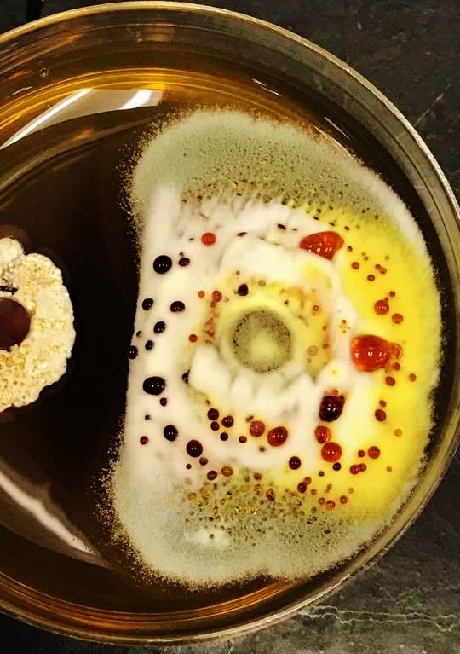
Recommendations
Select seed bacteria to
improve performance
in any tree species.
Streptomyces (left) inhibiting a seed fungus (right)
Center for Advanced Forestry Systems 2020 Meeting

Slide 22
Acknowledgements
Summary
Maria Marlin (UI, now OSU)
Mary Ridout (UI)
Diana Cervantes (UI)
Abby Ferson (UI)
David Foushee (USFS Coeur d’Alene Nursery)
J.D. Irving (Greg Adams)
Marc Rust and IETIC
Center for Advanced Forestry Systems 2020 Meeting

