Slide 1
Progress Report
Stand and Tree Responses to Late-Rotation Fertilization
CAFS.16.69
Eric Turnblom, Kim Littke, Jason Cross, Mason Patterson, and Rob Harrison (UW)
Kim Littke
Center for Advanced Forestry Systems 2020 Meeting
Notes:
1

Slide 2
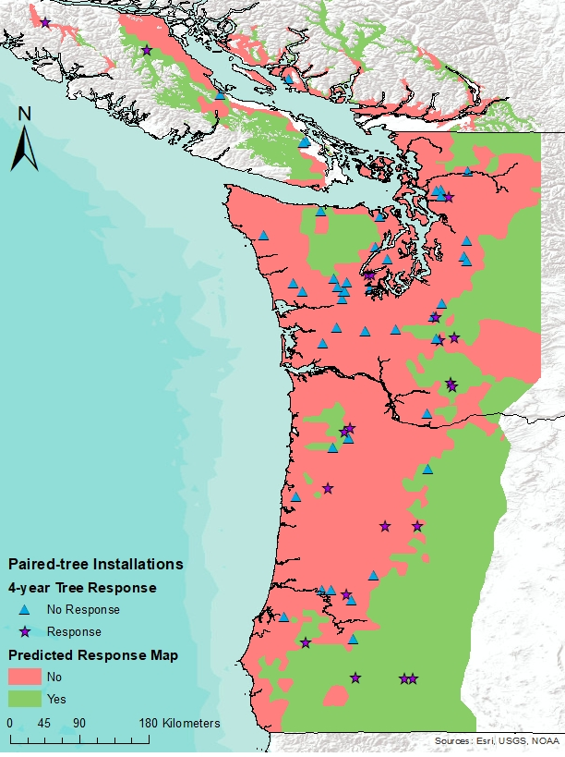
Project Overview
Soils in the Pacific Northwest have responded the best to N fertilization
Focusing fertilization on responding, late-rotation stands that are 8-10 years to harvest can decrease the risk and cost of fertilization
Objectives
Determine the average, area-based volume response to late-rotation fertilization
Estimate the regional economic returns of late-rotation fertilization
Validate the models developed from the CAFS supported Paired-Tree Study
Assess the ability to predict response to fertilization using plant root simulator (PRS) probes
Center for Advanced Forestry Systems 2020 Meeting

Slide 3
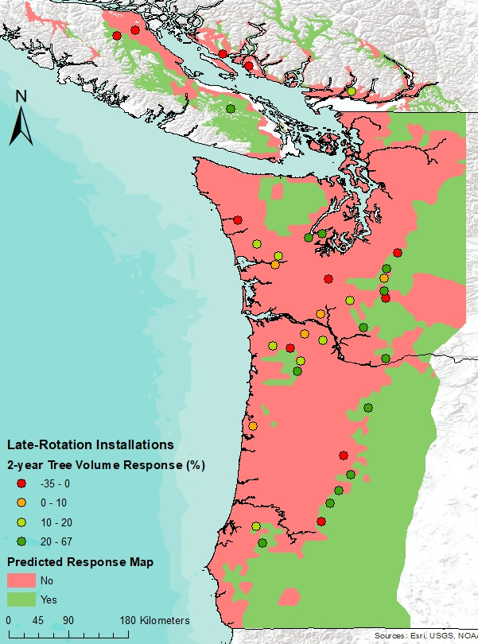
Current Progress
37 installations have been measured for two-year fertilizer response
Greater volume response per tree on installations with low PRS NO₃ adsorption (<50 mg)
Response was greater in predicted response regions from the Paired-Tree study
Predicted | Tree Response | Plot Response
No Response | 7.2% | 9 ± 82 ft³/ac/yr
Response | 26% | 63 ± 123 ft³/ac/yr
Center for Advanced Forestry Systems 2020 Meeting

Slide 4
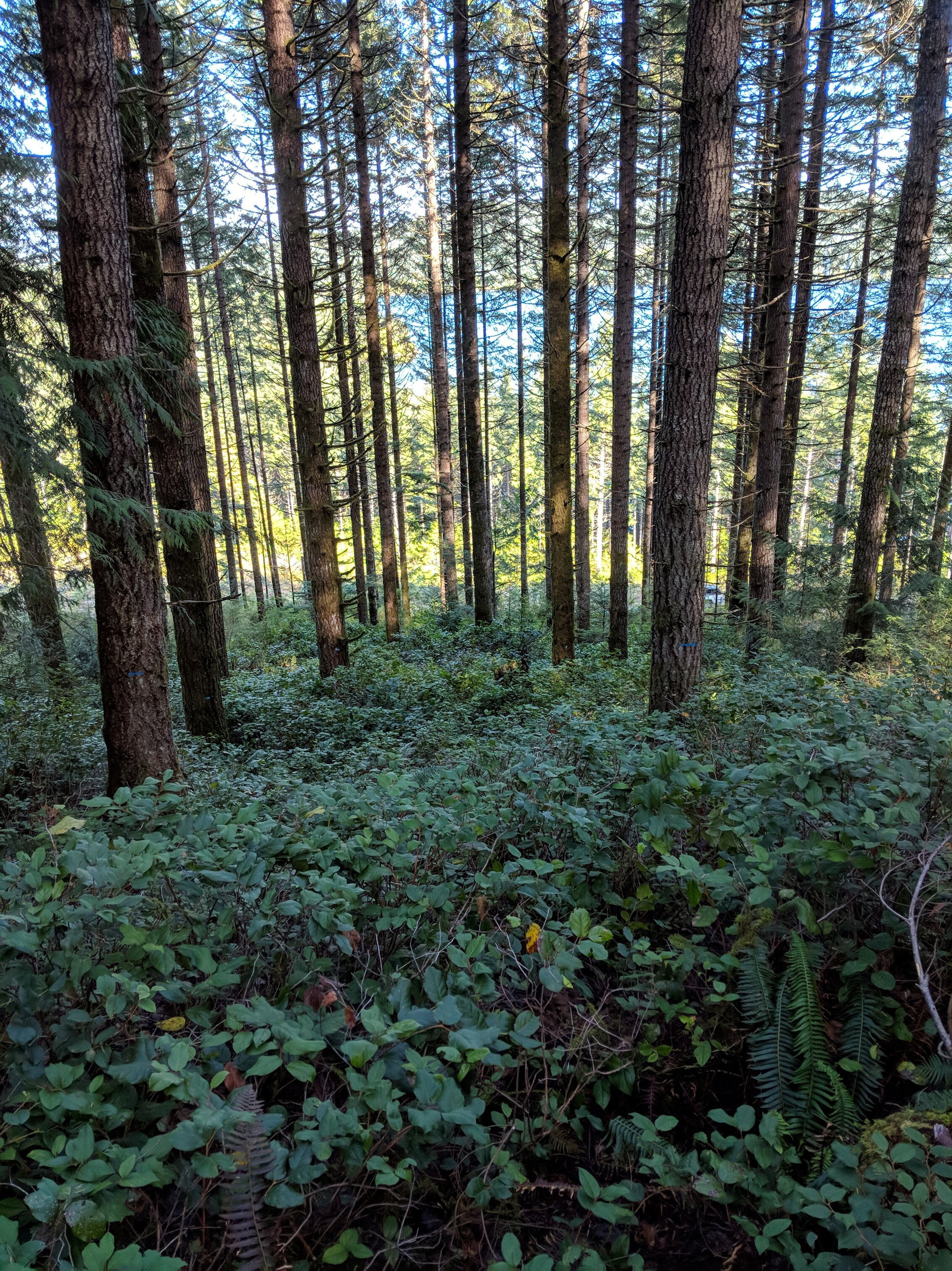
Future Plans
Continue measuring installations until harvest
Analyze fertilizer response per tree and per plot over time
Understand how tree nutrition affects response
Determine average regional response to fertilization and economic returns
Incorporate results into growth models
Center for Advanced Forestry Systems 2020 Meeting

