Slide 1
Continuing Project
Site-stand dynamics and pine beetle mortality in pine ecosystems
CAFS 23.101
UofI: Haley Anderson, Mark Kimsey, Steve Cook, Ann Abbott
Presenter: Haley Anderson
Center for Advanced Forestry Systems 2024 IAB Meeting
Notes:
1

Slide 2
Justification
Bark beetle outbreaks are socioecologically and economically impactful
Future climate change is predicted to shift and expand the range of bark beetles, and warming and drying trends are expected to result in increased susceptibility to bark beetles in water limited systems
Existing bark beetle susceptibility models are regionally specific, do not incorporate climate and abiotic variables, and are sometimes not “user friendly”
A need exists for a spatially, temporally, and granular explicit bark beetle susceptibility model that incorporates site, stand, and climate variables
Center for Advanced Forestry Systems 2024 IAB Meeting

Slide 3
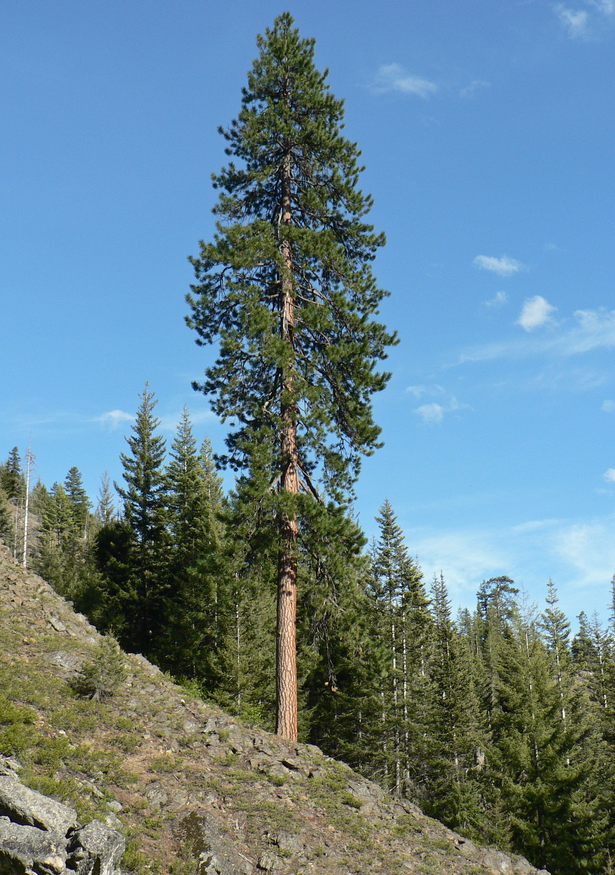
Hypotheses or Objectives
Identify site/stand variables related to pine beetle outbreak susceptibility
Incorporate temporal time series climate and abiotic data into outbreak susceptibility models for both western and mountain pine beetles
Develop SDImax density thresholds and management guidelines to aid in reducing epidemic attack potential.
Center for Advanced Forestry Systems 2024 IAB Meeting

Slide 4
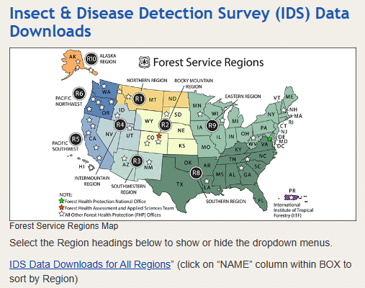
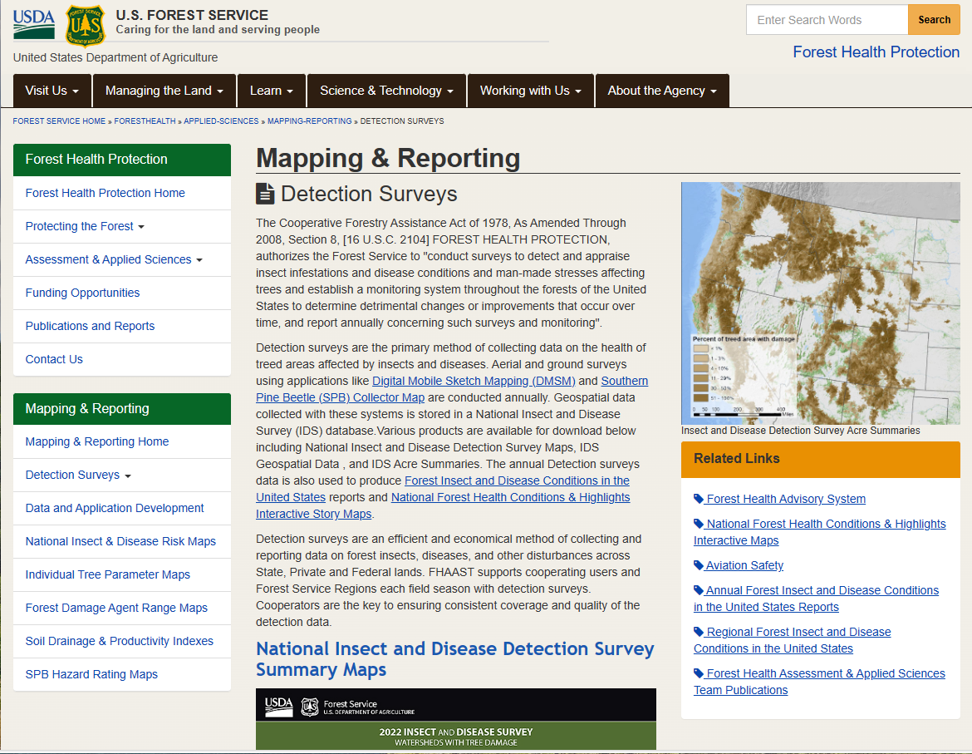
Methods
USDA Forest Service Insect and Disease Aerial Survey Data includes outbreak locations of the western and mountain pine beetles throughout the Intermountain West
Additional data includes in situ plot data (e.g., unfuzzed FIA data, state agency inventory records) and remotely sensed imagery (Landsat 7/8/9 TM/OLI) mined from Google Earth Engine at multiple temporal scales
Site/stand variables, including climatic (temperature, precipitation), abiotic data (latitude, longitude, elevation, slope, aspect, soil type), and stand information (density, species composition) will be explored and analyzed using machine learning to find relationships with western and mountain pine beetle epidemics
Center for Advanced Forestry Systems 2024 IAB Meeting

Slide 5
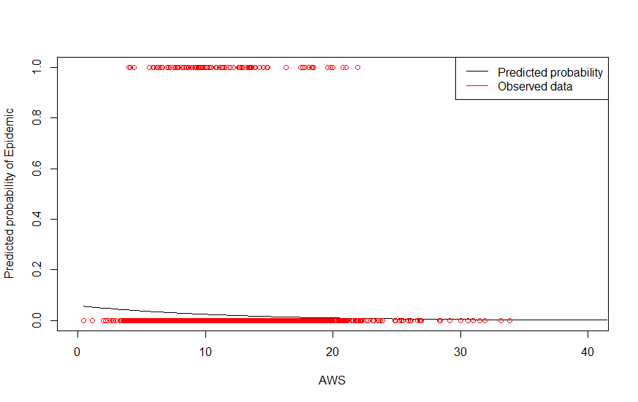
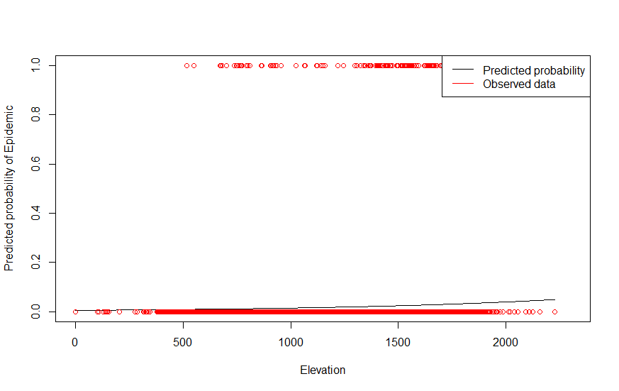
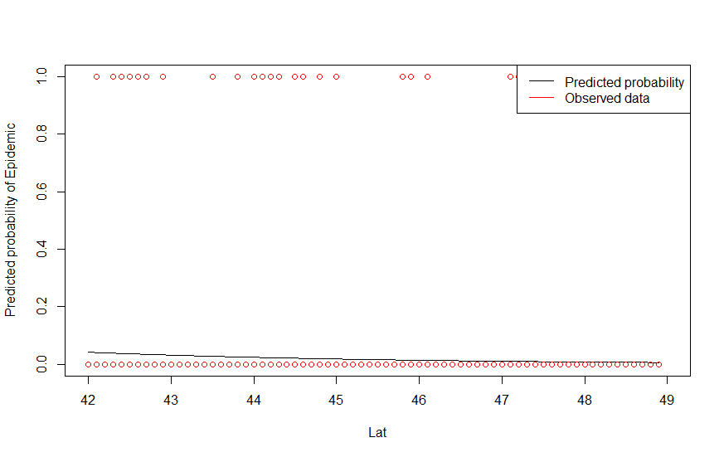
Major Findings
Covariate | Deviation in Deviance | Degrees of Freedom | Chi-Square
Available Water Storage (AWS) | 17.658 | 1 | 2.644e-05**
Depth to Restrictive Layer (D2R) | 0.37939 | 1 | 0.5379
Elevation | 17.196 | 1 | 3.372e-05**
Aspect | 0.11386 | 1 | 0.7358
Topographic Wetness Index (WTI) | 0.75957 | 1 | 0.3835
Heatload | 0.02240 | 1 | 0.881
Latitude | 29.369 | 1 | 5.984e-08**
Center for Advanced Forestry Systems 2024 IAB Meeting

Slide 6
Deliverables
1. Identification of size/density thresholds for mountain/western pine beetle
2. Determination if and at what point in stand development climatic conditions induce pine beetle outbreaks
3. Determination if climate change indicates shifts in pine carrying capacity as a function of site type and species composition
4. A user-friendly tool that provides effective density management recommendations for ponderosa pine stands flexible to climate, species composition, site type, and method of measurement at the stand-scale for reduced susceptibility of western and mountain pine beetle epidemics across their respective ranges.
5. A dissertation and published peer-reviewed journal article describing the project in detail.
Center for Advanced Forestry Systems 2024 IAB Meeting

Slide 7
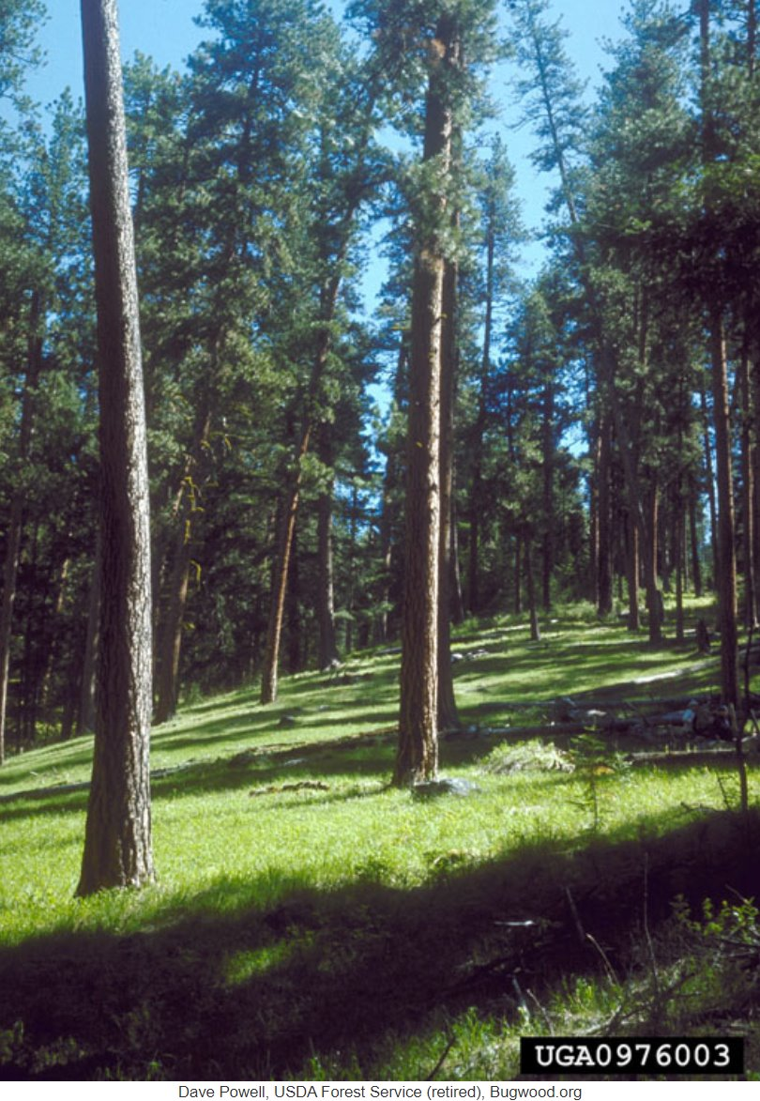
Company Benefits
Potential time and cost savings by reducing large-scale mortality from pine beetle epidemics
More resilient forest stands
Density threshold modifiers for existing SDImax models that incorporate pine beetle epidemic risk factors
Examples:
Time savings from new technique
Cost savings from discovery of new protocol
Center for Advanced Forestry Systems 2024 IAB Meeting

Slide 8
Summary
Shift from the original proposal which included southern pine beetle as well as western species (western pine beetle/mountain pine beetle/pine engraver) to just western species
  Allows a more focused approach for western species model
  Aerial survey data is “best guess” for species ID, due to sheer number of outbreaks surveyed each year
  Three western species may need to be lumped for holistic pine beetle model
Results of the logistic regression analysis of the impact of physiographic variables on likelihood of western pine beetle epidemic indicate that drivers of outbreaks are site/stand specific and should be explored in earnest
Preliminary results support need for user friendly tool that provides effective density management recommendations for ponderosa pine stands flexible to climate, species composition, site type, and method of measurement at the stand-scale for reduced susceptibility of western and mountain pine beetle epidemics across their respective ranges.
Center for Advanced Forestry Systems 2024 Meeting

