Slide 1


Continuing Project
UMaine/UMFK START
CAFS.21.92
Investigators
PI: Rubert-Nason, K. – University of Maine at Fort Kent
Weiskittel, A. – University of Maine at Orono
Thompson, N. – University of Maine at Fort Kent
Rogers, N. – University of Maine at Orono
Presenter: Kennedy “Ned” F. Rubert-Nason
Center for Advanced Forestry Systems 2024 IAB Meeting
Notes:
1

Slide 2
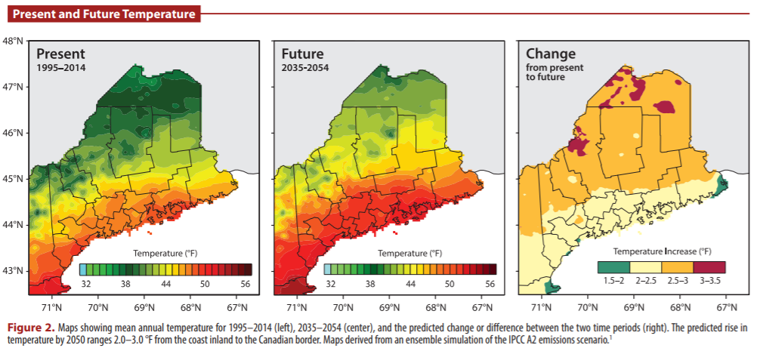
Justification
Environmental change affects commercial forests¹
Growth + health
Assessment and forecasting inform management
Forest products industry requires trained workforce²
Collaborative, leadership and multicultural skills
Applied methods + procedures
Fernandez, I.J., Schmitt, C.V., Birkel, S.D. et al. (2015) Maine’s Climate Future: 2015 Update. University of Maine, Orono, ME
2. Maine Science and Technology Action Plan (2010) https://digitalmaine.com/decd_docs/1
Center for Advanced Forestry Systems 2024 IAB Meeting

Slide 3
Hypotheses or Objectives
Objectives
Assess tree responses to environmental conditions
Collect, curate and communicate data for management decisions
Prepare future forestry professionals
Synergistic Projects
1. Rapidly assess tree health from hyperspectral images
(Rubert-Nason et al. UMFK. Sponsor: Maine Economic Improvement Fund [MEIF])
2. Estimate wood moisture content
(Li et al. UMaine. Sponsor: Maine Research Reinvestment Fund)
3. Identify, rank order probable causes of, and manage cedar health decline
(Landry et al. UMFK)
4. Evaluate effects of microclimate on forest regeneration
(Rogers et al. UMaine. Sponsor: Cooperative Forestry Research Unit [CFRU])
5. Create unified database for Maine Adaptive Silviculture Network (MASN) data
(Louis et al. UMFK. Sponsor: CFRU)
6. Identify uses of biochar soil amendments to mitigate climate impacts on trees
(Rubert-Nason et al. UMFK. Sponsor: MEIF)
7. Strengthen Maine’s research through strategic capacity building
(Moeykens et al. UMaine & Rubert-Nason UMFK. Sponsor: National Science Foundation)
Center for Advanced Forestry Systems 2024 IAB Meeting

Slide 4
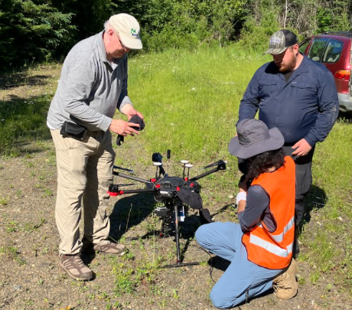

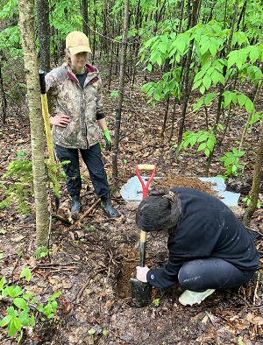
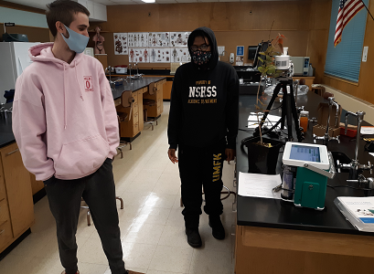
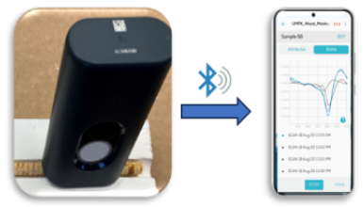
Methods
Geospatial analysis
UAV and ground-based remote sensing
Tree mensuration
Specimen collection, transport & storage
Soil chemical & physical analysis
Phytochemical analysis
Physiological measurements
Climate monitoring equipment operation
Data curation and analysis
Center for Advanced Forestry Systems 2024 IAB Meeting

Slide 5
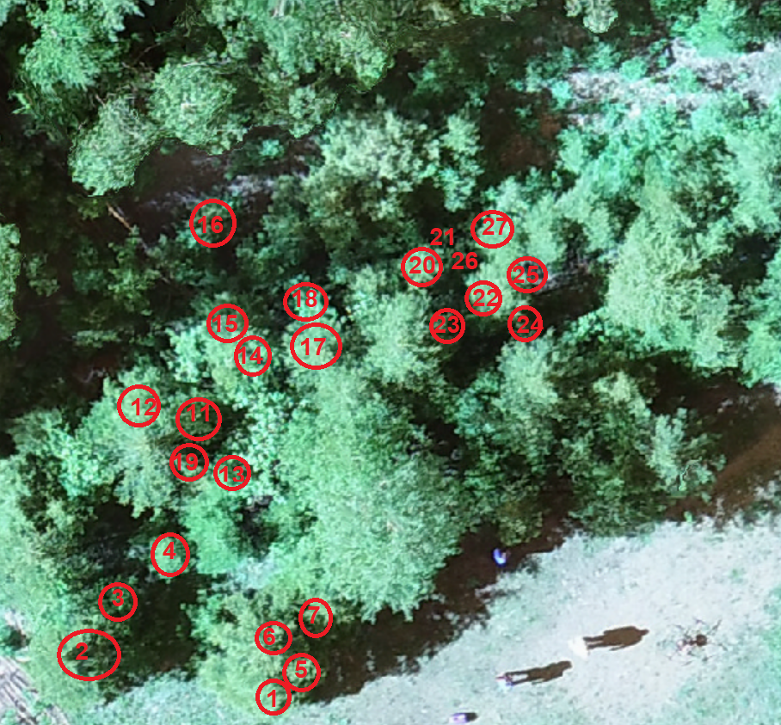
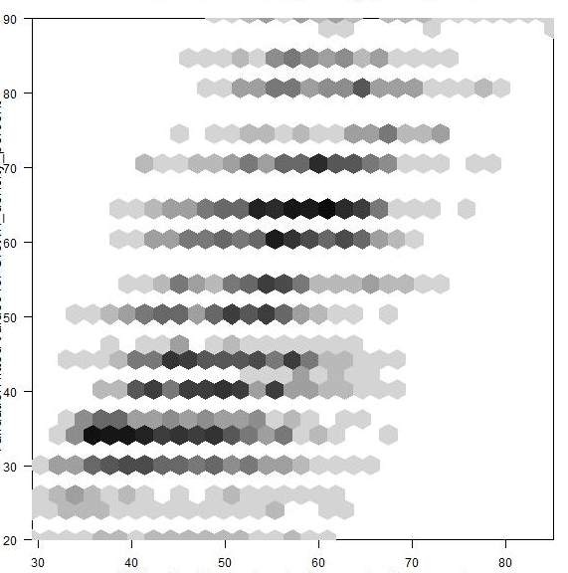
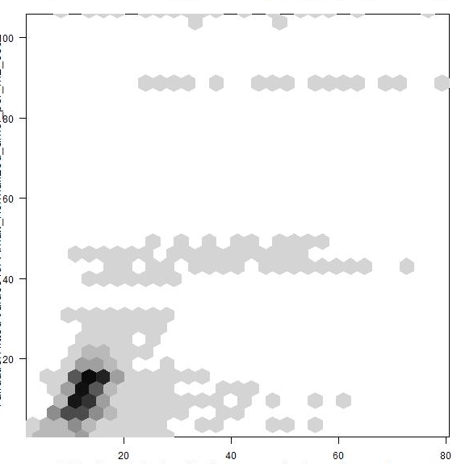
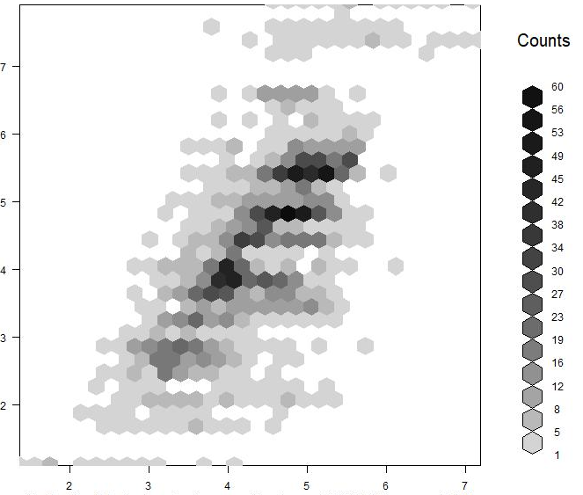
Major Findings
Innovative method: Forest health assessment with hyperspectral imaging
Innovative method: Wood moisture determination by handheld NIR
Validated for common northern hard + softwoods
n = 43, R² = 0.71, RMSEp = 0.11, RPD = 3.2
Data collection & curation:
    Cedar health assessments
    Microclimate effects on forest regeneration
    Create unified MASN plot database
Crown density (%)
A_{max} (μmol/m²/s)
Condensed tannins (%)
Validation
R² = 0.41
R² = 0.46
R² = 0.53
Image: K. Rubert-Nason & P. Nelson
Calibration
Center for Advanced Forestry Systems 2024 IAB Meeting

Slide 6
Deliverables
Innovative methods for forest health & wood moisture assessment
Presentation: Hyperspectral imaging for rapid health assessment of spruces (#80221). Ecol. Soc. Am. Natl. Mtg. Aug. 4-9, 2024. Long Beach, CA
Publication (in review): Wood moisture content determination by handheld NIR. Thapa, Li, Rubert-Nason, Wang, Mirtes, Brown, Pelletier, Zhang. Wood Sci Technol.
Publication (in prep): Hyperspectral imaging for tree health assessment. Can. J. For. Res.
Data collection to inform management
Cedar health pilot data
Microclimate effects on forest regeneration
Create unified MASN plot database
New collaborations: PERSEUS project - Estimating tree traits by hyperspectral imaging
New funding
Building a database from MASN inventories (CFRU, $35k)
Repurposing biochar residues as soil amendments (MEIF, $181k)
NSF ECORE RII: Strengthening Maine’s research ecosystem and pathways through strategic capacity building (Maine-SMART, #2412130, $99k)
Microclimate effects on forest regeneration (MEIF, $25k, 2022-24)
Career preparation for UMFK Forestry students
Center for Advanced Forestry Systems 2024 IAB Meeting

Slide 7

Company Benefits
Assess tree responses to environmental change
Financial loss mitigation: Fast, affordable ways to identify tree health changes
Optimize site selection for future plantings and management to maximize yield
Synergistic projects
2. Data collection & curation
Forest inventory + environmental data inform management decisions
Pilot data on tree health-environment connections
3. Workforce preparation
Collaborative, leadership, multicultural skills
Field and lab work
Logistics
Critical thinking
Tools, technologies & procedures
Networking
Center for Advanced Forestry Systems 2024 IAB Meeting

Slide 8
Recommendations
Environmental change impacts on forests
Rapid identification of changes in forest tree health is necessary for
efficient management decisions
Aerial and ground-based hyperspectral measurements have potential
to provide rapid, expansive forest health assessments at reduced cost
2. Data collection & curation
Long-term data collection is foundational to management decisions
Accessibility + useability are critical (FAIR + CARE compliance)
3. Workforce preparation
More undergraduate training opportunities needed
Invest in student recruitment + retention
Align student skills with industry + academic needs
Center for Advanced Forestry Systems 2024 IAB Meeting

Slide 9

Summary
Seven projects underway (+3 from 2023)
  Thrusts: Environmental change impacts on forests
  Technological innovation
  Mentoring: Embedded teaching + mentoring
  (“Ecopedagogy of human-Earth relationships”)
Data collection & curation: Increase availability
and accessibility of data to inform decisions
Workforce preparation:
  Collaborative, leadership and multicultural skills
  Logistics + field work
  Critical thinking
  Tools, technologies & procedures
  Networking
Center for Advanced Forestry Systems 2024 Meeting

