Slide 1
Continuing Project / Final Report
Physiologic Response to Commercial Fertilization Programs in Pacific Northwest Forest Plantations
CAFS 20.84
Eric Turnblom (UW), Kim Littke (UW), Michael Premer (UMaine)
Kim Littke
Center for Advanced Forestry Systems 2024 IAB Meeting
Notes:
1

Slide 2
Justification
Fertilizer response is highly variable in the Pacific Northwest mostly due to N availability
  Climate, soil, and stand conditions affect the magnitude and continuation of response
Fertilization causes a temporary increase in photosynthetic rate and water use efficiency, but long-term response requires an increase in leaf area
  Stands that cannot increase leaf area will likely not respond to fertilization even if N is limiting
Measurements of physiologic processes through C and O isotope ratios should further explain fertilizer response and guide future fertilization decisions
Center for Advanced Forestry Systems 2024 IAB Meeting

Slide 3
Objectives
Understand physiological patterns of response in fertilized Douglas-fir plantations
Investigate mechanisms of physiologic processes under various climate, soil, and stand conditions
Develop regional silvicultural guidelines for commercial forest operations
Provide data to inform changes in silvicultural treatments due to future climate change
Center for Advanced Forestry Systems 2024 IAB Meeting

Slide 4
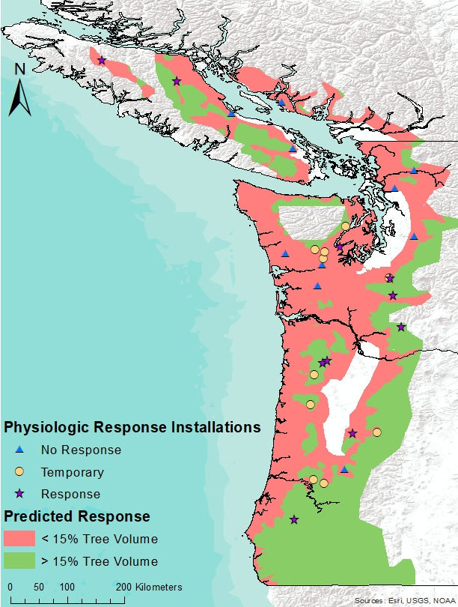
Methods
SMC Paired-tree Fertilization sites
Fertilized with urea and measured over 6 years
Selected a subset of
  Fert responsive (0-4+ years)
  Temporary response (0-2 years only)
  Non-responsive
  10 sites from each type
Center for Advanced Forestry Systems 2024 IAB Meeting

Slide 5
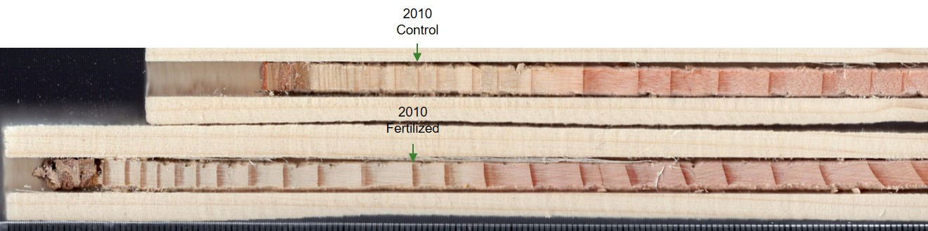

Methods
Dated and measured earlywood and latewood from 894 trees
  Detrended ring measurements to ring width index (average growth = 1)
  Determined ring area growth and fertilizer response
Up to 10 pairs per site split into earlywood/latewood 4 years prior to and 6 years post-fertilization
  Composited by site, treatment, component (EW/LW), and year
Isotopic composition (δ¹³C and δ¹⁸O) analyzed at Columbia University
  δ¹³C can be converted to intrinsic water use efficiency
    WUE = $\frac{photosynthesis}{stomatal conductance}$
  δ¹⁸O is negatively related to stomatal conductance
Center for Advanced Forestry Systems 2023 IAB Meeting

Slide 6
Major Findings
Photosynthesis?
Stomatal Conductance?
Control plots
Hotter, drier climates increased WUE and δ18O
  Lower stomatal conductance
Less effect of temperature on stomatal conductance in non-responsive sites
  Less risk of drought on these sites?
Stomatal Conductance

Slide 7
Major Findings
Photosynthesis
Stomatal Conductance
Control plots
Negative relationship between WUE and δ18O and RWI
Drought conditions decrease ring growth
No effect of WUE on ring width index in non-responsive sites
  Could be due to boost in photosynthesis with increasing stomatal conductance
  This effect not seen in responsive installations
Stomatal Conductance

Slide 8
Major Findings
Responsive sites grew more ring area
  Short-term growth response in Temporary sites
Responsive sites increased earlywood WUE over non-responsive sites
  WUE increase in Temporary sites was lower
There were few differences in δ18O between response types
  ↓ δ18O after fertilization suggests initial increase in stomatal conductance in all sites
  ↑ δ18O in temporary responders in year 4 suggests a decrease in stomatal conductance (drought)

Slide 9
Summary
Greater water use efficiency and δ18O is usually caused by drought
  Negative effect on ring width index
  RWI is also negatively related to hotter, drier conditions
However, when responsive stands are fertilized, an increase in WUE is due to a boost in photosynthetic assimilation
Non-responsive sites show less effect of drought and no effect of fertilizer
Potential for increased drought on sites that only responded temporarily to fertilization
Center for Advanced Forestry Systems 2024 Meeting

Slide 10
Deliverables
Relationships between biogeoclimatic variables and physiologic response to N fertilization
Proposed silviculture alternatives under potential changes in future climate
Three peer-reviewed publications that reflect each project objective
A study design that can be applied to national forests through the Center for Advanced Forestry Systems
Center for Advanced Forestry Systems 2024 IAB Meeting

Slide 11
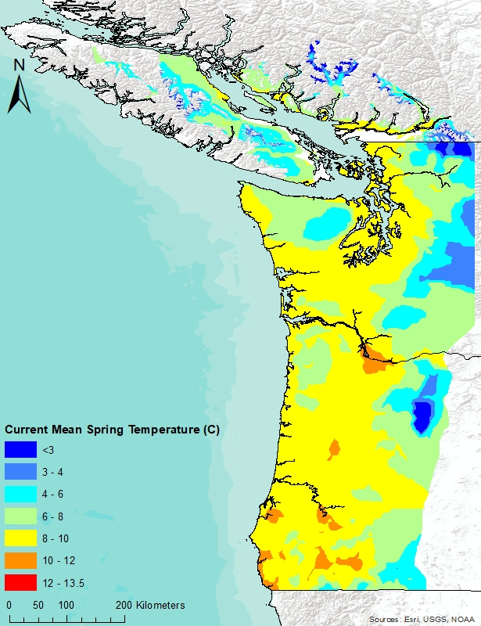
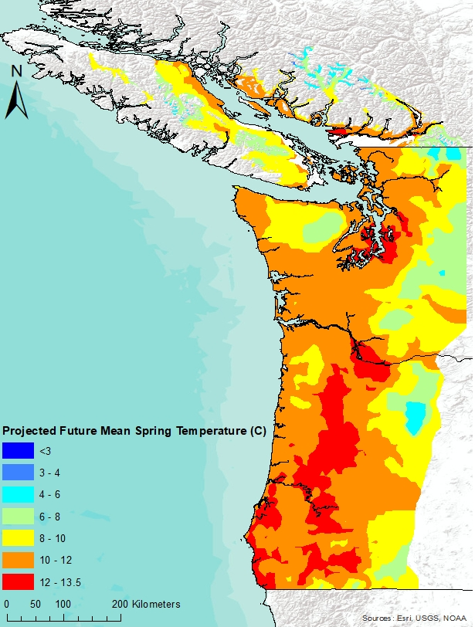
Company Benefits
Improved fertilization and silviculture recommendations for Douglas-fir plantations based on physiologic response
Recommendations for silviculture under future climate scenarios
Center for Advanced Forestry Systems 2024 IAB Meeting

