Slide 1
Final Report
Resilience of soil organic carbon to harvesting: A long-term soil productivity experiment
CAFS 20.81
Jeff Hatten, Oregon State University
Stephanie Winters, Oregon State University
Kim Littke, University of Washington
Center for Advanced Forestry Systems 2024 IAB Meeting
Notes:
We’re presenting current results from our study examining soil carbon in managed forests.
1

Slide 2
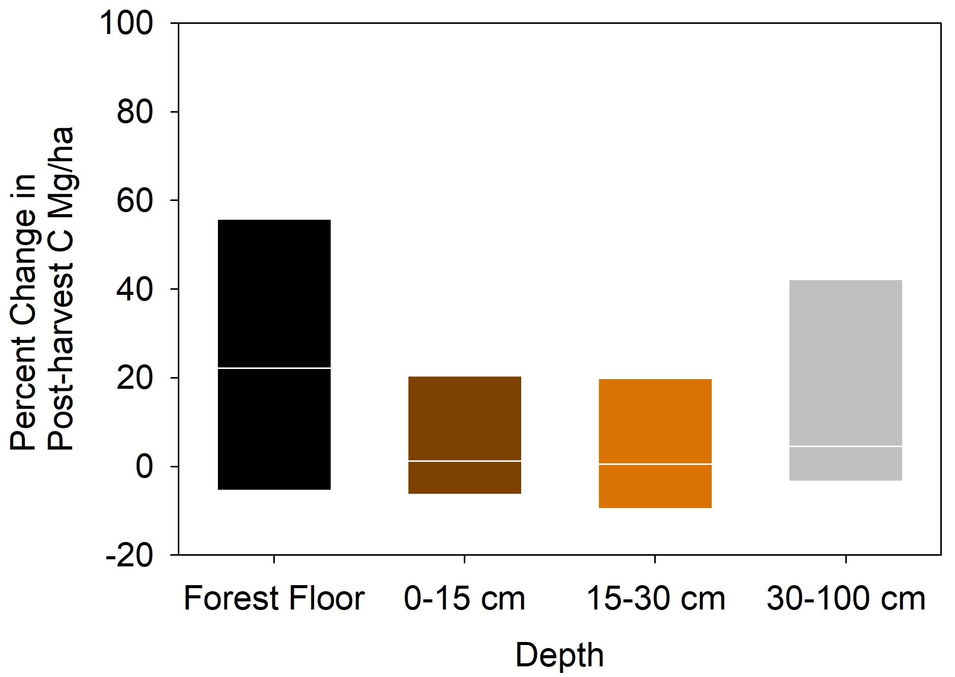
Justification
10 years post-harvest
9 sites
300 points per site sampled to 1m
10y results WY Soil Carbon Study. Holub et al. 2023 NAFSC
10y results Weyerhaeuser Soil Carbon Study. Holub et al. 2023 NAFSC
Center for Advanced Forestry Systems 2024 IAB Meeting
Notes:
Forest harvesting has been shown to have varying impcats to soil carbon.
In this example from a WY soil carbon study, we are showing that there has been little impact to soil carbon caused by forest harvesting after 10 years. However, other studies and meta-analysis show differing resposnses.

Slide 3
Hypotheses or Objectives
Determine the mechanisms of resistance and resilience in SOC severe disturbances across a wide range of soils and forest types.
Resistance: We hypothesize that those forests that initially have a higher proportion of mineral and aggregate stabilized SOC will resist changes associated with loss of aboveground biomass
Resilience: We hypothesize that 1) increased inputs of dead biomass (roots, stumps, and harvest residues) created because of the disturbance; and/or 2) a higher rate of stabilization of the C that is available will impart resilience to losses of aboveground biomass
Center for Advanced Forestry Systems 2024 IAB Meeting
Notes:
Many studies have shown little impact to soil carbon caused by forest harvesting and even forest fires. This is counterintuitive – How is it that we can remove large amounts of carbon from the forest through these activities or disturbances and have little impact on soil carbon???
This project is trying to determine those mechanisms that result in this resilience or resistance to soil carbon change.
O

Slide 4
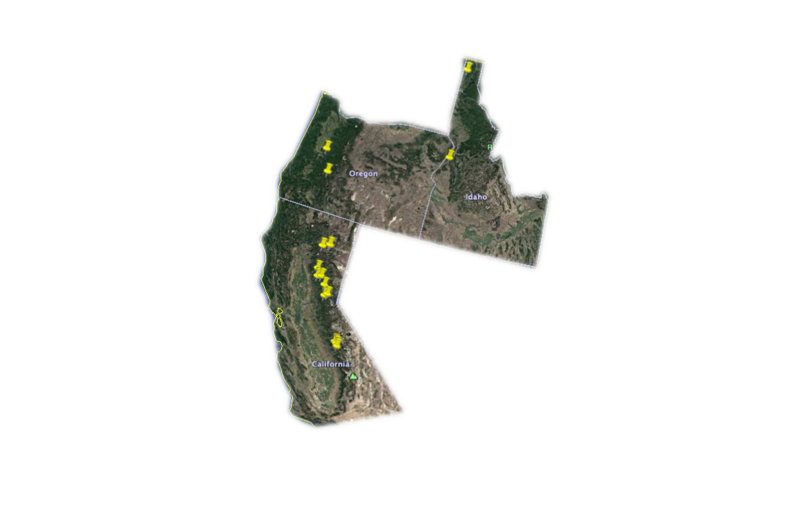
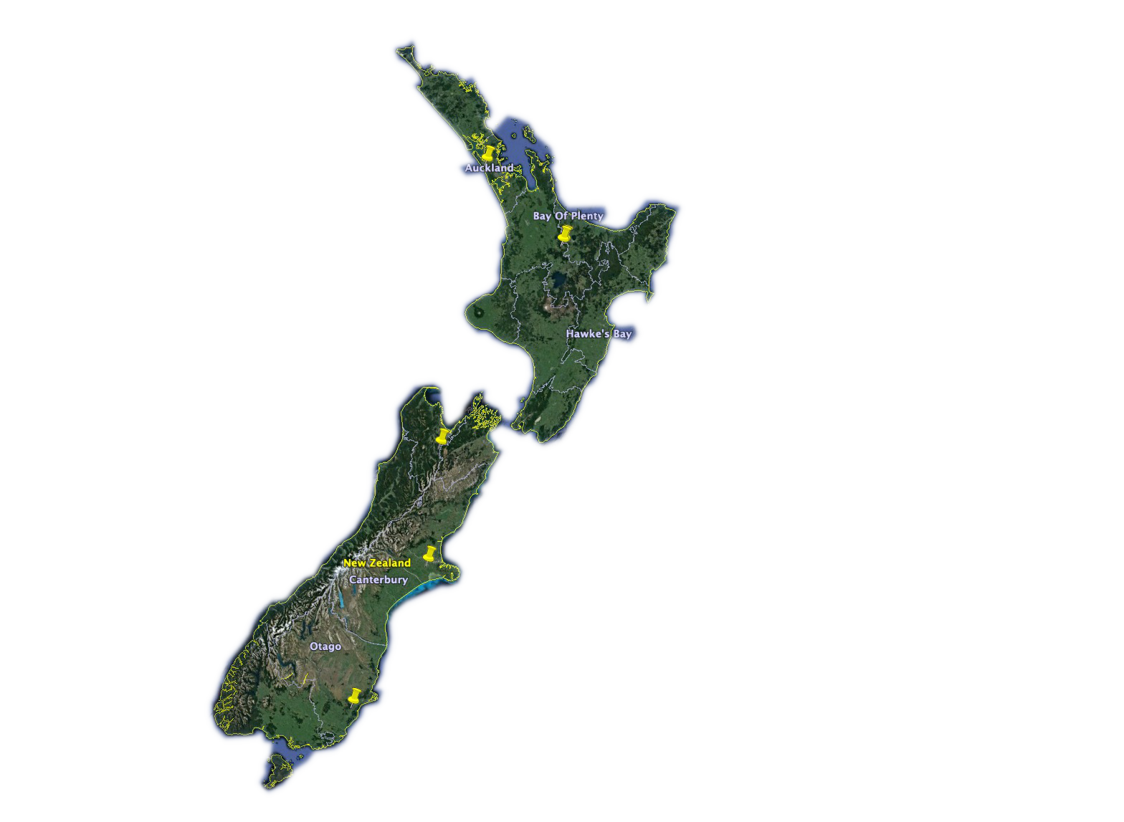
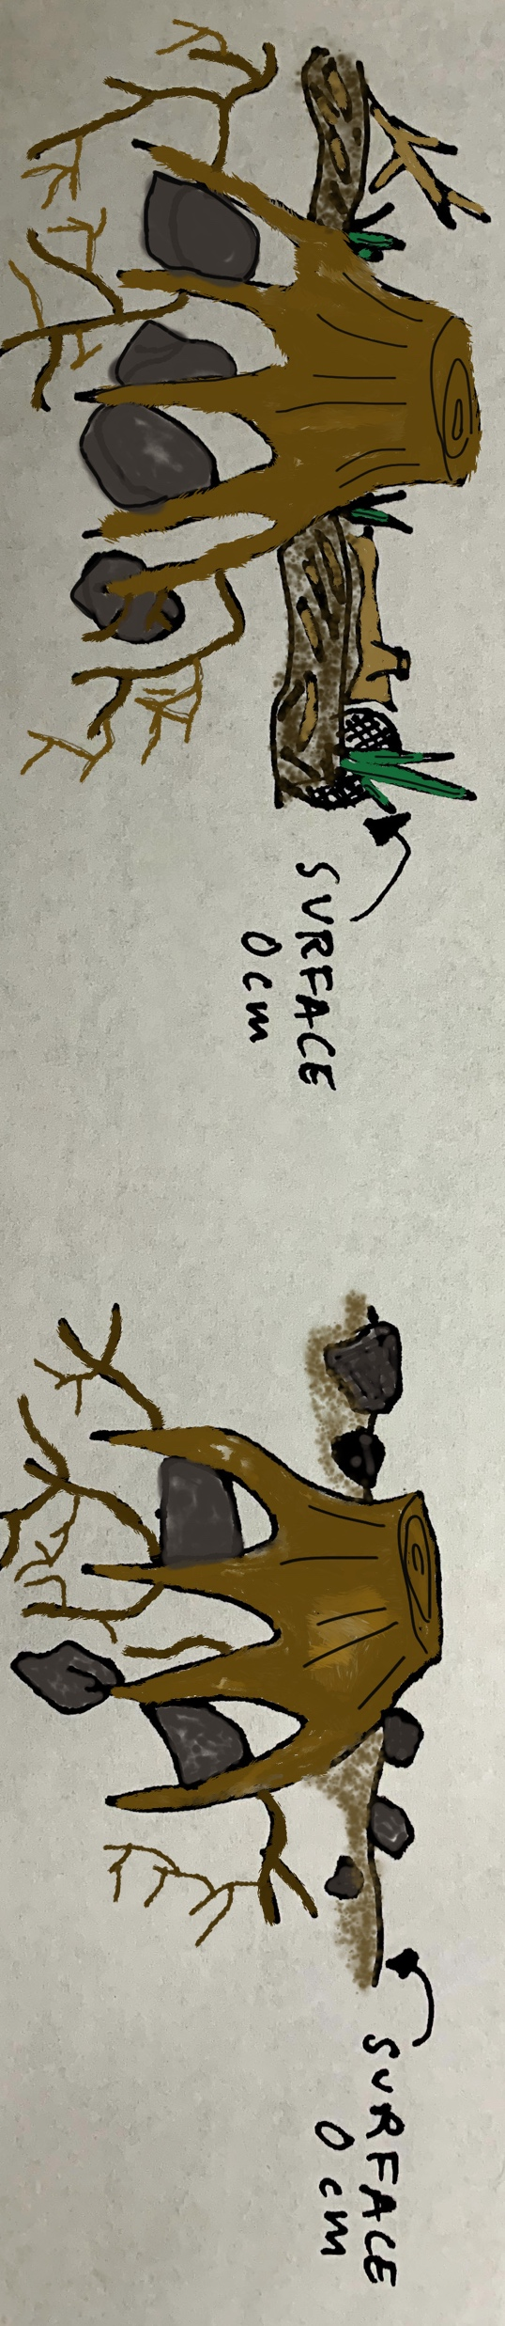
Methods
Soil Sample Timeline
Pre-harvest
5 years
15 years
25 years
United States
New Zealand
Organic Matter Removal Treatments
OM0 - Tree boles removed.
OM2 – All aboveground biomass removed. Bare soil exposed.
Center for Advanced Forestry Systems 2024 IAB Meeting
Notes:
We are using archived soils and data from LTSP sites. We were able to locate suitable archives in Weyerhauser, USFS and New Zealand Scion Long-term Soil productivity sites.
For this study we are using the bole-only and whole tree plus forest floor removal treatments.
There are 8 LTSP sites that meet our criteria. In the US we are fortunate to work with 6 sites: Priest River in Northern Idaho and Council in southern Idaho, Umpqua in Southern Oregon’s Cascades, and Brandy City, Lowell Hill, and Wallace in the northern Sierra Nevada's in CA. There are two LTSP sites located on the North Island of New Zealand. For this talk, I am using Brandy City LTSP as one of our examples. Soil at Brandy City is a clay loam formed from volcanic mudflow.

Slide 5
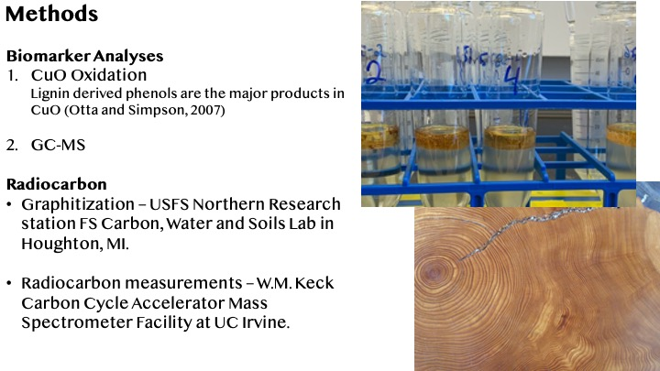
Methods
Center for Advanced Forestry Systems 2024 IAB Meeting
Notes:
Lab methodologies we are using for the biomarker analyses is copper oxidation analyses. We take the organic extract and run it on the GC-MS. I am presenting some radio carbon data briefly and we are fortunate enough to send samples to the USFS Northern Research Lab in Houghton MI to be graphitized and they send the graphization samples for radiocarbon measurements to UC Irvine.
Selective dissolution:
-Dithionite (DC), Oxalate (OX), Pyrophosphate (PY)
-Al, Fe, Mn, Si

Slide 6
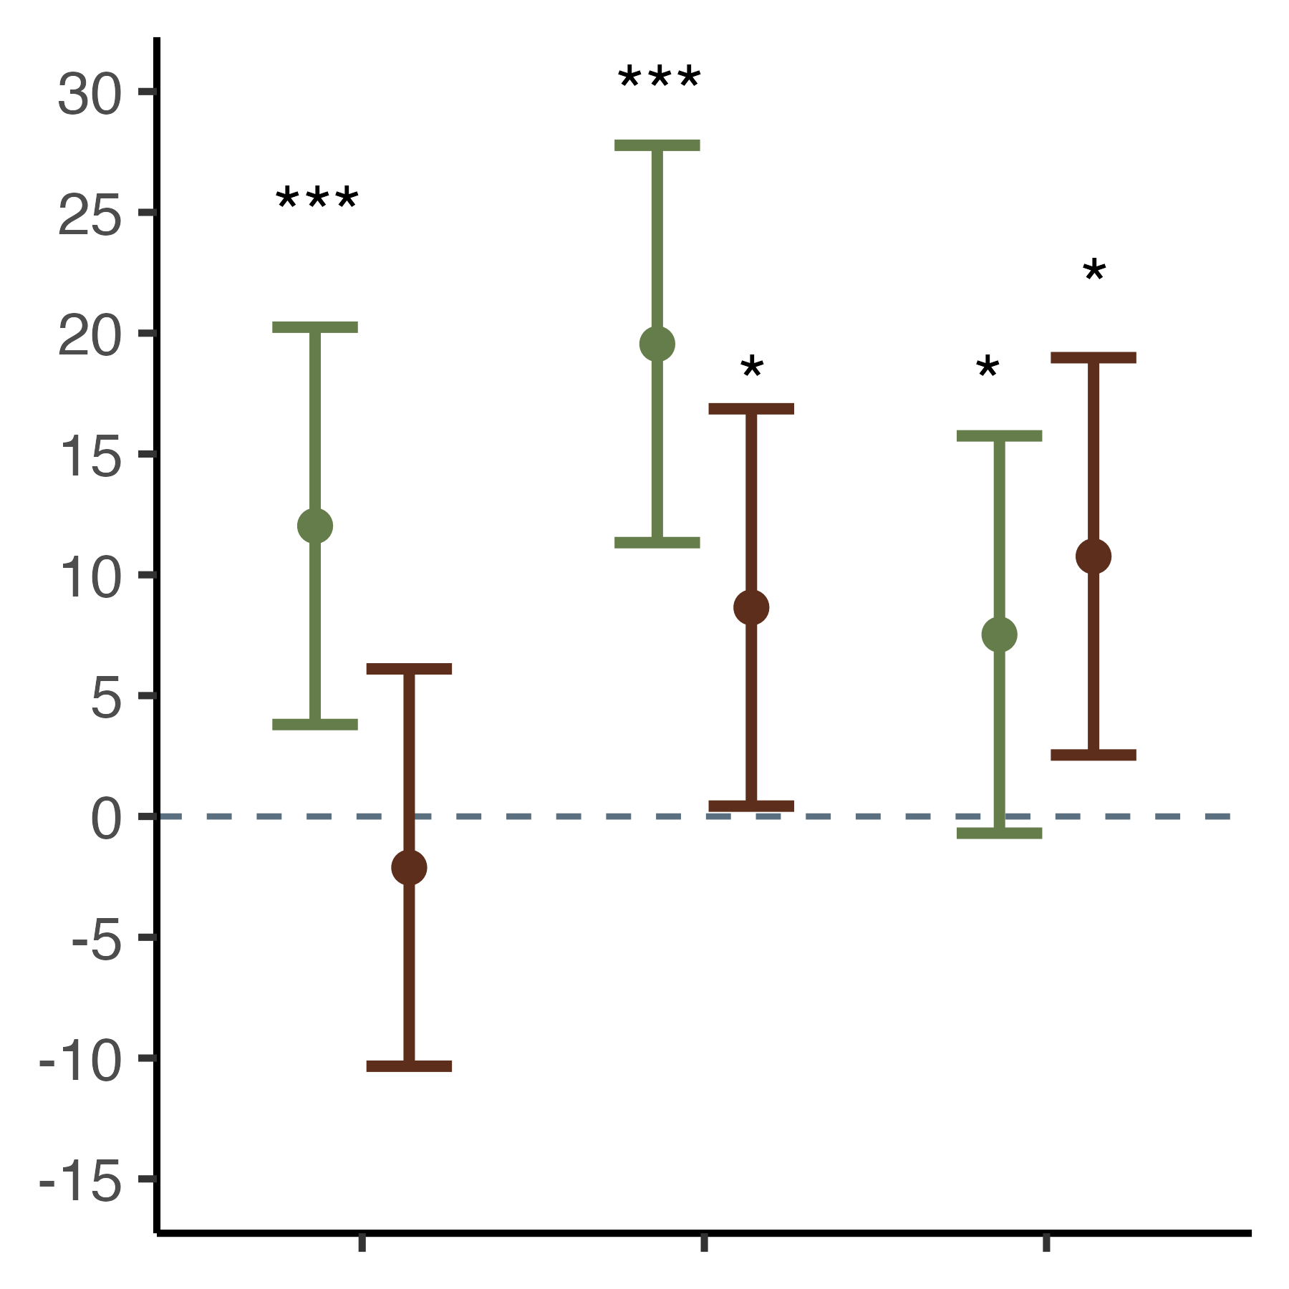
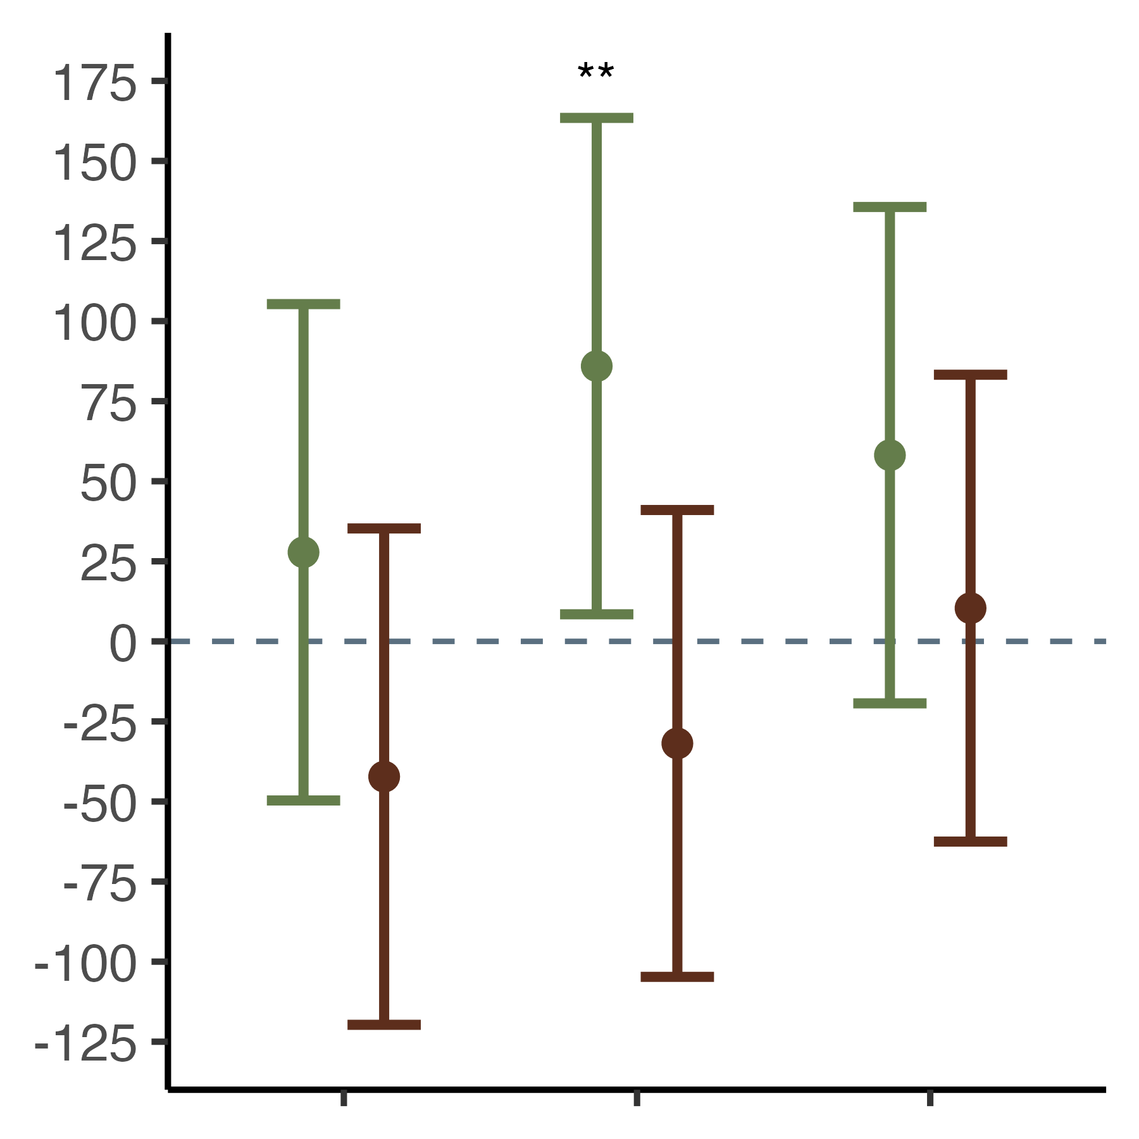
Major Findings
Stem only removal
Whole tree + forest floor
removal
Younger C
Difference in C Mg ha⁻¹
Difference in Δ ¹⁴C (‰)
Older C
10 yr - 0
20 yr - 0
20 yr – 10 yr
10 yr - 0
20 yr - 0
20 yr – 10 yr
Center for Advanced Forestry Systems 2024 IAB Meeting
Notes:
WE delve deeper into Brandy City LTSP. The left plot is the difference of C Mg ha-1 between pre-harvest, 10 years and 20 years post-harvest. The black dotted line at 0 is preharvest. So if points are above the dotted line there is an increase in C from pre-harvest levels and below means a decrease in C levels from pre-harvest. The points are estimated means from a linear model. And the asterisks represent significant differences between periods. We are calling carbon at Brandy City LTSP persistent, because after harvest C Mg ha are significantly greater in the SO biomass removal treatment plots. Even when all the aboveground biomass is completely removed from this site there is a significant increase in C stocks 20 years post-harvest.
The right graph is the same lay out but we are measuring the radiocarbon response to biomass removal. The more positive the y-axis, essentially the younger the carbon, and the more negative the older the carbon. We can see that the SO treatments are becoming enriched in C14, so soil carbon inputs are younger than preharvest levels. Whereas, despite the significant increase in C stocks in the WT + FF between pre-harvest and 20 years post-harvest soil carbon is older or more C14 depleted. So possibly two different mechanisms are happening in these two different biomass removal treatments. This is where we can implement biomarkers to look at the carbon composition.

Slide 7
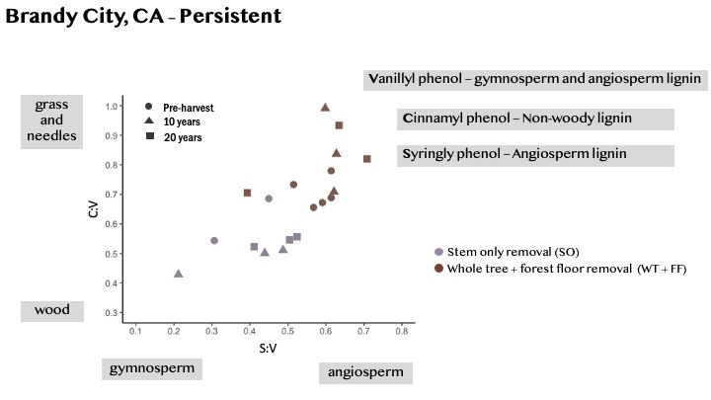
Major Findings
Center for Advanced Forestry Systems 2024 IAB Meeting
Notes:
This is a C:V to S:V scatterplot of the same site and soil. These are ratios of lignin phenols. The C:V ratio is on the y-axis and a higher C:V ratio indicates more grass and needle inputs and a decrease indicates wood. The S:V ratio is on the x-axis, an increase indicates more angiosperm dominated and a decrease is more gymnosperm dominated. So like are radiocarbon results, we can see that the soil carbon composition between these two biomass removal treatments are behaving differently! The WT + FF biomarkers, in brown, are indicating bulk soil carbon composition dominated by grass or forbs or shrubs. While the SO biomarkers, in purple, are closer to woody gymnosperm carbon composition, likely from the remaining slash. These differences in biomarker composition suggest that Carbon in these treatments are being maintained by forbs and grasses.

Slide 8
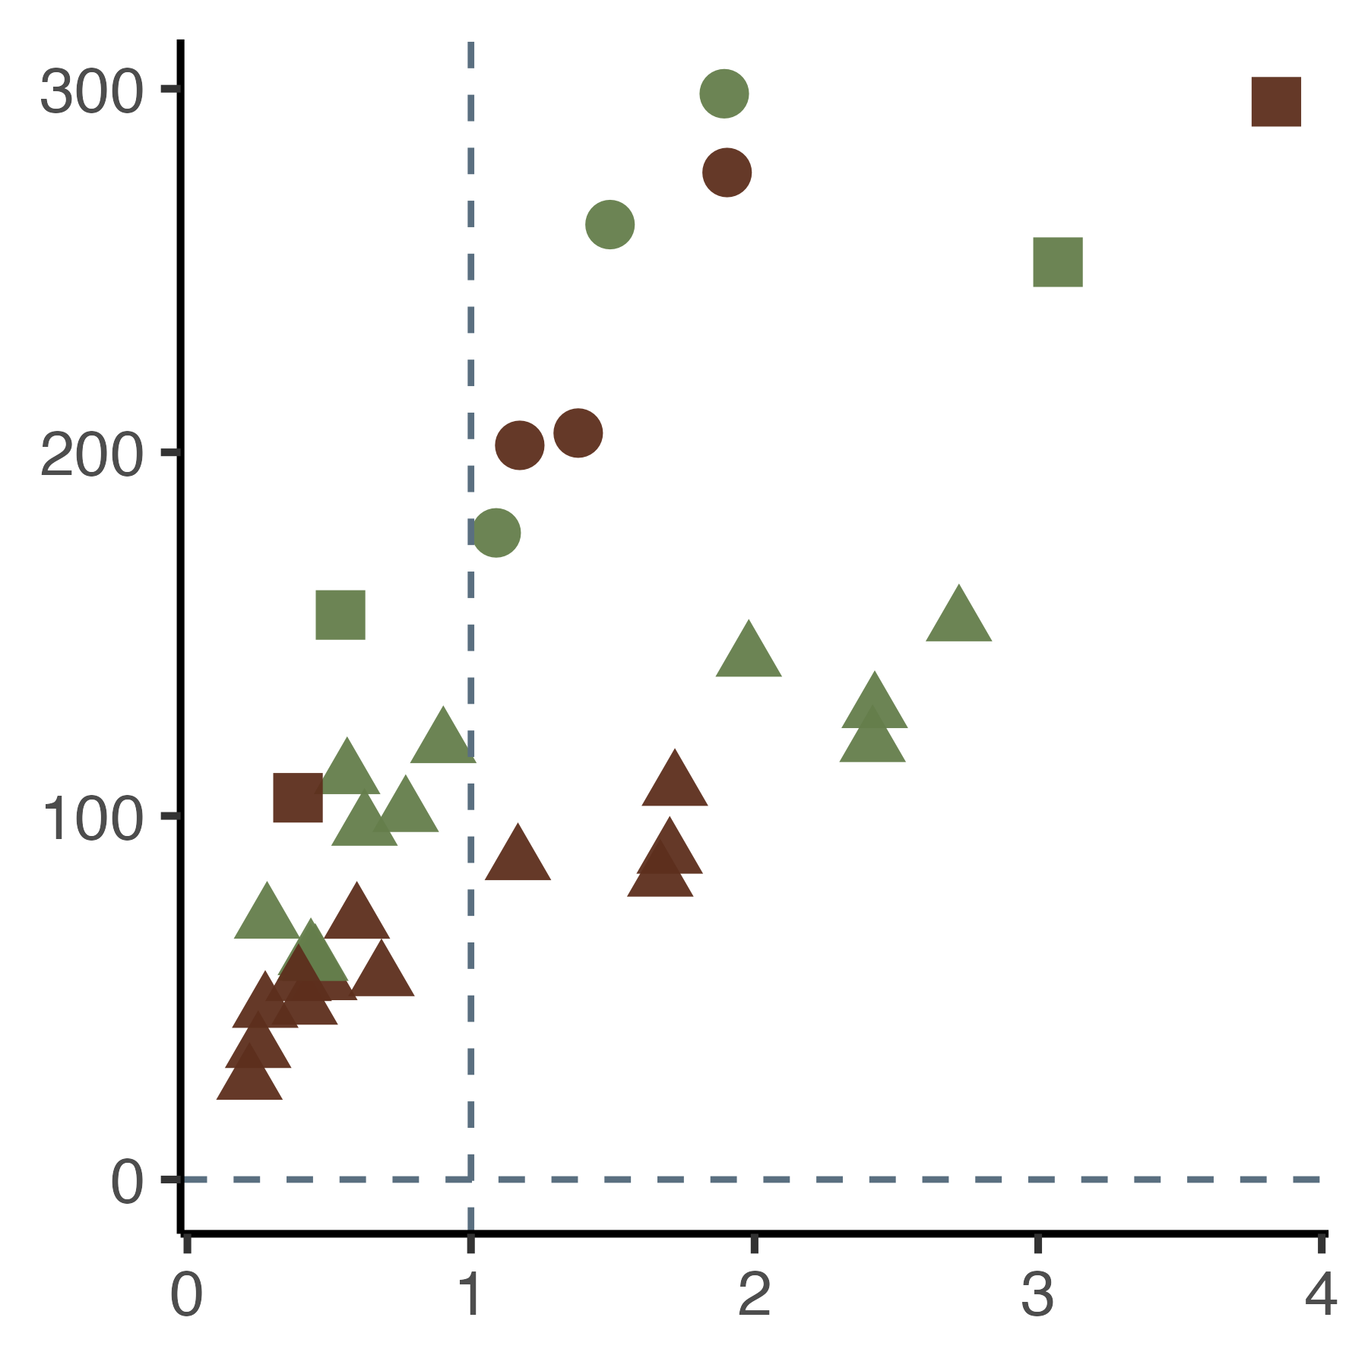
Major Findings
Tarawera’s soil carbon is vulnerable to loss after a disturbance. There is a decrease in SOC and radiocarbon abundance in both treatments through time.
Stem only removal
Decrease in SOC below 10 cm
Whole tree + forest floor
removal
Increase in SOC
0-10 cm depth
Δ ¹⁴C (‰)
Pre-harvest
5 years
25 years
Carbon (%)
Center for Advanced Forestry Systems 2024 IAB Meeting
Notes:
The second LTSP site I would like to talk about is Tarawera. This site was converted to an industrial Pinus radiata stand and in 1989 the second rotation harvest was done and also the same time the LTSP site began. This site experienced a basaltic eruption in 1886. So these soils are relatively recent and coarse textured. Kind of the opposite of Brandy City. Soil carbon at Tarawera is vulnerable to soil carbon loss after a disturbance. This scatterplot shows the delta 14C on the y-axis and total carbon on the x-axis of bulk soil samples. Shapes represent year soil was sampled and colors represent biomass treatment. Above the horizontal dotted line is recent radiocarbon.
All of the soil sampled, even 25 year post-harvest, is recent soil organic carbon.
The vertical dotted line represents the cutoff between an increase in soil organic carbon pre-harvest to year 25 in the upper 0-10 cm depth and a decrease in soil organic carbon below 10 cm 25 years post-harvest.
.

Slide 9
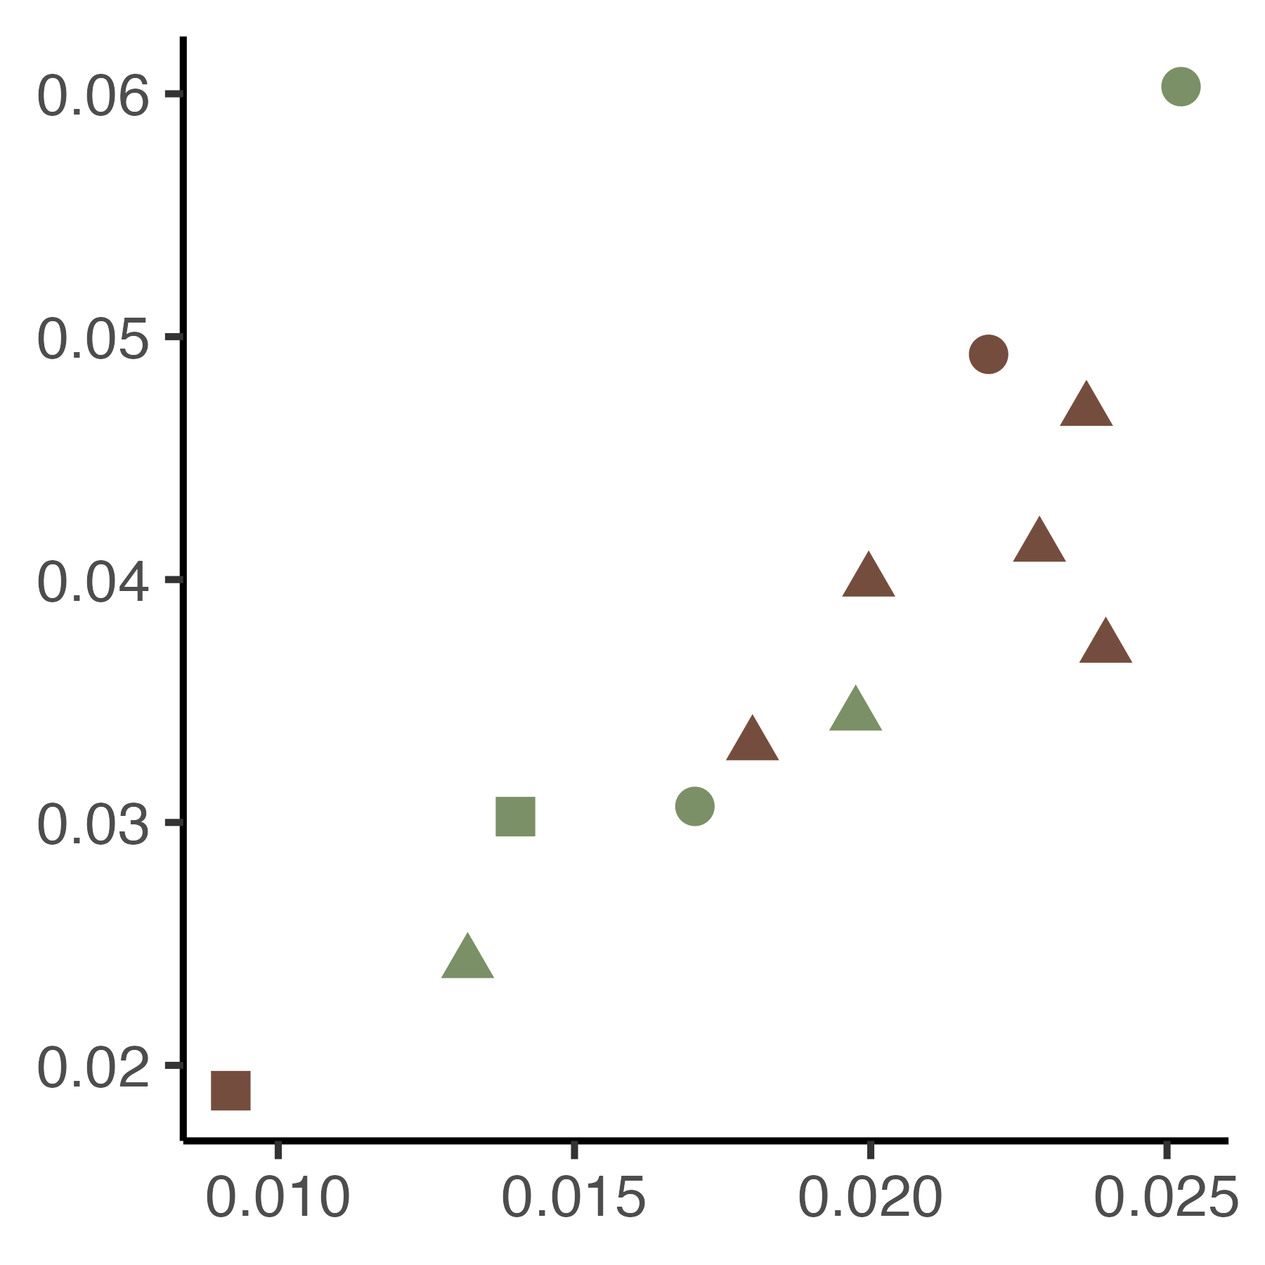
Major Findings
The 0-10 cm soc carbon is mostly free light fraction and biomarkers indicate carbon here is of degrading angiosperm lignin.
Representing angiosperm forest present before conversion to conifer plantation?
Angiosperm
Stem only removal
Whole tree + forest floor
removal
S:V
3,5 Bd = 3,5-Dihydroxybenzoic Acid – a signal of lignin degradation
Gymnosperm
More degraded
3, 5-Bd:V
Notes:
To further examine the dynamics at the Tarrawera site we will look at the S:V ratio to examine the characteristics of lignin and the 3,5-Bd:V ratio to examine the relative degradation state of the carbon.
Generally, we are seeing that the more degraded the soil organic matter at the site is – the more it looks like angiosperm. This suggests that the SOM at this site may be being influenced by carbon from pre-plantation angiosperm dominated ecosuyste.

Slide 10
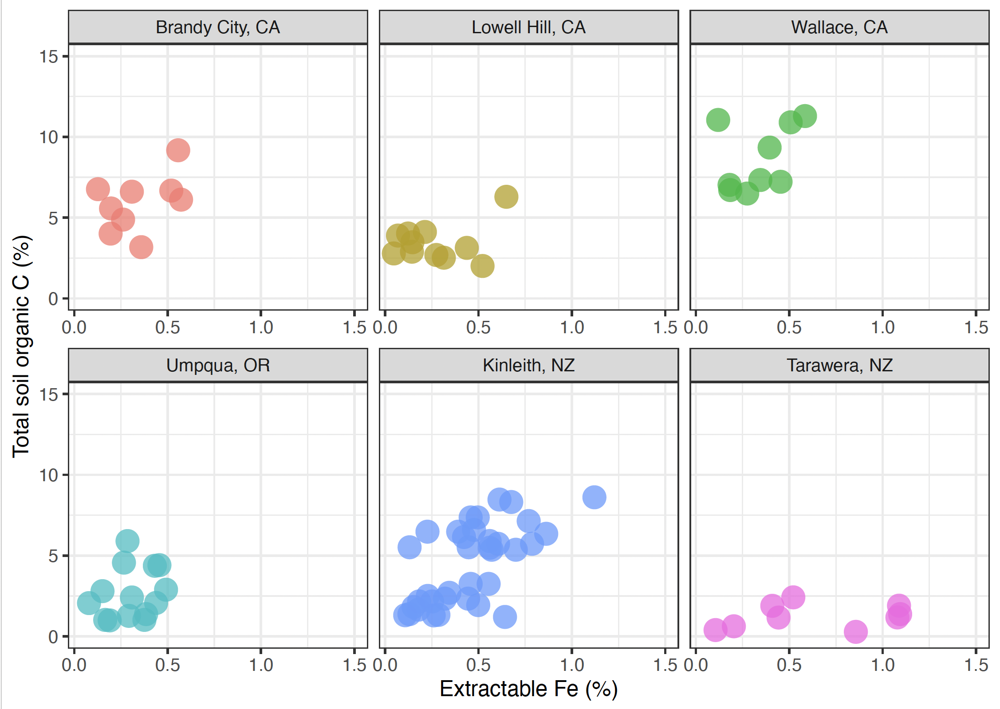
Major Findings
Notes:
We are currently digging into the mineralogy of the sites. Here we are showing the relationship of pyrophosphate extractable Fe in relation to total carbon. The positive relationship between these two variables suggests that more reactive minerals result in more stabilized carbon. This supports our hypothesis that sites with more reactive minerals will be better at resisting changes in soil carbon due to disturbances caused by harvesting (or fire, etc.)

Slide 11
Deliverables
Enhanced understanding of SOC dynamics by providing data on how SOC responds to forest management practices across diverse forest types and soil conditions
Evidence-based management practices for SOC conservation and management by identifying the mechanisms of SOC resistance and resilience
Directly inform efforts to increase carbon sequestration in forest soils across the United States
Center for Advanced Forestry Systems 2024 IAB Meeting

Slide 12
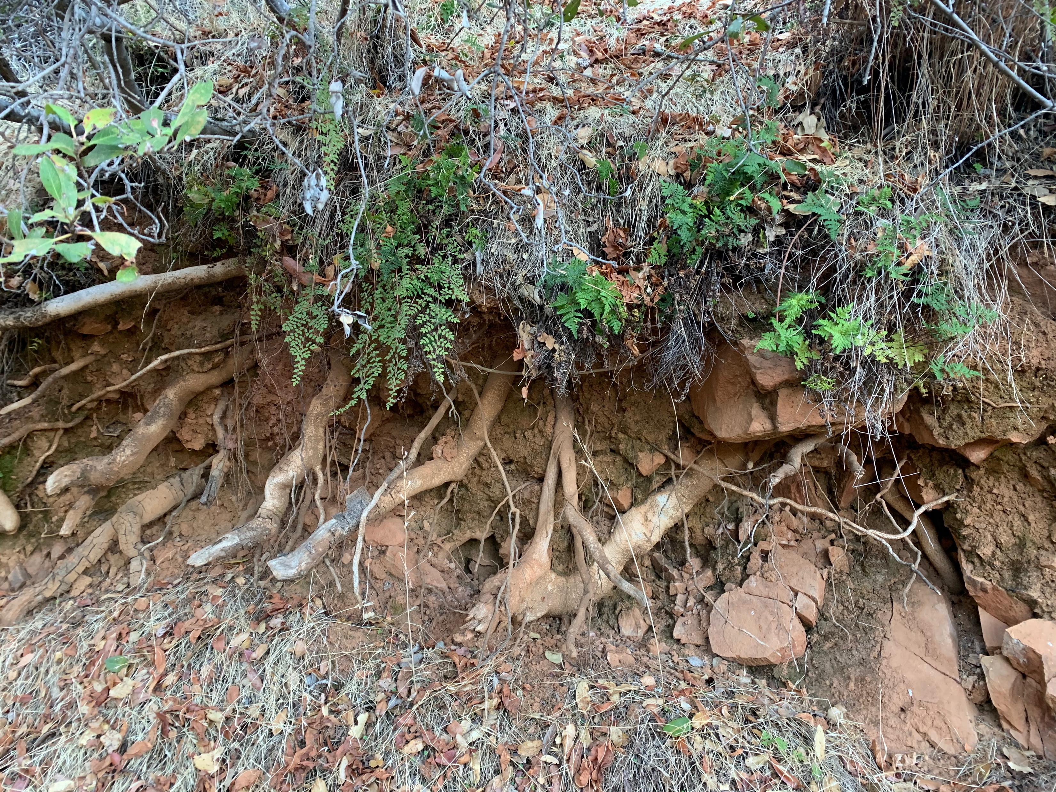
Future Plans
Field sampling summer 2021!
Idaho and Oregon for third time point
Data analysis
Preparing manuscripts
Important Deadlines
  Student's defense Fall 2024
Funding:
USDA-AFRI Grant 2018-06813
CAFS
Center for Advanced Forestry Systems 2024 IAB Meeting
Notes:
More work to be done and students to graduate!

