Slide 1
Progress Report
Characterizing abiotic and biotic tree stress using hyperspectral information
CAFS 20.80
John Couture, Sylvia Park, Melba Crawford, Matthew Ginzel,
Brady Hardiman, Douglass Jacobs (Purdue University)
Aaron Weiskittel, Parinaz Rahimzadeh, Peter Nelson (University of Maine) Cristian Montes, Caterina Villari, Kamal Ghandi (University of Georgia)
John Couture (Purdue University)
CAFS 2024 Summer IAB Meeting
Notes:
1

Slide 2
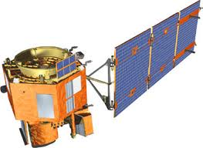
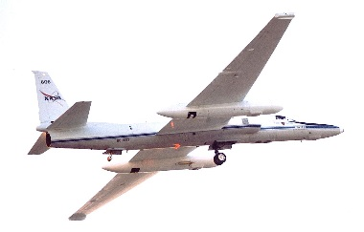
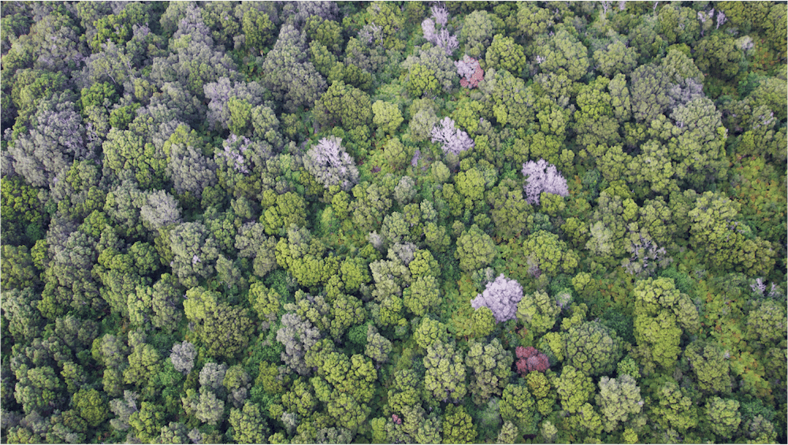
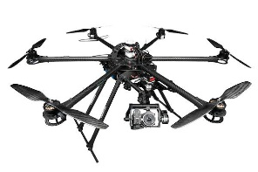
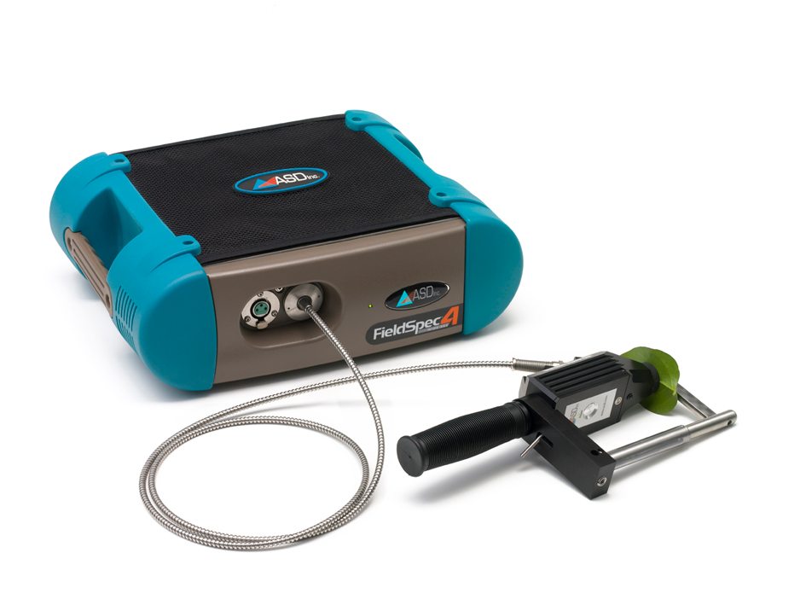
Project Overview
Reflectance spectroscopy can capture tree stress responses
• Rapid and accurate observation of forest traits is necessary for effective monitoring of forest health
• Leaf spectral reflectance has been used to investigate functional traits and to detect diverse forest issues at different spatial scales
Rapid ‘Ohi’a Death, Hawaii (Greg Asner)
CAFS 2024 Summer IAB Meeting

Slide 3
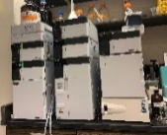
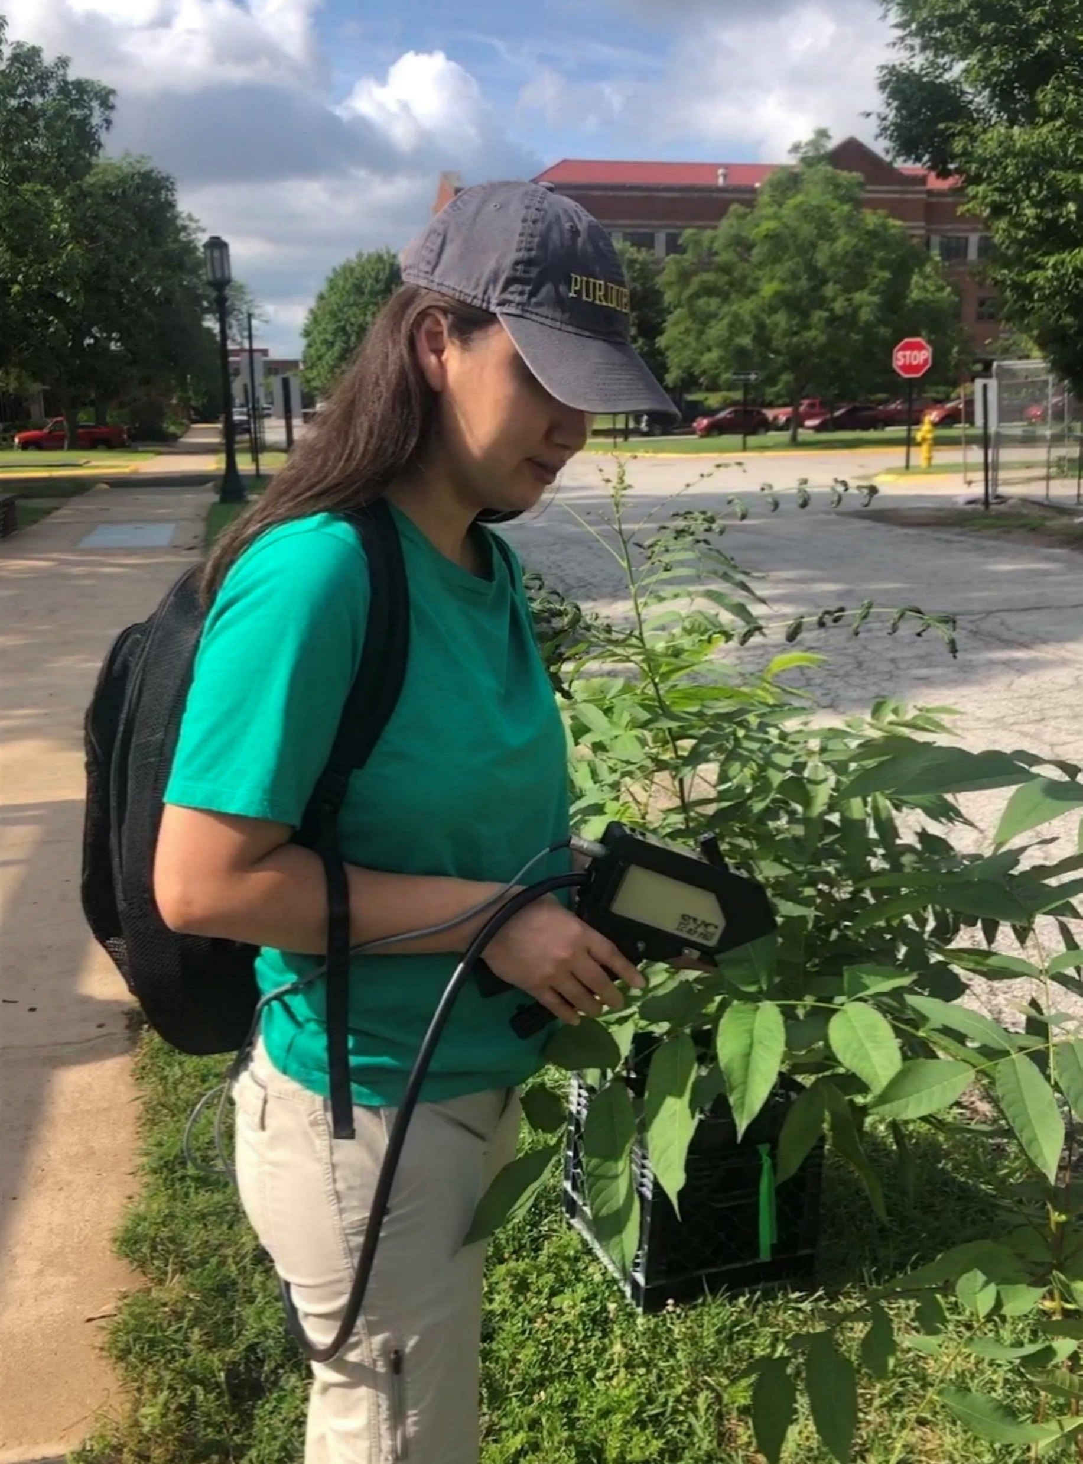
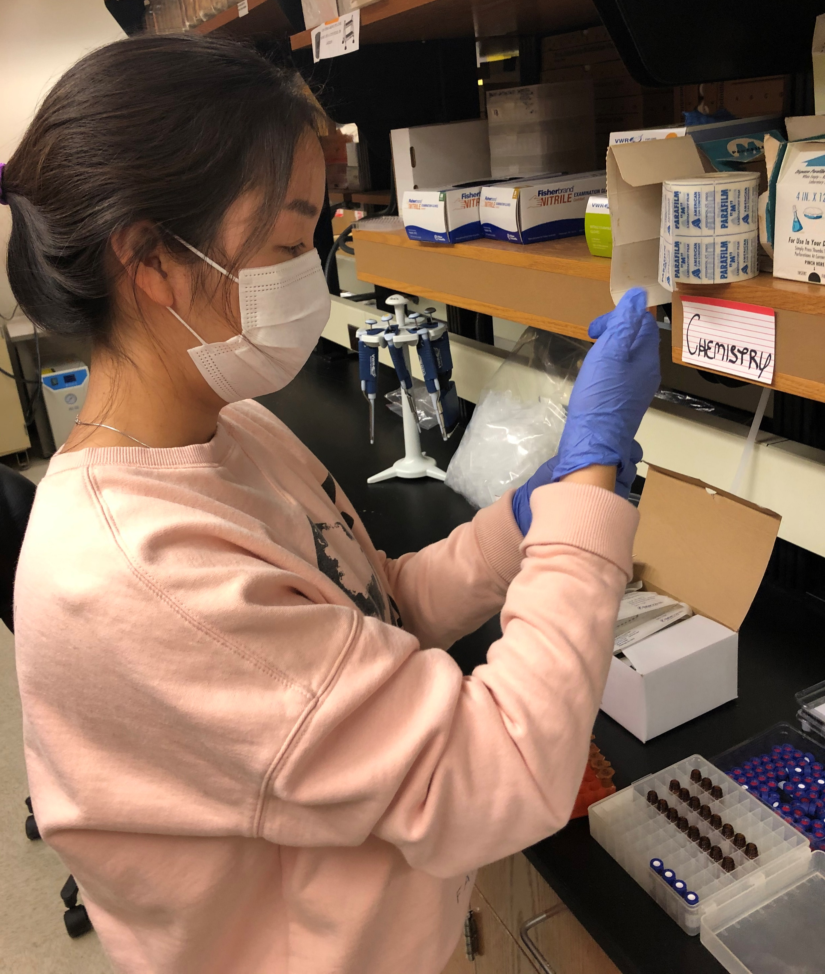
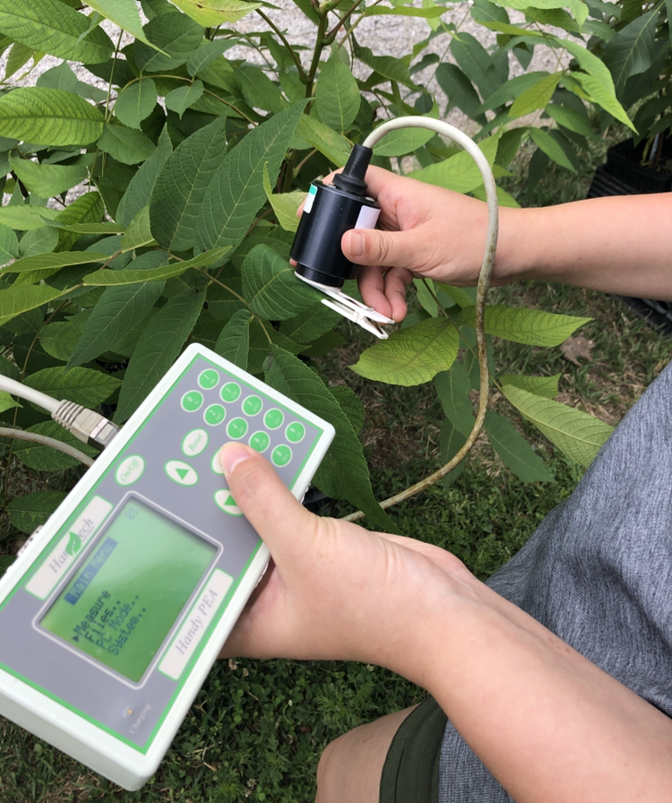
Research question
Can spectrally predicted leaf traits be used to discriminate stressed from non-stressed trees as effectively as observed leaf traits?
Reference data
Spectral data
Abiotic and biotic stress
Leaf functional traits
Gas-exchange
Water
Biochemical
Leaf reflectance spectra (400−2400 nm)
Fungal infection +
Soil quality
Nitrogen deficiency + Drought
Spectroradiometer
(SVC HR-1024i)
Fungal
infection +
Drought
Nitrogen deficiency + Salt deposition
CAFS 2024 Summer IAB Meeting

Slide 4
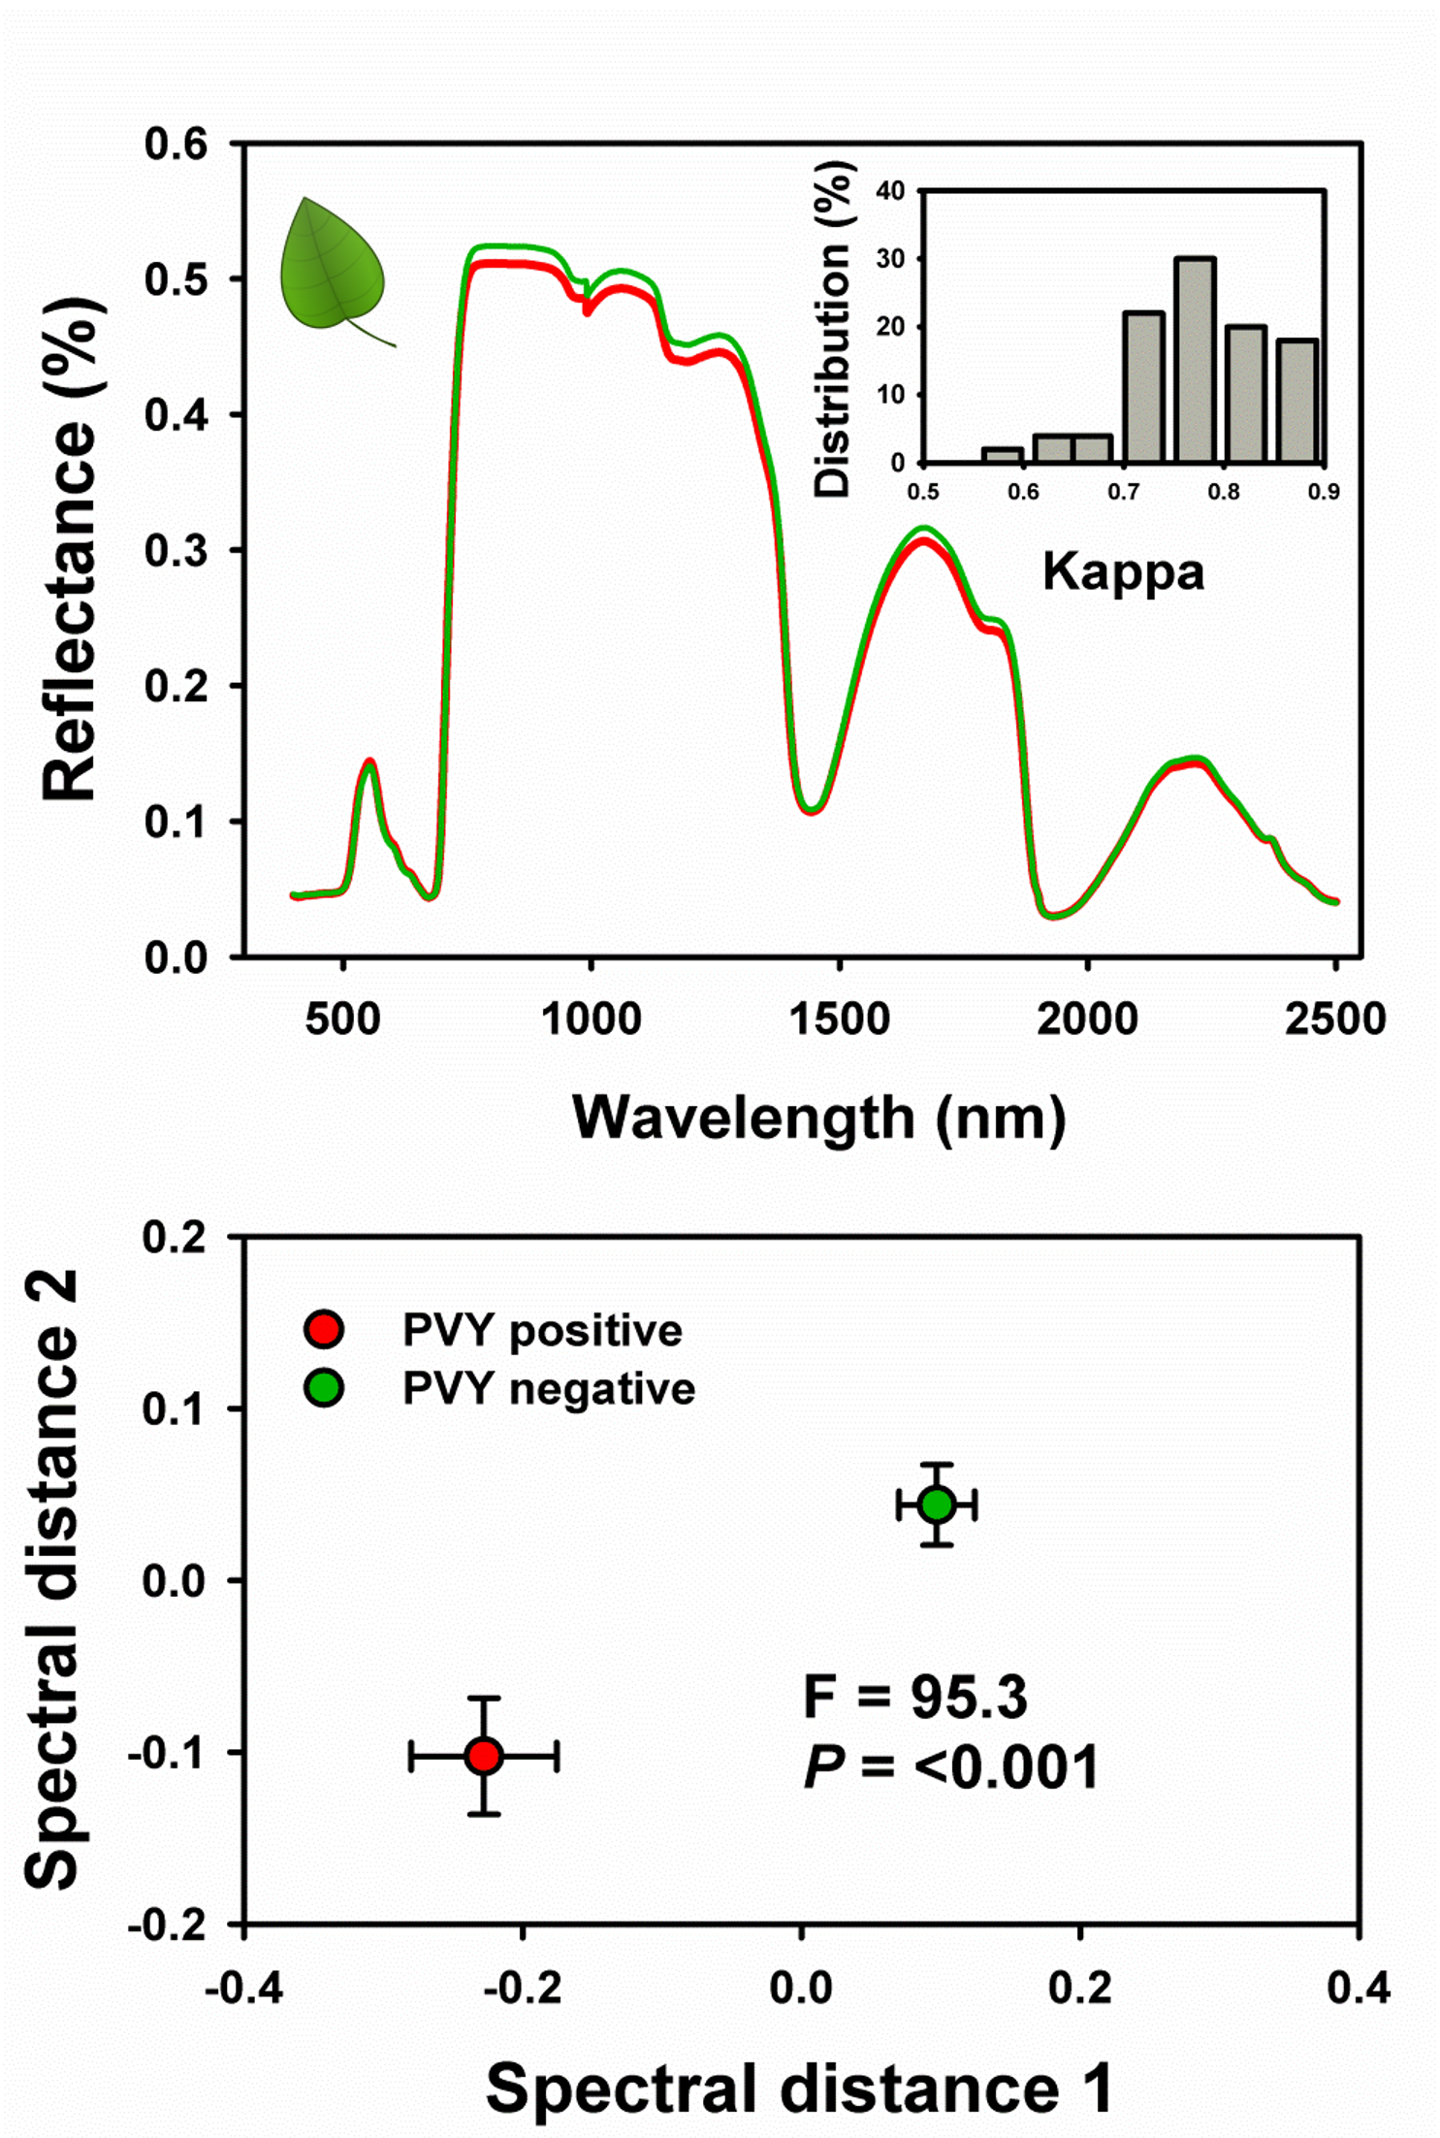
Stress response monitoring using plant spectral traits
Introduction
Abiotic and biotic stress
Plant traits
Plant optical traits
Potato disease infected
vs non-infected leaves
Trait models
Spectral profiles
Trait estimates
Stress identification. Often used separately, the latter to back up the former.
If used together can stress specific events be discriminated?
(Couture et al., 2018)
CAFS 2024 Summer IAB Meeting
3

Slide 5
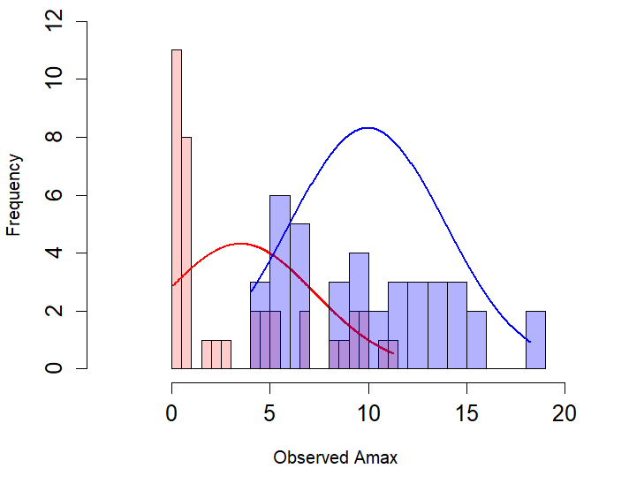
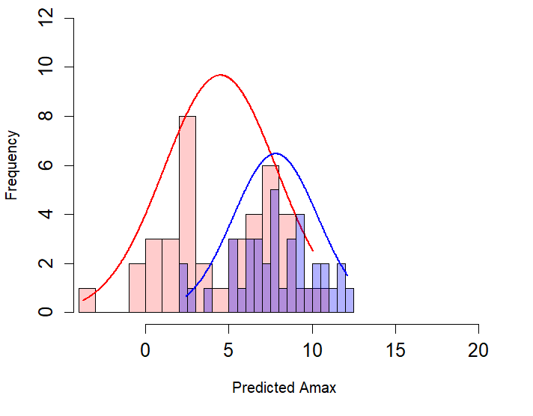
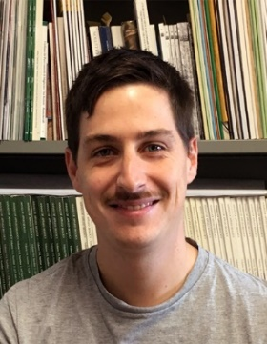
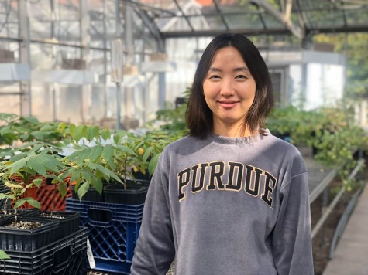
Observed vs predicted trait responses to drought
Current Progress
Ex 1) CO₂ assimilation rate, A_{max}
Control
Drought stress
Frequency
True A_{max}
A_{max} observed (μmol m⁻² s⁻¹)
Frequency
Model A_{max}
Dr. Lorenzo Cotrozzi Sylvia Park
A_{max} predicted (μmol m⁻² s⁻¹)
CAFS 2024 Fall IAB Meeting

Slide 6
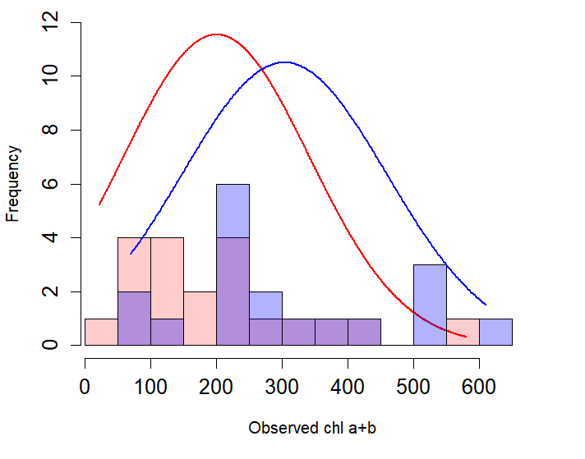
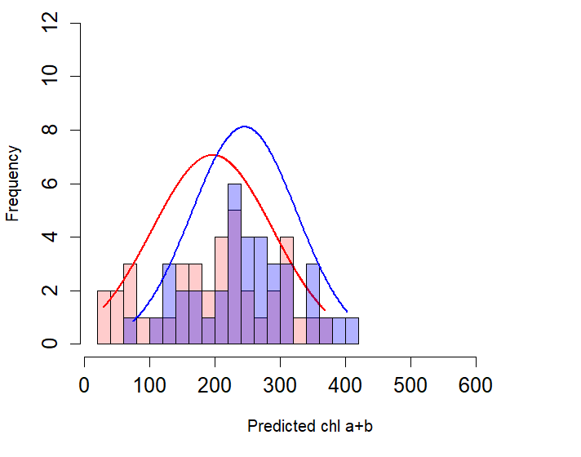
Observed vs predicted trait responses to drought
Current Progress
Ex 2) Chlorophyll a and b, Chl ab
Control
Drought stress
Frequency
True Chl ab
Chl ab observed (mg/100g, DM)
Frequency
Model Chl ab
Dr. Lorenzo Cotrozzi Sylvia Park
Chl ab predicted (mg/100g, DM)
CAFS 2024 Fall IAB Meeting

Slide 7
Trait responses to drought and nitrogen deficiency
Dr. Lorenzo Cotrozzi Sylvia Park
(n= 77)
(n= 78)
(n= 78)
W: *** N: n.s. W×N: n.s.
W: n.s. N: n.s. W×N: n.s.
W: n.s. N: n.s. W×N: n.s.
(n= 78)
(n= 78)
(n= 78)
W: *** N:** W×N: n.s.
W: * N:* W×N: n.s.
W: n.s. N: n.s. W×N: n.s.
CO₂ assimilation rate, A_{max} Leaf water content, LWC Specific leaf area, SLA

Slide 8
Trait responses to drought and nitrogen deficiency
Dr. Lorenzo Cotrozzi Sylvia Park
(n= 39)
(n= 39)
(n= 39)
W: ** N:*** W×N: n.s.
W: ** N:*** W×N: n.s.
W: * N: *** W×N: n.s.
(n= 77)
(n= 78)
(n= 78)
W: * N:*** W×N: n.s.
W: * N:*** W×N: n.s.
W: n.s. N: *** W×N: n.s.
Leaf functional traits predicted from spectral data provide detailed information on shifts in tree health status

Slide 9
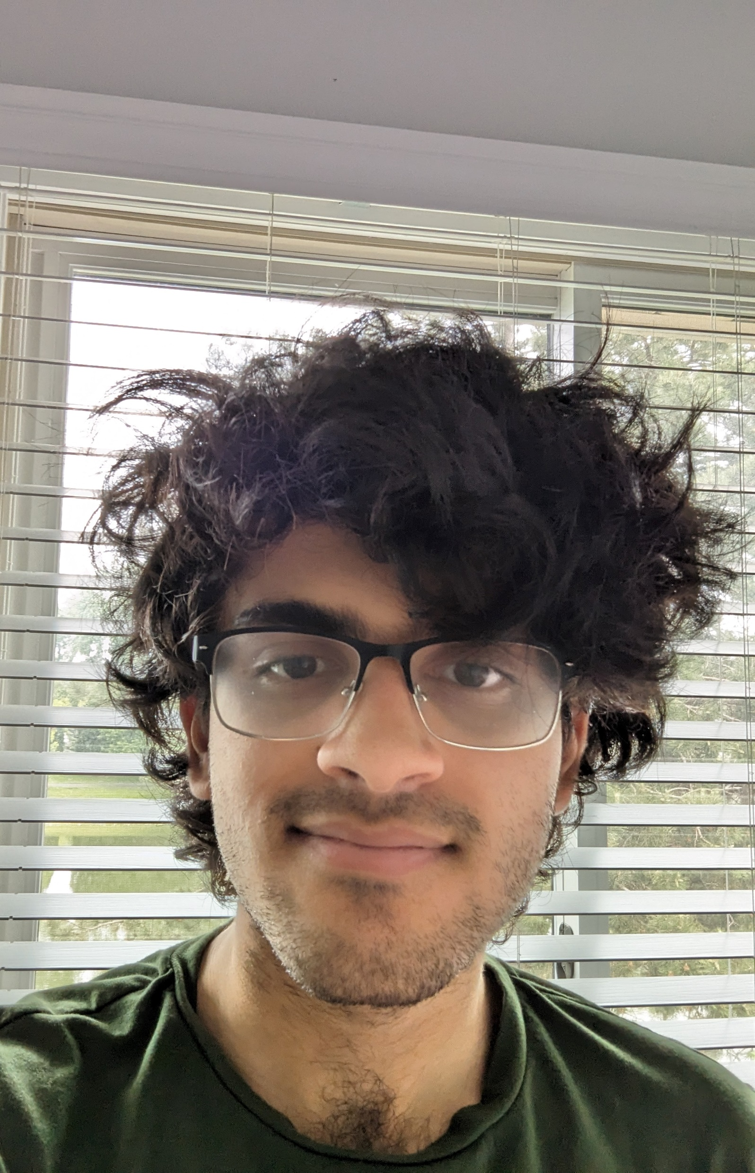
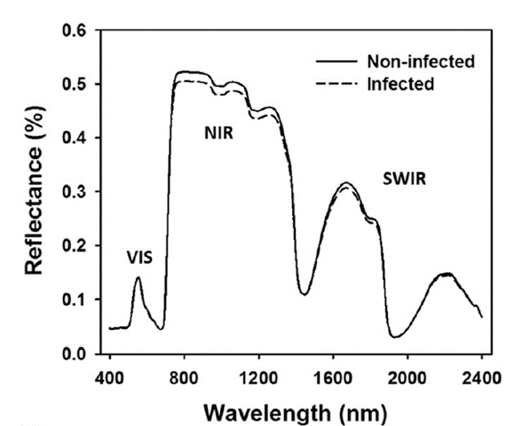
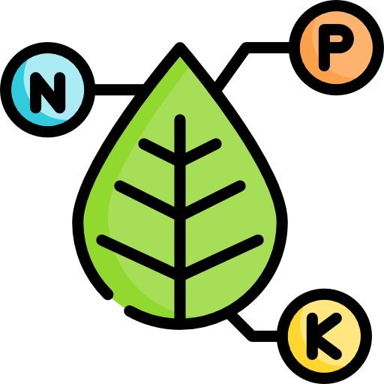
Synthesis research
Integrate multiple layers of stress-specific information using leaf trait predictions and hyperspectral phenotyping for stress-specific decision tree algorithms.
Aditya Tiwani
Anomalous data detection
Spectral distance 2
CNN 85-95% accuracy
Spectral distance 1
Foliar trait estimates
Abiotic stress
Biotic stress
Specific stress identification
CNN 90-95% accuracy

Slide 10
Company benefits and deliverables
Framework for tiered forest health monitoring
Paper submitted:
Park et al. Spectral wavelength range influences the performance of chemometric models estimating various foliar functional traits MME
Two other papers from Sylvias dissertation
Future work linking breeding and high-throughput phenotyping
Spectral distance 2
Spectral distance 1
Foliar trait estimates
Abiotic stress
Biotic stress
Center for Advanced Forestry Systems 2024 IAB Meeting

Slide 11
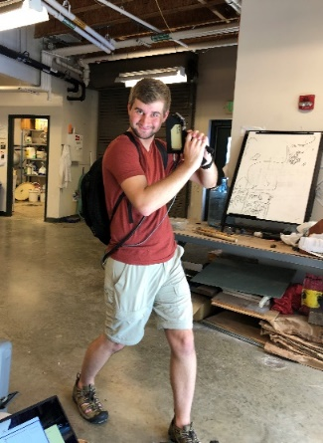
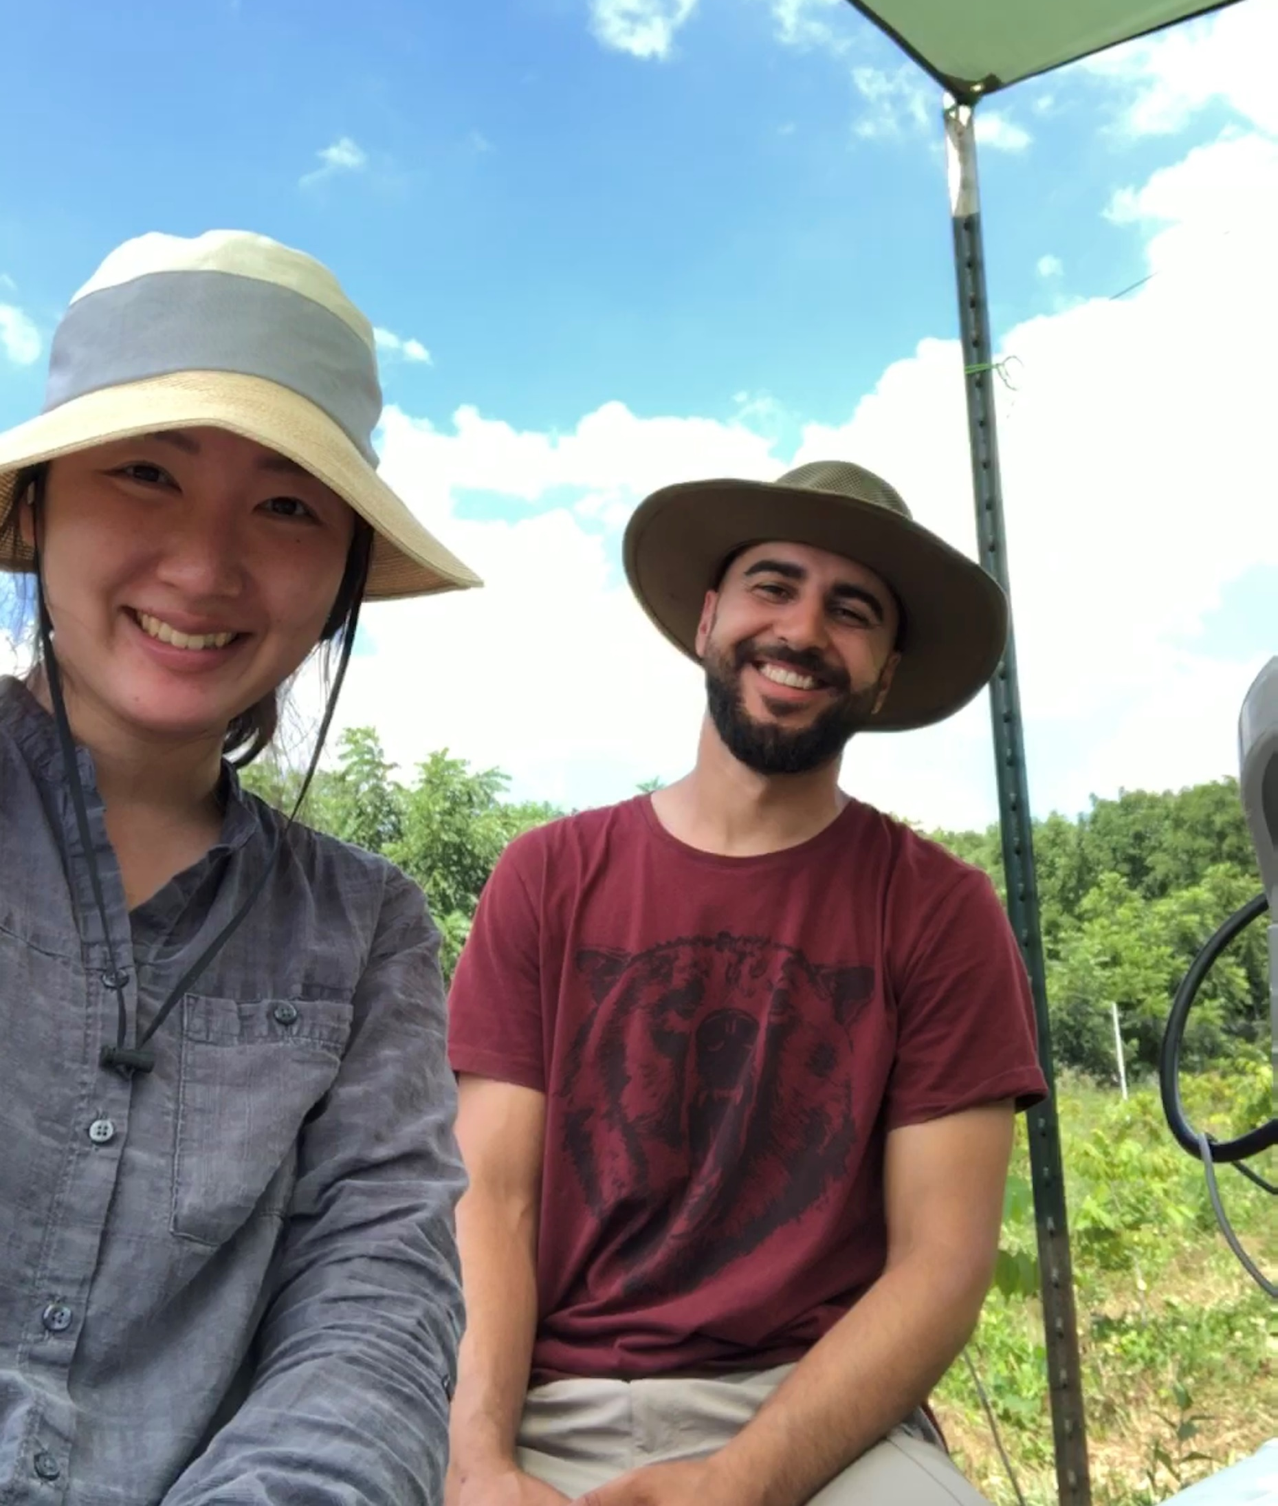
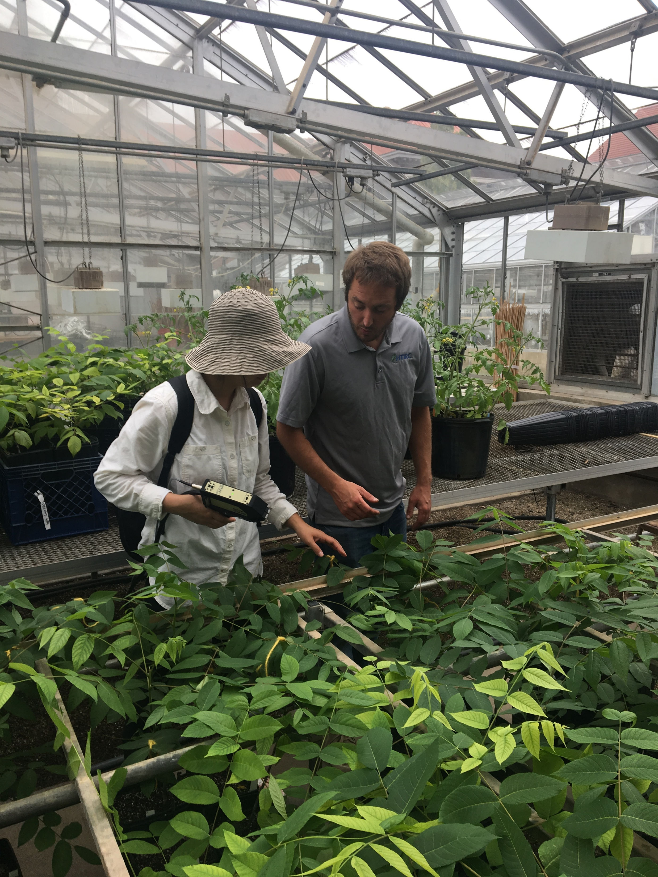
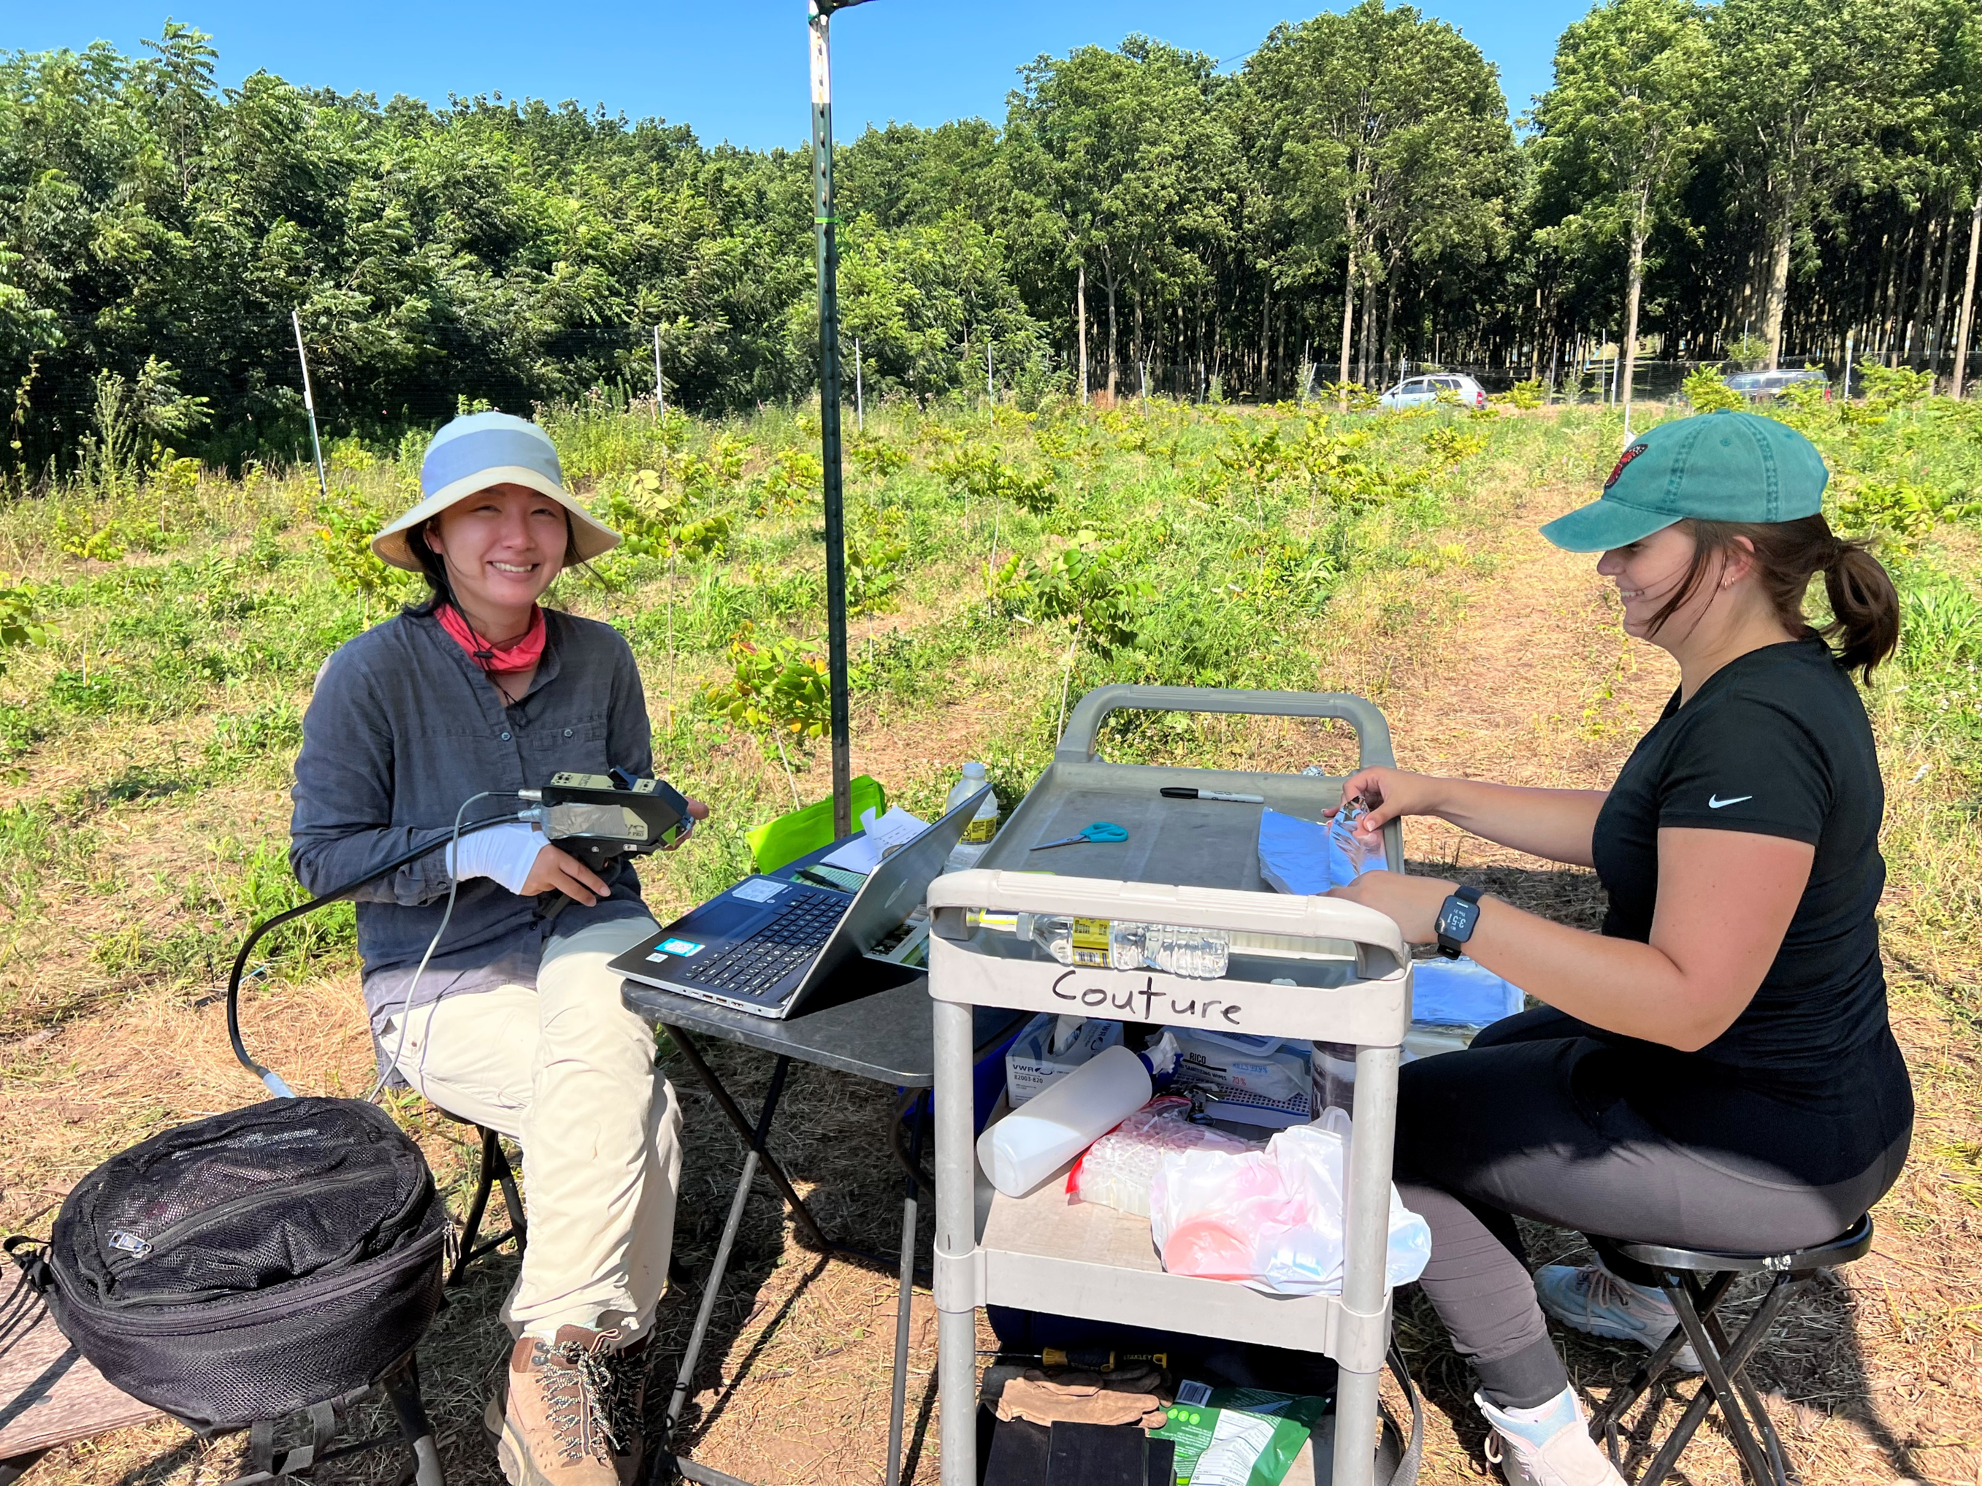
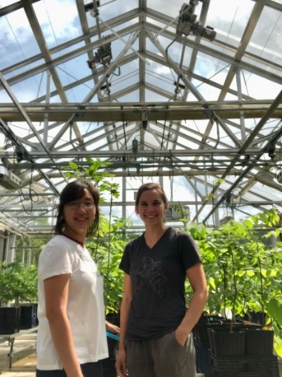
Acknowledgements
Plant-Insect Chemical Ecology Lab
Dr. John Couture
Dr. Lorenzo Cotrozzi
Scott Gula
Elisabeth Joll
Daniel Edwards
Megan Haas
Ted Heckard
Aditya Tiwani
Regeneration and Restoration Silviculture Lab
Dr. Douglass Jacobs
Dr. Andrei Toca
Forestry Entomology Lab
Dr. Matthew Ginzel
Dr. Geoffrey Williams
Scott Gula
Dr. Kelsey Tobin
Mickelbart lab
Dr. Michael Mickelbart
Michael Gosney
Funding
- National Science Foundation / Center for Advanced Forestry Systems
- Hardwood Tree Improvement & Regeneration Center

