Slide 1
Continuing Project
Assessing & Mapping Regional Variation in Site Productivity
CAFS.19.75
Investigators: Cristian Montes (UGA), Rachel Cook (NCSU), Aaron Weiskittel (UM), Mark Coleman (UI), Doug Jacobs (Purdue), Mark Kimsey (UI) Erik Turnblom(UW), Carlos Gonzalez (OSU)
Presented by:
Cristian Montes
University of Georgia
Center for Advanced Forestry Systems 2021 Meeting
Notes:
1

Slide 2
The project in a nutshell
Geologic maps compiled by NCSU and UMaine, hypotheses about nutrient limitations.
Use ALS to estimate Site Index, Biomass, and/or LAI using area based lidar parameters.
Combine Soil, Geology, and Environmental Variables for a prediction model.
Combine auxiliary variables with Site Productivity estimates make predictions for a larger area.

Slide 3
UGA part of the deal
Consolidated soil maps using DSM methods to produce similar outputs at common resolution.
Climatic data with known uncertainty.
Unified way to process remotely sensed data
Use of statistical methods to combine the information.
Develop raster datasets to use as auxiliary variable for countless models to test their relationship with complex systems.

Slide 4
Bottom up approach: Soils determining Stand Productivity

Slide 5
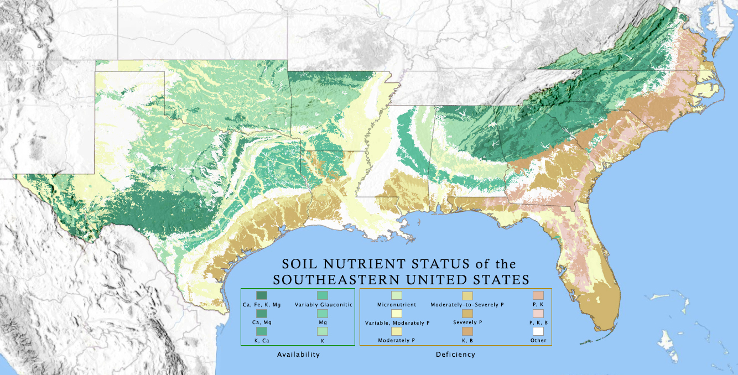
Derive a National Soil Productivity Map for Production Forest Systems
Center for Advanced Forestry Systems 2020 Meeting

Slide 6
Exhibited Site Index by Soils
Max
Mean
Min

Slide 7
Modeling approach
Chris Cohrs
Use FPC RW data to explore relationships between soil characteristics and response to fertilization with N+P
RW13, 15, 17, 18, 19
Compare traditional statistical methods and machine learning approaches
LASSO & Random Forest
Evaluate influence and interaction of soil characteristics with volume response

Slide 8
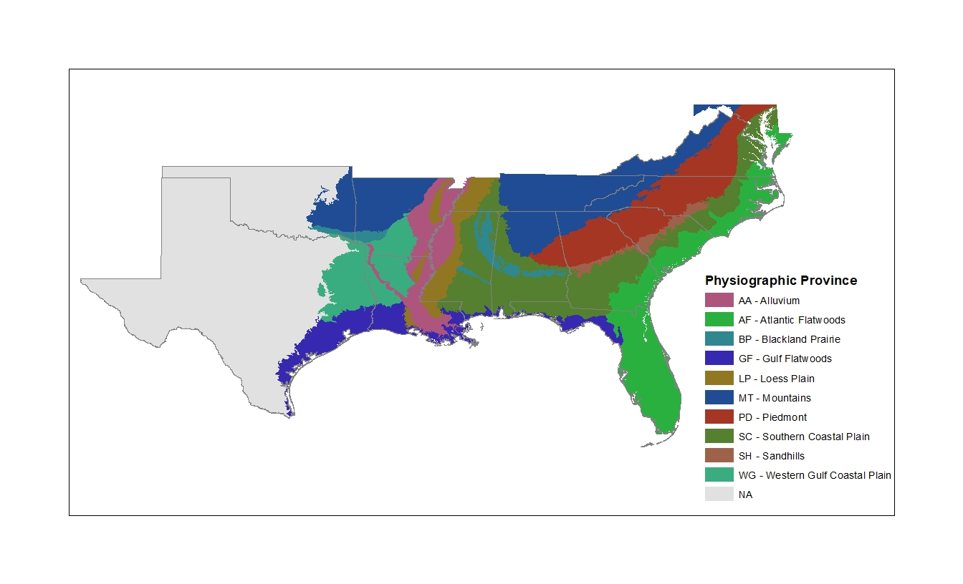
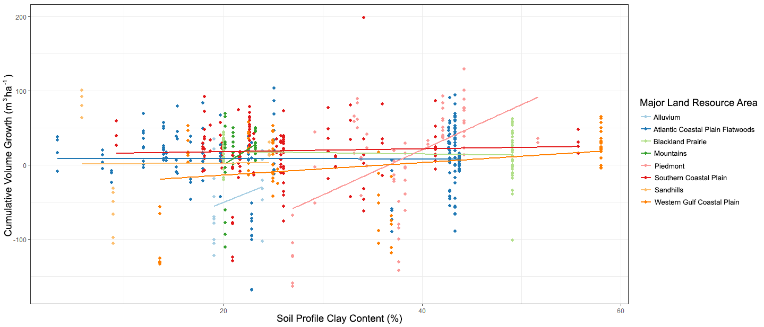
Response due to Soil Clay Content within Physiographic Provence
Piedmont

Slide 9
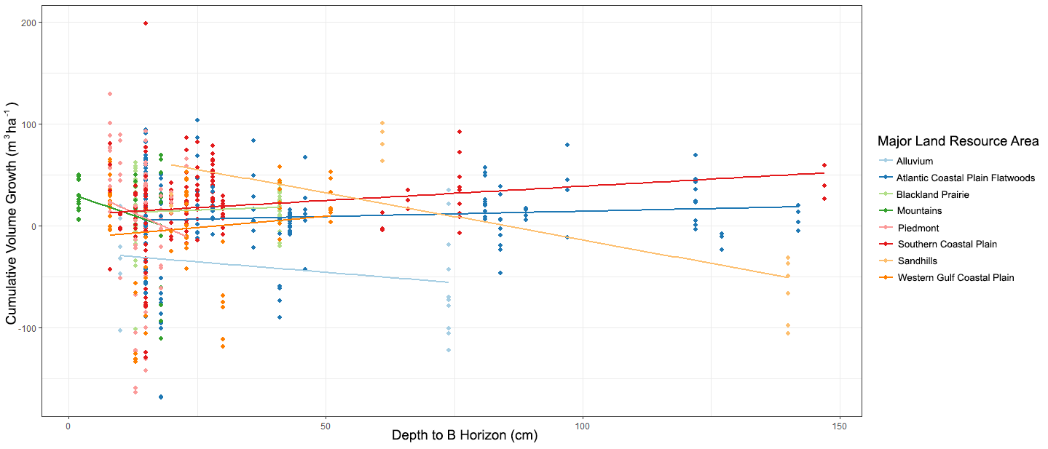
Response due to Depth to B horizon within Physiographic Provence
Sandhills

Slide 10
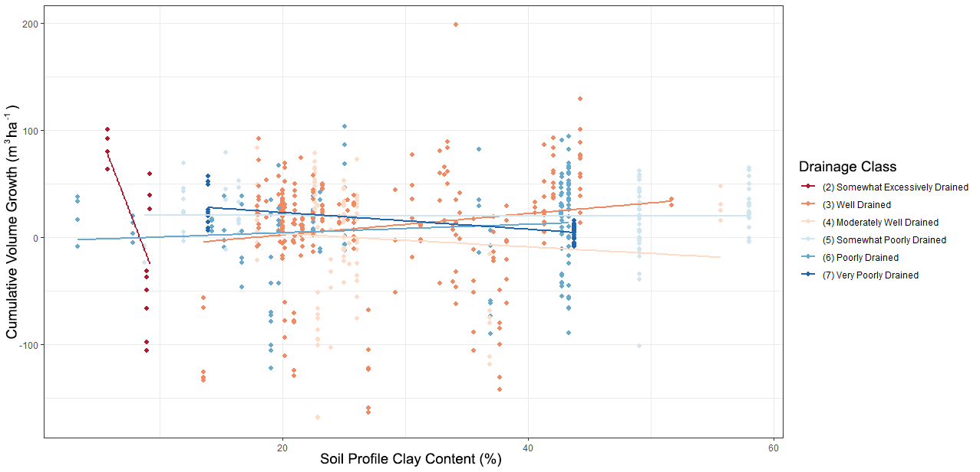
Volume growth affected on excessively drained sites

Slide 11
Stand Productivity estimation using a top-down approach (climate down to site)

Slide 12
Modeling approach
Dom. height models (3) fit using a Kalman Filter approach separating observation from process noise.
Within site HD₂₅ and model parameters saved to be used as dependent variable for a spatial model with auxiliary variables.
Spatial modeling approach included:
Generalized additive models and LASSO (for variable selection) was employed for this analysis.
Analysis compared with Xgboost and Random forest for the same predictors.
Bayesian Interpolation using the Integrated Nested Laplace Approximation.
Models compared using a K-fold Cross Validation

Slide 13
Predictors used for the general maps.
BAP interpolated NDVI or EVI
Yearly average Intercepted radiation (assuming extinction coefficient 0.6)
Yearly radiation sum.
Water Deficit
Water Excess
Depth to Water Table
Distance to the Coast
NO SOIL VARIABLES YET.
Dr. Holly Munro

Slide 14
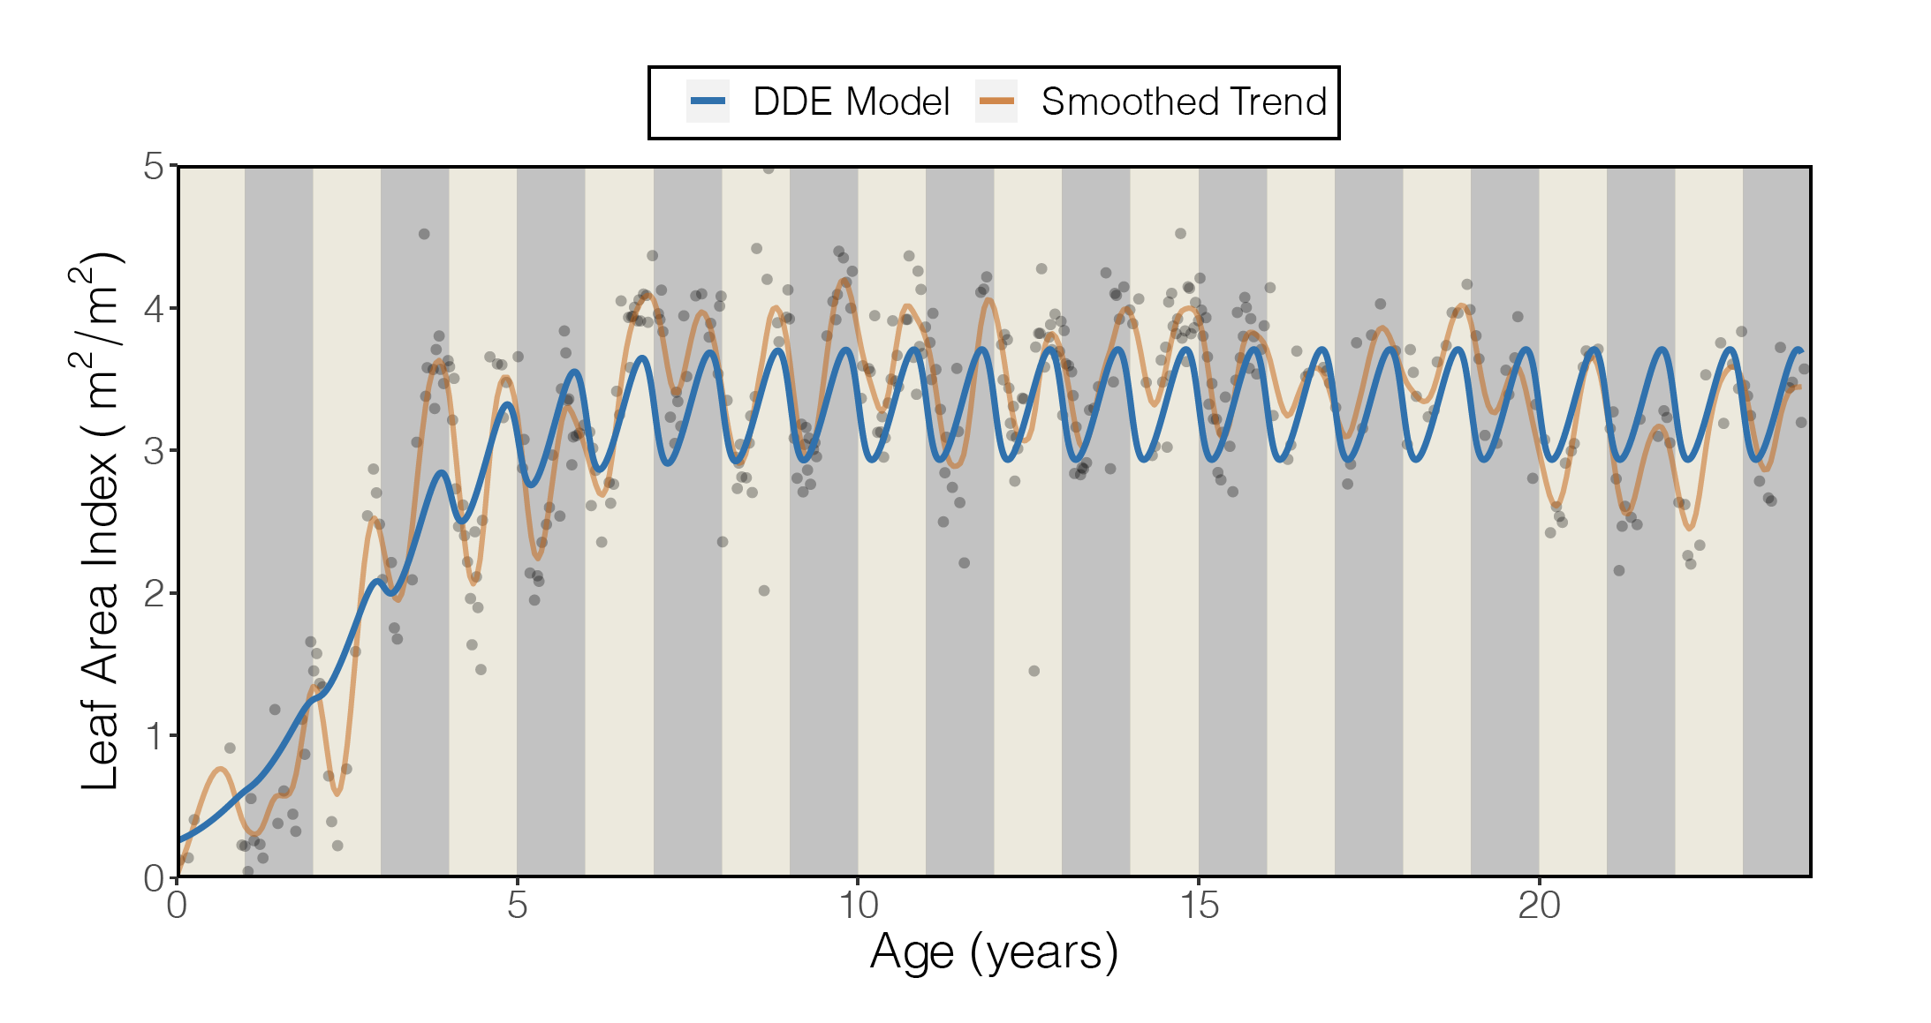
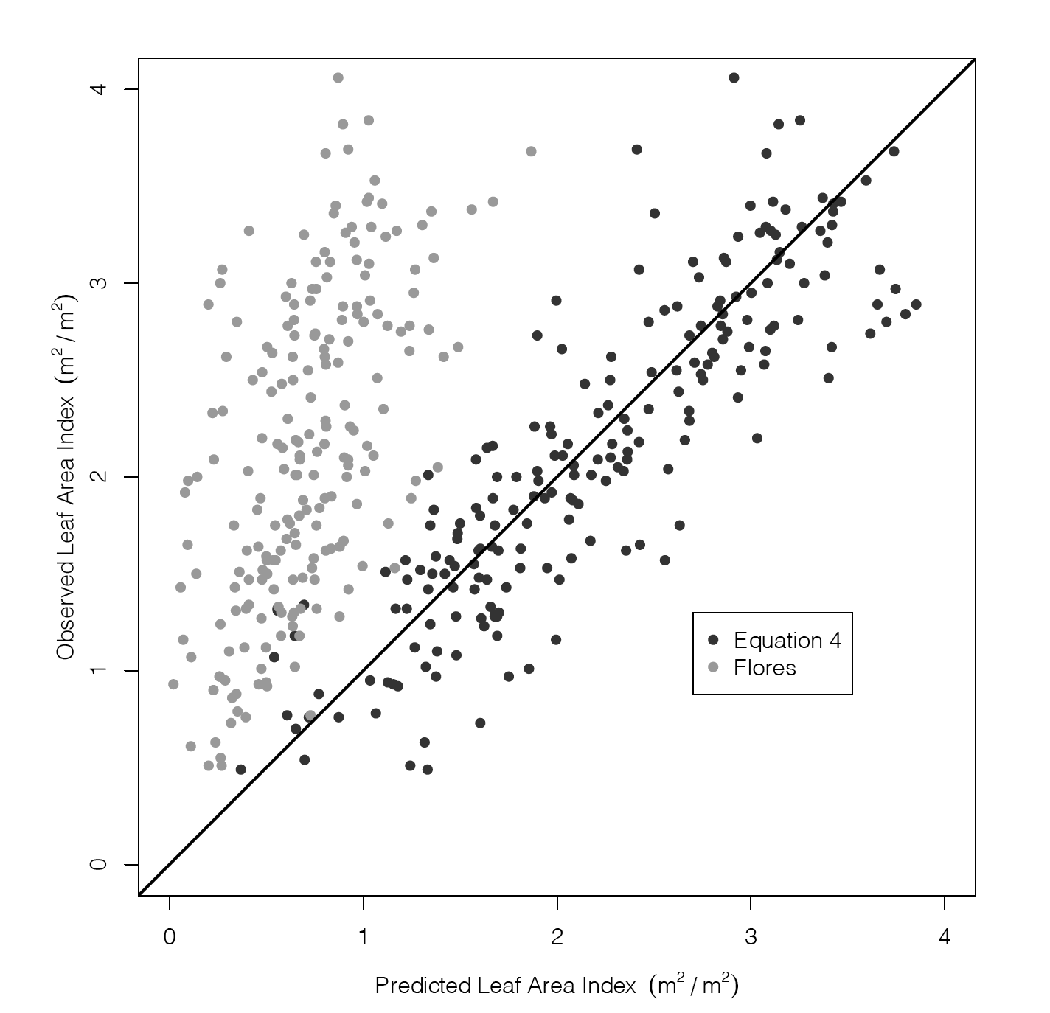
Main effect combined LAI for Landsat 5 and 7 allowing us to use previous images as part of a time series
Observed LAI
Dr. Stephen Kinane
Predicted LAI
Observed reflectance is corrected using a dynamic model and a KF.
Kinane, Montes, Albaugh, Mishra 2021; Kinane 2020

Slide 15
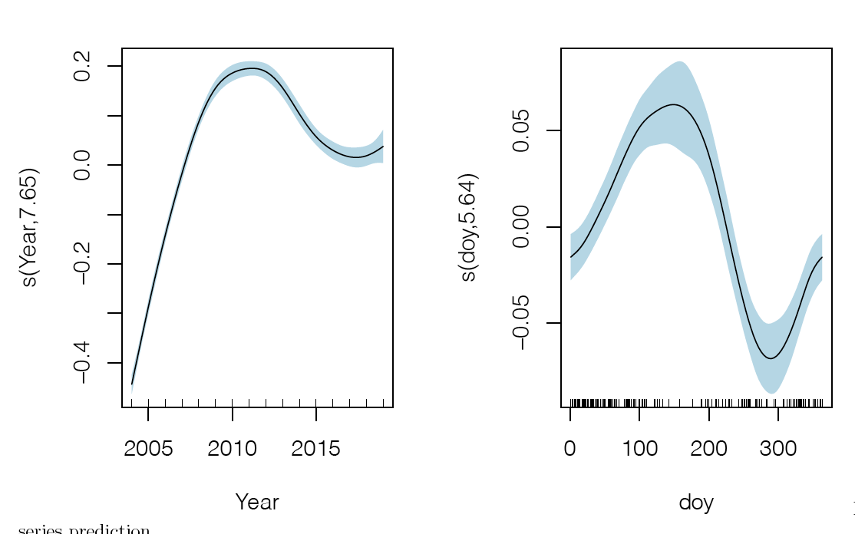
Main Effects: Temporal and seasonal distribution of multivariate index.
Partial Effect in
Surface Reflectance
Partial Effect in
Surface Reflectance
Between year (years)
Within year (days)

Slide 16
Main Effects: water relations
Anil Koirala
PhD candidate
Partial Effect in SI (ft)
Partial Effect in SI (ft)
Excess Water (mm)
Water Deficit (mm)
Koirala, Montes and Bullock, 2020

Slide 17
Main Effects: light and heat
17.7 threshold
Partial Effect in SI (ft)
Partial Effect in SI (ft)
Yearly light Interception (MJ/ha)
Yearly Average Temperature (Deg. C)

Slide 18
Main effects: Light Interception & Location Interaction

Slide 19
Main effects: Distance to feature
Partial Effect in SI (ft)
Partial Effect in SI (ft)
Distance to river (km)
Distance to the water table (meters)

Slide 20
The basic SI is giving proper residuals
Validation looks fine, considering the size of the area included.
81.5% deviance explained by the GAM-Lasso model.
80% deviance explained by the XGBoots

Slide 21
Site index prediction using each one of the 3 methods
Chapman Richards
ft
Ludkvist Korf (Bailey-Clutter)
ft
Hossfeld IV
ft

Slide 22
Uncertainty estimation was part of the model.
Here is how much we know about the equations.
There is a clear area with large information.
Some areas are far from knowledge values.

Slide 23
Parameter space vary by equation so did the number of predictors involved.

Slide 24
How many growing zones? (a.k.a. how many growth equations)
As we add more groups, the overall value for the the number of clusters is being reduced.

Slide 25
Summary
Good agreement between Sentinel LAI and Lidar LAI, with promise for better separation between understory and main crop when using ML techniques.
Soil variables alone were responsible for local variations in yield for only some
Biophysical variables related to canopy transpiration explained 81.5% of the deviance for Site Index in SE US.
Water Deficit, Excess Water, Depth to Water table, NDVI and Intercepted radiation were the most important variables explaining this variation.
Parameter interpolation was reduced down to 45% of explained deviance. Same variables were found important.
Results imply that phenomena behind dominant height mechanisms can be more impacted by other variables not considered in the 2nd analysis.
Same method can be used together with georeferenced company inventory data to narrow down productivity at the regional scale.

Slide 26
Thanks!

