Slide 1
Final Report
Environmental Predictors of Form and Quality
CAFS.18.74
Cristian R. Montes, Joseph Dahlen and Bronson P. Bullock
Presented by Cristian R. Montes
Center for Advanced Forestry Systems 2021 Meeting
Notes:
1

Slide 2
Justification
Stem quality is an important trait but is subjectively measured.
Stem quality influenced by
Soil
Climate
Stand productivity
Genetics
Inventory with full tree scanning using LiDAR might be able to accurately measure form, therefore improving information on a stand, and in the long run not increase inventory costs.
Center for Advanced Forestry Systems 2021 Meeting

Slide 3
Hypotheses or Objectives
Tree size and form are primarily related to biophysical variables.
Quantify stem form using LiDAR
Develop equations that relate tree size and form with biophysical variables (soil physical properties, environment proxies for water balance)
Center for Advanced Forestry Systems 2021 Meeting

Slide 4
Methods
GLS
(ground-based laser scanning)
Diameter and Branch density
Traditional Stem Taper
Sampling
Estimate Taper
Estimate Sweep
Estimate Branch Index
Biophysical Variables
Spatial Productivity
Spatial Taper
Spatial Sweep
Spatial Branch index
Center for Advanced Forestry Systems 2021 Meeting

Slide 5
Methods
Biophysical Variables
Spatial Taper
Spatial Sweep
Spatial Forking
Spatial Ramicors
Water Deficit
Excess Water
Water Deficit
Excess Water
Useable water
Center for Advanced Forestry Systems 2021 Meeting

Slide 6
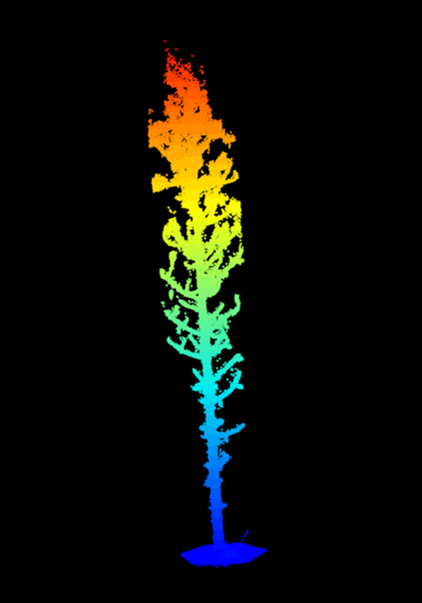
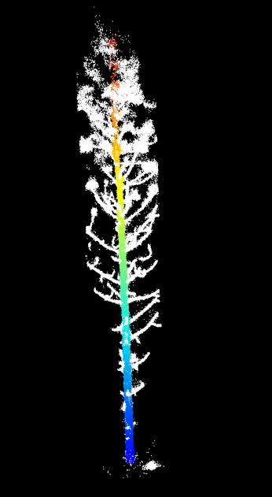
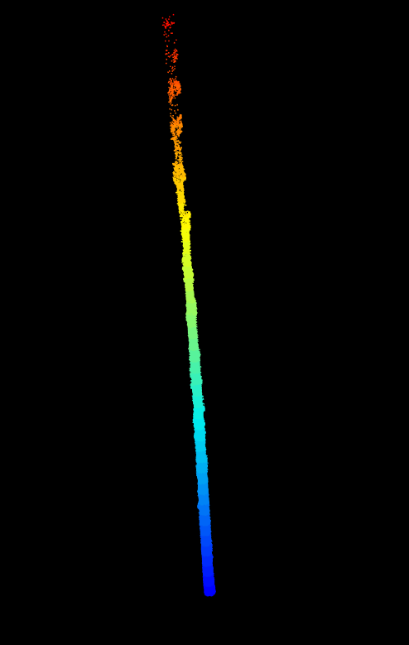
Segmenting LiDAR point clouds – separating the bole from the branches

Slide 7
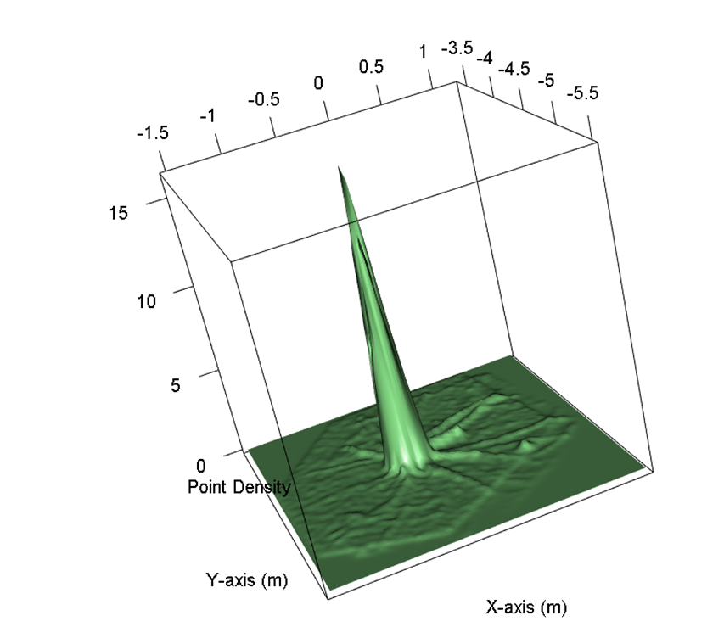
2D Kernel Density Estimation (KDE) of in a tree scan
Stem is solid and thus higher density points
2D kernel is computed after ground segmentation but before stem segmentation

Slide 8
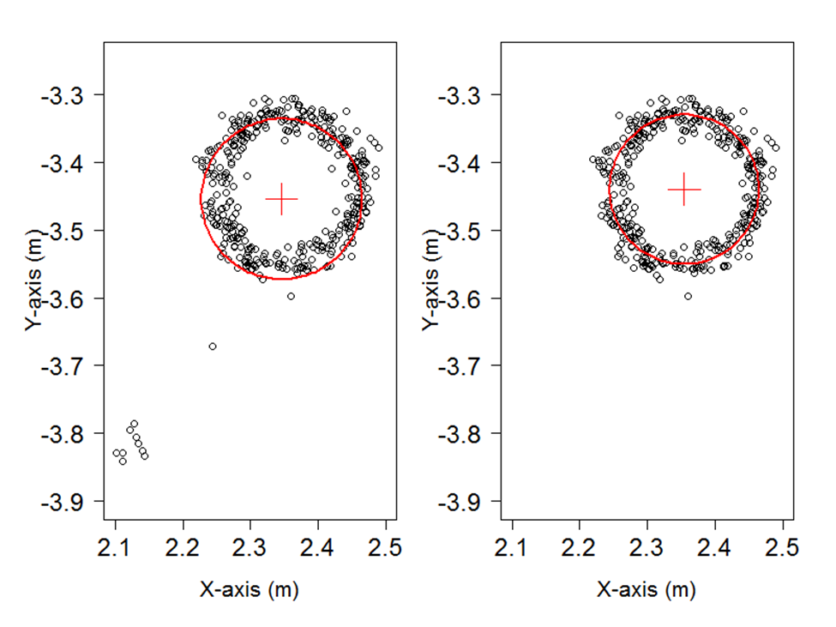
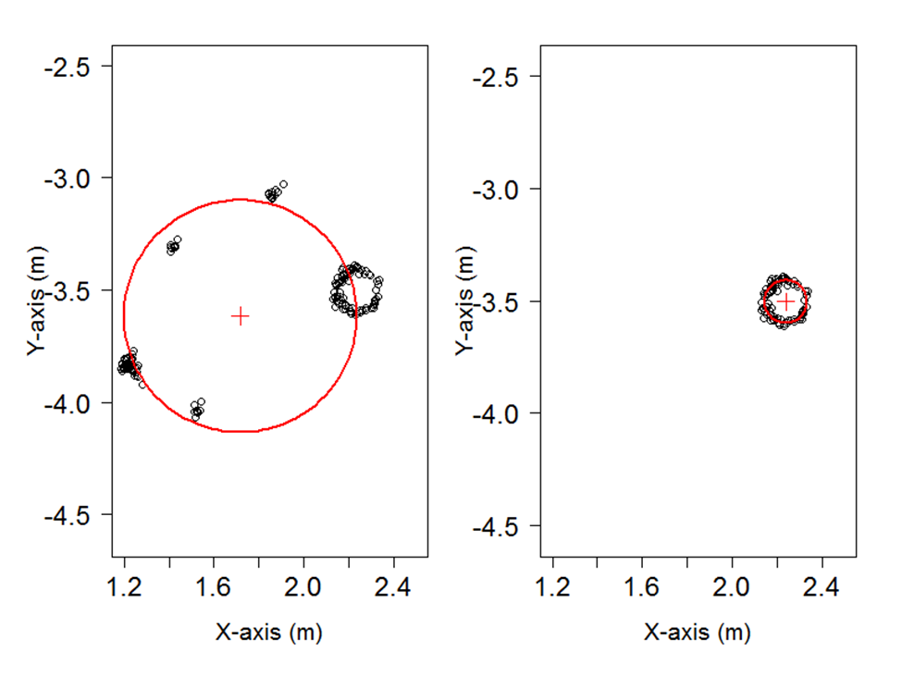
Improved fitting algorithm using a geometric transformation to separate branches from stem
Breast Height (1.3m), 1cm thick slice
6.1m above ground, 1cm slice

Slide 9
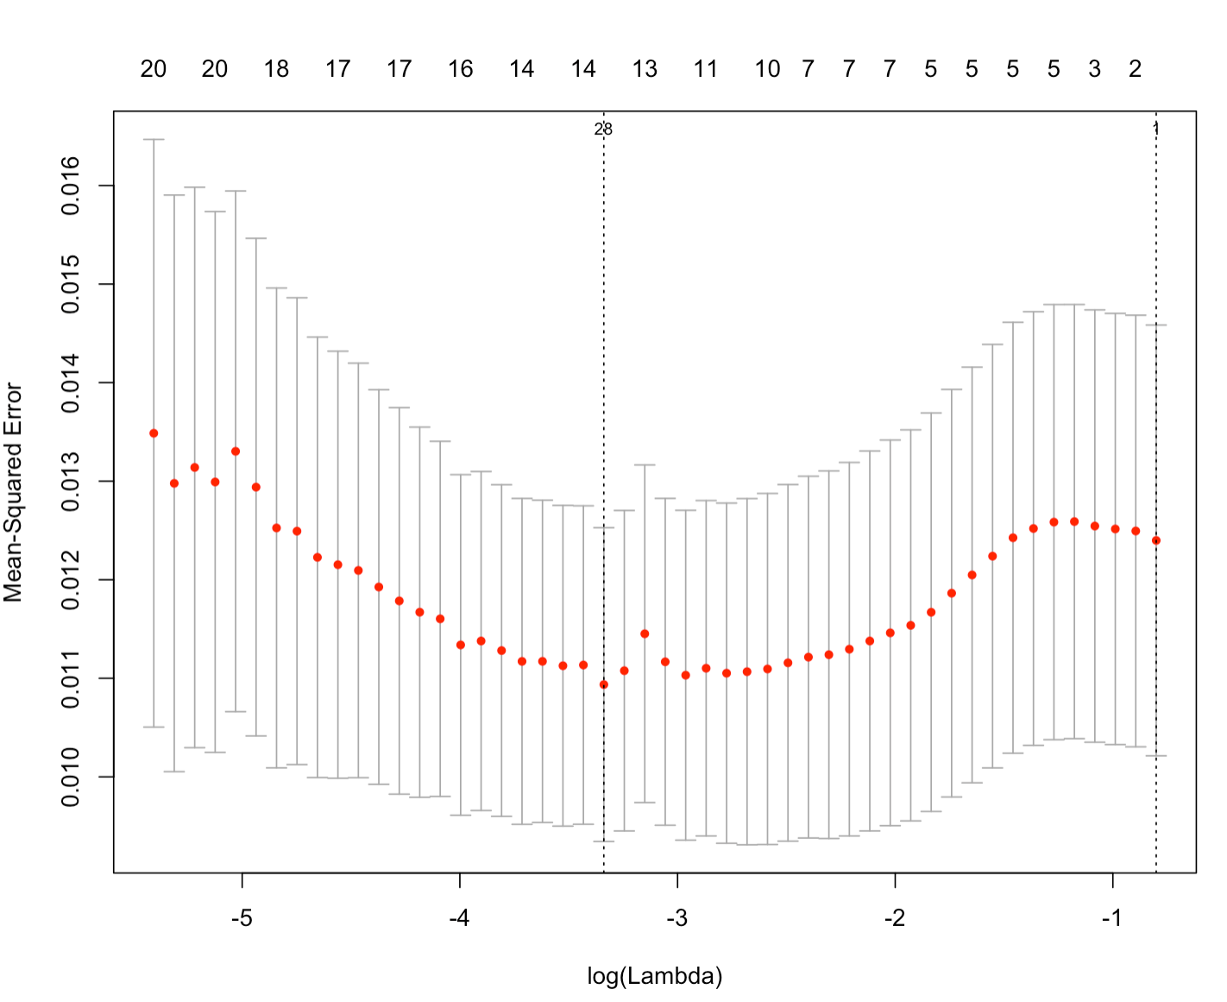
Spatial modeling framework used GAMS with l2 regularization
We used a generalized additive model with varying penalizing parameter to select for most relevant variables to impact defects.
L2 regularization was used, and best predictors extracted from the modeling framework.
K-fold cross validation

Slide 10
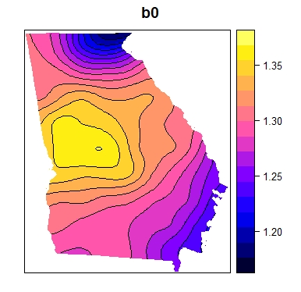
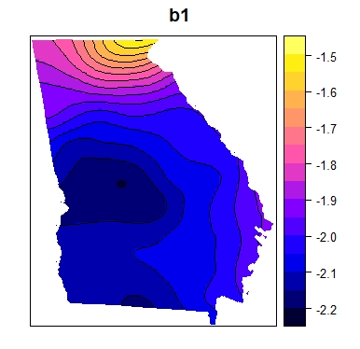
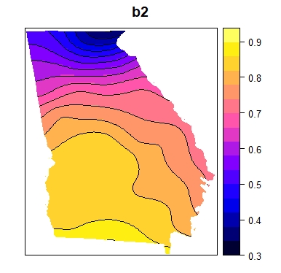
Deliverables
Fitting taper models to segmented stems
Spatial Variation in Kozak Taper Equation Parameters
Center for Advanced Forestry Systems 2021 Meeting

Slide 11
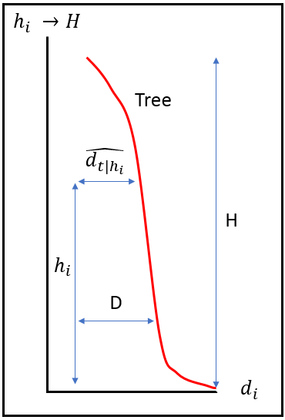
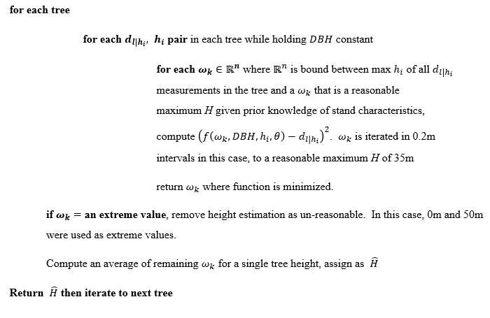
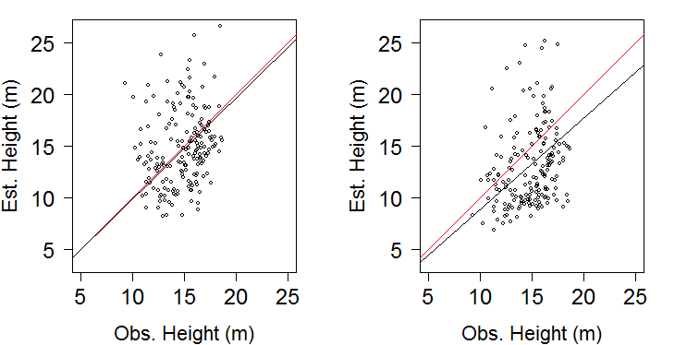
Alogrithm to determining height out several diameters using ground based Lidar.
Mark Porter, MS
Center for Advanced Forestry Systems 2021 Meeting

Slide 12
Variables affecting sweep
January radiation (MJ/ha)
Useable water (mm/year)

Slide 13
Variables effecting Forking
June Radiation (MJ/ha)
Distance from the coast (100 km)
Depth to Water Table (m)
53% deviance explained
Center for Advanced Forestry Systems 2021 Meeting

Slide 14
Variable affecting ramicorns
Radiation July (MJ/ha)
Water Deficit (mm/year)
57.5% deviance explained

Slide 15
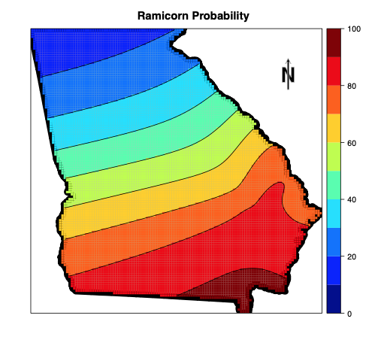
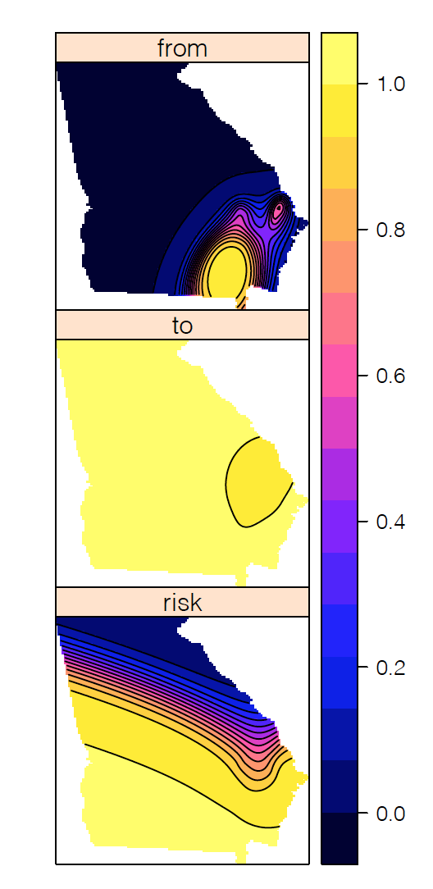
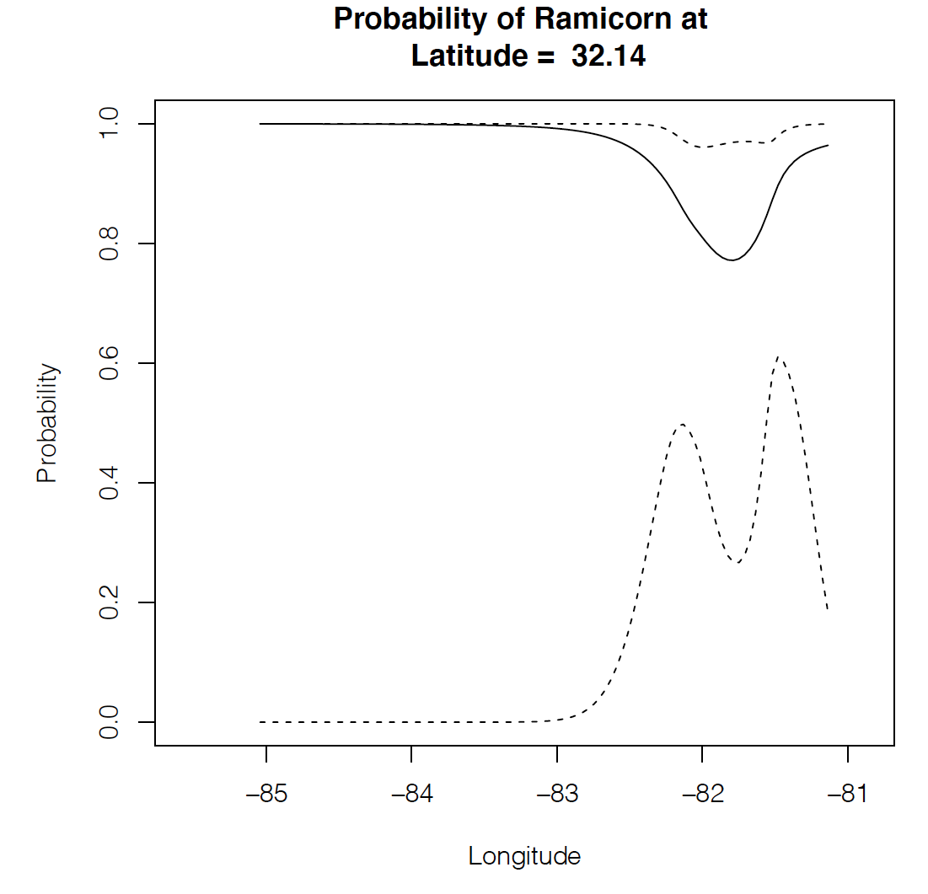
Ramicorn Probability as a function of WD, depth to Water Table
Center for Advanced Forestry Systems 2021 Meeting

Slide 16
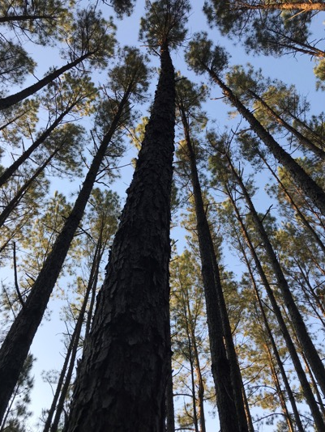
Major findings
Environmental variables biometrically linked to a traditional site index equation.
Taper equation parameters vary with respect to water deficit.
Sweep, ramicors and forking related to environmental variables Water Deficit, Useable water and Radiation in January or July.
Probability of Sweep had a 98% deviance explained.
Probability of ramicorns and forking ~ 50% explained
Center for Advanced Forestry Systems 2021 Meeting

Slide 17
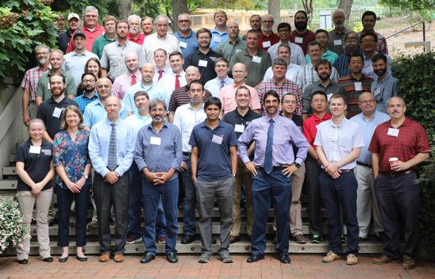
Acknowledgements
The PMRC and the WQC at the University of Georgia
Notes:
17

